Slide 1
Exam 3 Review
4/26/2023

Slide 2
Ch 21: Conjugate addition and Michael addition
1,2- vs 1,4- addition
  Only Grignard and Hydride (LiAlH₄ or NaBH₄) do 1,2-addition.
    Unstabilized enolates give a mixture of 1,2- and 1,4-
    Doubly resonance stabilized enolate – 1,4- only (Michael addition)
  Mechanism (don’t need to show tautomerization or true “1,4-” addition – can just show alpha-carbanion after nucleophile attacks.
Quenching with H₃O⁺ vs quenching with an alkyl halide or electrophile
Recognize Michael donors/acceptors
Other Ch 21 reactions will not be on the exam

Slide 3
Ch 16: Diels-Alder
Drawing product
  Rotating to s-cis correctly
  Regioselectivity (lining up partial charges)
  Stereospecificity (trans on alkene → trans on ring; cis on alkene → cis on ring; for diene and dieneophile)
  Stereoselectivity (EWG on dienophile faces “out”)
  **+ enantiomer**
Back-tracking from product to draw diene and dienophile
  You can leave the diene in the s-cis conformation
Comparing rates of Diels-Alder reactions
  Steric hindrance of s-cis conformation of diene
  Strength of EWG and EDG on diene/dienophile
Mechanism

Slide 4
Ch. 24: Carbohydrates
Bond-line → Fischer projection → Haworth projection → chair structure
Generic naming (aldohexose, ketotetrose, etc)
Assigning D- vs L-
  Don’t forget that D- and L- sugars of the same name (e.g. D-Glucose and L-Glucose) are always enantiomers of each other.
Epimers (a type of diastereomer)
Anomers (a type of diastereomer – ring form only)
Reactions of carbohydrates
  OH groups as nucleophiles
  Glycoside formation (and mechanism)
  Oxidation and Reduction
  Chain lengthening (mechanism for cyanohydrin formation only)

Slide 5

Ch 25: Amino Acids and Peptides
Drawing peptides using the amino acid table
  N-terminus always goes on the left. Any given amino acid sequence (e.g. Ala-Cys-His) will follow this rule.
  R group up → wedge; R group down → dash; for L-amino acids with N-terminus drawn on the left side
Determining pI of amino acids and small peptides (using table of amino acid pKa’s)
Drawing most prevalent protonation state of an amino acid or peptide at a given pH (using table of amino acid pKa’s)
  pH is above pKa of group – group is deprotonated [A:⁻]
  pH is below pKa of group – group is protonated [HA]

Slide 6
Ch 25: Amino Acids and Peptides
Peptide synthesis
  Amine + carboxylic acid + DCC → amide
    this is not limited to amino acids! Works with simple amine + simple carboxylic acid too.
    Mechanism
  Be able to recognize all of the protection/deprotection groups and appropriate reagents
    All protection mechanisms
    Deprotection with HBr mechanism (no other deprotection mechanisms)
  Tripeptide synthesis (like on practice exam)
      can use whichever protecting and deprotecting method you want as long as it’s correct

Slide 7
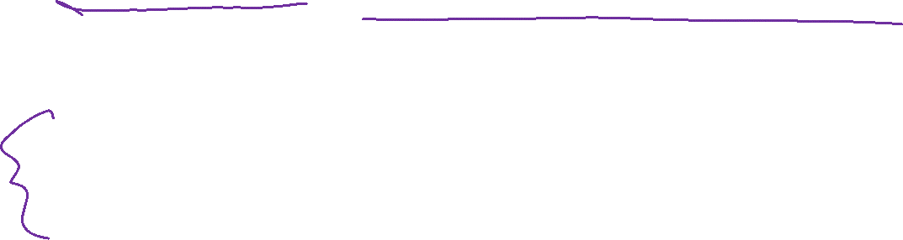
Exam format
There’s a limited number of things I can even ask you about!
You should be able to predict most of the questions on the exam as a result.
No open-ended synthesis – just ONE peptide synthesis (like practice exam)
Rest is all fair game!
I will be in my office on Monday, May 1st from 11-3:30pm to hand back Exam 3 and answer questions about it. Any unclaimed exams will be left in a box outside my office.

Slide 8
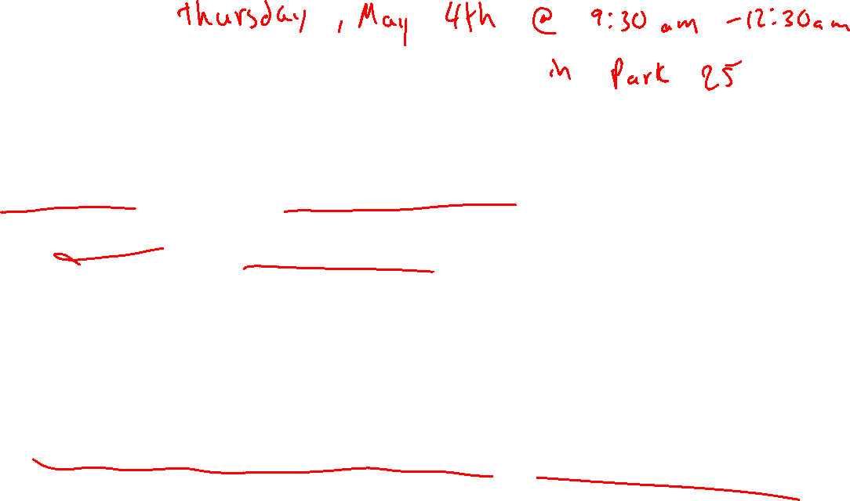
Final Exam
100 points
Same length as first three exams
Mechanisms will be limited to “common themes” from the class.
  Don’t try to memorize every mechanism from the whole class! That’s not the point!
  No EAS mechanisms. No Chromium mechanisms. No “unusual” or “weird” mechanisms.
No open-ended synthesis
  May still have a peptide synthesis like practice exam 3.
Roughly equal distribution between content from all 3 exams.
Email me if you have questions during finals week!! We can meet on Zoom.

