Slide 1
Week 2: Clarification of Theories

Slide 2
Agenda
Theories Overview
Review of Theories
Review of Freud Theory
Review Maslow Theory
Break
Registration w/ Marcy
Reflection time

Slide 3
Objective
We will be able to review and comprehend 2-3 theories and their models

Slide 4
Theories
Human development, diversity, and behavior in the environment
Ways to remember
  Mnemonics
  Practice practice practice!!
Notes:
24% of the exam

Slide 5
Freud Theory
Out And Proud Let’s Get it!
  Oral Birth (O-1)
  Anal (A-3)
  Phallic stage
  Latency/ Puberty
  Genital/ Adulthood

Slide 6

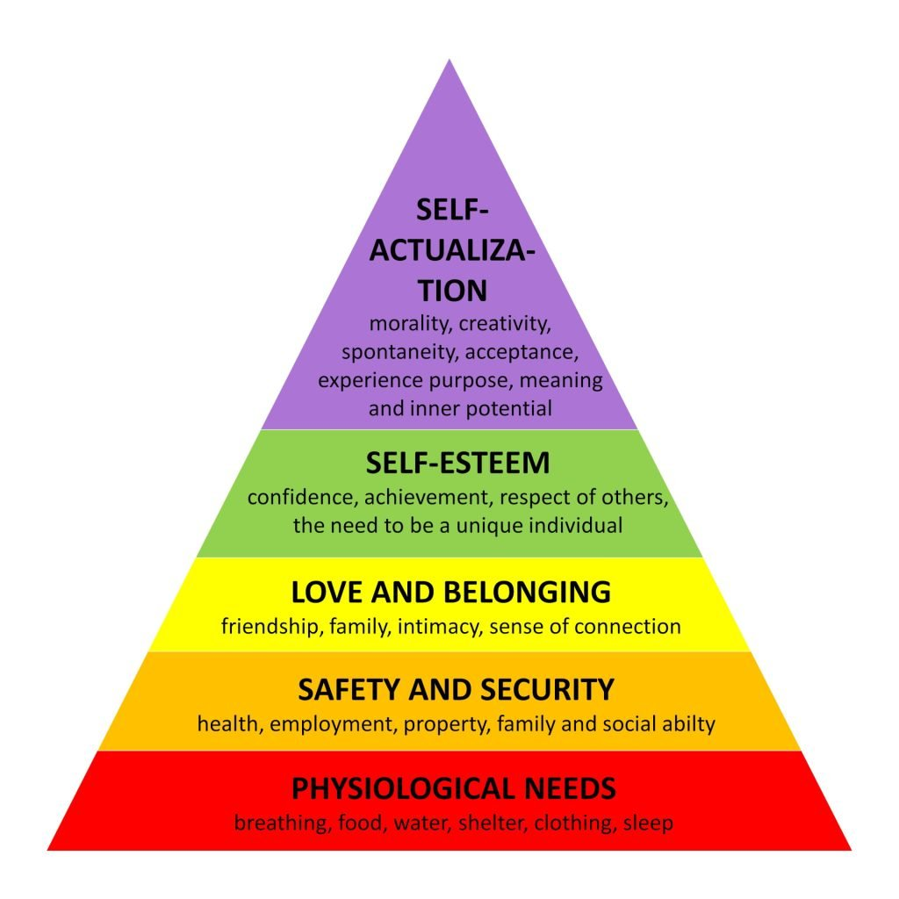
Maslow Theory
P.S. I Love Soft Snuggles
  Psychological Needs
  Safety and Security
  Love and Belonging
  Self-esteem
  Self- actualization

Slide 7
Resources
Raytube
Youtube
ASWB Prep App
Behavioral Health App

Slide 8

Break time

Slide 9
Small Group time
You will go into small groups and work on a few exam questions

Slide 10

Review Time

Slide 11
Action Plan
What is your biggest concern regarding the exam?

