Slide 1

Trauma Informed Social Work:
Trauma and the Stress Response System
Week 4

Slide 2

But First-Think, Pair, Share
Please take a moment to reflect on the following then discuss with a partner:
  How are you doing today, in this moment?
  What do you need to fill your cup?
  What are three things in this moment for which you are grateful?

Slide 3
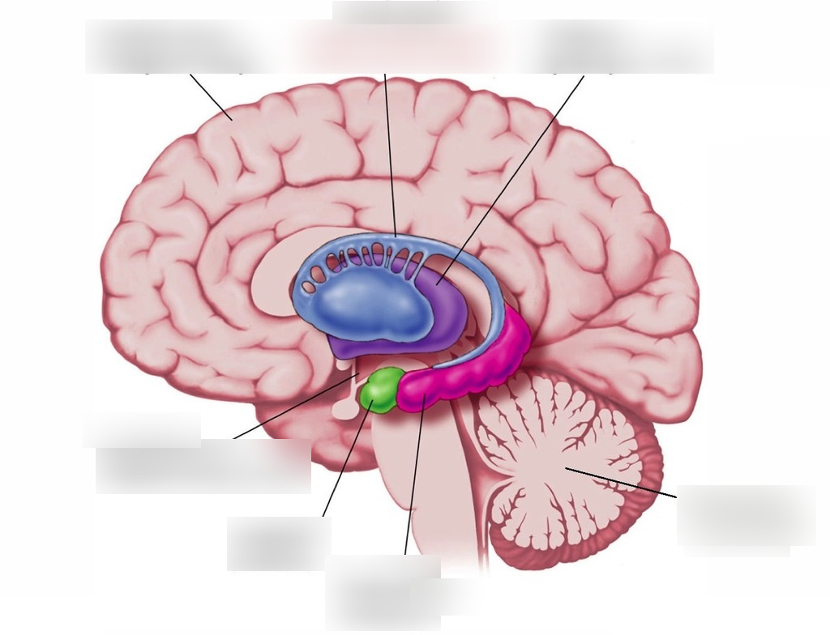
Brain Review Activity

Slide 4
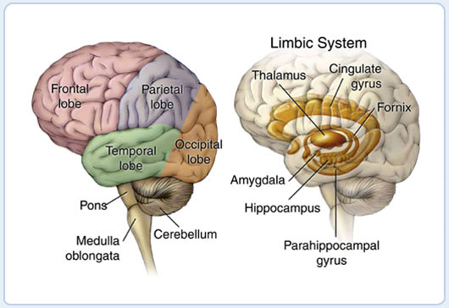
Notes:
Structures involved in the stress response system:
Thalamus: pathway of information from the environment to the brain and arousal structures
Hypothalamus: regulates body temperature and lets you know when you are hungry, thirsty, mad, or sad
Amygdala: processes emotional functioning
Hippocampus: involved in memory
Major Neurotransmitters involved in the stress response
Opiods: lowers perception of pain
Adrenaline: strength in times of emergency
Noradrenalin: increase heart rate and blood flow
Cortisol: suppress stress response and help the body return to baseline

Slide 5
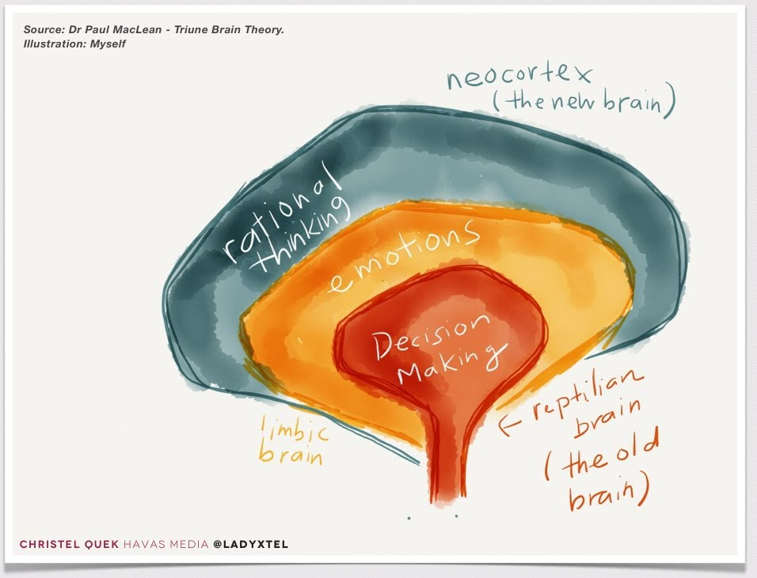
The Brain from Bottom to Top
The Truine Brain
  Brainstem: Basic housekeeping
  Limbic Brain: emotional relevance, categorization, and perception
  Neocortex: frontal lobe capacities
  Bessel Van Der Kolk, 2014

Slide 6
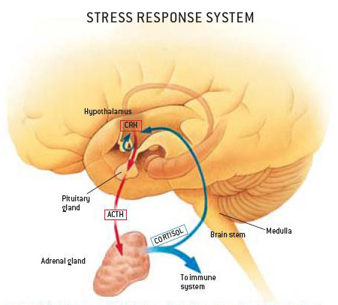
Notes:
HPA AXIS HYPER-REACTIVITY
The hypothalamic-pituitary-adrenal (HPA) axis is a feedback loop that includes the hypothalamus, the pituitary and the adrenal glands. The main hormones that activate the HPA axis are corticotropin-releasing factor (CRF), arginine vasopressin (AVP) and adrenocorticotropin hormone (ACTH). The loop is completed by the negative feedback of cortisol on the hypothalamus and pituitary.
The simultaneous release of cortisol into the circulation has a number of effects, including elevation of blood glucose for increased metabolic demand.
Cortisol also negatively affects the immune system and prevents the release of immunotransmitters. Interference from other brain regions (eg hippocampus and amygdala) can also modify the HPA axis, as can neuropeptides and neurotransmitters
Acute Stress Response:
Intense stress followed by the release of stress hormones
Increase in heart rate and blood flow
Response is swift and short lived with a rapid return to baseline

Slide 7
Our genetics prepare us to respond with fight or flight
During chronic and prolonged trauma, adrenaline and cortisol are released without actual threat and become out of balance.
Too much cortisol weakens muscles and cause early aging
Too little cortisol after years of stress leaves a person jumpy, hyper-alert, and unable to relax.
Notes:
Sapolsky's Why Zebra's Don't Get Ulcers, start at Chapter 2: 28:40-38:40.

Slide 8
Polyvagal Theory: Social engagement,
Fight/flight, and
Freeze
Image: Australian Children Foundation, 2011

Slide 10
Small Group Reflection
  Can you explain the physiological and psychological mechanisms behind the fight, flight, freeze, and faint responses? How do these reactions serve as adaptive survival mechanisms in threatening situations?
  How might an individual's past experiences, trauma history, or cultural background influence which response they are more likely to exhibit in a stressful or threatening situation? Can you provide an example or case study to illustrate this?
  In a clinical setting, how might an understanding of the fight, flight, freeze, and faint responses inform your approach to working with clients who have experienced trauma? What strategies can be employed to help individuals regulate their stress responses and feel safe in therapeutic settings?

Slide 11
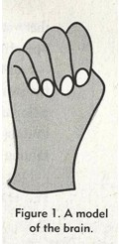
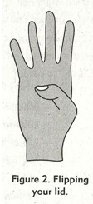

Hand Model of the Brain
(Dan Siegel)
Help to re-engage the neocortex
What part of the brain are you living in?
Notes:
https://search.yahoo.com/yhs/search?p=Flipping+your+lid+you+tube&ei=UTF-8&hspart=mozilla&hsimp=yhs-004

Slide 12

Practice
How would you explain the neurobiology of trauma to an adult or child?
For example:
  Fight, flight, freeze response, triggers,
  Flipping your lid etc…

Slide 13

Trauma “Wears a Groove” in the Developing Brain
Because brain is in a chronic state of fear-related activation, brain more easily triggered into the “fear” track
Fear-related activation includes:
  hypervigilance, increased muscle tone, focus on threat-related cues, anxiety, and behavioral impulsivity (Perry, 2000)
Notes:
Use-dependent” alterations in key neural systems involved in the stress response
Brain is in a chronic state of fear-related activation
Fear-related activation includes hypervigilance, increased muscle tone, focus on threat-related cues, anxiety, and behavioral impulsivity
Groove in the Brain—record analogy
Fear related activation is all useful in situations of danger (e.g., when someone is actually attacking you), normally, but…
Chronic use can lead to this system being quickly activated – triggered (by little things!), AND, the mechanisms that normally bring the activation back down become impaired
Think Toxic Stress

Slide 14


Video Clip
Captain Phillips
See handout
Notes:
https://www.youtube.com/watch?v=IJMDdT24_98

Slide 15

Questions?
Comments?

Slide 16

End of class exercise
Notes:
Graditude

