Slide 1

Fall 2020 Advising meet up
Wednesday – August 26, 2020
11:30am to 12:30pm
Advisor: Prof. Tamarah Moss

Slide 2
Agenda
Welcome
Introductions
Role of the academic advisor
Tour of Moodle Advising Page + Materials
Dates to Remember
Drop/Add period
Waiver for courses
Prep Programs
Midterm advising
Next Steps

Slide 3
Introductions
Small Group
Name
Pronouns if you like
Year in Program, Clinical/Macro, Interest areas
Where are you located?
Large Group
Mood during Orientation week/preparing for Fall 2020 semester

Slide 4
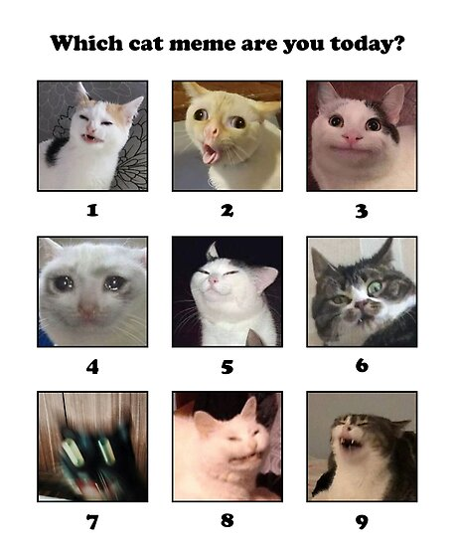

Slide 5
Roles of the Advisor – **email is the best way to reach me
Academic advisors assist in course planning and discuss with students during consultation a plan for tracking progress using the Requirements Checklist (posted on our website: https://www.brynmawr.edu/socialwork/current-students/academic-information). The Plans of Study for each Program (Part Time/Full Time/Advanced Standing) are posted on Moodle (https://moodle.brynmawr.edu/course/view.php?id=686) under Topic 1.
Advisors discuss with students any academic barriers, and refer students to support services, if needed.
Advisors discuss requests for Leave of Absence, Withdrawal, and other academic issues.
Incoming MSS students are expected to meet with their advisor during the first part of their first semester at the GSSWSR. During the mid-semester required advising period, all students are expected to meet with their advisor to discuss preliminary career goals, future courses, a tentative plan of study, and performance in class and field.
Required advising for all students before registration: 10/26 – 11/6 for spring registration; and 3/15 – 3/22 for summer and fall registration.

Slide 6
Tour of Moodle Advising Page Monthly Updates

Slide 7
Dates to Remember
Add/Drop deadline is Friday, September 18th – forms are available on our website (https://www.brynmawr.edu/socialwork/current-students/academic-information). Email completed forms to socialwork@brynmawr.edu, or to Antoinette Harrison, Assistant Dean for Administration, at aharriso01@brynmawr.edu.
Waiver Exams for Fall classes closed on August 14; The Waiver Exam for Research Informed Practice II (a semester II course) will be open October 26 – November 6. Information will be emailed from the Dean’s Office in early October.
Prep for Social Work Practice session (for students in field placements), Thursday, August 27, 2020.
Prep for Research (for all students enrolled in RIP I), Friday, August 28, 2020.
Prep for Tech, Friday, September 4, 2020.
Graduate and Professional School Program (GPS Transition Program), Saturday, August 29, 2020 and Saturday, September 5, 2020.
Please refer to the Academic Calendar posted on our website for other important dates (https://www.brynmawr.edu/socialwork/current-students-0.

Slide 8
Next Steps, Part I
Please visit the following pages on Moodle
Advising Page (Moss)
Student services with important documents and forms for submission
Consider having a hardcopy planner and alerts in your smart devise for due dates for assignments and meetings
As soon as you get your syllabus (which may be on your first day of class), start to make notes for due dates of assignments and exams
Be sure to meet your Instructor during office hours
Consider partnering with one other students as part of a support system through the course

Slide 9
Next Steps, Part II
Practice open communication with your Instructor about challenges you may be having. Also be sure to be in contact with Carolyn Solo should you need more support for academics or otherwise
Looking out for a list of meeting times for Incoming students for special office hours the 2nd week of the Semester
Please note that I will be out-of-office August 31-September 6, 2020. My email access will be very limited
Best days to reach me are Monday through Friday
For questions related to courses, please contact the instructor directly.
For questions related to registration, please email Assistant Dean, Toni (Antoinette) Harrison.
For general GSSWSR questions, please email socialwork@brynmawr.edu

