Slide 1

The Diagnostic Assessment of School Aged Children
Taking a history, critical areas of focus, structured vs. unstructured interviews

Slide 2
History taking from the biopsychosocial perspective:
Interactive components of a tripartite assessment:
-Individual
- Presenting problem
- Support Parameters in Context

Slide 3





Individuals

Slide 4
Three Different Ways of Thinking about Psychopathology and Strengths from a Relational Perspective:
Patterns of Attachment and Relatedness
Disturbed Patterns of Subjective Experience:
Problems of Self-Regulation
-insecure patterns of attachment
-problems with identification and confusion
-problems with interpersonal negotiation
-disturbed patterns of achievement
Disturbed Patterns of Subjective Experience:
Problems Feeling Real,
Authentic,
and Owning All Aspects of Oneself
Trauma
Emotional neglect
Temperament

Slide 5



The Presenting Problem

Slide 6

The parameters around taking a history
How thorough should I be, given context and time limitations?
What areas to discuss and explore? Ask about sexuality? Family difficulties? Drug and alcohol use by family members? Family violence?
General rule: the younger the child the more thorough the history needed at the outset.
Complicated presentations also need more thorough histories.
Try to not respond to the pressure to move more quickly than you are comfortable.

Slide 7
Assessment begins with first contact and is ongoing.
The concept of horses and zebras.
Have an awareness of common symptom figures and problems.
Example: An AA mother brings her 6 yo son to the local MH clinic referred by the school counselor. The boy has been increasingly behaviorally dysregulated in class, calling out, making noises, easily distracted, some minor aggressive behavior mostly to the girls in the class. Mother is an RN working at CHOP in the diabetes clinic, 8-4. She and her two children (she also has a 9 yo daughter) live in a large apartment near 50th and Cedar in West Philadelphia, and the children go to their grandmother’s place after school, a few blocks away, until mother gets home from work. Mother is divorced from the children’s father who lives in the Girard section of the city with a new girlfriend, and has the children with him every other weekend and one night a week. Mother has also recently started dating but the children have yet to be introduced to the man she is seeing. Mother reports seeing the school behavior some at home, but says he is “all boy”.
What is the first line of questioning you would take given this information? What are your initial hypotheses?

Slide 8
In a taking a history pay attention to how parents share information as much as what they say. Always ask if there is something more I might need to know, if there is a question I might have asked that is important. Always ask the parents theory as to what is going on with their child.

Slide 9
The Bio in the biopsychosocial evaluation
Temperament
The How of Behavior rather than What or Why
Biologically rooted
Can be modified, directed, contained, managed, tempered but doesn’t fundamentally change
Descriptive and value neutral- all temperamental traits have strengths and problems. Exist on a continuum and each end is potentially more problematic.
Forgiving to parents- they aren’t at fault.
Sleep
Sleep disorders in children and adolescents are common; even infants may have sleep disorders.
Studies have shown that poor sleep quality and/or quantity in children are associated with a host of problems, including academic, behavioral, developmental and social difficulties, weight abnormalities, and other health problems.
https://www.youtube.com/watch?v=ztGkmruGPqM

Slide 10
Three other biological conditions to keep in mind
Asthma/Allergens
Food related conditions
Precocious Puberty
According to the Centers for Disease Control and Prevention (CDC), 1 in 13 people have asthma.
Asthma is the leading chronic disease in children.
Asthma is more common in children than adults.
Asthma is more common in boys than girls.
It is the top reason for missed school days. In 2013, about 13.8 million missed school days were reported due to asthma.
African-Americans in the U.S. die from asthma at a higher rate than people of other races or ethnicities.
Sugar consumption does not make children hyperactive.
The percent of Black (25.6 percent) and Hispanic households with food-insecure children (24.3 percent) was nearly two times that of white households (13.2 percent) in 2016.
In 2018, 63 percent of food-insecure households were in the labor force; 53 percent were households with full-time workers.
During the 2017-2018 school year, 21.8 million children received free or reduced-price school lunch and 12.5 million received free or reduced-price breakfast.
Precocious puberty is defined as the onset of true puberty before 7 to 8 years of age in girls or 9 years of age in boys. Precocious puberty is 10 times more common in girls than in boys.
The earlier before age 12 a girl starts her period, the higher her lifetime risk for breast cancer (probably from the prolonged estrogen exposure).
Although still emotionally and mentally a nine-year-old, she now has the hormones of an adolescent. One of the most difficult things she is facing is finding a peer group. She no longer entirely fits in with her nine-year-old friends, but will not easily fit in with girls who are older.

Slide 11
Temperament Traits
Activity level
Rythmicity (biological rhythms)
Adaptability
Intensity of reaction
Threshold of responsiveness
Quality of mood
Distractibility
Attention span and persistence

Slide 12





Support Parameters in Context

Slide 13
Awareness of dimensions of cultural difference.
Florence Lieberman (1990) “it is impossible to be culturally sensitive as a general quality because this would demand an encyclopedic ethnographic and anthropological knowledge well beyond the reach of most of us”
Rather, cultural sensitivity it is an attitude, an attunement, an interpersonal sensitivity, a special kind of empathy.
But we can also be too ethnically sensitive in order to avoid perceived potential conflict or fear of offending, andins so doing miss important information or mis-diagnose a situation.

Slide 14
Dimensions to Consider
Ethnic identity
Language patterns (Navaho, Hawaiian, A.A.)
Unique stressors: prejudice & discrimination, inter-group and intra-group violence
Religious affiliations and their greater community
Emigration and acculturation- generational differences
Socioeconomic and environmental factors: it is important often to have a sense of a child’s physical world and neighborhood
Culture specific syndromes and indigenous forms of healing
Guarnaccia and Rogler, 1999, “Research on culture-bound syndromes: New directions” Am. Journal of Psychiatry 156(9), 1322 – 1327.

Slide 15
The Spirit Captures You and You Fall Down Anne Fadiman, 1997
On the most basic level, the book tells the story of the family's second youngest and favored daughter, Lia Lee, who was diagnosed with a severe form of epilepsy named Lennox-Gastaut Syndrome and the culture conflict that obstructs her treatment.
Through miscommunications about medical dosages and parental refusal to give certain medicines due to mistrust, misunderstandings, and behavioral side effects, and the inability of the doctors to develop more empathy with the traditional Hmong lifestyle or try to learn more about the Hmong culture, Lia's condition worsens. The dichotomy between the Hmong's perceived spiritual factors and the Americans' perceived scientific factors comprises the overall theme of the book.
While particularly sympathetic to the Hmong, Fadiman presents the situation from the perspectives of both the doctors and the family. An example of medical anthropology, the book has been cited by medical journals and lecturers as an argument for greater cultural competence, and often assigned to medical, pharmaceutic, and anthropological students in the US. In 1997, it won the National Book Critics Circle Award for General Nonfiction

Slide 16
Questions Regarding the Family
Are parents available and able to be a part of the therapy process?
How emotionally engaged and present are each parent? Are they psychologically minded?
Are the parents able to support individual therapeutic work relative to time commitment, transportation, financial backing, emotional engagement?
Extended family?
What are the other family stressors beyond the identified child’s stated problems?
Siblings who are struggling emotionally?
Parental or marital difficulties?
Financial burdens? Deployments or long separations due to work?
Family illnesses? Recent deaths or losses?
Typical areas of conflict between members of the household?

Slide 17





How to Begin? The Systematic Assessment of a Child

Slide 18
What You Need for the Assessment
Choosing toys for the office/traveling bag- making a play space
- Figurines or dolls; I use Beanie Babies, and some small stuffed animals.
- Plastic dinosaurs, snakes, dragons, and figures (knights, soldiers) to be used for aggressive expression.
- Puppets
Nerf gun.
Building materials like Legos; Jenga.
Ball (maybe 2-3 of different sizes), deck of playing cards, Uno.
- Talking, Feeling, Doing Game and other therapy games.
Other board games: Connect Four, Othello, Chess/Checkers, Chutes and Ladders, Candyland, Life, Careers, Clue, Battleship, Boobytrap. Pick-up Sticks.
- Laptop with computer games to be played together

Slide 19
Using Artwork in an Assessment
Drawing materials: crayons, colored pencils, markers, paper.
-requested drawings, ie. draw a person, draw your family, draw your school
vs. free drawing- draw a picture
-Squiggle game
Other materials: clay, Play-Doh, scissors, card board, tape, pipecleaners
Cathy Malchiodi- Understanding Children’s Drawing; Handbook of Art Therapy

Slide 20
Structured Interviews
First meeting- I bring the parents in (they have been prepped); job interview w/ older children
When interviewing a child: avoid “Why” questions; cover areas of their functioning; What you be doing right now if you weren’t here?
Family holidays questions
3 wishes/ Bird in the nest
Earliest memory/best memory/worst memory/first day of school this year-Kindergarten
Miracle question; How would you change yourself/ your looks/ your family?
Verbal projective questions or list of problems for non-verbal children
Dreams

Slide 21
Unstructured Interview Sessions
Observational Framework of Children in Session Stanley Greenspan MD
Physical and neurological development
Mood
Human relationship capacity
Affects and Anxiety
Use of the Environment
Thematic development
Subjective Response of Observer

Slide 22
Psychological Testing
Assessment of Intellectual Functioning (IQ)
Wechler (WISC IV); Stanford-Binet; Woodcock-Johnson (achievement tests)
Personality Assessment
Rorschach; Thematic Apperception Test (TAT), Minnesota Multi-Personality Inventory (MMPI)
Behavioral Assessment- use of Behavioral Rating Scales

Slide 23
Common Behavior Rating Scales for Children
Achenbach Scales
BASC-2
Conners
Child Behavior Checklist CBCL 6/18
Caregiver-Teacher Report Form (C-TRF)
Teacher Report Form (TRF),
Youth Self-Report (YSR)
The BASC-2 system enables assessment from three vantage points: self, teacher, and parent or caregiver.
The BASC-2 Parent Rating Scales (PRS) and Teacher Rating Scales (TRS) are normed for individuals ages 2 years to 21 years, 11 months. These scales can typically be completed in 10 to 20 minutes. The Self-Report Scale (SRP) can be completed by individuals 8 years through college-age and takes about 30 minutes to complete.
Conners Rating Scales (CRS) is one of the most popular tools for assessing ADHD and other disruptive disorders in children and adolescents. The 10 scales scored on the long parent and teacher forms are Oppositional, Cognitive Problems/ Inattention, Hyperactivity, Anxious-Shy, Perfectionism, Social Problems, Psychosomatic, DSM-IV Symptom Subscales, Global Index (formerly the Hyperactivity Index), and AD/HD Index. The short forms offer scores on four scales: Oppositional, Cognitive Problems/ Inattention, Hyperactivity, and AD/HD Index.

Slide 24

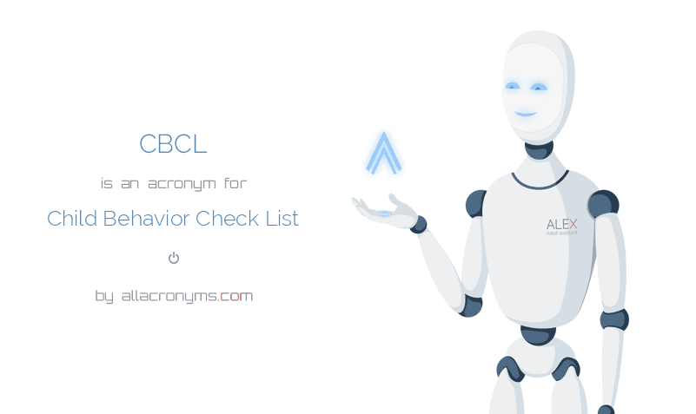
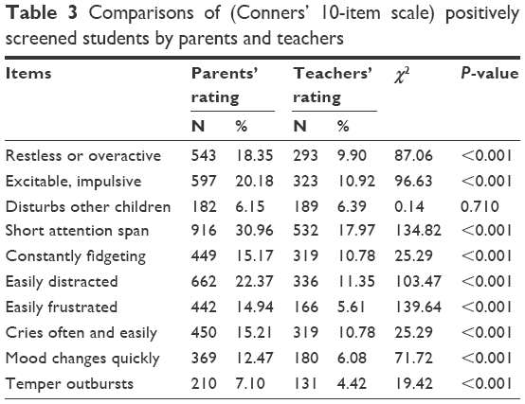
Link to Description of Common Scales
http://psychology.iresearchnet.com/counseling-psychology/personality-assessment/behavior-rating-scales/#:~:text=The%20most%20commonly%20used%20scales,(BRP%2D2)%2C%20the

Slide 25
Problem behaviors and psychopathology from a developmental perspective- ages and phases of development.
3-6 yr.old:
childhood sexual theories
fantasy life of 3-6 y.o.
masturbation
bed-wetting
nightmares/night terrors
dreams
phobic organization
6-11 yr.old
latency
imagining
play of latency
school issues
stealing
lying
cheating at games

Slide 26
Domains of developmental difficulties
aggression and overactivity
sadness and grieving
social connections.and isolation
phobias and fears; anxiety
feelings of imcompetence
difficulties expressing emotions
school performance issues/learning disabilities

Slide 27







