Slide 1
Searching Strategies for Research in Social Work
Kate Blinn, Social Sciences & Data Librarian

Slide 2
Get in touch…
Kate Blinn, Social Work Librarian ☺ 610.526.7467 kblinn@brynmawr.edu Make an appointment: http://calendly.com/kblinn
Email for library help, especially in the summer library@brynmawr.edu
https://www.brynmawr.edu/lits/library-help

Slide 3
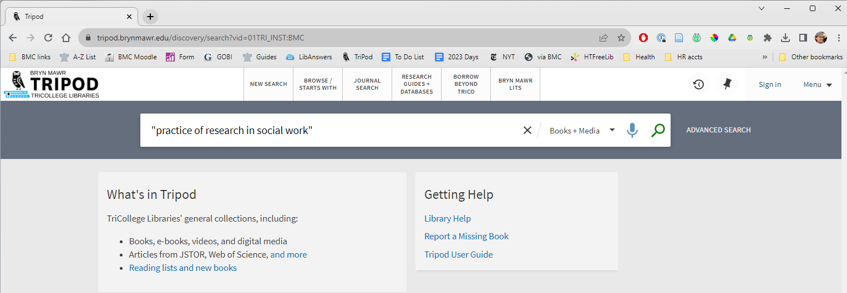
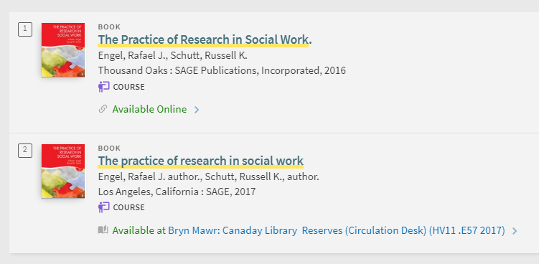
Library catalog (print and ebooks)
Tripod.brynmawr.edu
Notes:
Tripod Catalog includes all the print titles held by Bryn Mawr, Haverford, and Swarthmore libraries.
You can change “Books and Media” to “Course Reserves” for course materials that your faculty put on reserve for you.
You can also limit (on the left side) to online books/ebooks. Any ebooks you see in the catalog should be available to you. Let a librarian know if an ebook in Tripod is not working.

Slide 4

Research Process Overview
Start with an idea. Turn it into keywords.
Use keywords in combinations to search for broad sources.
Use the broad sources and other searches to find more specific sources (articles or chapters).

Slide 5
See your question as topic areas
Does pet therapy help veterans with PTSD?
Topic 1
Topic 4
Topic 2
Topic 3
Separate out the ideas:
Pet therapy
Veterans
PTSD
Notes:
It can help you to frame your topic, or break it down in manageable parts, so when you approach your search, you don’t get bogged down.
No “perfect” article
Approach your topic from several different angles. You will want to dive into the research about Veterans and trauma*
Look at the literature review section of any empirical study and see how the authors have laid out their conceptual framing.

Slide 6
Framing the Question
Think about your topics in terms of dependent and independent variables, or intervention-population-outcome.
Intervention | Pet therapy
Population | Veterans
Outcome | PTSD
Does pet therapy help veterans with PTSD?
Notes:
It can help you to frame your topic, or break it down in manageable parts, so when you approach your search, you don’t get bogged down.

Slide 7

Create your keywords list
Pet therapy
You
Databases
Animal assisted therapy
Notes:
Natural language vs. the language scholars use.

Slide 8
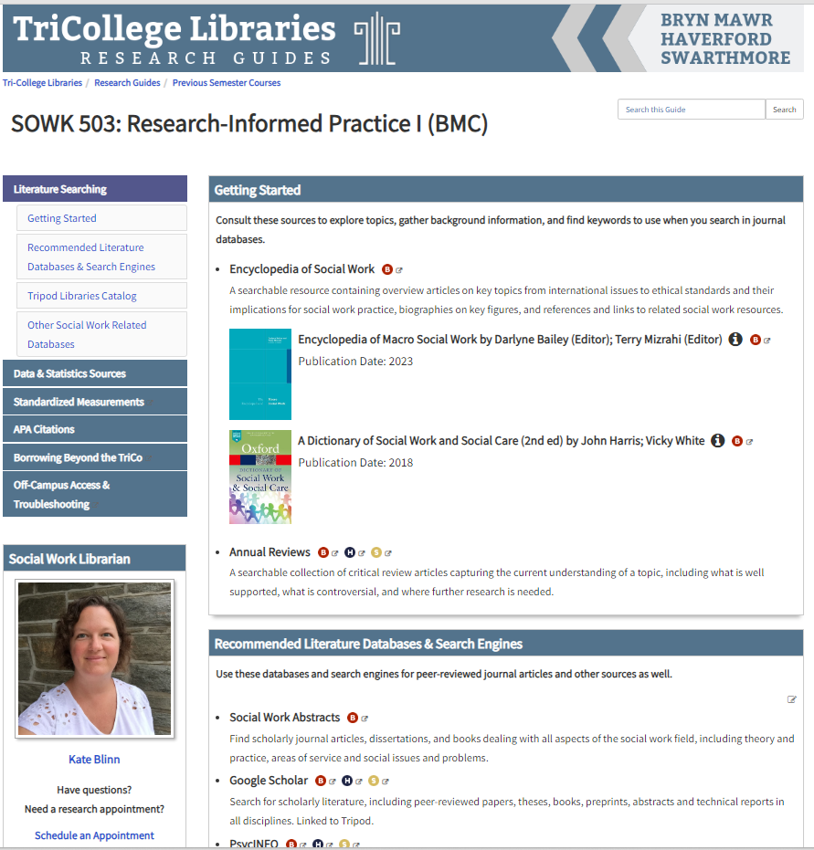

Click on the B for Bryn Mawr access.
Link to the guide
Notes:
This is important! Research guide is your portal into these tools. You MUST access them through the library; this is one way to do so.
Focus on the Getting Started box
Show how to open both encyclopedias, where to search within

Slide 9

Broad Sources
Look up big umbrella ideas in the Encyclopedia of Social Work or the Encyclopedia of Macro Social Work
Look up terms you aren’t sure of in the Dictionary of Social Work
Look for a recent literature review (Annual Reviews or databases)
Notes:
Background
Encyc SW – pet therapy = Human-Other animal bond, good keywords
Encyc Macro – pet therapy = nothing, animal therapy = veterans article
Dictionary -
Annual Reviews – veteran therapy, 2015-2023 = virtual reality review, ctrl-F for veteran

Slide 10
It’s Your Turn, part 1
Write down your question and circle or separate the topic areas.
Topic 1
Topic 3
Topic 4
Topic 2
Notes:
If time allows, ask for a volunteer to describe their research topic, and demonstrate another search.

Slide 11
Next: Combine Topic Areas in Searches
Combine search terms:
Animal assisted therapy AND veterans (variety of outcomes)
and, separately
Animal assisted therapy AND depression (variety of populations)
and, separately
Veterans AND depression (variety of interventions)
 | Search 1 | Search 2 | Search 3
Intervention | Animal assisted therapy | Animal assisted therapy | ?
Population | veterans | ? | Veterans
Outcome | ? | depression | depression
Notes:
Look at the literature review section of any empirical study and see how the authors have laid out their conceptual framing.
Limit to <10 years; methodology and other filters

Slide 12
Where to Search for Specific Sources (Scholarly Articles)
Social Work Abstracts
Google Scholar
PsycInfo
A search engine
Subject databases
Notes:
For many of you, Google Scholar and PsycINFO will suffice for this project…
Both are connected to library subscriptions, if you go through the library system (more later).
What’s the difference? (filters, subject terms are like #, etc.)
Overlap vs. unique content. Use them in tandem.
You have a lot of options available to you, both free search engines and databases

Slide 13
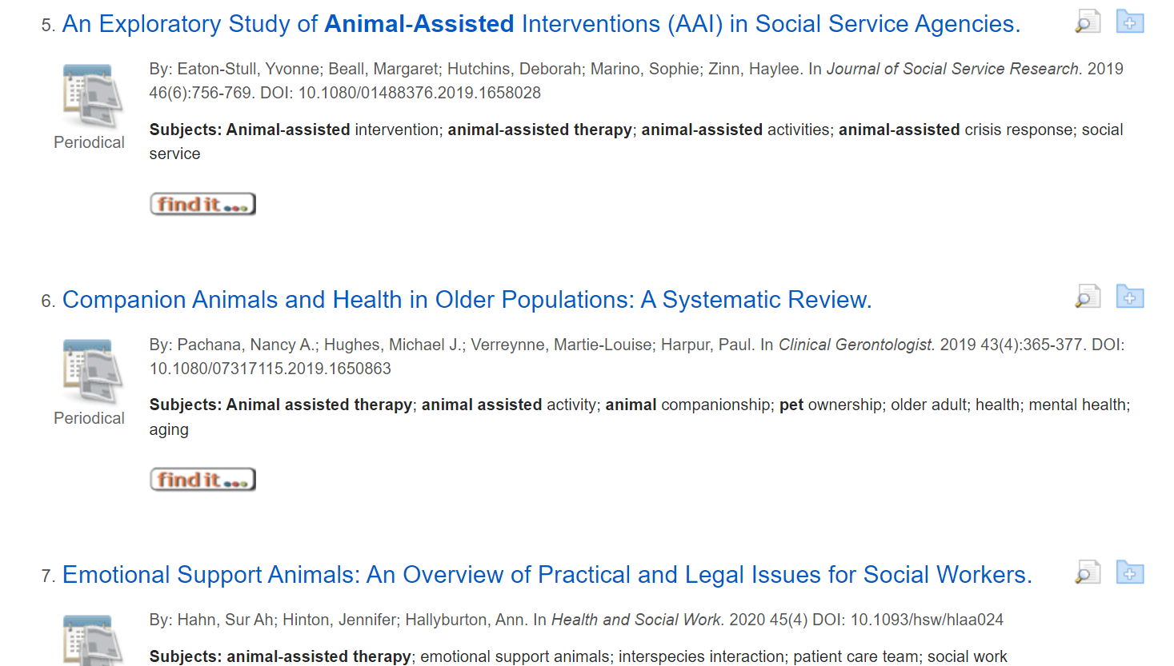
Social Work Abstracts
Social Work Abstracts

Slide 14
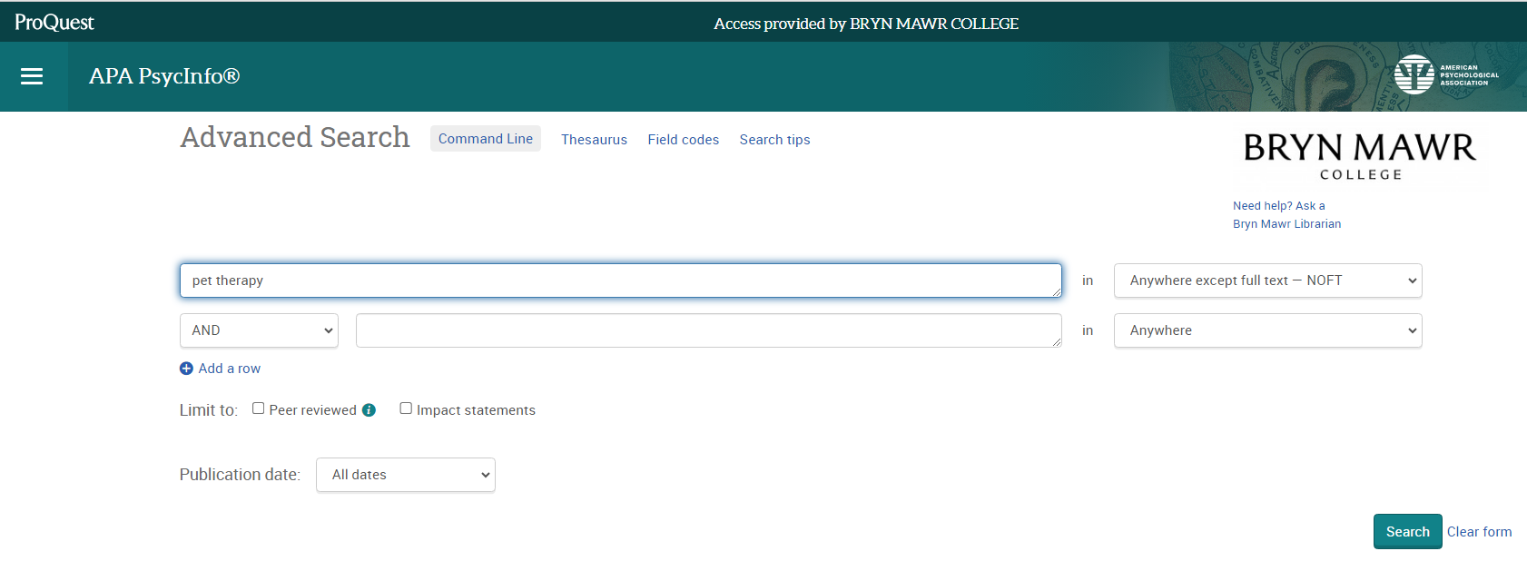
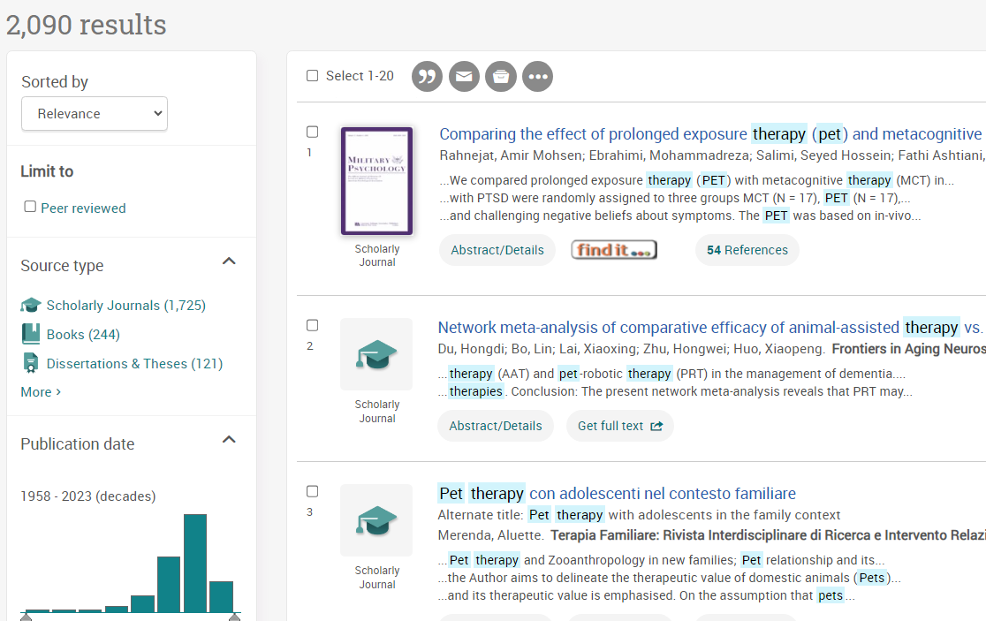
PsycInfo
PsycInfo
Notes:
Notice “prolonged exposure therapy (pet)” – good reason to use “animal-assisted therapy”

Slide 15
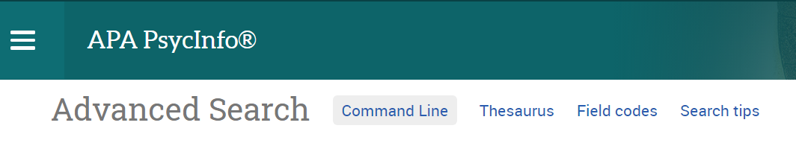
Thesaurus Only in PsycInfo
Notes:
Database thesaurus can disambiguate keywords for you by helping you identify the subject term the database uses to classify literature on a certain topic.

Slide 16
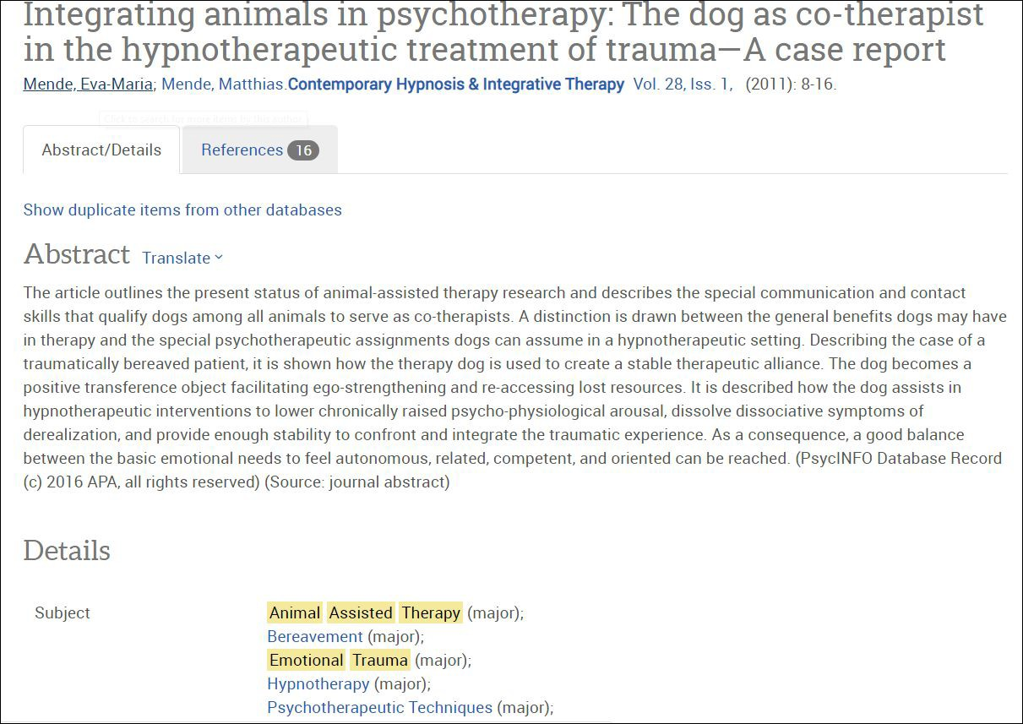
Subject Headings
Notes:
Example of PsycINFO record for article. Note the subject terms at the bottom; can help develop your topic.

Slide 17
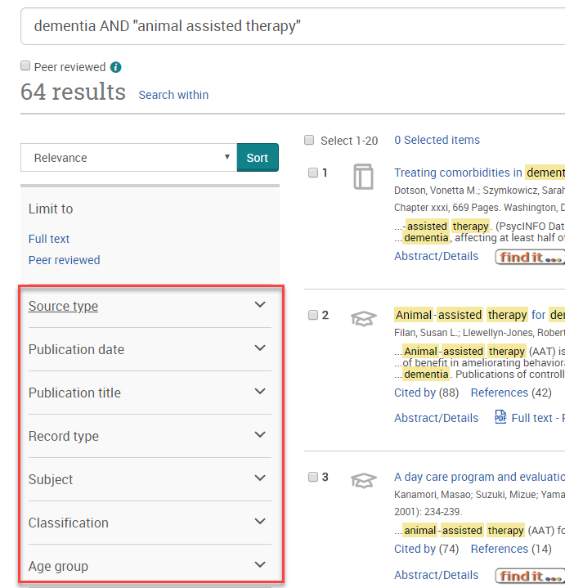
Filters and Limits
Publication date
Document type
Peer Reviewed
Only in PsycInfo:
Age group
Population
Methodology

Slide 18
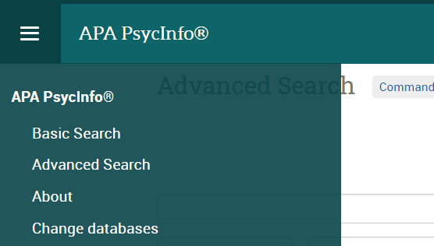
Optional: Add more Databases
Also in EBSCO:
ERIC (education-focused)
Family & Society Studies Worldwide
eBooks on Nursing, Psychology, Medicine
Also in ProQuest:
Coronavirus Research Database
PTSDpubs
Criminology Collection
Policy File Index

Slide 19
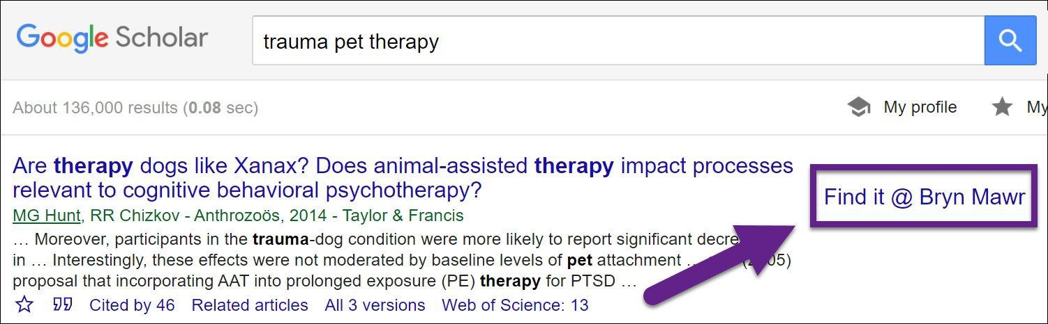
Google Scholar aggregator across disciplines
Google Scholar
The only way to access the article is by going to Google
Scholar or a database through the library system.
Notes:
An example of what the full text link in Google Scholar looks like when connecting via library system, not scholar.google.com.

Slide 20
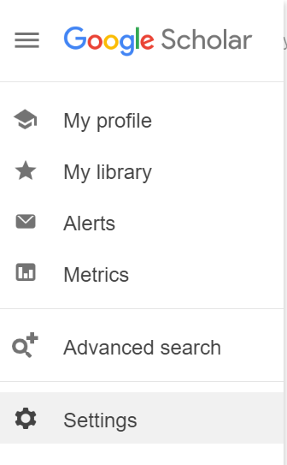
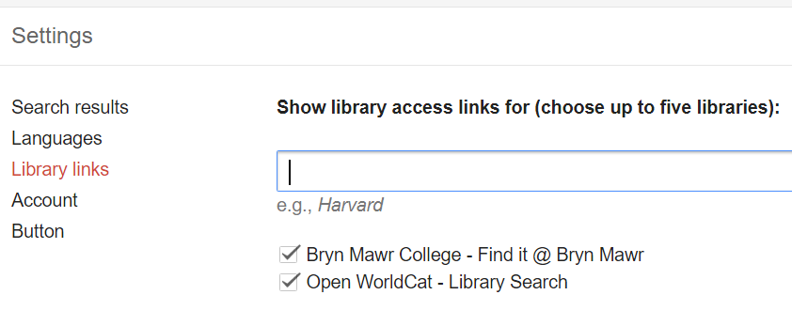
Google Scholar
Use “library links” to associate your Google account with Bryn Mawr’s resources & access options

Slide 21
Optional Tutorials
You have access in Moodle to two tutorials that cover:
Brainstorming keywords and connecting them using AND, OR, NOT
Difference between full-text searching, field searching, and subject searching
Truncation and wildcard searching (e.g. adolescen*)
Limiting your search
Notes:
How many were able to navigate through the tutorials, part 1 and part 2?
What questions did they bring up for you?

Slide 22
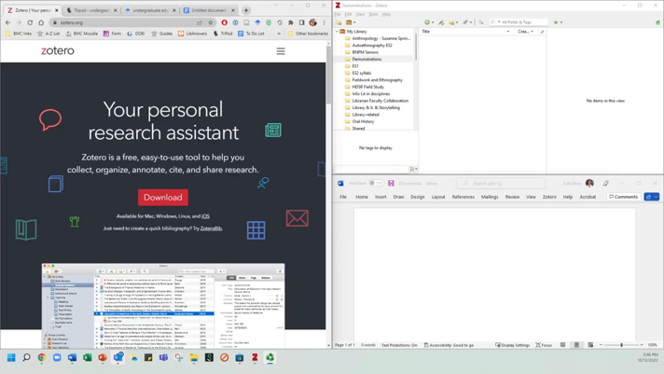
Zotero: Citation management

Slide 23
It’s Your Turn
Use the Research Guide
Visit https://bit.ly/rip1guide (or find the link in Moodle, Week 3)
Bookmark the Research Guide for later.
Use one of the Encyclopedias in the “Getting Started” box.
Did you find a new keyword?

Slide 24
It’s Your Turn
Explore your research topic in a database.
Go to RIP 1 Research Guide
Choose to start with PsycInfo or Social Work Abstracts
Try a search using your keywords in combinations.
Keep track of what searches give you more relevant results.

Slide 25







Goals for Today
Practice the process of framing a research topic in terms of search terms for a literature search
Better understand the tools within the digital library system
Know how to get help

