Slide 1
Trauma-Informed Social Work with Children and Adolescents
Prof. Lindsay Griffin
Summer 2024

Slide 2
Community Guidelines
Confidentiality- what is said in class, stays in class
Suspend judgement/Judgement Free Zone
Be willing to apologize if someone is offended
Respond to questions in a genuine and professional manner (questions posed are meant to further understanding and gain clarity)
Extend grace- everyone is in a different place and everyone processes differently
Notes:
Did I capture the essence of what the group wants as mutual agreements moving forward?

Slide 3
Recap Session 1

Slide 4
Definition of Trauma from SAMHSA
“Trauma results from an event, a series of events, or set of circumstances that is experienced by an individual as physically or emotionally harmful or threatening and that has adverse effects on the individual’s functioning and physical, social, emotional or spiritual well-being” (SAMHSA, 2014).

Slide 5
Three E’s of the Approach to Trauma Informed Care (Accessed at: www.samhsa.gov)

Slide 7
Session 2: Exploring Core Concepts

Slide 8

Quick Write, Think, Create
Write a few sentences down about what a typical developing child may present like (i.e. their behaviors, emotions, and social engagement) at any given age you’d like to describe. We will come back to this a little later in the class.
Notes:
Attendance while students are doing exercise

Slide 9
Objectives for today’s class
Overview of child development and positive youth development
Ecobiodevelopmental Framework
Discuss the 12 Core Concepts of Childhood Traumatic Stress
Brief discussion of group assignment and assign groups (3-4 individuals/group)

Slide 10

Basics of understanding child and adolescent development

Slide 11
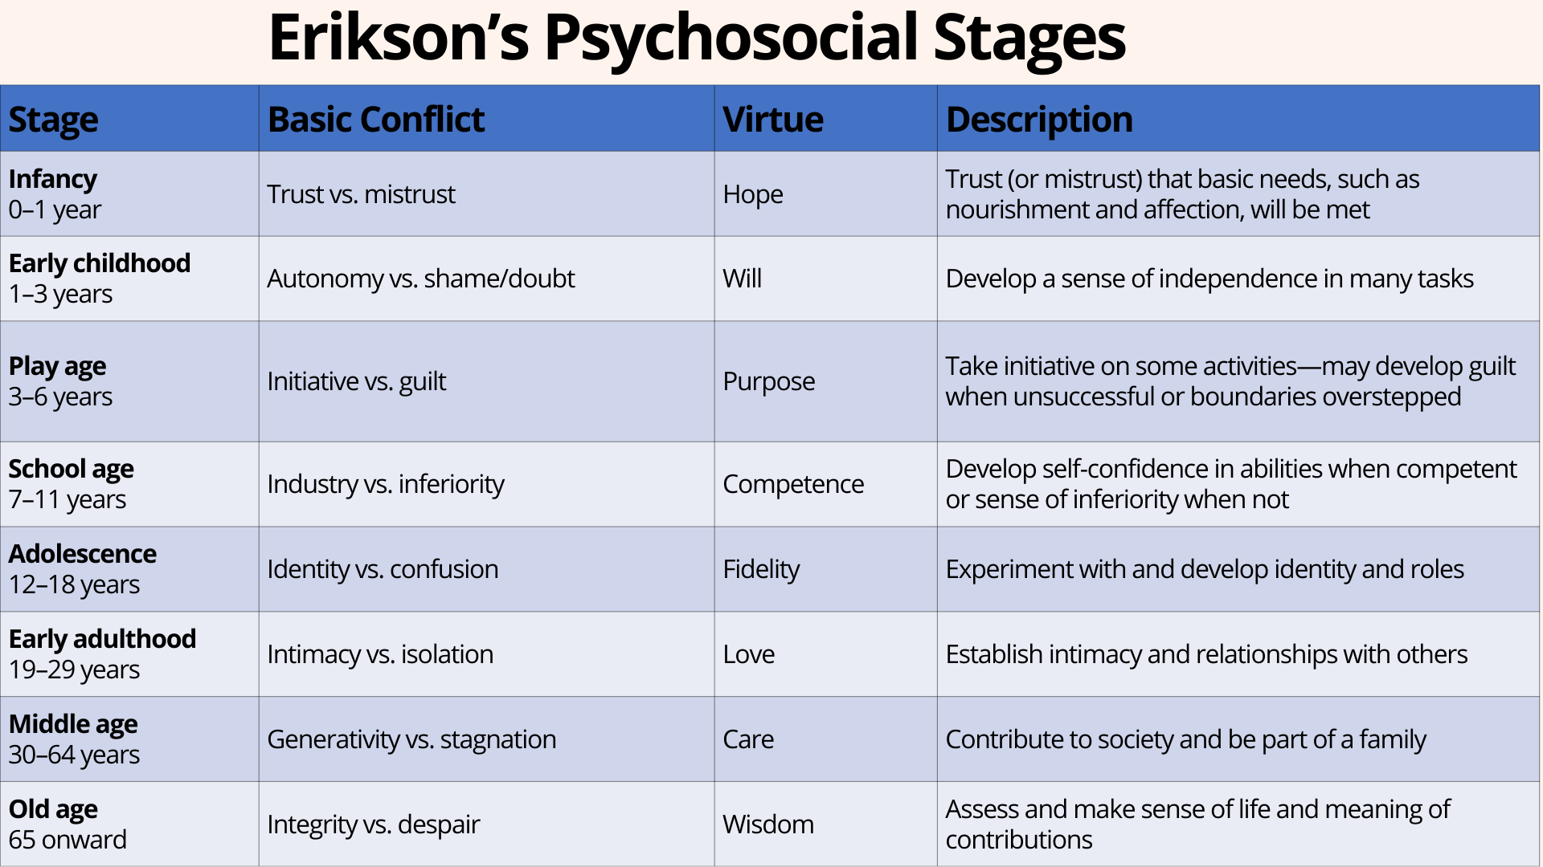
Child Development: Psychosocial Stages of Development (Erikson)
Notes:
https://www.simplypsychology.org/erik-erikson.html
8 stages—we will focus on Infancy-Adolescence in this class
The “left” side is what typical development will look like when child’s needs are met (i.e. trust, autonomy, initiative, industry, identity) vs. the right side is what is more likely to happen when needs are not met or supported. Trauma will typically disrupt these stages and a child’s psychosocial development.
Limitations around “stages”– stages signify that once that phase is over, it is completed.

Slide 12
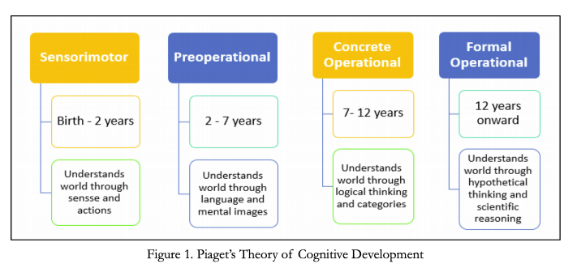
Cognitive Developmental Theory (Piaget)
Source Reference: Aljojo, N., Munshi, A., Almukadi, W., Alanaya, I., Zainol, A., Albalawi, H., Alharbi, G., Almadani, N., Almohammadi, E., Kadu, A., Abdulghaffr, N., & Abdulghaffar, N. (2019). The design and implementation of an Arabic pronunciation application for early childhood. Journal of Technology and Science Education, 9, 136. https://doi.org/10.3926/jotse.486
Notes:
Main takeway—children think differently than adults. Still limited as adolescents still think differently than adults, although there are some adults that think like adolescents.

Slide 13
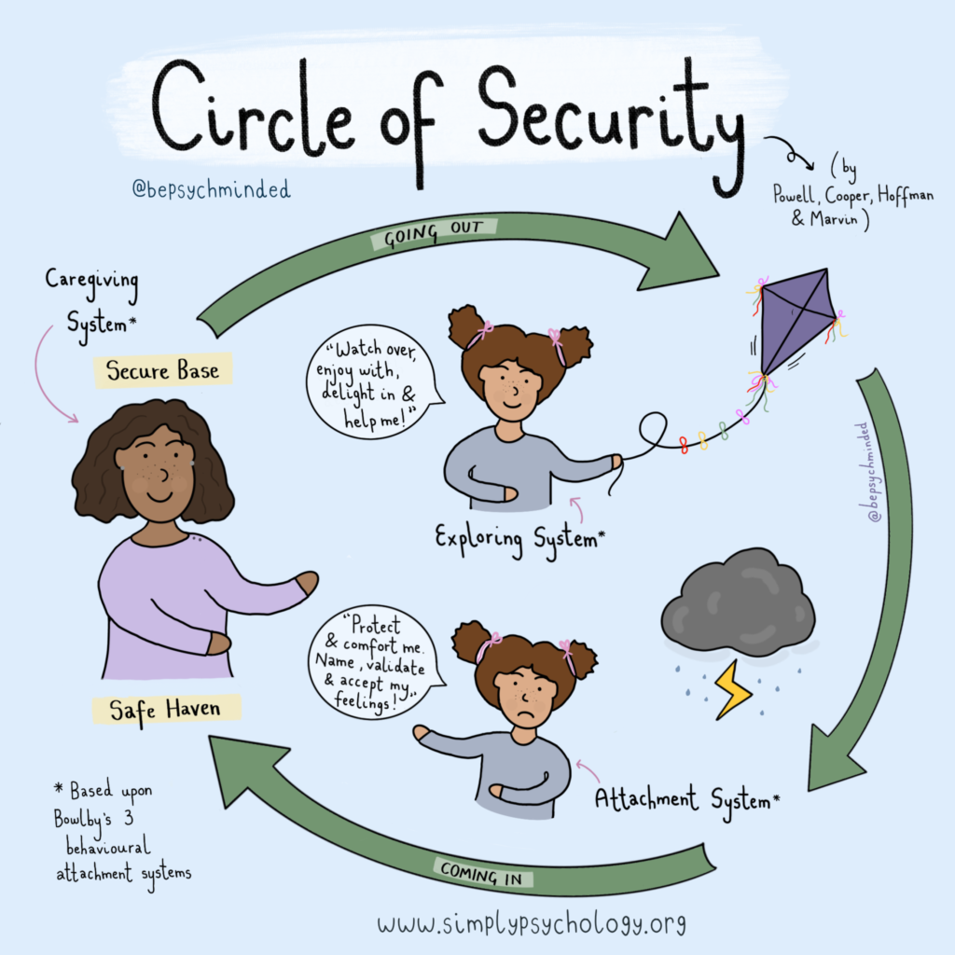
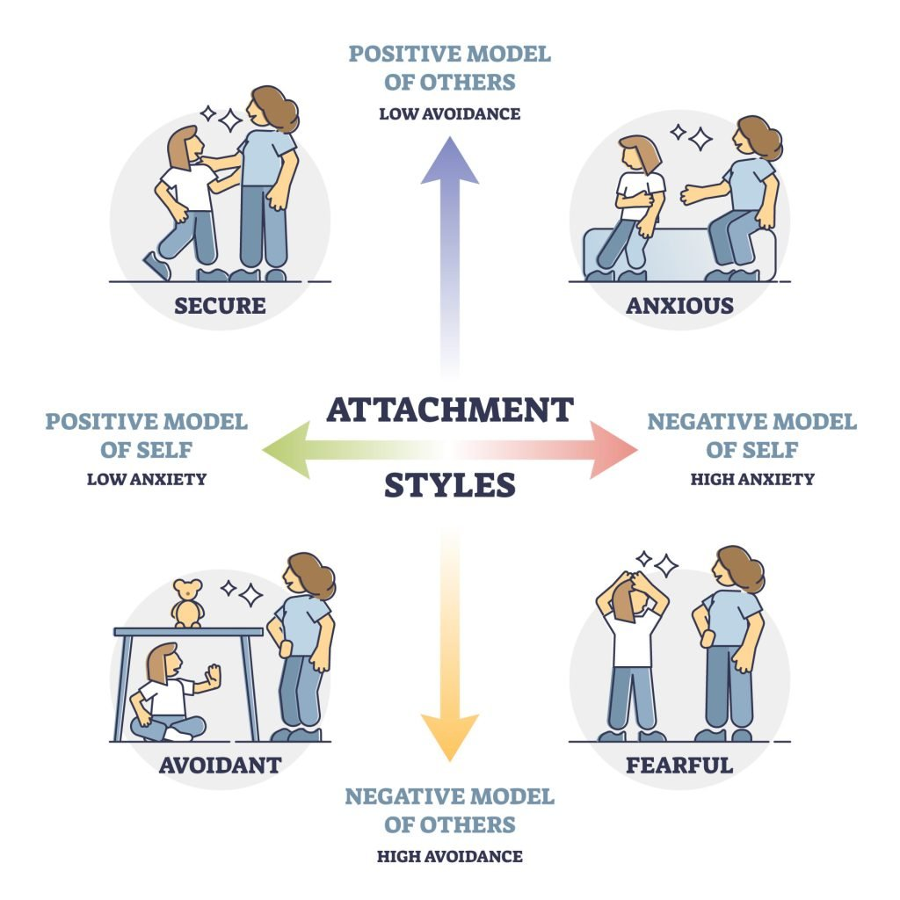
Attachment Theory (Bowlby)
https://www.simplypsychology.org/attachment.html

Slide 14
Level of Cognitive Development
Capacity to represent internal experience via verbal expression increases as child older
Even so, children are more likely than adolescents or adults to represent their internal experience via action, or play
Young children are normatively egocentric, and have difficulty with cause/effect relationships; tend to see themselves as causal agents of their experience
Notes:
Egocentric= focused on self, does not have full capability of perspective taking for others (ex: child whose parents get divorced, the child may think that they are the reason the parents divorce and parents’ arguments are about the child).

Slide 15
The Child’s Dependence on Others
Child’s dependence on caregivers has many implications for understanding child’s experience and for working with children
Children seldom refer themselves; and are often referred because an adult has become concerned about their behavior
Fear of loss or disruption in primary caregiving relationships
Collaborative work with caregivers

Slide 16
Fluidity in Ego Development
Fluidity is normative in childhood:
Primary process, or magical thinking, may predominate
Less differentiation between thought and action in the child’s mind
Ability to anticipate the future may be limited
May impact motivation for participation
Capacity for affect regulation and tolerance of ambiguity may be limited
Notes:
Ego= sense of self

Slide 17
Small Group Exercise
Looking back at what you wrote for the “Quick Write, Think, Create” activity at the beginning of class
Share in your groups what you wrote down
Talk about the information we just reviewed: What information stood out to you? How does having an understanding of basic psychosocial development, cognitive development, and attachment theory for children and adolescents help social workers be more prepared to work with this population? (If able to read the articles, also feel free to share what were some things that stood out to you here).
We will have a few people talk about their thoughts and observations in the large group when we come back.
Notes:
Have 4 groups—give 15 minutes to discuss

Slide 18

Common challenges in infancy to adolescence in context of trauma

Slide 19
Childhood Stress: Basic Concepts
Not all Stressful Experiences are Harmful
Research on Childhood Stress Differentiates Amongst 3 Types of Stress:
Positive Stress
Tolerable Stress
Toxic Stress

Slide 20
Birth to Five
Regulatory problems with sleep and hunger
Night terrors
Feeding/Eating disruption: Non-organic failure to thrive
“Freezing” or “Withdrawal”
Separation anxiety
Aggression against the self/others
Disrupted attachments
Easily alarmed/startled “hypervigilant”
Difficulty in gauging safety/danger and thus at risk for more accidental injury

Slide 21
School Age
Atypical sleep disruption
Difficulties with peer relationships
Impaired concentration and school performance
Hypervigilance and/or Withdrawal/numbing
Somatic complaints
Intrusive thoughts/images
Intense phobias/fears that become associated with avoidance behaviors

Slide 22
Adolescence
Peer relationship difficulties
Impulsivity and risk-taking behavior
Substance abuse
Affect dysregulation
Internalizing (anxiety/depression) and externalizing (aggressive/self-harm) behaviors
Withdrawal from peers and family
Disruption in self-concept

Slide 23
Many Factors Determine Impact of Stress
Age
Chronological Age and Maturational Age impact how a child interprets a particular series of stressors, the meaning that is made, and also, the particular developmental processes that are disrupted by ongoing stress exposure
The ability to cope with age-appropriate experiences of stress is important to ongoing developmental progression (e.g. first day of school)
Notes:
Define Chronological Age= biological age and Maturational Age (depends on a number of psychological/cognitive and physiological factors, i.e. IQ, achievement of developmental milestones, etc.).

Slide 24
Many Factors Determine Impact of Stress
Controllability and Predictability
Predictability
Understanding cause/effect and being able to anticipate stressful experience can lead to mounting of more effective coping responses; including anticipatory planning and reaching out to supportive adults
However, in children, “triggers” may also become diffused and difficult for surrounding adults to recognize
Example: Hyper-vigilance, Cross-Sensory Experience, Somatic Memory
Notes:
Define Chronological Age and Maturational Age

Slide 25
Many Factors Determine Impact of Stress
Presence of Supportive Relationships
In general, access to supportive adult relationships support child’s capacity to cope with stress exposure
Complex Trauma: When nature of trauma has to do with those relationships themselves
Double Jeopardy: Experience of traumatic stress combined with loss of access to supportive care, trauma in the caregiving relationship itself, and/or disrupted access to caregivers
Notes:
Will come back to importance of supportive relationships later

Slide 26
Many Factors Determine Impact of Stress
Past Experience with Stress
Impact of traumatic stress is cumulative
Each additional exposure raises the risk for negative developmental outcomes
As this occurs, each additional exposure has a greater impact on developmental vulnerability; meaning even “smaller” instances of traumatic stress can have “outsized” impact on child wellbeing
Notes:
Particularly important as risks to varioius types of traumatic stress are inter-related and…secondary effects of some trauma exposures themselves raise risk for additional stress experiences.

Slide 27
Many Factors Determine Impact of Stress
Child Coping Ability*
Age/Maturational Status
Pre-Trauma Adjustment
Current level of adjustment
Past experience with traumatic stress
Specific meaning of the stressor to the child
Social ecology of the child

Slide 28
Social Workers Use of Developmentally Informed Intervention Methods
A developmentally informed approach can guide our choice of techniques in our work with children
Build on child’s competencies and strengths
Respect for individual differences and variation with regard to developmental trajectory
Child’s capacity to express internal states and experience in the medium of verbal exchange
Child’s preference for displacement and externalization

Slide 29
Prenatal context implications for child & adolescent development
In State of Babies (2020) found in Session 1 in Moodle, pregnancy and birth contexts are discussed and disparities in these contexts for racial categories (note: these statistics generally identify those with a uterus as a “woman”)
Disparities in prenatal care utilization and access (9.9% of Black women get late or no prenatal care)
Preterm births for Black women is 55% higher than the rate for White women
Rate of Hispanic/Latinx women having low birth weight infants is 7.5%, for Black women it is 14.1% and for White women it is 6.9%
Preterm birth has a relationship to birth weight, and lower birth weight can have implications for development and developmental delays

Slide 30
Racial Disparities and Weathering
“Even before some of them become mothers, Black women can experience the daily emotional stress of racism, accumulating wear and tear on their health (referred to as “weathering”) that is substantially greater than that of their White counterparts. Looking at mothers and babies, particularly, evidence suggests that Black women’s lifelong exposure to interpersonal discrimination may be an independent risk factor for preterm births and infant mortality” (State of Babies, 2020, p. 7).
Weathering is the result of living in a society with social and political structures that causes a person to experience high levels of stress that are related to marginalization, discrimination, and oppression—such as structural racism and poverty. These exposures cause a person’s body to “weather” or “wear-down” over time.

Slide 31
Small Group Discussion-Think About It
When you think about developmental differences between children and adolescents, does it help you to think about how traumatic stress has impacted your client systems? If so, how?
How do you see prenatal contexts influencing the developmental trajectory of children in client systems?

Slide 32

Break Time!

Slide 33
Ecobiodevelopmental framework
https://www.youtube.com/watch?v=Vw32KCu5PDE&t=1s
Notes:
Dr. Jack Shonkoff: Director of the Center on the Developing Child at Harvard
He talks about “bioecodevelopmental model”– this is the same thing

Slide 34
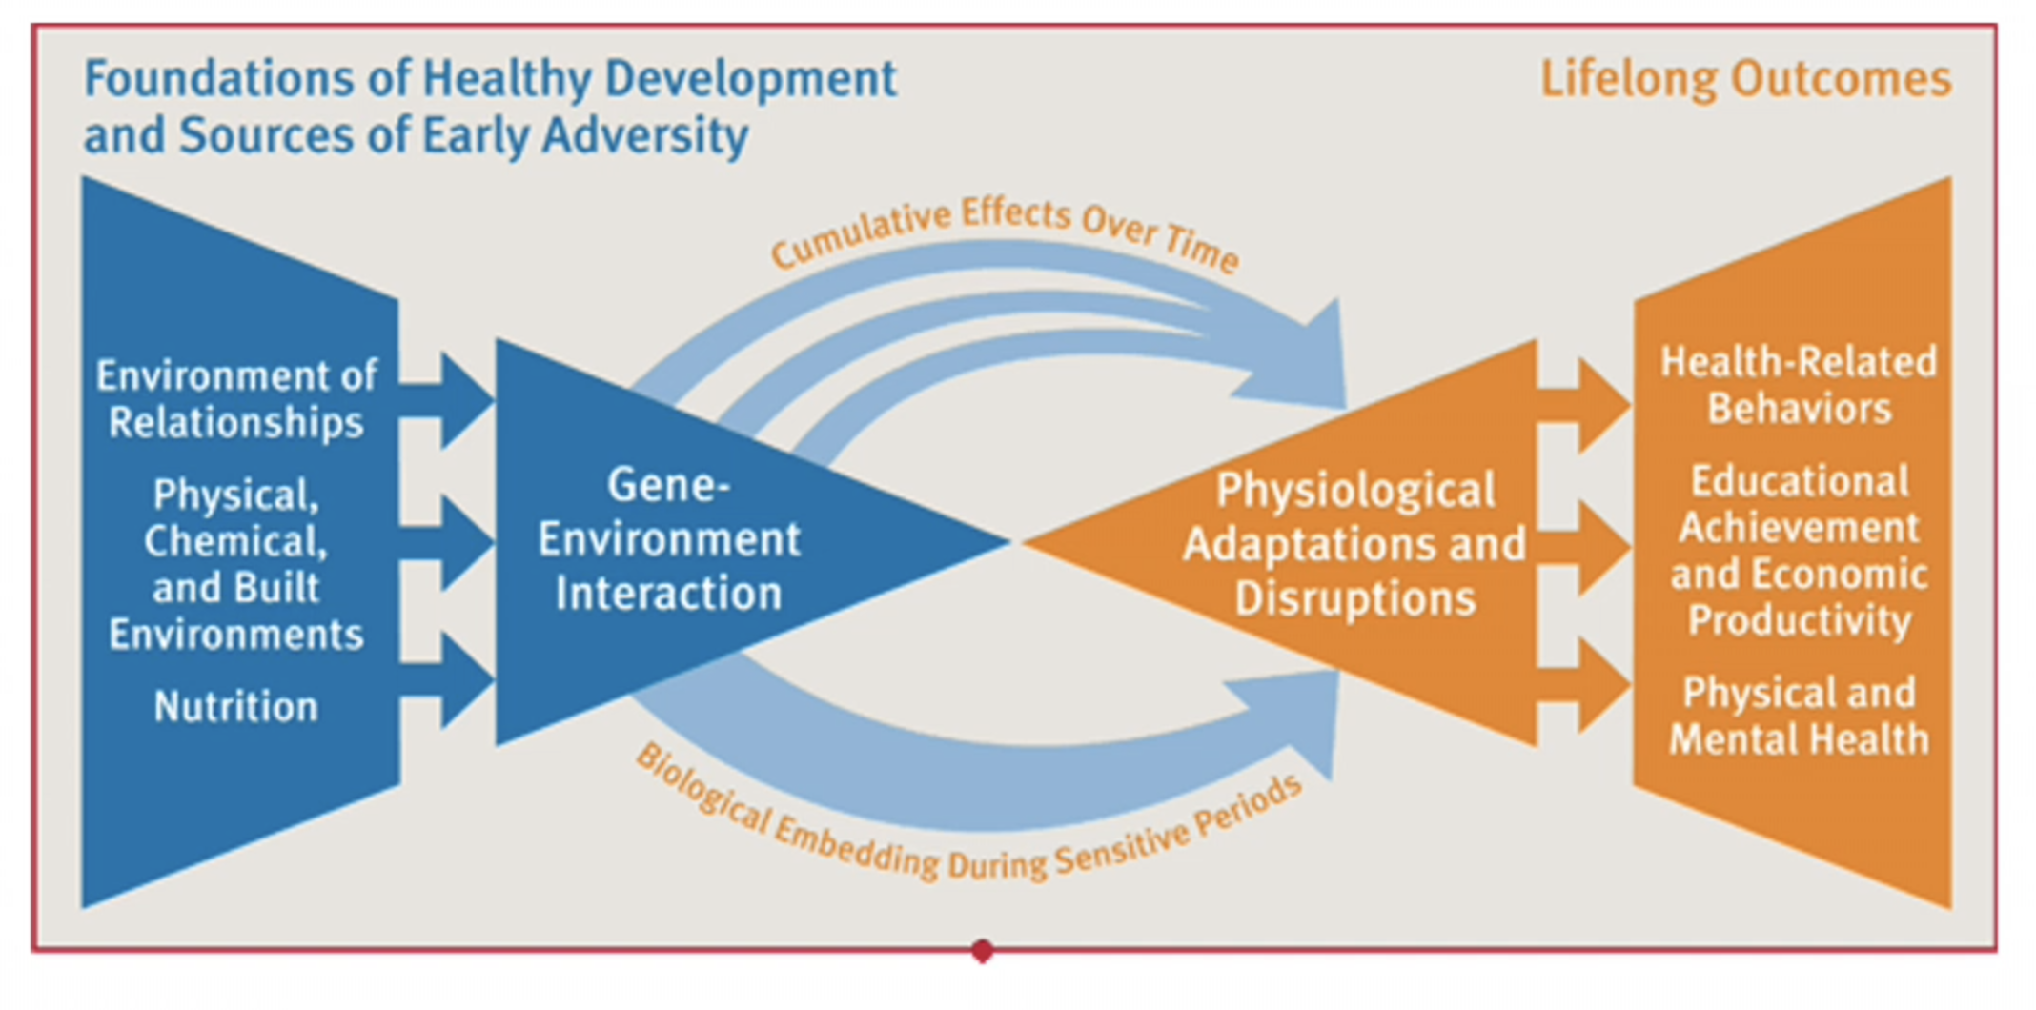
Ecobiodevelopmental Framework
Notes:
Discuss the relationship of epigenetics to weathering**

Slide 35
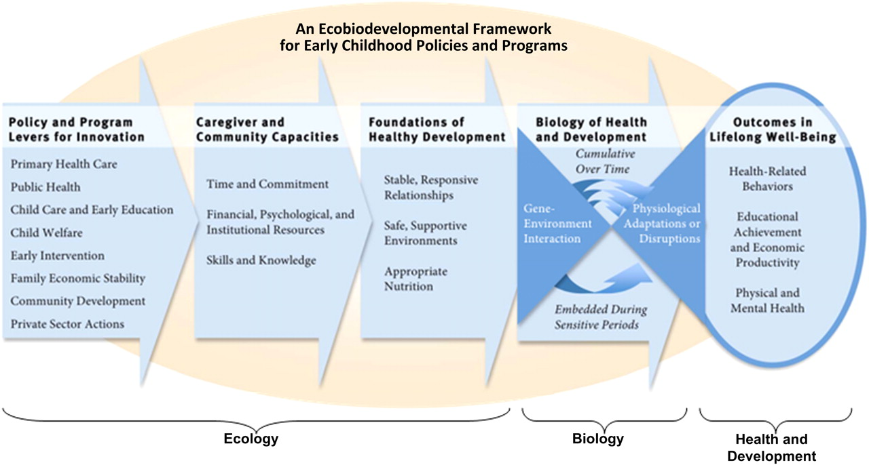
Notes:
Another example of the model that breaks down the 3 components as it relates to policies and programs

Slide 36
12 Core Concepts for Understanding Traumatic Stress Responsive in Children and Families
Notes:
This document is available in Moodle, please read for further and more in-depth descriptions on these concepts. You must discuss 4 of them in your group project

Slide 37
1. Traumatic experiences are inherently complex

Slide 38
2. Trauma occurs within a broad context that includes children’s personal characteristics, life experiences, and current circumstances.

Slide 39
3. Traumatic events often generate secondary adversities, life changes, and distressing reminders in children’s daily lives.

Slide 40
4. Children can exhibit a wide range of reactions to trauma and loss.

Slide 41
5. Danger and safety are core concerns in the lives of traumatized children.

Slide 42
6. Traumatic experiences affect the family and broader caregiving systems.

Slide 43
7. Protective and promotive factors can reduce the adverse impact of trauma.

Slide 44
8. Trauma and posttrauma adversities can strongly influence development.

Slide 45
9. Developmental neurobiology underlies children’s reactions to traumatic experiences.

Slide 46
10. Culture is closely interwoven with traumatic experiences, response and recovery.

Slide 47
11. Challenges to the social contact, including legal and ethical issues, affect trauma response and recovery.

Slide 48
12. Working with trauma-exposed children can evoke distress in providers that makes it more difficult for them to provide good care.

Slide 49
Small group activity
Pull up the “12 Core Concepts Worksheet” from Moodle
I will give you 5 minutes to independently work on examples you have experiences in your own work. You are not required to fill in each box. I will give 20 minutes to work in small groups to talk about the experiences. Think about the following questions to guide the discussion:
What are things that you notice in the examples discussed in your group?
What are things that appear to be similar?
What experiences seem unique?
Are there any experiences that seem particularly challenging?
How do we navigate and engage in self care as professionals in these situation?

Slide 50
Group Presentation Assignment
Purpose: Identification of relevance of 12 core concepts to our ability to address the issue from a social work perspective.
Each group must bring in an example of current events/news that can be discussed from a trauma informed perspective. In particular, students must identify at least four of the core concepts we cover in session 2 that could be useful in addressing the issue from a trauma informed and social work informed perspective. Groups will sign up for a date for this presentation. Each group should be prepared to share a brief PowerPoint with the class that will: 1) Present the current event/news area under discussion, 2) Identify risk and protective factors (we will discuss risk and protective factors in session 3) for children and adolescents utilizing an ecobiodevelopmental frame and 3) Connect the issue to at least 4 of the core concepts we covered in Session 2 (today’s session). Groups will be given work time in several classes to work together on this assignment.
Notes:
Assign groups. Give 15-20 minutes for the students to start talking about something of interest they want to focus on. Give class time in sessions 3, 5, and 7 (45-60 minutes) to work on project. Post rubric that will be used for grading.

Slide 51
What’s Next?
Reminder—We will meet on Tuesday, May 28 instead of Monday due to holiday
Developmental impact of trauma
ACES (Adverse Childhood Experiences)
Individual and Community Level Risk & Protective Factors
Please prioritize watching the TED Talk with Nadine Burke-Harris before our next meeting (approximately 16 minutes)

