Slide 1

Trauma informed social work with children and adolescents
Prof. Lindsay Griffin
Summer 2024

Slide 2
Session 3 Recap

Slide 3
Trauma’s Impact on Developmental Domains, ACEs, and Risk & Protective Factors
Discussed the original ACE study, the Expanded ACE study, the Pair of ACES Tree and the 3 Realms of ACEs
Critiques, limitations, and strengths of these tools
Developmental implications on the multiple domains of a person’s life who is exposed to trauma
Individual & Community Level Risk factors to consider as practitioners

Slide 4

Session 4: Trauma, attachment, neurobiology, and adolescent brain development

Slide 5
Today’s Objectives
Discuss how the brain develops and the relevance to child and adolescent development and implications for development in the context of trauma
Discuss core concepts of critical/sensitive periods, plasticity, risk and protective factors in relation to brain development and trauma

Slide 6
But first…
A quick poll ☺

Slide 7
For today
Think about a child you know—could be a child you have worked with professionally, it could be your own child, a niece/nephew, a cousin, or even could be your younger self. As we are going through brain development, it helps to think about examples.

Slide 8
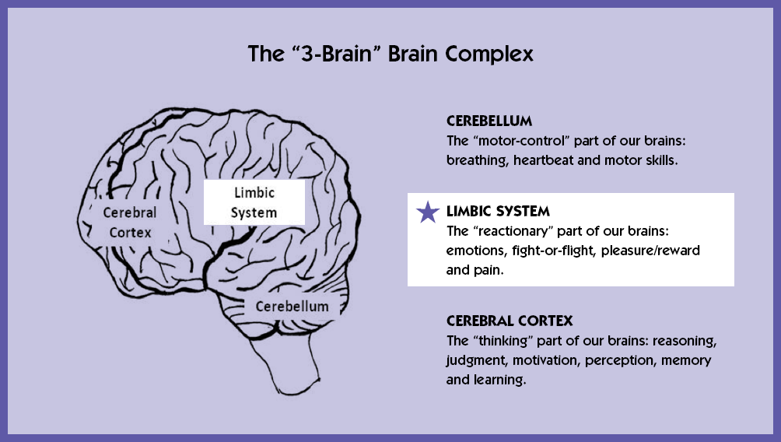
Notes:
We will come back to this in a video about the “hand model of the brain”

Slide 9
Notes:
Brain stem regulates our basic living functions—without this functioning we would not be able to survive

Slide 12
Planning
Decision-making
Reasoning
Motor skills
Imagination
Expressive language
Spatial orientation
Memory
Information processing
Sensory processing

Slide 13
Critical Periods of Brain Development
In-utero: the developing fetus is exposed to a variety of hormones that can be linked to later health outcomes; alcohol use during pregnancy can have severe implications on brain development
Birth to age 5: this period of time is considered a critical period where children are learning and developing a variety of skills and attachment to primary caregivers, including language development, motor development, and cognitive functions that lay the blueprint for later life

Slide 14
Brain Architecture Emerges in the Context of Attachment
Cognitive and social/emotional capacities are intertwined
Brain is highly interrelated organ and multiple aspects function in coordination
Emotional wellbeing and social competence are necessary for optimal cognition
Emerge in the context of human relationships/attachment
Toxic Stress weakens the architecture of the brain which can lead to lifelong problems in learning, behavior, physical and mental health
Experiencing stress is necessary and not all stress is bad
Toxic stress can impair the development of neural connections, especially in the areas of the brain associated with higher-order skills (e.g. self-regulation and executive functioning)

Slide 15

We have learned so much about the brain in recent years
The brain is not fully developed at birth
Throughout childhood and adolescence, brain development continues
Brain development is very sensitive to environmental inputs
For children, relationships with caring adults is a key ingredient to health brain development
Traumatic stress can negatively impact brain development during childhood and leave the child more vulnerable to future stressors

Slide 16
Brain Architecture Emerges in the Context of Attachment
Brains are built from the bottom up
Genes provide the blueprint
Ongoing process from before birth into adulthood
Interactions of genes and experience shape the developing brain
Simpler connections and skills first, then more complex neural networks
Circuits are reinforced by repeated use
“serve and return” interaction between children and caregivers/responsive caregiving necessary for optimal neural structure to emerge (we’ll talk about this more next session)
Notes:
Consider this from an ecobiodevelopmental framework (genes= nature) but attachment is part of nurture

Slide 17
Brain Architecture Emerges in the Context of Attachment
Video from the Center for the Developing Child
https://www.youtube.com/watch?v=VNNsN9IJkws
Notes:
2 minute video

Slide 18
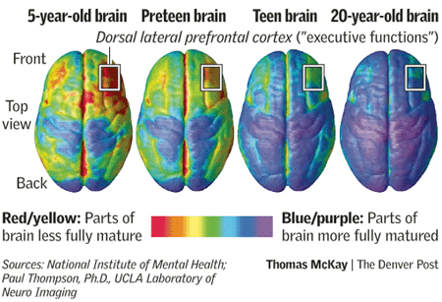
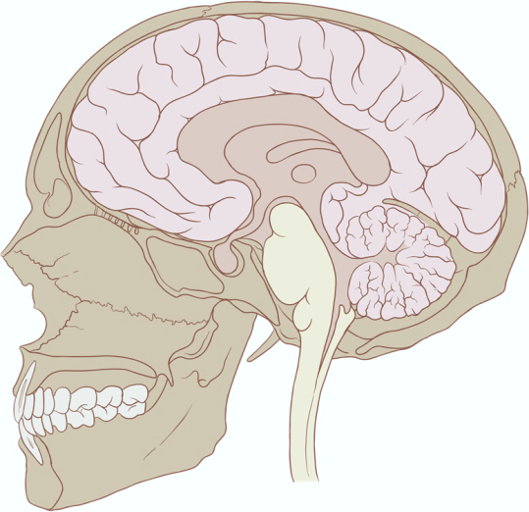
Brains Develop from the Bottom Up
Prefrontal Cortex
Limbic System
Brainstem
What do you notice in these images? How are the brains different that stand out to you?
Notes:
Ask class to keep this in mind as we continue to explore brain develop and implications of toxic forms of stress

Slide 20
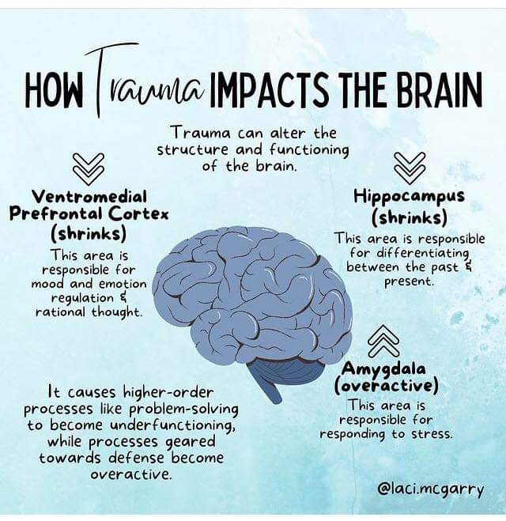
Notes:
Source: redit
This image shows the ways that a brain is impacted when exposed to trauma. Know let’s take a look at what a child’s brain can look like in circumstances of extreme neglect

Slide 21
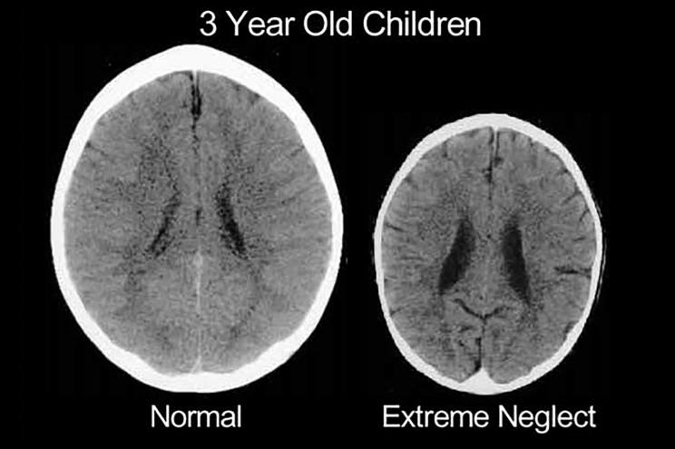
https://nypost.com/2017/11/02/brain-scans-reveal-how-badly-emotional-abuse-damages-kids/

Slide 22
Small Group Exercise
Work in small groups. What stands out to you in these two brain scan images? As these children grow, what types of expectations would you have for them? What aspects of their brain development would you be concerned about as a social worker? You will be given 15 minutes to discuss in group. Report back to the large group what you discussed.
Notes:
When we are coming in contact with children who have experienced extreme neglect and/or abuse and/or toxic stress—we have to start considering and thinking about what is the structure of their brain. There is hope for recovery. Neuroscientists know that the brain is malleable and can be changed. We have to understand that the experiences has literally shaped their brain but it can be re-shaped with the right supports.

Slide 23

Break time!

Slide 24
Plasticity: The Brain Develops in Response to Genetic Information and in Response to Experiences
Positive Experiences Act as Promotive and Protective Factors
Negative Experiences Act as Risk Factors
Freedom from abuse and neglect
Access to adequate nutrition and health care
Adult care that is warm, consistent and responsive
Protection from overwhelming stress and anxiety
Abuse and neglect
Environmental toxins
Poor nutrition
Disrupted or absent caregiving relationships
Overwhelming states of anxiety and stress without access to support
Notes:
Double Edged Sword

Slide 25
Notes:
An ounce of prevention is worth a pound of cure- Benjamin Franklin

Slide 26
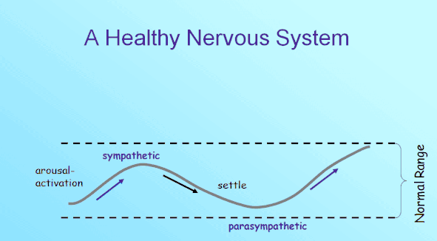
Notes:
Your sympathetic and parasympathetic nervous systems have opposite but complementary roles. Your sympathetic nervous system carries signals that put your body's systems on alert (typically on to have you ready to fight or flee when needed), and your parasympathetic carries signals that return those systems to their standard activity levels, but when the parasympathetic is dominant, a person may find that they will “freeze”. When activation remains in the normal range, we can regulate ourselves.

Slide 27
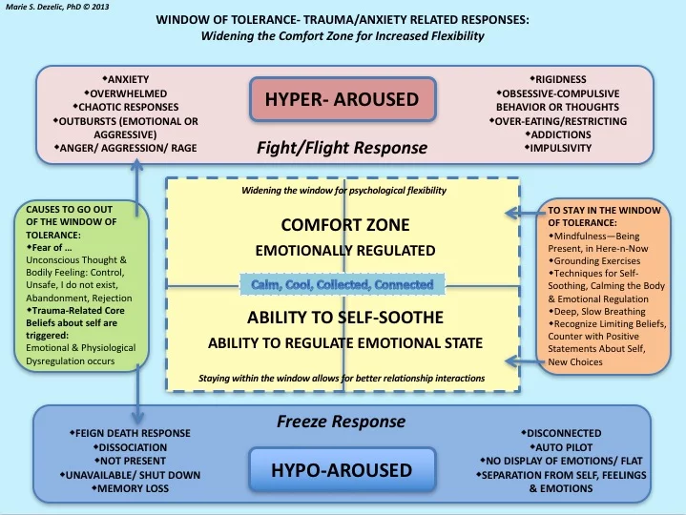

Slide 28
Dan Siegel: Hand Model of the Brain & “Flipping Your Lid”
https://www.habitsforwellbeing.com/dan-siegel-on-flipping-your-lid/

Slide 29
The Amazing Teen Brain
What was something surprising you learned from this video?
How is the teen brain unique?

Slide 30
Brain Development in Adolescence
NIH Identifies 7 Things to Know about the Teen Brain: https://www.nimh.nih.gov/health/publications/the-teen-brain-7-things-to-know
Adolescence is an important time for brain development
Brain development is related to social experience during adolescence.
The teen brain is ready to learn and adapt
Teen brains may respond differently to stress. (prefrontal cortex is still developing)
Most teens do not get enough sleep. (melatonin levels are different—hormone regulating sleep)
Mental illnesses may begin to appear during adolescence.
The teen brain is resilient
Notes:
https://www.nimh.nih.gov/health/publications/the-teen-brain-7-things-to-know

Slide 31
Brain Development in Adolescence
During adolescence, individuals are more likely to engage in the following:
Risk taking behaviors or acting on impulse
Misread or misinterpret social cues and emotions-–social conflicts are common
Get into accidents
Get involved in fights
Act before thinking
Less likely to consider consequences or implications in the future
More likely to want to live “in the moment”
https://www.aacap.org/AACAP/Families_and_Youth/Facts_for_Families/FFF-Guide/The-Teen-Brain-Behavior-Problem-Solving-and-Decision-Making-095.aspx
Notes:
In the context of trauma, we can see poorer developed problem-solving skills for this age group
We may see more attempts to control situations through behaviors, which may include aggression, self-sabotaging success, etc.
We may also see more risk-taking behavior-–engaging in unsafe sex behaviors, experimentation and/or addiction to drugs or alcohol, stealing, fights, etc.

Slide 32
Small Group Exercise
Think about what we discussed with brain development and what is typical for children and adolescents vs. how trauma impacts the brain of children and adolescents. 1) How might social workers expect to see impact on the developing brain and nervous system when a child or adolescent has experienced trauma? 2) Identify how we may expect children and adolescents to behave after these traumatic events. 3) How might you educate a child or adolescent about their brain? You will be given 15 minutes to discuss in group. Report back to the large group what you discussed.

Slide 33
What’s Next?
Session 5: Understanding impact of traumatic stress on children and adolescents and implications for trauma informed work
Group Presentation Work time will be given during class time
Assignment 2 is due on Saturday, June 1: Write a 1-2 page paper on “Why is it important for practitioners to understand adolescent brain functioning?”

