Slide 1

Trauma informed social work with children and adolescents
Prof. Lindsay Griffin
Summer 2024

Slide 2
Midcourse Feedback
I strive to make learning environments as conducive to every student’s learning and growth as future social workers
What is working well?
What isn’t working so well?
What are some suggestions for class time that might be more effective for individual and group learning?
Are the community guidelines working? Do we need to change anything?
Community Guidelines
Confidentiality- what is said in class, stays in class
Suspend judgement/Judgement Free Zone
Be willing to apologize if someone is offended
Respond to questions in a genuine and professional manner (questions posed are meant to further understanding and gain clarity)
Extend grace- everyone is in a different place and everyone processes differently
Notes:
Note: The next 2 classes I will be away, so I will integrate in any feedback given during the last 3 classes that I will be present for.

Slide 3
Session 4 Recap

Slide 4
Trauma, Attachment, & Neurobiology
Reviewed the main structures of the brain and the developmental implications for children and adolescents and implications for brain development in the context of trauma and toxic stress
Discussed some critical/sensitive periods, plasticity, risk, and protective factors

Slide 5

Session 5: Understanding Impact of traumatic stress on children and adolescents and implications for trauma informed work

Slide 6
Today’s Objectives
Discuss complex trauma in the context of primary caregiving relationships
Discuss attachment disruptions and implications to the child and adolescent brain
Start discussing best practices for trauma-informed work

Slide 7
Impact of Attachment Disruption/Trauma on Brain and Body of Developing Child
Key Points
  Brain development occurs from the bottom up
  From the more primitive (survival/brainstem) to the more complex (rational thought, abstraction, planning)
  Brain develops by forming connections (Synaptogenesis)
  Interactions with caregivers are key
  The more an experience is repeated, the stronger the neurological connection
Notes:
Babies are biologically prepared to depend on caregivers
We share this with rhesus macaque and with many other species.

Slide 8
https://www.attunedcoaching.com/blog/attachment-theory

Slide 9
Healthy Serve and Return Interactions are critical to brain development
https://www.youtube.com/watch?v=KNrnZag17Ek
Notes:
Also an article in Moodle for more information

Slide 10
Think about it
After seeing the last video, what are your thoughts on how trauma can interrupt the serve and return process?
  How may a child act when trauma has interrupted the serve and return process?
  What may the interruption look like for a caregiver who has experienced and been affected by trauma?

Slide 11
Attachment as the Foundation for Executive Function and Self-Regulation
Executive function and self-regulation are the mental processes that enable us to plan, focus attention, increase our memory, multi-task, delay gratification and tolerate frustration/disappointment
Several aspects of brain function are related to executive function and self regulation:
  Working memory
  Mental flexibility (shifting attention)
  Self-control (impulse control)
Children develop these capacities, and their neurobiological substrate, in the context of early care environments

Slide 12
Neglect can be considered a source of trauma
Neglect can be terrifying to a child
  Can not access an adult’s capacity to co-regulate the child’s affective states
  May not have access to state regulation support (hunger/satiation, cold/heat, pain)
Neglect can be conceptualized as ongoing and chronic mis-attunement
Neglect can impair emergence of self-regulatory abilities:

Slide 13
Attachment Disruption Impacts Child Well-being
How does “secure attachment” confer developmental benefits on the developing person?
  Children are more likely to successfully learn to manage negative states of arousal and to internalize effective models of self-soothing and self-regulation
  Human infants/young children depend on co-regulation of adult caregivers: physical states of arousal, social/emotional, attentional patterns (e.g. social referencing)
  Affective attunement is associated with secure attachment: Over time, child learns to modulate states of arousal
  Attachment theory is sometimes referred to as “regulatory theory”

Slide 14
Attachment Disruption Impacts Child Well-being
How does quality of attachment affect capacity for stress regulation?
  When stress is not modulated, even in the caregiver, alterations in infant brain development change the infant’s capacity to respond effectively to stress
  Similarly, secure attachment and contingently responsive care protects against these negative consequences even in exposure to other aspects of adversity

Slide 15
Attachment Disruption Impacts Child Well-being
How does quality of attachment affect response flexibility?
  Capacity for brain to respond to changes in internal or external environments with a flexibly adaptive range of behavioral or cognitive responses
  Develops within a context of attachments in which people become connected through shared appraisal and modulation of arousal

Slide 16
Attachment Disruption Impacts Child Well-being
How does quality of attachment affect development of reflective function (capacity for mentalization)?
  Capacity to reflect on the mental states of oneself and others so that actions and experiences can be understood in a meaningful way
  Contributes to affect regulation, impulse control, and experience of agency
  Attachment is secure when caregiver is overall accurately able to reflect the child’s mental state back to him/her in a modulated state (what about parents overwhelmed with anxiety about a child?)

Slide 17
Impact of Attachment Disruption/Trauma on Brain and Body of Developing Child
Biologically prepared to depend on caregivers
Temperature regulation
Neuroendocrine regulation
Protection from infection
Protection from danger
Contact comfort
Security
Notes:
Babies are biologically prepared to depend on caregivers
We share this with rhesus macaque and with many other species.

Slide 18
Impact of Attachment Disruption/Trauma on Brain and Body of Developing Child
Trauma, and especially within context of primary attachment relationships, can have serious impact on developing brain, brain chemistry and nervous systems
Notes:
Babies are biologically prepared to depend on caregivers
We share this with rhesus macaque and with many other species.

Slide 19
Impact of Attachment Disruption/Trauma on Brain and Body of Developing Child
Trauma induced alterations in biological stress systems can adversely affect brain development, cognition/learning, language development
Atypical development of HPA axis which can predispose children to later mental health problems
Can display hormonal alterations similar to those seen in combat veterans
Affects the way children respond to stress in the future

Slide 20
Impact of Attachment Disruption/Trauma on Brain and Body of Developing Child
Possible Impact of Trauma on Brain Structure
  Smaller Corpus Callosum (controls communications between hemispheres and is key to regulating arousal/emotion and accessing higher order cognition even when emotionally dysregulated)
  May be a decrease in the volume of the hippocampus (learning and memory)
  May be a decrease in the volume of the prefrontal cortex

Slide 21
Impact of Attachment Disruption/Trauma on Brain and Body of Developing Child
Still, brain is shaped by experience which means there is an opportunity to repair some of this negative impact through corrective/alternative experiences
Notes:
Emphasize that a child who experiences trauma and/or attachment disruption is not “beyond repair”—there is hope for recovery with having the right supports and interventions

Slide 22
Small Group Exercise
Work in small groups to identify one or more groups of children and adolescents who have experienced traumatic separations. Prepare to present back to the group about: 1) How are attachment relationships impacted? 2) Describe the biopsychosocial impacts, 3) How might social workers expect to see impact on the developing brain and nervous system? You will be given 15 minutes to discuss in group. Report back to the large group what you discussed.

Slide 23

Break Time!

Slide 24
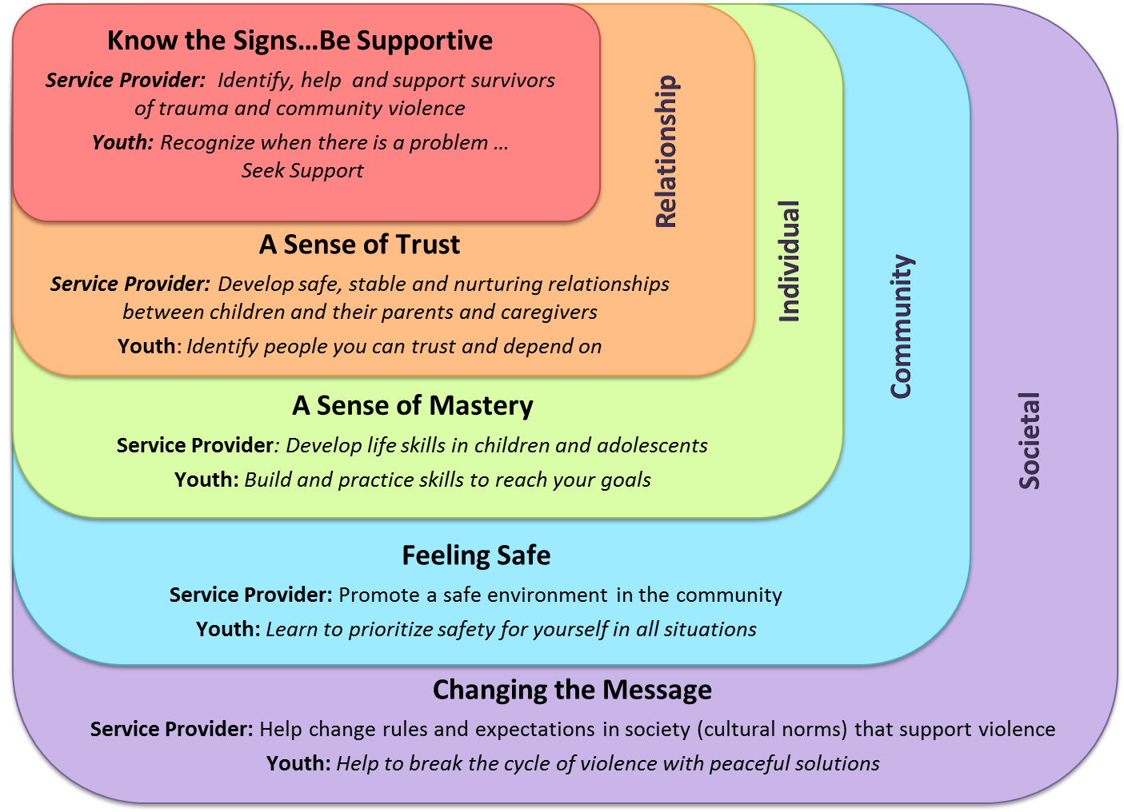
Best Practices for Violence Prevention and Trauma Intervention
https://www.psych.uic.edu/research/urban-youth-trauma-center/public-awareness/best-practices/best-practices-for-violence-prevention-and-trauma-intervention
Notes:
This was on Moodle—want to think about this from a service provider standpoint and what this looks like from a micro, mezzo, and macro scope of practice. For the areas that state “youth” we want children and adolescents to also develop these skills. We will go through each of these best practices next.

Slide 25
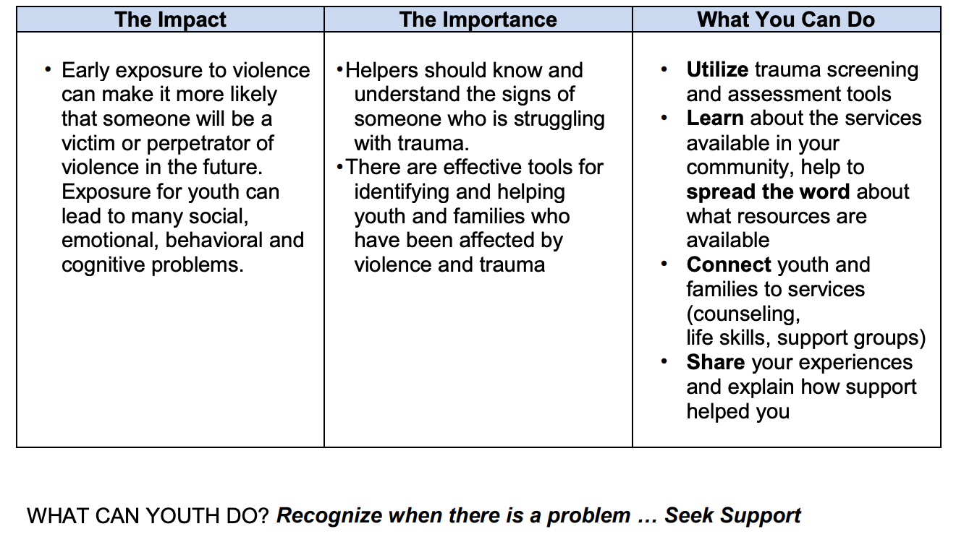
Know the signs...Be Supportive
Notes:
Children living in areas with a high degree of violence leads to a variety of social, emotional, behavioral, and cognitive problems, as we have already discussed.

Slide 26
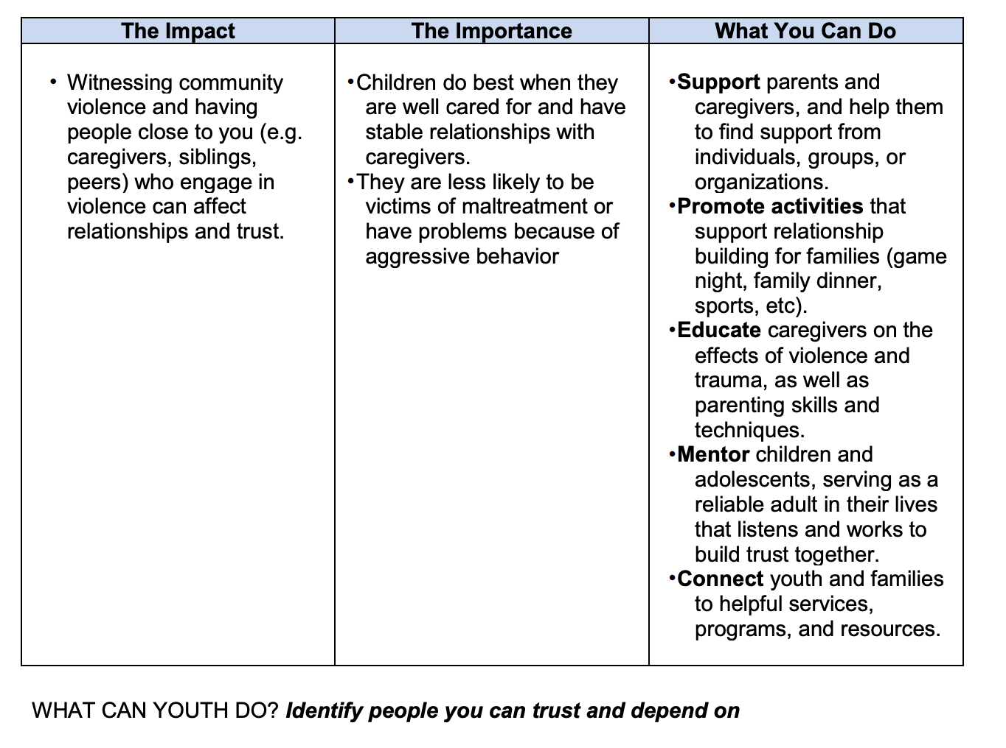
A Sense of Trust

Slide 27
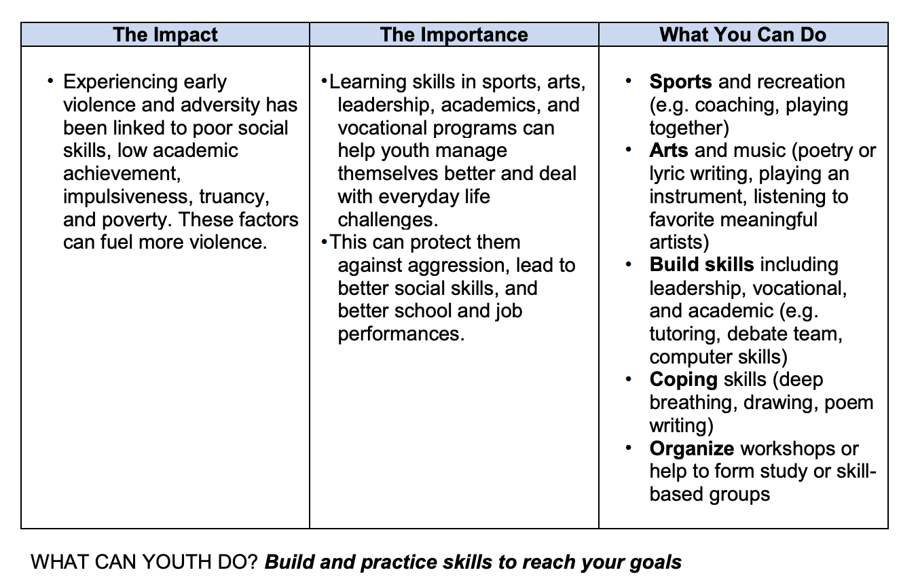
A Sense of Mastery

Slide 28
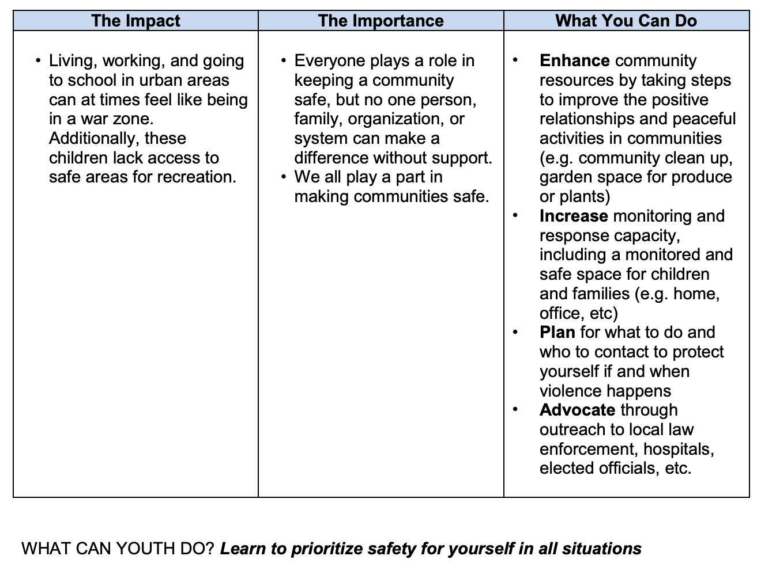
Feeling Safe

Slide 29
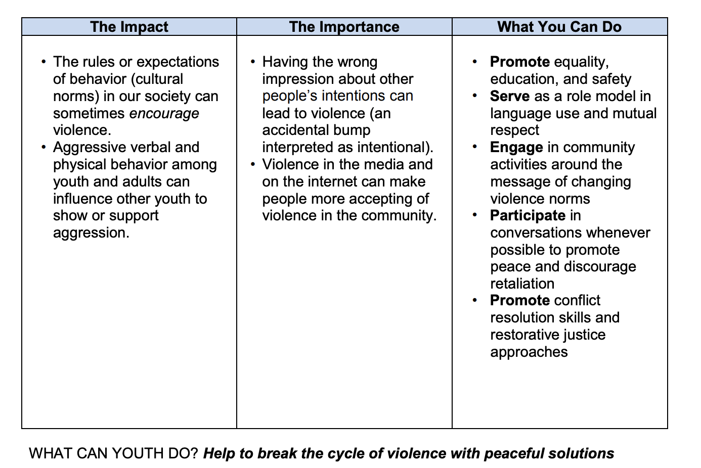
Changing the Message

Slide 30
Large Group Discussion
Take 1-2 mins to reflect on the best practices that we just reviewed:
What stands out to you?
How do you think these practices align or not align with SAMHSA’s 4 R’s (Realize, Recognize, Respond, and Resist Re-traumatization)?

Slide 31
What’s Next?
Reminder: I will be away for the next two sessions. I will not have access to e-mail from June 6-June 11. I will read and respond to messages when I return.
Session 6: Guest Speaker- Susan Burns will talk about work experiences in child welfare and discussing evidenced-based approaches for this work setting. Assignment 3 is due on Saturday, June 8th. If you are unable to make the class—send me an e-mail to me and modify the 3rd assignment (you will be unable to answer about what stood out to you from the guest speaker’s lecture).
Session 7: During class time, watch Paper Tigers documentary. Arrange with your group members today who will send out the Zoom link for you to meet and discuss the film after you have completed watching it. Plan to give a report out of your discussion during Session 8
Session 8: We will be back together to discuss Trauma Informed Approaches to Juvenile Justice. Prioritize listening to the Victor Rios lecture and choose TWO of the readings to skim/read before the next class. We will have the last group work time in Session 8

Slide 32
Group Work Time
Please take the remaining part of class to work with your group members on your final presentation. Once you feel like you have gotten to a good place, feel free to log off for tonight. I will float around to groups to check-in with progress and to answer any questions.

