Slide 1
Research Informed Practice II
Summer 2024
Session 1
Prof Lauren Montemuro-Rode

Slide 2
Session 1 Agenda
Introductions
Why Stats?
Course Overview
Break
Variables
Levels of Measurement
Graphs

Slide 3
Teaching Team
Prof: Lauren Montemuro-Rode
  Lmontemuro@brynmawr.edu
TA: Devorah Scheiner
  sscheiner@brynmawr.edu

Slide 4
Introduction
Interview pairs
Introduce your partner
Please remember to email your interview sheet!

Slide 5
Why Stats?
Welcome to RIP II!

Slide 6
Statistics in Social Work Practice
Program evaluation
Grant applications
Proof of intervention effectiveness
Demonstration of need for intervention

Slide 7
Grant example
Section A: Project Information
  Who will be served and how many?
  Project goals
  Short- and long-term measurable outcomes
  Activities to meet goals (demonstrated effectiveness)
  Key staff and volunteers
  Long-term funding plan
Section B: Evaluation
  Evaluation process
    Track and measure effectiveness
  Use results to inform future programming
Section C: Budget Narrative Justification
  Description of each line item

Slide 8
Grant example
My contribution
  Database development
    Tracked demographics and primary needs
    Tracked outcomes of interventions
  Statistics applications
    Descriptive statistics
    Demonstrated needs being met
    Demonstrated effectiveness

Slide 9
Long history of using numbers as a part of social justice work
Reggie Williams was an x-ray technician when he first met patients diagnosed with AIDS.
He recognized efforts to prevent the spread of AIDS was not reaching Black gay and bisexual men. He called a meeting at his house in 1985 to see what could be done, the National Task Force on AIDS Prevention, an organization dedicated to expanding AIDS education and health access among Black men, was started.
The Task Force conducted the first comprehensive survey of Black gay and bisexual men during the AIDS crisis. The survey found that 2/3 of the men surveyed had not significantly altered their sexual behavior since the start of the crisis and 46% percent continued to have unprotected sex.
In response to the results, educational materials featuring culturally relevant information and images of Black men in Black communities were developed and distributed.

Slide 10
Other examples?
How are numbers/statistics used (or could be used) in your agency settings?

Slide 11
And…
It’s required

Slide 12
Course Goal
A key goal of this course is to increase your ability to read and understand statistical research.
Focus on statistical tests and analysis:
  Descriptive statistics- Describe the characteristics of a sample
  Inferential statistics – Make inferences about relationships between variables, and inferences from samples to larger populations

Slide 13
Recap
If you like (grant)money
If you want to be able to evaluate and demonstrate program effectiveness
If you want to make a case for a social justice issue
If you want to graduate
You need (at least some) stats!

Slide 14
Course Overview

Slide 15
Learning through practice
In-class examples and discussion of key concepts, including time as needed for questions and review
Weekly practice problems and videos
Computer assignments
Written assignments
  Analysis of variables in one of four datasets (codebooks)
  Progressive assignment in three stages
Weekly time in class to work on practice problems and computer assignments
Review sessions and individual work with TAs

Slide 16
What to expect
Class format
Moodle
Assignments
  Paper assignments
  Computer output assignments
  Article reviews
  Readings
Exams

Slide 17
Class format
Check-in/Q&A
Lecture
Guided Practice
Article Review (when applicable)
Small Group Practice
  Computer assignment
Housekeeping

Slide 18
Moodle
Syllabus
  Course calendar
All course materials organized by session
  Session 1, Session 2, Session 3
  Practice problems/ exam prep
Articles
Computer output assignments
Paper assignments

Slide 19
Paper assignments
Finished product is ~10 page research article
Use OLS or logistic regression
Use existing data
  Data available: PSID, CDS, Adolescent Sample, BRFSS
Guidelines on Moodle
  Assignment 1, 2, 3, 4 – each builds on previous
Talk to me (and one another) early and often
  1:1 Appts available with me/TA

Slide 20
Computer output assignments
Practice different methods we are learning
Measures of central tendency to logistic regressions
Remote desktop allows you to access SPSS
  Steps on Moodle
Practice questions are a part of each assignment
  Will be used as in-class practice

Slide 21
Article reviews
Used as examples for concepts we are learning in class
Focus on skills/strategies for reading scholarly literature AND writing
Designed to help you to think critically while reading

Slide 22
Readings
Course text – skim, use as a reference
Articles – read some sections closely, skim others – depends on what you’re looking for
Handouts – read closely
Assignment guidelines – read VERY closely

Slide 23
Exams
Two exams
Mid-Term
Final
Time: during class time
Formula sheet
Practice problems, so, so many
  And you really should do them
TA review sessions

Slide 24
First Assignments
Computer Assignment 1
  Session 2
Written Assignment 1
  Session 4

Slide 25
Break

Slide 26
Variables
Levels of Measurement
Graphs

Slide 27
Variables
Variables change (vary) in ways that can be measured. If a variable does not vary (change) within a sample, it is a constant.
  In some statistical tests, the independent (predictor) variable is represented by X, and dependent (criterion) variable is represented by Y
Statistical tests will not work with constants- they must use variables.

Slide 28
Levels of Measurement
Nominal:
Categorical
Can’t rank/order or measure differences between categories
Ordinal:
Categorical (usually)
Can rank, but cannot measure differences between categories
Interval:
Numeric
Can measure differences between values
NO absolute zero
Ratio:
Numeric
Can measure differences between values
Absolute zero (0 means absence of variable)
Notes:
Nominal: Question 2, 6
Ordinal: Question 5, 8
Interval: Question 1
Ratio: Question 9

Slide 29
Levels of Measurement

Slide 30
Identify the following as nominal level, ordinal level, interval level, or ratio level data:
Ice crem flavor preference
Amount of money in savings accounts
Language ability as: beginner/intermediate/fluent)
Religions
Commuting times to work
Pain level as: None/Mild/Moderate/Severe/Excruciating
Car brand
Temperature in Celsius
Number of pets in a household
Notes:
Answers:
Nominal
Ratio
Ordinal
Nominal
Ratio
Ordinal
Nominal
Interval
Ratio

Slide 31
In this class, we will primarily use variables in two categories:
0/1
Nominal (dummy) variables
Categories
1= yes 0=no
I/R
Interval and Ratio are interchangeable
Real numbers & numeric scales

Slide 32
Graphs
Advantages: Visual representation of data Gives essential facts and big picture Can understand data “at a glance” | Disadvantages: Sacrifice detail, especially explanations Can be unintentionally or intentionally misleading May be difficult to interpret or understand

Slide 33
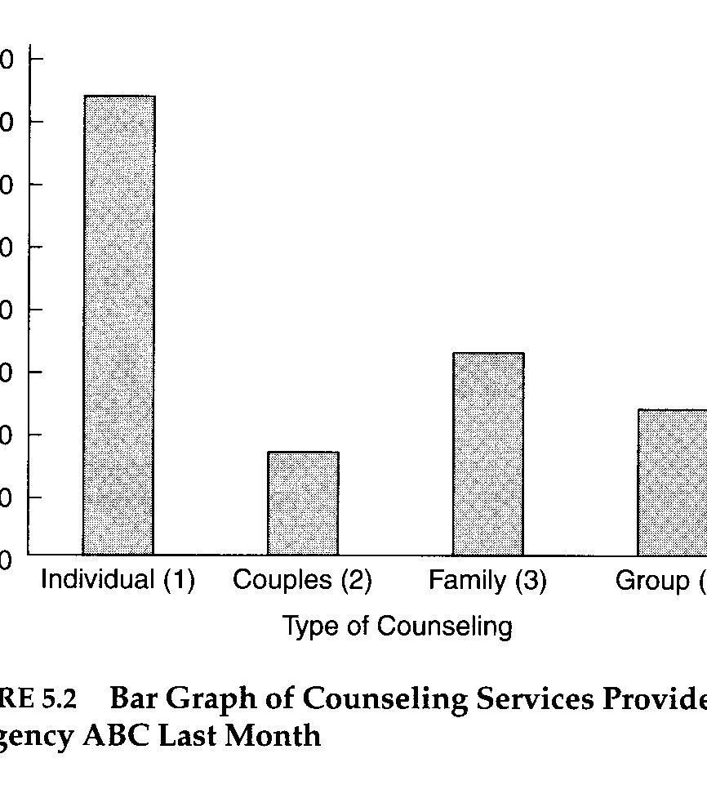
Bar Charts
Useful for nominal level data
Features:
  1 bar for each category
  Height = frequency
  Bars:
    Are equal width
    Do not touch
    Presented in any order

Slide 34
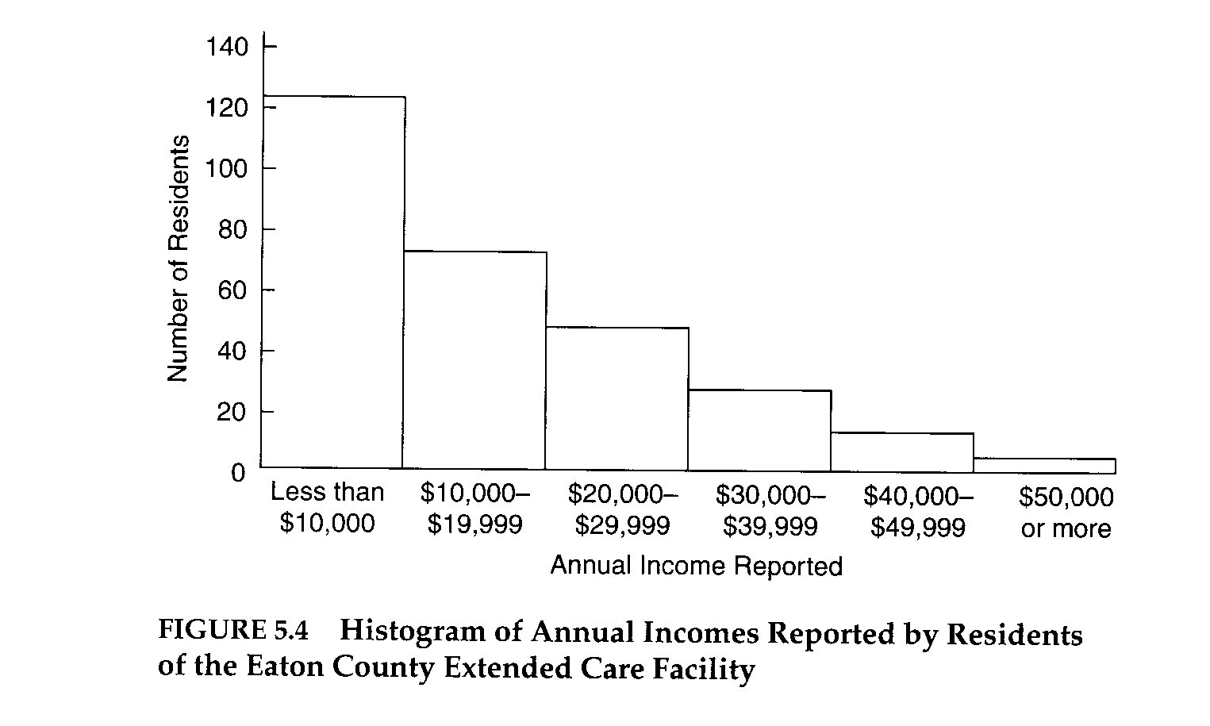
Histograms
Useful for ordinal and some interval/ratio data
Like bar graphs BUT:
  Bars touch
  Bars ordered from lowest to highest value or rank
  Bars do not have to be equal width

Slide 35
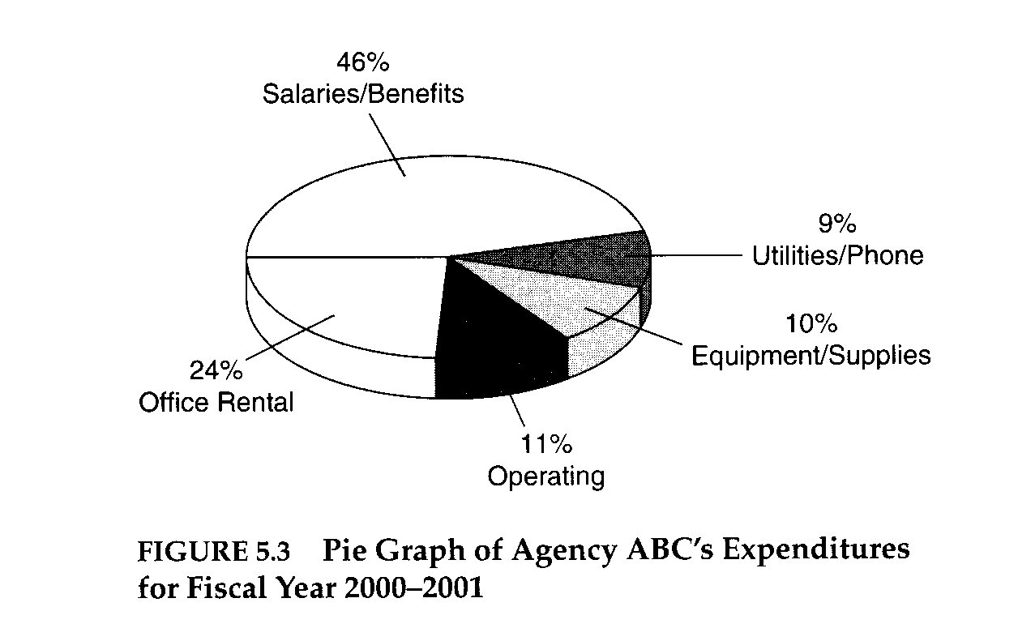
Pie Charts
Particularly useful for categorical data; can be used for I/R variables too.
Circle divided into 2+ wedges
  Wedge size = frequency
Features:
  Show proportion
  Quickly assess relative importance of a value

Slide 36
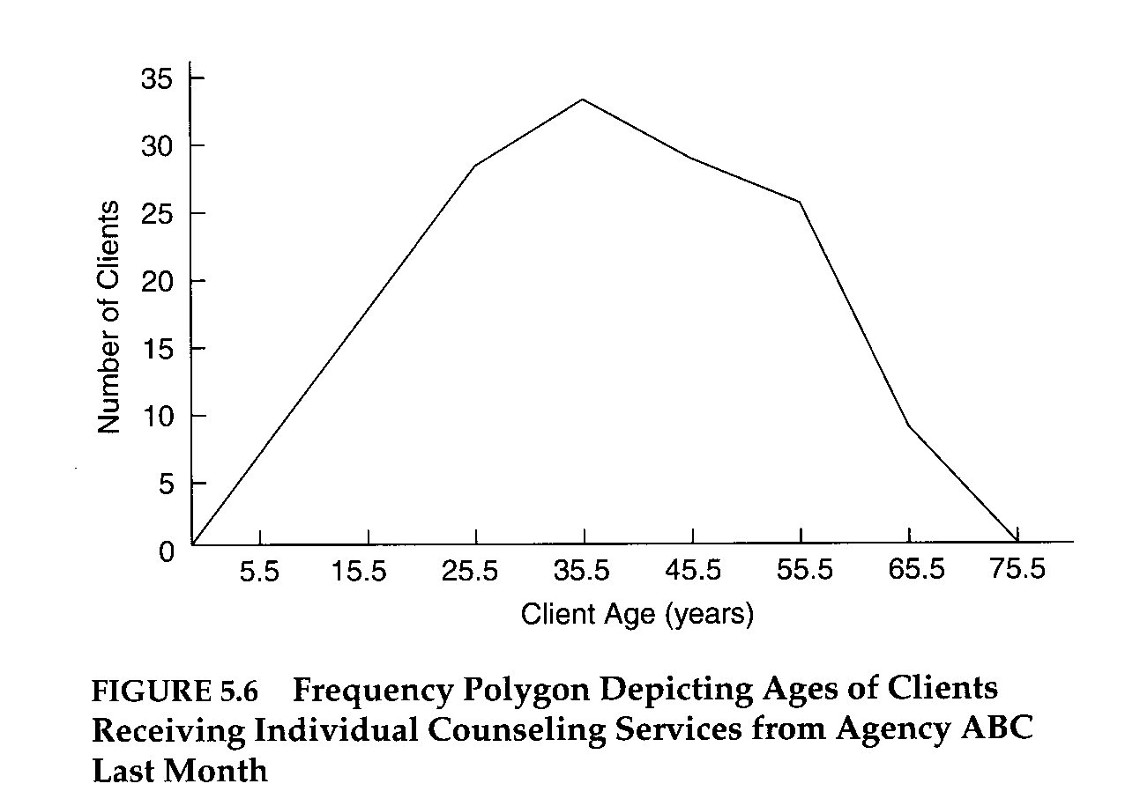
Frequency polygons
I/R and some ordinal
Line graph reflecting the shape of the histogram
Connecting dots at top of each bar with a line
Anchored on axis

Slide 37
Practice Reading Figures
Questions go with: Tracking the Covid-19 Economy’s Effects on Food, Housing, and Employment Hardships
  https://www.cbpp.org/research/poverty-and-inequality/tracking-the-covid-19-economys-effects-on-food-housing-and
In your group answer the questions associated with your assigned figures. When we come back together to the full class select one of the figures to briefly explain –
  What is the figure showing us?
  What is a key take-away from the figure?

Slide 38
Next class
Focus
  Frequency distributions
  Measures of central tendency
  Measures of variability
  Written Assignment 1 – discuss in more detail
  Bring output for Computer Assignment 1

Slide 39

Misc.
You may find yourself feeling, at least at some point:
  Everything, all feelings ever
  Confused
  Frustrated
  Angry
  Proud
  Accomplished
  You won RIP II!

