Slide 1
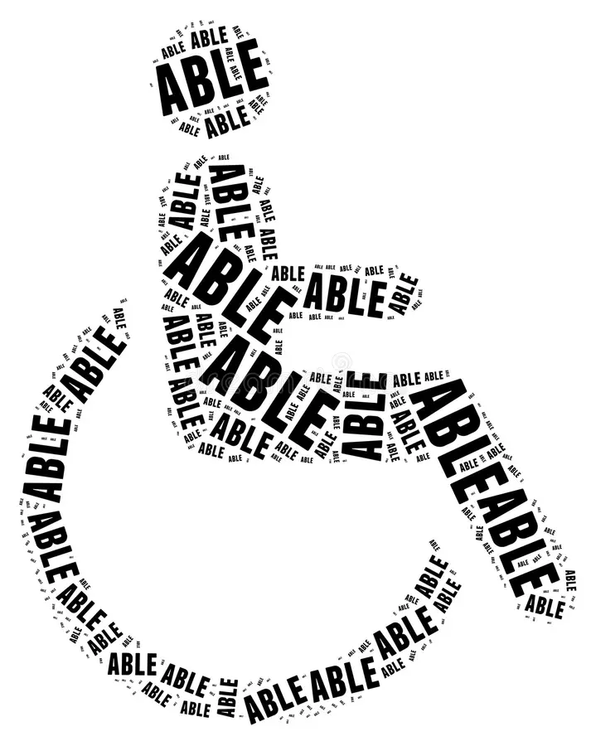
Pregnancy and (my) Disability
Lex Farrah

Slide 2
Overview
The history of pregnancy in people with disabilities and its ties to Eugenics
Statistics regarding Disability and Pregnancy
Spotlight on Ehlers Danlos Syndrome and Hypermobility Spectrum Disorders, and specific complications in pregnancy
Pregnant “Zebras” positionality within Reproductive Justice Framework
Discussion of ethics regarding the creation of new disabled human lives
How social workers can help promote a social model of disability

Slide 3
Why does everything that has to do with reproductive justice always go back to the concept of eugenics?!

Slide 4

The Ugly Historical Context of Preventing Child Rearing within Disabled Population
People with disabilities historically have been subject to poor treatment, abuse, neglect, and forced sterilization
Classic case from 1927: Buck v Bell… that has never been overturned:
  Carrie Buck was molested by a family member and impregnated.
  Family responded by having her committed to the Virginia State Colony for Epileptics and the Feebleminded.
    The same institution her mother resided in.
  After the birth, she was given a legal forced sterilization, as she was deemed “mentally defective” as Judge said “three generations of imbeciles is enough”
    Historical records reveal that none of these individuals truly had intellectual disabilities.
Notes:
Mutcherson

Slide 5
Eugenics still happens today, but in more covert ways
Mainstream abortion rights cite disability (in either the parent or fetus) as a crucial rationale for allowing legal abortion access.
  Feminist disability scholars coin this as “neo-eugenic” - termination of a pregnancy upon prenatal screening demonstrating disability, as it implies a life with a disability is not worth living
    Often seen in cases of prenatal Down Syndrome
  Marsha Saxton argues that healthcare professionals that encourage people to “test then terminate” have too narrow of a view of disability - that the disability itself is not inherently the source of suffering, without acknowledging ableism and other social factors that contribute to said suffering
Notes:
Jarman, chapter 8.

Slide 6

Statistics regarding Disability prevalence in our society
It is estimated that 1 in 4 women in the US live with a disability.
~12% of childbearing age/ability individuals live with some type of a disability.
People with disabilities experience higher rates risks for adverse outcomes related to pregnancy, delivery, and access to appropriate postpartum care.
Notes:
Signore, et al.

Slide 7
Despite the size of the disability population, historically the sexual and reproductive health needs of this population have largely been ignored.
Disabled AFAB who desire pregnancy - 61% of people
Able-bodied AFAB who desire pregnancy - 60% of people
Disabled AFAB who intend to conceive in future- 43% of people
Able-bodied AFAB who intend to conceive in future - 50% of people
The concept of sexuality is people with disabilities is stigmatized.
Notes:
Signore, et al.

Slide 8
Barriers Pregnant Disabled Parents Encounter
Behavioral health consequences:
Increased maternal stress (and the subsequently associated pregnancy health risks)
Hesitancy to seek care, decreased help-seeking behaviors
Inadequate social supports and caretaker support
Social determinants of health and risk factors for poor pregnancy outcomes are more prevalent in the disability community as a whole
Many folks encounter negative experiences and discrimination from providers who doubt their ability to become pregnant, carry the baby to term, deliver safely, and/or adequately care for the newborn.
From healthcare providers and the public at large.
Notes:
Signore, et al.
Mutcherson

Slide 9

Spotlight on Ehlers Danlos Syndrome and Hypermobility Spectrum Disorders

Slide 10
What is EDS?
Heritable connective tissue disorder that causes generalized joint hypermobility, joint instability, tissue fragility, and chronic pain.
There are 13 known types
Associated with a variety of other symptoms and related conditions that affect many different areas of the body:
  Autonomic Dysfunction/Dysautonomia, POTS (Postural Orthostatic Tachycardia Syndrome), Cardiovascular issues, Prolapsed Mitral valve
  MCAS (Mast Cell Activation Syndrome), Histamine and hormone imbalances
  Musculoskeletal issues, Degenerative Disc Disease, Scoliosis
  Gastrointestinal issues: GERD, Gastroparesis, IBS, IBDs
  ME/CFS (Chronic Fatigue Syndrome), Autoimmune issues, Fibromyalgia, Complex Regional Pain Syndrome
Currently classified as a “rare disorder” and is thought to affect at least 1 in 3,100–5,000 people.
  However, the true prevalence of hEDS is not known and may be underestimated
  Takes, on average, 10 years to get diagnosis
Notes:
EDS society website

Slide 11
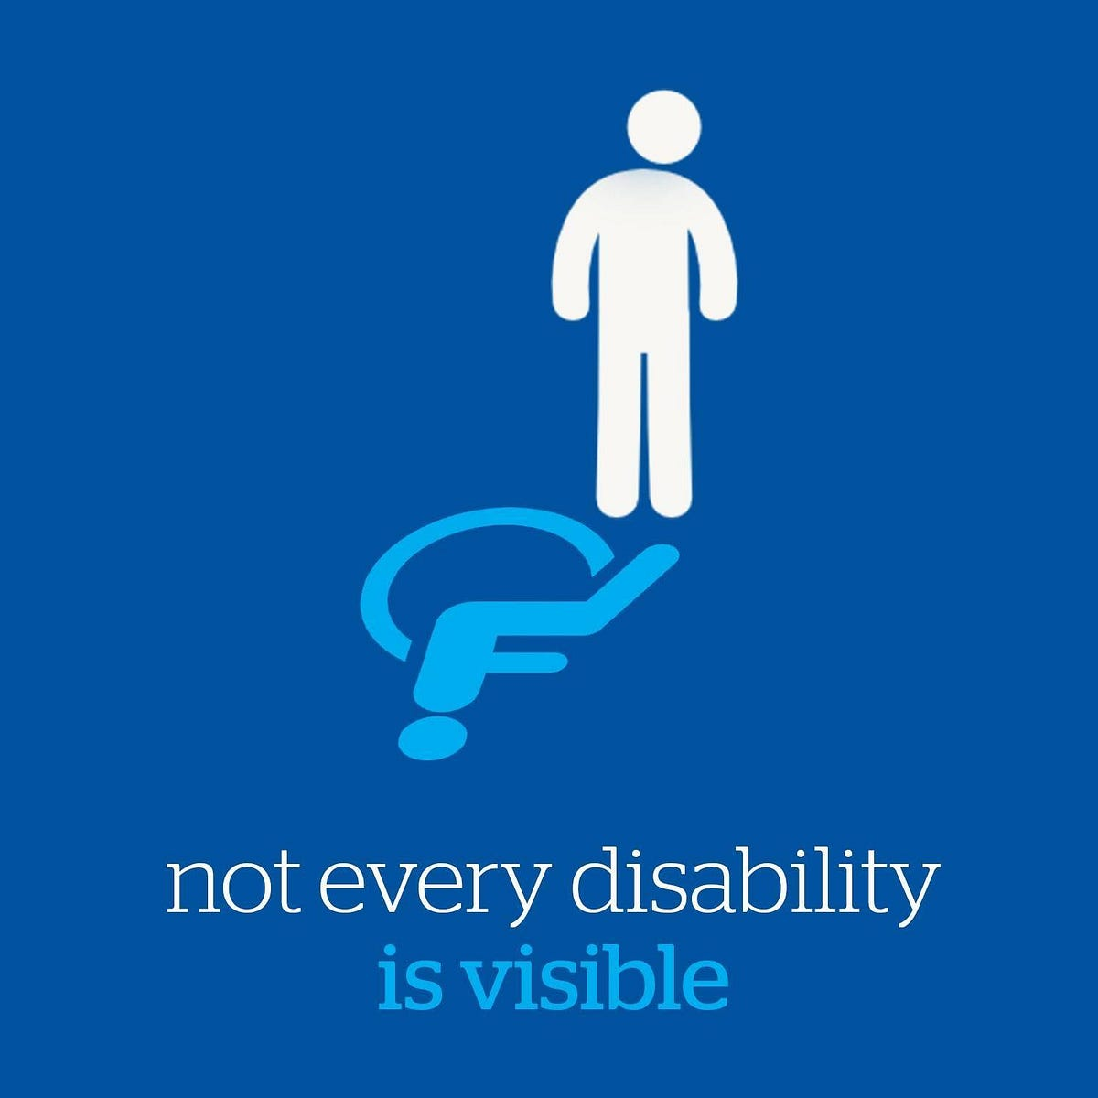
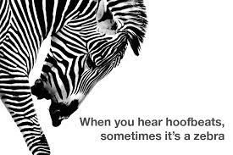
“When you hear hoofbeats, think of horses - not zebras. In other words, most things are exactly what they seem, and the simplest answer is usually the right one.”
- Judy Melinek

Slide 12
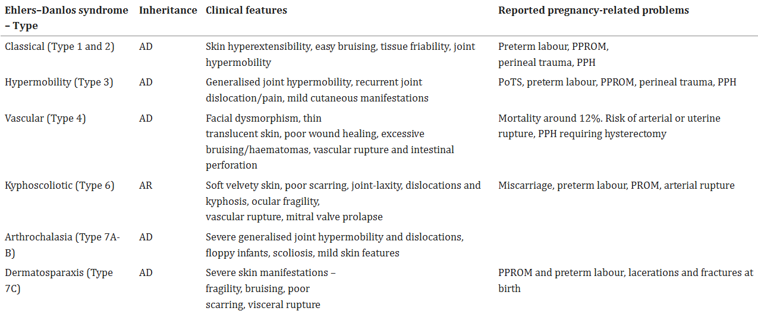
AD: autosomal dominant; AR: autosomal recessive; PPROM: preterm prelabour rupture of membranes; PPH: postpartum haemorrhage; PoTS: postural orthostatic tachycardia syndrome
Notes:
Karthikiyen

Slide 13
Important Considerations for Pregnancy
The majority of pregnancies are uncomplicated, but definitely considered “high risk”
Pregnancy and birthing complications can include:
Increased likelihood of endometriosis, PCOS, and infertility
Increased incidences of misscarraige
Increased likelihood of preterm labor, uterine ruptures, and arterial ruptures
Resistance to local anaesthetics
Lower neonatal birth weight
Increased likelihood of pelvic girdle pain, pelvic floor complications, pelvic prolapse, postpartum hemorrhages, poor healing
Worsened chronic pain
Patients often struggle navigating the healthcare system and face:
Gaslighting and denial of belief of pain and symptoms
“It’s all in your head”
Medical trauma
Identity and Intersectionality
Notes:
Karthikeyan
Global Learning Conference

Slide 14
Positionality within Reproductive Justice framework
1 | 2 | 3
The right to not have a child | The right to have a child | The right to raise children in healthy and safe environment
Choice of preserving one’s own health. Choice of preventing potential life of pain for disabled child. | In spite of the barriers and stigmas previously stated for people with disabilities. | Healthcare access issues. Implications of having a child with a poorly understood illness.

Slide 15
Bioethical Considerations
NASW Core Values in Code of Ethics:
Service
Social Justice
Dignity and Worth of the Person
Importance of Human Relationships
Integrity
Competence
As a social worker, would you advise or dissuade your client from creating a child who will likely experience severe chronic pain?
What if it were you??
Notes:
NASW Code of Ethics

Slide 16
We need a paradigm shift to the social model
Social model of disability:
Holds disability as an identity that is a morally neutral and normalized,
Where the inherent deficit or impairment is the “disadvantage or restriction of activity caused by a contemporary social organization which takes no or little account of people who have physical impairments and thus excludes them from participation in the mainstream of social activities.”
Medical model of disability:
“a person’s functional limitations (impairments) are the root cause of any disadvantages experienced and these disadvantages can therefore only be rectified by treatment or cure”
Notes:
Goering

Slide 17
Social change, not the amelioration of people with disabilities (or their ailments), is what will ultimately eliminate the suffering of disabled people, and allow for true repro justice.
The only “right” choice is what is right for each individual.

Slide 18
References:
About. NASW, National Association of Social Workers. (2024). https://www.socialworkers.org/About/Ethics/Code-of-Ethics/Code-of-Ethics-English
Goering S. (2015). Rethinking disability: the social model of disability and chronic disease. Current reviews in musculoskeletal medicine, 8(2), 134–138. https://doi.org/10.1007/s12178-015-9273-z
Hypermobile Ehlers Danlos Syndrome. The Ehlers Danlos Society. (2024). https://www.ehlers-danlos.com/heds-body-system/
Jarman, M. (2020). Disability rights through reproductive justice. Chapter 8. Eugenic legacies in the abortion wars. The Routledge Handbook of Disability and Sexuality.
Karthikeyan, A., & Venkat-Raman, N. (2018). Hypermobile Ehlers-Danlos syndrome and pregnancy. Obstetric medicine, 11(3), 104–109. https://doi.org/10.1177/1753495X18754577
Mutcherson, K. (2017). Disability, procreation, and justice in the United States. Laws, 6(4), 27.
Nelville, C. (2024). The Hips are the Center of the Universe. Global Learning Conference 2024: EDS & HSD From Head to Toe. Philadelphia, PA; The Ehlers Danlos Society.
Signore, C., Davis, M., Tingen, C. M., & Cernich, A. N. (2021). The intersection of disability and pregnancy: risks for maternal morbidity and mortality. Journal of Women's Health, 30(2), 147-153.

