Slide 1
Intersex & Trans Youth deserve bodily autonomy
Why it’s important for social workers to understand current legislation that denies transgender youth gender affirming care, and supports invasive, unnecessary pathologization and surgeries on intersex babies and youth

Slide 2
overview
Introduction
-Legislation: Gender Affirming Care
-Trans Affirming Care
-Intersex Medical Interventions
Relevance to Reproductive Justice
How Social Workers Can Support Trans & Intersex Youth

Slide 3
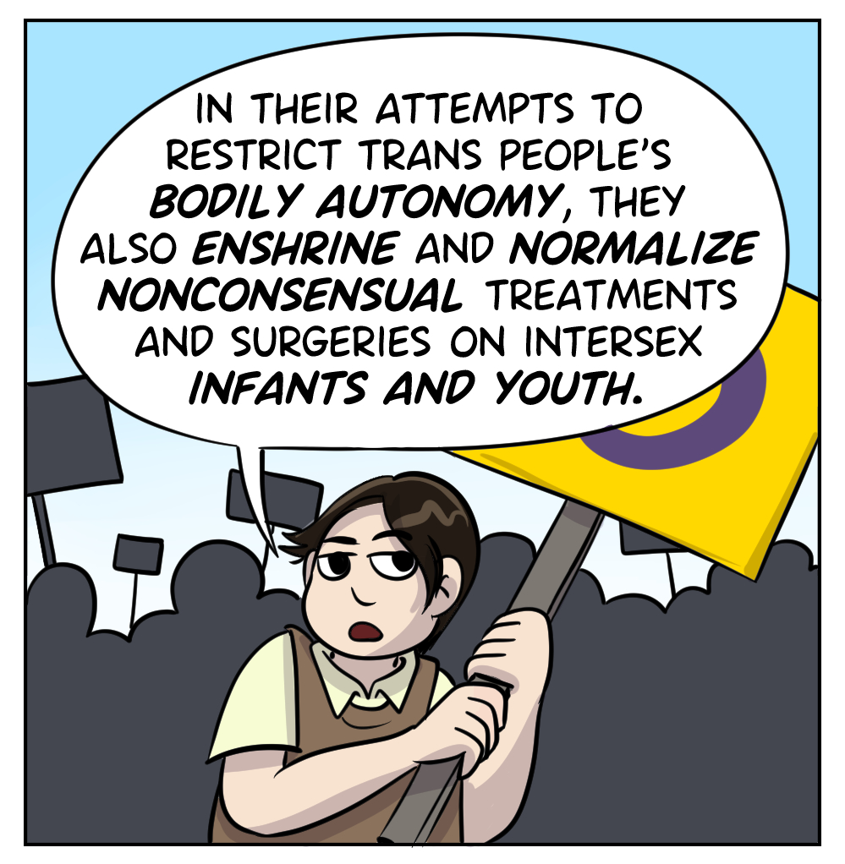
INTRODUCTION
Since 2021, 25 states across the US have passed laws and policies banning or limiting access to gender affirming care for trans youth.
Within this same legislation, movement is being made to solidify legal precedent for invasive “intersex medical interventions.”
These serve the same cause of taking away bodily autonomy from youth.
Kates, L. D. and J. (2024, July 17)
Dodds, I. (2024, June 29)

Slide 4
Many of these bills include an explicit exception for procedures performed on intersex children, usually described in these pieces of legislation as “children with a medically verifiable disorder of sex development” or “DSD,” which is a medicalized term for intersex variations widely viewed as pejorative. These provisions purport to ensure that doctors who perform genital and other surgeries on infants and young children with intersex traits are immune from prosecution and civil or professional penalties. These clauses are in the same laws that attempt to punish performing the exact same procedures on older transgender youth who are actively requesting such care.
Human Rights Watch (2023, August 2)

Slide 5
What is gender affirming care?
Gender-affirming care is a model of care which includes a spectrum of “medical, surgical, mental health, and non-medical services for transgender and nonbinary people” aimed at affirming and supporting an individual’s gender identity.
Gender affirmation is highly individualized. Not all trans people seek the same types of gender affirming care or services and some people choose not to use medical services as a part of their transition.
Kates, L. D. and J. (2024, July 17)

Slide 6
What is gender affirming care?
Gender-affirming care is a model of care which includes a spectrum of “medical, surgical, mental health, and non-medical services for transgender and nonbinary people” aimed at affirming and supporting an individual’s gender identity.
Gender affirmation is highly individualized. Not all trans people seek the same types of gender affirming care or services and some people choose not to use medical services as a part of their transition.
Gender affirming care is evidence based, widely supported by the larger medical community, and has demonstrated overwhelmingly positive outcomes for trans, nonbinary, and gender nonconforming youth and adults.
Kates, L. D. and J. (2024, July 17)

Slide 7
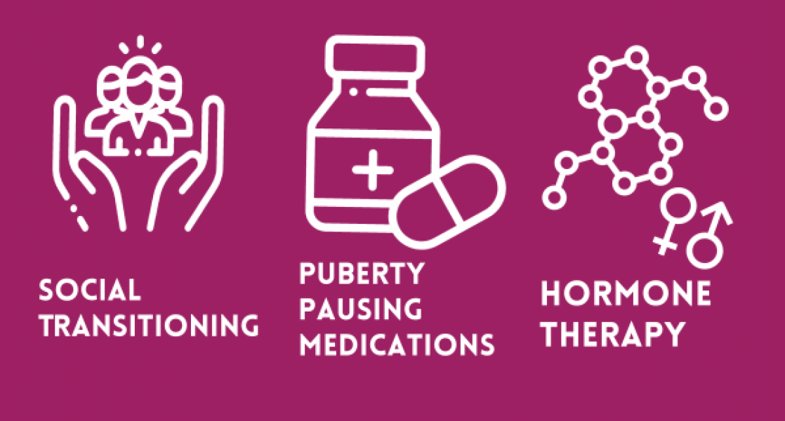
Every single major medical organization, including the American Academy of Pediatrics, the American Medical Association and the American Psychiatric Association, supports the provision of age-appropriate, gender-affirming care for transgender and non-binary people. These organizations represent millions of doctors, researchers and mental health professionals in the United States.
Gender-affirming care has always existed and isn’t a new phenomenon — it’s just that in recent years, extremist politicians have made it into an issue for their own self-gain.
What kind of care is most common for trans youth?
-support with social transition (presentation, appearance, name, pronouns)
-physical (puberty blockers; hormone therapy)
-support (therapy; connection to other trans youth; support for parents of trans youth)
Human Rights Campaign. (n.d).
Mazzoni Center. (n.d.)

Slide 8
The “I” in LGBTQIA+
Intersex
About 1.7% of people are born intersex.
1 in 2,000 babies (0.05% of humans) are born with genital differences that a doctor might suggest changing with unnecessary surgery.
  Compare to: 0.3% chance of having identical twins
  Roughly the same odds as having red hair
Intersex is an umbrella term for differences in sex traits or reproductive anatomy. Intersex people are born with these differences or develop them in childhood. There are many possible differences in genitalia, hormones, internal anatomy, or chromosomes, compared to the usual two ways that human bodies develop.
Some intersex traits are noticed at birth. Others don’t show up until puberty or later in life. Intersex people often face shame—or are forced or coerced into changing their bodies, usually at a very young age. Most surgeries to change intersex traits happen in infancy.
InterACT (2021, January 26)

Slide 9
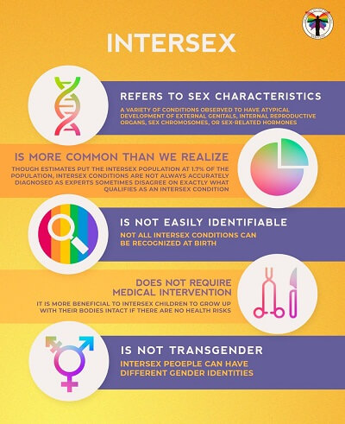
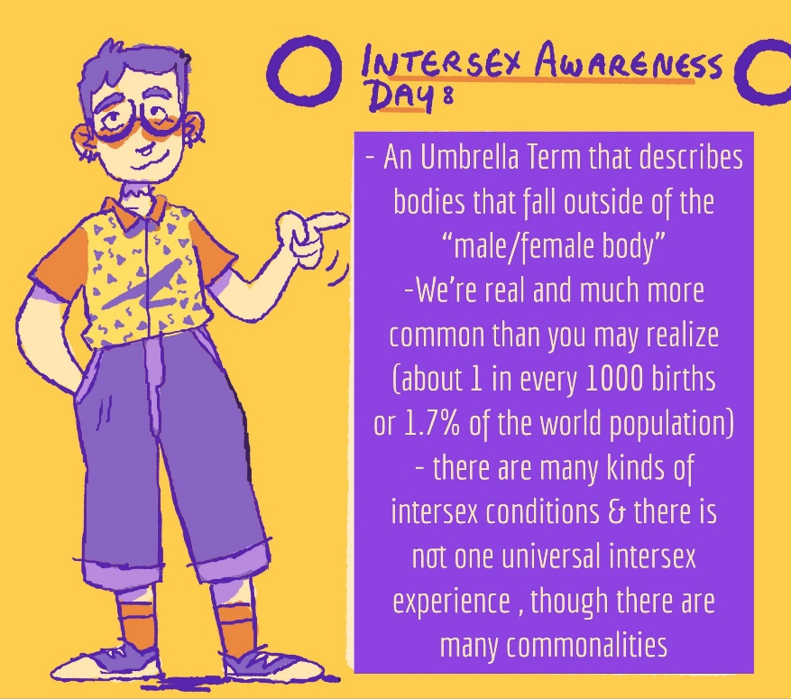
InterACT (2021, January 26)
https://x.com/JamRoGram/status/1320743484567941121

Slide 10
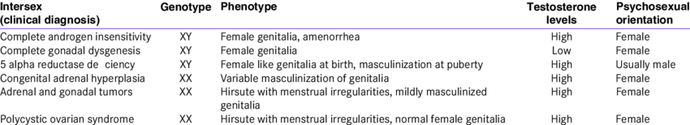

Intersex characteristics vary widely, here are Just a few examples
Sanjay K., S., et. al. (2012, November)

Slide 11
Invasive surgeries on Intersex babies & youth
Since at least the 1950s, babies born with atypical genitalia have undergone surgeries to normalize the appearance of their sex organs.
Most of these surgeries are medically unnecessary and are done for cosmetic purposes or to make an intersex child appear more male or female.
Unnecessary surgeries on intersex babies and youth can create lifelong consequences including:
• Infertility
• Reduced sexual function
• Disruptions to emotional well-being
• Chronic pain
Surgeries are often framed by doctors and medical providers as urgent, emergency, or a necessity. Parents are frequently not informed about the risks of lifelong physical and emotional harm. Intersex children are frequently misled or lied to – being told they have serious medical issues to cover up reasons for performing surgeries.
InterACT (2021, January 26)

Slide 12
Intersex people in the USA suffer significant harm as a result of genital-normalising surgery in childhood, involuntary sterilisation, excessive genital exams and medical display, human experimentation and denial of needed medical care. Such treatment constitutes a violation of human rights as recognised by multiple international bodies.
“
”
Juan E. Méndez
UN Special Rapporteur on torture
Jorge, J. C., et. al. (2021, May)

Slide 13
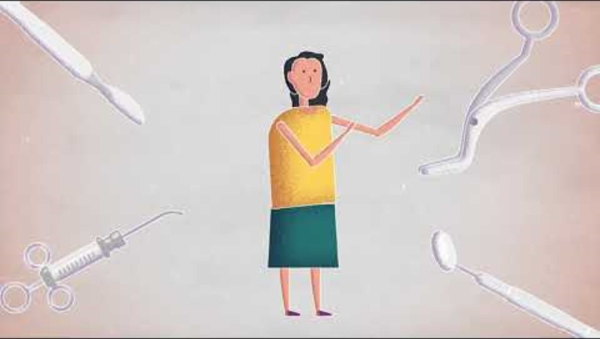

Slide 14

Relevance to reproductive justice
Tenet 1:
The Right to Have A Child
Tenet 3:
The Right to Parent in Safe and Healthy Environments

Slide 15
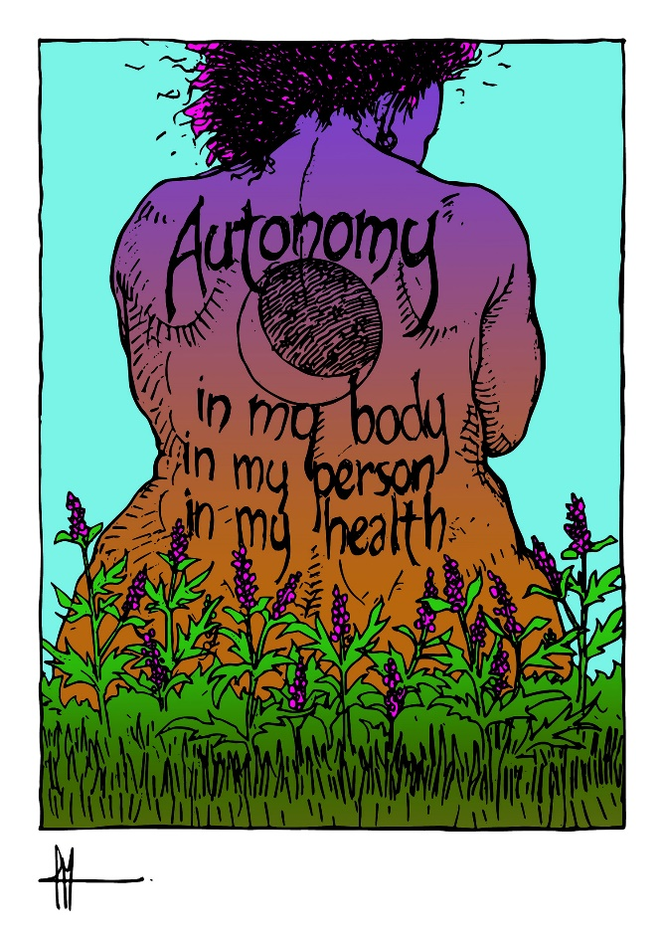
Bodily autonomy matters!
Trans youth deserve bodily autonomy and access to gender affirming care.
Intersex babies and youth deserve bodily autonomy and the opportunity to make their own decisions.
Bodily autonomy is a human right!!!!!!!

Slide 16

Relevance to social work
The National Association of Social Workers (NASW) asserts that discrimination and prejudice directed against any individuals on the basis of gender identity or expression are damaging to the social, emotional, psychological, physical and economic well-being of transgender and gender diverse (TGD) people and society as a whole.
Social determinants affecting the health of TGD people are rooted in discrimination and oppression. Despite increased public awareness, every day TGD individuals and communities experience unprecedented and intolerable amounts of social judgement, stigma, verbal harassment, physical violence, and trauma.
Research tells us that no one is confronted with more hate crimes and intolerance than TGD people who also hold Black, Brown and Indigenous identities.
National Association of Social Workers (2023, March 28).

Slide 17
Relevance to social work
Providing holistic care while honoring intersectionality is a foundational element of informed social work practice. To achieve health equity for all, we believe that trauma-informed care, gender-affirming care, and mental and behavioral health care should all be recognized as evidence-based and informed health care in our nation.
NASW calls on all members of the social work profession to support, promote, affirm and “protect the rights, legal benefits, and privileges of people of all gender identities and expressions.” NASW will work to repeal discriminatory legislation and regulations that do not honor someone's self-identified gender identity, transgender-inclusive health care access, health insurance options, or use of language promoting health equity and inclusive communication.
National Association of Social Workers (2023, March 28).

Slide 18
Ways social workers can support trans and intersex youth
As social workers, we have a duty to support our clients as best we are able. This includes being knowledgeable about best practices for treatments, evidence-based interventions, and harms that can be perpetuated by systems.
We owe it to our clients and their families to understand intersex conditions, care for intersex youth, and gender affirming care for trans youth.
As social workers, we have the power to reduce harm, lessen stigma, and to support our clients.
Mazzoni Center. (n.d.)

Slide 19
Ways social workers can support intersex youth & their families
Social workers can help intersex people in many ways, including providing counseling and advocating for their rights:
Advocacy: Social workers can advocate for policies, laws, and programs that support intersex people, families, and communities. They can also work to protect the human rights of intersex people and ensure they can fully participate in civic life.
Counseling: Social workers can provide counseling to intersex people.
Addressing dehumanization: Social workers can address the dehumanization of intersex people and the lack of services available to them.
Working with children: Social workers can help children with sex variances and their families.
InterACT (2021, January 26)

Slide 20
Ways Parents can support trans youth
Affirm your child
Always use your child’s name and pronouns that align with their gender identity
Make sure your child feels supported and valued by their family
Celebrate, love, and support your child’s gender expression
Be an advocate
Call out transphobia
Learn what your school can do to support your child
Ask others to respect and affirm your child’s identity
Work with your child’s school to create a gender support plan or gender communication plan to help facilitate your child’s transition in school. In Philadelphia, Policy 252 can help with this.
Cultivate your knowledge
Find resources like books, documentaries, or websites to learn more about what it means to be transgender or gender expansive
Mazzoni Center. (n.d.)

Slide 21



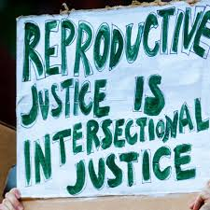

Slide 22
References
Kates, L. D. and J. (2024, July 17). Policy tracker: Youth access to gender affirming care and state policy restrictions. KFF. https://www.kff.org/other/dashboard/gender-affirming-care-policy-tracker/
Dodds, I. (2024, June 29). ‘My consent was never required’: The childhood gender-assignment surgeries Republicans don’t want to ban. Independent.
https://www.independent.co.uk/news/world/americas/intersex-surgery-trans-children-republicans-ban-b2570501.html
National Association of Social Workers (2023, March 28). Gender-Affirming Health Care Saves Lives. NASW.
https://www.socialworkers.org/News/News-Releases/ID/2642/Gender-Affirming-Health-Care-Saves-Lives
Human Rights Campaign (n.d.). Get the Facts on Gender-Affirming Care. HRC Foundation.
https://www.hrc.org/resources/get-the-facts-on-gender-affirming-care
Mazzoni Center (n.d.). Gender Affirming Care. Mazzoni Center.
https://www.mazzonicenter.org/gender-affirming-care/gender-affirming-care-youth/gender-affirming-care
Mazzoni Center (n.d.). How to Support Trans and Gender Expansive Youth – The ABCs. Mazzoni Center.
https://www.mazzonicenter.org/gender-affirming-care/gender-affirming-care-youth/how-support-trans-and-gender-expansive-youth-abcs
InterACT (2021, January 26). What is intersex?. InterACT Advocates for Intersex Youth.
https://interactadvocates.org/faq/#howcommon
Sanjay K., et. al. (2012, November). We care for intersex: For Pinky, for Santhi, and for Anamika. Indian Journal of Endocrinology and Metabolism. Pubmed. 16(6):873-5. DOI:10.4103/2230-8210.102980.
https://www.researchgate.net/publication/233889245_We_care_for_intersex_For_Pinky_for_Santhi_and_for_Anamika
Jorge, J. C., et. al. (2021, May). Intersex care in the United States and international standards of human rights. Global public health. https://www.ncbi.nlm.nih.gov/pmc/articles/PMC8659864/#R35
Human Rights Watch. (2023, August 2). US: Anti-Trans Bills also Harm Intersex Children.
https://www.hrw.org/news/2022/10/26/us-anti-trans-bills-also-harm-intersex-children
https://x.com/JamRoGram/status/1320743484567941121
https://justseeds.org/graphic/autonomy-in-my-body-person-health/
https://youtu.be/fnR_rMVlk3o?si=wxxeIGnMj04dxPwI

