Slide 1

The true cost of childcare
Meryl Lammers
Reproductive Justice and SW Praxis
Professor Lindsay Griffin
7/25/24

Slide 2
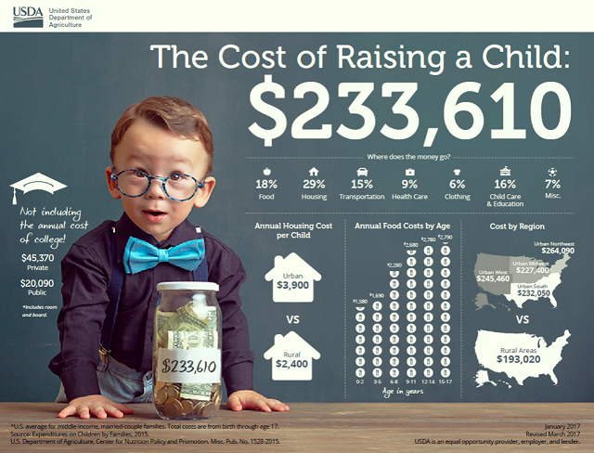
When adjusted for inflation, the number jumps to $312,202 as of March 2024 (and is probably higher).
The percentages of cost have changed, especially for childcare.
A 2024 survey found on average parents are spending 24% of income on childcare alone.
The US Government says affordable childcare is up to 7% of income.
(Holten, 2023), (Carbonaro, 2024)
(US News and World Report, 2024).

Slide 3
Cost of Living Expenses
Housing: Average rent is $2,047 per month, and the average 30 year mortgage monthly payment is $2883 (Rosen, 2023) & (Grace & Knueven, 2024).
Food: Monthly cost of groceries for a single person is $240-$450, whereas for a family of 4, monthly cost is anywhere from $970-$1580 (USDA 2024).
Clothing: Families typically spend 6% of income on clothing. Clothing small children can get pricey with rapid growth, wear, and rising clothing costs due to inflation and corporate greed (USDA, 2024).
Healthcare Costs: Average healthcare premium for a family in 2023: $23,968 per year. 22% increase from 2018 (KFF, 2023).
Transportation: $12,295: Average Annual expenditure for a family (US Dept of Transportation, 2023).

Slide 4
Childcare Costs
The average annual cost of childcare for ONE child in 2023 was $17,000-$36,000: 10% of a married couples median income, and up to 85% of a single parent’s income.
23.1% of families cannot secure childcare due to financial costs, wait lists, travel/commute times, lack of safe facilities, transportation.
Infant childcare in 34 states and DC is more than in-state college tuition.
23% of parents who have been fired from a job report that it was due to absences related to difficulties accessing childcare
The emotional labor and mental load of childcare disproportionately effects women, women of color, and women in poverty, leading to poor mental health outcomes.
No federal paid family leave policy places financial and physical burdens on new parents that take away from beneficial bonding with the baby.
$122 Billion in lost earnings, productivity, and revenue from the US economy. This impacts working parents: $78 billion in lost wages, employers: lost $23 billion due to absences caused by childcare, and taxpayers lose $21 billion in lower federal and state tax revenue.
(Romig & Bryant, 2021), (CFSA, 2023). (Annie E. Casey Foundation, 2023), (Landivar, 2023), & (Wong, 2024).

Slide 5
Childcare Facilities and Workers
Median national pay for childcare workers is $14.60 per hour. Poverty wage in PA is $17.59/hr for a family with children in PA.
Poverty rates for early childhood educators is 7.7 times higher than those who teach grades K-8.
High student to teacher ratios, low wages, and lack of resources result in lack of an adequate early childhood workforce and high turnover rate.
94% of childcare workers are women, the majority are women of color.
60% of childcare workers report having difficulty paying their utility and grocery bills.
As of 2018, more than 1/2 of the country is considered a childcare desert (area with insufficient supply of licensed childcare facilities).
370,000 childcare jobs were lost at the beginning of the COVID 19 pandemic and still has not recovered fully.
(Wong, 2024), (Annie E Casey Foundation, 2023), & (Khattar & Coffey, 2023).

Slide 6
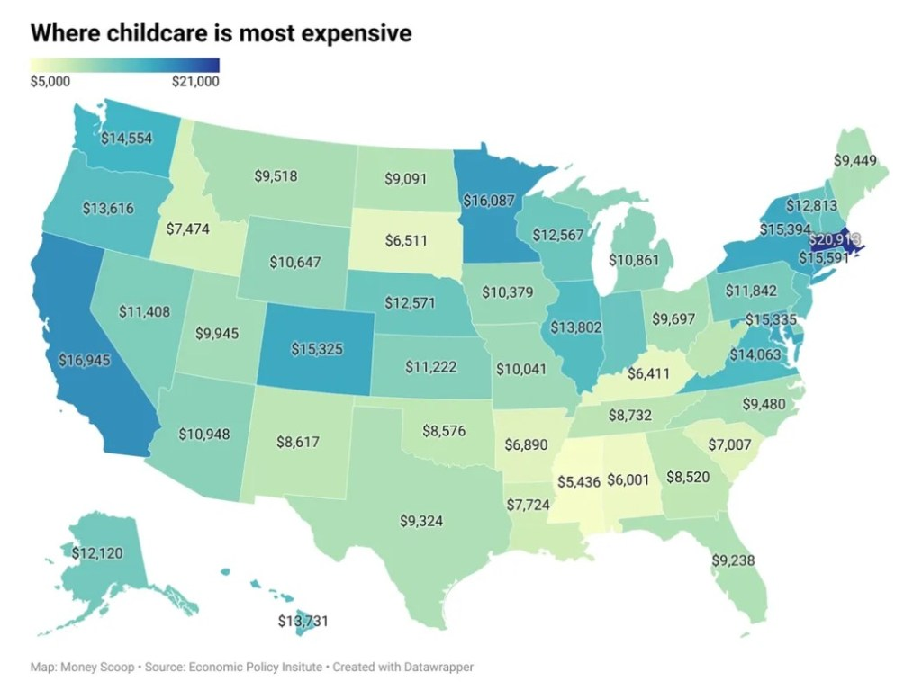
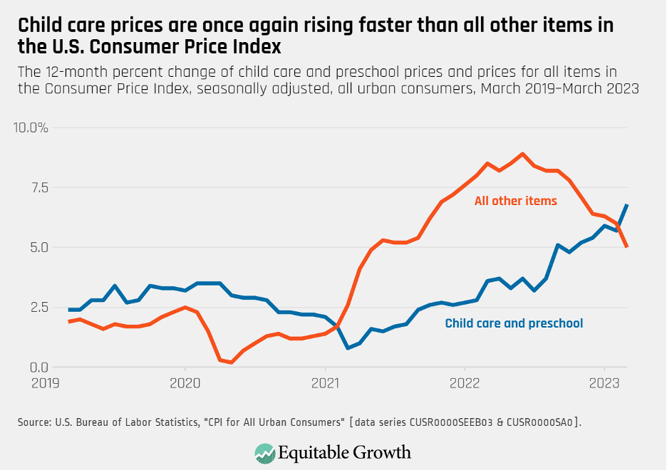
These prices account for day care, preschool, and before & aftercare for school aged children.
(US Bureau of Labor Statistics, 2024) & (Economic Policy Institute, 2024)

Slide 7
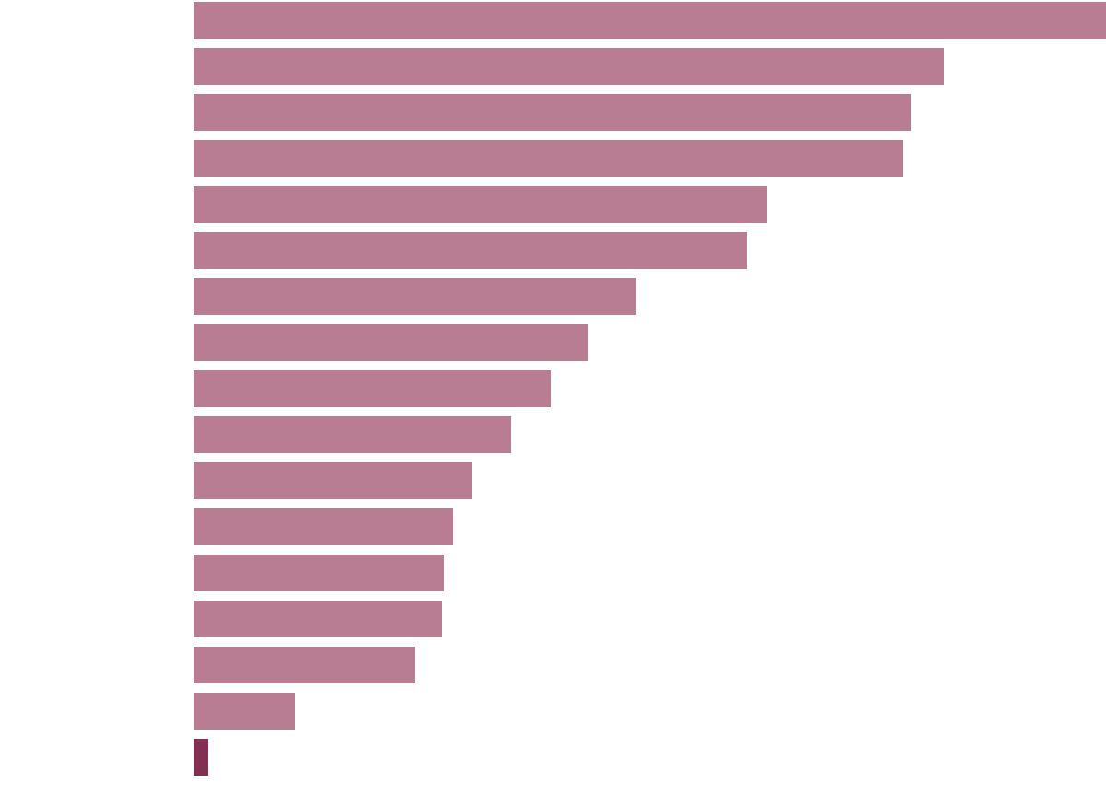
How Much Governments Spend on Child Care for Toddlers
Annual public spending per child on early childhood care (Miller, 2021).
24,427
23,353
23,140
18,656
18,010
14,436
12,864
11,664
10,349
9,084
8,450
8,184
8,088
7,222
3,327
500
Norway
Iceland
Finland
Denmark
Germany
Sweden
O.E.C.D. average
Austria
Slovenia
New Zealand
Spain
Chile
Lithuania
Australia
Hungary
Israel
United States

Slide 8

History of Childcare Policy in the US
Early 1900s-1960s: Mother’s pensions (cash payments) which Black mothers were excluded from, childcare facilities did not match demand, facilities were paid for by private money, and there was lack of support for federal funding for childcare.
1960’s: Kennedy lacked support for Universal Childcare. Welfare reform was introduced, linking childcare to requiring low-income and poor mothers to enter training programs and work outside the home to reduce amount of people on welfare.
1971: Nixon vetoes Comprehensive Child Development Act: Universal childcare policy, that was introduced by a coalition of feminists, activists, civil rights leaders, and early childhood advocates. Media pushes negative view of people on welfare.
1980s: Regan guts the AFDC, imposes work requirements, family caps, and time limits.
1990s: Clinton creates TANF which ends family entitlement to cash assistance, imposing behavioral and work requirements, disproportionately negatively impacts Black mothers.
(Michael, 2011)

Slide 9
Childcare, Reproductive Justice, and Social Work
Tenet 3 of RJ: The Right to Parent Children in Safe and Healthy Environments
“Individuals must have the ability to raise their children with the social supports they need to provide safety, health, and dignity.” – Loretta Ross
Social Work Ethics: Social Justice: SWs have a duty to help combat inequality when it comes to race, economic status, gender and gender identity, social class, and education.
Social and Economic resources create advantages and disadvantages for parenthood based on income, social class, education, race, gender, and gender identity (Ross & Solinger, 2017).
Women, people of color, and people living in poverty are all disproportionately effected by the cost and labor of childcare. Living in poverty and being the recipient of discrimination in early childhood increases toxic stress, which leads to poor health outcomes in adulthood (Shankoff et al., 2012).
Poverty creates poor conditions for mothering: Lack of housing and neighborhood safety; Food insecurity; Lack of transportation; Lack of healthcare; Lack of social connections; Lack of quality educational resources (Ross & Solinger, 2017).

Slide 10
How Racial Disparities Prevent Tenet 3 of RJ
CHILDCARE:
Black Americans bear the largest childcare cost burden in the country: 24.5% of income (United Way, 2023).
Childcare cost percentage of income for working single mothers (2017): Black: 56%; AI/AN: 51%; Latino: 42%; White: 26% (Banks, 2019).
HEALTHCARE:
Rates of Postpardum Depression in 2021: Black: 22%, AI/AN: 22%; Hispanic: 18.8%; Asian Pacific Islander: 13.8%; White 11% (Getahun et al., 2023).
Maternal Mortality Rate 2022 (per 100,000 people): Black: 49.5, White: 19, Hispanic: 16.9; Asian: 13.2 (Hoyert, 2024).
BIPOC children are 2-3 times more likely to not have health insurance than white counterparts (Artiga et al., 2024).
Living in poverty and being the recipient of discrimination in early childhood increases toxic stress, which leads to poor health outcomes in adulthood (Shankoff et al., 2012).
FOOD:
BIPOC households experience food insecurity at greater rates than White households (USDA, 2024).
Food deserts are more prevalent in BIPOC communities, creating negative health outcomes (El, 2024).

Slide 11
HOUSING:
Children of color are more likely to experience unsafe housing, being exposed to lead, mold, pests, second hand smoke, which leads to negative health outcomes (Bovell-Ammon et al., 2020).
People of color are disproportionately effected by environmental contamination (Tabuchi & Popovich, 2021).
Black and Latinx families are more likely to live in neighborhoods of concentrated poverty due to intentional racist policies (red-lining, etc) (Bovell-Ammon et al., 2020).
Black households with children account for 50% of homelessness (National Alliance to End Homelessness, 2023).
WORKFORCE:
The War on Drugs and mass incarceration separated Black fathers from families and the “no man in home” rules discouraged families to remain together, placing the domestic burden on women.
1/3 of Black women are employed in service positions as compared to 1/5 of White women.
Significant pay disparities: Black workers average 24.4% less than White workers. Average annual income for Black women was just over $36,000, 21% lower than White women.
80% of Black mothers are the breadwinners in their families
Currently, 78% of Black mothers are in the work force compared to 66% of White, Asian, and Lantinx mothers (Banks, 2019).

Slide 12
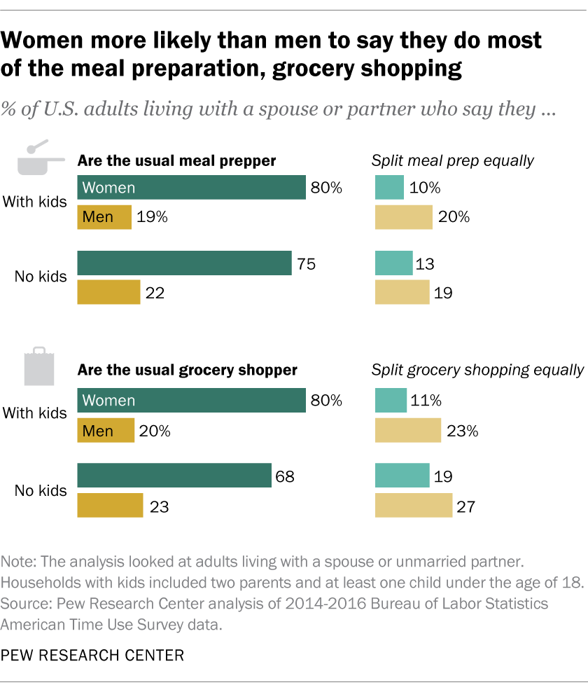
GENDER GAP
Mothers are 4 times as likely to miss work than fathers due to childcare.
95% of stay-at-home parents of heterosexual married couples are women.
Division of household labor disproportionately falls on women in heterosexual couples.
Emotional, Cognitive, and Physical Labor (invisible load) disproportionately effect women/mothers, leading to burnout, exhaustion, relationship issues, and impacts ability to perform paid labor.
Gay fathers found to have equal division of household labor.
Gay and lesbian couples are more likely to feel the division of labor is fair even when not equal as compared to heterosexual couples.
(Miller, 2018), (Tornello et al., 2015), (Delaney et al., 2023),
(Annie E Casey Foundation, 2023)

Slide 13
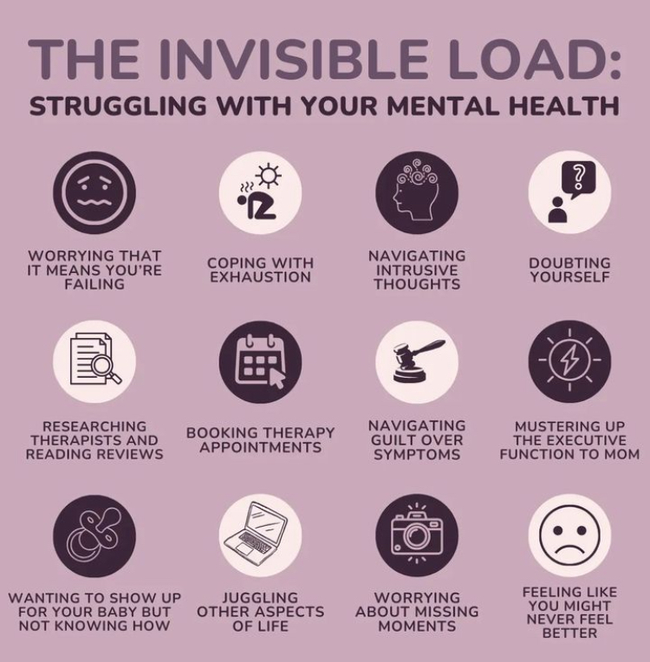
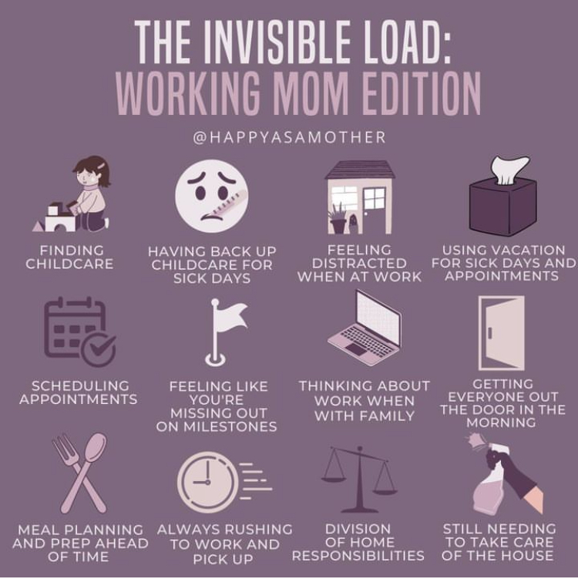

Slide 14

Negative Effects on Childhood Development
Children who don’t participate in early childhood learning miss out during an important stage of brain development, which can lead to:
Academic Struggles
Behavioral Issues
Poor health outcomes in adulthood
(Annie E. Casey Foundation, 2023)

Slide 15
How Social Workers Can Help
Clinical/Micro:
  Connecting those eligible with WIC, SSI, SNAP, Medicaid, childcare subsidies, formula, housing voucher programs.
  Connecting those who want to breast/chest feed with lactation consultants, free breastfeeding support groups, and programs that offer free breast pumps and supplies.
  Researching free childcare programs, such as Philadelphia’s free pre-school program funded through the sugary drink tax.
  Offering counseling for postpardum depression and anxiety, connecting with a psychiatrist if needing.
  Connecting new mothers/people experiencing IPV with safe houses/shelters and other programs.
  Connecting those who want to grow their families with birthing centers that will value their wishes/customs/practices/beliefs.
  Connecting LGBTQIA+ parents with supportive parenting groups and communities.
Macro: Support policy efforts for:
Universal PreK and childcare.
Universal Healthcare.
Paid sick leave.
Pushing for child tax credits and cash payments for families with children.
Increase in pay for early childhood care workers.
Matching other high income countries with paid family leave after having a child.
Addressing the racial wealth gap.
Government subsidies for affordable housing.
Addressing the high Black maternal mortality rate and continuing to dismantle medical racism.
Increased access to maternal mental health.
Increase access to perinatal support

Slide 16
References
Almalik, M. M. (2017). Understanding maternal postpartum needs: A descriptive survey of current maternal health services. Journal of Clinical Nursing, 26(23-24), 4654–4663. https://doi.org/10.1111/jocn.13812
ANNIE E. CASEY FOUNDATION. (2023, June 14). 2023 KIDS COUNT Data Book. The Annie E. Casey Foundation.
https://www.aecf.org/resources/2023-kids-count-data-book
Artiga, S., Hill, L., & Damico, A. (2024). Health coverage by race and ethnicity, 2010-2019. Kaiser Family Foundation.
https://www.kff.org/racial-equity-and-health-policy/issue-brief/health-coverage-by-race-and-ethnicity/
Bovell-Ammon, A., Yentel, D., Koprowski, M., Wilkinson, C., & Sandel, M. (2020). Housing Is Health: A Renewed Call for Federal Housing Investments in Affordable Housing for Families With Children. Academic Pediatrics.
https://doi.org/10.1016/j.acap.2020.06.141
Caporal, J. (2024, February 28). American Households’ Average Monthly Expenses | The Motley Fool. Www.fool.com.
https://www.fool.com/the-ascent/research/average-monthly-expenses/#:~:text=in%20each%20category.-
Carbonaro , G. (2024, July 15). America’s cost of parenting crisis. Newsweek.
https://www.newsweek.com/america-cost-parenting-crisis-1923290
Counsel for a Strong America. (2023, February 2). $122 Billion: The Growing, Annual Cost of the Infant-Toddler Child Care Crisis. Council for a Strong America. https://www.strongnation.org/articles/2038-122-billion-the-growing-annual-cost-of-the-infant-toddler-child-care-crisis
Economic Policy institute. (2024). Child care costs in the United States. Economic Policy Institute.
https://www.epi.org/child-care-costs-in-the-united-states/?gad_source=1&gclid=CjwKCAjwqf20BhBwEiwAt7dtdT7G- wNAH8GDhMpCtdnauE59p6mY9Y06w2Bwe1fnqrT_icAbMkLS4hoCPRkQAvD_BwE
El, I. (2024). Food Outcry Dismantling Food Inaccessibility in BIPOC Communities. Diverse Health Hub.
https://www.diversehealthhub.org/programs/food-outcry-dismantling-food-inaccessibility-in-bipoc-communities-kj28
Getahun, D., Oyelese, Y., Peltier, M., Yeh, M., Chiu, V. Y., Takhar, H., Khadka, N., Mensah, N., Avila, C., & Fassett, M. J. (2023). Trends in Postpartum Depression by Race/Ethnicity and Pre-pregnancy Body Mass Index. American Journal of Obstetrics and Gynecology, 228(1, Supplement), S122–S123.
https://doi.org/10.1016/j.ajog.2022.11.248
Grace, M., & Knueven, L. (2024, July 20). Average mortgage payment by state, city, and year. Business Insider.
https://www.businessinsider.com/personal-finance/mortgages/average-mortgage-payment#:~:text=The%20average%20mortgage%20payment%20is
Hoyert, D. (2024). Maternal Mortality Rates in the United States, 2022.
https://www.cdc.gov/nchs/data/hestat/maternal-mortality/2022/maternal-mortality-rates-2022.pdf
Kaiser Family Foundation. (2023, October 18). Section 1: Cost of Health Insurance - 10240. KFF.
https://www.kff.org/report-section/ehbs-2023-section-1-cost-of-health-insurance/#:~:text=PREMIUMS%20FOR%20SINGLE%20AND%20FAMILY
Kendra Holten. (2023, July 17). The True Cost of Raising a Child. Institute for Family Studies.
https://ifstudies.org/blog/the-true-cost-of-raising-a-child

Slide 17
Khattar, R., & Coffey, M. (2023, October 19). The Child Care Sector Is Still Struggling To Hire Workers. Center for American Progress. https://www.americanprogress.org/article/the-child-care-sector-is-still-struggling-to-hire-workers/
Michel, S. (2011, January 19). The History of Child Care in the U.S. Social Welfare History Project.
https://socialwelfare.library.vcu.edu/programs/child-care-the-american-history/
National Alliance to End Homelessness. (2023, April). Homelessness and Racial Disparities. National Alliance to End Homelessness.
https://endhomelessness.org/homelessness-in-america/what-causes-homelessness/inequality/#:~:text=The%20most%20striking%20disparity%20can
Romig, K., & Bryant, K. (2021, April 27). A National Paid Leave Program Would Help Workers, Families. Center on Budget and Policy Priorities; Center on Budget and Policy Priorities.
https://www.cbpp.org/research/economy/a-national-paid-leave-program-would-help-workers-families
Rosen, P. (2023, October 12). Americans’ average rent payments have jumped to $2,047. This chart shows how affordability has evolved in the last decade. Markets Insider. https://markets.businessinsider.com/news/commodities/housing-market-average-rent-charts-affordability-zillow-real-estate-property-2023-10
Shonkoff, J. P., Garner, A. S., Siegel, B. S., Dobbins, M. I., Earls, M. F., Garner, A. S., McGuinn, L., Pascoe, J., & Wood, D. L. (2012). The Lifelong Effects of Early Childhood Adversity and Toxic Stress. PEDIATRICS, 129(1), 232–246.
https://doi.org/10.1542/peds.2011-2663
Tabuchi, H., & Popovich, N. (2021, April 28). People of Color Breathe More Hazardous Air. The Sources Are Everywhere. The New York Times. https://www.nytimes.com/2021/04/28/climate/air-pollution-minorities.html#:~:text=By%20Hiroko%20Tabuchi%20and%20Nadja
U.S. Bureau of Labor Statistics. (2024). Consumer Price Index. Bls.gov.
https://www.bls.gov/cpi/
U.S. Department of Transportation. (2023). Transportation Economic Trends: Transportation Spending - Average Household. Data.bts.gov. https://data.bts.gov/stories/s/Transportation-Economic-Trends-Transportation-Spen/ida7-k95k/#:~:text=Households%20spent%20an%20average%20of
US Department of Agriculture. (2024, April 8). Food insecurity in U.S. households varies across race and ethnicity.
Www.ers.usda.gov. https://www.ers.usda.gov/data-products/chart-gallery/gallery/chart-detail/?chartId=108925
US News and World Report. (2024, May 9). How Much Does It Cost to Raise a Child? WTOP News.
https://wtop.com/news/2024/05/how-much-does-it-cost-to-raise-a-child-4/
USDA. (2024, March 22). USDA Food Plans: Monthly Cost of Food Reports | Food and Nutrition Service.
Www.fns.usda.gov. https://www.fns.usda.gov/cnpp/usda-food-plans-cost-food-monthly-reports
Wong, A. (2024, May 13). The child care system is broken. Here are 5 striking statistics that show why. USA TODAY. https://www.usatoday.com/story/news/education/2024/05/13/child-care-system-statistics/73602963007/#:~:text=While%20the%20numbers%20vary%20by

