Slide 1
Trauma- and Stressor-Related Disorders
Rachel Speer
Class 7

Slide 2

Think. Pair. Share.
What are you looking forward to?

Slide 3

Trauma- and Stressor-Related Disorders
Trauma- and stressor-related disorders include conditions where exposure to traumatic or stressful events is a diagnostic criterion.
These disorders are closely related to anxiety disorders, obsessive-compulsive and related disorders, and dissociative disorders.

Slide 4
Trauma- and Stressor-Related Disorders
Trauma- and stressor-related disorders are positioned close to anxiety disorders, obsessive-compulsive and related disorders, and dissociative disorders in diagnostic classification.
This reflects shared symptoms, comorbidity, and overlap in treatment approaches.
Trauma- and stressor-related disorders encompass a range of conditions linked to exposure to traumatic or stressful events.
Understanding these disorders involves recognizing their specific diagnostic criteria and their relationship with other mental health conditions.

Slide 5
Types of Trauma- and Stressor-Related Disorders
Reactive Attachment Disorder
Difficulty forming emotional attachments due to early neglect or trauma.
Disinhibited Social Engagement Disorder
Indiscriminate social interactions due to lack of caregiver responsiveness.
Posttraumatic Stress Disorder (PTSD)
Persistent symptoms following exposure to traumatic events.
Symptoms include intrusive memories, avoidance, negative alterations in mood and cognition, and arousal.
Notes:
Disinhibited Social Engagement Disorder: The essential feature of disinhibited social engagement disorder is a pattern of behavior that involves culturally inappropriate, overly familiar behavior with relative strangers (Criterion A). This overly familiar behavior violates the social boundaries of the culture. A diagnosis of disinhibited social engagement disorder should not be made before children are developmentally able to form selective attachments. For this reason, the child must have a developmental age of at least 9 months.

Slide 6
Types of Trauma- and Stressor-Related Disorders
Acute Stress Disorder
Similar to PTSD but occurs within a month of the traumatic event.
Symptoms may resolve within days to weeks or progress to PTSD.
Adjustment Disorders
Emotional or behavioral symptoms in response to identifiable stressors.
Symptoms exceed what would be expected in response to the stressor.
Prolonged Grief Disorder
Persistent grief and mourning beyond expected norms.
Distinct from major depressive disorder and adjustment disorder.

Slide 7
Case Presentation

Slide 8
What is Trauma?
trau·ma
ˈtroumə,ˈtrômə/
noun
noun: trauma; plural noun: traumata; plural noun: traumas
1. a deeply distressing or disturbing experience.
"a personal trauma like the death of a child“
emotional shock following a stressful event or a physical injury, which may be associated with physical shock and sometimes leads to long-term neurosis.
synonyms: | shock, upheaval, distress, stress, strain, pain, anguish, suffering,upset, agony, misery, sorrow, grief, heartache, heartbreak, torture; -Google
Notes:
Posttraumatic stress disorder (PTSD) is a highly prevalent and disabling disorder with onset after trauma experiences. Since its introduction into the classification systems in 1980 (DSM-III: American Psychiatric Association, 1980), the exact definition and formulation of the disorder has been subject to considerable debate.

Slide 9
Trauma
An overwhelming, over stimulating, extremely painful and/or terrifying experience
An inability to employ the fight or flight response (e.g., cannot escape)
At the core of the traumatic stress is a breakdown in the capacity to regulate internal states
(Herman, 1997) (Van der Kolk, 2005)
Type I Trauma; single episode
Type II Trauma; repetitive episodes
Notes:
Involves “debilitating loss of control”
“…if the distress is overwhelming, or when the caregivers themselves are the source of the distress, children are unable to modulate their arousal. This causes a breakdown in their capacity to process, integrate, and categorize what is happening. At the core of the traumatic stress is a breakdown in the capacity to regulate internal states.” (van der Kolk, 2005, p. 403) (quoted by Gil, 2006)
Event, experience of event, effects, the tree E’s
type I (single event; sudden and unexpected, high levels of acute threat) vs. type II (repeated and/or protracted; anticipated) trauma (

Slide 10
Defining Trauma
Trauma = an emotional state of discomfort and stress resulting from memories of an
extraordinary, catastrophic experience that shatters the survivor’s sense of
invulnerability to harm, rendering him acutely vulnerable to stressors (Figley, 1988, 1995).
Trauma overwhelms an ordinary system of care that gives people a sense of control, connection, and meaning in the world (Herman, 1992).
Traumatic events disrupt attachments btw individuals and within families
( Allen, 2001).
Distinction btw events that are traumatic (ex: represent a threat to physical integrity)
and the responses to trauma.
Traumatic Stress Response = set of neurobiological reactions along with strong affective experiences (McEwen, 1999).
Not all people react to horrific event in the same way
Notes:
Types Of Trauma
Experiences in life can be trauamtic. Whether an event is deemed traumatic is defined by the 'subjective experience' of it rather than the event itself. Trauma and PTSD symtoms are experienced on a spectrum and are different for different people. They can also vary in terms of their severity. Trauma is experienced. in a number of different settings. Settings might include home life, at school, the work place, in the wider community or in a war zone. Traumas are sometimes categorised into different groupings.
Type 1 Trauma
Type 1 refers to single-incident traumas which are unexpected and comes out of the blue. They can be referred to as big T trauma, shock or acute trauma. A condition related to big T trauma or Type 1 trauma is Post Traumatic Stress Disorder.
Examples of type 1 trauma might include:
Severe illness or injury
Violent assault
Sexual assault
Traumatic loss
Mugging or robbery
Being a victim of or witness to violence
Witnessing a terrorist attack
Witnessing a natural disaster
Road accident
Military combat incident
Hospitalisation
Psychiatric hospitalisation
Childbirth
Medical trauma
Post suicide attempt trauma
Life threatening illness or diagnosis or perceived life threatening illness
Type 2 Trauma
Types 2 traumas are more likely to be experienced over a length of time and repeated. They could be experienced as part of an interpersonal relationship or with a close attachment figure in childhood. You might feel trapped emotionally or physically and are more closely related to complex post traumatic stress disorder.
Examples of type 2 trauma include:
Sibling abuse
Childhood emotional abuse
Domestic violence
Emotional neglect and attachment trauma
Abandonment
Verbal abuse
Coercion
Domestic physical abuse
Long term misdiagnosis of a health problem
Bullying at home at school or in a work setting
Sexual abuse
Emotional abuse
Physical neglect
Overly strict upbringing sometimes religious
Historical, Collective or Intergenerational Trauma
The most prominent example of collective, intergenerational trauma is the holocaust experienced by the Jewish community in world war 2. Hisotorical trauma can affect communities or groups of people in a physical, emotional and a psychological way. Adaptive coping patterns can be passed down generations of families, groups and communities of people.
Racism
Slavery
Forcible removal from a family or community
Genocide
War
Vicarious or Secondary Trauma
This type of trauma can occur when someone speaks to someone who has experienced a trauma or witnessed a trauma first hand. The person listening can experience secondary trauma and experience symptoms experienced by the person explaining the trauma.
Little (t) Trauma
Little t trauma is less prominent and discussed less often. Little t traumas are experiences which are part of the everyday and are an expected part of life. They may however be very traumatic. Examples might include:
Loss of a loved one (not traumatic bereavement)
Moving to a new house
Losing a job

Slide 11

What types of trauma are you aware of or have you seen in your practice?

Slide 12
DSM V TR: PTSD 309.81
https://www.ptsd.va.gov/professional/treat/essentials/dsm5_ptsd.asp

Slide 13
Criteria A
The person was exposed to: death, threatened death, actual or threatened serious injury, or actual or threatened sexual violence, as follows: (one required)
Direct exposure.
Witnessing, in person.
Indirectly (learning that a close relative or close friend was exposed to trauma. If the event involved actual or threatened death, it must have been violent or accidental)
Repeated or extreme indirect exposure to aversive details of the event(s)
usually in the course of professional duties (e.g., first responders, collecting body parts; professionals repeatedly exposed to details of child abuse).
This does not include indirect non-professional exposure through electronic media, television, movies, or pictures

Slide 14
Presence of one (or more) of the following intrusion symptoms associated with the traumatic event(s), beginning after the traumatic event(s) occurred:
Recurrent, involuntary, and intrusive distressing memories of the traumatic event(s). Note: In children older than 6 years, repetitive play may occur in which themes or aspects of the traumatic event(s) are expressed.
Recurrent distressing dreams in which the content and/or affect of the dream are related to the traumatic event(s).
Note: In children, there may be frightening dreams without recognizable content.
Dissociative reactions (e.g., flashbacks) in which the individual feels or acts as if the traumatic event(s) were recurring. (Such reactions may occur on a continuum, with the most extreme expression being a complete loss of awareness of present surroundings.)
Note: In children, trauma-specific reenactment may occur in play.
Intense or prolonged psychological distress at exposure to internal or external cues that symbolize or resemble an aspect of the traumatic event(s).
Marked physiological reactions to internal or external cues that symbolize or resemble an aspect of the traumatic event(s).
Criteria B: Intrusive Symptom (one sx required)

Slide 15
Criteria C: Avoidance (one sx required)
Persistent avoidance of stimuli associated with the traumatic event(s), beginning after the traumatic event(s) occurred, as evidenced by one or both of the following:
Avoidance of or efforts to avoid distressing memories, thoughts, or feelings about or closely associated with the traumatic event(s).
Avoidance of or efforts to avoid external reminders (people, places, conversations, activities, objects, situations) that arouse distressing memories, thoughts, or feelings about or closely associated with the traumatic event(s).

Slide 16
Negative alterations in cognitions and mood associated with the traumatic event(s), beginning or worsening after the traumatic event(s) occurred, as evidenced by two (or more) of the following:
Inability to remember an important aspect of the traumatic event(s) (typically due to dissociative amnesia and not to other factors such as head injury, alcohol, or drugs).
Persistent and exaggerated negative beliefs or expectations about oneself, others, or the world (e.g., “I am bad,” “No one can be trusted,” ‘The world is completely dangerous,” “My whole nervous system is permanently ruined”).
Persistent, distorted cognitions about the cause or consequences of the traumatic event(s) that lead the individual to blame himself/herself or others.
Persistent negative emotional state (e.g., fear, horror, anger, guilt, or shame).
Markedly diminished interest or participation in significant activities.
Feelings of detachment or estrangement from others. 7. Persistent inability to experience positive emotions (e.g., inability to experience happiness, satisfaction, or loving feelings).
Criteria D: Negative Alterations in cognitions and mood (two sxs required)

Slide 17
Criteria E: Alterations in arousal and reactivity (two sxs required)
Marked alterations in arousal and reactivity associated with the traumatic event(s), beginning or worsening after the traumatic event(s) occurred, as evidenced by two (or more) of the following:
Irritable behavior and angry outbursts (with little or no provocation) typically expressed as verbal or physical aggression toward people or objects.
Reckless or self-destructive behavior.
Hypervigilance.
Exaggerated startle response.
Problems with concentration.
Sleep disturbance (e.g., difficulty falling or staying asleep or restless sleep).
7

Slide 18

Criteria F: Duration
Persistence of sx: more than one month
Criteria G: Functional Significance
significant symptom related distress or functional impairment (social, emotional or occupational functioning)
Criteria H: Exclusion
Disturbance is not due to medication, substance use or other illness

Slide 19
Specifiers
Specify if: With dissociative symptoms
Depersonalization (experience of being an outside observer or detached from oneself-not happening to me or a dream)
Derealization: experience of unreality, distance, or distortion (things are not real)
Specify if: with delayed expression
full diagnosis not met until at least 6 months after the trauma(s)
7

Slide 20

Acute Stress Disorder 308.3
Share main symptom of PTSD
Symptoms occur 3 or more days and less than one month after exposure to an extreme stressor

Slide 21
Differential Diagnosis
Adjustment Disorder
Bipolar Mood Disorder
Obsessive Compulsive Disorder
Psychosis

Slide 22

Diagnostic Application: Case Examples
After reviewing the DSM criteria for PTSD/ASD and accessing the case example, work in your group to determine what diagnosis, if any, you would give the case examples.

Slide 23
Screening
To determine if a person has a history of trauma or trauma related symptoms.
Typically “yes” or “no” answers.
Positive screens indicate further assessment and evaluation is needed.
Negative screens do not necessarily mean that an individual doesn’t have symptoms that warrant intervention.
Not an end in itself.
Can be administered by trained staff whereas assessments for trauma-related disorders require a mental health professional trained in evaluation and assessment process.

Slide 24
Assessments and Screenings
Important to use validated measures
Screen all clients
Some clients will not make the connection to trauma in their histories and current symptomology
Paper-and-pencil assessments can be easier and less threatening for some clients than clinical assessments
Conduct assessments throughout treatment
This allows a therapist to track changes in presence, frequency and intensity of sxs.
Adjustment of diagnoses and treatment plan
Select appropriate prevention/intervention strategies
Always make sure a client is grounded and safe before leaving the interview/intake/session.

Slide 25
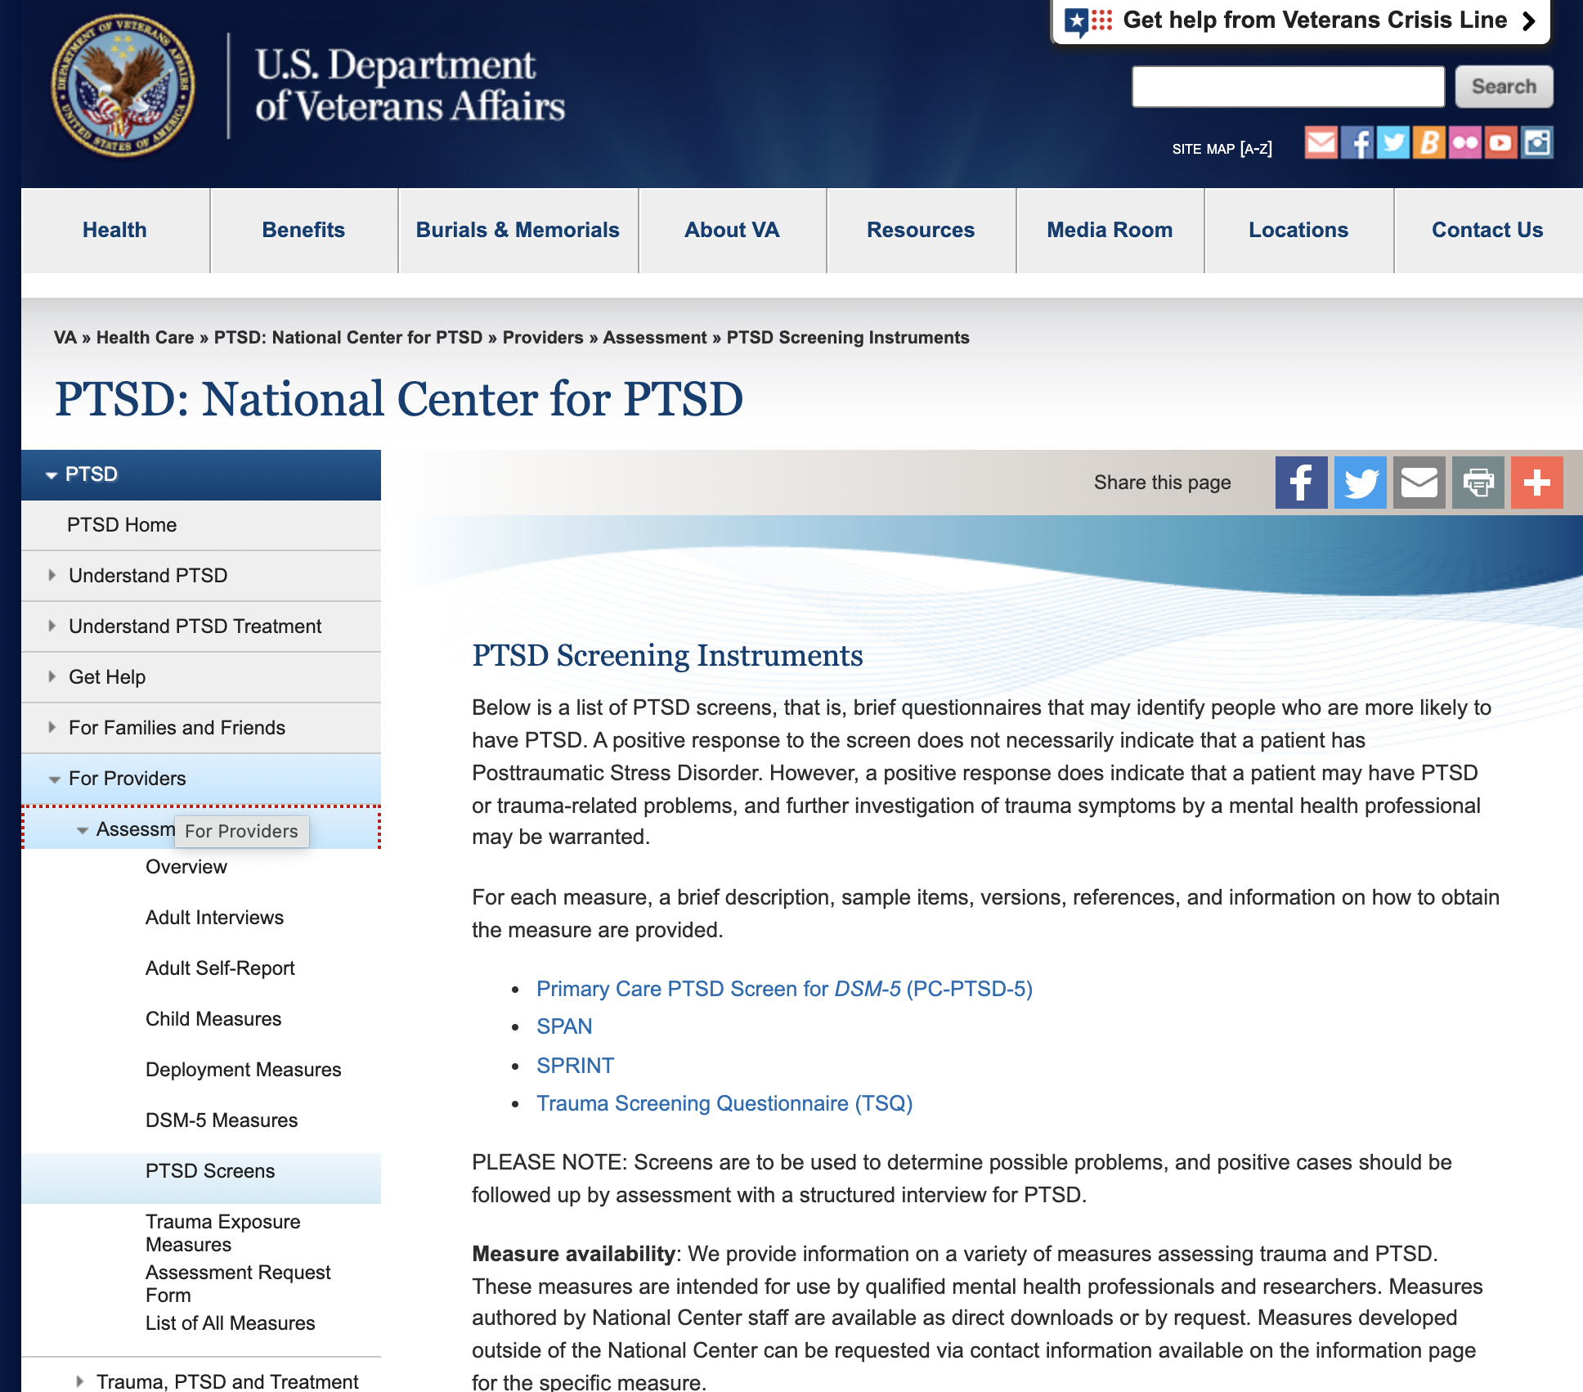
https://www.ptsd.va.gov/professional/assessment/screens/index.asp
Notes:
https://www.ptsd.va.gov/professional/assessment/screens/index.asp

Slide 26
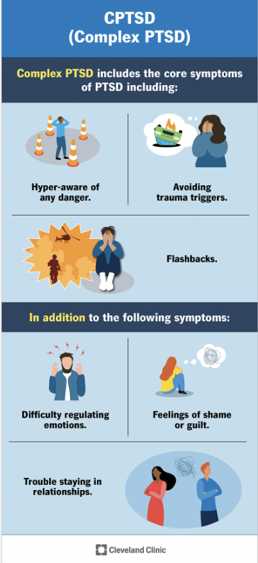
Complex PTSD/DESNOS
Exposure to multiple traumas
Exposure to high levels of chronic stress
Changes brain function
Can result in problems with identity and relatedness
https://my.clevelandclinic.org/health/diseases/24881-cptsd-complex-ptsd
chrome-extension://efaidnbmnnnibpcajpcglclefindmkaj/https://www.ptsd.va.gov/professional/articles/article-pdf/id52075.pdf

Slide 27
Complex PTSD/Borderline Personality Disorder (Herman)
Complex PTSD may be more appropriate diagnosis than BPD
Characteristics of BPD
Failure to form reliable and well integrated inner representations of trusted people
Can not calm themselves by calling up a mental image of a secure relationship

Slide 28
What is missing from PTSD?
Diagnosis does not necessarily capture effects of complex trauma (these factors might better be captured by mood disorders, personality disorders, or regulatory disorders);
Emotional dysregulation
Dysregulation of consciousness/dissociation
Somatization
Existential adjustment (the damaged or stained self)

Slide 29

Adjustment Disorders
Development of Symptoms: Symptoms develop in response to an identifiable stressor(s) within 3 months of its onset.
Clinical Significance: Symptoms or behaviors are clinically significant if: There is marked distress disproportionate to the stressor's severity, considering cultural factors.
There is significant impairment in social, occupational, or other important areas of functioning.
Exclusion Criteria: Symptoms do not meet criteria for another mental disorder or normal bereavement.
Duration: Symptoms do not persist beyond 6 months after the stressor has ceased.
Notes:
Diagnostic Features
Essential feature: Development of emotional or behavioral symptoms due to an identifiable stressor.
Stressors can be single or multiple, recurrent, continuous, and may affect individuals or larger groups.
Examples include relationship difficulties, financial stress, illness, or traumatic events.
Prevalence of Adjustment Disorders
Adjustment disorders are common across various populations.
Prevalence in outpatient mental health settings ranges from 5% to 20%.
Higher rates may be observed in specific demographic groups or during certain periods of life transitions.
Development and Course
Onset typically occurs within 3 months of a stressor.
Acute onset with brief duration if stressor is acute; may persist if stressor or consequences endure.
Symptoms must resolve within 6 months after the stressor ends for diagnosis.

Slide 30

Specifiers for Adjustment Disorders
With Depressed Mood (F43.21): Predominance of low mood, tearfulness, or hopelessness.
With Anxiety (F43.22): Predominance of nervousness, worry, or separation anxiety.
With Mixed Anxiety and Depressed Mood (F43.23): Combination of depression and anxiety symptoms.
With Disturbance of Conduct (F43.24): Predominance of behavioral symptoms.
With Mixed Disturbance of Emotions and Conduct (F43.25): Combination of emotional and conduct disturbances.

Slide 31
Specifiers for Adjustment Disorders (cont’d)
Unspecified (F43.20): For maladaptive reactions that do not fit specific subtypes.
Acute Specifier: Symptoms persist for less than 6 months.
Persistent (Chronic) Specifier: Symptoms persist for 6 months or longer. This applies when symptoms continue due to a chronic stressor or one with enduring consequences.

Slide 32

Small Group Activity

Slide 33

Risk and Prognostic Features
Environmental Factors: Individuals from disadvantaged backgrounds may be at higher risk due to frequent exposure to stressors.
Culture-Related Issues: Cultural context influences the assessment of maladaptive responses to stressors.
Responses may vary in perceived adaptiveness across cultures.
Considerations for migrants, refugees, and cultural norms impacting distress reactions.

Slide 34

Questions? Comments?

