Slide 1
Substance-Related and Addictive Disorders
Class 8
Rachel Speer

Slide 2

Think. Pair. Share.
What is one thing you can do this week to engage in intentional self-care?

Slide 3

Introduction to Substance-Related Disorders
Substance-related disorders encompass a range of conditions involving 10 classes of drugs.
These classes include alcohol, caffeine, cannabis, hallucinogens, opioids, sedatives, stimulants, tobacco, and others.
All drugs that are taken in excess activate brain reward systems, impacting behaviors and memory formation (Koob and Volkow, 2016).

Slide 4
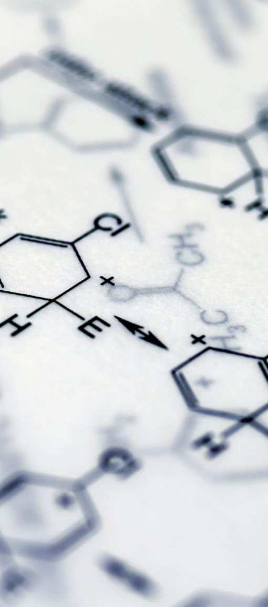
Mechanisms of Reward Activation
Drugs vary in their pharmacological mechanisms but generally produce a "high" by activating reward systems.
Neurobiological roots of substance use disorders can be observed in behaviors preceding actual substance use (Aliev et al., 2015; Moffitt et al., 2011).
Substance use also affects brain inhibitory mechanisms, contributing to addictive behaviors (Lucantonio et al., 2012).

Slide 5

Substance Use Disorder vs. "Drug Addiction"
The term "substance use disorder" replaces "drug addiction" in DSM-5 due to its neutral and defined diagnostic criteria.
Severity ranges from mild to severe, describing a chronically relapsing, compulsive pattern of drug use.

Slide 6

Gambling Disorder and Behavioral Addictions
Gambling disorder is included due to similarities in activating reward systems like substance use disorders.
Other behavioral addictions (e.g., Internet gaming, sex addiction) lack sufficient evidence for diagnostic criteria.
Substance-Induced Disorders
Divided into substance use disorders and substance-induced disorders.
Includes substance intoxication, withdrawal, and substance/medication-induced mental disorders.
Criteria vary across drug classes and include conditions like psychotic, depressive, and anxiety disorders.

Slide 7

Differential Diagnosis and Organization
The chapter is organized by substance class to aid in differential diagnosis.
Substance-induced mental disorders are aligned with their respective diagnostic chapters (e.g., depressive disorders, anxiety disorders).
https://www.youtube.com/watch?v=BtG9basK1KY

Slide 8
Article Presentation

Slide 9
Substance Use Disorders
The equal opportunity class of mental disorders
Effects millions of Americans and costs billions of dollars
  These just direct costs
  Costs to productivity, legal, etc.
Public Health Frame; primary, secondary, and tertiary prevention
Person in Environment
  Individual, Relational, Cultural, and Societal Dynamics (Access and Legality)

Slide 10

Key Terms
Let's Review

Slide 11
Etiology
Complex etiology
Learned
Object relations, attachment and symbolic nurturance
Affect regulation theory
Behavioral systems of reward (positive and negative reinforcement)
Operant conditioning

Slide 12
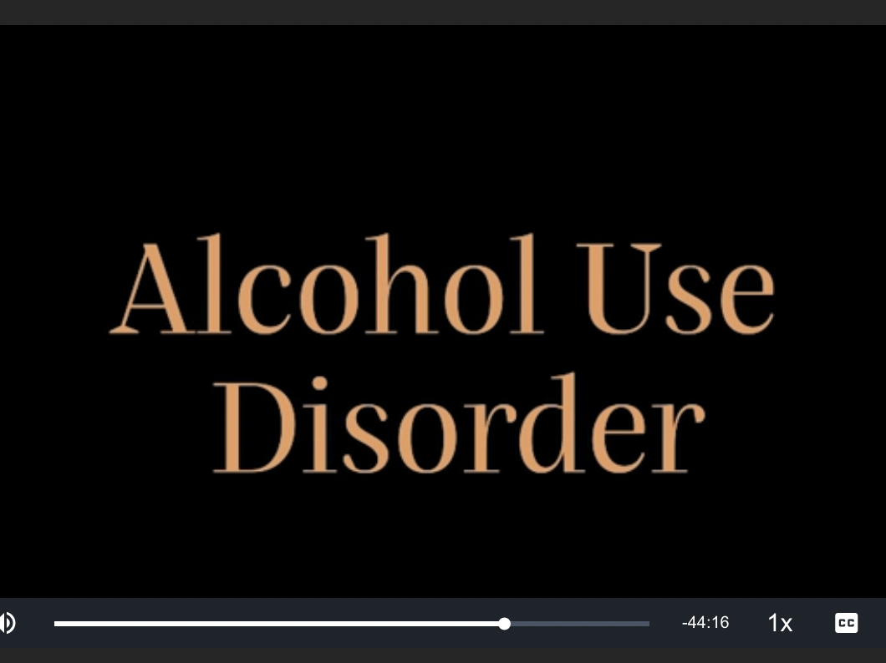
Notes:
https://www.kanopy.com/en/brynmawr/watch/video/6016382
Start at 2:18:29

Slide 13
Small Group Reflection
In the video with Buckels and Yalom, Buckels discusses that clients may be wary of fully reporting the extent of their use.
  Have you seen this in practice?
  What implications might there be for our work?
  What does that mean to you in terms of diagnosing?

Slide 14

Screening
Many screening tools exist to help assess for substance use (e.g., SBIRT).
Let’s take an opportunity to practice administering a substance abuse screener. Choose one of the questionnaires below to role-play with a partner.
  Alcohol screening questionnaire (AUDIT)
  Drug Screening Questionnaire (DAST)

Slide 15
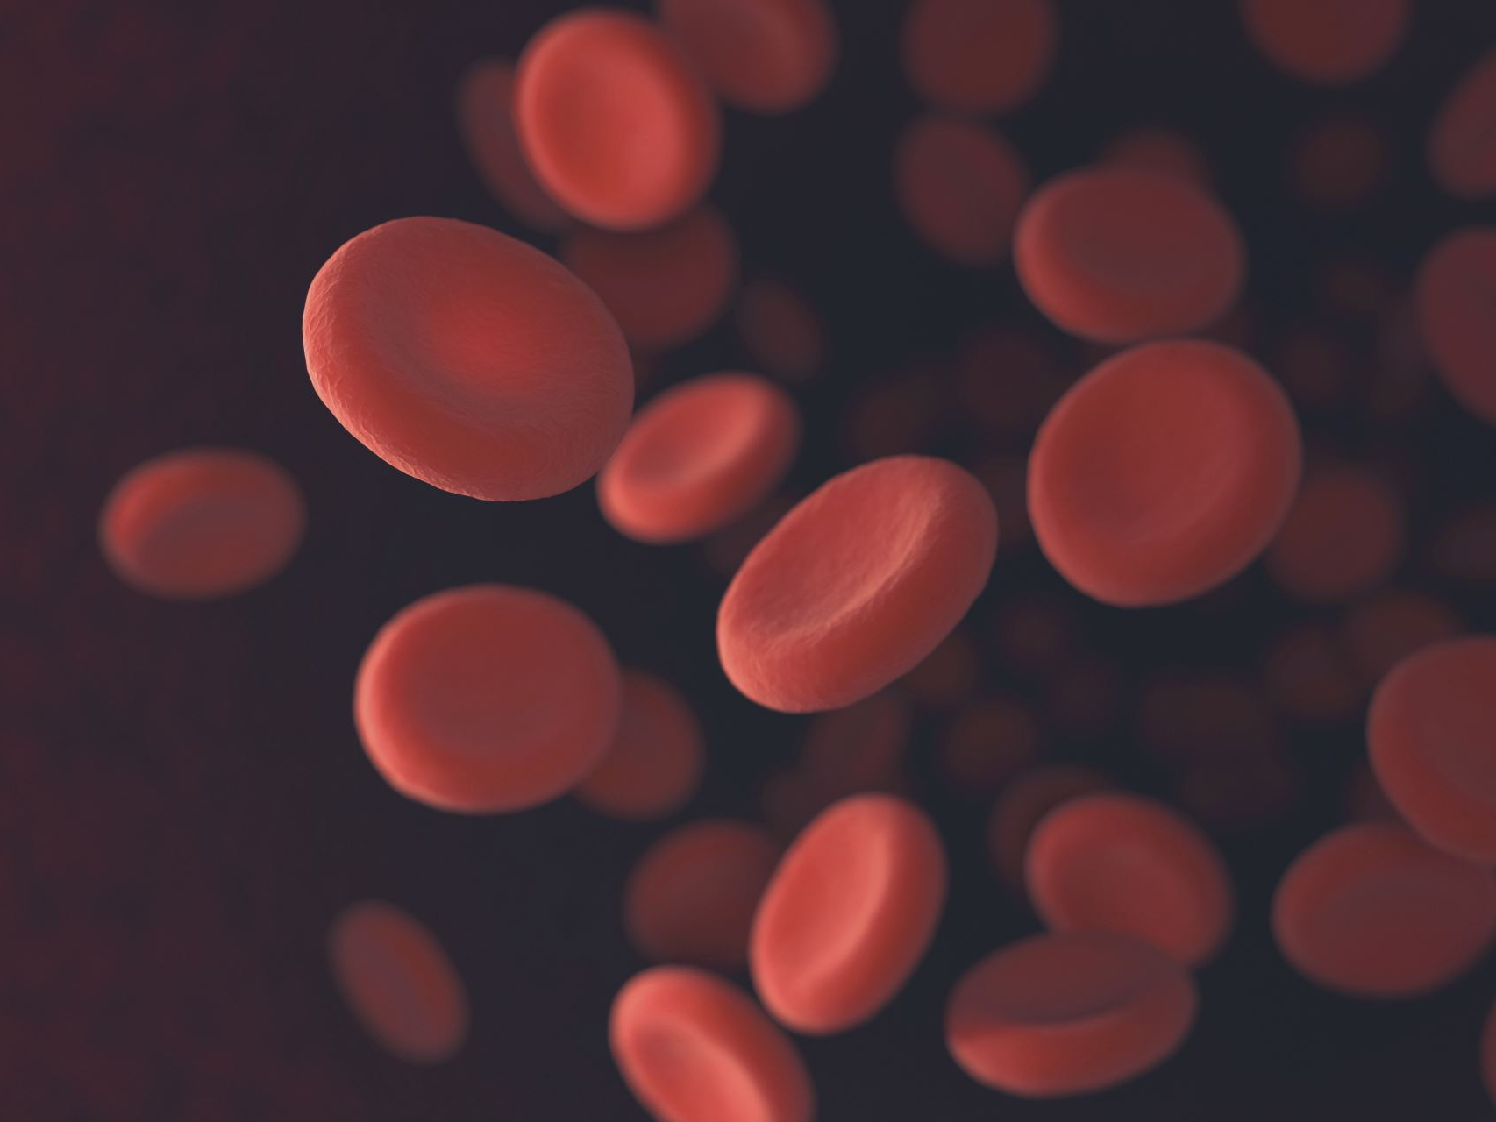
Brief Review of
Neurocognitive Disorders

Slide 16

Cognitive Symptoms of Dementia
Impairs Functioning (Activities of Daily Living)
Memory Loss and one other...
Loss of Orientation
Confusion=memory loss + loss of orientation
Loss of Comprehension
Lack of Concentration
Impairment in Problem Solving
Anxiety
Delusions/hallucinations

Slide 17
Costs of Dementia
Excess disability
Increased hospitalization and institutionalization
Premature institutionalization
Suffering
Costly to person and society

Slide 18
Assessment Tools
Standardized measures
Direct interview/observation
Caregiver reports

Slide 19

How might we “see” dementia?
Psychosis
Depression (pseudo-dementia)
Altered circadian rhythms
Agitation (restlessness, repetitive mannerisms, pacing, hiding objects, inappropriate dressing/undressing, physical aggression, negativism, repetitive sentences, constant interruptions, requests for attention)
Disinhibition
Anxiety

Slide 20
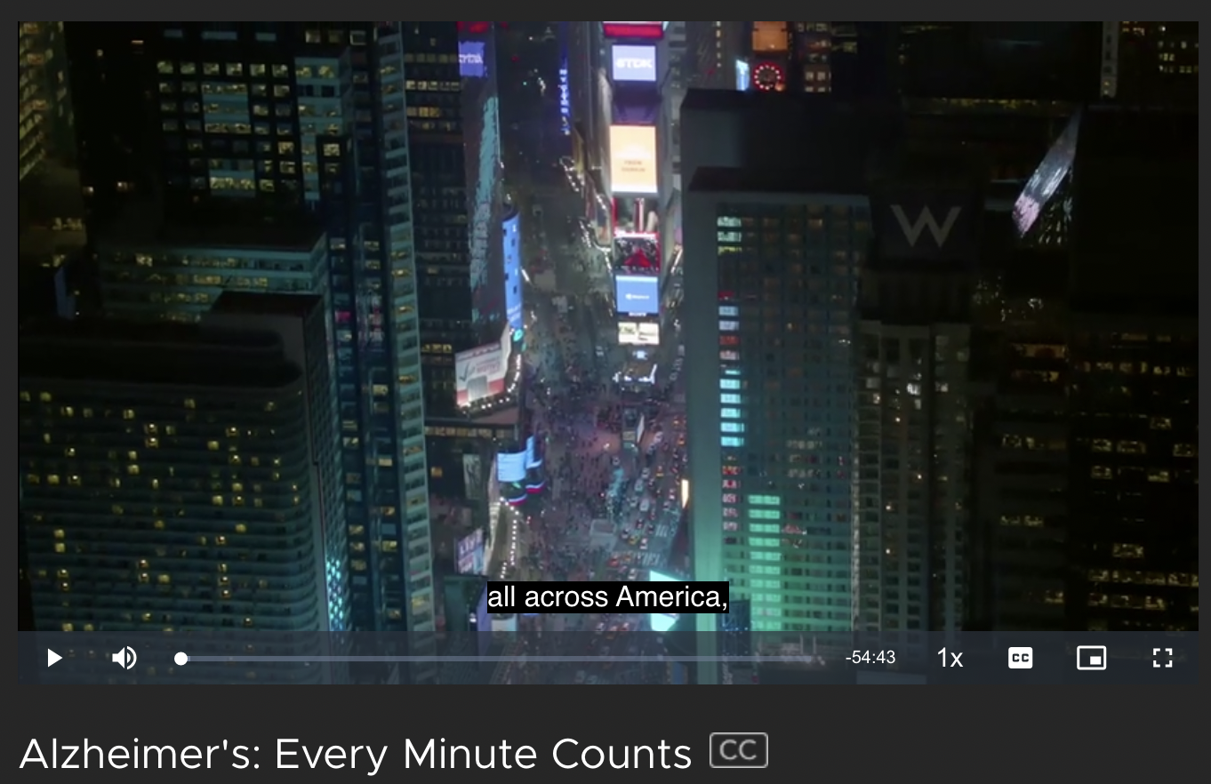
Notes:
2 min in to 9min22sec
https://www.kanopy.com/en/brynmawr/video/459756?vp=du&frontend=kui

Slide 21
Alzheimer’s Disease
Normal Aging | Possible AD
Forget to turn off stove | Forget how to turn off stove
Having to retrace steps | Forgetting how you got some place
Forget someone’s name | Forget name repeatedly
Most common type of dementia, affects 7% of those 65+ and 29% of those 85+

Slide 22
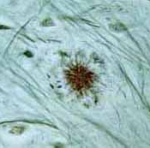
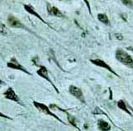
Changes in Brain Structure:
Plaques and Tangles

Slide 23

Caring for Someone with Alzheimers’
The vast majority of persons with Alzheimer’s are cared for in the community
One family member, usually a spouse or an adult child, take on caregiver role
  Results in significant drain of resources
  Results in caregiver burden
    Objective (Time, Financial)
    Subjective (Identity Loss, Grief Reactions)

Slide 24

Alzheimer’s and Identity Loss
“members of a dyad, come to know aspects of one another through countless daily interactions (Orona,1997)”…
  over time, our identity in relationships becomes taken for granted
  each member of the dyad reciprocally maintains the other’s identity

Slide 25
Identity Loss Continued…
Early Indicators of Alzheimer’s
  Strange and unexpected changes in identity
  Explained away by each member of the dyad, situation normalized
Next is Mobilization; identity shifts immediately to the role of caregiver
The Taken-for-Granted activities of daily life become the primary chore
  Dressing, Feeding may take hours
  The meaning of time and space is completely altered

Slide 26

Identity Loss continued…
Caregivers are losing a person that was able to validate their own identity
Often attempt protect the identity of the patient by holding on to old habits
  Coffee and ice cream
  Patient not always aware of changes in identity that are occurring

Slide 27
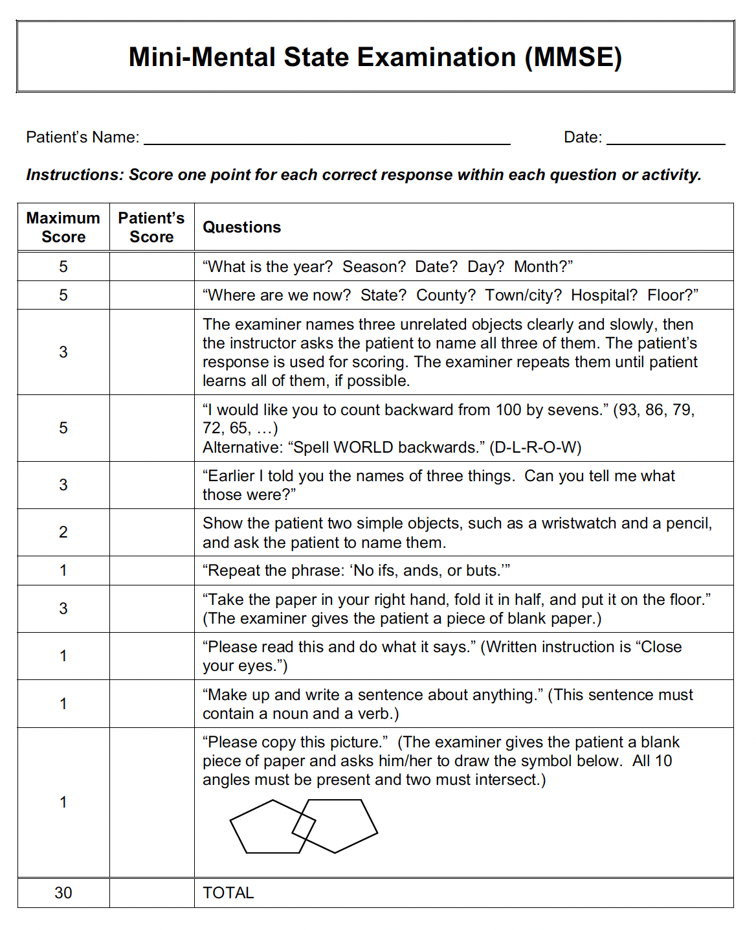
Let’s practice. In a dyad or triad, please take turns administering the MMSE.

Slide 28

Other Losses of Caregivers of AD
Physical death the second death
  Disenfranchised grief; grief that is not publicly shared or socially supported
  Ambiguous grief; no clear beginning and end
Loss of Social Support
  Friends uncomfortable with person with AD
  Lack of time available for socializing
Loss of Health
Loss due to institutionalization…loss of role may result in “who am I” and feelings of guilt

Slide 29
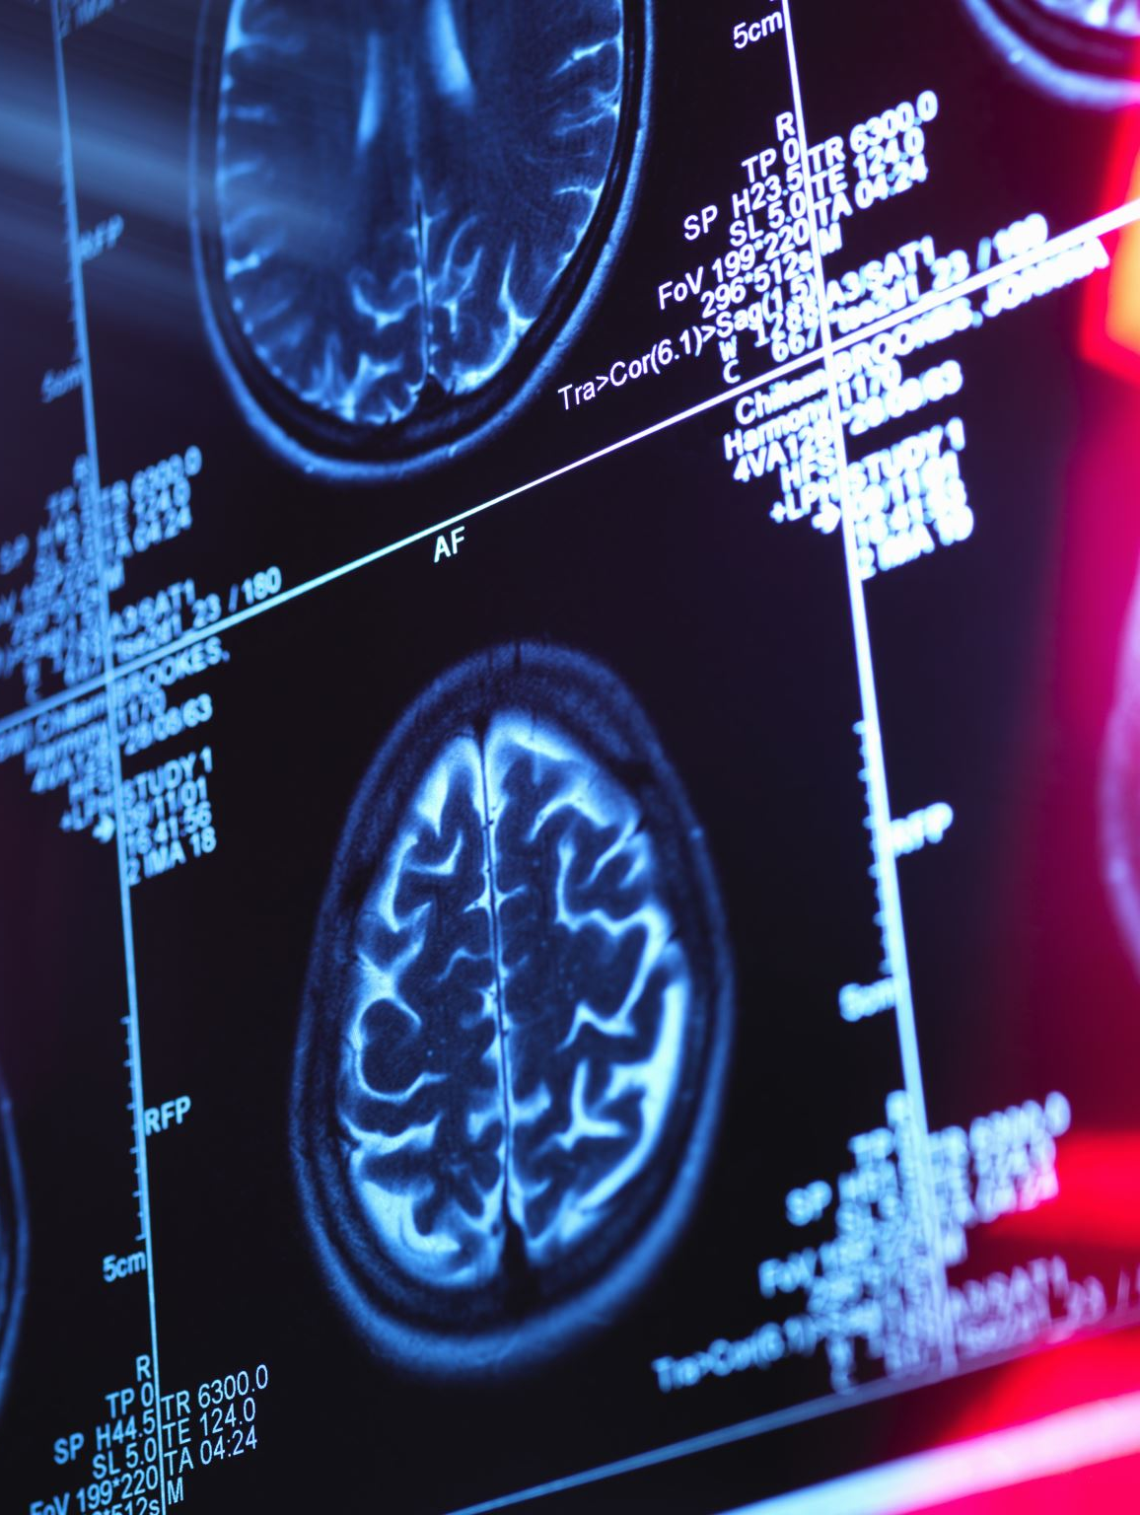
New Areas of Federally-Funded Research for Alzheimer’s
Delaying the onset of Alzheimer’s for those with Mild Cognitive Impairment
  Randomized Clinical Trials with Aricept, Vitamin E, Vitamin C, Gingko Biloba
  Delayed for 7-18 months
Neuro-imaging
  PET scans and MRI to detect changes in hippocampus
Brain Inflammation
  NSAIDS
Gene Studies
Vaccination

Slide 30

Questions?
Comments?

