Slide 1

Reproductive Justice & Social Work Praxis
Session 6: The Right to Have a Child:
Pregnancy and birth injustice
Prof. Lindsay Griffin

Slide 2
Infertility and Eugenics Wrap Up
Last class session covered infertility and eugenics and how this relates to strategies of population control and stratified reproduction—how politics and policies values some people’s ability to reproduce over others.
Content covered included Addressing Infertility, Reproductive Justice, and Artificial Reproductive Technology talk by Dr. Camille Hammond
Class Slides covered:
Definition of Infertility of ASRM
Overview of IVF: process, common difficulties, and ethical challenges
Eugenics: definition, origins of eugenics, history of forced sterilization with connection to eugenics and, IVF concerns around eugenics
What thoughts and reactions did you have?
What questions came up for you?

Slide 3

Current RJ News/Journal Article
Notes:
Savannah, Yasmeen, and Adrianna

Slide 4
Today’s Objectives:
Brief Stats to Know
Briefly discuss readings
Small group discussion on the podcast
Wellness Break
Current RJ News: Meryl, Mel, Lex
Case scenario for Discussion
Final Presentation- finalizing schedule and class worktime (if available)
What’s Next?

Slide 5
Brief Stats
Maternal mortality is referring to deaths of those who are pregnant and up to 42 days postpartum/post-termination of a pregnancy
In the US, the maternal mortality rate is approximately 32.9 deaths per 100,000 live births as of 2021, which was up from a rate of 23.8 in 2020
The US maternal mortality rate is rated one of the highest amongst “developed” countries.
Significant areas of disparities for Native Hawaiian and other Pacific Islander, Indigenous/Native Americans, and Black/African American birthing groups (see chart on next slide)

Slide 6
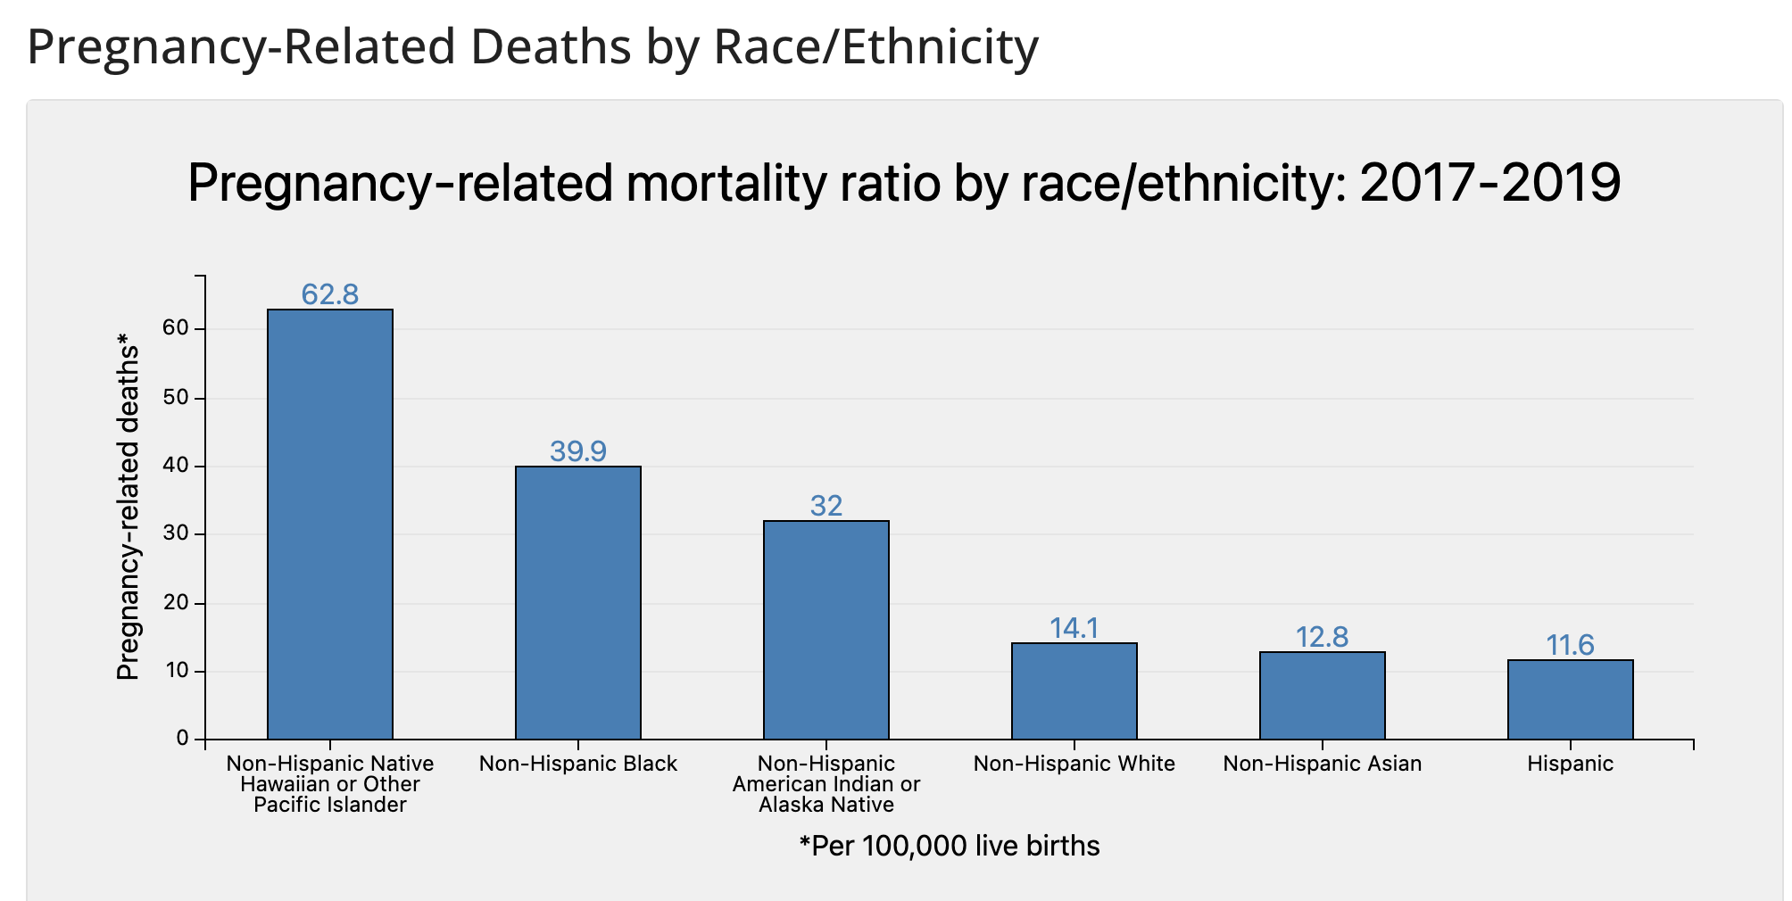
Maternal Mortality
https://www.cdc.gov/reproductivehealth/maternal-mortality/pregnancy-mortality-surveillance-system.htm

Slide 7
Class Readings
Davis (2019): Obstetric Racism: The Racial Politics of pregnancy, Labor, and Birthing

Slide 8
Small Group Discussion: Reproductive Injustice Podcast
What were some things that were shocking to you or was new information to you?
We heard stories from several individuals. Which story stood out or left an impact on you? What were the details that stuck with you?
In reflecting on the podcast, what may be a role for social workers inside and outside these settings to support birthing individuals in the prison system?
What ways can clinical social work support individuals like we heard from on the podcast?
What ways can macro social work support policy changes that are informed by RJ?

Slide 9

Wellness Break!

Slide 10
Current RJ News/Journal Article
Notes:
Meryl, Mel, and Lex

Slide 11
Case Scenario (Trigger Warning)
Backstory: Kyira Adele Dixon, the daughter-in-law to TV Judge Glenda Hatchett gave birth via scheduled repeat cesarean section on April 12, 2016. She was considered an overall healthy individual. Unfortunately, approximately 12 hours after her delivery, she was pronounced dead due to extensive hemorrhaging (internal bleeding). Despite her husband’s advocacy for concerns to be addressed, the hospital staff failed to render care. Dixon was not taken back for surgery until nearly 10 hours after her caesarean. We will watch a clip of Judge Hatchett from 2023 discussing what has been happening since the loss of her daughter-in-law.
https://youtu.be/HUkejM-Tbu8?si=g0L91tmzOfqZ3SL-

Slide 12
Large Group Discussion
What are some initial thoughts that come up when watching this video clip?
What are your thoughts about the family sharing their experiences? How may this align with RJ?
Clinical: What may be some clinical approaches that you may consider taking if you were treating a surviving member of this family? What types of support would you recommend for a family after experiencing this type of loss?
Macro: What are your thoughts on the steps the federal government is taking? What other steps may be considered in shaping future policy in this area?

Slide 13
Final Presentations
Guidelines and rubrics are on Moodle—are there any current questions?
We will finalize the schedule—I will post it to Moodle (next slide)

Slide 14
Final Presentation Sign-Ups
8 Students for Session 9 (Mon. Jul 22)
1 Sam P.
2 Lex
3 Adrianna
4 Kat
5 Savannah
6
7
8
8 Students for Session 10 (Thurs. Jul 25)
1 Meryl
2 Sam S.
3 Mel
4 Julie
5 Alison
6 Jamie
7
8

Slide 15
What’s Next
Next session: Moving into the 3rd tenet! The Right to Parent in Safe & Sustainable Communities with discussing Perinatal Mental Health, Family Leave Policies & Child Welfare
Current RJ News: Samantha S, Pria, Ayana
Use the remainder of class time today to work on final projects
Weekly Reflection #3 (last one!) due Saturday

