Slide 1

Reproductive Justice & Social Work Praxis
Session 8: The right to parent in safe & sustainable communities
Environmental Justice & Implications of Poverty
Prof. Lindsay Griffin

Slide 2
Course Evaluations
Your feedback matters to me! Please take the next 20 minutes to work on completing the course evaluation.

Slide 3
Quick Think, Write, Create
On a piece of paper:
Take 5 minutes to draw a representation on how you feel right now about about reproductive justice and environmental justice. Note: Does not have to be elaborate, it can be a symbol or figure.
I will ask for volunteers to give a few words on what your drawing means

Slide 4
Quick Recap
In the last session, we started discussing the last tenet “The Right to Parent in Safe and Sustainable Communities” with discussing perinatal mental health with discussing some statistics of who tends to be more impacted along with discussing policy around family leave and child welfare practices that disproportionately impact BIPOC individuals.

Slide 5
Today’s Objectives:
Identify and discuss the connection between Reproductive Justice (RJ) and Environmental Justice (EJ) and implications for social work
Identify and discuss the implications of poverty to the RJ movement and implications for social work
Time left today will be given for working on final presentations

Slide 6

Current RJ News/Journal Article
Notes:
Kya, Lex, Nicole

Slide 7
Introducing Environmental Justice
This video gives a brief description of what is environmental justice along with highlighting a case example of youth advocacy
https://youtu.be/y8cAhsr5j6U

Slide 8
Environmental Justice
“China, the United States, India, the EU27, Russia and Brazil were the six world largest GHG emitters in 2022 (see Figure 1). Together they account for 50.1% of global population, 61.2% of global Gross Domestic Product (WB, 2023), 63.4% of global fossil fuel consumption (EI, 202311) and 61.6% of global GHG emissions”(graph on next slide)
file:///Users/lindsaygriffin/Downloads/GHG_emissions_of_all_world_countries_booklet_2023report.pdf

Slide 9
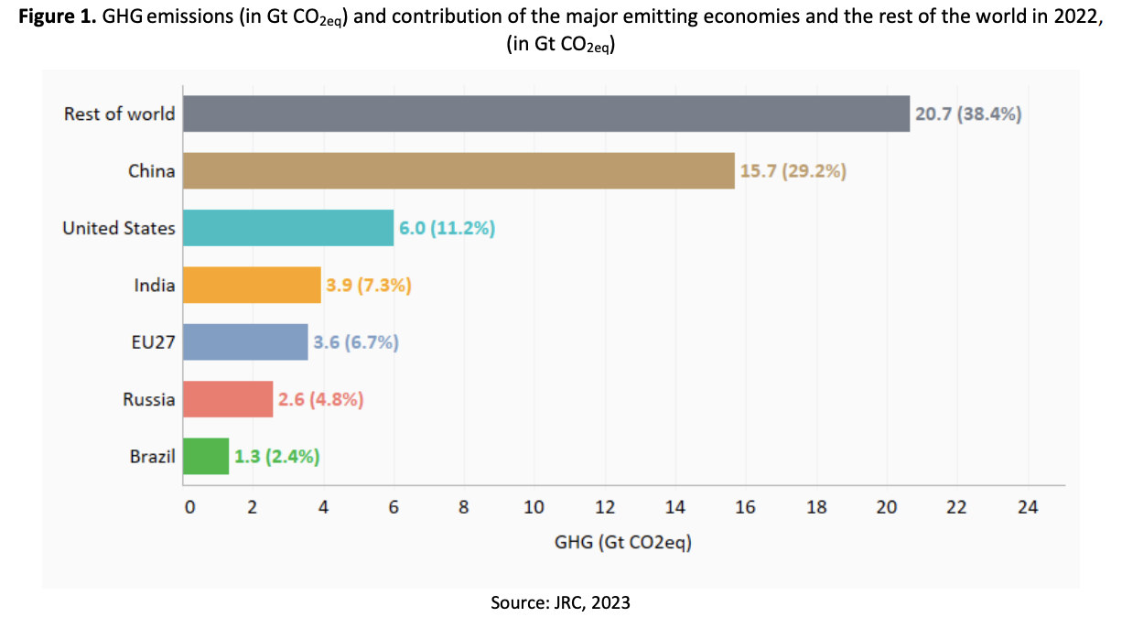

Slide 10
Class Readings
Bovell-Ammon, A., Yentel, D., Koprowski, M., Wilkinson, C., & Sandel, M. (2021). Housing is health: A renewed call for federal housing investments in affordable housing for families with children. Academic Pediatrics, 21(1), 19–23.
Hoover, E. (2018). Environmental reproductive justice: Intersections in an American Indian community impacted by environmental contamination.
For the Hoover article, what thoughts arose from you in thinking about the concept of “environmental reproductive justice” ERJ?
For the Bovell-Ammon article, what thoughts did you have given that housing has become less affordable in recent years? While the article specifically talked about pediatricians, what role can social workers take to support families? What thoughts/responses did you have on there suggestions of strategies?

Slide 11

Wellness Break Time!

Slide 12
EJ Activity
Environmental injustice can feel like a very big problem to tackle. We will watch 2 news clips about forever chemicals in the water and the Flint, MI water crisis to frame our activity and discuss some ways social workers can think about approaching this aspect of environmental justice.
https://www.youtube.com/watch?v=0onkOVkf5zM
https://www.youtube.com/watch?v=W4GeqH4RkaM (Trigger warning: Miscarriage)

Slide 13
Discussion Questions
From what we learned and discussed so far, why is it important that forever chemicals tend to show up more in urban areas? Who do you think will be more affected? What impacts do you think these groups will experience compared to those in more rural settings?
As social workers, what are some steps that we can think about taking from a micro, mezzo, and macro approach? (Whiteboard activity)
Clinical: If Nakia, or another Flint resident came to you seeking mental health treatment for peripartum loss and described feelings of anger related to the water crisis, what steps would you take to support? What may be some interventions you would consider?
Mezzo/Macro: What may be some steps to consider for community organizing on this issue? What may be some policy actions that social workers can advocate for?

Slide 14
Further Info
Race & Health Podcast covers a variety of topics related to how race and racism drive health disparities. They have a series on Environmental Justice for further learning on this area.

Slide 15
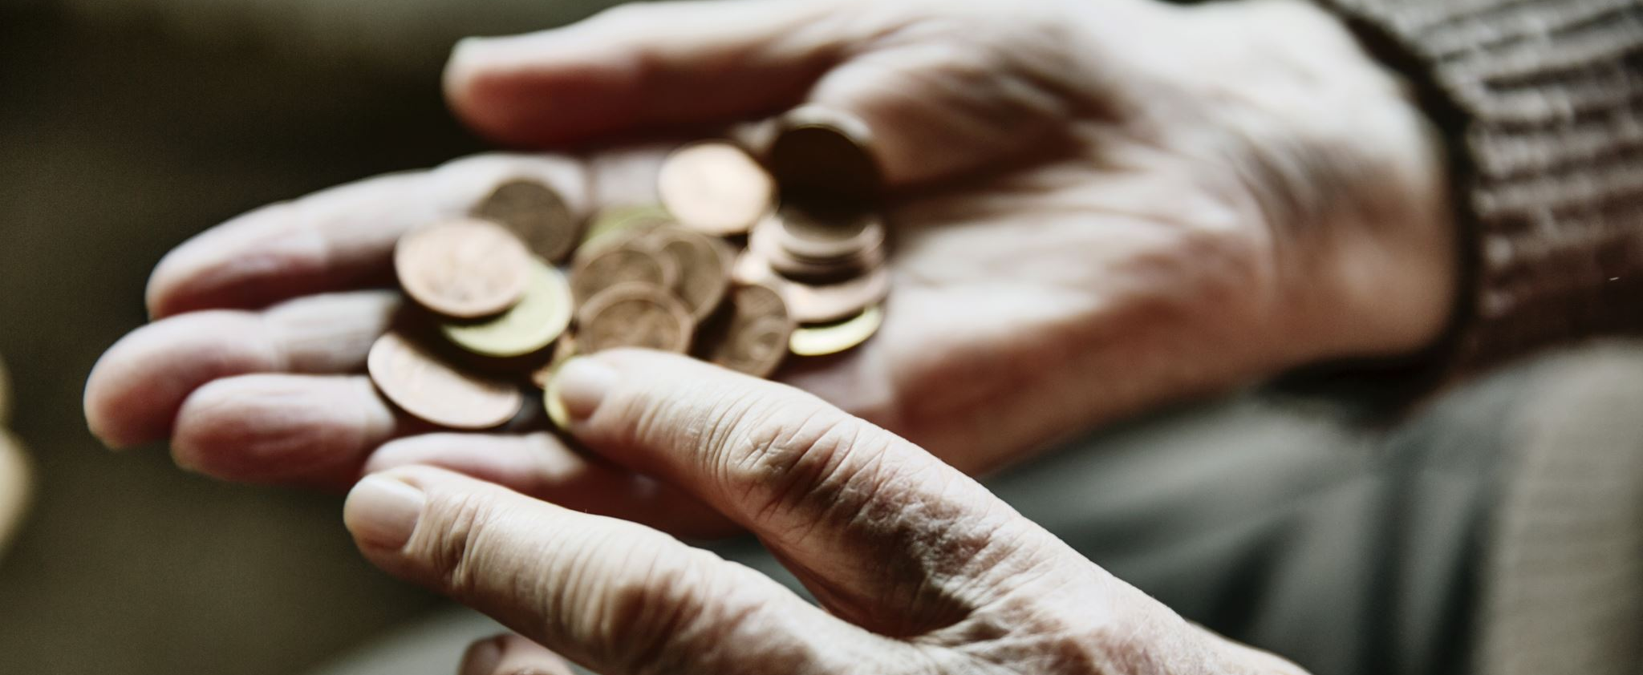
Implications of Poverty

Slide 16
Stats: Food (In)Security
Food insecurity: defined as the difficulty to provide enough food to all members of the household at least one time in a year
Approximately 12.8% (approximately 1 in 8) of households are considered food insecure in the US according to the USDA (as of 2022). This figure is an increase from 10.2% in 2021—any thoughts on why this might be?
Approximately 17.3 % of households with children are impacted by food insecurity
Single-mother led households have a higher rate of food insecurity
Low food security and very low food security are traumatic exposures when looking at the ACEs questionnaire: First question “Did you feel that you didn’t have enough to eat, had to wear dirty clothes, or had no one to protect or take care of you?”
Food insecurity is associated with other poor developmental outcomes (social, emotional, cognitive) for children/adolescents
From https://www.ers.usda.gov/data-products/ag-and-food-statistics-charting-the-essentials/food-security-and-nutrition-assistance/#:~:text=The%20prevalence%20of%20food%20insecurity,of%20a%20lack%20of%20resources.

Slide 17
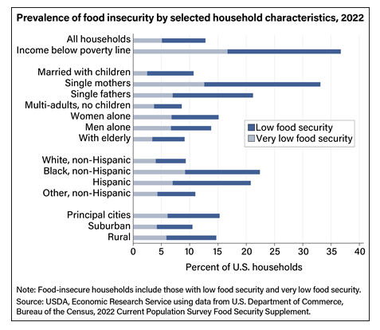
Very Low Food Security: A more severe form of food insecurity in which food intake is restricted and normal eating patterns are disrupted
Things to notice:
Married w/ children vs. single mothers vs. single fathers
Consideration of pay gaps

Slide 18
What’s Next
Final presentations next week!
No reflection assignment this week!

