Slide 1

Opening Option 5
Day 3
Formative Assessments
Notes:
This slide can be used at the very start of your presentation deck.
Click on the icon to add your school, division, department, or office logo.

Slide 2
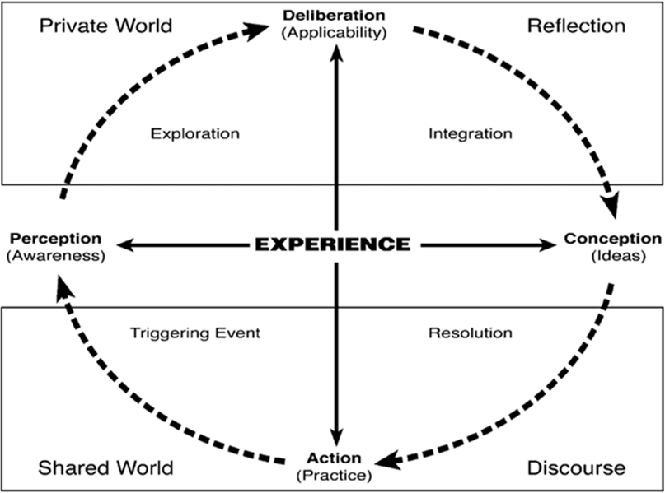

Cognitive Presence
Cognitive presence is the extent to which learners can construct and confirm meaning through practical inquiry, sustained reflection, and critical discourse in a community of inquiry.
Formative assessments can be designed to move students through these phases of cognition. For instance, a graduated Moodle Forum can direct students to:
Identify key themes in a reading
Explore the ramifications of the author’s conclusion
Integrate this reading with other course topics
Resolve this area of study in a summative assessment
Or an exploratory discussion board can lead to a group project and then a discursive essay with peer review.
Notes:
Update the text on the slide.
To add bullets, use the Format dropdown > Bullets & Numbering.

Slide 3
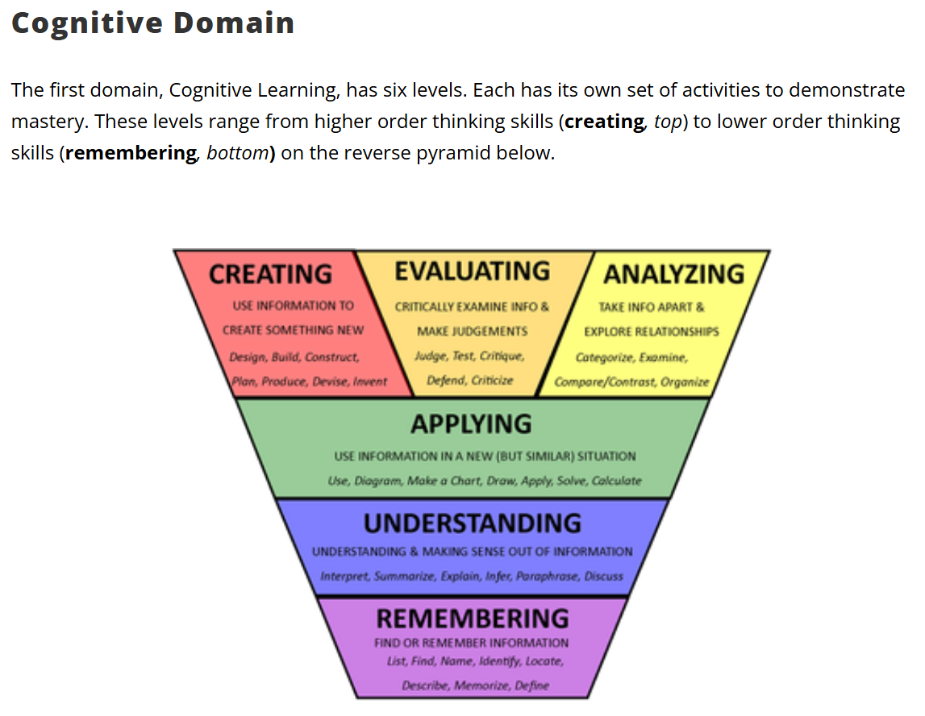
Bloom’s Taxonomy
This taxonomy is composed of three domains:
Cognitive domain = knowledge based
Affective domain = attitude based
Psychomotor domain = skills based
In the late 1940’s, a group of educators led by Benjamin Bloom devised education goals and objectives for thinking behaviors important in the learning process. This classification has been revised and adapted to reflect digital learning.
Examples of possible assessments: After a reading assignment:
Design a real-life test of the author’s conclusion (Creating)
Compare and contrast this reading with another (Analyzing)
Explain the implications of the central idea (Understanding)
Describe the author’s thesis and conclusion (Remembering)
https://www.aliem.com/blooms-digital-taxonomy/
Notes:
Update the text on the slide.
To add bullets, use the Format dropdown > Bullets & Numbering.

Slide 4
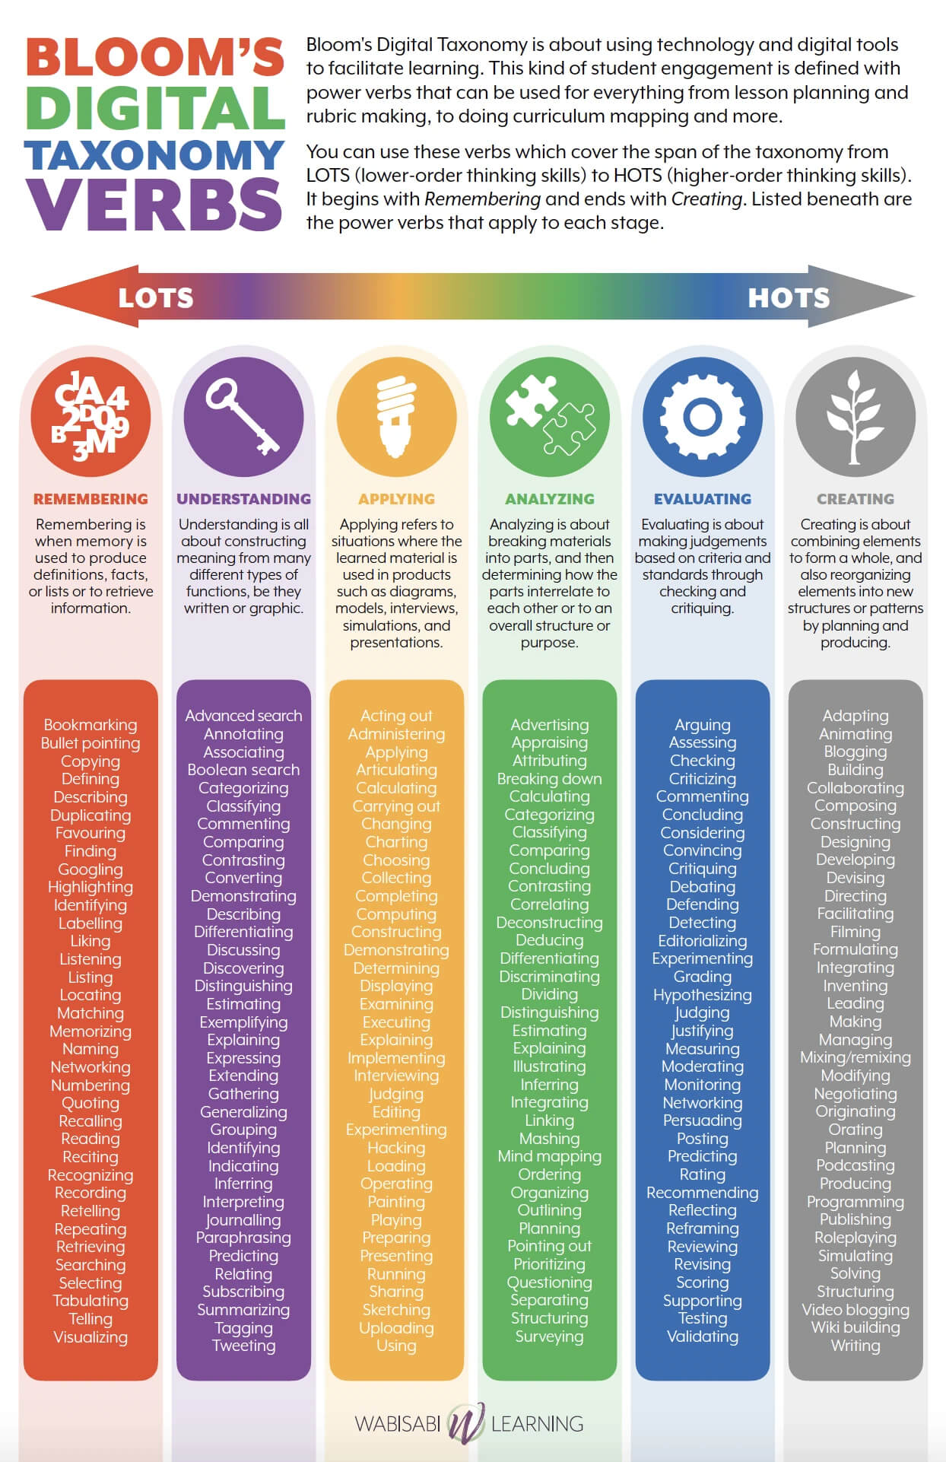
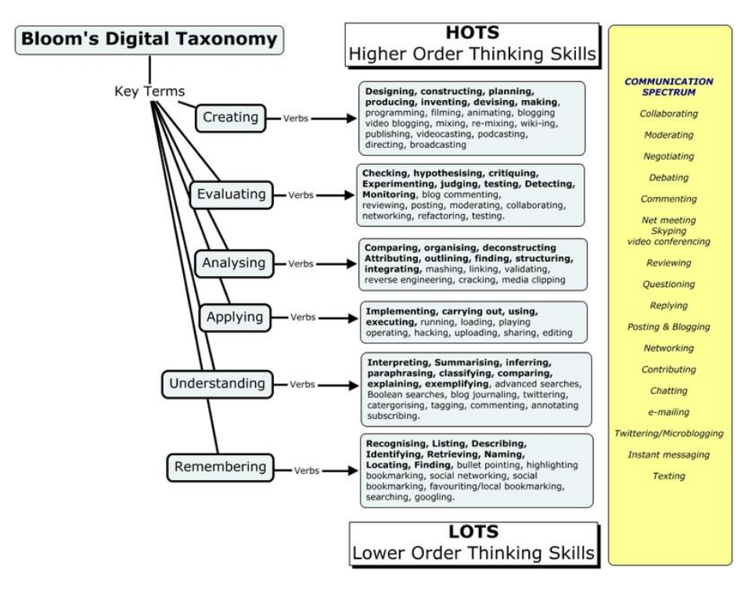
Bloom’s Digital Taxonomy
Notes:
Update the text on the slide.
To add bullets, use the Format dropdown > Bullets & Numbering.

Slide 5
Building a better learning activity:
Instructor-modeled participation
Students as activity leaders and socially-engaged participants
Phased cognitive development leading students to higher order thinking skills
Feedback (self, peer, or instructor) on student performance
Notes:
Update the text on the slide.
To add bullets, use the Format dropdown > Bullets & Numbering.

Slide 6
Consider: Group Activities Consider: Wikis
Moodle's Groups feature allows instructors to divide a class into sections or create collaborative working groups for course activities, so that each group can have their own Forum to communicate about project work.
Find this feature in the Participants tab. You may manually create your groups’ enrollments or auto-create them with a specified number of participants randomly assigned to each group. There also are settings to make the groups entirely separate, so their work can’t be seen by other groups, or visible to the entire class. In addition, instructors may assign work to an individual group.
See the Ask Athena article, linked above, for more information.
The Wiki activity allows students to create a collaborative document by building pages together, similar to Wikipedia. Unlike other collaborative editing programs (such as Google docs) the Wiki is a standard Moodle activity and so no extra permissions or logins are needed.
Although Wikis are usually collaborative, it is possible to allow each student to create their own Wiki for individual use. In Settings under “Wiki Mode” choose between "Individual wiki" where each student gets a personal wiki, or "Collaborative wiki" where students work together on a single wiki. (Group mode may also be used along with a collaborative wiki for small group projects and presentations.) For more information, click the link above for instructions or watch this video.
Notes:
Update the text on the slide.
To add bullets, use the Format dropdown > Bullets & Numbering.

Slide 7
Consider: Moodle Forums
The Forum activity in Moodle is more than a traditional discussion board. Depending on the settings you select, it can be:
A single simple discussion: the instructor posts one thread and students discuss it.
Each person posts one discussion: every student posts a thread, all of which can be discussed by the class.
Q and A forum: students ask questions in threads and the instructor (or other students) post answers. For a Q&A tool with more features, use the Moodleoverflow activity. Moodleoverflow is similar to a Forum, but it lets users rate posts. Users who have started a discussion can mark an answer as helpful, and teachers can mark a posted response as correct.
Standard forum for general use: In a typical forum, everyone can post threads and everyone can reply.
Standard forum displayed in a blog-like format: essentially the same as “standard forum for general use“ but gives the participant the option to view each discussion topic with its text, like a blog post instead of a discussion thread.
Use Subscription and tracking settings to adjust email notification preferences, so you know when new posts are submitted.
Notes:
Update the text on the slide.
To add bullets, use the Format dropdown > Bullets & Numbering.

Slide 8
Improving Online Discussions
Problem #1:
The submissions are superficial and the discussion doesn’t go anywhere.
Possible Solution:
The design, facilitation, and instructor modeling may need improvement. Consider grading posts and/or developing a rubric for their evaluation.
Problem #2:
The students don’t respond meaningfully to each other’s comments.
The real issues:
The students are speaking to the instructor and not each other, or the goals are unclear. Offer feedback and model responses with more depth.
Notes:
Update the text on the slide.
To add bullets, use the Format dropdown > Bullets & Numbering.

Slide 9

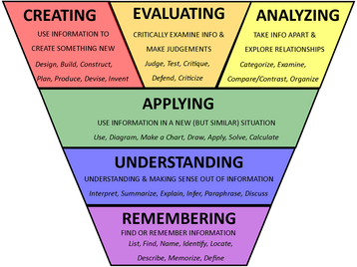
Discuss: What assessments are you considering?
Notes:
Update the text on the slide.
To add bullets, use the Format dropdown > Bullets & Numbering.

