Slide 1

Online Course Design in Moodle
Online Teaching Institute 2025

Slide 2
Every Moodle Course is Online …
In fully online courses, instructors and students never meet “IRL.”
However, every Moodle course page is an “online course” in the sense that students interact with it asynchronously.
And most college courses coursework outside of class meetings, which is (or could be) described or managed through Moodle.
Many features introduced here will apply to any course that uses Moodle.

Slide 3
Creating Learning Paths
Online Course Design in Moodle
Explore features and tools that help you create accessible and engaging learning experiences that reduce students’ cognitive overhead.

Slide 4
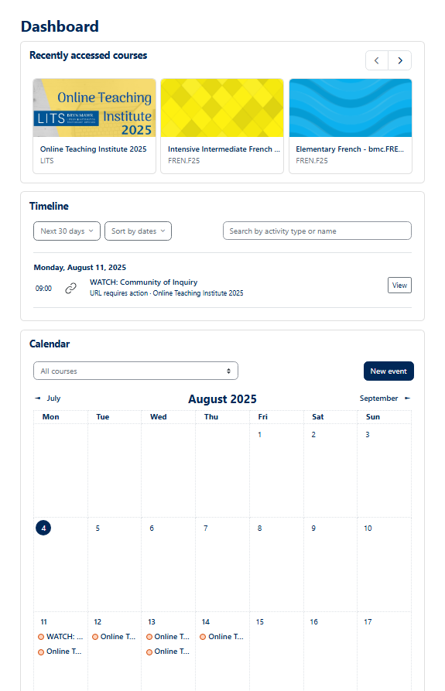
Timeline and Calendar
Dashboard features that help students manage time and responsibilities.
Timeline items have action buttons (View, Submit, etc.) C
To add things to the Timeline and Calendar:
Give Activities (Quizzes, Assignments, etc.) a due date in Availability settings
Give Resources (URLs, Files) a Completion conditions setting with a timeline reminder option
Zoom Activity meetings are automatically added to the Calendar; click New event to add others (like in-person meetings).
Share Moodle: Keep organized with Calendar and Timeline with students.
Items from all courses show up; students can filter and sort.
Click calendar events for description and location or action links.

Slide 5
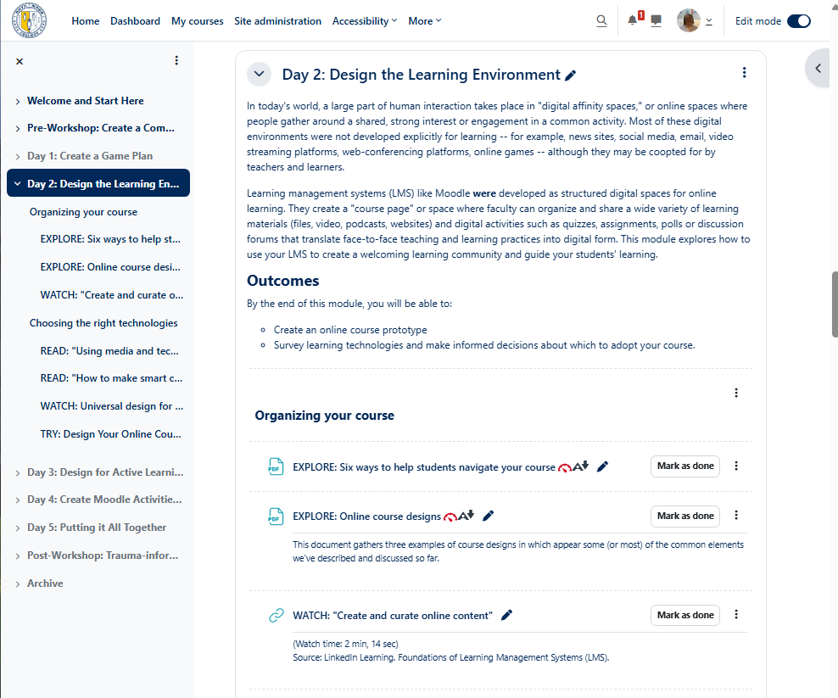
Course Index and Page Layout
Give your course sections meaningful names to make the course index more useful. (In long courses, students can Collapse all, find the section they need, then expand it.)
Indenting activities and resources can make page and index organization clearer.
Here I added Text and Media Area resources to make subheadings, then indented items under them.
Click the Edit title icon to rename a section. (Press Enter to save!)
(To auto-label all sections with week dates, change Settings > Course Format to Weeks.)
Click the Edit icon, then choose → Move right or ← Move left to control indenting.
See Moodle: Customize and organize your course

Slide 6
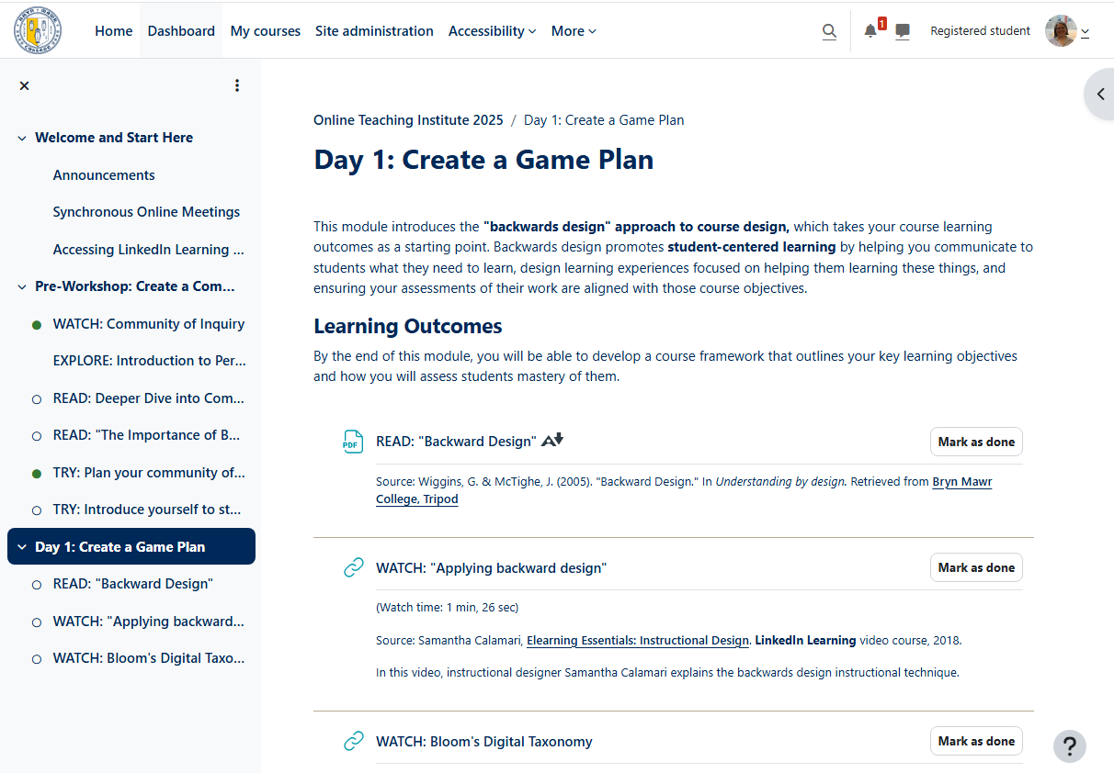
Embrace Consistency
Like things should be similar, differences should be meaningful.
Develop and use naming and presentation conventions.
Use built-in heading styles to create semantic and visual hierarchy.
Don’t forget settings! Notice the circles in course index, which are based on settings.
Format text consistently and beware of accessibility traps:
  Hyperlinks are underlined; DON’T use underline for titles for emphasis
  If you italicize titles, don’t use italics for emphasis (bold is usually more accessible).
  If you use color to indicate something, also use formatting colorblind and screen readers can detect (bold, italics, etc.)

Slide 7
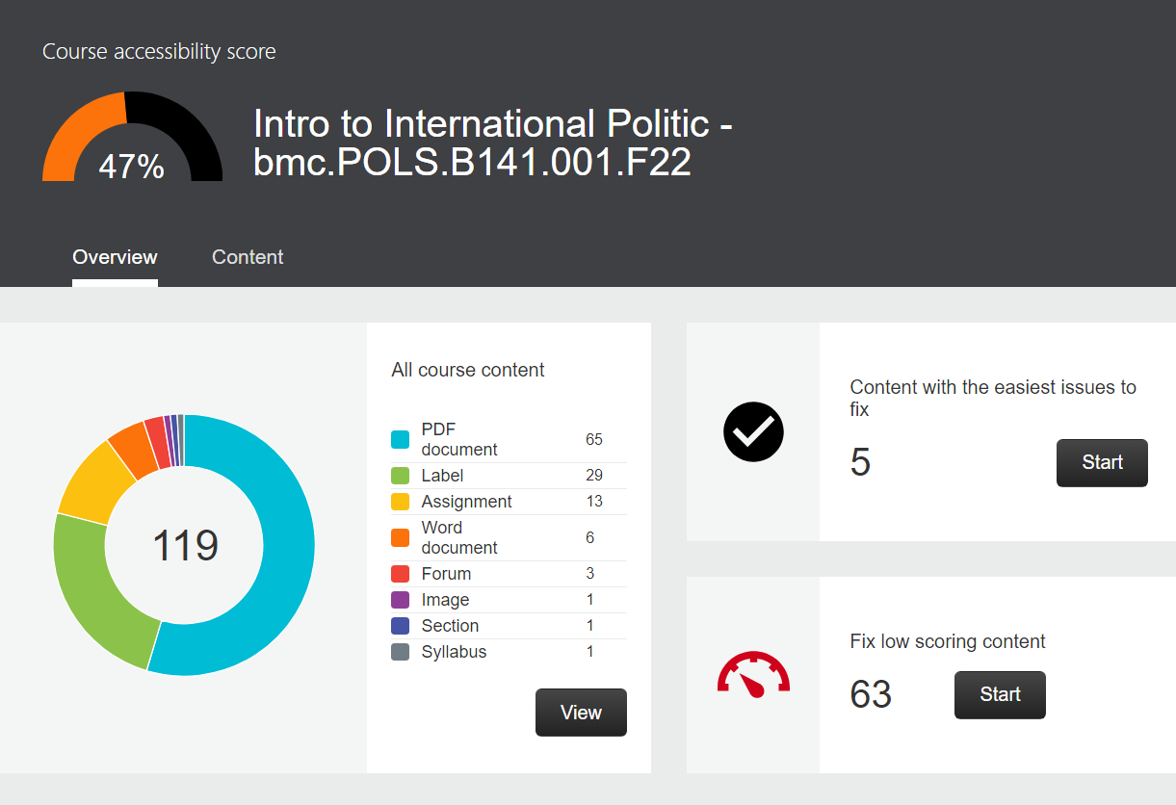

Ally Accessibility Features
Icons next to uploaded files provide accessibility info and assistive technology:
The dial (invisible to students) indicates the file’s accessibility rating click for a guide to improving and re-uploading a low-rated file.
Use A↓ to open the file with assistive technologies or get alternative formats (e.g., Braille, mp3).
See Moodle: Check course document accessibility for more details.
For a course-level score and triaging advice, choose Accessibility report from the Reports menu of the course page.
See also:
Accessibility Policy for Classroom Instruction
Accessibility Best Practices

Slide 8
Presence and Communication
Online Teaching Institute 2025
This section introduces options for meeting with students, showing up asynchronously and fostering collaboration and connection.

Slide 9
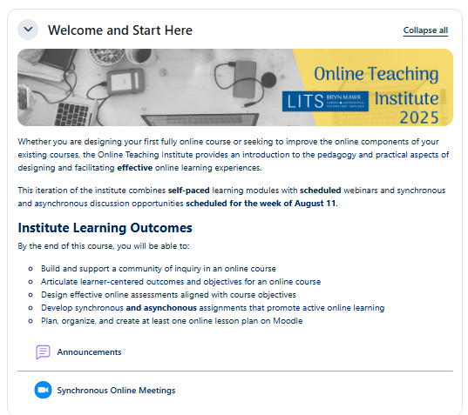
Announcements and Messaging
Post messages for the entire class in the Announcements forum
  Students receive email notifications AND can view in Announcements.
  You can schedule posts in advance!
All participants can use Messaging (IM) to communicate with one another.
Teachers can use also use Quickmail.
See Moodle: Message course participants

Slide 10
Zoom Activity and Zoom Scheduler
Add a Zoom Activity to your course to:
Create Zoom Whiteboards for the course
Schedule Zoom Meetings for the course
Puts all course-related meetings, meeting recordings and whiteboards in one place, and …
Moodle adds Meetings to the Calendar
Recordings are uploaded to Panopto folder
See Use the Zoom Activity in Moodle.
You may want to use Zoom Scheduler for appointment-booking instead:
Scheduler is connected to your Outlook calendar and can send calendar invites
Scheduler has additional options for reminders, locations, etc.
All BMC faculty, students and staff can set up a Scheduler; anyone can book through it.
See Use Zoom Scheduler for appointment booking.

Slide 11
Asking Questions
Activity | Uses | Who can ask? | Has anonymous post options? | Visibility to students
Quiz | Assessment (incl. formative) | Only teachers | No | Never
Choice | Sign-ups, polling, voting, etc. | Only teachers | Yes | Optional
Feedback | Surveys; ask questions without a right answer | Only teachers | Yes | Optional (anonymously only)
Moodleoverflow (new!) | User-moderated Q&A forums | Anyone | Yes | Always, instructor approval optional
Forum | Depends on type | Depends on type | No | Always (except Q&A type)

Slide 12
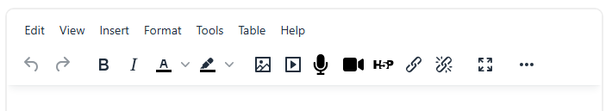
Audio and Video Options
Panopto
Panopto is both a recording tool and an online streaming video library.
Use the Panopto block in a Moodle course to manage course videos.
Record audio, video and/or screencasts with the Panopto desktop app or Panopto Capture
Or upload files recorded outside of Panopto.
ASR captioning is applied, but may require editing for full accessibility -- see Panopto: Captions
Moodle Text Editor buttons
Best as a tool for students to record short (~2 min), contextual responses
Lack of captioning and limited playback options hamper accessibility
Students will need to another tool like Panopto if they need screen capture

Slide 13
Students can also use Panopto!
Panopto: student guide to recording and uploading and recording videos.
Panopto: Collect audiovisual assignments
Known limitation:
Panopto/Moodle options aren’t designed for students viewing and commenting on each other’s videos. Having them post “Share with anyone” links on a forum is currently our best workaround.

Slide 14
Contact
Jennifer Spohrer
Director of Educational and Scholarly Technology
Pronouns: She/Her
jspohrer@brynmawr.edu
Meet with me
Notes:
Use the text boxes to update your contact information.

