Slide 1


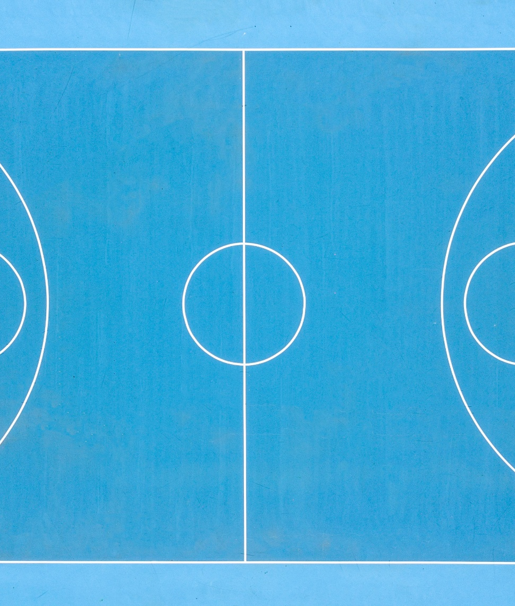
Your Body, Your Ally: Physical Wellness as A foundation for everything
Week 3

Slide 2

Agenda
Warm Up: Show and Tell
Defining Physical Wellness
College Culture: The Shift
Wellness Mission Statement
Resources
Scenarios
Homework

Slide 3

Show and tell

Slide 4

WARM UP: 3 WORD Introductions
Notes:
Pair Up​
You will have five minutes to interview (get to know) each other​
Once the time has passed, each pair will introduce each other in only three words.

Slide 5
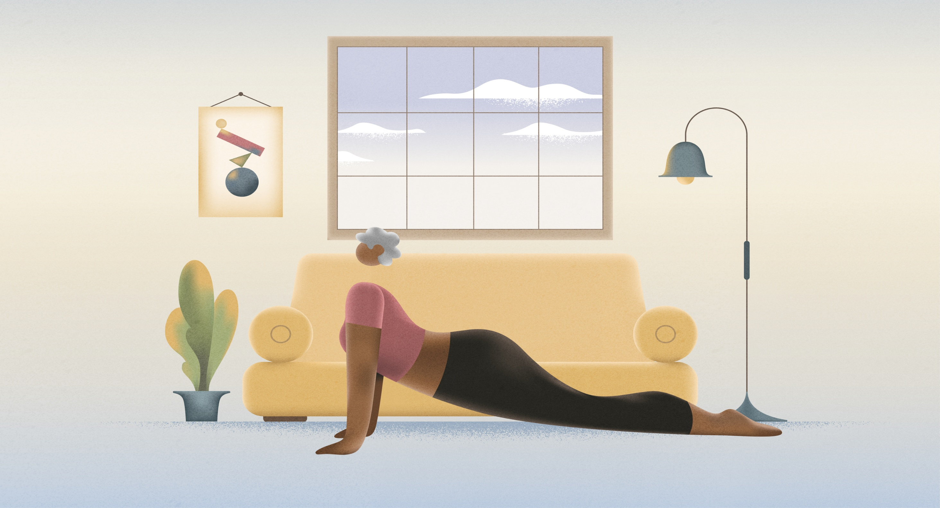
Physical Wellness
A "healthy" body. Good physical health habits. Nutrition, exercise, and appropriate health care. These make up the physical dimension of wellness. A few ways we can get there might be choosing things that make our body feel good and trimming back the things that bring us down. We can also feel better by creating a routine that balances activity with inactivity, and that is manageable within our obligations and needs. Our body is intelligent, and learning to listen to it more deeply can be very important and empowering.
Note: Being "physically well" can look different for everyone, depending on individual abilities, needs, and resources.
Notes:
Ask them how they would define wellness.

Slide 6
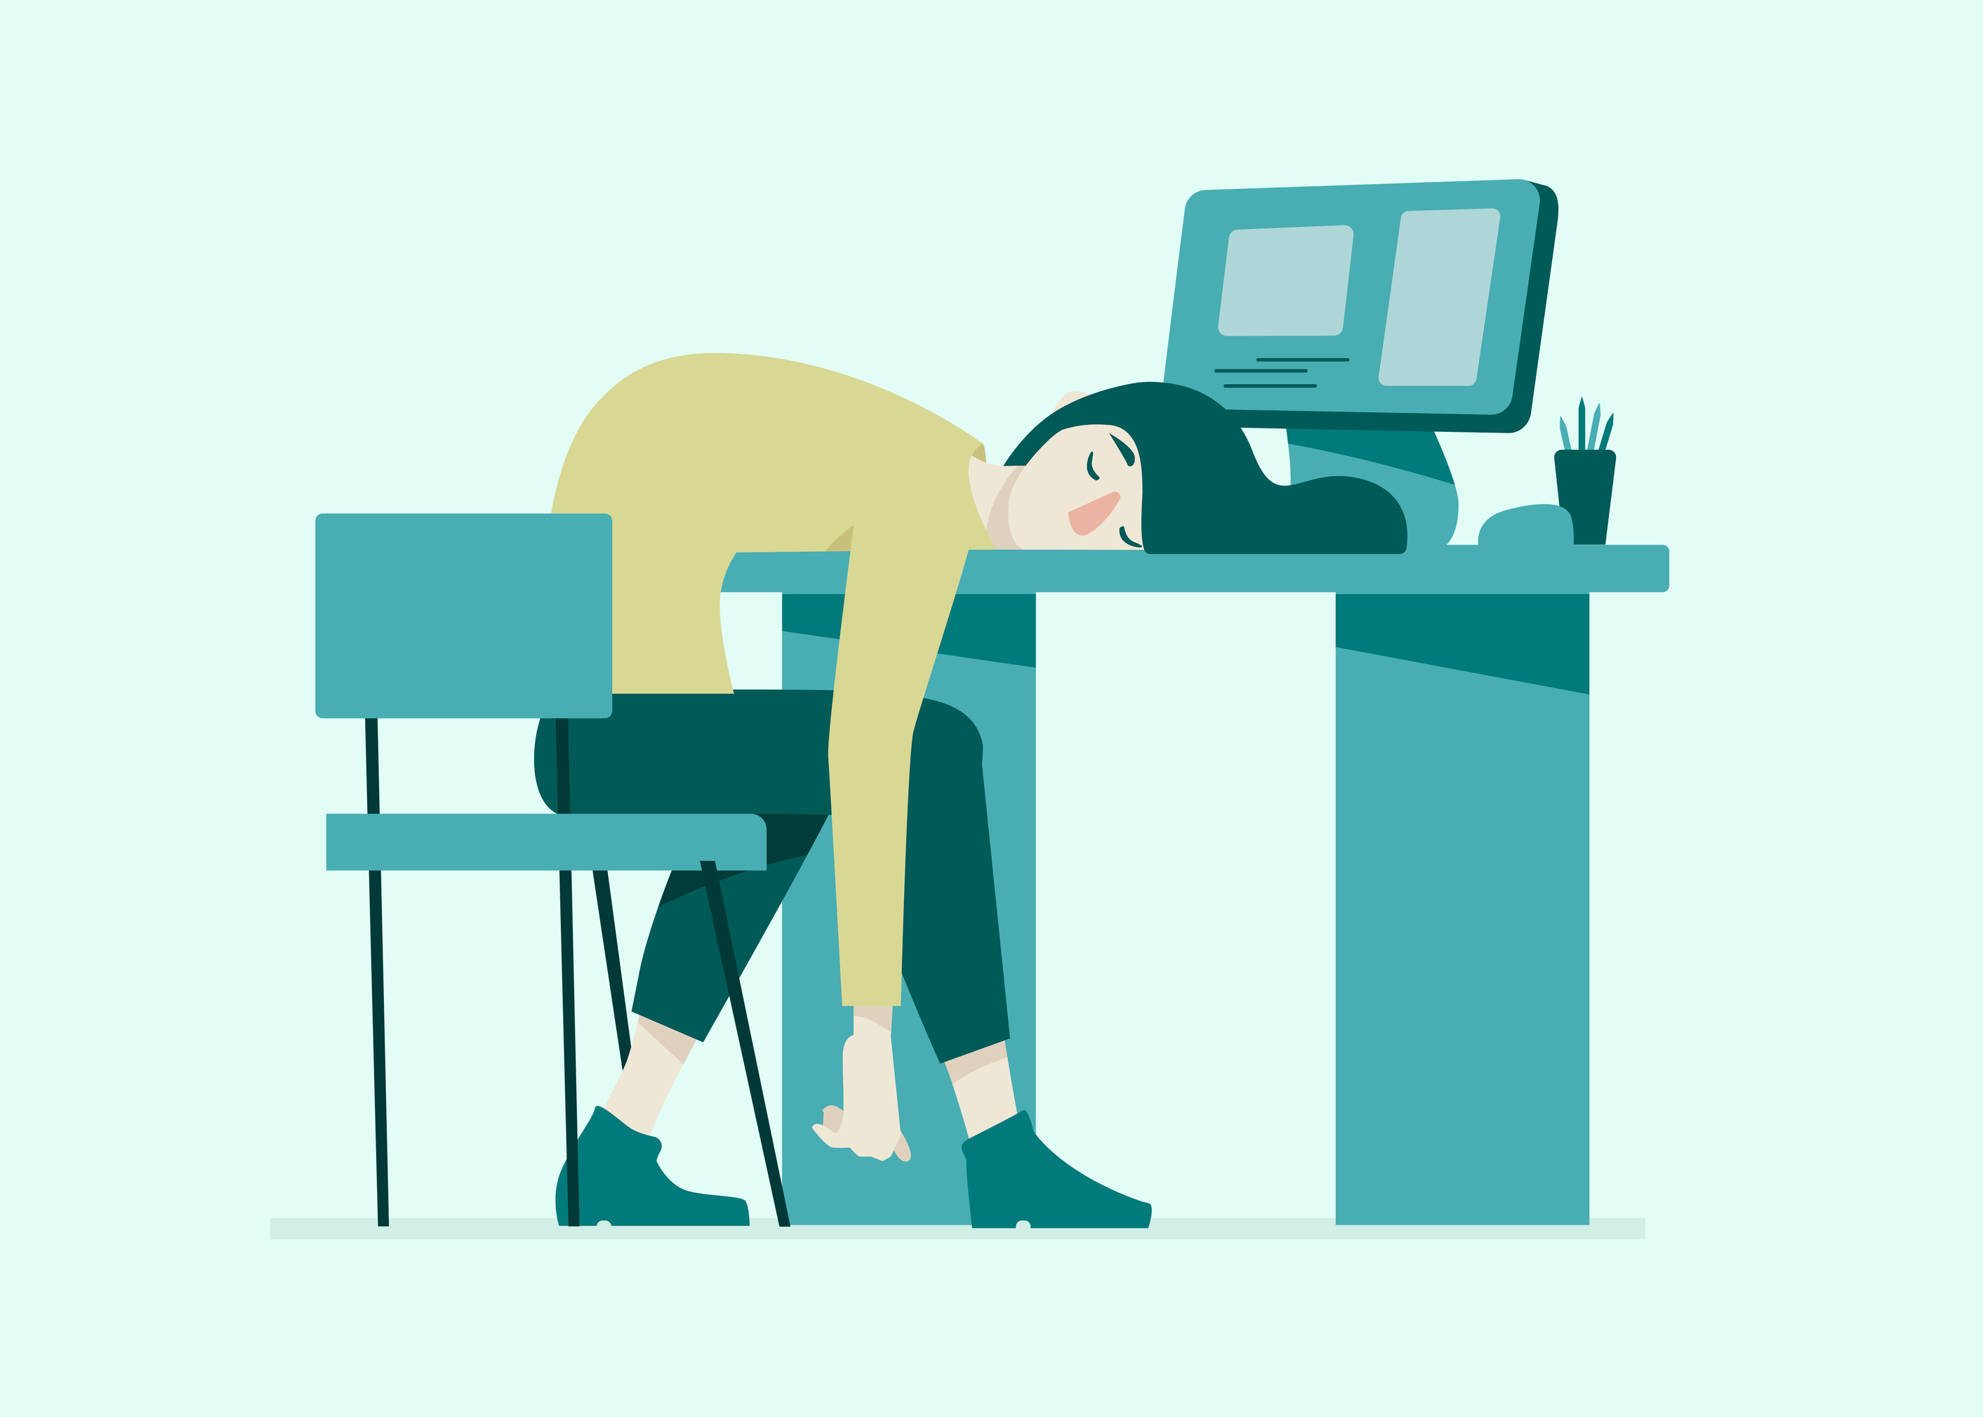
College Culture: The Shift
Notes:
Freedom = Responsibility
You might only have a few classes a day—or none on some days—which feels like free time, but isn’t.
You’re expected to use that time for reading, studying, group work, or office hours.
Long-Term Planning Matters More
Assignments and exams are often spaced far apart, which leads many students to procrastinate.
Without planning, deadlines pile up quickly and become overwhelming.
Varied Priorities
Balancing academics with jobs, clubs, sports, social life, and possibly living alone for the first time.
You have to decide what to prioritize every day—no one does it for you.
Different Sleep Schedules
In high school, sleep and wake times are fairly consistent.
In college, you might have an 8 AM class one day and a noon class the next—this leads to irregular sleep patterns if you’re not careful.

Slide 7
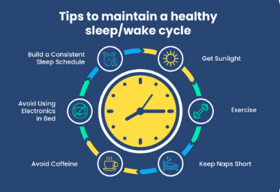
Sleep
Notes:
Why does this matters? ​
Circadian Rhythms (sleep quality, digestion, hormone secretion, cognitive performance)​
Disrupting these rhythms (pulling all-nighters, erratic light exposure, caffeine at the wrong time)​
Decreased recovery from exercise​
Fatigue despite sleeping "enough"​
Poor muscle and memory retention​
What to do?​
Anchor your day: Expose yourself to natural light within 1 hour of waking. This stabilizes your body clock more than caffeine does.​
Protect your night: Use blue light filters after 8 PM. Avoid screens in bed, which suppress melatonin even if you “feel tired.”

Slide 8



Food
Not just energy, it informs your biology
Notes:
When and What you Eat Affects:
Attention span in class
Workout effectiveness
Sleep depth
Overlooked Truths:
Skipping breakfast and eating late disrupts blood sugar rhythms, which can impair memory consolidation.
High-carb lunches lead to post-meal brain fog—bad news before an exam or presentation.
College students often under-consume protein, which is vital for neurotransmitters (mood) and muscle repair.
What to do?
Front-load protein: 20–30g at breakfast increases alertness and reduces cravings later in the day.
Buffer caffeine: Wait 60–90 minutes after waking to drink coffee—this prevents the caffeine crash and supports natural cortisol regulation.
Smart snacking: During late-night study sessions, opt for protein or fat-based snacks (nuts, eggs, Greek yogurt) to avoid insulin spikes that ruin sleep.

Slide 9



Movement
Not just a Fitness tool
Notes:
You don't need to go to the gym to "work out"​
Movement is essential for:​
Brain-derived neurotrophic factor (BDNF), which enhances memory and learning.​
Blood circulation to the brain (supports problem-solving and focus).​
Regulating dopamine and serotonin levels (boosts motivation and mood).​
​
What to do?​
Walk briskly before or after lectures to “lock in” what you learned.​
Use short bodyweight circuits (5–10 mins) in your dorm between study sessions to reset focus.​
Dance, climb, play—non-repetitive movement improves motor learning and creativity.

Slide 10

Longevity in College: Building Resilient Systems
Biological Resilience= Recovery Capacity + Adaptation
Instead of chasing aesthetics or short-term goals, ask:
  How adaptable is my body to stress?
  How quickly can I recover from a light night, intense class load, or illness?
  What to do?
  Cold rinse (30 seconds) in your morning shower to train stress tolerance
  Deep nasal breathing before an exam or workout to shift into a calm focus
  10 minutes of nature exposure a day to reduce systemic inflammation

Slide 11

Reflection Exercise:
Wellness Mission Statement
Fall 2025
In 3–5 sentences, describe how you want to feel physically and what habits will help you get there. Focus on rhythm, recovery, nourishment, and self-regulation—not just exercise.

Slide 12

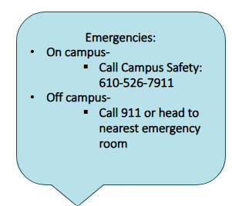
Health and Wellness Center Hours
General Health
Counseling
Tuesday & Thursday: 9am-7pm​
Monday, Wednesday, & Friday: 9am-5pm​
After hours (non-emergency):​
610-517-4921 to speak with nurse on-call.
General hours: ​
Monday- Friday: 9-5​
Triage/ Drop in Hours: ​
Monday-Friday: 10-12 and 2-4​
After hours: ​
Use TELUS (App or 1-866-743-7732) ​
Or Protocall (610-526-7778)

Slide 13

Bryn Mawr’s Wellness program
Located on the 2nd floor of
The Well (Room 251)
Open Monday-Friday
1pm-4pm
Come relax, ask questions about health and wellness, do some crafting, get wellness supplies, or just take a nap!
Staffed by both professional staff members and peer educators.
Contact Director Cristen Kennedy (ckennedy2@brynmawr.edu) for more information!

Slide 14


Mental Health resources

Slide 15
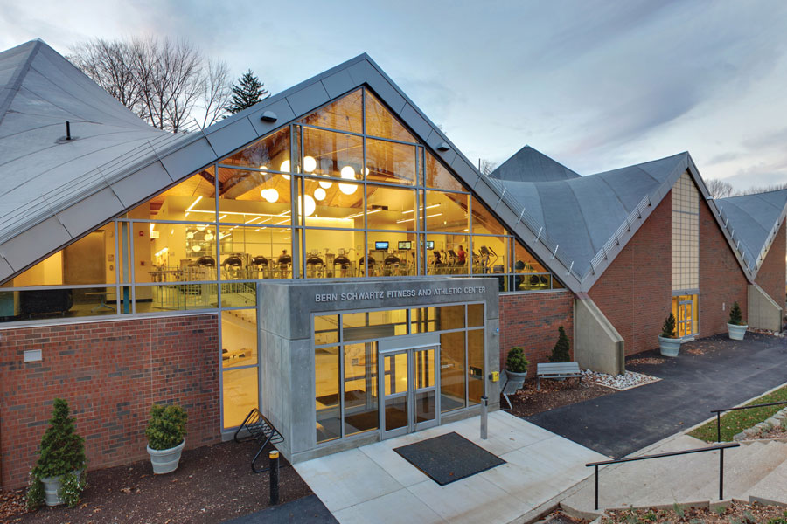
Bern Schwartz Fitness and Athletic Center
Fitness Center Hours:
  9AM-10PM (Monday-Thursday)
  9AM-8PM (Friday)
  9AM-6PM (Saturday/Sunday)
Fitness Classes:
  Yoga
  Indoor Cycling
  Strength and Movement
  Pilates

Slide 16

Scenarios
Break into groups of 3 or 4
Discuss the scenarios with the College resources in mind.

Slide 17

Scenario #1
A friend of yours has been missing class, missing meals, and rarely comes out of their room. You are very concerned about them, but you’re not sure exactly what to do or who to talk to. You are looking for some help deciding what to do next…

Slide 18

Scenario 1: Recommended resources
​Resources:
Assistant Director of the First Year Experience-Andrew Wilbraham​
Graduate Assistant of the First Year Experience-Maggie Hernan
Customs Person/Hall Advisor​
Health and Wellness Center (includes counseling center) ​
Professor​
Dietician
Class Dean

Slide 19

Scenario #2
For the past two weeks you’ve been feeling low. You find yourself isolating from others. You are having difficulty sleeping: some nights you get too much sleep, other nights you can’t relax and stay up most of the night. You no longer feel like doing things you used to enjoy. It’s 12 am on a Saturday night and you would like some help. What do you?​

Slide 20

Scenario 2: Recommended resources
After Hours Mental Health Support
Telus 24/7 Line: 1-844-451-9700.​
Protocall 24/7 Line: 610-526-7778 (will notify and send notes to Counseling Center)
Dorm Leadership Team:​
Customs Person​
Hall Advisor​
Peer Mentor (class skipping)
Working Hours Mental Health Support:​
Counseling Center Triage Hours: 10am-12pm and 2pm-4pm Monday-Friday

Slide 21

Scenario #3
You or a friend have stopped having menstrual periods and are concerned about this. You’ve heard stress and being in a new environment can cause a skip in periods, but you’re also worry you might have something called Polycystic Ovary Syndrome that you googled. It’s 3 o’clock on a Tuesday.

Slide 22

Scenario 3: Recommended resources
For Health Information and Care:​
Health and Wellness Center (includes counseling center)​
​
Exploring potential sources of/ ways to reduce stress from transition: ​
Academic Support Services​
Assistant Director of the First Year Experience​
Graduate Assistant of the First Year Experience

Slide 23

Homework: Show and tell
For next class students are encouraged to bring in an item that is a symbol or artifact of their personal leisure lifestyle. This could be something related to a sport, hobby, interest, or activity they participate in.

Slide 24

Announcements
Campus Philly's College Fest
Saturday, September 20th-Sunday, September 21st
Your CP will be taking your Customs Group ​on Saturday the 20th
Block Party is the 20th from 10AM-3PM (you do not need to stay the entire time)
CPs will communicate where to meet to go into the city and when they are leaving to come back (you do not need to come back when they do)
Things to do Before the Event​
  If you are unable to go on the 20th you can also go on the 21st (make sure to send you CP proof of your attendance).
  You must register for the event: https://campusphilly.org/collegefest-2025/​
  Pick up and register your SEPTA Card ​
If you're unable to attend either day, please email Andrew Wilbraham awilbraham@brynmawr.edu for an alternate assignment

Slide 25

NEXT WEEK:
Physical wellness pt. 2

Slide 26

Next weeK:
Thinking Beyond Grades: Intellectual Wellness as self development

