Slide 1



Thinking beyond grades: intellectual wellness as self development
WEEK 3

Slide 2

Agenda
Warm Up: Show and Tell
Defining intellectual wellness
The hidden obstacles
Intellectual wellness practices
Intellectual wellness tools
Activity
Time management/Study Tips/Effective communication
Campus resources

Slide 3

Show and tell

Slide 4

Defining intellectual wellness
The Intellectual Wellness Dimension involves many things that keep our brains active and our intellect expanding. In a broad sense, this dimension can involve looking at different perspectives of an issue and taking them into consideration. Through a number of activities—from learning about current events to organizing game nights in your home or community center—you can broaden your perspective and understand diverse points of view.

Slide 5
What is intellectual wellness?
Common (and Limited) Definition:​
"Being mentally stimulated"​
"Going to class, studying, staying informed"​
Deeper Definition:​
Intellectual wellness is the ability and freedom to explore, evaluate, and expand your thinking — including:​
Valuing questions over answers​
Engaging with complexity and contradiction​
Developing an intellectual identity independent of grades or external validation​
Learning how you learn (metacognition)

Slide 6
Activity
Map out the five strongest influences on your worldview (e.g., culture, books, parents, religion, experiences).​
Then ask: What kinds of ideas do I tend to reject too quickly? What do I overtrust without thinking?

Slide 7

Hidden obstacles
College can inhibit intellectual wellness when students experience:​
Knowledge as Performance​
Learning becomes about “sounding smart” or “getting it right.”​
Result: Impostor syndrome, perfectionism, intellectual anxiety.​
External Validation Loops​
GPA, rankings, awards can distract from curiosity.​
Students stop reading, asking questions, or debating unless it’s graded.​
Overidentification with Beliefs​
Students can feel unsafe evolving their views because of fear of “betraying” a group, culture, or previous self.​
True intellectual wellness requires psychological flexibility — the ability to change your mind.

Slide 8
Deep Practices that support intellectual wellness
1. Intellectual Humility​
“I don’t know” is not a weakness — it’s the beginning of wisdom.​
Practice: Before arguing a point, ask yourself: “What could I be wrong about?”​ ​
2. Intellectual Identity Mapping​
You’re not just a major. You’re a whole thinker shaped by your life, values, and context.​

Slide 9
Deep Practices continued
3. Productive Discomfort​
Learning should sometimes feel like stretching a sore muscle — growth isn't always pleasant.​
When you feel bored, confused, or challenged, it can often be assumed as failing. In fact, it may be exactly where growth begins.​
Practice: Learn to sit with cognitive dissonance — the tension between conflicting ideas — without needing immediate resolution.​ ​
4. Cognitive Sustainability​
Intellectual burnout is real. Cramming, overworking, and fear-based learning breaks down your capacity to stay engaged.​
Red flags: Reading but not absorbing, constant multitasking, working while exhausted, thinking only in bullet points.​
Harm reduction:​
Take “conceptual breaks”: reflect, doodle, voice record instead of just reading more.​
Revisit why you’re learning something — connect ideas to values, not outcomes.

Slide 10

Three level questioning framework
Tools for Deepening Intellectual Wellness
Level​ | Question Type​ | Example​
Surface​ | What is this saying?​ | What’s the thesis of this article?​
Interpretive​ | What does it mean?​ | Why does the author frame it this way?​
Reflective​ | Why does it matter to me?​ | How does this idea challenge or support my lived experience?​

Slide 11

The curiosity Audit
Consider for yourself:​
What kinds of questions energize me?​
When did I last feel genuinely curious in class or life?​
What curiosity have I been suppressing because it seems impractical or “off-track”?​ ​
Reading for Depth, Not Completion​
Teach: “Reading all of it” isn’t always learning. Instead:​
Pre-read for structure and argument​
Identify 1 idea that surprises or bothers you​
Dialogue with the text: write a note, ask a question, critique the framing

Slide 12
Multiple Intelligences theory
Developed by Howard Gardner, the theory proposes that intelligence is not a single general ability, but a combination of distinct intelligences
“We all have all eight intelligences, but in different proportions”-Howard Gardner
The 8 types of intelligences
Linguistic-Word smart (writers, speakers)
Logical/mathematical-number/reasoning smart (scientists)
Spatial-picture smart (artists, architects)
Bodily/kinesthetic-body smart (athletes, dancers)
Musical-music smart (musicians, composers)
Interpersonal-people smart (teachers, leaders)
Intrapersonal-self smart (philosophers, psychologists)
Naturalistic-nature smart (biologists, farmers)

Slide 13
How to apply multiple intelligences
Intelligence | College Application Example
Linguistic | Take notes creatively, join debate or writing clubs
Logical-Mathematical | Use data-driven study techniques, excel in STEM subjects
Spatial | Use mind maps, visualize concepts, study with diagrams
Bodily-Kinesthetic | Learn by doing – labs, hands-on projects, movement breaks
Musical | Study with music, write songs to memorize content
Interpersonal | Form study groups, get involved in clubs or student gov
Intrapersonal | Set personal goals, reflect in a journal
Naturalistic | Study outdoors, connect learning to real-world systems

Slide 14


How do you practice time management?

Slide 15

How do you study? Any tips and Tricks that work for you?

Slide 16

How do you effectively communicate with professors?

Slide 17
Effective Communication
Schedule Appointments: visit during office hours or schedule an appointment
Prepare in Advance: bring any relevant materials or questions
Communicate Clearly and Professionally
Email Etiquette: use a clear and concise subject line, start with a formal greeting, and be polite and professional
Be Specific: Clearly state the purpose of your email or meeting request, and provide necessary details or attachments
Be Mindful of Timing
Respect their time: avoid contacting professors outside of reasonable hours or on weekends unless its urgent
Follow Up Respectfully: if you haven’t received a response in a reasonable time; follow up politely
Use Hours Effectively

Slide 18
Effective Communication Example: Email
Email to Professor:​
Subject: Clarification on Assignment Deadline​
Greeting: Dear Professor (Last Name), ​
Message: I hope this message finds you well, I am writing to clarify the deadline for the upcoming (insert assignment). The syllabus states it is due on (insert date), but I wanted to confirm if this is the final deadline or if there are any changes.​
Thank you for your assistance.​
Best Regards, ​
(Your Full Name)​
(Your Course Name/Number)

Slide 19

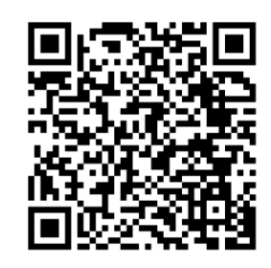
Campus resources
Notes:
Academic Support: Weekly Study Hours – Tuesdays/Thursdays 6-8p Dalton 2
Roadmap to Academic Success workshops
Thurs 9/25 - 4-5p
Sticky Skills Tabling – Saturday 3-4p in Main Lounge

Slide 20

Announcements
Campus Philly's College Fest is this Weekend
Saturday, September 20th-Sunday, September 21st
Your CP will be taking your Customs Group ​on Saturday the 20th
Block Party is the 20th from 10AM-3PM (you do not need to stay the entire time)
CPs will communicate where to meet to go into the city and when they are leaving to come back (you do not need to come back when they do)
Things to do Before the Event​
If you are unable to go on the 20th you can also go on the 21st (make sure to send you CP proof of your attendance).
You must register for the event: https://campusphilly.org/collegefest-2025/​
Pick up and register your SEPTA Card ​
If you're unable to attend either day, please email Andrew Wilbraham awilbraham@brynmawr.edu for an alternate assignment
Notes:
Make sure your SEPTA card works!! If got it this past week, it may not be active until 10/1

Slide 21
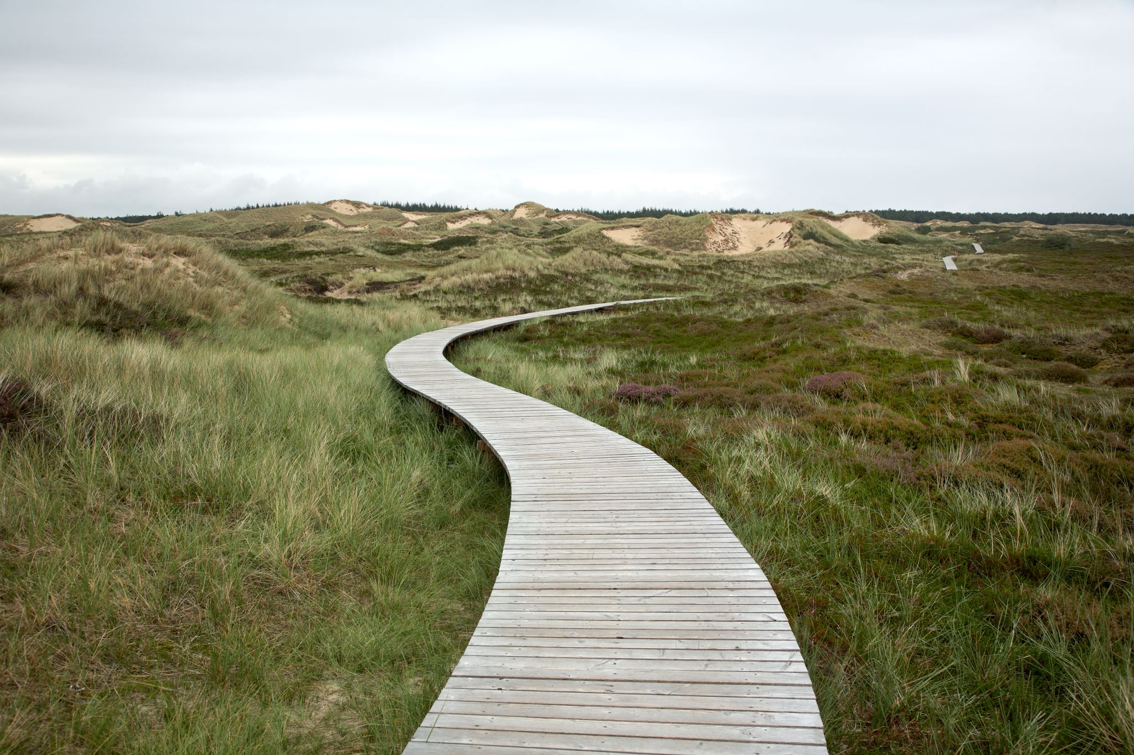
NEXT WEEK: Physical wellness pt. 2

