Slide 1

Physical Wellness Part 2: Harm Reduction
THRIVE Week 4
This Photo by Unknown author is licensed under CC BY-SA-NC.

Slide 2
Agenda
Warm Up: Rose, Thorn and Bud
Defining Harm Reduction/Principles/Model
Harm Reduction: Sex, Alcohol, & Drugs
Harm Reduction in other areas
Reframing Harm Reduction
Activity: Personal Wellness Harm Reduction Plan
Campus Resources
Harm Reduction Jenga

Slide 3
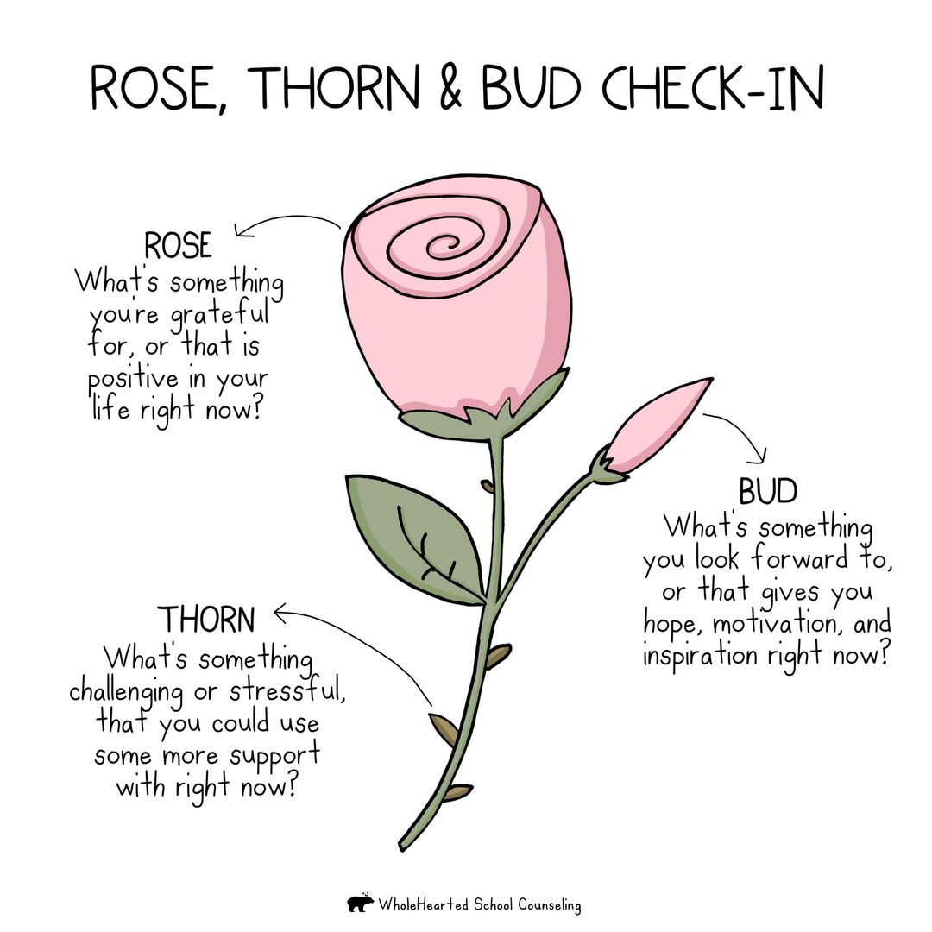
Warm UP

Slide 4
What is Harm Reduction?
Harm reduction is a pragmatic public health approach to practices, programs, and policies that aim to reduce the adverse health, social, and economic consequences of substance use without requiring individuals to abstain from substance use (CNA, 2011; Rassool, 2010).

Slide 5
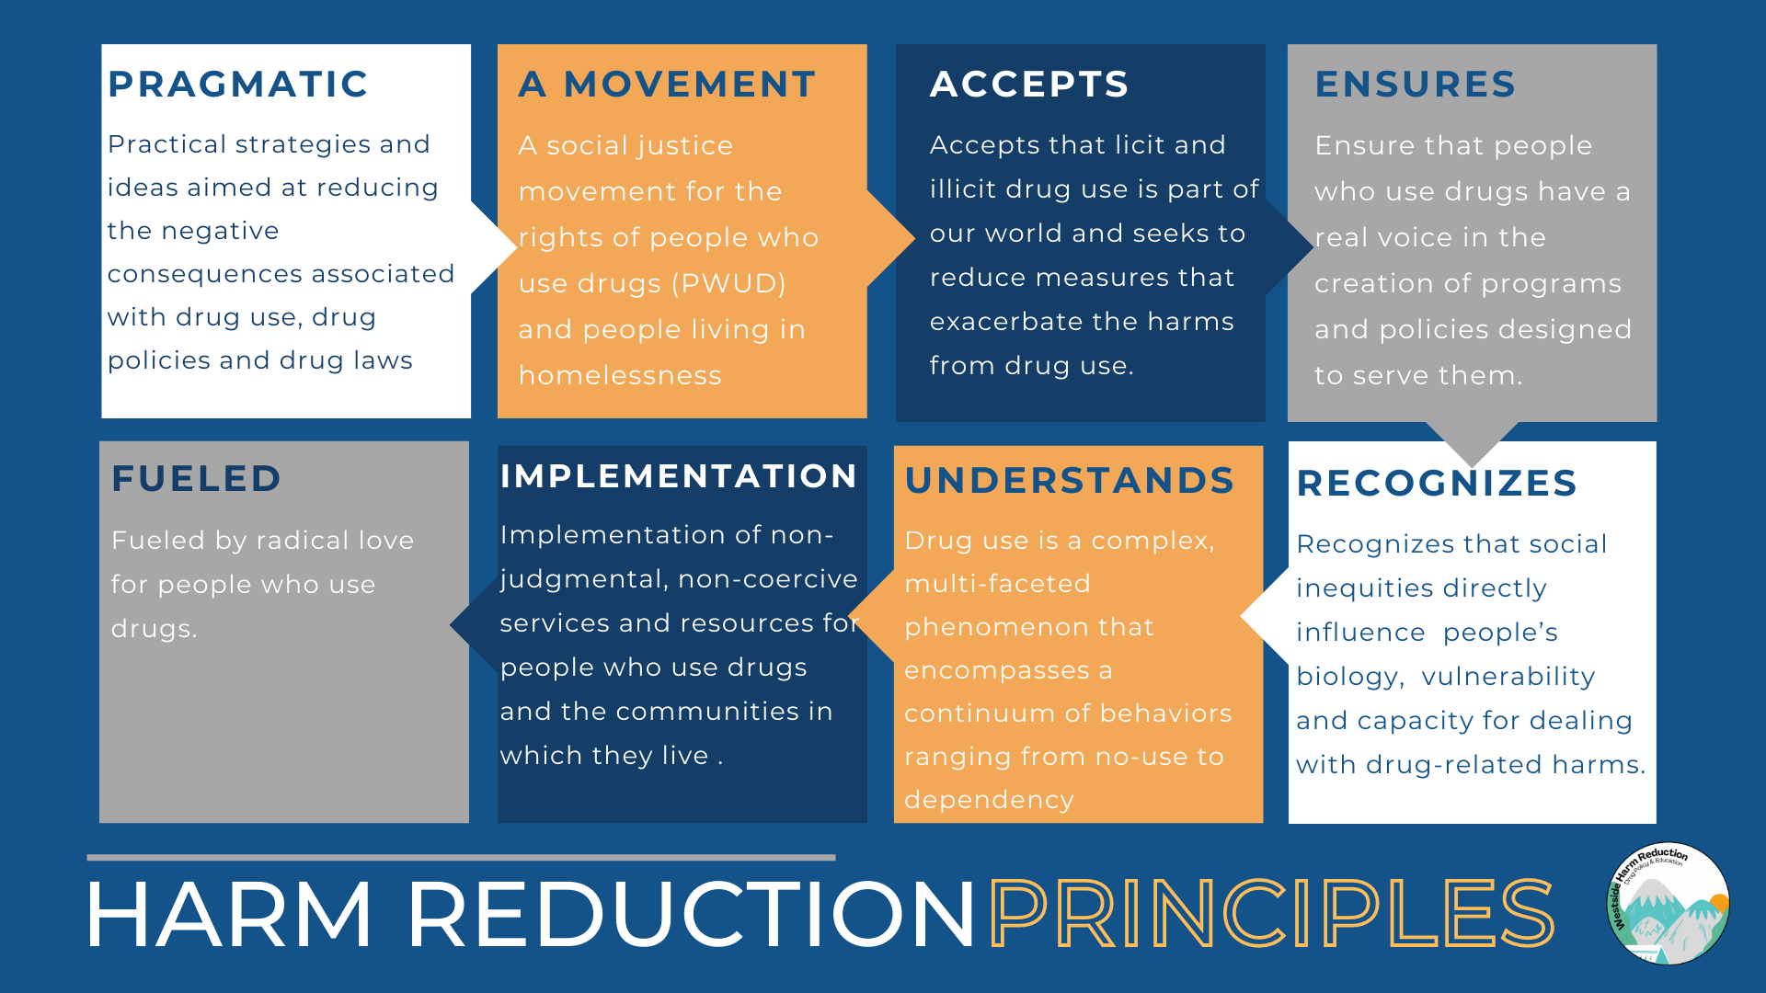
Harm reduction principles

Slide 6
Why This Model?
The aim of a harm reduction approach is to reduce the negative consequences of risky behaviors, including the harmful effects of substance use (CNA, 2011; Rassool, 2010). As such, a harm reduction response recognizes that substance use is a complex phenomenon that encompasses a continuum of behaviors, ensures a non-judgmental provision of care, and advocates for equal access to resources and services for care, regardless of drug use or engagement in other at-risk practices (CNA, 2011).
It also focuses on promoting harm reduction within the communities that clients live in and in the areas and conditions where substances are used, rather than in contexts that are removed from these settings (Rassool, 2010).
The dangers associated with substance use are not minimized in a harm reduction approach, which also recognizes the realities of poverty, racism, social isolation, past trauma, and other social inequalities that affect a person’s vulnerability and capacity to deal effectively with substance-related harm (Rassool, 2010).
According to RNAO’s (2015) Engaging Clients Who Use Substances, harm reduction: ​
Is an alternative to the disease causation model of substance use. ​
Accepts that at any given time some people are not ready to choose abstinence. ​
Accepts that substance use occurs in society and works to minimize its harmful effects.​
Accepts that people who are substance-dependent should have a voice in the creation of programs and policies designed to serve them.​
Values patient autonomy. ​
Does not exclude abstinence as an option (Beirness, Jesseman, Notarandrea, & Perron, 2008; CNA, 2011). ​
Notes:
https://mharesource.rnao.ca/section-five/harm-reduction-teaching-activities-and-resources

Slide 7
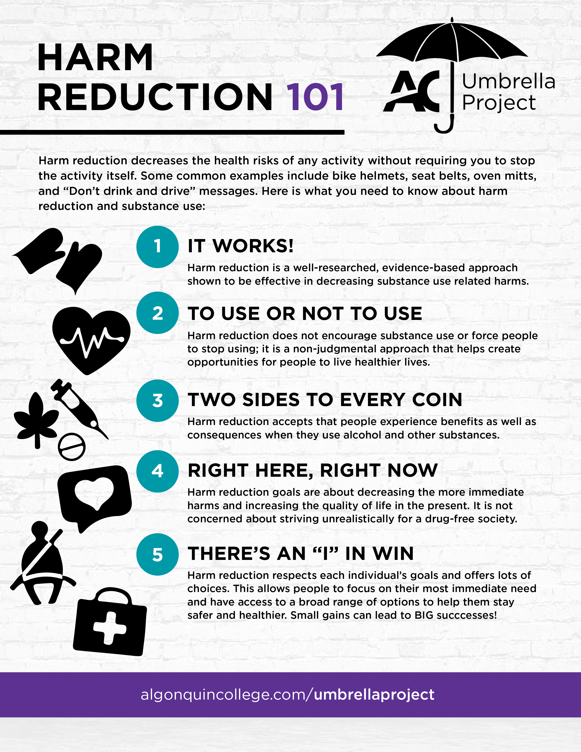
Harm reduction 101
Notes:
Talk about bystander intervention! Community effort, even if you've chosen not to partake

Slide 8
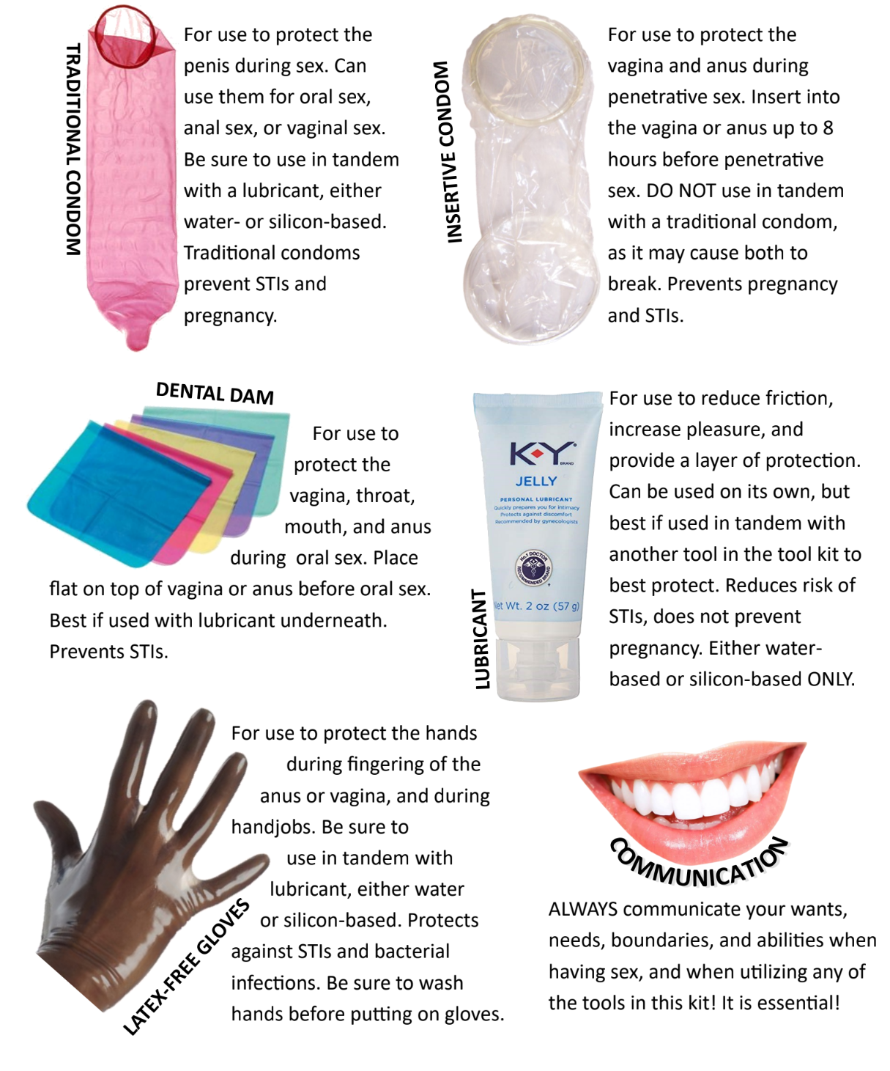
Harm Reduction and Sex
Tools for Safer Sex
(or toys)
Sex is inherently risky—-the only 100% way to avoid an unwanted pregnancy or a sexually transmitted infection is abstinence--but if you are going to have sex, there are ways to reduce risks:
Use barrier methods and/ or birth control
Get tested for STIS regularly/ after contact with new partners
Use emergency contraception (Plan B) as needed
PrEP & PEP (Pre and Post-exposure HIV Prevention)
Discuss STI status and boundaries with your partner(s)
(https://www.workithealth.com/blog/safer-sex-is-harm-reduction/)

Slide 9
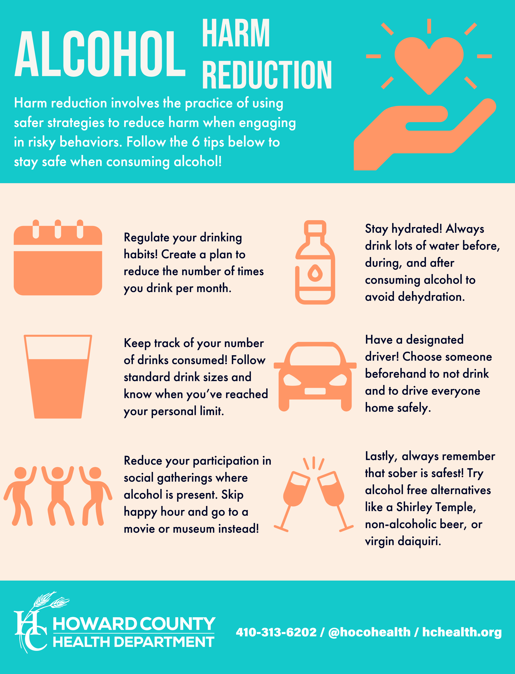
Harm Reduction and Alcohol

Slide 10
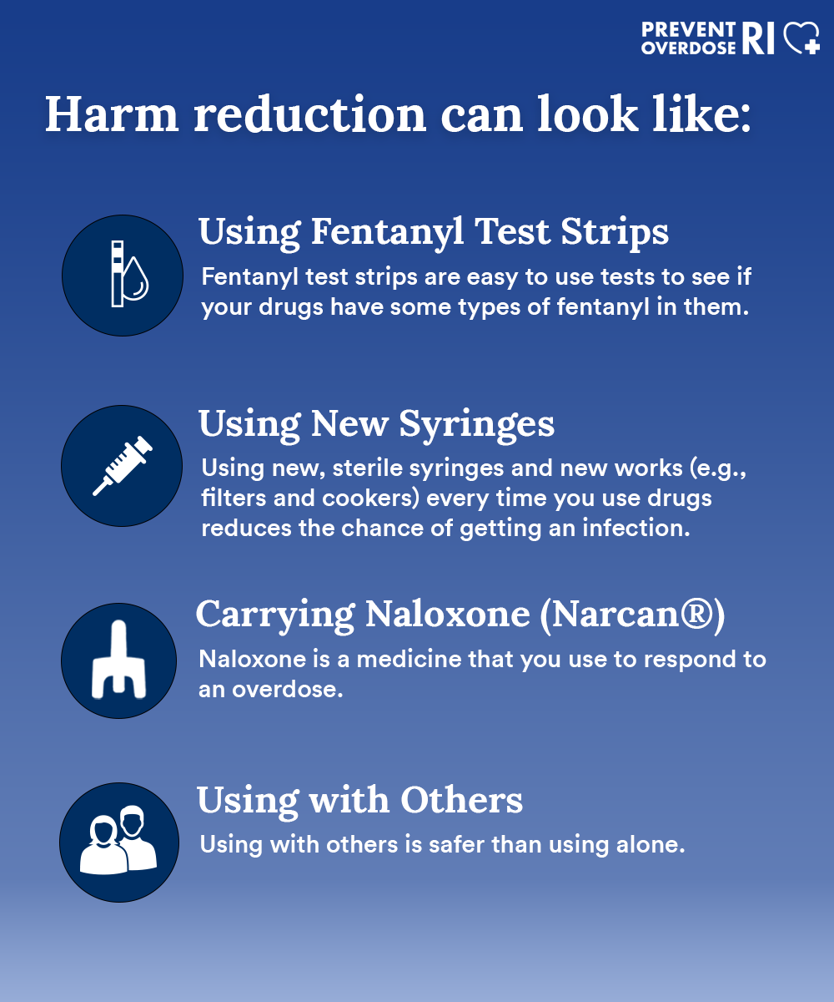
Harm Reduction and Drugs

Slide 11
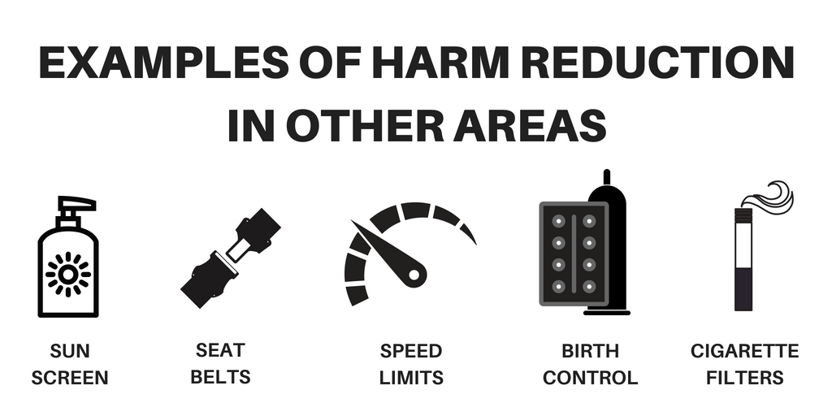
Examples of harm reduction in other areas

Slide 12
Reframing Harm Reduction
Misconception:
“Using condoms, not sharing needles, don’t binge drink.”
What It ACTUALLY Can Be:
A compassionate, judgment-free practice of reducing the negative consequences of behaviors that may not be ideal — because perfection is not always possible.
A way to balance reality with intention, especially under stress, trauma, or pressure.
Key Principle: Harm reduction doesn't mean “do whatever you want” — it means “be honest about what you need and protect yourself while doing it.”

Slide 13
Reflection:
“Where in your life are you pushing yourself in ways that quietly harm your mental, physical, or emotional health — but feel ‘normal’ in college?”

Slide 14
Harm Reduction as a Wellness Lens
Behavior | Normalized Message | Actual Hidden Harm
Skipping meals when busy | “I’m just too busy to eat” | Metabolic deregulation, anxiety spikes, fatigue
Saying yes to every opportunity | “I don’t want to miss out” | Burnout, resentment, disconnection
Sleeping 3–4 hours before tests | “I’m grinding for success” | Memory impairment, cortisol dysregulation
Taking on emotional labor for others | “I’m just a good friend” | Compassion fatigue, identity loss
Self-shaming when struggling | “I should be doing better” | Internalized harm, reduced help-seeking

Slide 15
Wellness Harm Reduction Framework
Instead of an “all-or-nothing” model (“healthy” vs. “unhealthy”) there is the behavior spectrum
Example: Sleep
Total Avoidance | Harm Reduction | Ideal Behavior
Pulling all-nighters constantly | Setting a 4-hour minimum + 20-minute nap buffer | 7–8 hours of nightly sleep with routine

Slide 16
Exercise:
Pick one wellness domain (sleep, food, movement, emotion, social life). Plot your current behavior on a behavior spectrum.
What’s my bare minimum for feeling functional?
How can I make low-capacity days less harmful, even if not ideal?

Slide 17
Harm Reduction as Pattern Disruption
Some harm is not a one-time choice — it's a repeated pattern based on:
Emotional avoidance
Overcompensation
People-pleasing
Perfectionism
Reflection: What coping pattern do I fall into when I feel stressed or not enough? What would a harm-reduced version of that behavior look like?
Example:
Pattern: Ghosting everyone when overwhelmed
Harm-reduced version: One auto-text to close friends: “I’m off the radar this week, but I’m okay.”

Slide 18
Micro Harm Reduction: The 2 Minute Rule
Harm reduction isn’t always a big plan — it’s a micro-decision in the moment.
Strategy: Ask yourself: “If I can’t do everything right, what’s the 2-minute version that reduces the most harm?”
Examples:
Can’t work out? Stretch for 2 minutes.
Can’t write the paper? Open the doc and write one sentence.
Can’t cook? Eat a handful of protein and drink water.
Can’t text back? Heart the message to signal presence.

Slide 19
Connecting Harm Reduction to Self-Worth
Unspoken Truth: Many self-sabotage not because they’re reckless — but because they feel like they don’t deserve rest, boundaries, or compassion.
This is internalized harm culture — a cycle where:
You push through pain → feel proud → crash → feel shame → repeat
Harm reduction interrupts that cycle by replacing:
Shame with curiosity
Perfectionism with sustainability
Punishment with protection

Slide 20
Activity: Create a Personal Wellness Harm Reduction Plan
Students choose 1 area they struggle to maintain wellness in, then complete:
A. What do I tend to do when I’m stressed or overwhelmed in this area? (Examples: skip class, stop eating, overwork, isolate, rage-text)
B. What deeper need is this behavior meeting (control, relief, connection)?
C. What is the minimum safety net version of wellness I can use instead? (Examples: drink water before caffeine, one paragraph instead of a full draft, ask for an extension instead of disappearing)
D. What resources or people help me regulate or return to myself?

Slide 21
Campus Resource Spotlight: Recovery Support Group
A confidential support group for any and all students grappling with substance use and abuse.
Facilitated by Rabbi Nora Woods
The goal is to provide a safe and supportive environment to talk about substance use and recovery

Slide 22
Campus Resource Spotlight: The Well
Wellness Program
Location: 2nd floor of The Well (between Health and Counseling)
Cristen Kennedy-Wellness Program Director
Ckennedy2@brynmawr.edu
Erika D'Andrea-Wellness Program Coordinator
Edandrea@brynmawr.edu
For students struggling with substance abuse/alcohol dependency who want to be in a peer support group they can email Rabbi Nora at nwoods@brynmawr.edu
Hosting Narcan training
Narcan trainings are available by request and scheduled directly with Cristen
Must be trained to carry Narcan (available after the training or if already certified can be found in the Well)
October-Substance Use Awareness Month

Slide 23
Campus Resource Spotlight: Campus Safety
First contact and first responder for all campus emergencies
Number: 610-526-7911
When Calling About Any Emergency
Give your name
Give your number
Give the building name and room number or other specific location
Describe the condition clearly and accurately
Don't hang up! You may be an important link in an emergency. Other information may be needed, and special instructions may be provided
Why call Campus Safety First?
It will provide faster fire, ambulance, and police response
Outside responders will not know the names, locations, or fastest routes to buildings
Immediate assistance, call outside emergency responders for you, and direct them to the scene

Slide 24
Campus Resource Spotlight: Student EMS
BMCEMS is a student-led and student-staffed volunteer organization dedicated to providing Bryn Mawr with the highest quality medical care (Hours are 10PM-3AM on Fridays)
If interested in joining BMCEMS contact Campus Safety directly
Provides immediate medical assessments and life-saving interventions if necessary and determines the need for further treatment-whether it be a visit to the Health and Wellness center the next day, a ride to the ER with Campus Safety, or an ambulance transport
All members are EMT certified and receive extensive training at Narberth Ambulance, the local 9ll ambulance corps. BMCEMS works under campus safety and a Campus Safety officer is always on scene with BMCEMS
A medically related call that comes into Campus Safety will dispatch BMCEMS with an officer when BMCEMS is in service

Slide 25
Campus Resource Spotlight: Party Policy
Bryn Mawr College is committed to maintaining a social atmosphere that emphasized the safety of all students, whether they choose to drink. Moderation, concern for others, and individual accountability should be characteristic of all activities on campus
Party Training
Levels-1, 2, and 3
Staffing-Host, Server, Bouncer (no more than 2 shifts are permitted/4 hours total)
Limits-21 years or older
Guests-must be members of the Tri-Co or guests of a Tri-Co community member
Party Fund-nonalcoholic beverages and food
Any questions or if you would like to participate in a Party Training contact studentengagement@brynmawr.edu
Expect Dates Soon!

Slide 26

Let's Play a Game
Get into teams of 3-4 (different than your group project group)
You will take turns sending someone up to remove a Jenga Piece and answer a question based on the color tape of the piece ( 1 point for getting a piece and 1 point for answering the question right)
Red: Alcohol
Green: Drugs
Yellow: Miscellaneous
Orange: Safe Sex
No Sticker: Name an example of harm reduction in your life right now
ink: Alcohol
Green: Drugs
Yellow: Miscellaneous
Blue: Safe Sex
This Photo by Unknown author is licensed under CC BY.
Notes:
If there is no sticker on the Jenga piece
Ask them to name harm reduction things that they have learned/is in their life

Slide 27
Reminder: Philly Project Topics Due Next Week!!

Slide 28
Next Week: Cultivating Meaningful and Resilient Human Connections

