Slide 1

Cultivating meaningful and resilient human connections
THRIVE Week 5

Slide 2
Agenda
Warm Up: Philly Project Updates
Pair and Share
Defining Social Wellness
The Psychology Behind Social Wellness
Letting Go to Grow
Hidden Dynamics
Intentional Practices for Social Wellness
Activity: Core Five Relationship Model
Healthy vs Unhealthy Relationships
Resources

Slide 3
Warm Up: PHILLY Project updateS
Notes:
One word go around for how you are feeling in this moment

Slide 4

Philly Project Guidelines
Must be on a topic related to Philly (sports teams, history, famous people, food, etc).
Presentation must be no longer than 10 minutes, no shorter than 5 minutes
Examples of presentations: PowerPoint, Prezi, video, interpretive dance, skit, puppet show, movie, multimedia art project, music video, song, poem, art, photography
Any questions please contact fye@brynmawr.edu or Andrew Wilbraham at awilbraham@brynmawr.edu
Notes:
At least 5 minutes, no longer than 10 minutes

Slide 5

Sensitive Topic
Today, we are going to take a look at the characteristics of healthy, unhealthy, and abusive relationships. Part of this will be a discussion in a pair and share format. This can be a difficult topic to address, especially for those in the room who might have been directly impacted by relationship violence. As we engage with the topic today, please be respectful in your dialogue and interactions with each other. If you feel that you need to take a break to give yourself some space from the content, please feel free to do so.

Slide 6
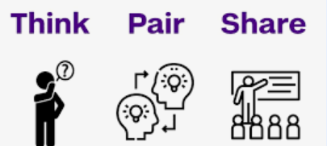
How would you define social wellness -without using the words friends or networking?

Slide 7
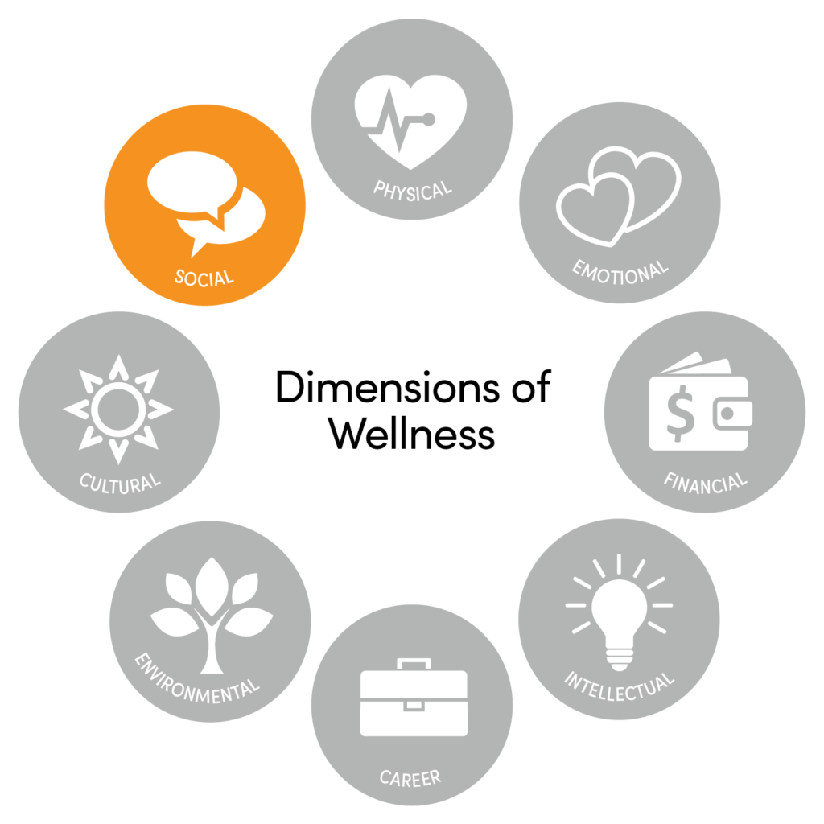
Defining Social Wellness
The Social Wellness Dimension involves having healthy relationships with friends, family, and the community, and having an interest in and concern for the needs of others and humankind.

Slide 8

Social Wellness: A Deeper Meaning
Social wellness is not the quantity of your social interactions, but the alignment between your social needs and your relationships, marked by:
Mutual support
Healthy boundaries
Psychological safety
Emotional authenticity
Resilience during conflict or isolation

Slide 9
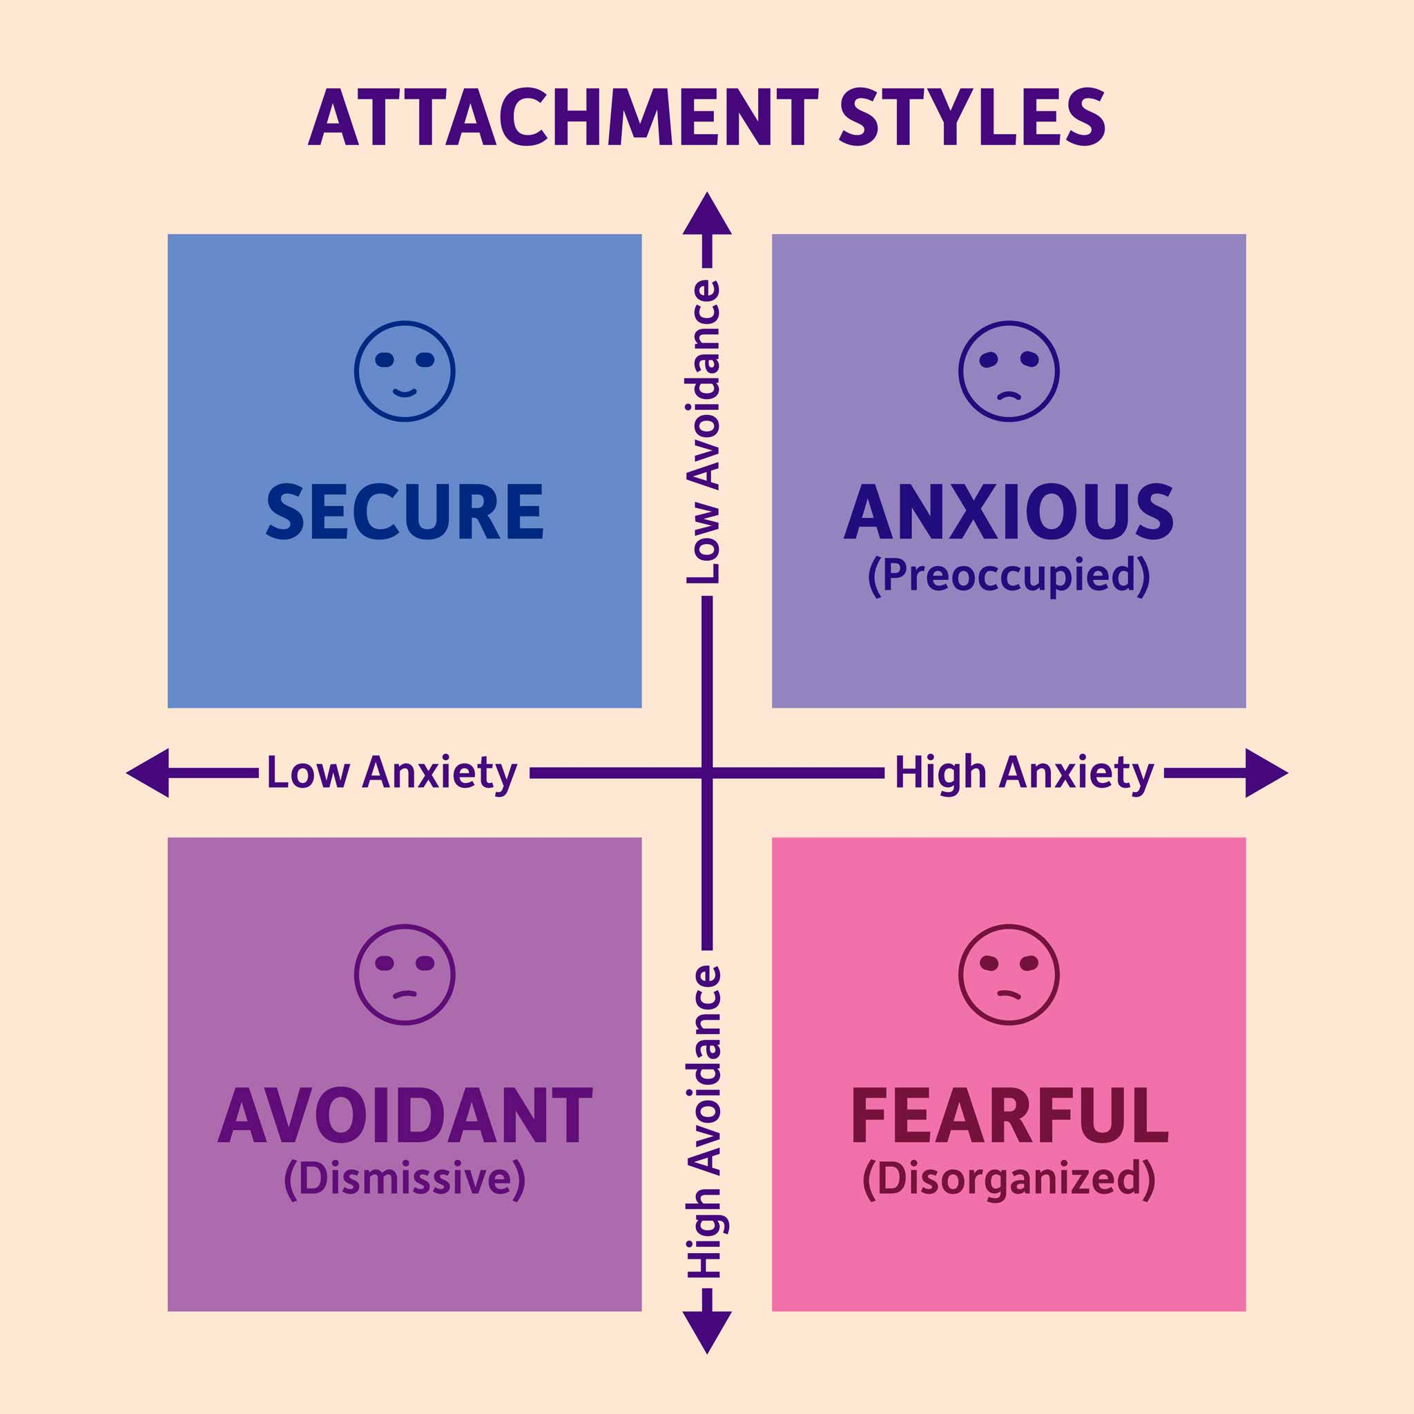
The Psychology Behind Social Wellness
Attachment Styles in College Relationships
Understanding your attachment style (secure, anxious, avoidant, disorganized) can help you:
Choose better connections
Recognize toxic dynamics
Stop confusing intensity with intimacy
The Social Bandwidth Principle
Social bandwidth = the limited mental and emotional capacity you have for social interaction.
Introverts & extroverts both have limits.
Overcommitting can lead to shallow or performative connections.

Slide 10

Letting Go to Grow
Just like your body clears out dead cells, your social life sometimes needs pruning.
Old high school friendships that no longer fit
Peer groups formed out of fear of isolation
“Situationship” style friendships where reciprocity is absent
Reflection: What’s one connection I’m holding onto out of guilt, obligation, or fear of being alone? What would letting go look like?

Slide 11

Hidden Dynamics of Social Life in College
Performative Belonging vs. Authentic Belonging
Performative: Constantly trying to "be" someone to gain approval.
Authentic: Being safe enough to show imperfection.
Reflection: Who in your life allows you to “mess up” and still be safe? Where are you trying to earn your belonging by performing?
Emotional Labor in Friendships
Some students unintentionally become the “therapist friend” or “crisis manager.”
Others become emotionally dependent on peers to an unhealthy degree.
Emotional Check-in: Reflect: Are my friendships emotionally reciprocal? Or do I give/receive more than I return?

Slide 12

Proximity does not equal intimacy
Living in a dorm or hanging out daily doesn’t automatically build closeness.
Closeness requires vulnerability, emotional attunement, and trust over time.
Dorm culture may breed convenience-based relationships, not meaningful ones.

Slide 13

Intentional Practices for Social Wellness
1. The “Core Five” Relationship Model
Encourage students to aim for balance in 5 types of people:
Challenger – pushes your thinking
Comforter – gives emotional safety
Connector – introduces new ideas or people
Co-visionary – shares a long-term goal or passion
Confidant – holds your private struggles or secrets
Activity: Identify the people in your life that fall into the above five categories
Reflection: Do I have people in each of these categories? Where are the areas that are not currently being fulfilled?

Slide 14

Intentional Practices Continued
2. Micro-boundaries That Preserve Relationships
Saying “I’m not up for talking right now, but I care about you.”
Scheduling time for recharging, not just connecting.
Checking in instead of venting.
3. Rupture and Repair
Conflict in relationships isn’t bad—avoiding repair is.
How to name a rupture without blame.
How to invite repair: “Can we talk about what happened the other day?”

Slide 15
Introduction of Healthy, Unhealthy, and Abusive Relationships
The purpose of this week’s lesson is to understand the behaviors and actions that define healthy, unhealthy, and abusive relationships. We also will become familiar with campus and community resources that are designed to support those who are impacted by interpersonal violence.

Slide 16
Definition: Healthy Relationship
Healthy Relationship: These involve honesty, trust, respect and open communication between partners and they take effort and compromise from everyone involved. There is no imbalance of power. Partners respect each other’s independence, can make their own decisions without fear of retribution or retaliation, and share decisions.

Slide 17
Definition: Unhealthy Relationship
Unhealthy Relationship: One person tries to make most of the decisions about the relationship without regard for their partner(s). There may be dishonesty, breaks in communication, imbalances of power, or pressure to engage in behaviors that the other partner(s) may be uncomfortable with. Feelings of guilt may arise regarding spending time with anyone other than your partner(s).

Slide 18
Definition: Abusive Relationship
Abusive Relationship: A partner or partners make all of the decisions regarding many aspects of day to day life, including sexual choices, friend groups, boundaries, finances, etc. without the input of consideration of anyone else in the relationships. Manipulation of facts and situations is common, as is denial of actions as being abusive. Communication is often hurtful or threatening. There may be attempts from an abusive partner(s) to isolate someone from their friends or family. Abusive relationships can (but don't always) include physical or sexual violence.
Source: LoveIsRespect, National Domestic Violence Hotline.

Slide 19
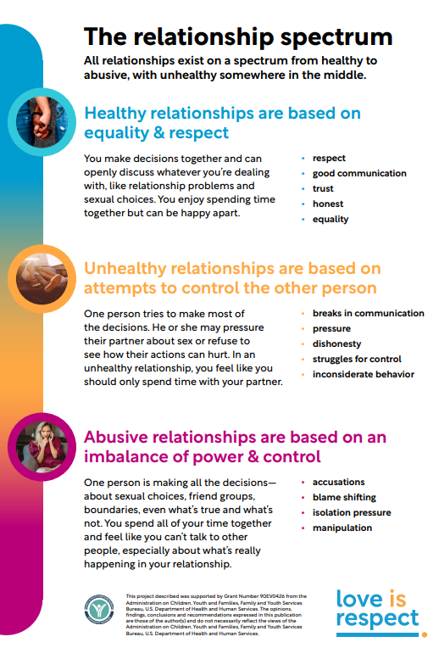
The Relationship Spectrum
All relationships exist on a spectrum from healthy to abusive, with unhealthy somewhere in the middle. Everyone defines relationships in their own way, but for a relationship to be considered healthy, it must include open communication, clearly defined personal boundaries, and trust.

Slide 20
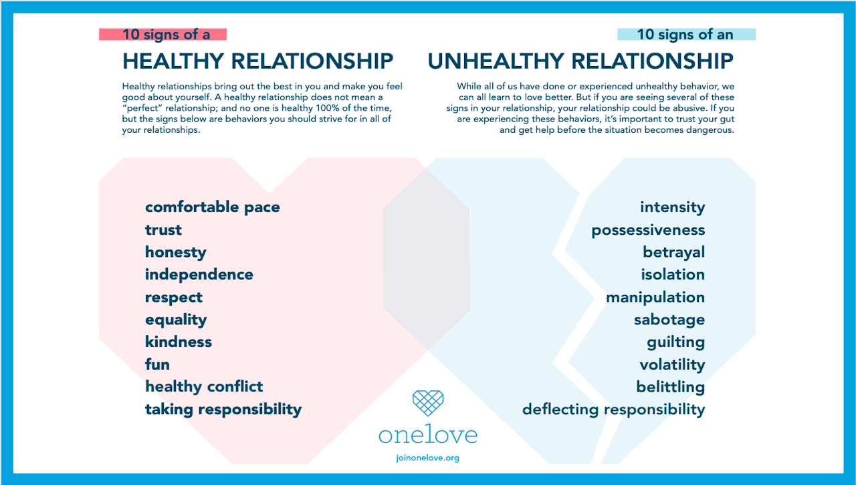
Healthy and Unhealthy relationships – 10 signs

Slide 21
Interpersonal Violence
(1)Interpersonal violence happens across the life course, from childhood into older age.
(2) Interpersonal violence can be physical, but also might include other types of abuse that can’t be “easily seen” on a person being harmed.

Slide 22
Interpersonal Violence Continued
(3) Interpersonal violence is about a perpetrator wanting power and control and the choice they have made to exercise that power and control over another person. Regardless of the situation or the experience that someone has had, it is of the utmost importance to remember that sexual & interpersonal violence of any kind is NEVER the fault of the person who has experienced it. It is never caused by something someone has done, said, worn, or anything else

Slide 23
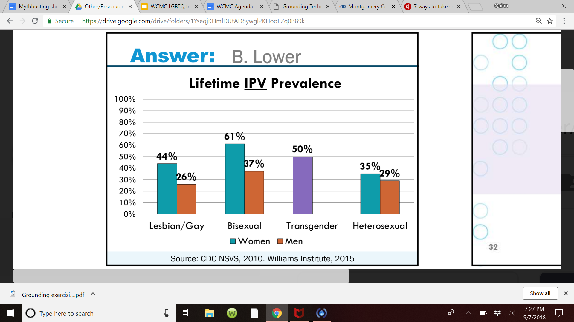
Intimate Partner Violence in LGBTQ+ communities
Conversations, movements, and services to address IPV often center cisgender women who are in relationships with cisgender men BUT
IPV is at least as common in relationships of lesbian, gay, bisexual, transgender, and queer (LGBTQ) people as in relationships of non-LGBTQ people
Important note: Statistics are limited because of the stigma and difficulty of reporting; percentages are likely higher

Slide 24
Things to Consider
(1) The way one person thinks about a healthy relationship will vary depending on multiple factors - their personal values, community values, cultural background, identity, and individual goals may all influence this vision of what it means to be in a healthy relationship with another person. But even with all these influences, healthy relationships are universally defined by open communication, clear personal boundaries, and trust.

Slide 25
Things to Consider Continued (pt 2)
(2) Healthy relationships are not always perfect. Every so often, unhealthy behaviors can become present. What still makes the relationship characteristically healthy, though is how the unhealthy behavior is addressed and resolved. Unhealthy would be ignoring the problem and pretending like it didn’t happen. Healthy would be talking about how that problem made each person feel, how’d they like to work together to resolve it, and move forward in a way that they don’t experience that behavior again.

Slide 26
Things to Consider Continued (pt 3)
(3)Unhealthy and abusive relationships are not the same thing. The difference is intent (whether conscious or unconscious). Two people may enter into a relationship that becomes unhealthy, usually due to
lack of a reference point for what a healthy relationship should be/look like
past hurt or trauma that has caused one or both people to develop unhealthy coping skills or attachment issues.

Slide 27
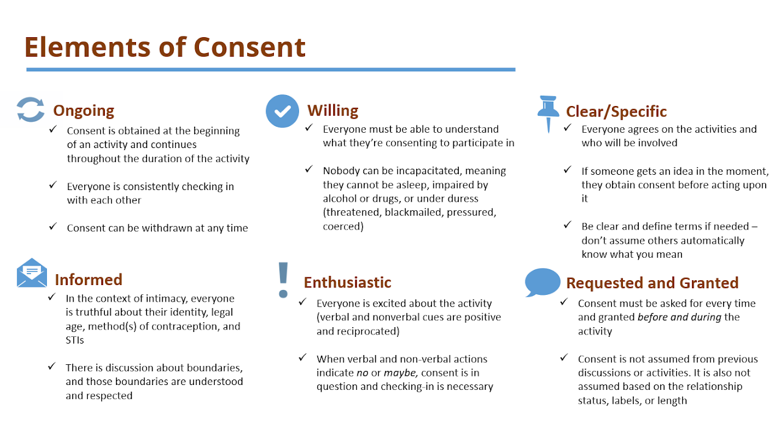
Consent

Slide 28
Bella Swan & Edward Cullen (Twilight)
Notes:
Students decide if it is healthy, unhealthy, or abusive

Slide 29
Unhealthy Why it’s unhealthy: Obsession, emotional dependency, stalking behaviors

Slide 30
Nick & Charlie (Heartstopper)

Slide 31
-Healthy -Why it’s healthy: Extremely sweet, respectful relationship that shows consent, checking in emotionally, and navigating coming out.

Slide 32
Maddy Perez & Nate Jacobs (Euphoria)

Slide 33
-Abusive -Why it’s abusive: Nate controls Maddy’s clothing, isolates her, gaslights her, and physically intimidates her. Their relationship is toxic and volatile.
Notes:
Think about friendships, family, etc. Can be outside of romantic relationships.

Slide 34
Turn to the person next to you... Think about other examples in movies, or shows that depict healthy, unhealthy, and abusive relationships
For the Healthy Example: Note why the relationship is healthy?
For the Unhealthy Example: What about the relationship is unhealthy?
For the Abusive Relationship: What makes the relationship abusive?
Is this type of violence or abuse something that society has taught us to be "normal" in our relationships?

Slide 35
Campus Resource Spotlight:
Associate Director of Civil Rights and Bias Response & Title IX Coordinator
Cary Carr
Email: ccarr1@brynmawr.edu

Slide 36
Confidential Resource Spotlight:
Interfaith Chaplain
Rabbi Nora Weiser-Woods
Email: nwoods@brynmawr.edu
Assistant Chaplain
Soaad Elbahwati
selbahwati@brynmawr.edu
Health and Wellness Center

Slide 37
Next Week
Developing Emotional Precision and Internal Resilience

Slide 38
Resource Spotlight
Health & Wellness Center
Cristen Kennedy, Wellness Program Director; ckennedy2@brynmawr.edu
Erika D'Andrea, Wellness Coordinator; edandrea@brynmawr.edu

Slide 39
Resource Spotlight:
Off Campus Resources
Laurel House Domestic Violence Center: 1‑800‑642‑3150; laurel-house.org
Victims Services Center of Montgomery County: 888-521-0983; victimservicescenter.org
Network of Victim Assistance (Bucks County): 1-800-675-6900; novabucks.org
Safe Berks (formerly Berks Women in Crisis) (Berks County): 610-372-9540; safeberks.org
Women Against Abuse (Philadelphia): 866-723-3014; womenagainstabuse.org
WOAR – Philadelphia Center Against Sexual Violence (formerly Women Organized Against Rape) (Philadelphia): 215-985-3333; woar.org

Slide 40
Introduction to Social Wellness
The Social Wellness Dimension involves having healthy relationships with friends, family, and the community, and having an interest in and concern for the needs of others and humankind.
Community:
Have you found groups/ clubs in which you can connect with like-minded peers?
Have you made a date with friends for a movie, dinner, coffee, or other social activities?
Are you keeping in touch with people you care about?
Social Time:
Do you set aside quality time to spend with family and friends?
Are you making time to go to places where you can meet new people, or visiting a new location?

Slide 41
Resource Spotlight:
Other Resources
RAINN HOTLINE: 800-656-4673
NATIONAL DOMESTIC VIOLENCE HOTLINE: 1-800-799-7233
NATIONAL HUMAN TRAFFICKING HOTLINE: 1-888-373-7888 OR TEXT THEM AT 233-733

Slide 42
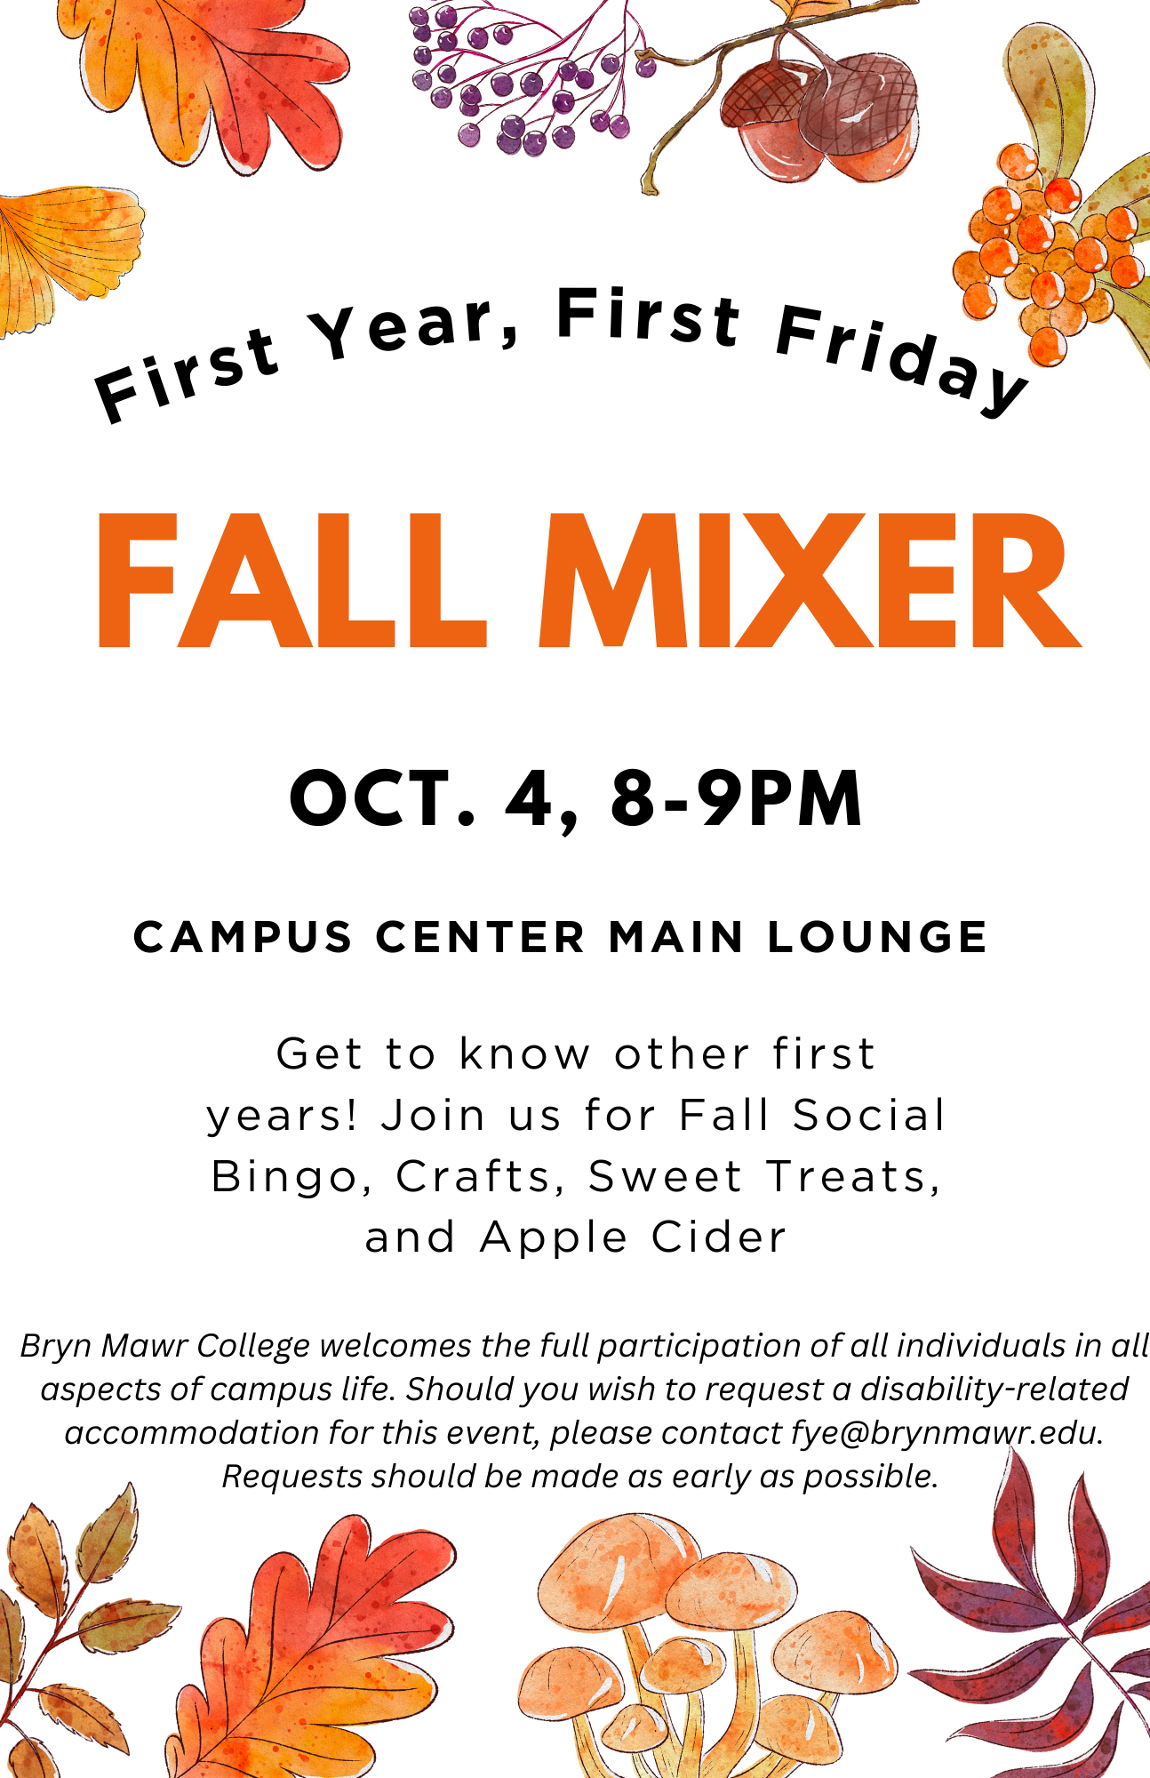
Fall Mixer poster

