Slide 1

Developing Emotional Precision and Internal Resilience
THRIVE Week 6

Slide 2

Agenda
Warm Up: Wheel of Emotions
Defining Emotional Wellness
Emotional Wellness Core Concepts
Emotional Cycles in College
Emotional Resilience
Boundaries for Emotional Protection
Activity: Emotional Emergency Toolkit
Campus Resources

Slide 3
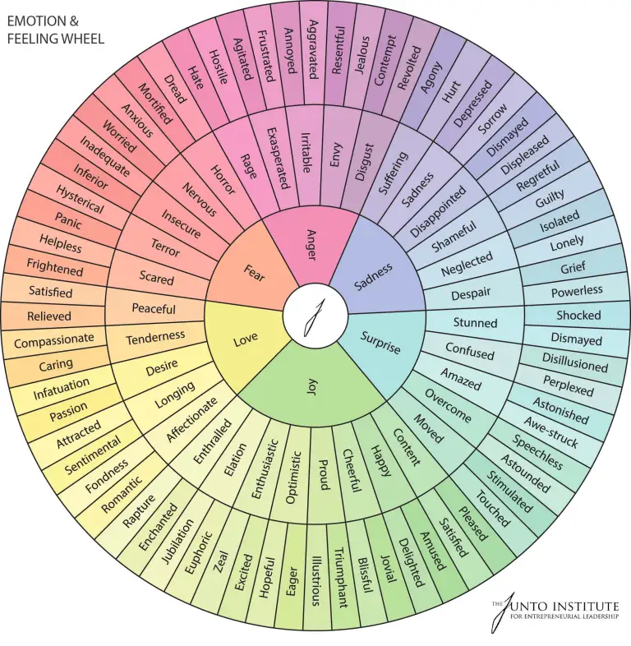

Pair and Share
What’s an emotion you’ve felt recently that didn’t fit neatly into “happy, sad, or mad”? Use the wheel of emotions to identify the emotion that you were experiencing. What did it feel like? What did you do with it?

Slide 4
Defining Emotional Wellness
The Emotional Wellness Dimension involves the ability to express feelings, adjust to emotional challenges, cope with life’s stressors, and enjoy life. It includes knowing our strengths, as well as what we want to get better at and living and working on our own, but letting others help us from time to time.

Slide 5
What is emotional Wellness?
Beyond "Good Vibes"
Common Misconception:
Emotional wellness means "feeling happy" or "being positive."
Deeper Definition:
Emotional wellness is your ability to experience, name, regulate, and express emotions in a way that honors your full humanity without being hijacked by them or cut off from them.

Slide 6
Core Concepts
Emotional Granularity: The Language of Feeling
Emotional Agility vs Emotional Rigidity
Emotional granularity is your ability to identify subtle differences in your emotions (e.g., distinguishing between irritation, frustration, and resentment).
Research shows that high granularity leads to better emotion regulation, fewer depressive symptoms, and stronger social relationships.
Coined by psychologist Susan David, emotional agility is the ability to:
Notice your emotions without judgment
Detach from them when needed (not suppress them)
Choose values-based actions even in emotional discomfort
Opposite = Emotional Rigidity: Over-identifying with emotions or treating them as truth ("I am worthless" vs. "I feel worthless right now").
Notes:
Being able to identify emotions, you can slow down thought processes and make better choices.

Slide 7
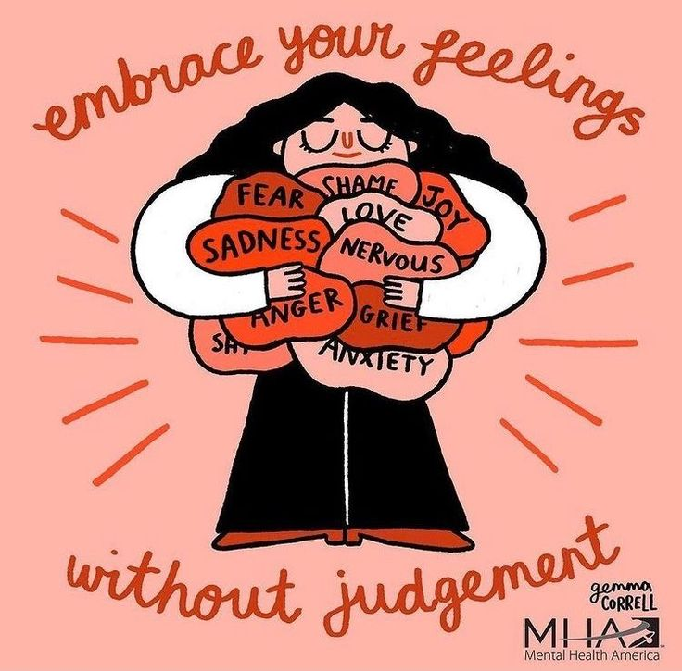
Core concepts continued
Suppression vs Regulation
Suppression = Avoiding or denying emotions (leads to burnout, increased stress, and poorer memory).
Regulation = Naming, validating, and managing an emotion without denying it or being overwhelmed.
Research Insight:
Suppressing sadness increases physiological arousal (heart rate, cortisol) more than expressing it in a safe way.
The R.A.I.N. Method:
Recognize what you're feeling
Allow it without resistance
Investigate where it’s coming from
Nurture yourself with compassion

Slide 8
Understanding emotional Cycles in college
Emotional Dysregulation and the Academic Calendar
Midterms, holidays, homesickness, burnout → emotional waves are predictable but often misread as personal failure.
Emotions as Information, Not Instruction
Key Concept: Emotions carry signals, not commands. Feeling anxious doesn’t mean you’re unsafe — it might mean you're stretching into something important.

Slide 9
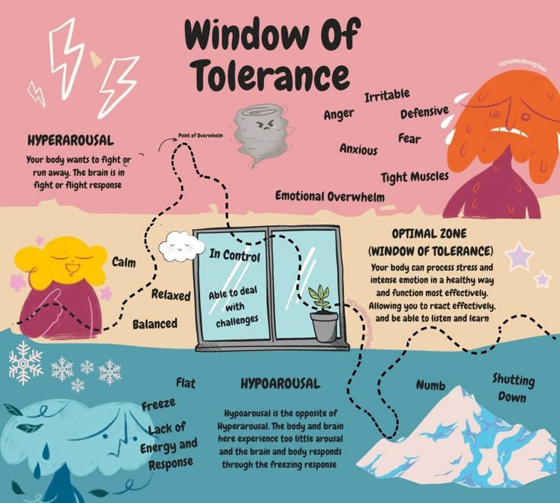
Mental Models for Emotional Resilience
Window of Tolerance (by Dr. Dan Siegel)
Think of your nervous system like a window:
  Too much stress = hyperarousal (panic, anger)
  Too little = hypoarousal (numbness, shutdown)
Emotional Debt
Emotions you don’t process are like debts with interest — they don’t disappear; they collect.
Notes:
The window of tolerance is your emotional comfort zone—the range where you can think clearly and feel grounded. When stress pushes you outside that window, you might either get overwhelmed and anxious or shut down and numb. Learning what helps you stay in or return to your window is key to managing stress and emotions.

Slide 10



Practices to cultivate emotional wellness
Emotional Labeling ("Name It to Tame It")
  Regularly name your emotions with specificity (e.g., “I feel rejected,” not just “I feel bad”).
  Use an Emotion Wheel to expand your vocabulary.
  Builds cognitive control over reactive emotions.
Daily Emotional Check-In
  Ask: What am I feeling? What triggered this? What do I need?
  Journaling or voice notes can make this more effective.
Body Scan Meditation
  Learn to recognize where emotion manifests physically (tight jaw, shallow breathing, etc.).
  Helps connect your mind to body sensations and process emotions somatically.

Slide 11
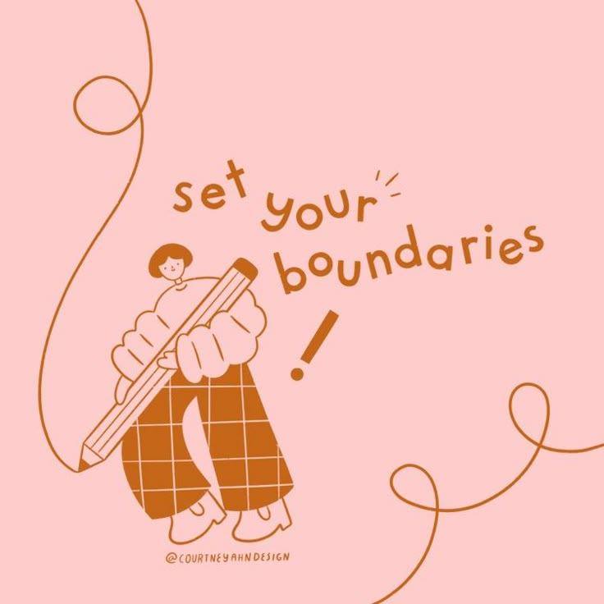

Boundaries for emotional protection
Learn the difference between venting and dumping, empathy and enmeshment.
Protect your energy with scripts like:
  “I care about you, but I’m not in the emotional space to hold this right now.”
  “Can we talk about this after I’ve had time to regulate myself?”

Slide 12

Who has heard of a disaster emergency kit?
Give examples of what would be in them and why they are needed...

Slide 13
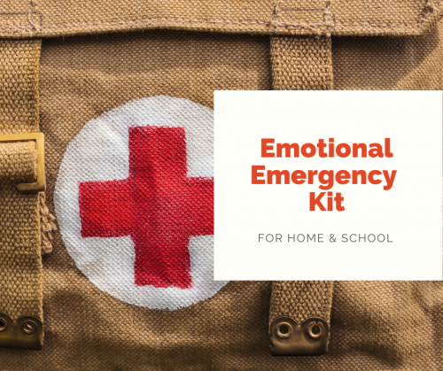
Thank you to Takai Tyler, Co-CEO FROM Girls leadership for the content for this lesson
How to create your emotional emergency kit
For the purposes of this presentation, "emotional emergency" refers to a moment when you have big feelings of distress and/ or anxiety that are possible to manage without professional support

Slide 14
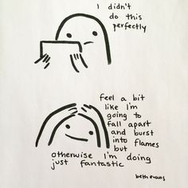
What goes in your kit
Emotional food/water
Emotional flashlight
Emotional batteries
Emotional Cell Phone
Emotional Charger
Emotional Self-Check In Tool
Emotional Blanket
Emotional Map

Slide 15
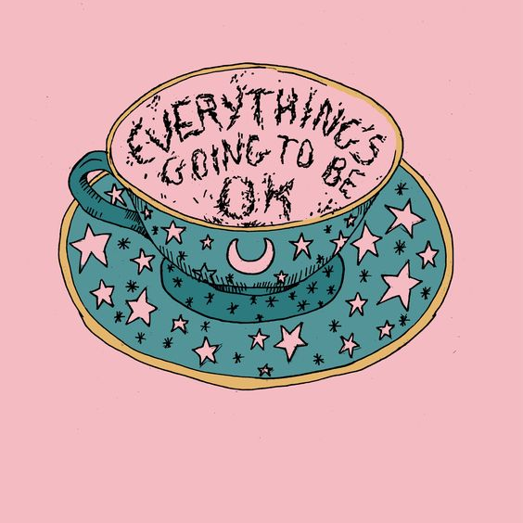
Emotional food and water
Probably
Daily Nourishment: doing at least one thing a day that promotes nourishment.
Examples: eating your favorite food for a meal, or having a cup of a warm beverage like tea.

Slide 16
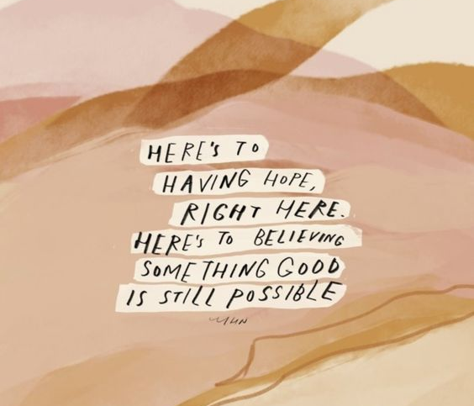
Emotional Flashlights
Identify something that reminds you to focus on hope.
Creating a mantra can be helpful:
“I am showing love for myself by choosing hope no matter what.” - Cleo Wade

Slide 17
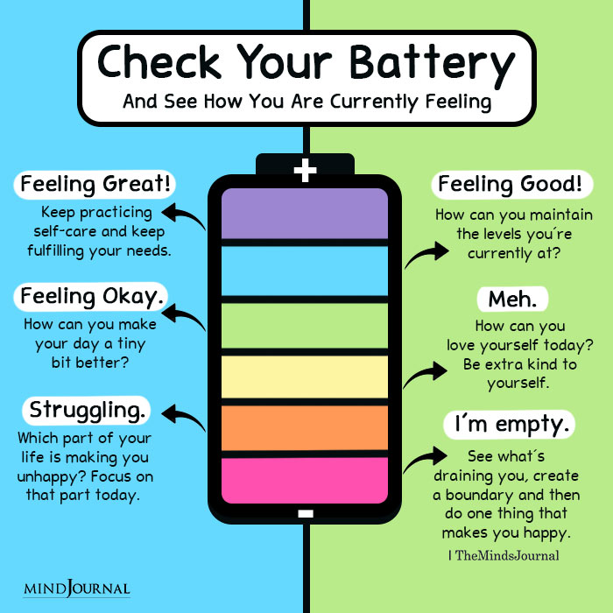
Emotional batteries
Prioritize checking in on how you are feeling...

Slide 18
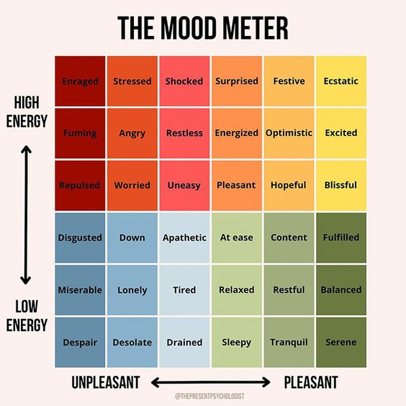
Emotional self-check in tool
It can be helpful to engage in activities that help you identify your feelings so you can take steps that promote wellness: journal writing, art projects, meditation, or talking to trusted friends.

Slide 19

Emotional Charger
Taking a 10–15-minute break when feeling overwhelmed can reduce feelings of being overwhelmed. A time-out can include taking a walk or run, having a laugh, praying, or singing.

Slide 20

Emotional Cellphone
Make a list of people you can contact when you are struggling. Check in with them on a regular basis.
Make sure to provide them with emotional support too.
Be wary of energy vampires!!

Slide 21

Emotional Blankets
Spend time doing something that makes you feel good, like playing with pets, reading favorite books, playing games, dancing, sports, and spending time with friends and loved ones.

Slide 22
Emotional toolkit creation &Wellness Visual Creation
Having an overall goal for moving through this time with as much ease as possible can be beneficial. Spend some time packing your own emotional emergency toolkit

Slide 23
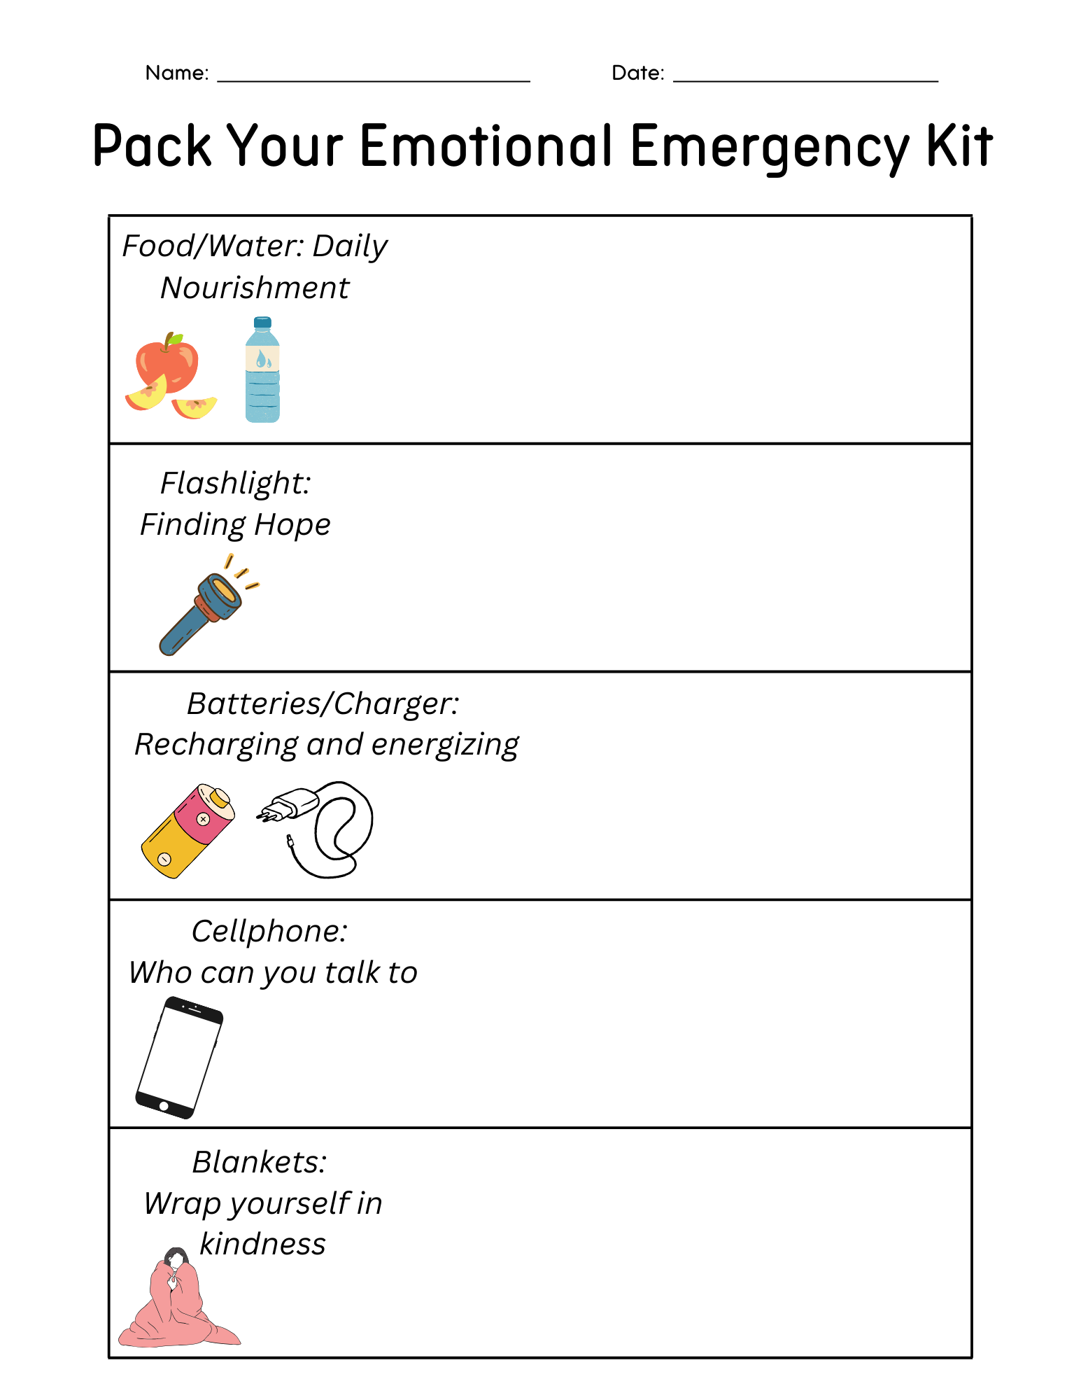
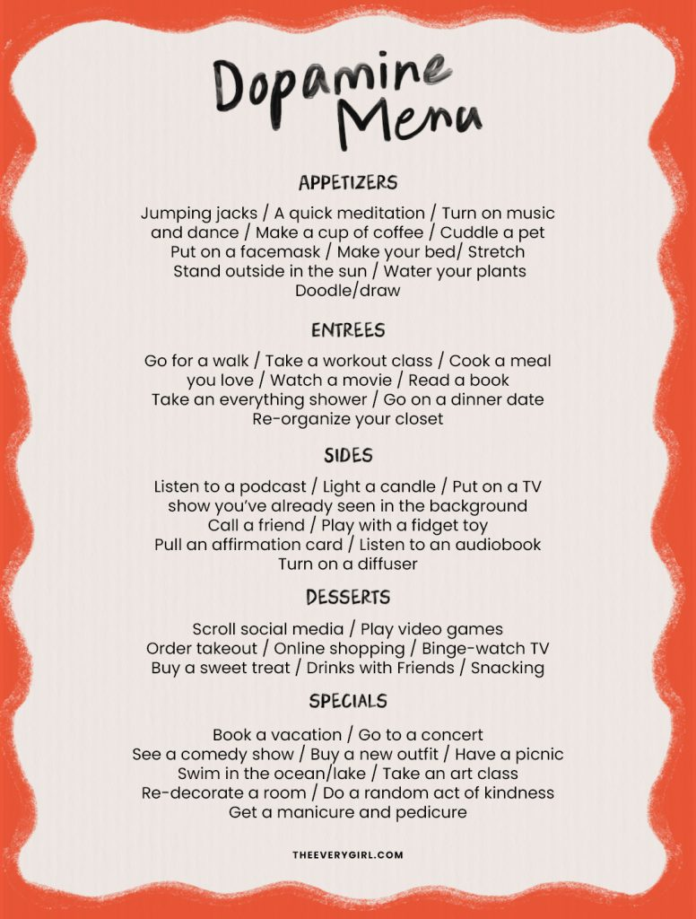
Visual Examples

Slide 24
Activity
Pick one thing in your emotional emergency toolkit and share what it is and why you chose it

Slide 25
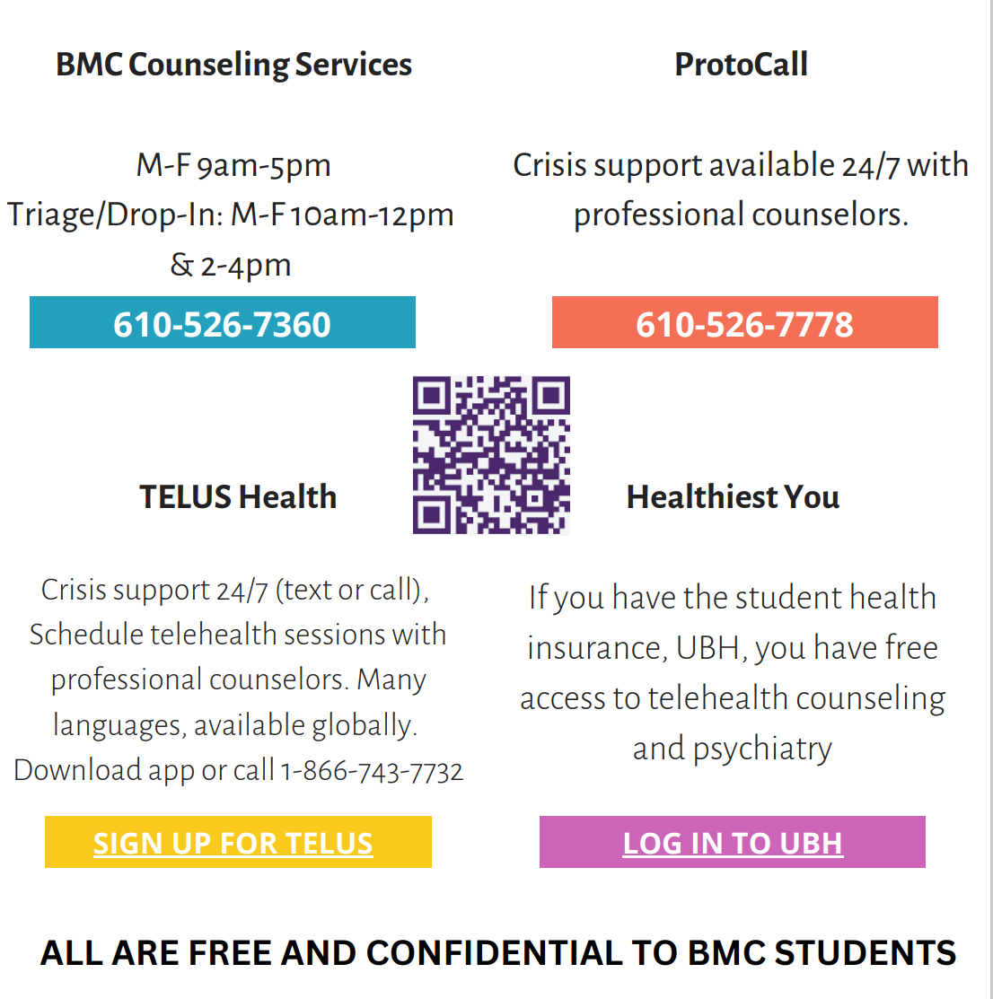
Campus Resource Spotlight

Slide 26
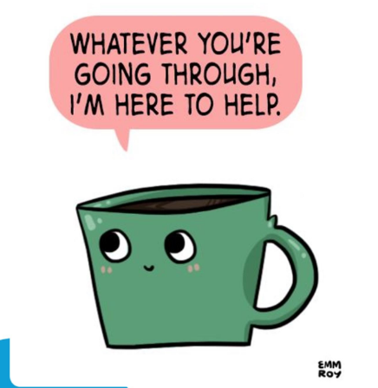
Bryn Mawr’s Wellness program
Located on the 2nd floor of
The Well (Room 251)
Open Monday-Friday
1pm-4pm
Come relax, ask questions about health and wellness, do some crafting, get wellness supplies, or just take a nap!
Staffed by both professional staff members and peer educators.
Contact Director Cristen Kennedy (ckennedy2@brynmawr.edu) for more information!

Slide 27
Campus resource spotlight
Student Support Services
  Location: Guild
  Contact: Lindsay Van Ostenbridge

Slide 28
Campus Resource Spotlight Continued
Reasons to Connect
  Distress related to anticipated transitions and/or unexpected events
  On and off-campus resource consultation
  Recent physical and/or mental health hospitalization
  Assistance with contacting faculty for short-term medical experience or personal emergencies impacting academics
  Leave guidance and support
  A referral to Student Support Services may be made by the student (a self-referral) or by a faculty or staff member. Include student information and a summary of concern. It is best practice to inform students you are referring them – include students on the email if they know they are being referred.
  Student of Concern Form

Slide 29


Master Your Money: The Power of Budgeting
Next week: financial wellness

Slide 30
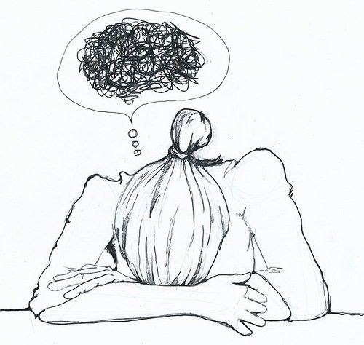
Before we begin...
What is one kind thing you plan to do for yourself this week/ weekend?

Slide 31
Activity
What word or phrase comes to mind when you think of emotional wellness?

Slide 32
Definition
The Emotional Wellness Dimension involves the ability to express feelings, adjust to emotional challenges, cope with life’s stressors, and enjoy life. It includes knowing our strengths as well as what we want to get better at, and living and working on our own but letting others help us from time to time.

Slide 33
Reflection
Feelings/ Emotions:
Do you allow yourself to be open to and acknowledge your feelings without judgment?
Self Care:
Do you write your thoughts in a journal, listen to music, or talk to family or friends when you are in need?
Are you maintaining a daily routine?
Stress:
Do you recognize stress triggers and appreciate that you are not your feelings? .
Do you welcome and cultivate positive, empowering thoughts and emotions?

Slide 34
Emotional Wellness Considerations
It may be more difficult for some folks to attain emotional wellness given experiences of trauma, mental health diagnoses, lack of access to resources, etc.
Being mentally and emotionally well does not mean you are happy all the time. It means you are aware of your emotions (self-aware) and you can safely navigate your negative feelings

Slide 35
Wellness Visual creation
Then try creating a visual image of your primary goal at this time (e.g. staying connected, maintaining balance, minimizing stress, practicing gratitude, etc.). What is your vision for yourself?

Slide 36
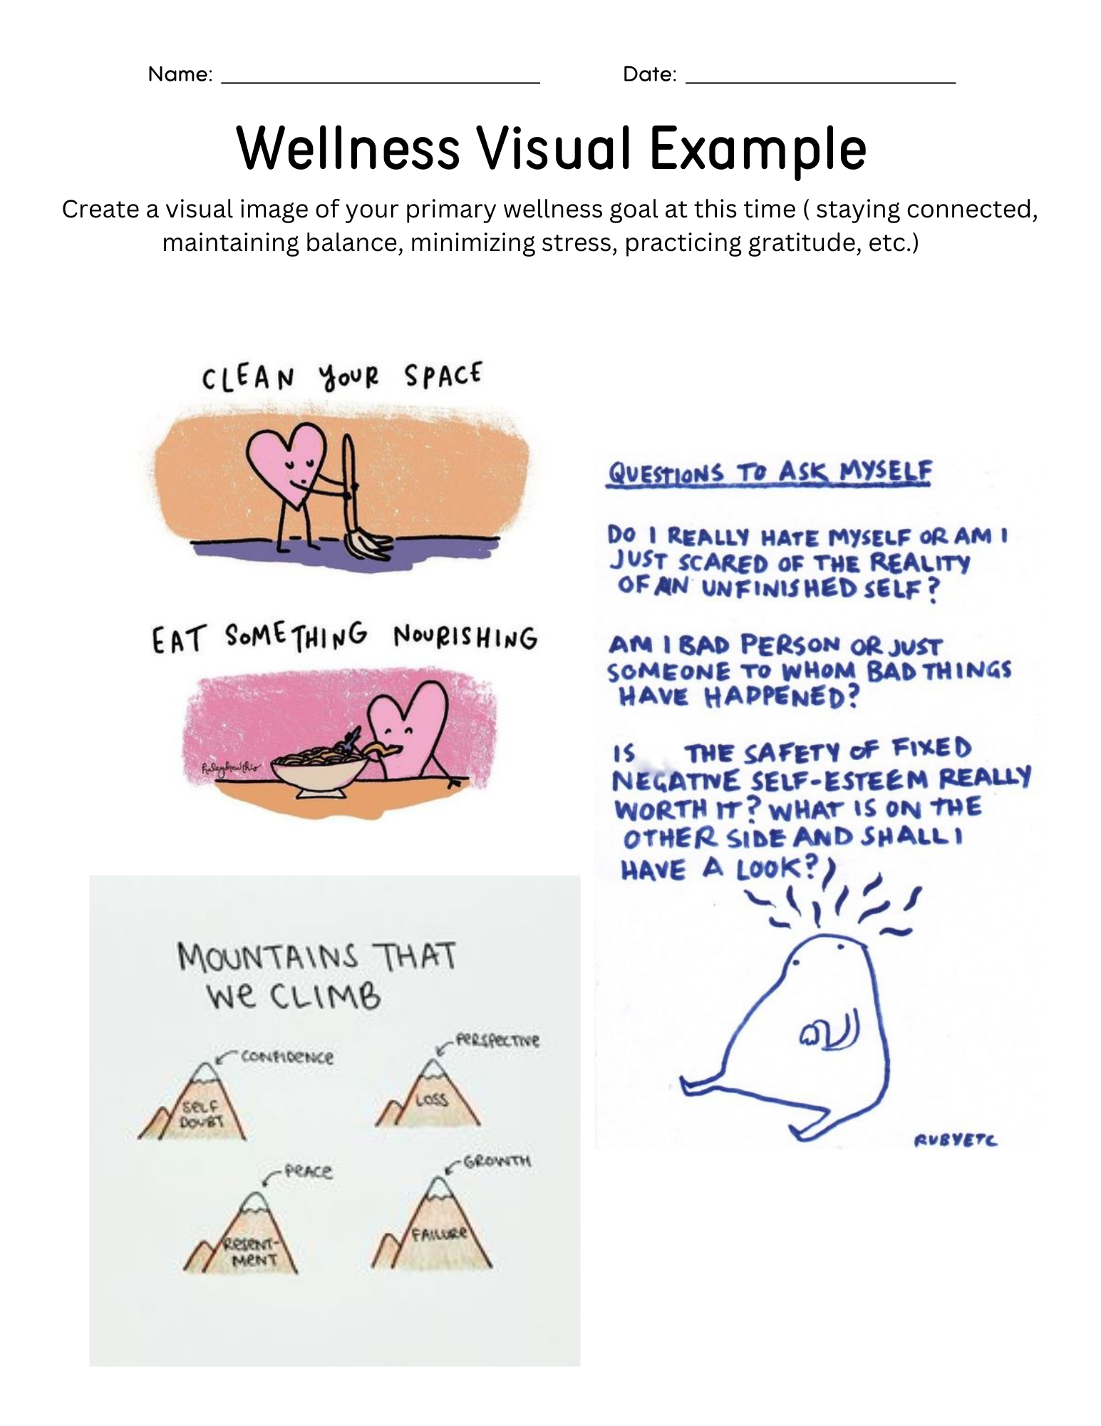
Wellness visual example

Slide 37
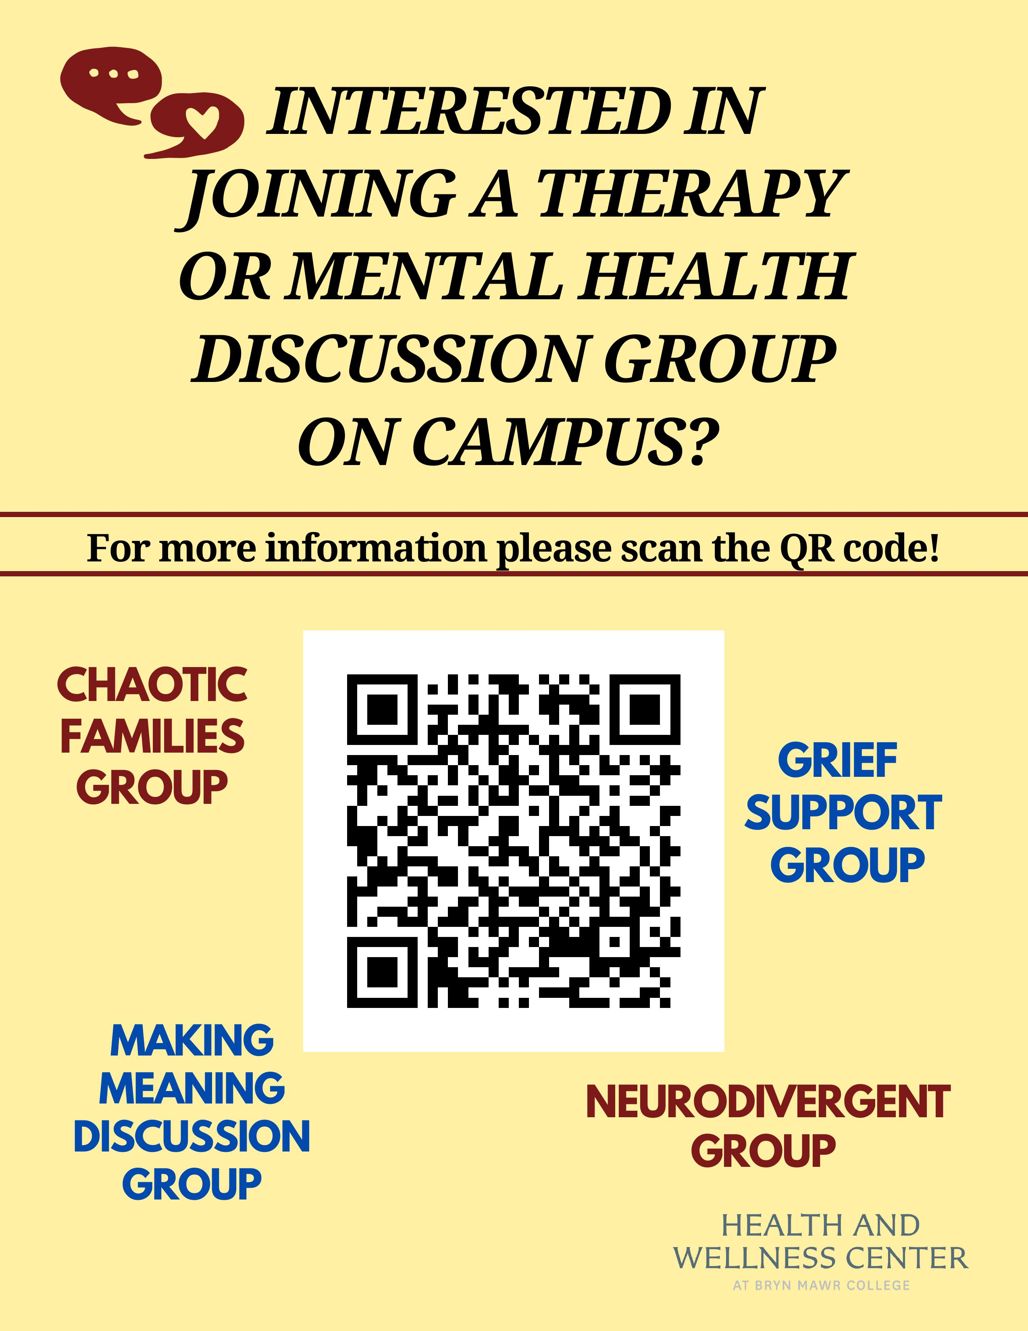
Therapy and Mental Health Discussion Groups

Slide 38
Reminder: Attendance Policy
Student are only allowed to miss 3 THRIVE classes
  Please communicate with your facilitator if you know you're going to be absent
    Your facilitator will reach out after class if they do not hear from you
  If you miss more than 3 you will not pass the class and must repeat it in the Spring

