Slide 1




FINANCIAL
WELLNESS
THRIVE 2025

Slide 2

Warm Up
Turn and talk to the person next to you: how was your fall break?
Notes:
Give students 1-2 minutes to discuss

Slide 3


AGENDA
1
Campus Resources
2
Intro to Budgeting
3
Practice!
4
Takeaway resource / feedback form
Notes:
Facilitator Suggested Dialogue:
“In this session, we’ll learn about some campus offices and resources related to your finances, then we’ll learn the basics of creating a budget and practice on a sample student. At the end, you’ll get access to a financial literacy resource and complete a quick feedback form”

Slide 4


WHAT IS FINANCIAL WELLNESS?
      Financial wellness refers to the skills and attitudes related to your finances and the ability to meet your financial needs now & in the future
      At Bryn Mawr, we hope to encourage a positive relationship with your finances through resources, tools and support.
      In this session, we'll discuss:
        Resources to support your financial wellbeing as a student
        Budgeting as an introduction to managing the finances of your everyday life
Notes:
Facilitator: read the slide

Slide 5


FINANCIAL RESOURCES
AT BRYN MAWR
Office of Financial
Aid
Student Accounts Office
Student Employment Office
Student Assistance Fund
Financial Wellness at Bryn Mawr
Notes:
Facilitator Suggested Dialogue:
“There are several offices and resources on campus that can help you with different aspects of your finances. We’ll go over a brief overview of each of the following: Financial Aid, Student Accounts, Student Employment, Student Assistance Fund, Financial Wellness at Bryn Mawr”

Slide 6


OFFICE OF FINANCIAL AID
What we do:
      Review your financial aid application, determine eligibility for need-based and federal financial aid
      Process outside scholarships and tuition benefits
      What you need to do:
      Reapply for financial aid by April 15th every year (if you applied during admission)
      Inform our office if you are receiving a scholarship or tuition benefit
      Reach out to the office if you have questions about your financial aid or if your family’s financial situation changes
      Read emails from our office, check financial aid portal on Bionic
Notes:
Facilitator: Read the slide word for word. Much of the content had to be pre-approved by the offices in question
If students have questions, they can search for the office / resource on the Bryn Mawr website and contact the office or point person directly

Slide 7
STUDENT ACCOUNTS
      Contact Student Accounts with questions related to:
        Billing
        Paying your bill
Notes:
Facilitator: Read the slide word for word. Much of the content had to be pre-approved by the offices in question
If students have questions, they can search for the office / resource on the Bryn Mawr website and contact the office or point person directly

Slide 8
STUDENT EMPLOYMENT
      Contact the Student Employment Office with questions related to working on campus
        Finding a campus job (spring job fair)
        New hire paperwork
Notes:
Facilitator: Read the slide word for word. Much of the content had to be pre-approved by the offices in question
If students have questions, they can search for the office / resource on the Bryn Mawr website and contact the office or point person directly

Slide 9
STUDENT ASSISTANCE FUND
      The Student Assistance Fund provides grant funding to students experiencing financial hardship due to unanticipated events / emergencies
        You can apply for up to $500 of funding if you are receiving need-based financial aid and have accepted all loans / work
      Examples of expenses that could be covered:
        Travel due to illness, death or emergency in your immediate family
        Unexpected medical expenses
        Essential dental work or eyeglasses
        Replacement of essential personal belongings due to fire, theft, natural disaster
        Safety needs (ex: winter clothing for students from warm climates)
Notes:
Facilitator: Read the slide word for word. Much of the content had to be pre-approved by the offices in question
If students have questions, they can search for the office / resource on the Bryn Mawr website and contact the office or point person directly

Slide 10
STUDENT ASSISTANCE FUND
      Ineligible expenses: your Bryn Mawr bill, books / supplies, study abroad expenses, loss of parental income, medical expenses of a family member
      To apply for funding from the Student Assistance Fund, refer to the link on the Student Support Services webpage
Notes:
Facilitator: read the slide verbatim

Slide 11
FINANCIAL WELLNESS
What we do:
      Hold financial wellness workshops throughout the semester to teach financial literacy information and skills
      Provide independent learning through CashCourse (more information to come!)
      What you can do:
Register for workshops when they become available
Sign up for CashCourse at the end of this session
Reach out to Emily Stevens, the Financial Wellness Counselor for individual concerns
Notes:
Facilitator: Read the slide word for word
If students have questions, they can contact Emily (my contact info is on the financial aid website and in the staff directory)

Slide 12









BUDGETING 101
Notes:
Facilitator: “In this next section, we’ll learn some basics about the budgeting process and get some practice”

Slide 13

What is a Budget?
A budget is a financial plan that balances your income & expenses for a given period of time​
People also use the word “budgeting” to refer to tracking their spending & ensuring that they’re sticking to the plan​
Notes:
Facilitator: Read the slide
Stop and check if students have questions

Slide 14
Why Should I Budget?
Avoid debt
Ensure you don’t spend more than you make
Be aware of what you’re spending / avoid overspending
Use data to make informed choices​
Meet savings goals
Be prepared for the future​
Notes:
Facilitator: Read the slide
Discuss: are there any other reasons why someone would want to plan and track their spending? Which of these reasons could be most relevant to a college student?
Discuss or have students consider on their own: Which of these reasons do you most identify with?

Slide 15

Basic Monthly Budgeting Steps
Step 1: Decide how you’ll create / track your spending​
Pen & paper, spreadsheets, or apps​
​
Step 2: Calculate your monthly income
If you get paid every other week --> 2 paychecks per month
Consider if your income is predictable or varies. If you have a more variable income, use an average income amount
Step 3: Analyze your spending​
Look back at your spending for the last month
  What do you buy frequently: weekly, monthly?​
  What do you need to buy only 1-2 times a semester?​
  Prioritize your needs over your wants​
Notes:
Facilitator: Read the slide
Stop and check if students have questions

Slide 16
Basic Monthly Budgeting Steps
​Step 4: Set a goal for your budgeting and spending
Do you want to cut back on spending in a certain category? Save for a big expense? Set money aside for an emergency? Gain an awareness of your spending habits? Get out of debt?
Having a goal helps make budgeting feel more grounded and useful
Step 5: Create your first budget
Based on your last month of spending, your income and your goals, decide how much you want to spend and save.
Step 6: Track your spending & revisit your budget and goals
Create a realistic habit of sitting down and comparing your spending to your budget.
After each month, look at your budget. Do you need to adjust it?
Did you meet your goals? Find a (responsible) way to celebrate!
Notes:
Facilitator: Read the slide
Stop and check if students have questions

Slide 17



Group Practice: Part 1
In pairs / small groups, answer the questions in Part 1 on your worksheet
When all groups are done, discuss the questions on the next slide as a whole group
Notes:
Have students split into groups of 2-4
Direct them to their worksheets and instruct them to complete only the first part (from Angie’s spending to the chart where they create a budget for her)
Start the timer on the slides. Check in with students after 3, 5 and 7 minutes to see how much more time they need. 10 minutes is the maximum amount of time that should be spent on this section

Slide 18
Group Discussion
What is Angie doing well? What could she improve?
Does Angie have enough money to continue her spending habits?
If not, what options does she have?
What would happen to Angie if she had an emergency expense like a surprise trip to urgent care?
Notes:
Discuss the questions on the slide
Talk through any other questions that come up!

Slide 19
Group Practice: Part 2
In pairs / small groups, answer the questions in Part 2 on your worksheet
When all groups are done, discuss the questions on the next slide as a whole group
Notes:
Have students split into groups of 2-4
Direct them to their worksheets and instruct them to complete only the first part (from Angie’s spending to the chart where they create a budget for her)
Start the timer on the slides. Check in with students after 3, 5 and 7 minutes to see how much more time they need. 10 minutes is the maximum amount of time that should be spent on this section

Slide 20
Group Discussion
How did Angie do in October? Did she overspend or have money left over? Did she meet her goals?
Compare Angie's income / spending in September and October. What lifestyle changes did she make? Did anything happen outside of her control in either month?
Does Angie's budget feel reasonable? Is it too restricted or too generous?
Notes:
Discuss the questions on the slide
Talk through any other questions that come up!

Slide 21

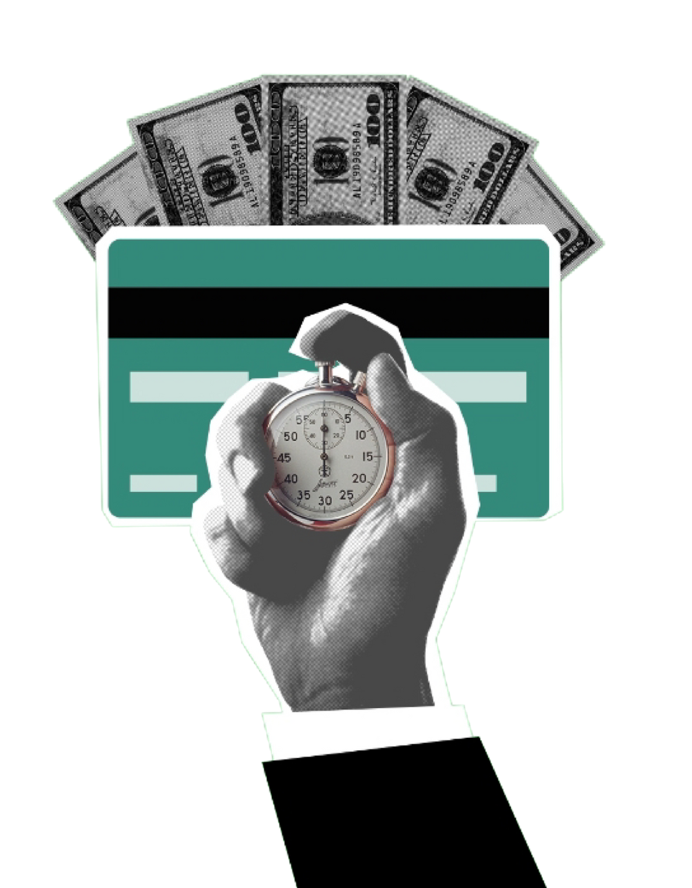
Your Turn!
The third section of your worksheet gives you space to start to plan your own budget
If you have time, work on this independently during your THRIVE session. If you don't, bring it home with you to start thinking about your own budgeting practice
Notes:
If you have more than 5 minutes left in the session, have students work independently on Part 3 of the worksheet. Stop them when you have 5 minutes left in the session
If you have 5 minutes or less, tell them that they can use that as a resource in their own time to start thinking about budgeting

Slide 22


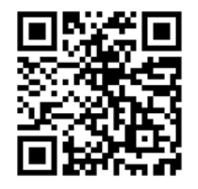
CashCourse
CashCourse is a FREE financial education platform with self-paced lessons & resources related to a variety of financial topics
Scan to sign up:
Notes:
Read the slide
Pause for 1 minute so students can scan the QR code to sign up (or at least open the webpage to sign up later)

Slide 23

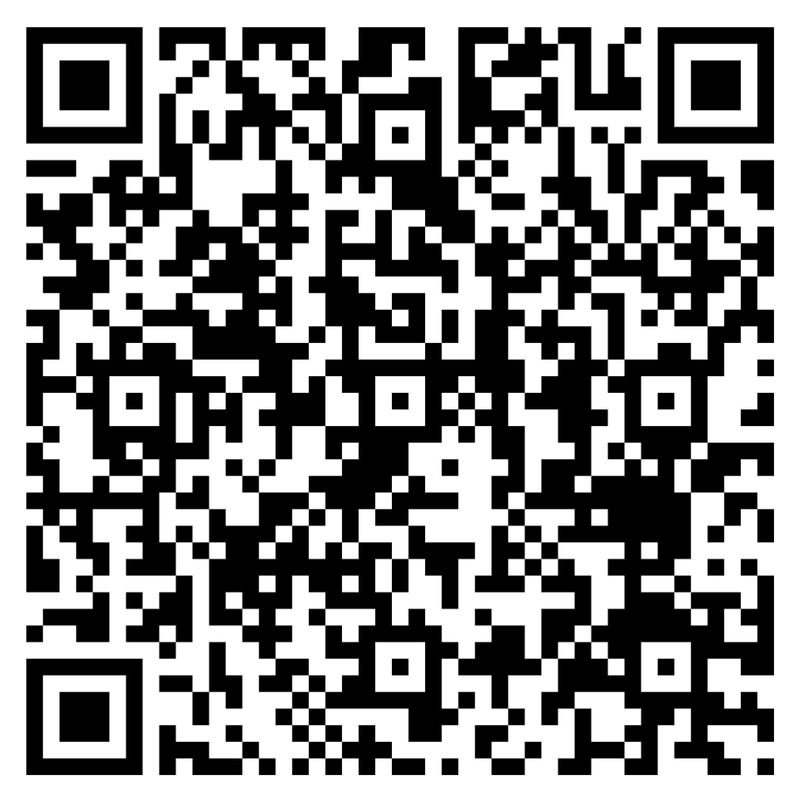
Feedback Form
Scan the QR code to complete the feedback form (< 2 minutes)
Responses are anonymous
Feedback helps improve the session for next year. Your help is appreciated!
Notes:
Read the slide & remind students that all feedback is anonymous
Please encourage students to complete the feedback form! The feedback helps me to make changes year to year

Slide 24
Homework: Strengths Quest
You will receive an email with the link, access code and directions on how to take the assessment.
This is due on Sunday, October 26th
Any questions please contact Katie Krimmel at kkrimmel@brynmawr.edu
Overall results will be revealed during Week 9 of THRIVE

Slide 25
Next Week
Week 8
      Roots and Reverence:
      Building Belonging, Meaning, and Presence in a New Environment

