Slide 1

THRIVE Week 9:
Occupational Wellness
THRIVE WEEK 9
Resources Revisited to help you prepare for next semester

Slide 2

Starter Questions:
Reflect on 1 or more of the following questions in groups of 3-4
What were you like as a child? What did you enjoy doing?
How would your best friend describe you?
What are some real-life "superpowers" you possess now?
Notes:
These questions are meant to get people thinking about what they're naturally drawn to, what's special about them as a person, what they're good at, etc., which are both fun to think about and good data to help you discover your strengths! :)

Slide 3
Defining Occupational Wellness
The Occupational Wellness Dimension involves participating in activities that provide meaning and purpose and reflect personal values, interests, and beliefs, including employment.

Slide 4

Today's Agenda
Context: Liberal Arts Setting
Career & Civic Engagement Center Competencies
Perspectives on Vocational Discernment
Strengths!
Career & Civic Programs, Resources, and Opportunities
Design Your Path Forward
How to stay connected

Slide 5

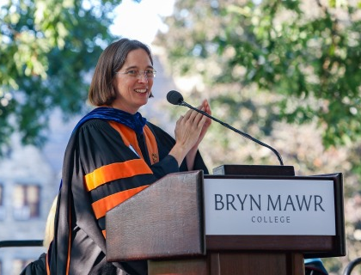
As President Wendy Cadge sees it...
"The liberal arts are about engaging with people at a pivotal developmental time and helping them learn for themselves what it means to be who they are and how they want to move through the world. It’s not about giving them the answers to questions, but rather teaching them how to shape and engage with those questions, in today’s complicated and often difficult world."
Notes:
Can someone please read this quote for us?
Do any specific words or phrases in President Cadge's quote stand out to any of you?
What stands out to me is "who they are and how they want to move through the world." That involves self-knowledge about your identities, your talents, what you can contribute, reflection on what you value, and choice in terms of how you'll spend this one brief but precious life! If you're independently wealthy, maybe you don't have to enter the world of work, but for the vast majority of us, a lot of our time is spent working. Also, we need to think about how we'll engage as members of any community we find ourselves a part of. These are the conversations we are having all the time in Career & Civic Engagement!
At Bryn Mawr, our Career & Civic Engagement Center starts with 7 core competencies. We'll tell you more about them on the next two slides!

Slide 6
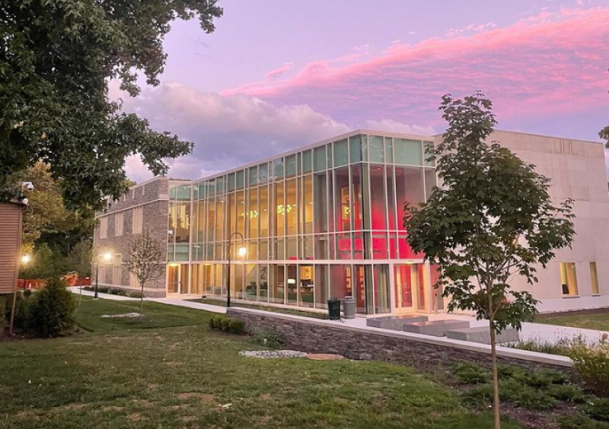
Career & Civic Engagement Center Competencies
(p. 1 of 2)
Social Responsibility: ethical behavior in relation to the groups and communities of which one is a part
Communication: articulation of thoughts and experiences to influence, inspire and explain
Conceptual Thinking: creative search for new ideas and solutions
Notes:
Have volunteers read these competencies

Slide 7

Career & Civic Engagement
Center Competencies
(p. 2 of 2)
Connection: establishment of authentic, purposeful relationships and collaboration with others
Cultural Competency: respectful engagement with people of diverse identities and backgrounds in different contexts
Implementation: thoughtful translation of ideas and theories into action
Reflective Practice: intentional synthesis of experiences, both successes and challenges, to make connections, explore meaning and inform future choices
Notes:
These Center Competencies ground all of the work we do in Career & Civic Engagement. Through experiential learning and community engagement, students explore the world and learn more about themselves. The leadership skills they develop and connections they build prepare students to pursue what matters most to them when they graduate.

Slide 8

Perspectives on Work
A Job / A Career / A Vocation
A Paycheck / A Journey / A Calling
All are valid ways to think about work! Throughout your life, you might shift in how you approach work. That's totally fine and normal!
Notes:
There are three main ways you can think about work:
As a job: lots of people think of work as something they do primarily for the stability and security of a paycheck and healthcare. Even if you find enjoyment in what you do, you might or might not think about what you do as being intimately linked with who you are.
A career: for someone driven to "work their way up" in terms of competence and prominence in their field. They are motivated to do well, gain influence, and lead others as they advance in their career over time.
A vocation: someone who feels their work is their true "calling" in life, often in a deep or spiritual way. Vocation: from the Latin, vocare, "to call" (like the word "vocal," "advocate," etc.)

Slide 9
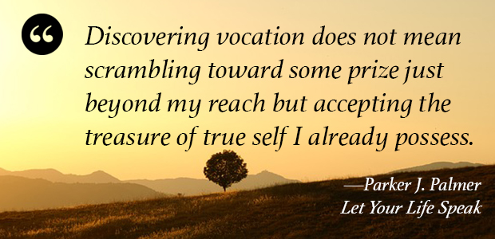

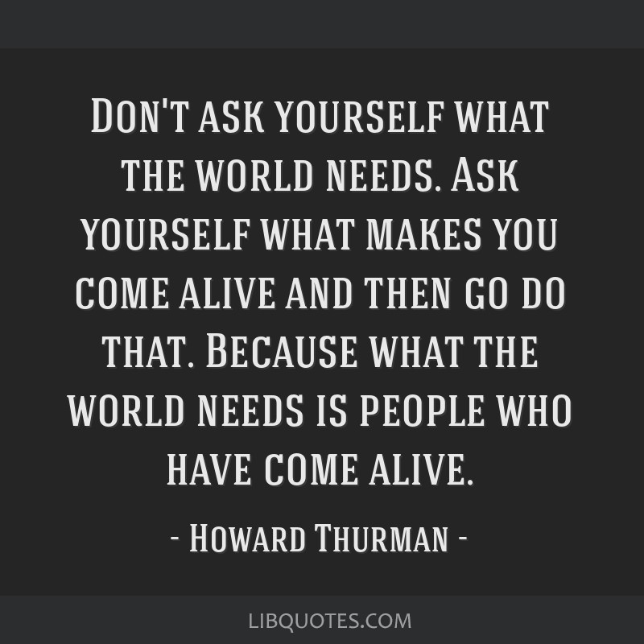
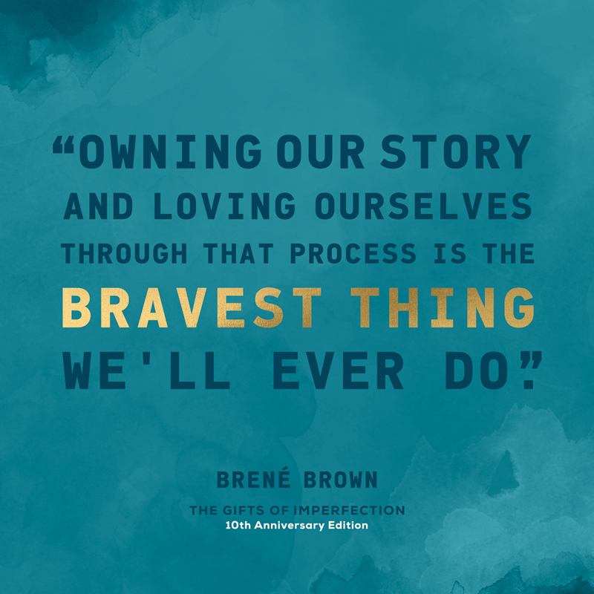
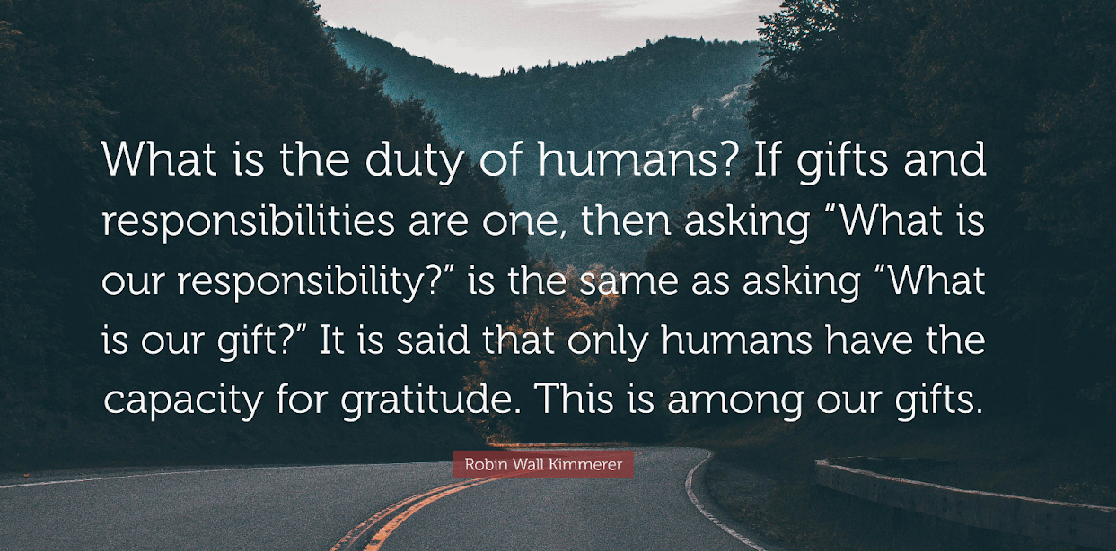
What is Vocation?
Notes:
There are many great thinkers who have some insightful perspectives on the concept of vocation.
Turn to a friend:
Which quote speaks to you the most?
Do you have a favorite quote up here? My favorite is the bottom right hand one, by Robin Wall Kimmerer, the author of Braiding Sweetgrass – she's an environmental scientist and member of the Citizen Podawatami Nation. In her indigenous culture, they approach the concept of vocation as thinking about what gifts we have been given, which can be tangible or intangible. They believe that, in order to be a truly educated person, you must know your gifts. They also believe all gifts bring with them a responsibility for the recipient to show gratitude by using that gift, paying it forward to help others. I like this quote because sometimes talking about strengths can feel uncomfortable or "braggy." I think reframing in terms of having gratitude and acknowledging the gifts you've been given can be helpful in that sense.
Do you see any similarities or differences between the quotes? Something that stands out to me: Knowing oneself is important to vocation. Noticing what brings you joy, what gifts and strengths you possess, and learning how to use them. This brings us to our next section, the StrengthsFinder!

Slide 10

Strengths - Why?
We are most successful (and happiest!) when we understand what our individual talents look like, how to use our talents purposefully, and how to work around or overcome areas where we may be lacking.
The strengths approach isn't just a good idea someone had. It is the result of a revolutionary, five-decade study of excellence.

Slide 11

Strengths - Why? (2)
Your greatest talents - the ways in which you most naturally think, feel and behave - represent your innate power and potential. You can think of them as gifts you were given, which you have a responsibility to use (to call back to Robin Wall-Kimmerer's definition of Vocation!)
Notes:
•Why focus on strengths? Shouldn’t we instead be fixing the things that hold us back? That’s the conventional wisdom, right? – focus on what’s wrong and fix it.
•Quick show of hands – How many of you spend more time or energy worrying or thinking about one bad test grade or subject rather than all the other great ones?
•It’s our culture to focus more on deficits than strengths. Then, in our capitalist society, they try to get you to buy things because they've sown a belief that there is something lacking or wrong with you.
•From Strengths-based approach, rooted in positive psychology, we can most successfully maximize our potential, happiness, and engagement when we focus on what’s unique and amazing about us – our strengths. It's the radical view that you are already enough.

Slide 12

Strengths
Through this research, they've identified 34 unique, individual strengths.
Everyone has them all, but in different rankings.
  Your report gives you your top five
  Don't remember your results? --> https://login.gallup.com/
The strengths all fall within 4 different leadership domains
  Executing = Purple
  Influencing = Orange
  Relationship Building = Blue
  Strategic Thinking = Green
Notes:
***Colors correspond to the strength themes on the next slide
Your individual reports found on the Gallup website provide valuable information for you to consider, including what your strengths mean, what domain they are connected to, tips for success, and applications
EXECUTING: these strengths answer the question "How do you make things happen?" They may help you turn ideas into reality. When teams need to implement a solution, they look to people with Executing themes who will work tirelessly to accomplish the goal.
INFLUENCING: these strengths answer the question "How do you influence others?" They may help you take charge, speak up and make sure others are heard. When teams need to sell their ideas inside and outside the organization, they turn to people with Influencing themes to convince others.
RELATIONSHIP BUILDING: these strengths answer the question "How do you build and nurture strong relationships?" They may help you hold a team together. When teams need to be greater than the sum of their parts, they turn to people with Relationship Building themes to strengthen their bonds.
STRATEGIC THINKING: these answer the question "How do you absorb, think about and analyze information and situations?" They may help you make better decisions and create better outcomes. When teams need to focus on what could be, they turn to people with Strategic Thinking themes to stretch the team's thinking for the future
.

Slide 13
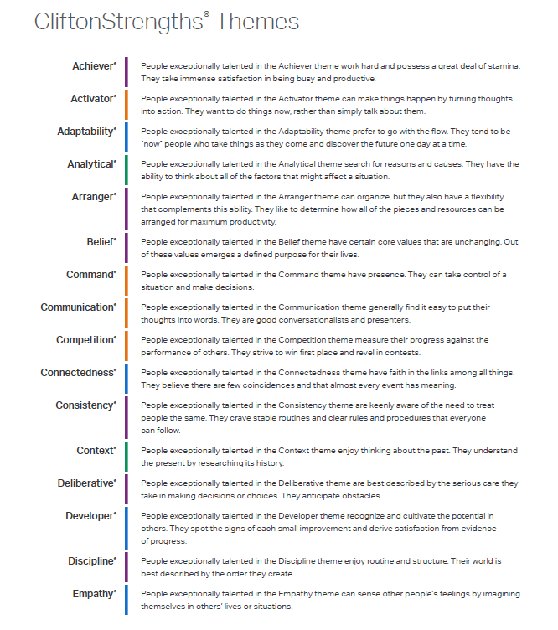
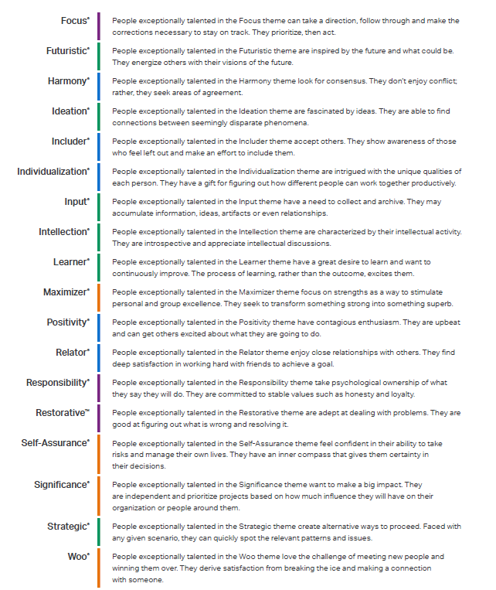

Clifton Strengths Themes
Notes:
•Themes help you begin to discover and talk about your greatest talents, and it gives us a common language.
•Among these 34 themes, no one is more special or better than another. Themes are neutral and every one has value.
•Fun Fact: Similar to a fingerprint, your signature themes are unique to you. The odds that someone has the same top 5 signature themes in the same order as you is 1 in 33 million.

Slide 14
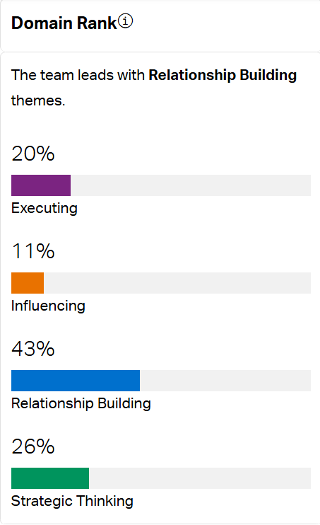
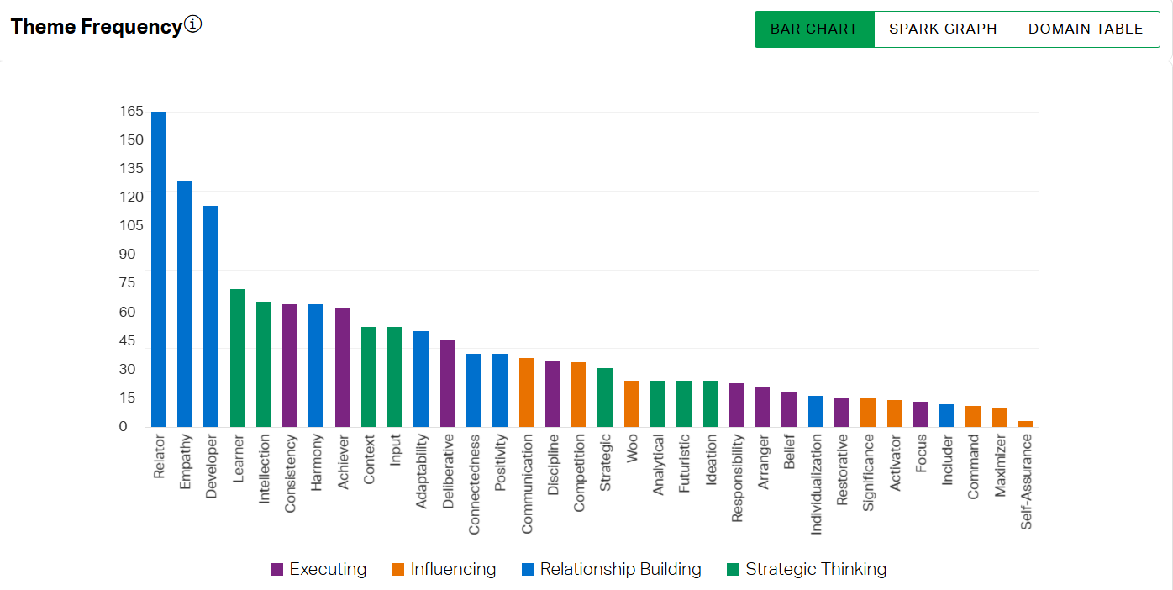
Class of 2029 – Strengths (260 responses)
Notes:
This data is from the class of 2029!
Top strength: Relator (top 3 are all relationship building strengths!)
Least common strength: Self-Assurance (bottom 3 are all in the "influencing" category!)

Slide 15
Gather in groups!
Please move to the assigned area of the room for the domain that is most represented in your Top 5.
(Gather with other people who have similar types of strengths to you.)
If you haven't completed the StrengthsFinder, go to the part of the room with the strength category that resonates most with you.
  Reminder :)
  Executing = Purple
  Influencing = Orange
  Relationship Building = Blue
  Strategic Thinking = Green

Slide 16

Group Discussion: 5 min.
What was your first reaction to seeing your Top 5 strengths?
What is great about having the strengths that you have? Are there any drawbacks to those strengths, as well?
Can you think of a time when you used one or more of your top 5 strengths? What was that experience like for you?
  Reminder :)
  Executing = Purple
  Influencing = Orange
  Relationship Building = Blue
  Strategic Thinking = Green
Notes:
It's true that every strength has positive aspects, but they all also have the potential to be taken to excess, to hold you back in certain ways, etc. (e.g. someone great at doing research and analyzing might get stuck in "analysis paralysis" and indecision. Someone with lots of empathy can be prone to emotional burnout. Etc.) Knowing the possibility for these tendencies can help you use your strengths the most effectively!
If you haven’t completed your Strengths yet, what area do you think might be your top? What resonates with you?

Slide 17

For further reflection and exploration:
You can make an appointment with a career counselor to talk about your strengths, your intended major or interest areas, and how they might intersect!
You're also encouraged to make an account on MawrterConnect (like an internal LinkedIn for Mawrters!) and complete the PathwayU assessments. PathwayU will give suggestions for potential career paths that are a good fit for your personality, interests, and values!
Notes:
If you're someone who likes taking personality tests, learning about things like your Myers Briggs type and how your leadership style shows up in different settings, you'll really like PathwayU!

Slide 18
Career & Civic Engagement Programs, Resources, & Opportunities
The next slides will guide you through our programs, resources, and opportunities. We've organized them based on research on the stages of college student career development:
  Self-Reflection: Identifying your strengths, interests, values, and goals
  Preparation: Using available resources to help you get ready for what's next
  Exploration: Learning about the world around you, opportunities, and fields of work
  Experience: Putting values into action, gaining experience, and practicing skills
Note: Personal development (career or otherwise) is rarely linear! You may revisit the "earlier" stages of Self-Reflection, Preparation, and Exploration as often as you'd like! (It's not just okay, it's encouraged!)

Slide 19

Career & Civic Engagement
Programs, Resources, & Opportunities for Self-Reflection
Career Counseling Appointments
  General career counseling, values card sort activity, resume writing, PathwayU or Clifton Strengths assessments
  You do NOT have to have a specific "task" to work on (i.e. job you're applying to, etc.) in order to make a career counseling appointment!
"What Can I Do with This Major?" Tool
  An online resource where you can browse by major and see the career fields people with that major tend to go into! It is nice to look through and notice what you feel drawn to.
Handshake
  Our database where you can learn about upcoming Career & Civic events and programs, as well as job and internship opportunities. We encourage you to browse through and see what stands out to you!
Design-Your-Life
  Offered as a 1-credit PE course, or use the self-guided book/workbook available in the Well for free! Uses design principles and generative activities to approach life with curiosity and possibility!

Slide 20
Career & Civic Engagement
Programs, Resources, & Opportunities for Preparation (1 of 2)
Career Counseling Appointments
  Resume/CV/Cover Letter, Mock Interviews, Personal Statement Support
  Meet with a Career Counselor (professional staff) or a Career Peer (trained student staff)
Voter Registration, Voting Day Shuttle
  Forms pre-printed, addressed and stamped envelopes, and staff to answer any and all questions!
Career Closet
  Professional clothing, free to borrow or keep! Come in any time M-F 9:00-5:00 and ask the front desk to browse. :)
Interview Rooms
  Available to reserve if you need a quiet, private space to do a job or grad school interview!
Mini Grants
  Up to $200 per student per year to attend professional conferences, support civic engagement and activism (e.g. fund transportation to a rally/march), fund test prep materials or curriculum

Slide 21
Career & Civic Engagement
Programs, Resources, & Opportunities for Preparation (2 of 2)
Intensives: Technical Trainings
  We typically hold 18 or more virtual technical skill training intensives each year, in partnership with AESOP Academy. These trainings cover sought-after technical skills such as Excel, SQL, Tableau, and AI for Analysts.
Forte Foundation Career Ready Certificate
  Self-guided 25-30 hour program for students interested in going into business fields
MawrterConnect
  Like an internal LinkedIn for BMC students and alums! Includes PathwayU, an assessment tool that can help you think about what jobs align best with your personality and values
Job & Grad School "Bootcamp"
  Takes place for 1 week before the start of fall semester. Typically 40-60 students participate per year. Involves site visits to various employers.

Slide 22


Resources at BMC
The Career Closet!
Bryn Mawr College Votes – look for this logo for voting resources on campus!

Slide 23
Career & Civic Engagement
Programs, Resources, & Opportunities for Exploration
Career Counseling Appointments
  Internship Search, Job Search, Networking & LinkedIn, Grad School Search & Application Support
Career Fairs and Meet-Ups
  Tri-Co Career Fair takes place once per semester (will be @BMC in January!)
  Meet-ups are like a mini career fair, less formal, and focused on a specific topic or field (e.g. Museums Meet-up, Inclusive Hiring Meet-up, Publishing & Journalism Meet-up, Environment & Sustainability Meet-up)
Externship Program
  During winter break and spring break, match with an alum for a virtual or in-person job shadowing opportunity
Employer & Alum 1:1s
  We often host employers and alums at the Well; see Handshake to sign up for a 1:1 chat!
Forte Foundation Conferences
  Emerging Leaders, Fast Track to Finance, and more!
Listen/Learn/Connect
  Series of alum panels on a variety of topics (e.g. data science careers, nonprofit careers, communications & marketing, government & politics)

Slide 24

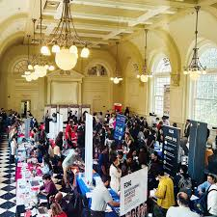
Photos from a Tri-Co Career Fair :)

Slide 25
Career & Civic Engagement
Programs, Resources, & Opportunities for Experience
Volunteer Opportunities
  Connect with one-time and ongoing volunteer programs, e.g. tutoring and after-school programs where you can volunteer along with other BMC students
Intensives
  ~25 programs per year that are typically 1-5 days in length. Explore an area of personal or professional interest in a hands-on way while building your network and skills! (e.g. Storytelling, Entrepreneurship, Policy Seminars in DC, Finance trek to NYC, and more!)
Praxis
  Academic internships in partnership with nonprofit organizations!
Summer of Service
  Provides funding and on-campus housing for a cohort-based summer non-profit internship
Beyond Bryn Mawr Internship Funding &/or Academic Credit Opportunities
  Annual application process to receive full funding to support students in unfunded or under-funded summer internships. >100 students received funding last year!

Slide 26
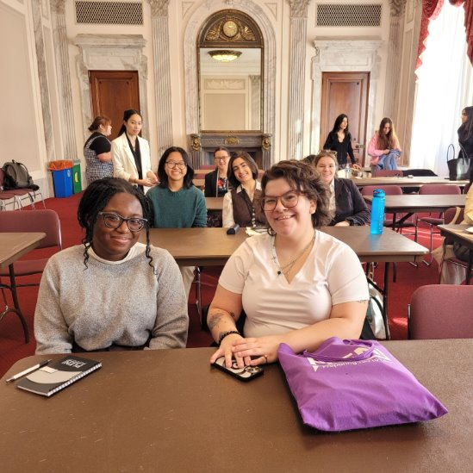

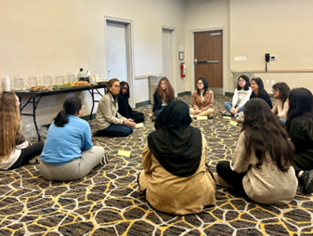
Photos from Intensives
(L to R: PLEN Public Policy Seminar in Washington DC, Finance Trek in NYC, and Entrepreneurship & Innovation Retreat in Philadelphia)

Slide 27
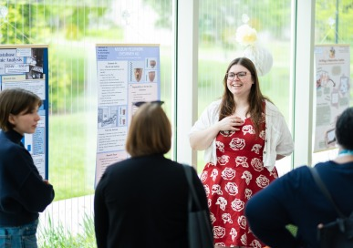
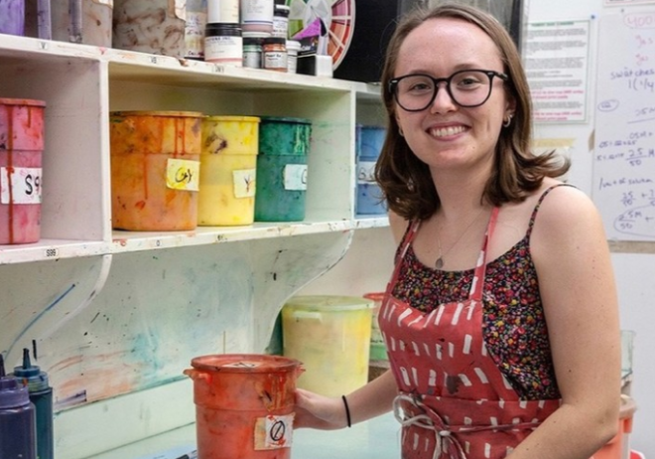
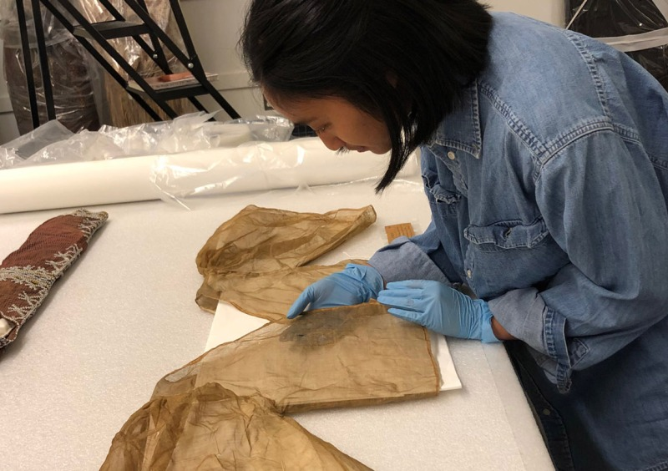
Photos from Praxis
Photo from a Praxis Poster Session
Photos of Praxis in action!

Slide 28
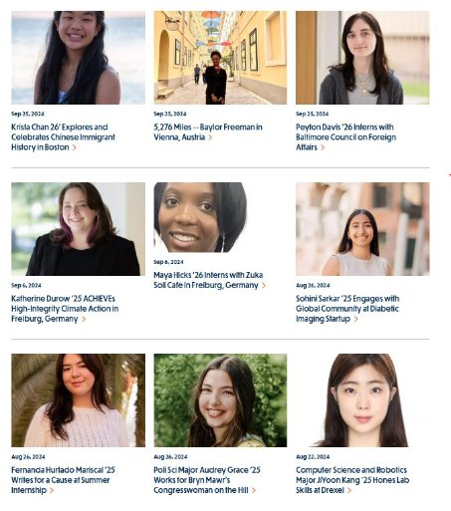
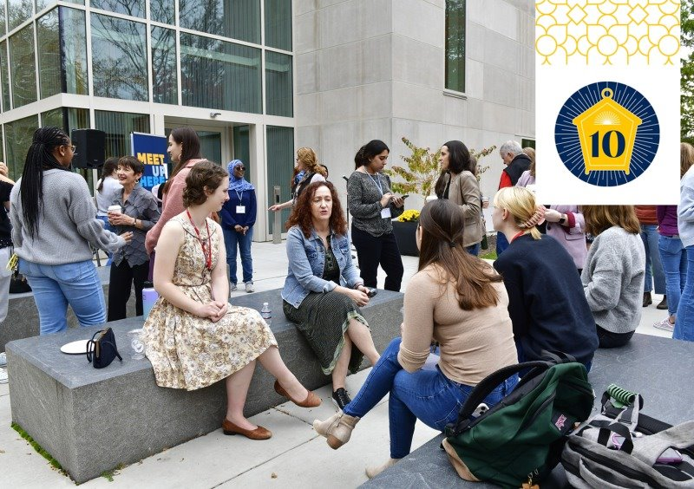
Summer Interns share their experiences at Bryn Mawr & Beyond Celebration each fall! (During Owls Fest!)

Slide 29
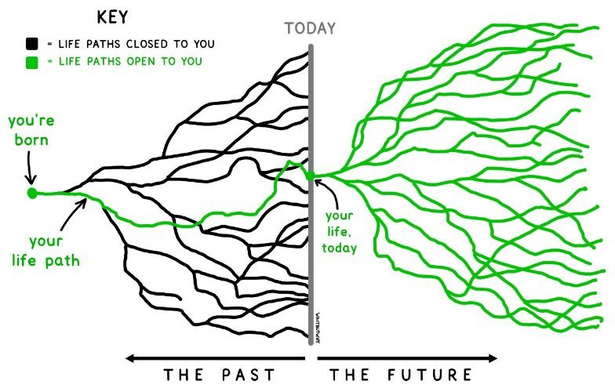
Graphic of Life Paths

Slide 30

Design Your Path!
This activity is based in research on the stages of career development for college students:
  Self-Reflection: Identifying your strengths, interests, values, and goals
  Preparation: Using available resources to help you get ready for what's next
  Exploration: Learning about the world around you, opportunities, and fields of work
  Experience: Putting values into action, gaining experience, and practicing skills
Reminder: Personal development (career or otherwise) is rarely linear! You may revisit the "earlier" stages of Self-Reflection, Preparation, and Exploration as often as you'd like! (It's not just okay; it's encouraged!)
This is a continuous, lifelong process. You've already begun, and you will continue this process well beyond your time at Bryn Mawr!
Use the handout provided to select up to 4 of the programs, opportunities, and resources from each column that you are interested in pursuing. See the back of the sheet for an example!

Slide 31
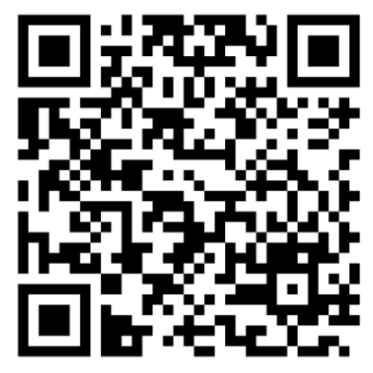
Staying Connected :)
Handshake: brynmawr.joinhandshake.com and this QR code -->
  For appointment scheduling, finding & registering for events, and job/internship search!
Drop-in Appointments daily (M-F, 2:00-3:00 p.m, S-TH 7:00-8:00 p.m)
Sample of Upcoming Events:
  Listen, Learn, Connect with Social Science Graduates: Fri. Nov. 7th, 12:00-1:30 in Wyndham Alumnae/i House, Ely Room
  Bi-Co Alumni in Law School Virtual Panel: Wed. Nov. 12th, 6:00 p.m.
  Technology + Data Science & Analytics Virtual Info Session (NBC Universal Internships): Thurs. Nov. 13th, 7:00 p.m.
  Museums Meet-Up: Fri. Nov. 14th, 1:00 p.m. in the Well
  Forte and You: A Fireside Chat w Kayinsola Abiana: Mon. Nov. 17th, 6:30 p.m. in Campus Center
  Summer Global Opportunities Fair: Thurs. Nov. 20th, 2:00 p.m. in the Well
  Tableau Basics (data dashboard/visualization software) Virtual Training: Sat. Nov. 22nd, 11:00 a.m.
  Tableau Advancement (data dashboard/visualization software) Virtual Training: Sun. Nov. 23rd, 11:00 a.m.
Notes:
We're all on our journey and trying to figure things out. You don't have to do it alone. We are here with you and with LOTS of resources to share!

Slide 32
Reminder: Required Assignments
Attend Campus Philly or Complete Alternate Assignment
Black at Bryn Mawr Tour (Virtual or In person)
Strengths Quest
Philly Project (Next Week)
All Assignments must be completed by the end of the course! Email Andrew Wilbraham at awilbraham@brynmawr.edu if you have any questions

Slide 33

PRESENTATIONS ARE NEXT WEEK!
This Photo by Unknown author is licensed under CC BY-NC.

Slide 34
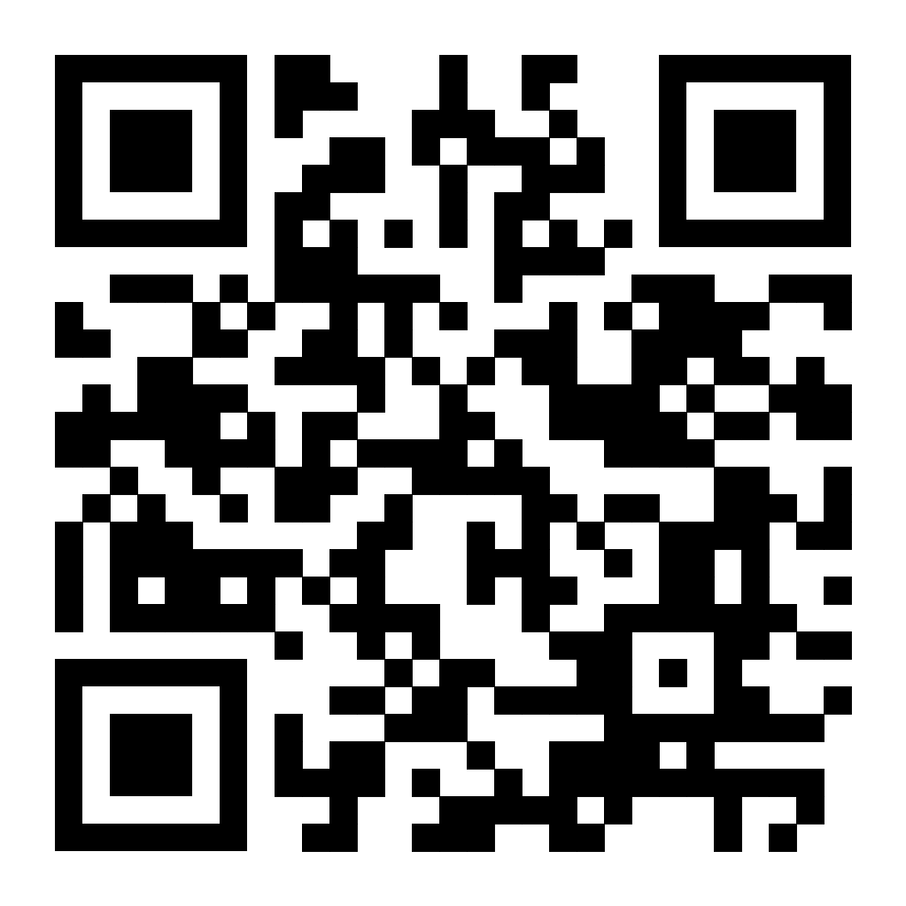
Sense of Belonging Survey

