Slide 1
Introduction to biochem
Chemistry from a biological perspective

Slide 2
Key concepts for review
What is biochemistry?
Limited conditions for biochemistry
  pH, aqueous, temperature
WATER!!!!
Bonding
Amino Acids and their properties
Protein structure and function
  Bonding
  Why pH matters
  Significance of seemingly minimal structural differences

Slide 3
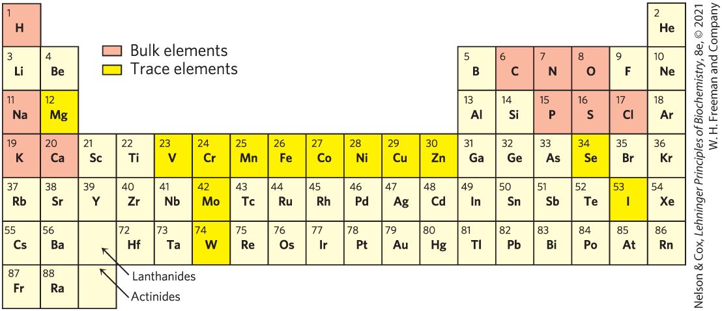
Simplified period table for the biochemist
When are we interested in some of the non-shaded elements?
What sorts of pH and temperature conditions do we expect? Exceptions?
Notes:
FIGURE 1–12 Elements essential to animal life and health. Bulk elements (shaded orange) are structural components of cells and tissues and are required in the diet in gram quantities daily. For trace elements (shaded bright yellow), the requirements are much smaller: for humans, a few milligrams per day of Fe, Cu, and Zn, even less of the others. The elemental requirements for plants and microorganisms are similar to those shown here; the ways in which they acquire these elements vary.

Slide 4
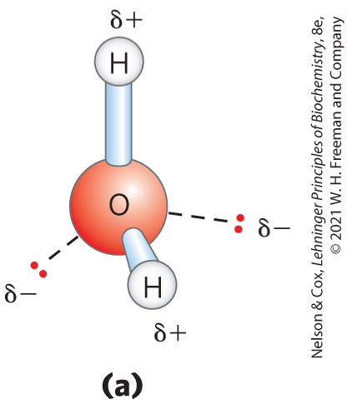
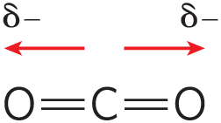
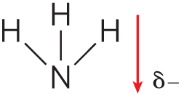
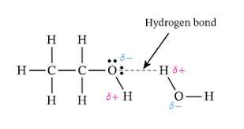
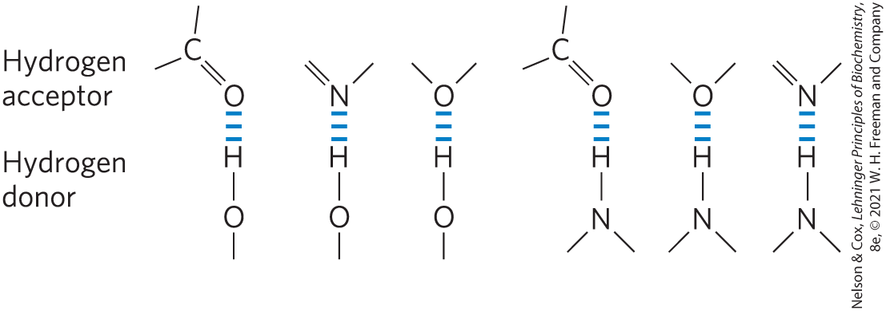
Why is the polarity of bonds important?
What kinds of bonds will we consider?

Slide 5
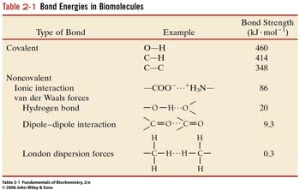
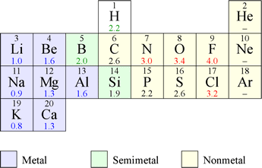
Noncovalent bonds
Electronegativity is key for polar bonds
All of the values for bond strength are approximate and depend upon the specific context.
Calculate the difference in electronegativity to determine how polar the bond is.

Slide 6
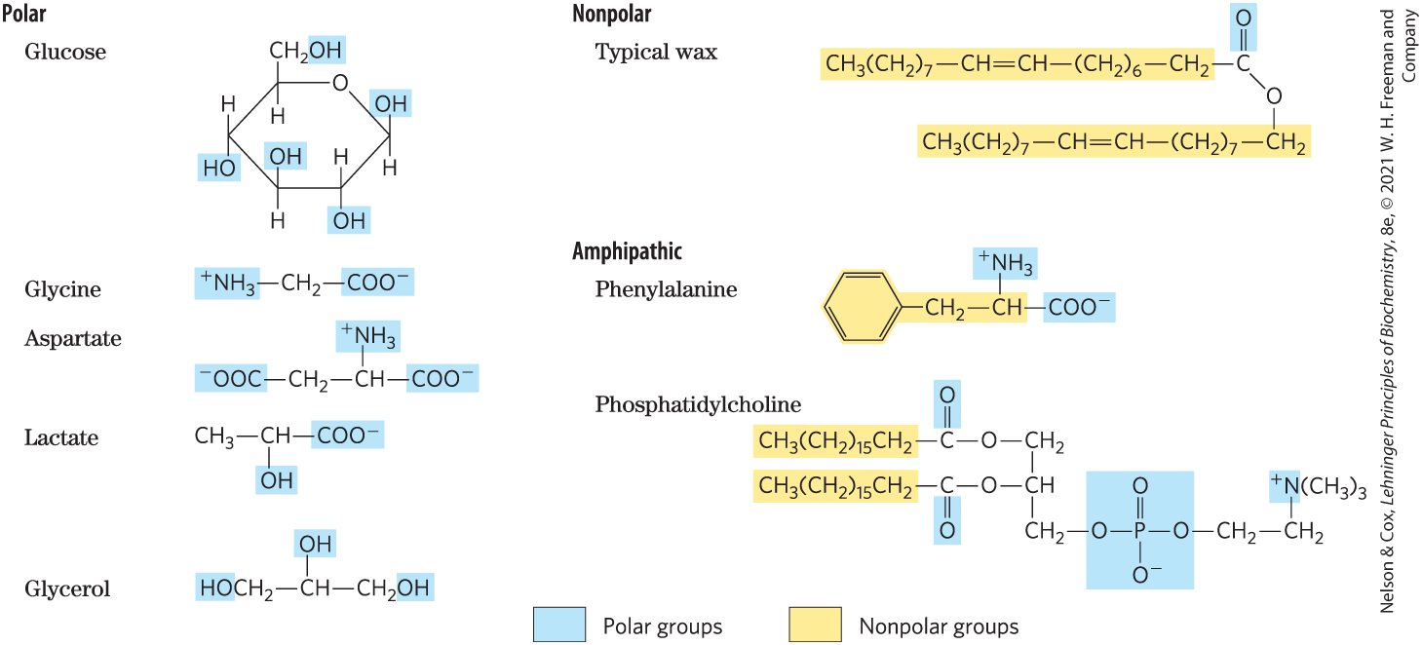
Properties of some common biological molecules
Is any molecule entirely polar? Nonpolar?
What about the groups that aren’t shaded?
Why is polarity important to consider?

Slide 7
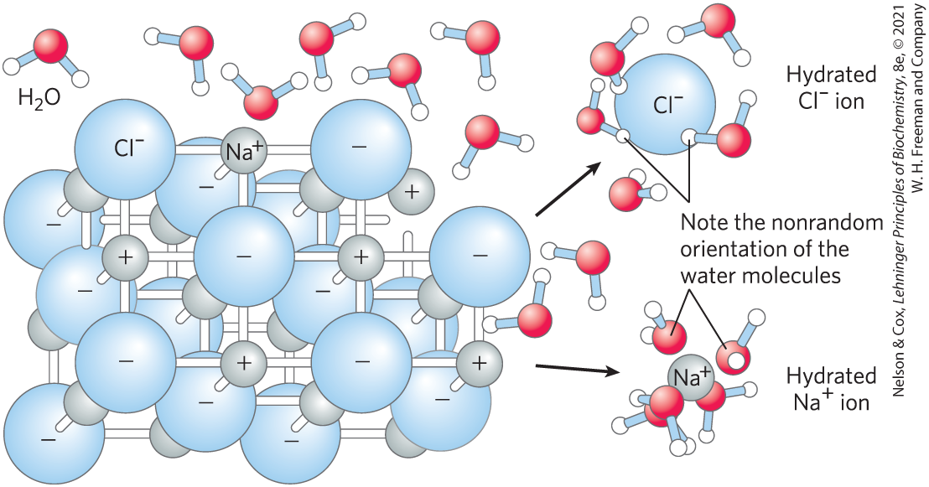
What happens to salts/ions in water?
How is entropy changing as the salt dissolves?

Slide 8
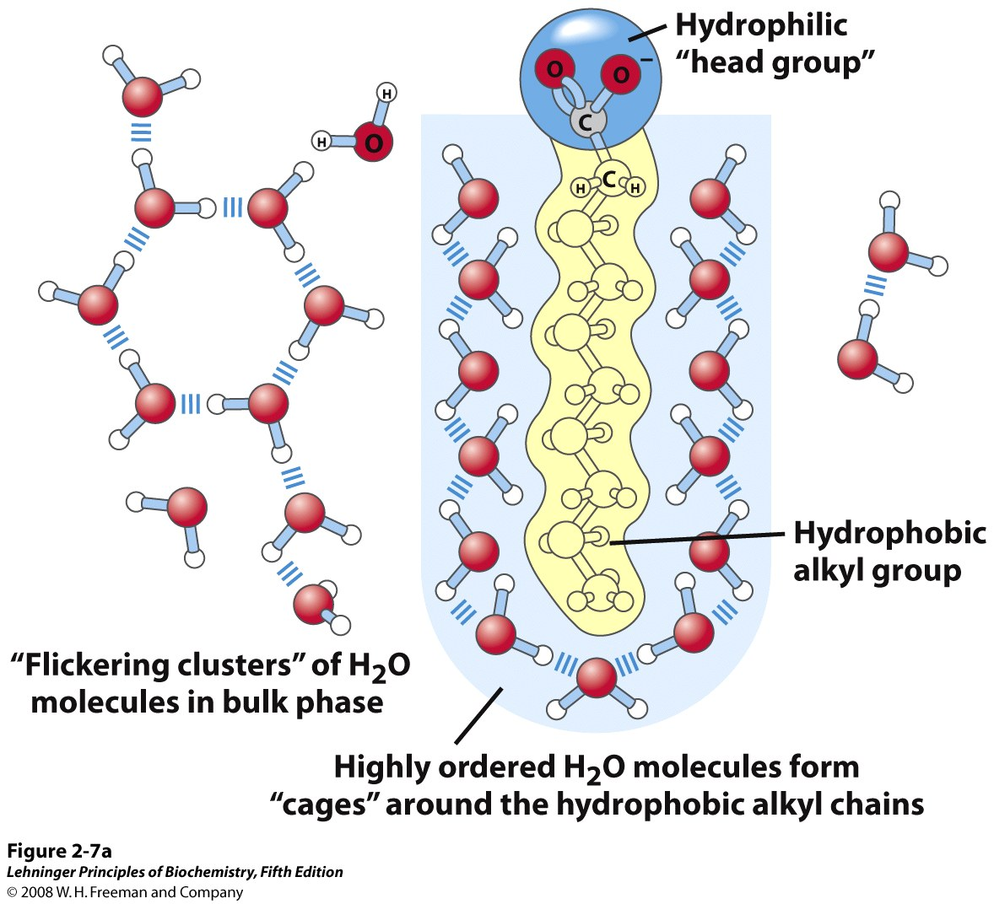
The behavior of an isolated amphipathic molecules in water
Dissolving amphipathic molecules in H₂O is energetically unfavorable.
No compensating interactions make up for the loss of entropy in the water.
Notes:
FIGURE 2-7a Amphipathic compounds in aqueous solution. (a) Long-chain fatty acids have very hydrophobic alkyl chains, each of which is surrounded by a layer of highly ordered water molecules.

Slide 9
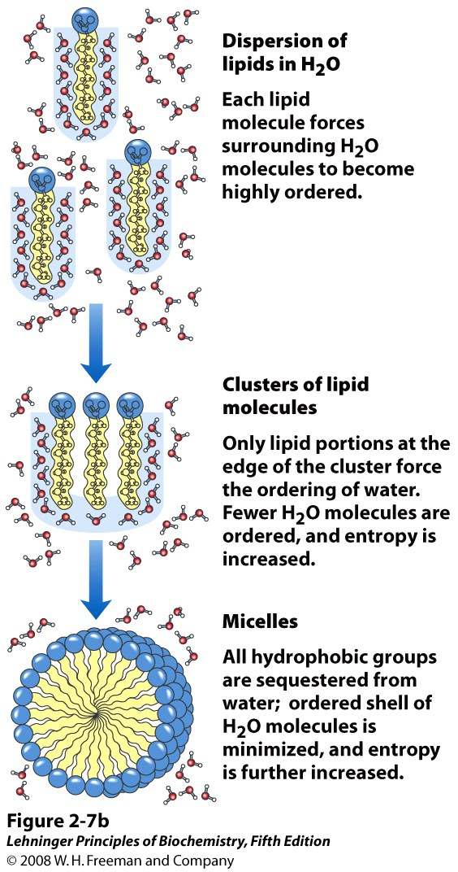
Energetically, we want to expose the minimum amount of the hydrophobic surface to the aqueous solvent.
Thus, when the hydrophobic bits pack together, entropy is increased.
This is what explains the hydrophobic effect.
Note: there are NO attractive forces between h-phobic bits.
Notes:
FIGURE 2-7b Amphipathic compounds in aqueous solution. (b) By clustering together in micelles, the fatty acid molecules expose the smallest possible hydrophobic surface area to the water, and fewer water molecules are required in the shell of ordered water. The energy gained by freeing immobilized water molecules stabilizes the micelle.

Slide 10
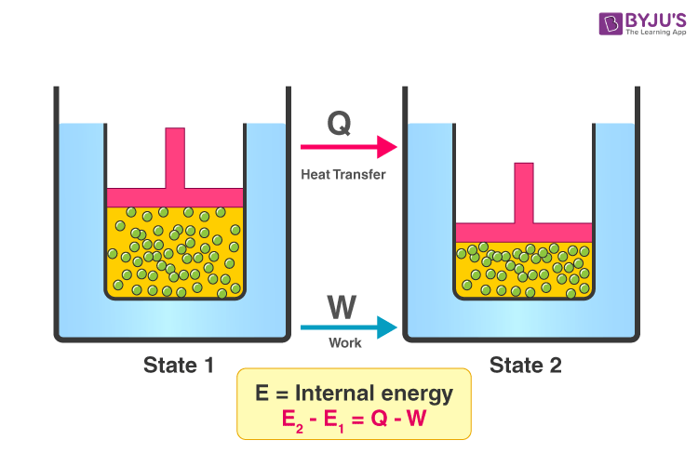
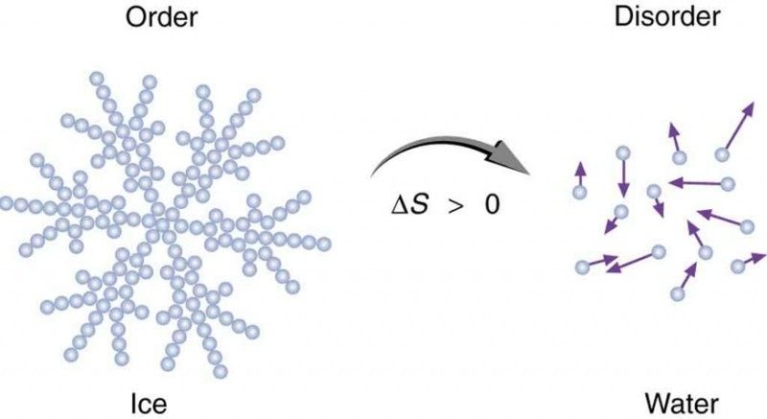
Thermodynamics
First law: conservation of energy (energy is neither created nor destroyed)
Second law: Energy conversions are not 100% efficient; entropy is increasing*

Slide 11
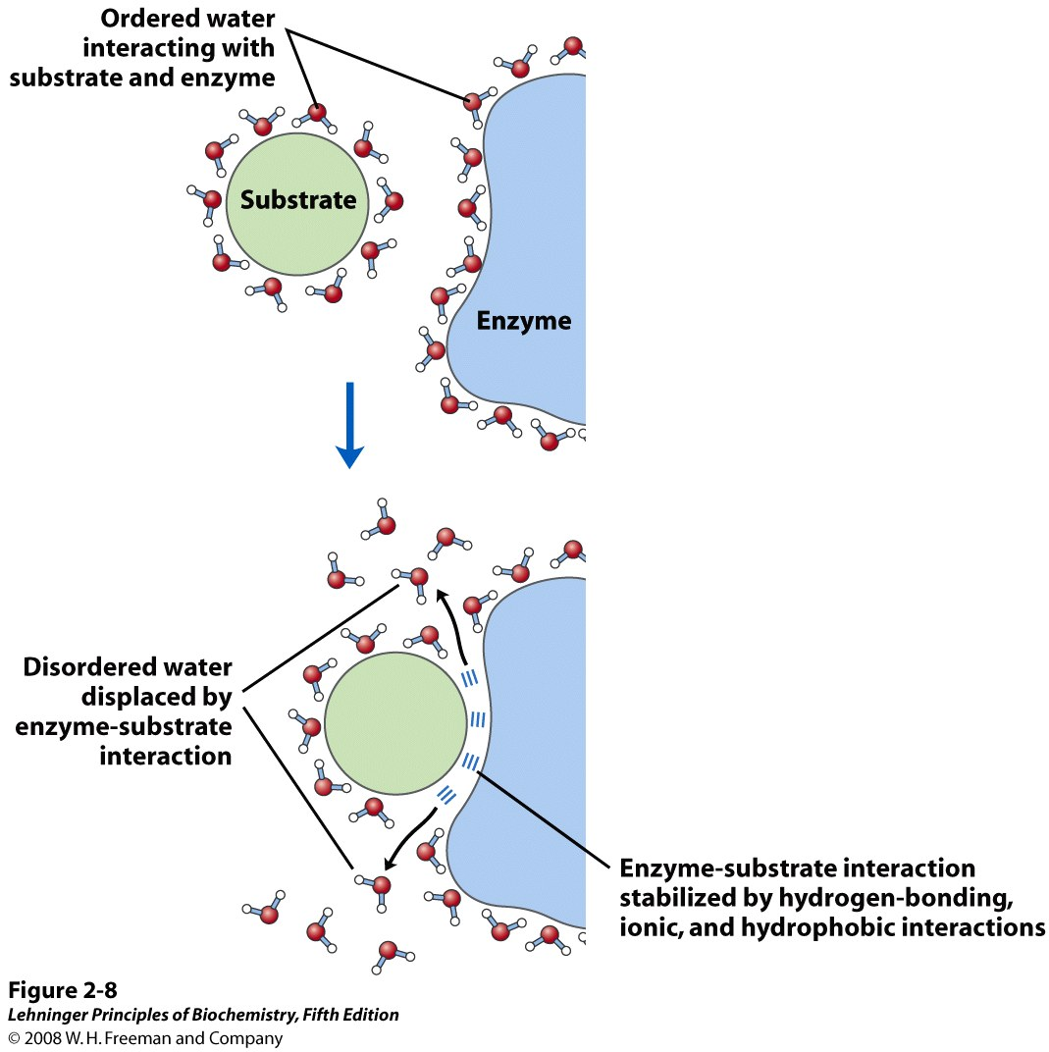
Why are biochemical reactions dominated by changes in entropy and not enthalpy?
Release of ordered waters increases entropy. This helps compensate for the decrease in entropy upon forming the complex.
How is the number of bonds changing?
Is it “better” if the binding site is hydrophobic or hydrophilic?
Notes:
FIGURE 2-8 Release of ordered water favors formation of an enzyme-substrate complex. While separate, both enzyme and substrate force neighboring water molecules into an ordered shell. Binding of substrate to enzyme releases some of the ordered water, and the resulting increase in entropy provides a thermodynamic push toward formation of the enzyme-substrate complex (see p. 192).

Slide 12
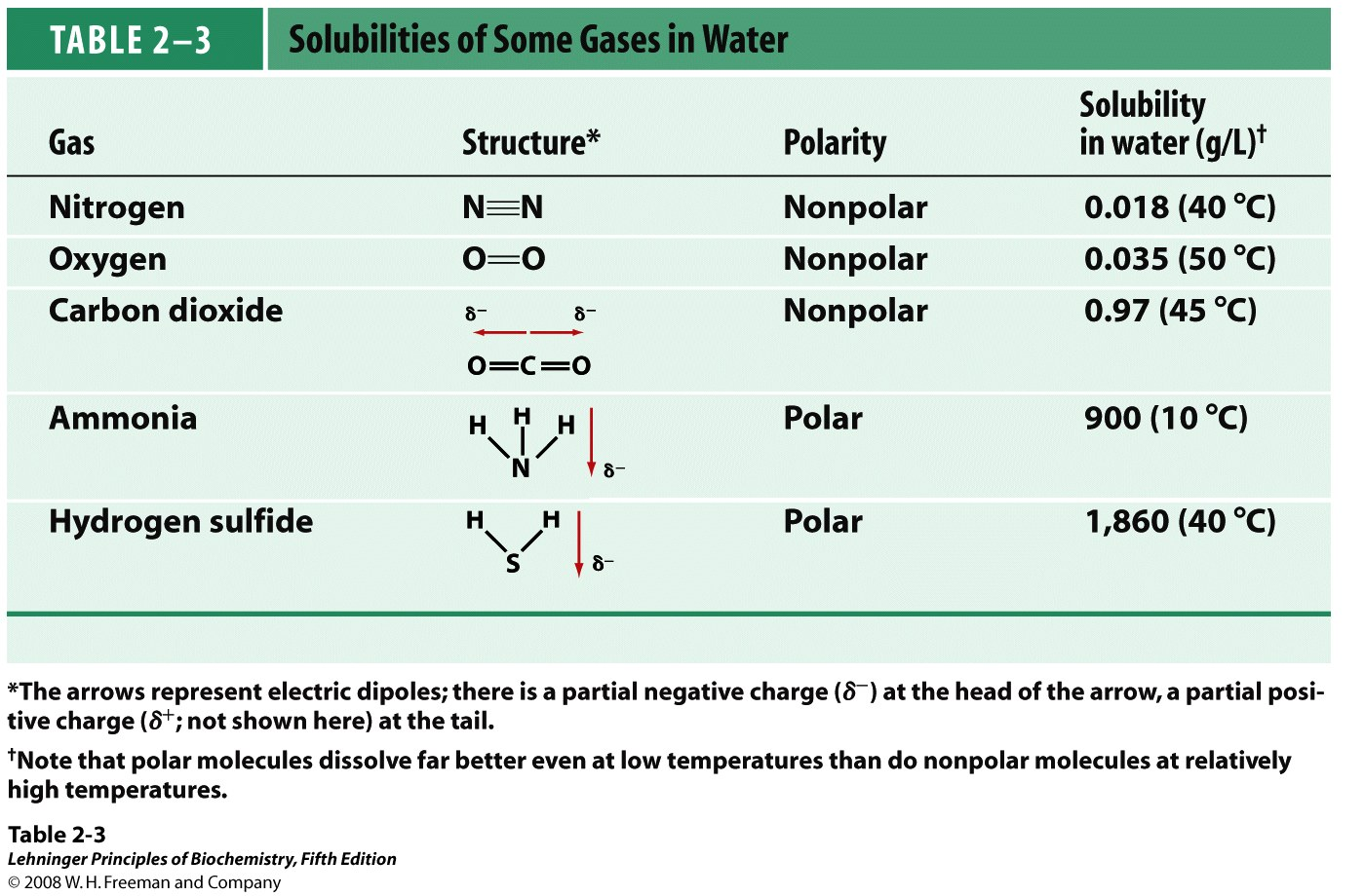
Why is it important to consider the solubility of gases? What makes a gas more soluble?

Slide 13
Amino Acids and peptides

Slide 14
Why are amino acids so key?

Slide 15
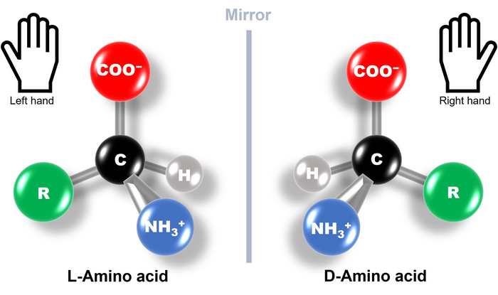
Amino Acids
The building blocks of proteins
What defines an amino acid?
Number?
  Are they all found in proteins?
  Are they all encoded in the genome?
Chiral?
Which Isomer is found in proteins?

Slide 16
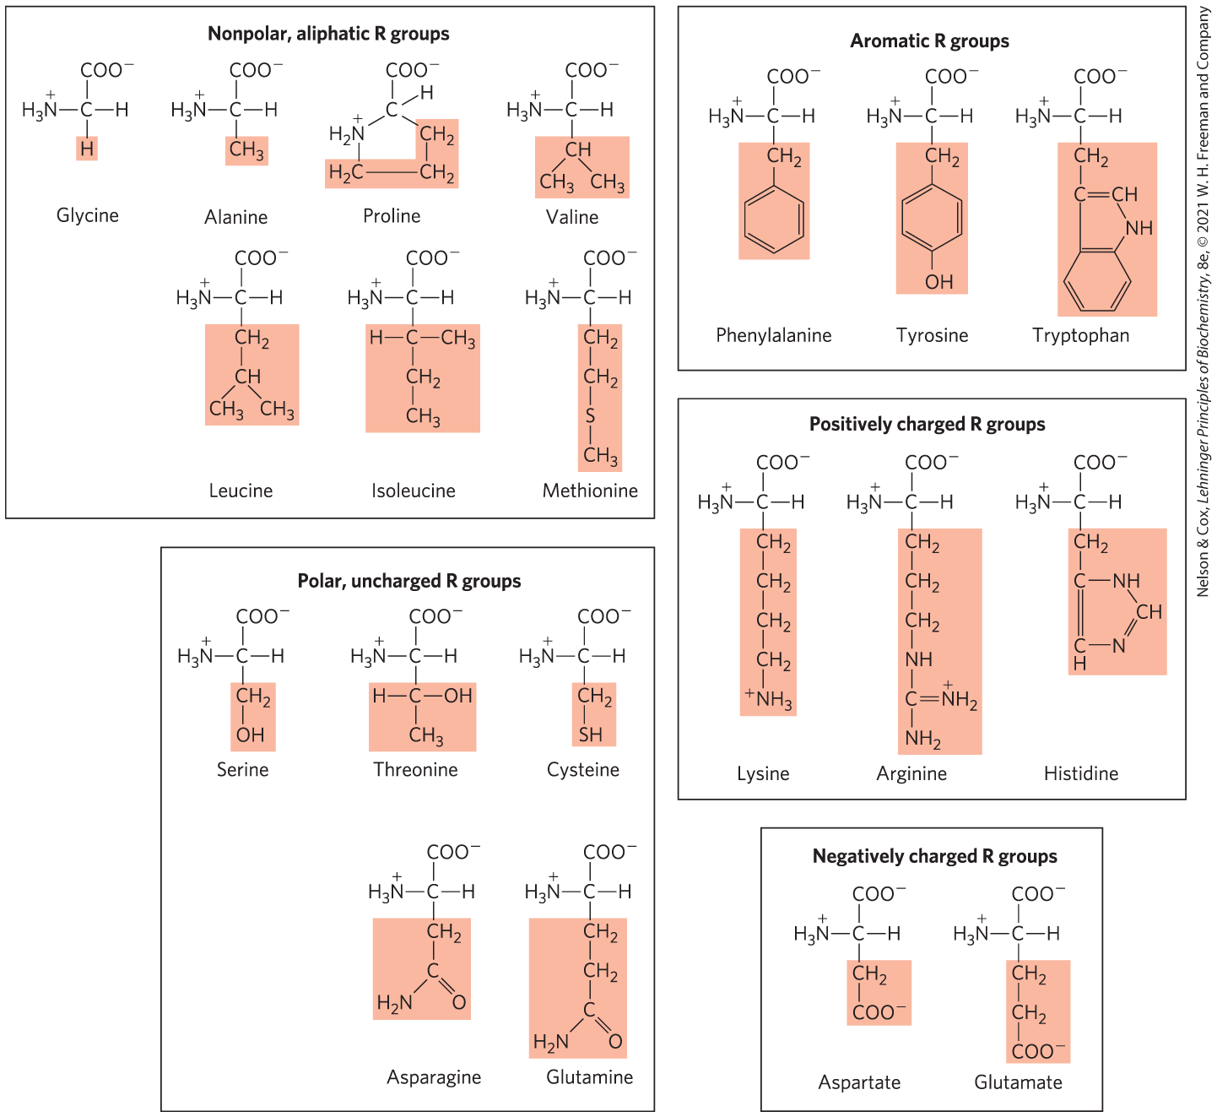
Classic categorization of amino acid R-groups
Why are we only characterizing by R-group and not the whole molecule?
Why is histidine shown uncharged but classified as positively charged?
*
Notes:
FIGURE 3-5 (part 5) The 20 common amino acids of proteins. The structural formulas show the state of ionization that would predominate at pH 7.0. The unshaded portions are those common to all the amino acids; the portions shaded in pink are the R groups. Although the R group of histidine is shown uncharged, its pK_{a} (see Table 3-1) is such that a small but significant fraction of these groups are positively charged at pH 7.0. The protonated form of histidine is shown above the graph in Figure 3-12b.

Slide 17
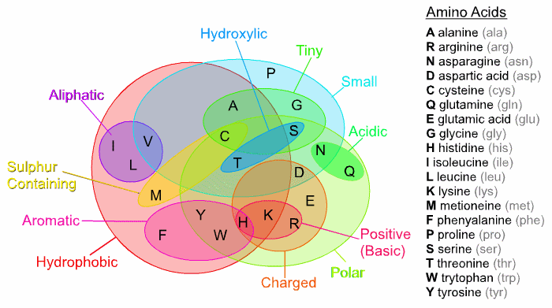
Other classifications
Strictly, only C and H in R group, not aromatic
Many R-groups can be classified in more than one way. What is strange about how we refer to acidic and basic R groups?

Slide 18
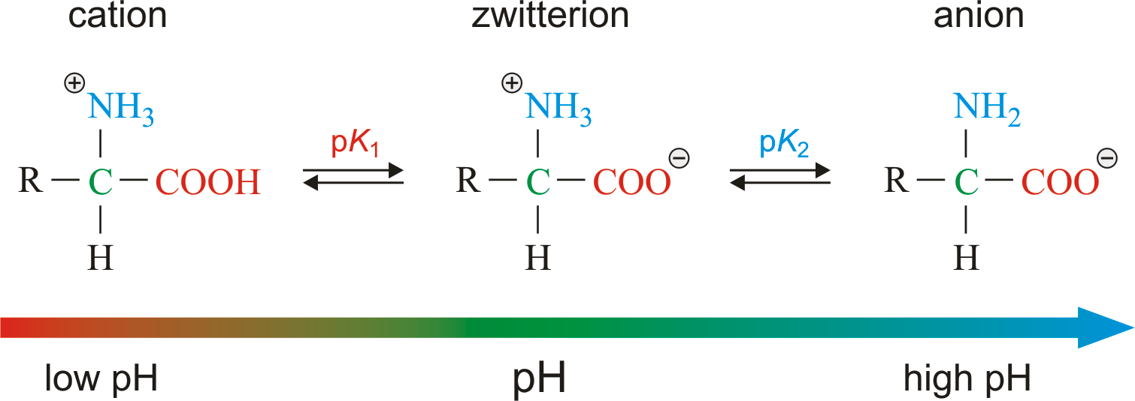
In aqueous solution, amino acids generally exist in their zwitterionic form
Ignoring the R-group, the net charge is zero at neutral pH.
Notes:
https://glossary.periodni.com/glossary.php?en=zwitterion
The nonionic form does not occur in significant amounts in aqueous solutions. The zwitterion predominates at neutral pH. A zwitterion can act as either an acid (proton donor) or a base (proton acceptor).

Slide 19
Ionization of Amino Acids
At acidic pH, the carboxyl group is protonated (COOH) and the amino acid is in the cationic form.
At neutral pH, the carboxyl group is deprotonated (CO⁻) but the amino group (NH₃⁺) is protonated. The net charge is zero; such ions are called Zwitterions.
At alkaline pH, the amino group is neutral (NH₂) and the amino acid is in the anionic form.

Slide 20
Isoelectric Point
The isoelectric point (pI) is the pH at which the amino acid has an overall zero charge.
Isoelectric Point (pI) for an uncharged amino acid is the average of the pKa values for its amine and carboxyl groups.
For charged amino acids:
  The pI of an acidic amino acid is obtained by averaging the two most acidic pKa values. (see figure 3-1 from text).
    For example, the pI of aspartic acid is (1.88 + 3.65)/2 =2.77
  The pI of a basic amino acid is obtained by averaging the two most basic (least acidic) pKa values.

Slide 21
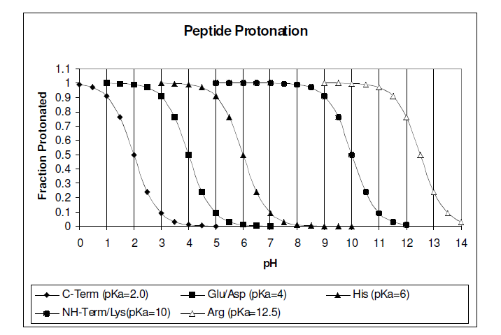
Fractional protonation of some amino acid groups
If we are at around pH 7 in the cell, what do we expect? Are there places in the body that aren’t pH 7ish?

Slide 22
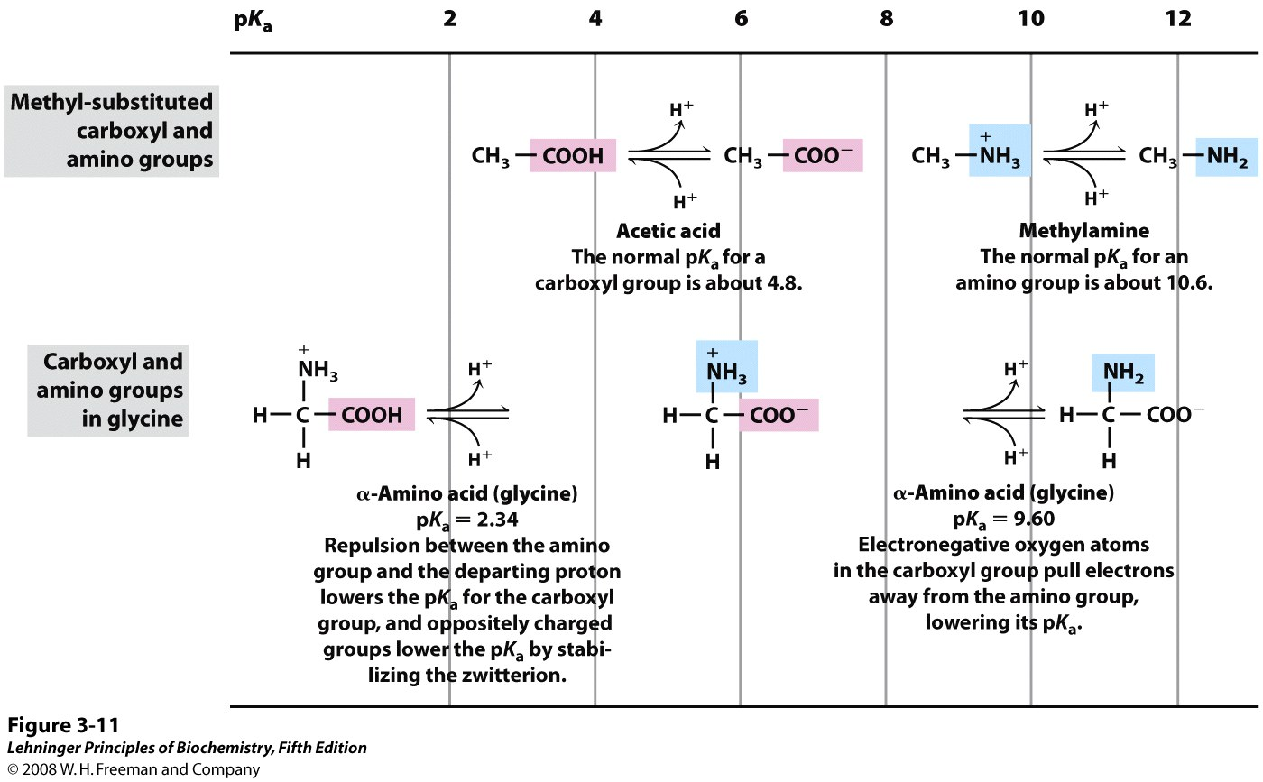
The chemical environment can affect the pK_{a} of a group.
Notes:
FIGURE 3-11 Effect of the chemical environment on pK_{a}. The pK_{a} values for the ionizable groups in glycine are lower than those for simple, methyl-substituted amino and carboxyl groups. These downward perturbations of pK_{a} are due to intramolecular interactions. Similar effects can be caused by chemical groups that happen to be positioned nearby—for example, in the active site of an enzyme.

Slide 23
Amino acids with special properties
Glycine
Proline
Histidine
Cysteine
Tyrosine and tryptophan
Acidic and Basic
  With a full + or – charge, can make ionic and h-bonds
Serine, threonine and tyrosine (together)
  Can be phosphorylated by a kinase

Slide 24
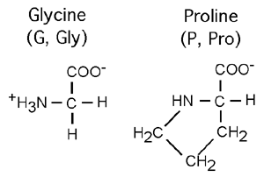
Glycine and Proline
Glycine, the smallest amino acid, can fit in tight spots.
  With just H as the R group, no steric hindrance and many more dihedral angles allowed. Not chiral.
Proline, the amino acid whose side chain loops around, is constrained and bent.

Slide 25
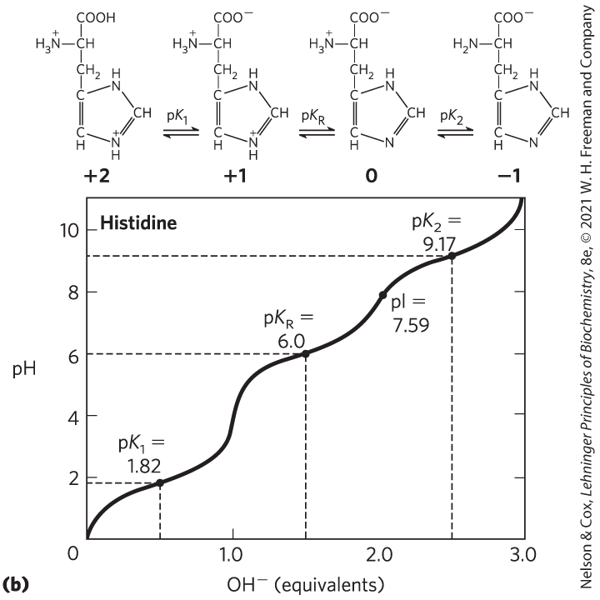
Histidine is a special case amino acid
At pH 6.0, 50-50. About 5% protonated at pH 7.3
Notes:
FIGURE 2-19 Ionization of histidine. The amino acid histidine, a component of proteins, is a weak acid. The pK_{a} of the protonated nitrogen of the side chain is 6.0.

Slide 26
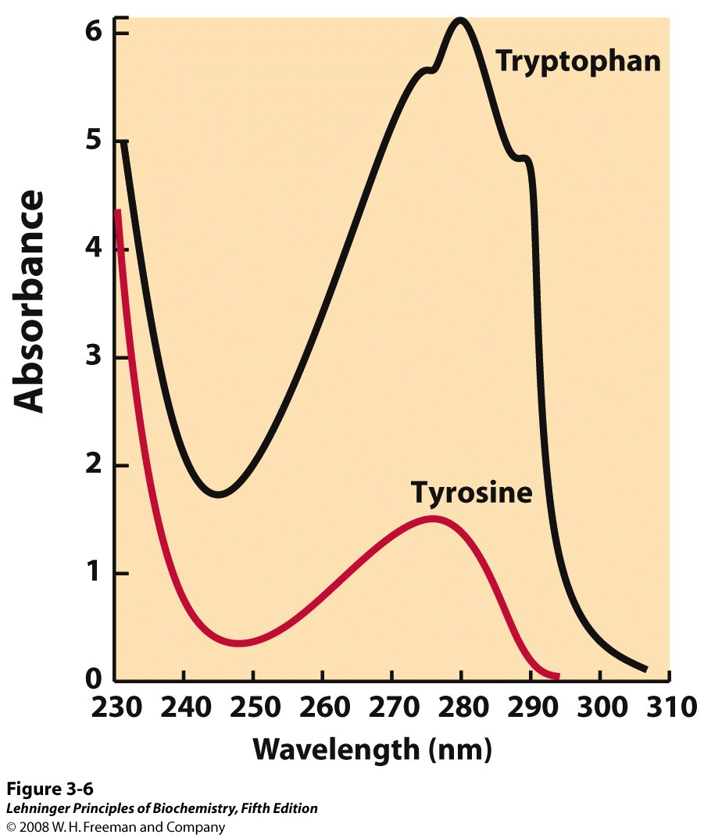
Tyrosine and tryptophan absorb UV light at 280 nm
We exploit this when we use the spec to check the concentration of a protein in solution.
Nucleic acid absorbs maximally at 260 nm.
Notes:
FIGURE 3-6 Absorption of ultraviolet light by aromatic amino acids. Comparison of the light absorption spectra of the aromatic amino acids tryptophan and tyrosine at pH 6.0. The amino acids are present in equimolar amounts (10^{–3} M) under identical conditions. The measured absorbance of tryptophan is as much as four times that of tyrosine. Note that the maximum light absorption for both tryptophan and tyrosine occurs near a wavelength of 280 nm. Light absorption by the third aromatic amino acid, phenylalanine (not shown), generally contributes little to the spectroscopic properties of proteins.

Slide 27
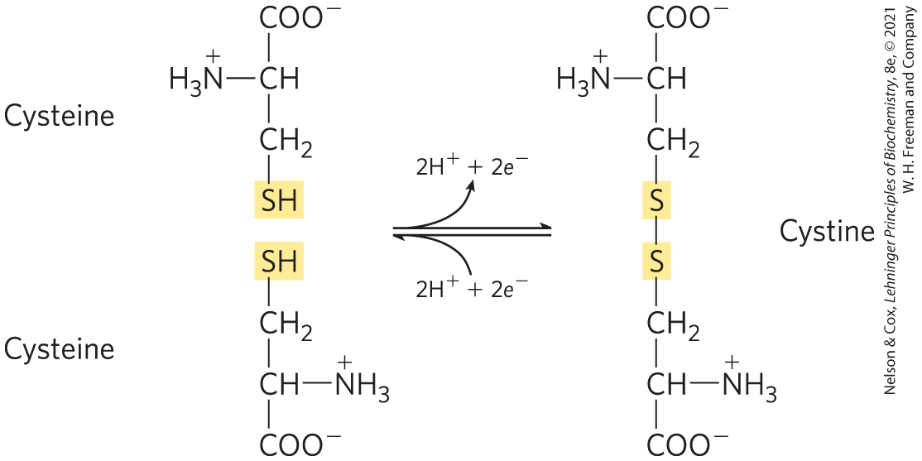
Cysteine has the only R-group that can made a covalent bond
Oxidized
Reduced

Slide 28
Importance of pH in biochem
Functional groups are in some cases ionizable groups
  Examples?
What might the ionization state of one of these groups effect?
Consequently, it’s important to be able to figure out the ionization state of a group at a given pH.

Slide 29
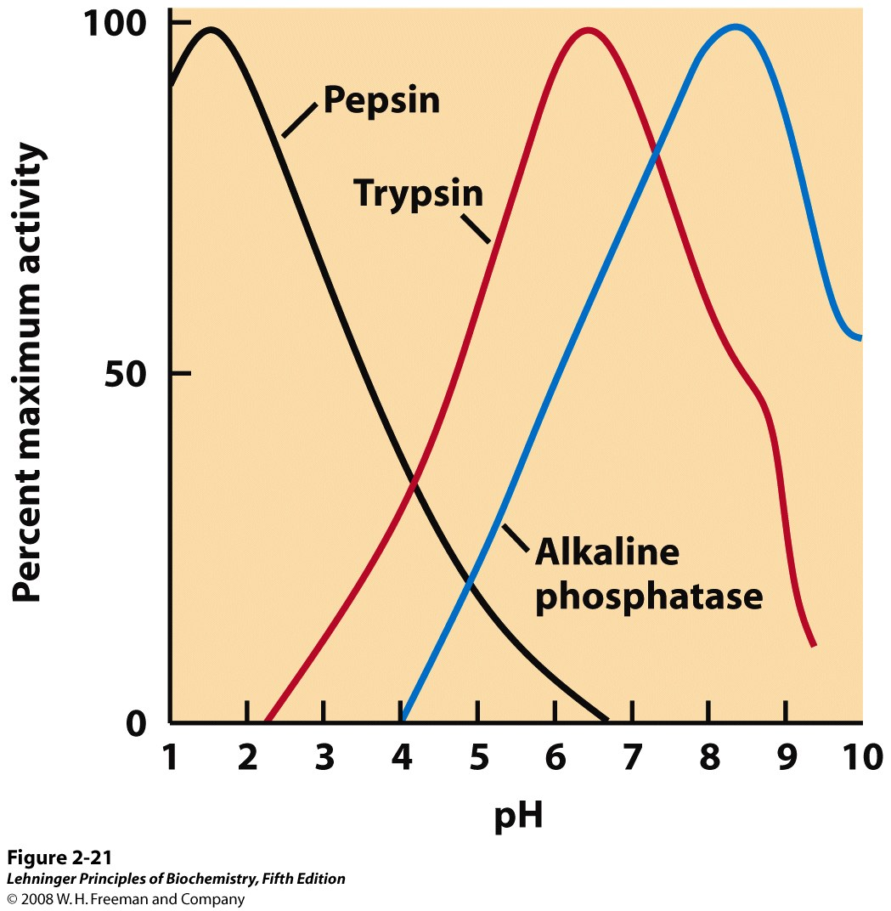
Why do enzymes have an optimum pH?
Notes:
FIGURE 2-21 The pH optima of some enzymes. Pepsin is a digestive enzyme secreted into gastric juice, which has a pH of ~1.5, allowing pepsin to act optimally. Trypsin, a digestive enzyme that acts in the small intestine, has a pH optimum that matches the neutral pH in the lumen of the small intestine. Alkaline phosphatase of bone tissue is a hydrolytic enzyme thought to aid in bone mineralization.

Slide 30
What is different about the various amino acids?
What is hydropathy index? What does this tell us?
Why are the pK_{R} values important? Why aren’t they listed for every amino acid?
Why are the pK₁ and pK₂ values different?
pI is isoelectric point, where the amino acid has no net electrical charge.

Slide 31
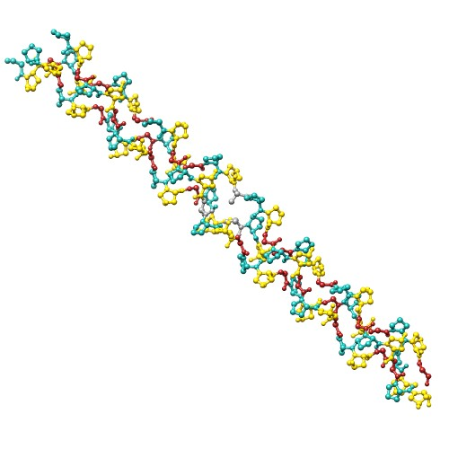
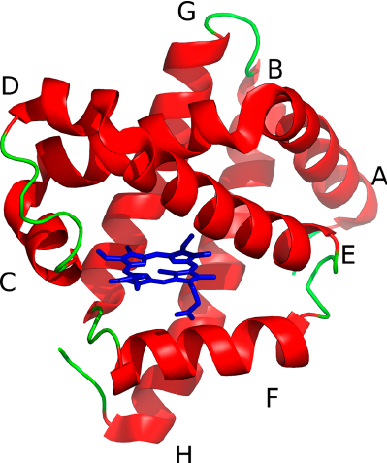
Proteins
How structure and function are intertwined

Slide 32
Proteins are
Polypeptides (covalently linked α-amino acids) + possibly cofactors.
Cofactors are functional non-amino acid components.
        Can be metal ions (inorganic)
        Coenzymes (organic molecules) i.e. NADH
        Prosthetic groups (covalently attached) i.e. Heme
Other modifications can include the covalent attachment of lipids, sugars, or phosphate groups after translation.

Slide 33
Proteins often contain non-protein parts
Class | Prosthetic group | Example
Lipoproteins | Lipids | β₁-Lipoprotein of blood (Fig.17-2)
Glycoproteins | Carbohydrates | Immunoglobulin G (Fig. 5-20)
Phosphoproteins | Phosphate groups | Glycogen phosphorylase (Fig. 6-39)
Hemoproteins | Heme (iron porphyrin) | Hemoglobin (Figs 5-8 to 5-11)
Flavoproteins | Flavin nucleotides | Succinate dehydrogenase (Fig.19-9)
Metalloproteins | Iron Zinc | Ferritin (Box 16-1) Alcohol dehydrogenase (Fig. 14-12)
 | Calcium Molybdenum Copper | Calmodulin (Fig. 12-17) Dinitrogenase (Fig. 22-3) Complex IV (Fig. 19-12)
Cofactors
Inorganic (metal ions)
Organic
Prosthetic groups
Coenzymes
Prosthetic group: A molecule that is non-proteinaceous and binds to a protein to aid in its function. Is bound to protein either covalently or noncovalently but tightly.
Coenzymes must be required for catalytic activity.
Many vitamins serve as organic co-factors!

Slide 34
Proteins come in many shapes and sizes
Protein | Molecular weight | Number of residues | Number of polypeptide chains
Cytochrome c (human) | 12,400 | 104 | 1
Myoglobin (equine heart) | 16,700 | 153 | 1
Chymotrypsin (bovine pancreas) | 25,200 | 241 | 3
Hemoglobin (human) | 64,500 | 574 | 4
Hexokinase (yeast) | 107,900 | 972 | 2
RNA polymerase (E. coli) | 450,000 | 4,158 | 5
Glutamine synthetase (E. coli) | 619,000 | 5,628 | 12
Titin (human) | 2,993,000 | 26,926 | 1
Residues= amino acids. As a general rule, chains of 100 amino acids or more are considered proteins, and shorter chains are peptides.

Slide 35
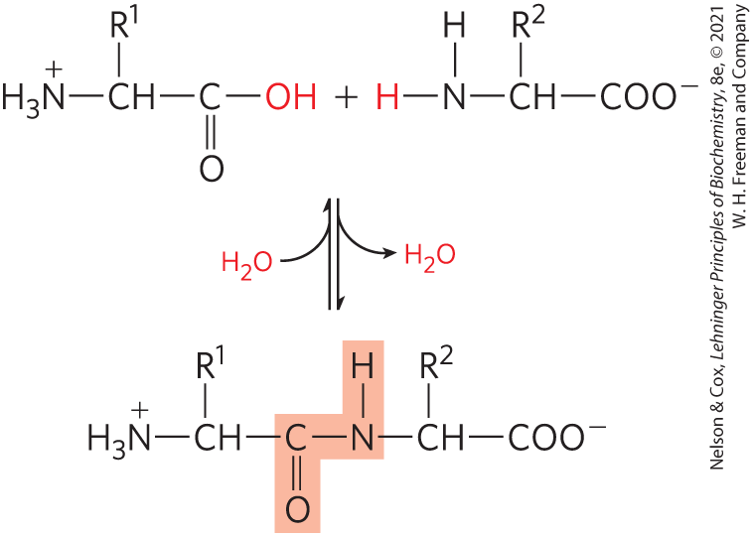
Making a protein from amino acids: the peptide bond
What is the catalyst for this reaction?

Slide 36
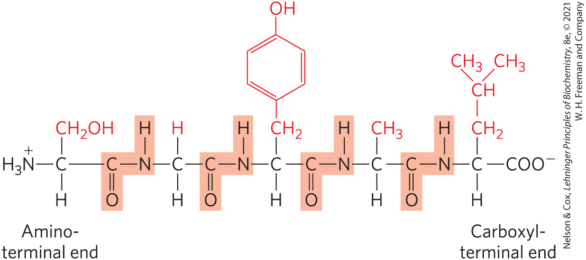
Proteins are chains of amino acids

Slide 37
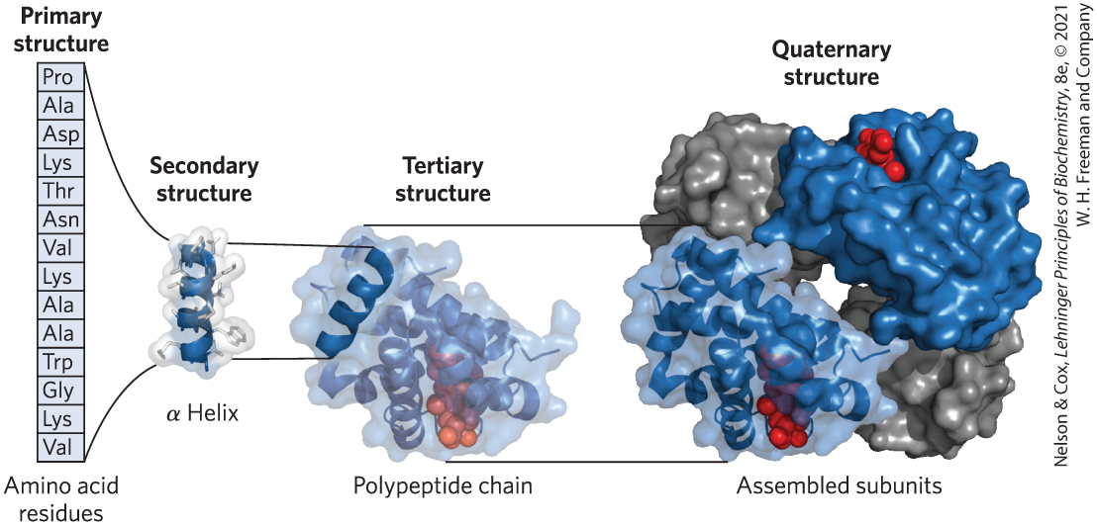
Levels of protein structure

Slide 38
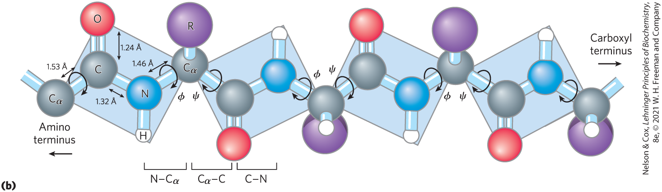
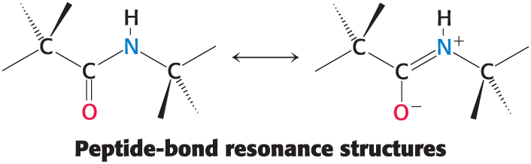
Primary structure and the peptide bond
These small electric dipoles are important for stabilizing secondary structure.

Slide 39
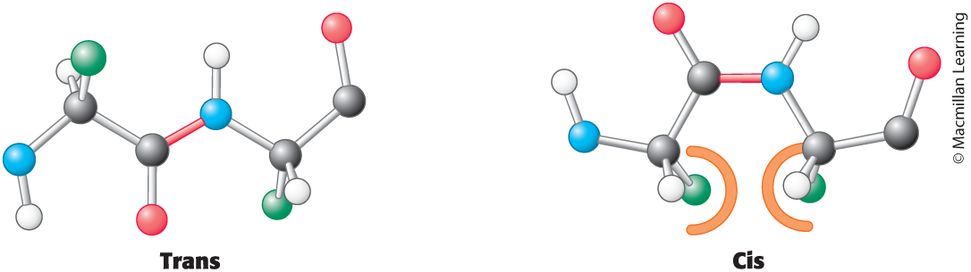
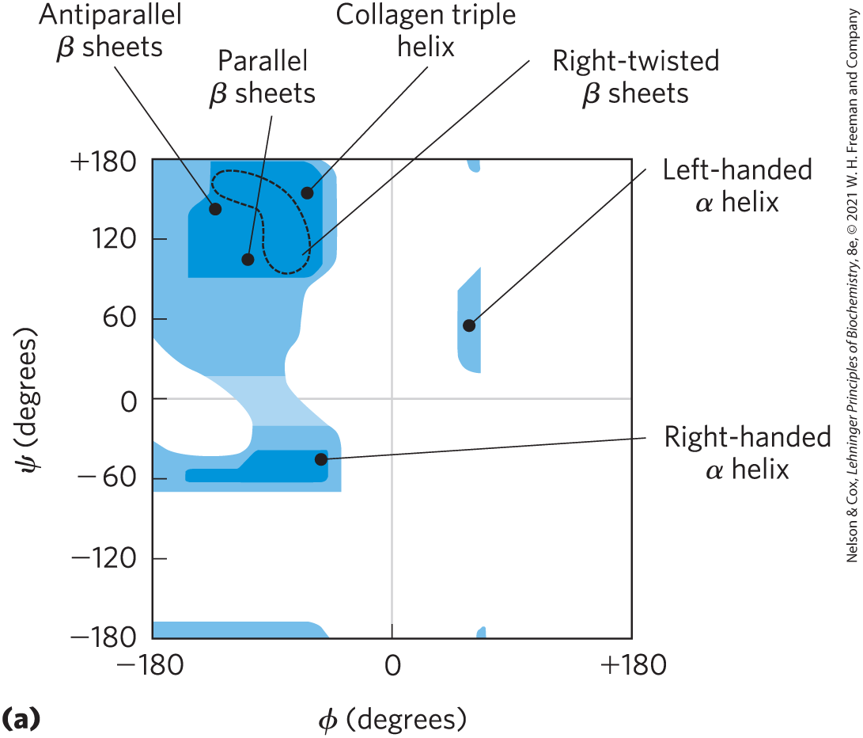
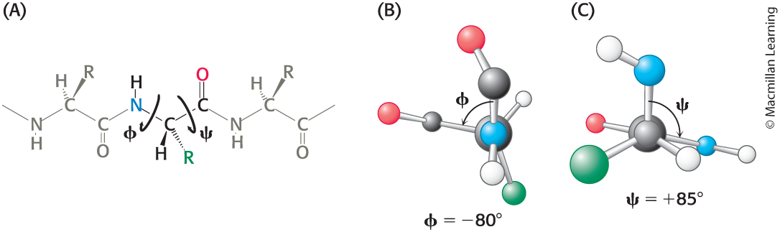
Only certain psi-phi angles are favorable
Rotation around the phi and psi bonds is permitted but limited.
Glycine and proline are exceptions—why?

Slide 40
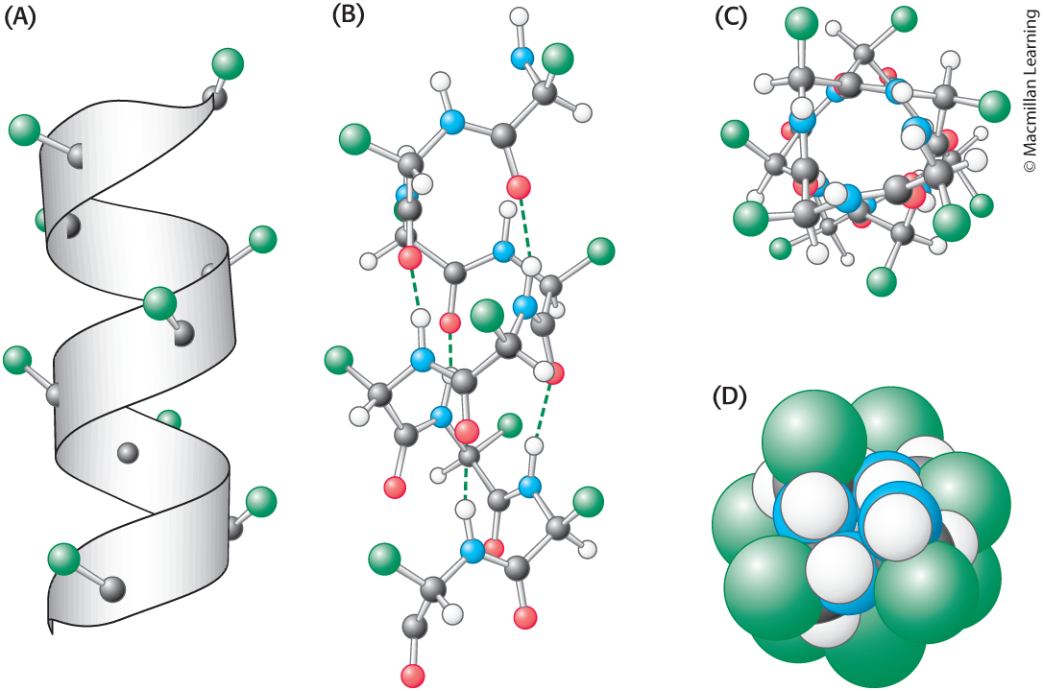
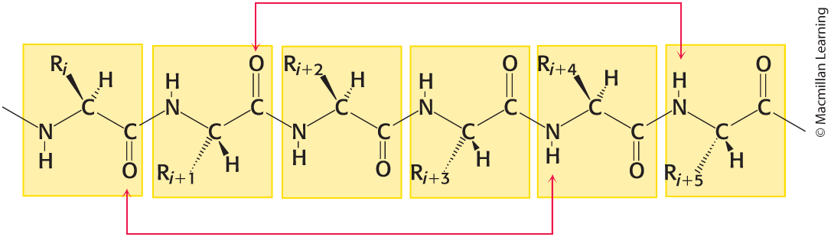
Secondary structure—alpha helix
Secondary structure is stabilized by interactions between mainchain atoms.

Slide 41
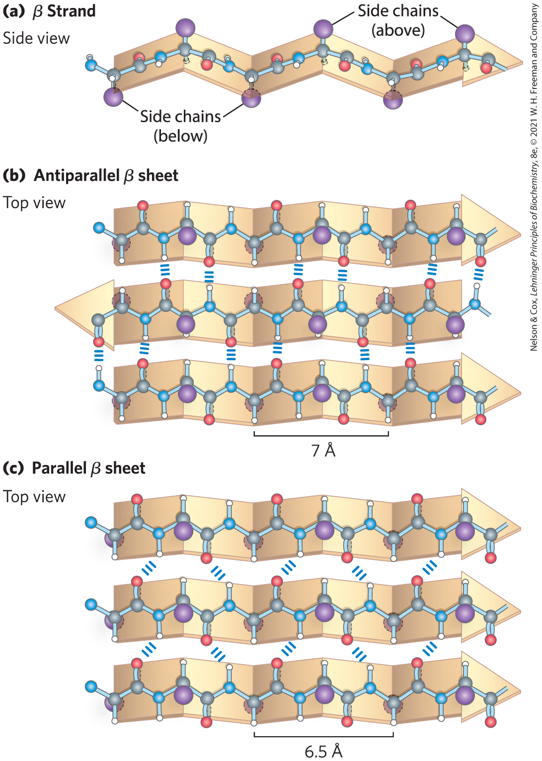
Secondary structure—beta (pleated) sheet

Slide 42
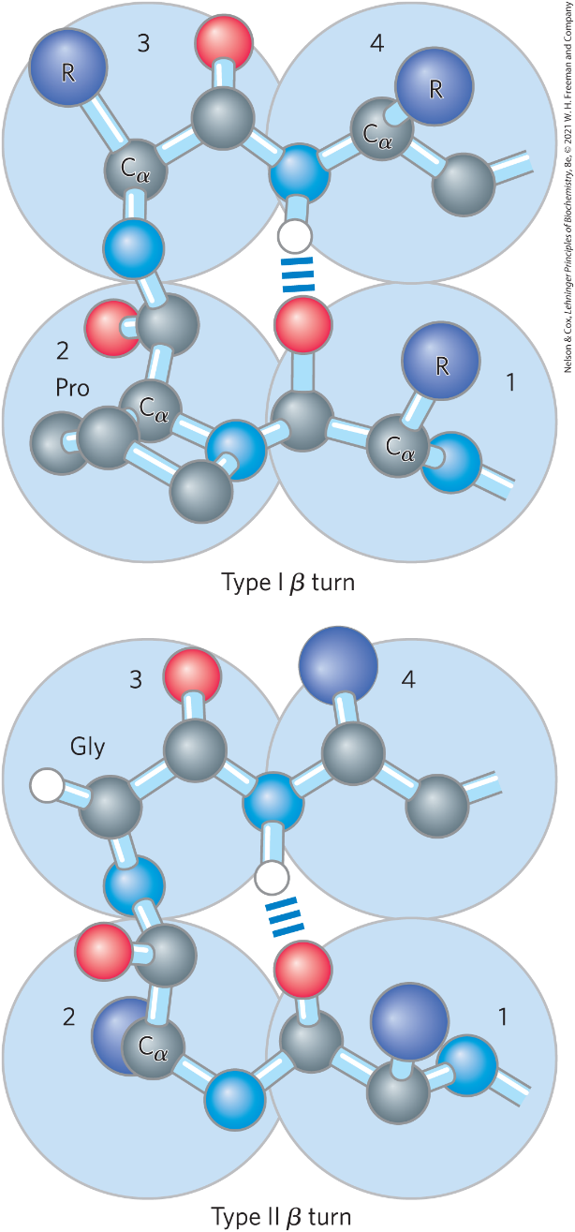
Secondary(ish) structure—beta turns

Slide 43
Relative frequencies of amino acids in secondary structures
Amino acid | α helix | β sheet | Reverse turn
Glu | 1.59 | 0.52 | 1.01
Ala | 1.41 | 0.72 | 0.82
Leu | 1.34 | 1.22 | 0.57
Met | 1.30 | 1.14 | 0.52
Gln | 1.27 | 0.98 | 0.84
Lys | 1.23 | 0.69 | 1.07
Arg | 1.21 | 0.84 | 0.90
His | 1.05 | 0.80 | 0.81
Val | 0.90 | 1.87 | 0.41
Ile | 1.09 | 1.67 | 0.47
Amino acid | α helix | β sheet | Reverse turn
Tyr | 0.74 | 1.45 | 0.76
Cys | 0.66 | 1.40 | 0.54
Trp | 1.02 | 1.35 | 0.65
Phe | 1.16 | 1.33 | 0.59
Thr | 0.76 | 1.17 | 0.96
Gly | 0.43 | 0.58 | 1.77
Asn | 0.76 | 0.48 | 1.34
Pro | 0.34 | 0.31 | 1.32
Ser | 0.57 | 0.96 | 1.22
Asp | 0.99 | 0.39 | 1.24

Slide 44
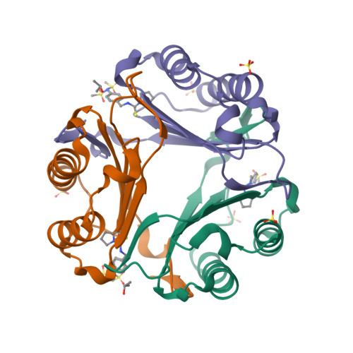
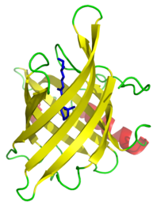
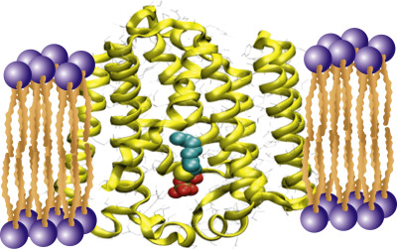
Tertiary structure
Note how the ribbons highlight secondary structure elements. Tertiary structure is stabilized by interactions between R-group atoms.

Slide 45
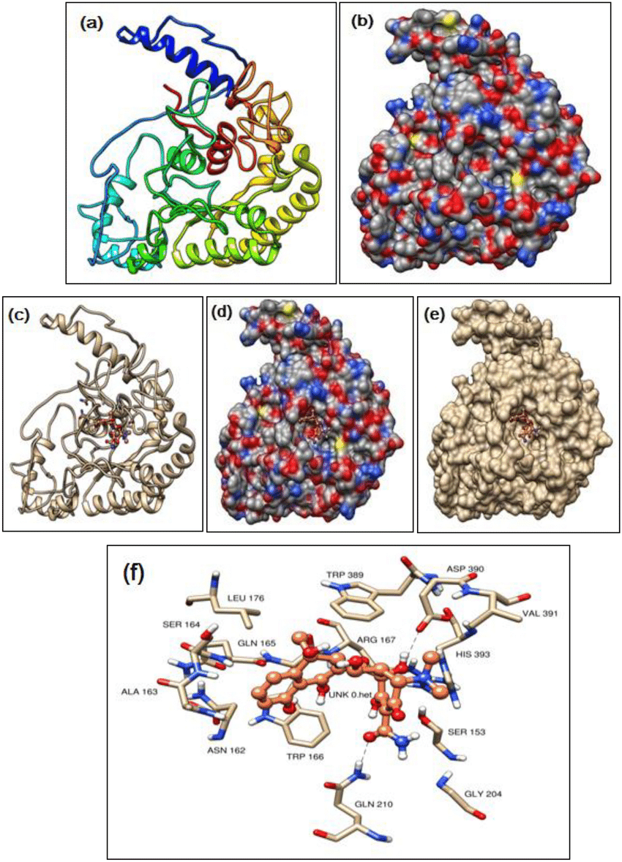
Different structural representations of a single protein
Note the ligand binding site
Notes:
Sivakumar, Krishnamoorthy & Kannappan, Sudalayandi & Vijayakumar, Balakrishnan & K.P., Jithendran & Balasubramaniam, Sivamani & Panigrahi, Akshaya. (2021). Molecular docking study of bio-inhibitors extracted from marine macro-alga Ulva fasciata against hemolysin protein of luminescence disease-causing Vibrio harveyi. Archives of Microbiology. 203. 10.1007/s00203-021-02408-1.

Slide 46
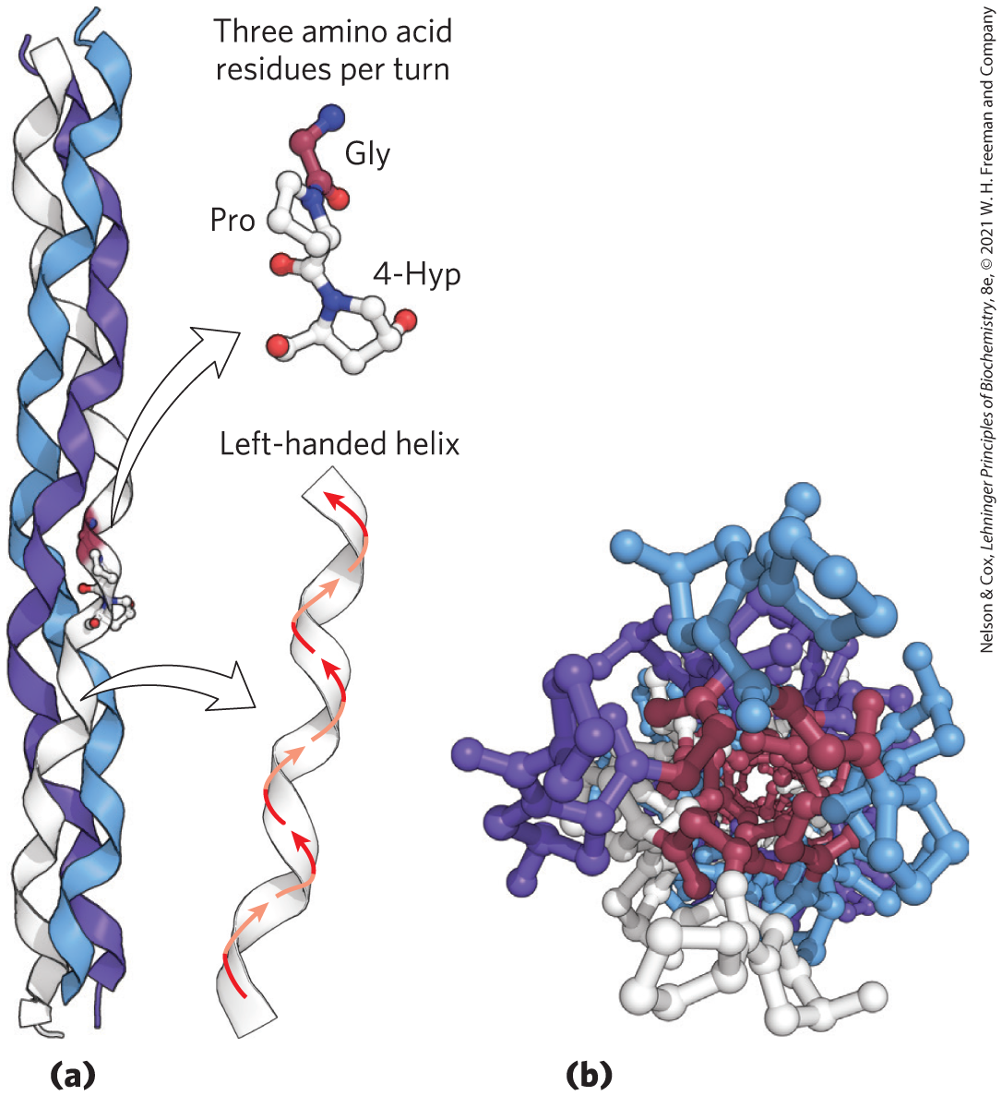
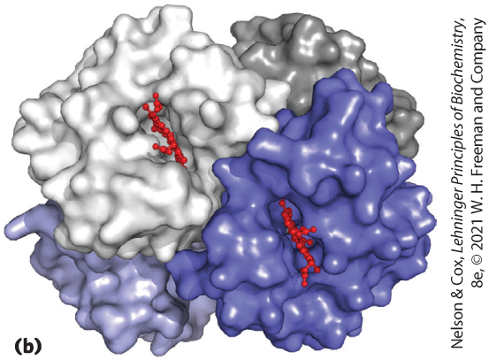
Quaternary structure
Hemoglobin
Collagen (triple helix)

Slide 47
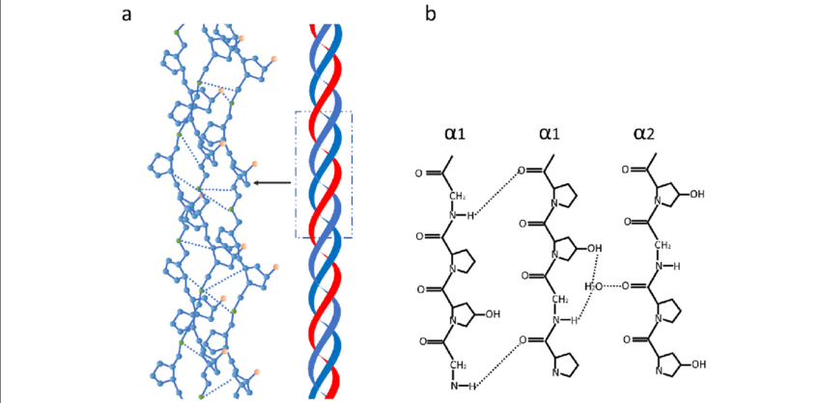
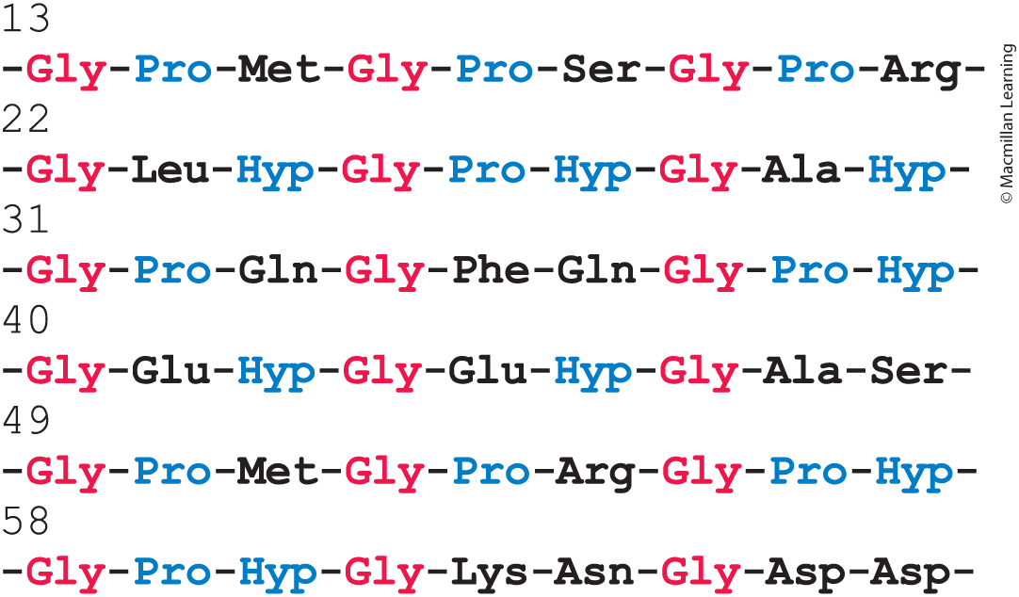
The importance of the sequence of collagen
What is the importance of collagen in the body? What might happen if a glycine were substituted with a different amino acid?
Notes:
https://www.researchgate.net/figure/a-The-triple-helix-of-type-I-collagen-6-b-Hydrogen-bonds-of-the-collagen-model-7_fig1_343444800

Slide 48
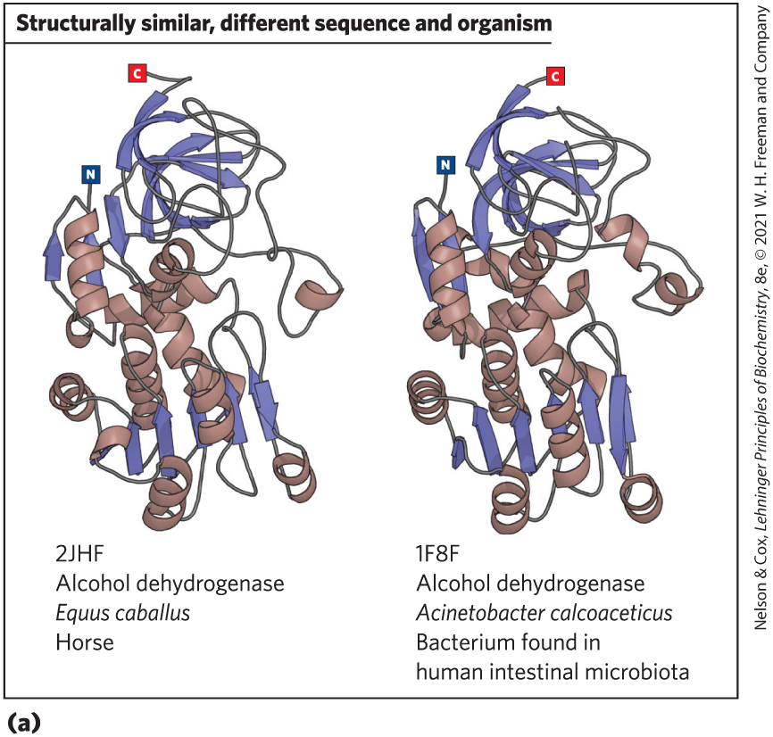
What does structure tell us about evolution?
Across many proteins, structures are much more conserved than primary sequences.
Why might the primary sequence change over time?

Slide 49


How do proteins fold?
Mystery: Proteins do not have time to try all possible conformations before settling on a low-energy 3-D structure. “Levinthal’s paradox”
  Why is the unfolded state not “low energy”?
How does the amino acid chain avoid local minima?
https://www.nature.com/articles/nature10317

Slide 50

Proteins start folding during translation

Slide 51


Anfinsen denaturation and renaturation of ribonuclease
In vitro (not in vivo)
Why did he use both urea and mercaptoethanol?
What conclusion was made from this experiment?
Would this work for every protein?

Slide 52

Can we use computation to predict the structure of proteins?

Slide 53

In contrast to what Anfinsen found, many proteins need help such as HSPs to fold (or re-fold)
What does HSP stand for?
Are there other HSPs?
https://www.nature.com/articles/nature10317
Notes:
Substrate binding to GroEL (after transfer from HSP70) may result in local unfolding⁴². ATP binding then triggers a conformational rearrangement of the GroEL apical domains. This is followed by the binding of GroES (forming the cis complex) and substrate encapsulation for folding. At the same time, ADP and GroES dissociate from the opposite (trans) GroEL ring, allowing the release of substrate that had been enclosed in the former cis complex³² (omitted from the figure for simplicity). The new substrate remains encapsulated, free to fold, for the time needed to hydrolyse the seven ATP molecules in the newly formed cis complex (∼10 s). Binding of ATP and GroES to the trans ring causes the opening of the cis complex. A symmetrical GroEL–(GroES)2 complex may form transiently. Structural model is based on PDB accession 1AON.

Slide 54

What is proteostasis? Why is it important?
Notes:
The proteostasis network integrates chaperone pathways for the folding of newly synthesized proteins, for the remodelling of misfolded states and for disaggregation with the protein degradation mediated by the UPS and the autophagy system. Approximately 180 different chaperone components and their regulators orchestrate these processes in mammalian cells, whereas the UPS comprises ∼600 and the autophagy system ∼30 different components. The primary effort of the chaperone system is in preventing aggregation, but machinery for the disaggregation of aggregated proteins has been described in bacteria and fungi, involving oligomeric AAA⁺-proteins such as HSP104 and the E. coli molecular chaperone protein ClpB, which cooperate with HSP70 chaperones²⁵. A similar activity has been detected in metazoans, but the components involved have not yet been defined⁸³.

Slide 55

How protein misfolding leads to aggregation

Slide 56

Diseases associated with protein aggregation
Notes:
Monaco, Antonio & Fraldi, Alessandro. (2020). Protein Aggregation and Dysfunction of Autophagy-Lysosomal Pathway: A Vicious Cycle in Lysosomal Storage Diseases. Frontiers in Molecular Neuroscience. 13. 10.3389/fnmol.2020.00037.

