Slide 1
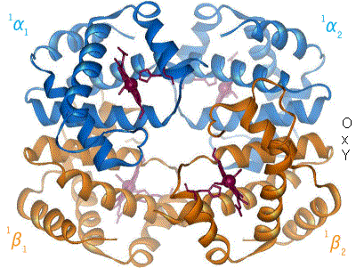
Protein structure and function
Protein-ligand interactions
Myoglobin and hemoglobin

Slide 2
What do proteins do?
Bind other proteins and/or small molecules
This is why we will start with an examination of ligand binding.
Catalyze reactions
Build structures
Facilitate membrane transport
Make up molecular motors
Organize things within the cell

Slide 3
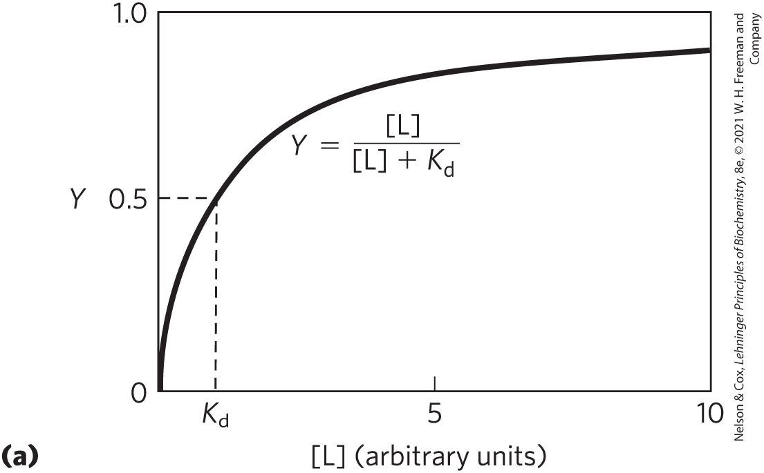
Graphical representation of ligand binding
P(protein) + L(ligand)→ PL
Fraction of binding sites occupied
Association constant K_{a} = [PL]/[P][L] = k_{a}/k_{d}
Dissociation constant K_{d} = [P][L]/[PL] =?

Slide 4
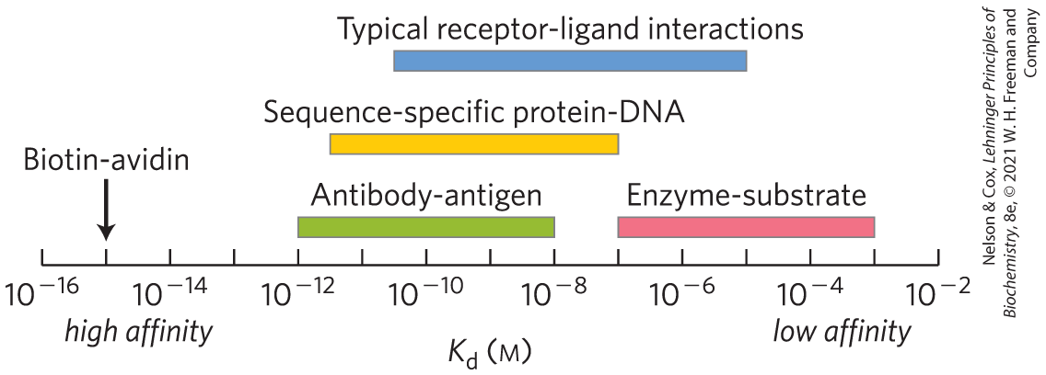
Why such a range in affinity?
*
*One of the strongest non-covalent interactions found in nature!

Slide 5
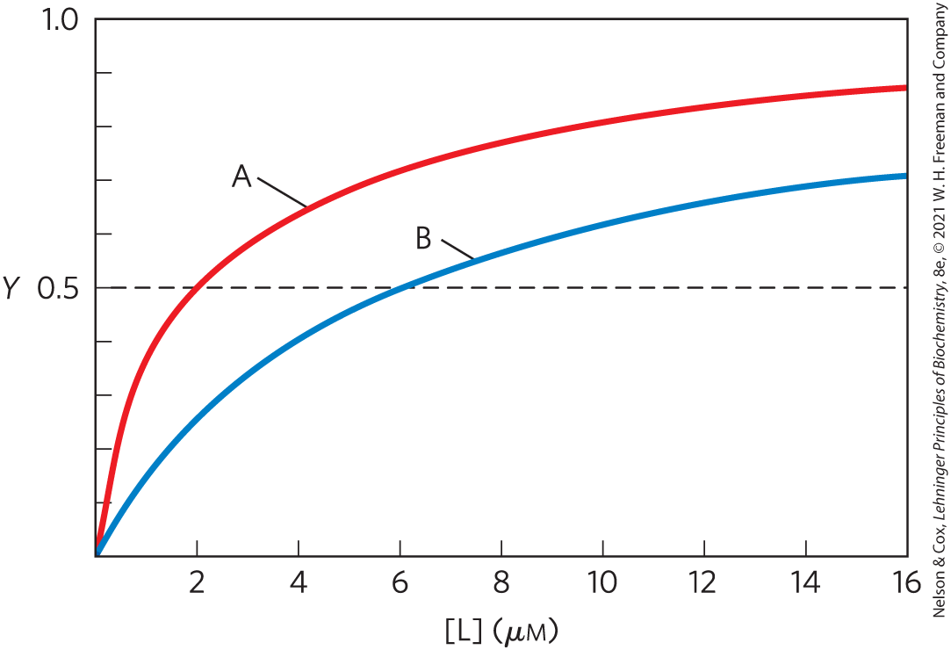
Proteins A and B bind the same ligand—how does the binding differ?
Estimate K_{d} from the graph for each protein.

Slide 6
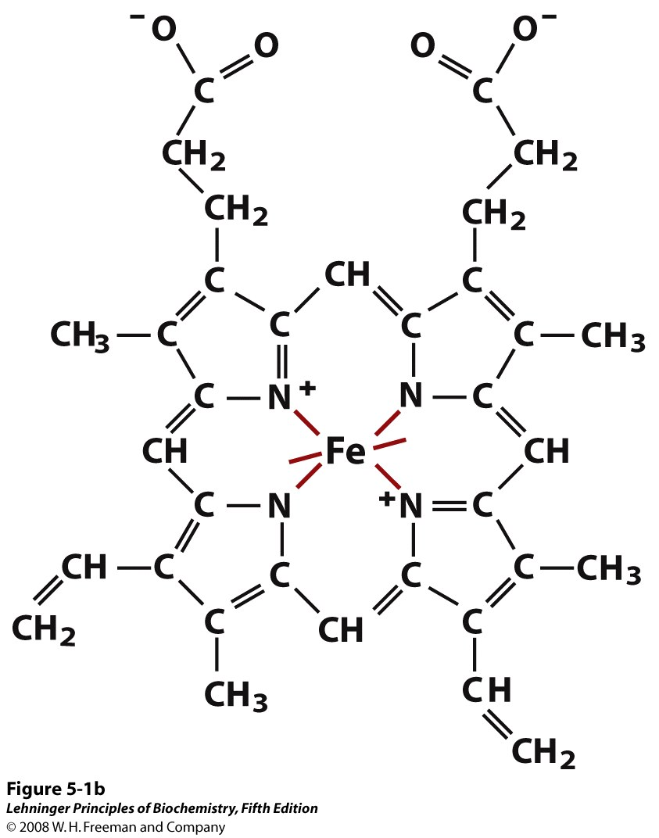
First application of protein-ligand interaction: binding of oxygen at heme group in Myoglobin
Heme is a prosthetic group-- an organic, tightly bound, non-proteinaceous unit required for the biological function of some proteins.
Heme is present in a variety of proteins.
(We’ll see them again in electron transport.)
Notes:
FIGURE 5-1a Heme. The heme group is present in myoglobin, hemoglobin, and many other proteins, designated heme proteins. Heme consists of a complex organic ring structure, protoporphyrin IX, with a bound iron atom in its ferrous (Fe²⁺) state. (a) Porphyrins, of which protoporphyrin IX is only one example, consist of four pyrrole rings linked by methene bridges, with substitutions at one or more of the positions denoted X.
FIGURE 5-1b Heme. (b, c) Two representations of heme (derived from PDB ID 1CCR). The iron atom of heme has six coordination bonds: four in the plane of, and bonded to, the flat porphyrin ring system, and (d) two perpendicular to it.

Slide 7
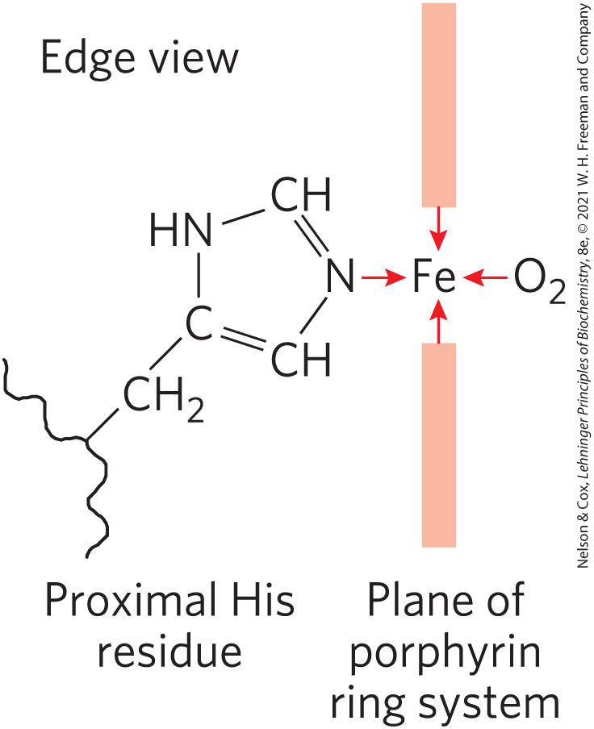
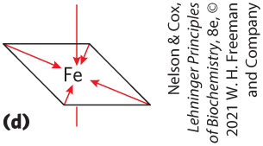
How does the heme group facilitate the binding of oxygen?
O₂ binding is coordinated by the Fe at the center of the heme and a histidine side chain from the protein.
The iron atom of heme has six coordination bonds
Notes:
FIGURE 5-5c Steric effects caused by ligand binding to the heme of myoglobin. (c) Another view of the heme of myoglobin (derived from PDB ID 1MBO), showing the arrangement of key amino acid residues around the heme. The bound O₂ is hydrogen-bonded to the distal His, His E7 (His⁶⁴), further facilitating the binding of O₂.

Slide 8
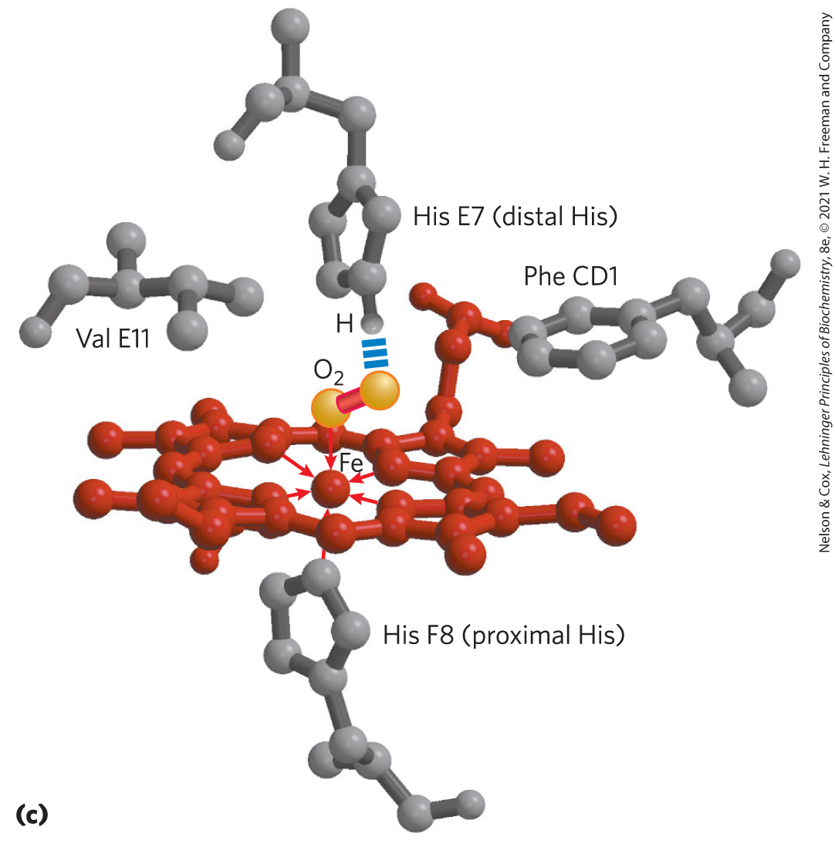
Key side chains at the heme-O₂ binding site

Slide 9
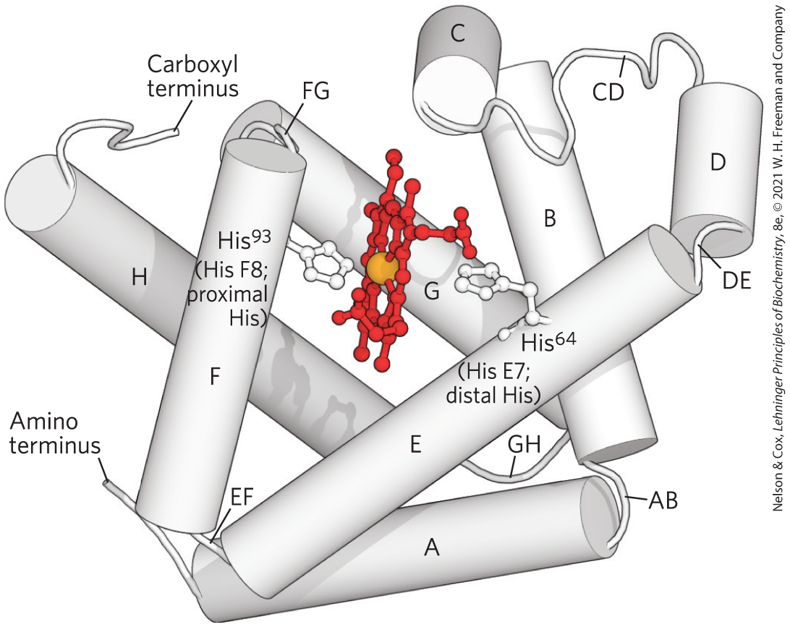
Structure of Myoglobin
Myoglobin solubilizes O₂ in skeletal muscle. Same mechanism of O₂ binding.
Why is oxygen important?
What is the role of the proximal and distal histidines?
Notes:
FIGURE 5-3 Myoglobin. (PDB ID 1MBO) The eight α-helical segments (shown here as cylinders) are labeled A through H. Nonhelical residues in the bends that connect them are labeled AB, CD, EF, and so forth, indicating the segments they interconnect. A few bends, including BC and DE, are abrupt and do not contain any residues; these are not normally labeled. (The short segment visible between D and E is an artifact of the computer representation.) The heme is bound in a pocket made up largely of the E and F helices, although amino acid residues from other segments of the protein also participate.

Slide 10
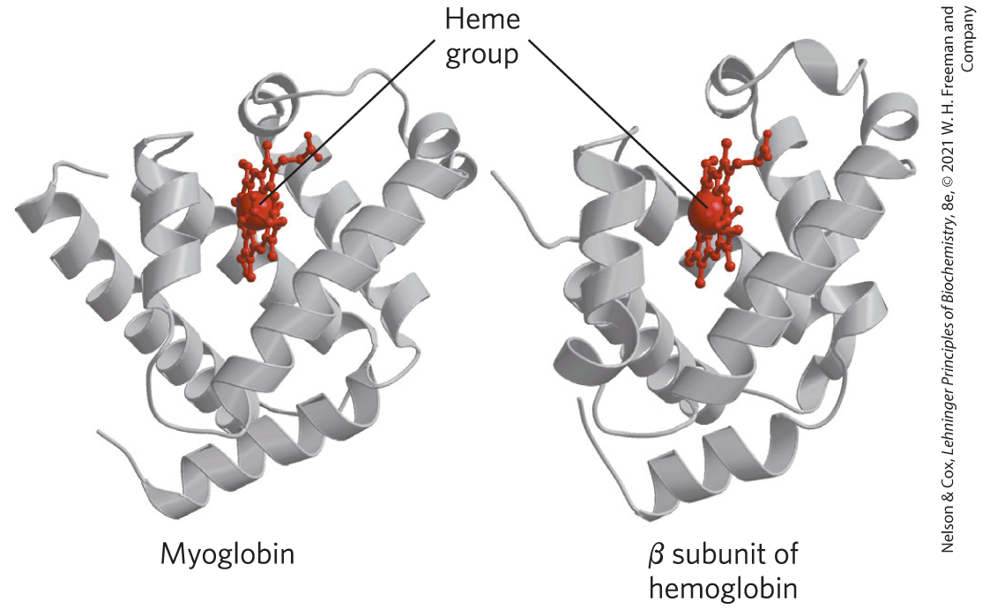
Myoglobin vs. Hemoglobin
Hemoglobin is a tetramer of 2α and 2β subunits (α₂β₂).
Each subunit is structurally similar to myoglobin.
Notes:
FIGURE 5-6 Comparison of the structures of myoglobin (PDB ID 1MBO) and the β subunit of hemoglobin (derived from PDB ID 1HGA).

Slide 11
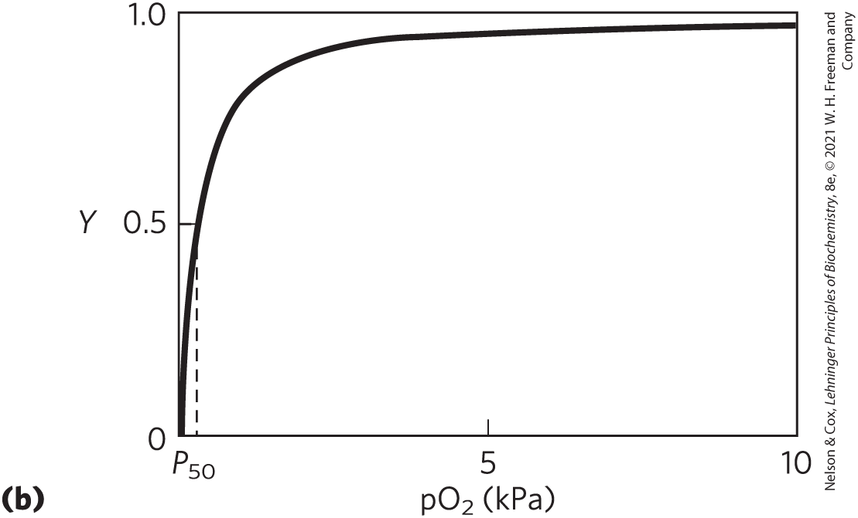
What can we learn from the oxygen binding curve of myoglobin?

Slide 12
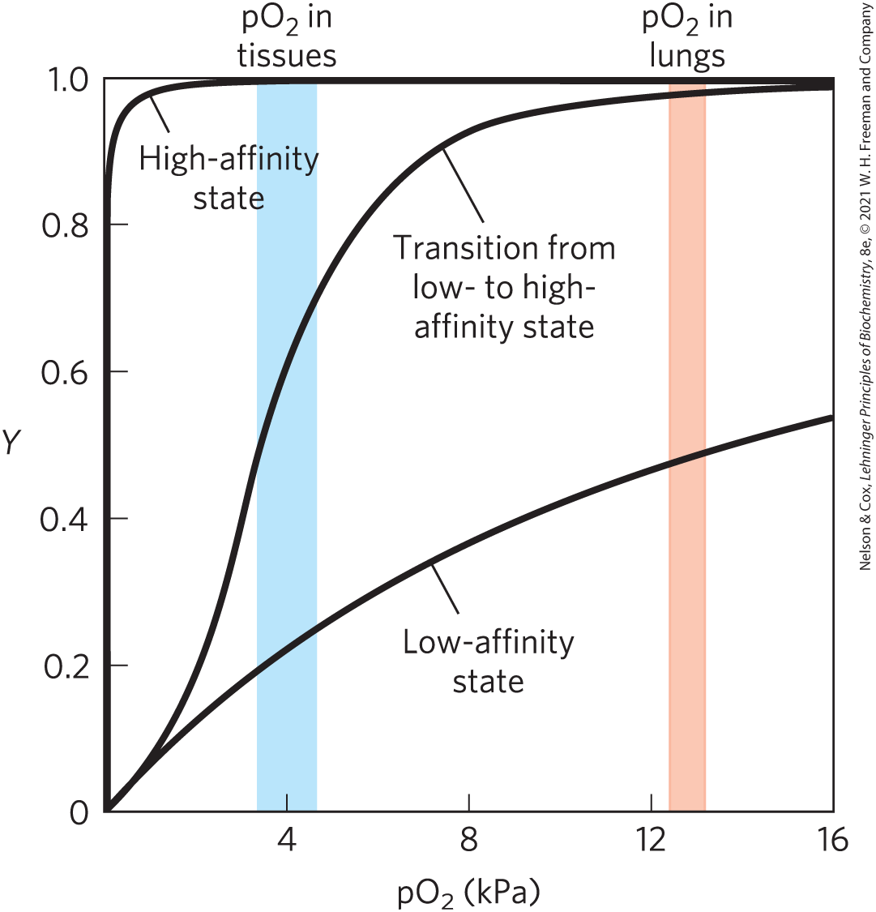
What kinds of binding can we observe?
An important thing here is that hemoglobin, via the RBC, travels to and from two very different environments.
Notes:
FIGURE 5-12 A sigmoid (cooperative) binding curve. A sigmoid binding curve can be viewed as a hybrid curve reflecting a transition from a low-affinity to a high-affinity state. Because of its cooperative binding, as manifested by a sigmoid binding curve, hemoglobin is more sensitive to the small differences in O₂ concentration between the tissues and the lungs, allowing it to bind oxygen in the lungs (where pO₂ is high) and release it in the tissues (where pO₂ is low).

Slide 13
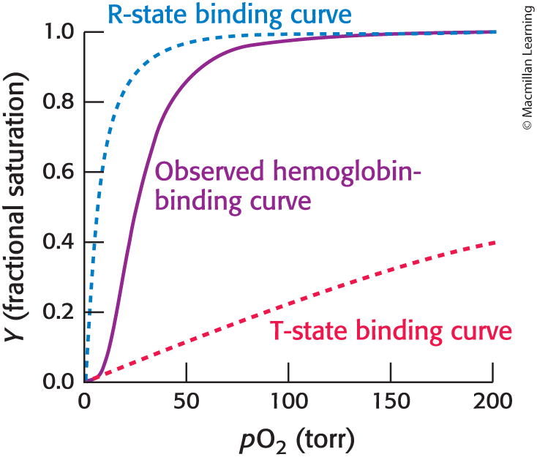
The Hb binding curve is a mash-up of the R and T state curves
R-state is a _____affinity state
T state is a _______ affinity state

Slide 14
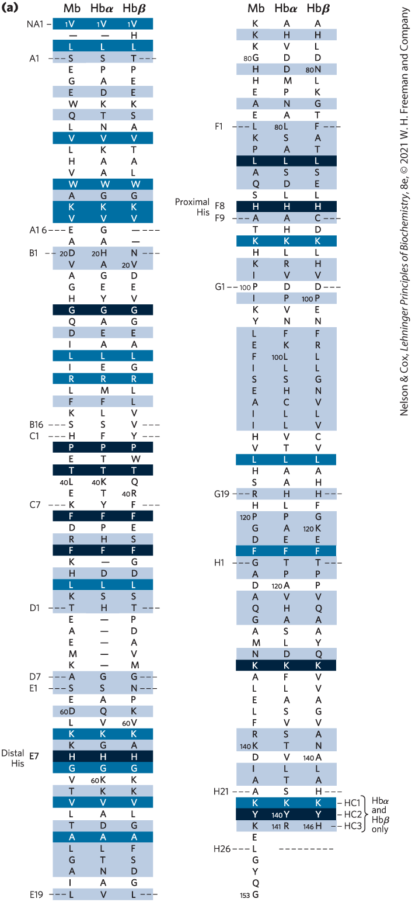
Amino Acid sequence comparison of myoglobin and hemoglobin
Shading key:
Black conserved in all known globins
Darker blue: conserved in these sequences
Lighter blue: conservative substitutions (what does this mean?)
Which parts of the structure are most conserved?

Slide 15
Hemoglobin has quaternary structure
Deoxy=T
Oxy= R
Proteins with quaternary structure may/often demonstrate cooperative binding.
What is the consequence of the structural change we see here?

Slide 16
R and T States of Hemoglobin
T = Tense state, O₂ binding triggers a T R conformational change.
R = Relaxed state, this state has higher affinity for O₂ than the T state.
Deoxyhemoglobin subunits are more stable in the T state, hence the designation “tense”.
Conformational change from the T state to the R state involves breaking ion pairs between the α1-β2 interface.

Slide 17
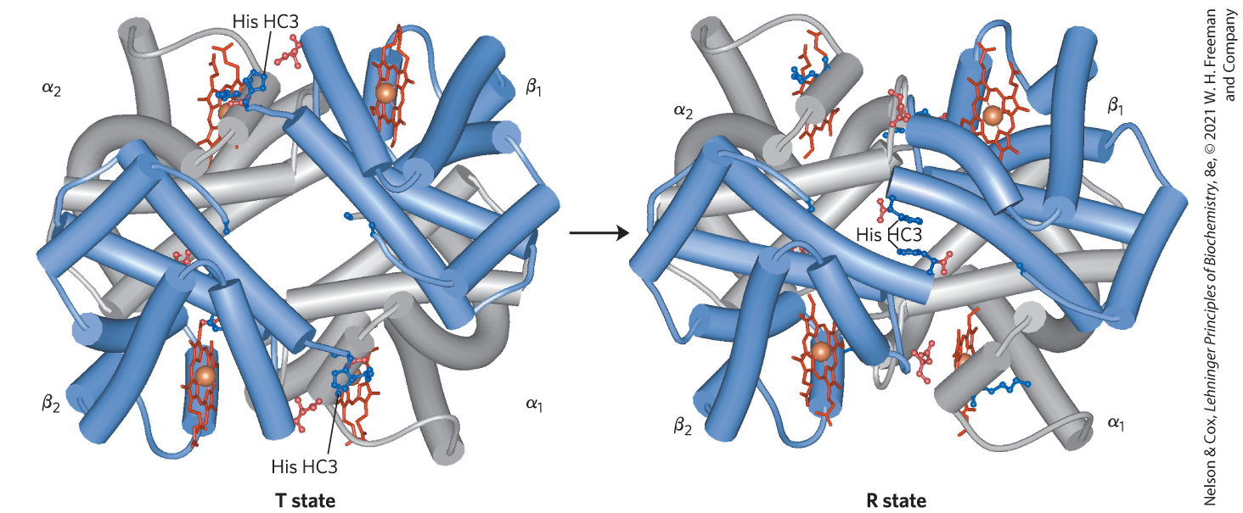
T vs R state of hemoglobin
The transition from T to are is driven by the binding of oxygen and involves the breaking of ionic bonds

Slide 18
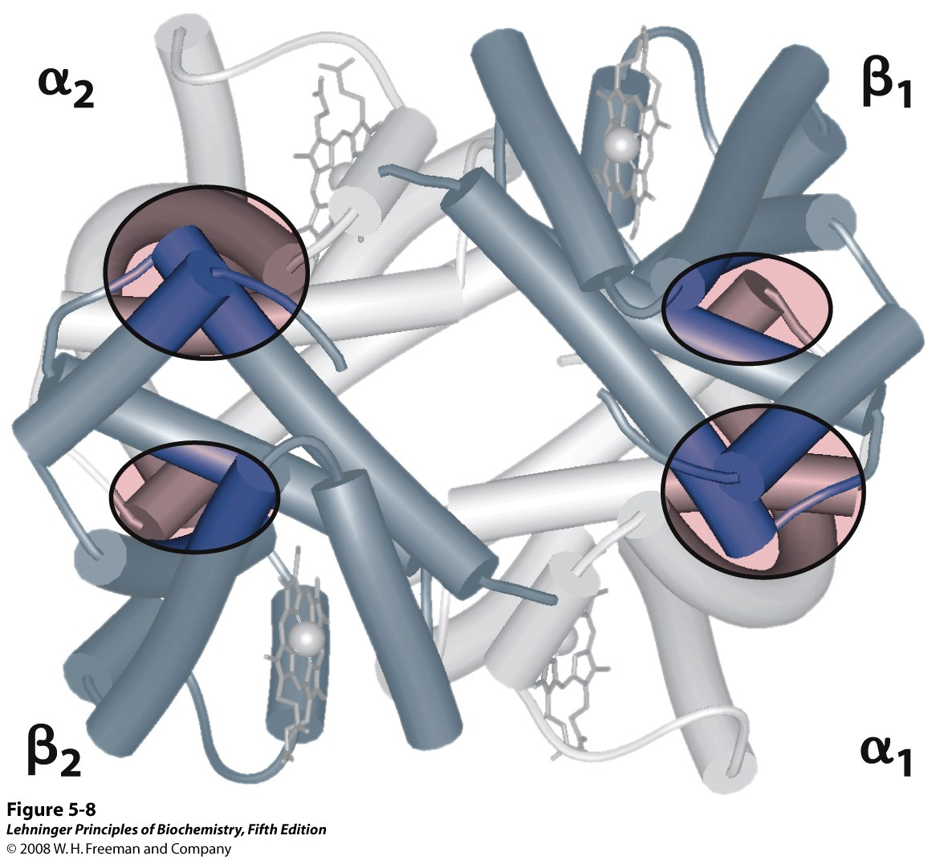
The highest affinity interactions in Hemoglobin are between 𝛼₁ and 𝛽₁ (𝛼₂𝛽₂)
𝛼₁𝛽₁ interactions change a bit in presence and absence of oxygen.
This perturbation drives larger changes at the 𝛼₁𝛽₂ interfaces.
Notes:
FIGURE 5-8 Dominant interactions between hemoglobin subunits. In this representation, α subunits are light and β subunits are dark. The strongest subunit interactions (highlighted) occur between unlike subunits. When oxygen binds, the α₁β₁ contact changes little, but there is a large change at the α₁β₂ contact, with several ion pairs broken (PDB ID 1HGA).

Slide 19
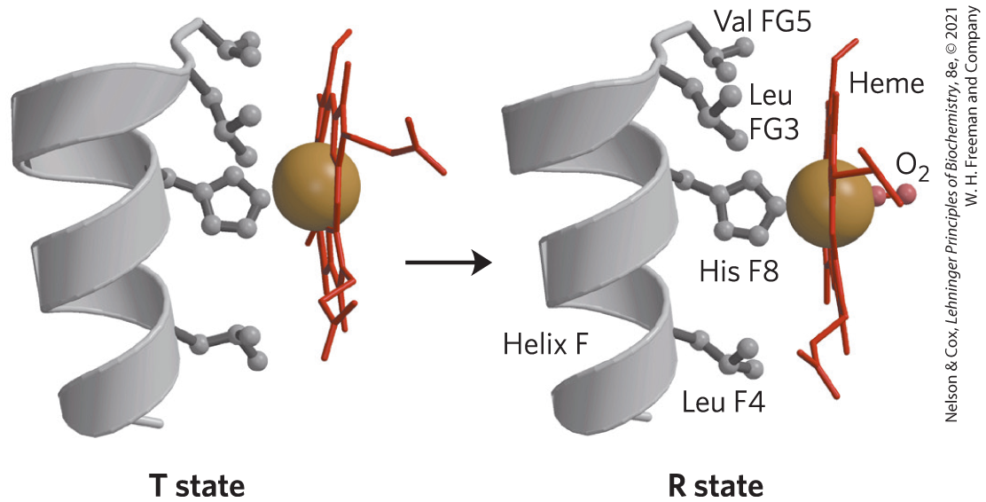
How does oxygen binding drive a conformational change?
Helix F shifts towards the heme group in the presence of oxygen, as Fe moves more into the plane of the heme

Slide 20
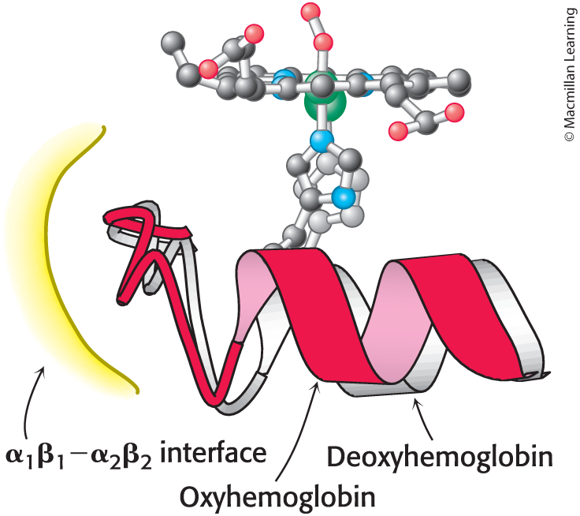
Upon O2 binding, the helix shifts to the red position and perturbs the 𝛼₁ -𝛽₁ interface

Slide 21
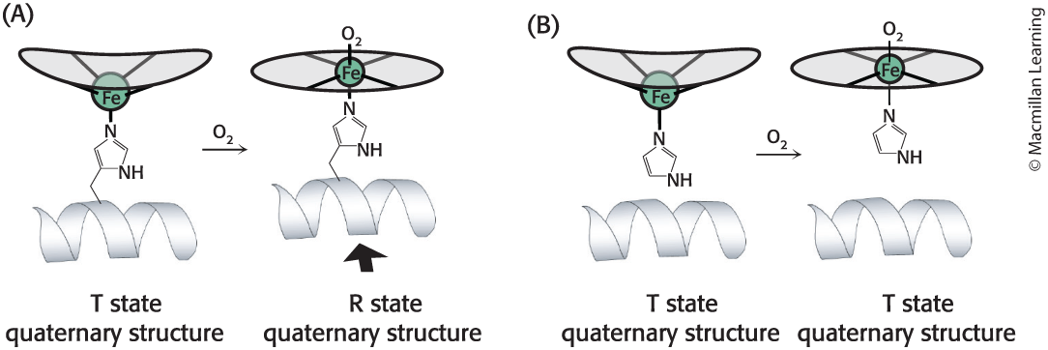
How did scientists show the key role for the proximal histidine?
Wildtype
No shift
In the experiment (B), the proximal histidine was replaced with an alanine, and imidazole was added to mimic the R-group of histidine unattached to the helix.

Slide 22
How can binding be “cooperative”?
Must be a protein with multiple binding sites (the protein is usually but not always multi-subunit).
Binding sites must be able to interact with each other.
This phenomenon is called cooperativity.
Positive cooperativity: first binding event
increases affinity at remaining sites
Negative cooperativity: first binding event
reduces affinity at remaining sites
Positive cooperativity can be recognized by sigmoidal binding curves

Slide 23
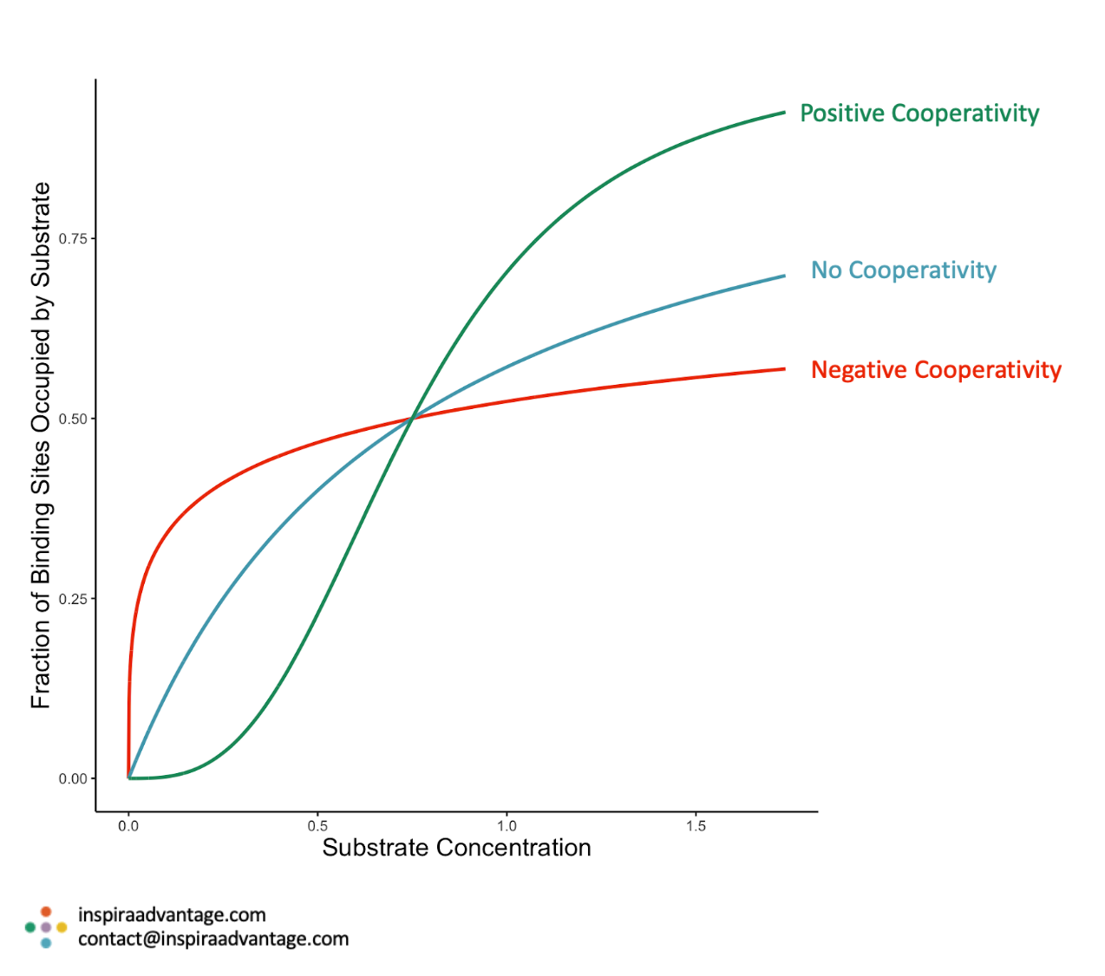
Hill coefficient is a measure of cooperativity
Hill coefficient > 1
Hill coefficient=1
Hill coefficient < 1
How can we interpret the shape of each curve?
https://www.inspiraadvantage.com/blog/hill-coefficient-mcat-test-prep-simple

Slide 24
What factors impact the interaction between Hb and oxygen?
pH
CO₂
CO (carbon monoxide)
Temperature
BPG

Slide 25
pH Effect on O₂ binding to Hemoglobin
Blood in tissues has slightly lower pH than blood in the lungs.
Metabolism results in the presence of some acidic compounds
Affinity for oxygen depends on the pH
Oxygen binds well at higher pH
Oxygen is released well at lower pH
The pH difference between lungs and metabolic tissues increases the O₂ transfer efficiency.
This is known as the Bohr effect.

Slide 26
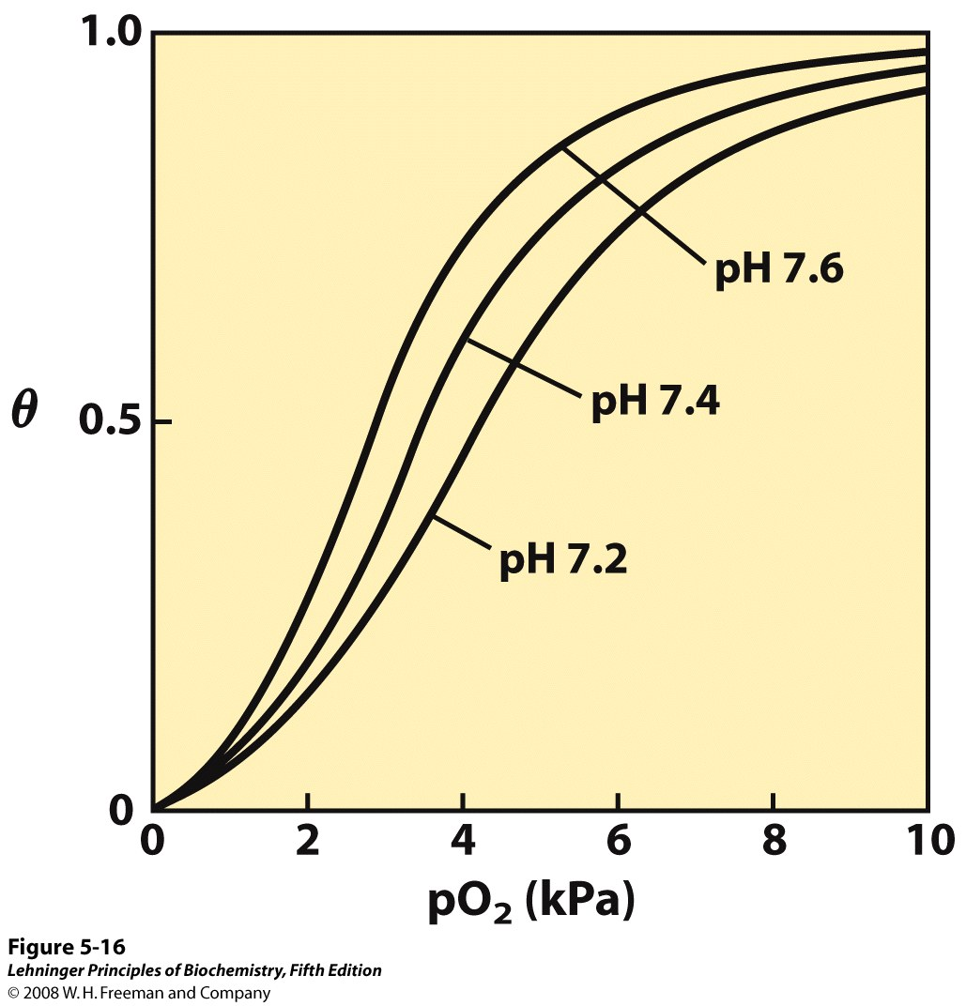
Bohr (pH) effect
Venous blood is generally reported to be about pH 7.2 and arterial blood 7.38-7.42.
Venous blood pH may drop even lower in muscle tissue during exercise.
Notes:
FIGURE 5-16 Effect of pH on oxygen binding to hemoglobin. The pH of blood is 7.6 in the lungs and 7.2 in the tissues. Experimental measurements on hemoglobin binding are often performed at pH 7.4.**This is what the books says, but I think this is incorrect.

Slide 27
Hemoglobin and CO₂ Export
CO₂ is produced by metabolism in tissues and must be exported to the lungs.
Some CO₂ exported is dissolved in the blood plasma and most CO2 is converted to bicarbonate in the blood.
Some CO₂ is exported in the form of a carbamate on the amino terminal residues of each of the polypeptide subunits.
Notice that the formation of a carbamate yields a proton which can bind to hemoglobin and promote oxygen dissociation

Slide 28
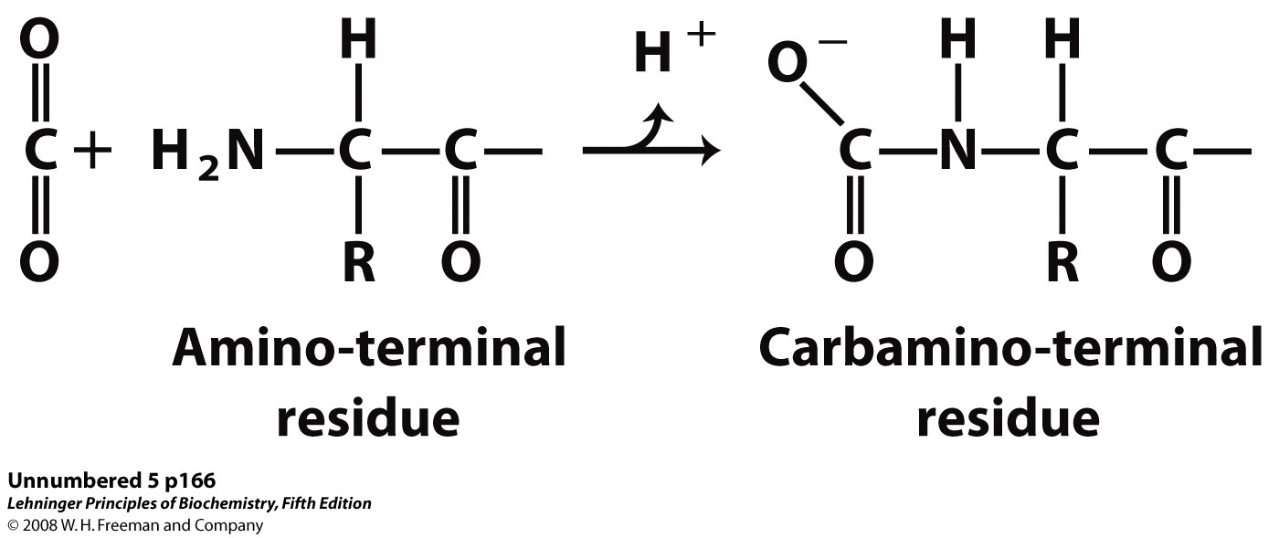
Some CO₂ is carried covalently attached to the N terminus

Slide 29
Binding of Carbon Monoxide
CO has similar size and shape to O₂; it can fit to the same binding site
CO binds over 20,000 times better than O₂ because the carbon in CO has a filled lone electron pair that can be donated to vacant d-orbitals on the Fe²⁺
CO is highly toxic as it competes with oxygen. It blocks the function of myoglobin, hemoglobin, and mitochondrial cytochromes that are involved in oxidative phosphorylation

Slide 30
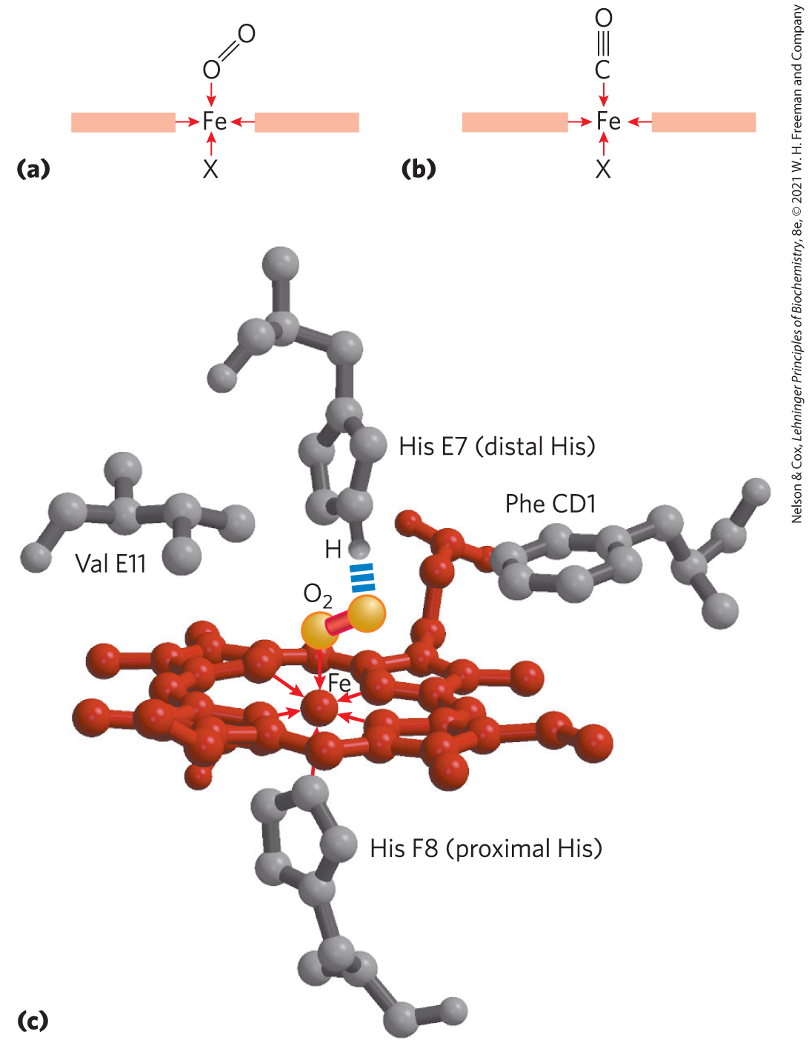
Carbon Monoxide locks hemoglobin in the T state
Why is this a problem in the body?
Why is CO binding hard to reverse?

Slide 31
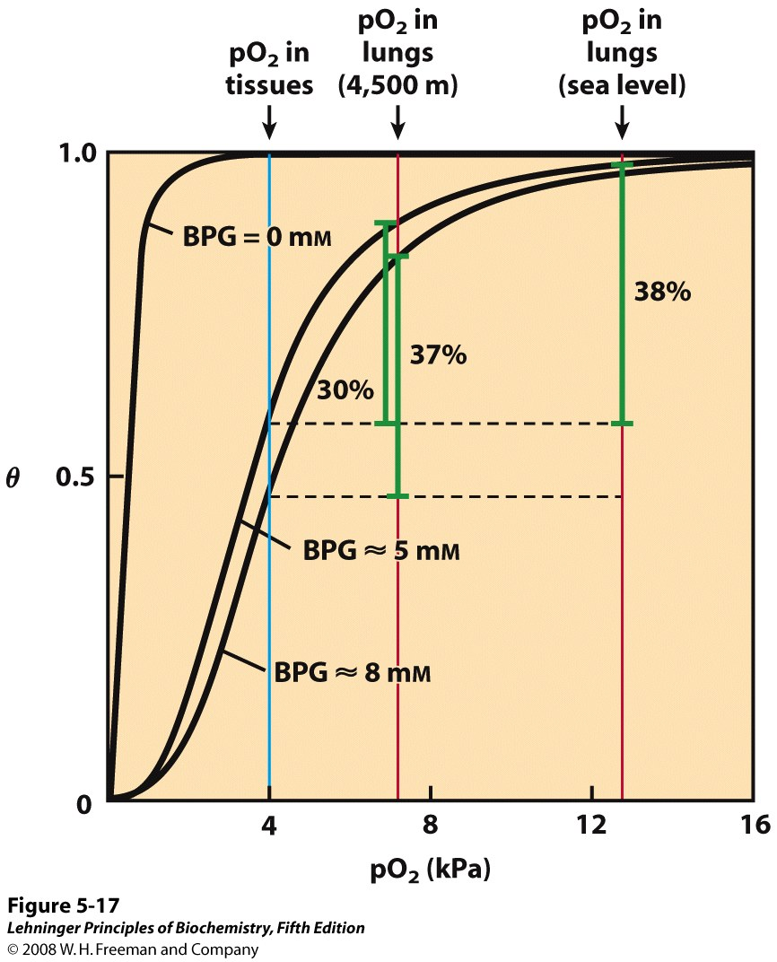
Regulation of O₂ Binding by 2,3 BPG
What can affect the quantity of BPG present?
Notes:
FIGURE 5-17 Effect of BPG on oxygen binding to hemoglobin. The BPG concentration in normal human blood is about 5 mM at sea level and about 8 mM at high altitudes. Note that hemoglobin binds to oxygen quite tightly when BPG is entirely absent, and the binding curve seems to be hyperbolic. In reality, the measured Hill coefficient for O₂-binding cooperativity decreases only slightly (from 3 to about 2.5) when BPG is removed from hemoglobin, but the rising part of the sigmoid curve is confined to a very small region close to the origin. At sea level, hemoglobin is nearly saturated with O₂ in the lungs, but just over 60% saturated in the tissues, so the amount of O₂ released in the tissues is about 38% of the maximum that can be carried in the blood. At high altitudes, O₂ delivery declines by about one-fourth, to 30% of maximum. An increase in BPG concentration, however, decreases the affinity of hemoglobin for O₂, so approximately 37% of what can be carried is again delivered to the tissues.

Slide 32
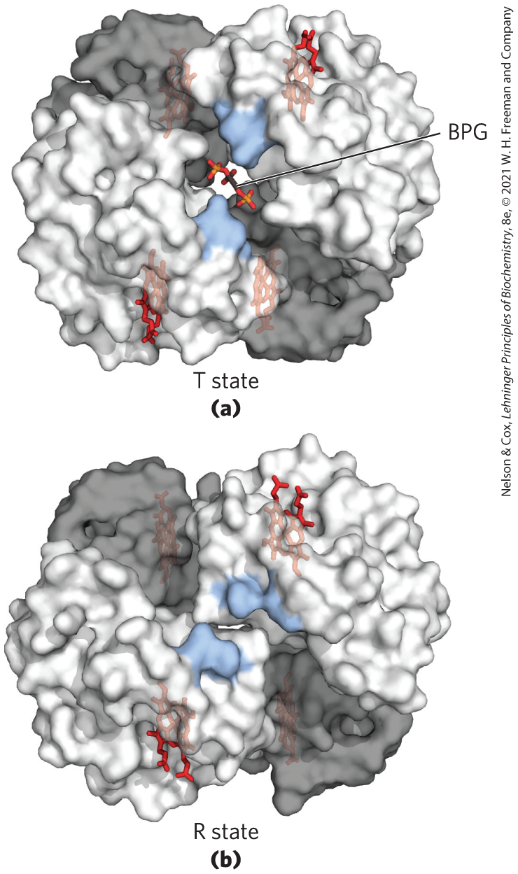
BPG binds at the center of the tetramer
Why does this stabilize the T state?

Slide 33
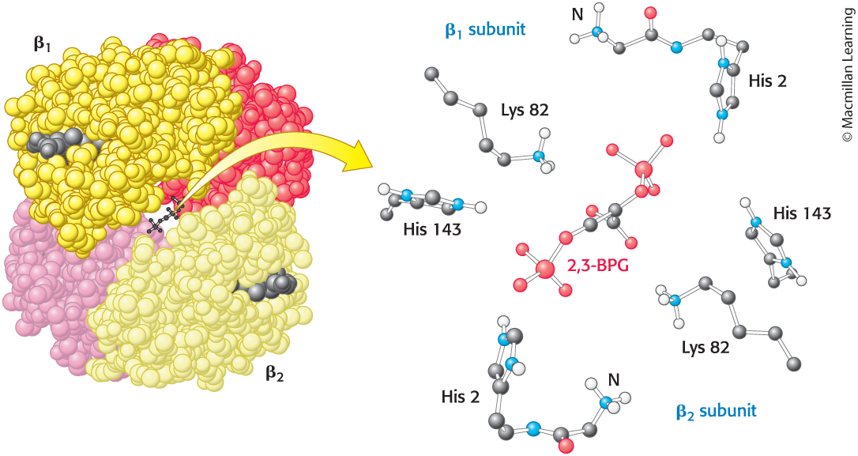
Chemical interactions between Hb and BPG

Slide 34
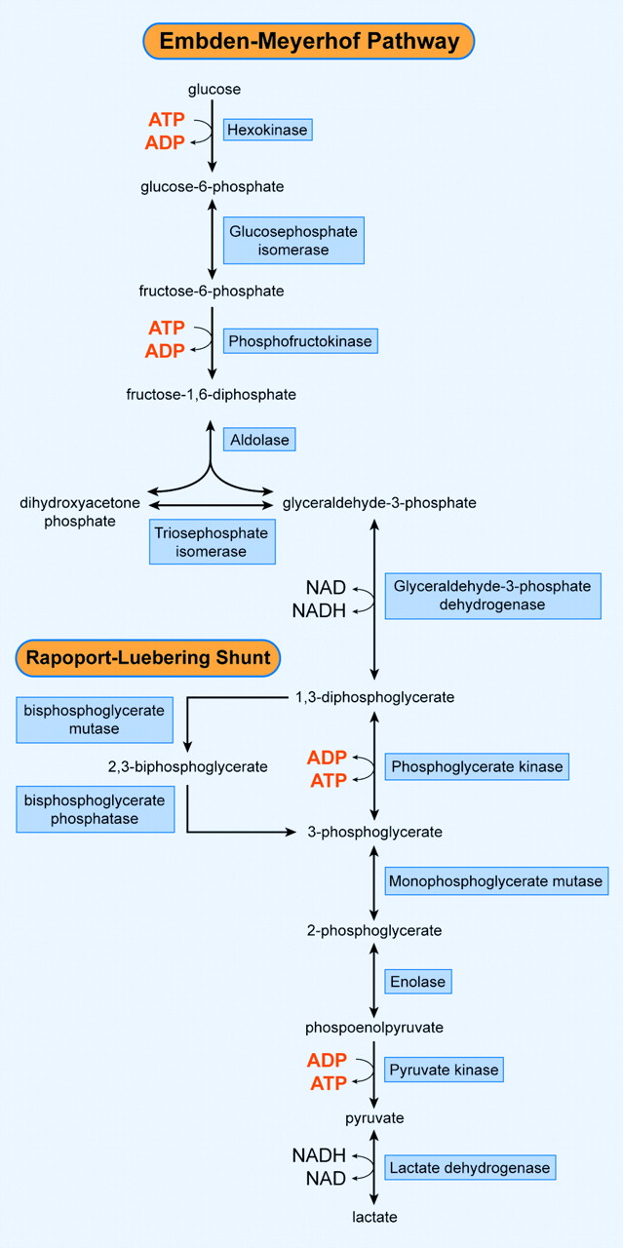
Formation of 2,3 BPG in RBCs
Emden-Meyerhof: The anaerobic metabolic pathway by which glucose, especially the glycogen in human muscle, is converted to lactic acid.

Slide 35
High altitude adaptations
Short term:
Make more BPG in glycolysis (more anaerobic energy production)
Hyperventilation
Increased heart rate
Longer term
Increase in hematocrit
Capillary growth (angiogenesis)

Slide 36
Antibodies
Antibodies are proteins that are expert at binding a wide variety of ligands
The immune systems distinguishes self from non-self (in part) using antibodies
Antibodies tag foreign invaders for phagocytosis
Each antibody is specific, but there are many different antibodies we can make with different specificities
Antibodies are a great laboratory tool

Slide 37
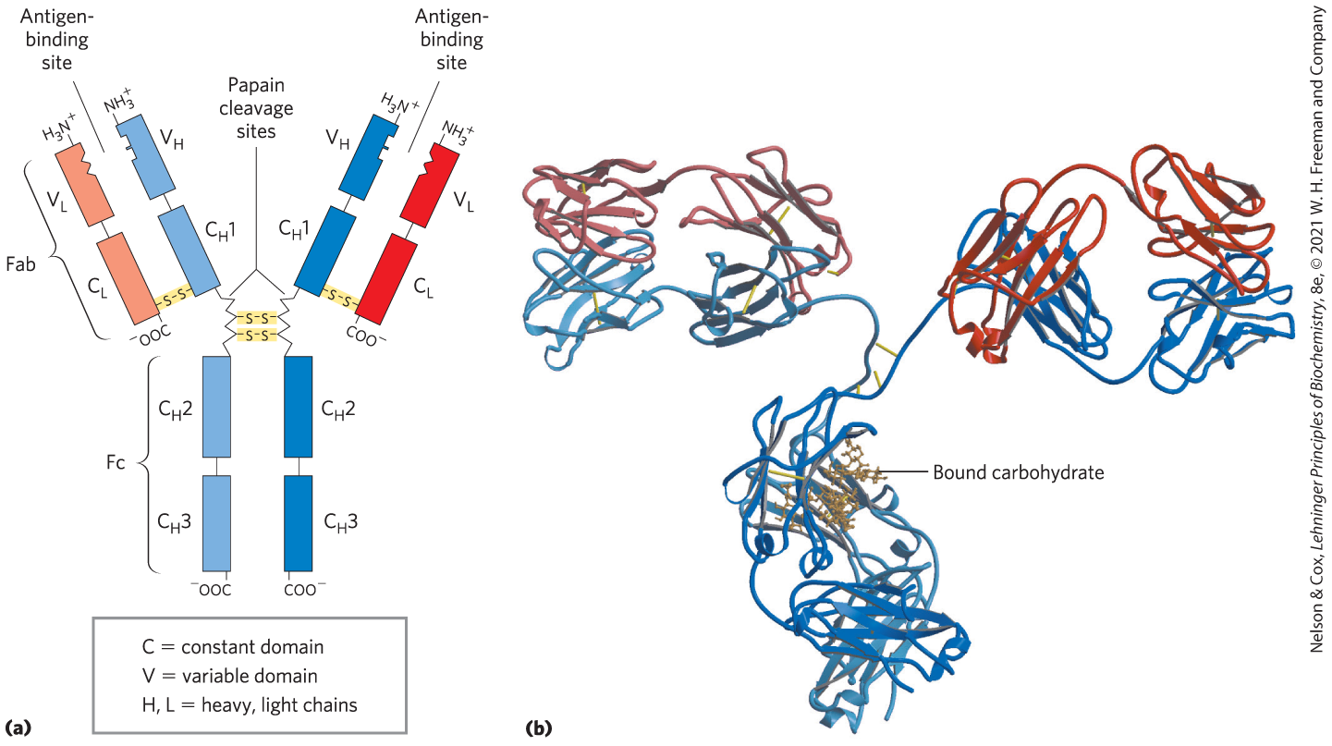
The general structure of an IgG antibody

Slide 38
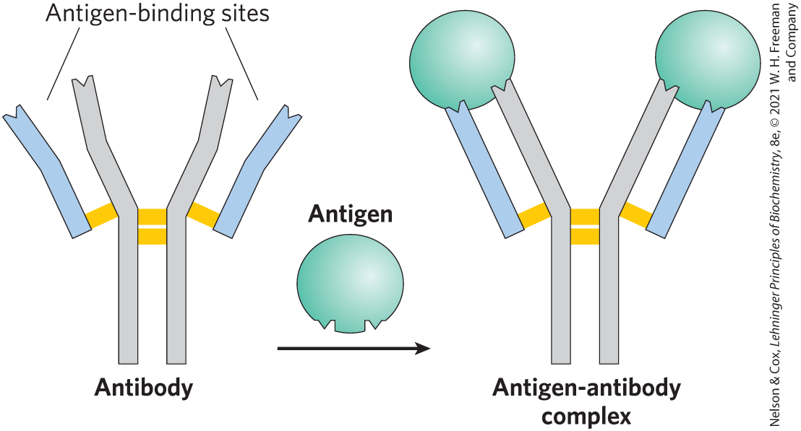
Each natural antibody has two identical antigen-binding sites
What about bi-specific antibodies?

Slide 39
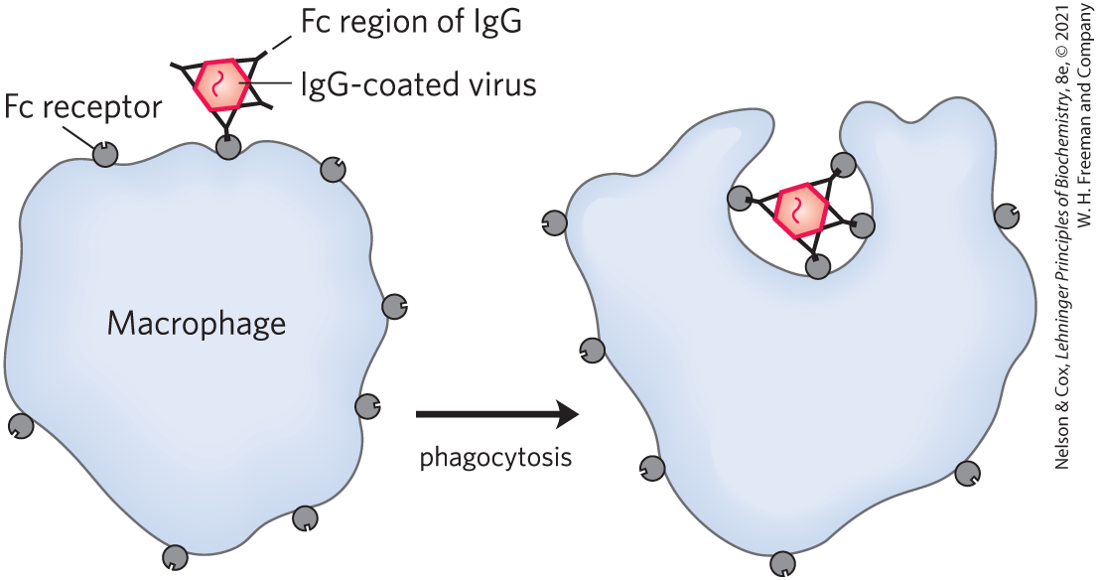
Antibodies can signal to macrophages for phagocytosis

Slide 40
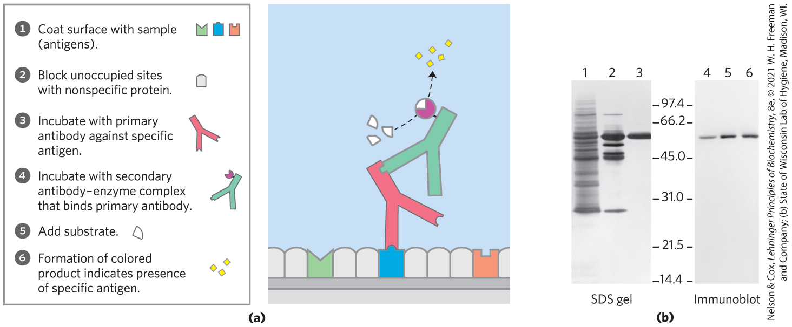
Antibodies as a laboratory tool

Slide 41
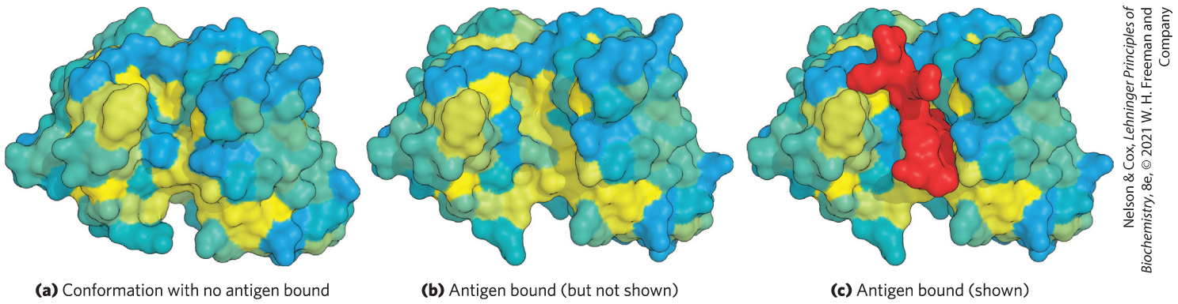
Antigen-antibody binding as an example of induced fit

