Slide 1
How do we understand place?
Exploration, looking around – our own experience of seeing and experiencing a place
Reading
Learning to analyze drawings and images
Talking to people about their experience
Empirical research

Slide 2
“the built environment is a sort of palimpset, a document in which one layer of writing has been scraped off, and another one applied”
Stilgoe, Outside Lies Magic

Slide 3
The built environment functions as a system.
There are two different systems that function in two different ways and compete with each other.
Notes:
Seth Harry, Pro-Urb post, 10/18/10:
I should add that all of these things reinforce the perception that suburban retail is a fundamentally different system of good distribution and selling, than urban retail, which is why it is so hard to do real urban retail formats in suburban market contexts. The closest we are usually most able to achieve is mere urban-like places that are only superficially urban, at best, while still retaining most of the fundamental attributes and business models of a conventional suburban shopping center. The other interesting thing related to this systemic line of thinking is the happy coincidence of the suburban arterial/interstate connection, and the nature of goods distribution, from the suburban retailer's perspective. The same system that facilitates the daily mass migration of bodies into and out of our urban centers every day -- an over-sized arterial network -- is essentially the same system that allows for the efficient conveyance of goods as part of a national and global distribution network. The ideal interface between this distribution system and its intended consumer market occurs at the same interface as that between those residential bedroom communities, and their urban commutes -- suburban arterial/interstate interchanges. This allows retailers to essential terminate their supply chain at what had previously been their warehouse and retail distribution level (hence, the term warehouse stores), while also encouraging those same retailers to rely directly on an extra-regional supplier to provide those goods. This juxtaposition was a significant factor in enabling the rapid development of globalization, and the off-shoring of America's fundamental food supply system. I guess you could call this efficient, if you discount the larger implications of this system, and the fact that consumer is "paying" for this efficiency through other means, but it is fundamentally different from the way urban centers typically conveyed goods to retail consumers. By way of reference, the rural village where I currently live and work, just outside of Baltimore, and situated along the Baltimore and Ohio rail corridor, was a farming community which shipped locally grown food products directly into the city by rail. At the end of my street, which is where both the rail line and the Patapsco River reside (both running directly into Baltimore's waterfront) there are the stone remnants of a mill and cannery from which local harvests where processed and shipped to downtown Baltimore for distribution to neighborhood retailers. This supply chain, and its long-gone passenger rail network, has been totally supplanted by the endless stream of commuters and 18-wheelers on nearby Interstate 70, which is now the preferred route for goods and commuters both into the city, and also to the nearby suburban arterial interchanges around which all the usual big-box suspects are clustered. And the goods themselves, of course, within these boxes are from all over the country and abroad, virtually none are locally sourced. While I still have cows across the street, and horses and sheep on either side of me (someone recently posted that you're not really in a rural community unless you have livestock within your ped-shed), the farming community to which I moved from Capitol Hill is now no more than a suburban bedroom community of gentleman farmers and commuters, appearances notwithstanding. For that reason, I'm moving my office to nearby Frederick, Maryland, a real city in its own right (though falling within both Baltimore's and Washington, DC's commuter shed), and fortunately, in the meantime, I still have a pied-a-terre in Old Montreal, to keep my urban street cred intact. The point is that none of this is coincidental -- there has been a consistent and systemic change in the way we produce, distribute and consume goods in this country over the last 60 years, and the nature of our settlement patterns over that same period of time has played a direct and influential role in that change. Beyond the immediate direct effects of that change, related to our local economies, food security, the nature of our food production (factory farming, etc.), there have been substantial systemic implications also associated with this change in terms of fair trade, exploitative/unsustainable production practices, environmental degradation, etc. It's time we start thinking about these things in terms of these systemic considerations, and not merely on the basis of the aesthetic qualities of their associated environments.

Slide 4
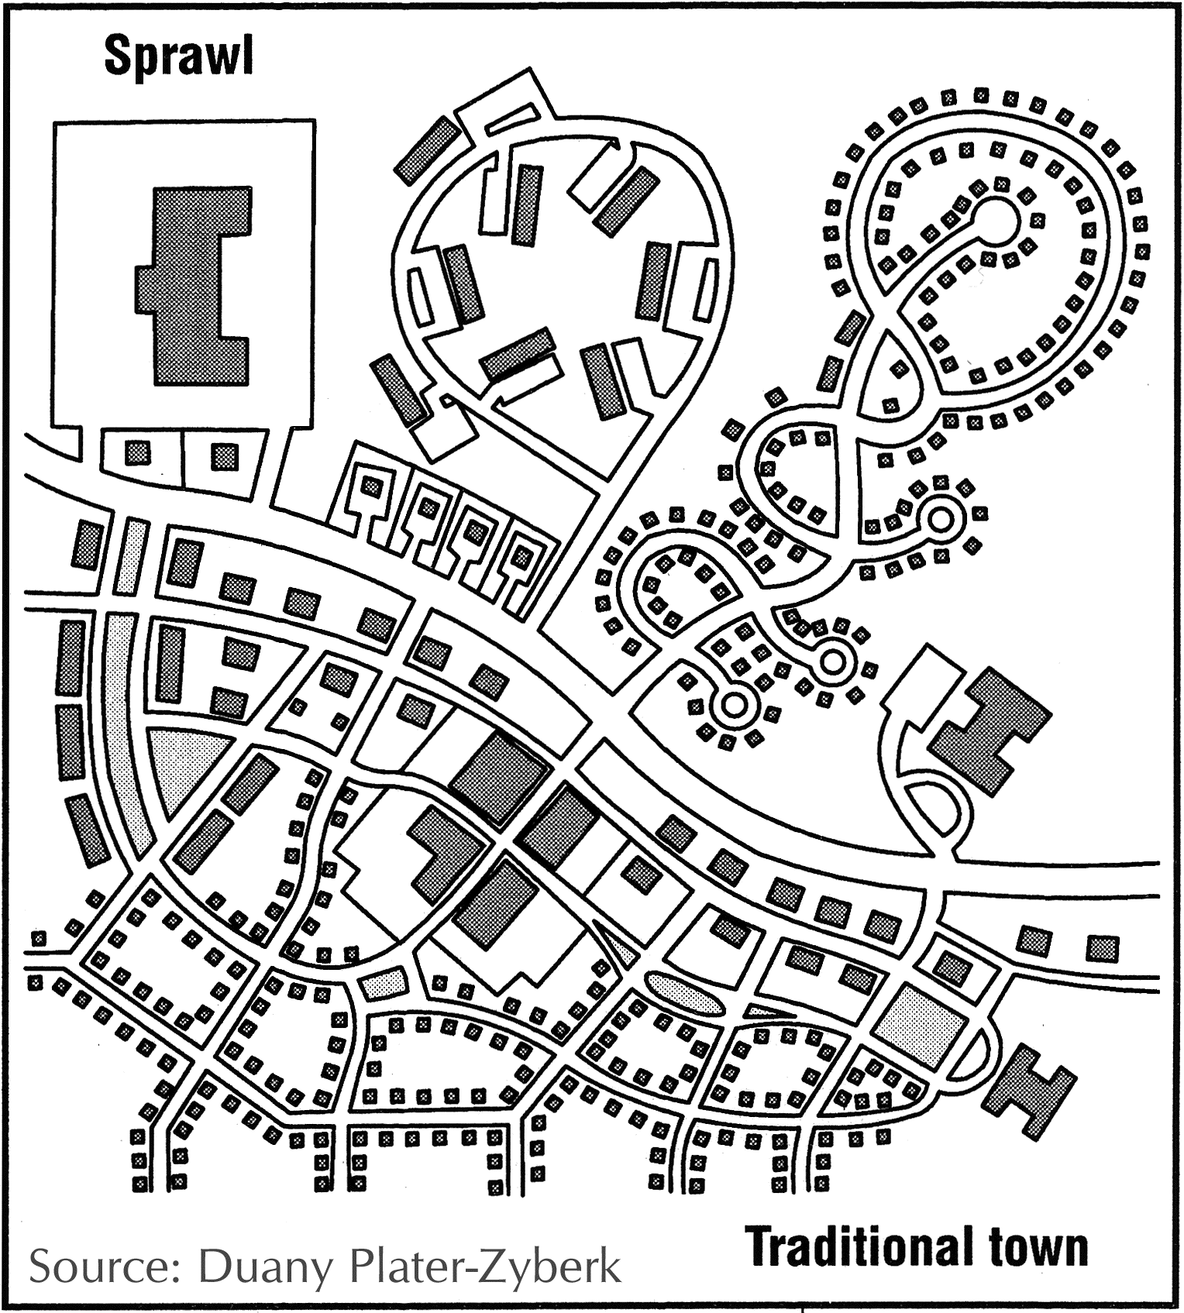
Traditional (Urbanism) vs. Modernist (Sprawl)
Notes:
Holston:
“That Brasilia's design derives from ClAM proposals is easily
demonstrated. Its most Significant manifesto, The Athens Charter,
defines the objectives of city planning in terms of four functions:
"The keys to city planning are to be found in the four functions:
housing, work, recreation (during leisure) and traffic" (Le
Corbusier 1957 [1941]: art. 77). The last function, traffic,
"bring[s] the other three usefully into communication" (ibid.,
art. 81). A later ClAM meeting augmented these to include a
"public core" of administrative and civic activities. Planners
refer to the organization of these functions into typologies of
social activity and building form as zoning. What distinguishes
modernist zoning from its precursors is the conception that urban life may be understood for planning purposes in terms of
these four or five functions and, more important, that they
should be organized as mutually exclusive sectors within the
city. Together with circulation, this organization determines
both the internal order and the overall shape of the ClAM city.”

Slide 5
Terms
Traditional Urbanism
Sprawl
New urbanism
Smart growth
Livable
Traditional Neighborhood Development (TND)
Transit Oriented Development (TOD)
Transect-Based
Pedestrian-Oriented
Walkable
Modernist
Auto-Oriented
Conventional suburban development (CSD)

Slide 6
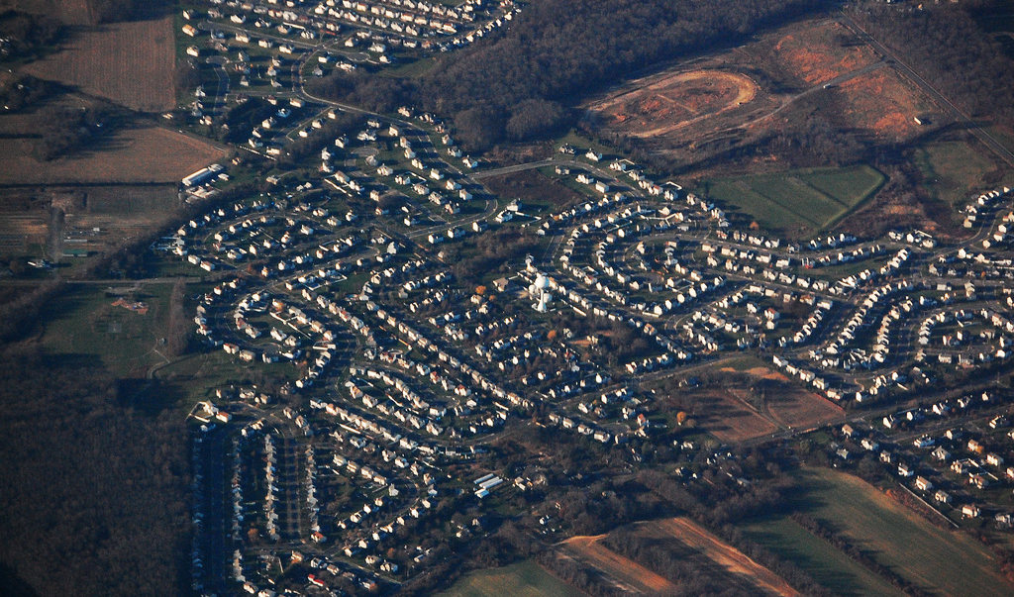
Notes:
http://www.njfuture.org/wp-content/uploads/2011/06/Aerial-Sub-Sprawl-RebeccaWilson.jpg

Slide 7
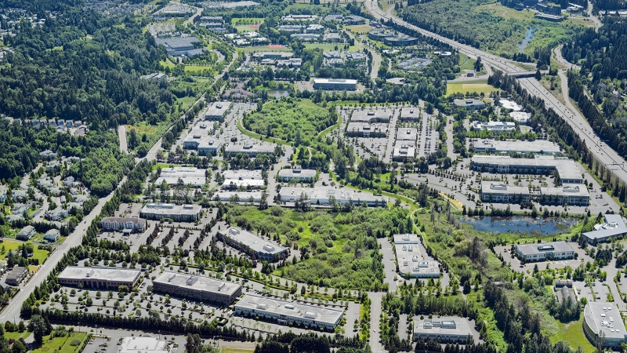
Notes:
http://www.dci-engineers.com/sites/default/files/styles/project_image/public/projects/North%20Creek%20Office%20Park%202sm_s.jpg?itok=MYrTe0qI
http://www.njfuture.org/wp-content/uploads/2011/06/Aerial-Sub-Sprawl-RebeccaWilson.jpg

Slide 8
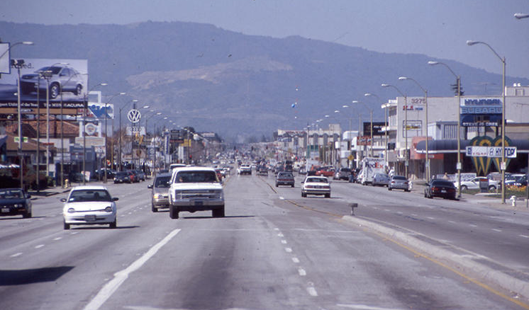
Notes:
http://h.fastcompany.net/multisite_files/fastcompany/imagecache/slideshow_large/slideshow/2014/02/3024987-slide-231-suburb-arterial-el-cam-real.jpg

Slide 9
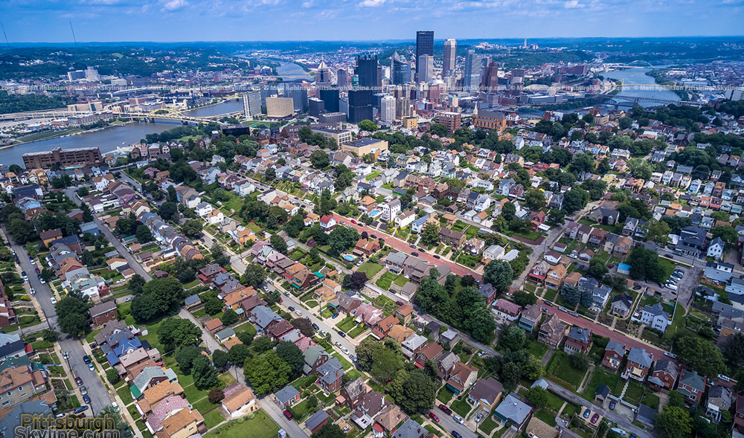
Notes:
http://images.pittsburghskyline.com/images/2015/08.18/july_2015_pittsburghskyline.com_02.jpg

Slide 10
Traditional (Urbanism) Space | Modernist (Sprawl) Anti-Space
High street connectivity (small blocks) | Dendritic street pattern (large blocks)
Mixed use, mix of housing types and sizes | Segregated uses, housing types and sizes
Buildings provide substantial sense of enclosure so that public spaces feel like “outdoor rooms” | Little or no sense of enclosure
Full transect of distinct rural – urban spaces | Rural and urban conflated
Mix of densities, but generally higher density in built areas | Lower density everywhere
Range of retail formats and sizes, corresponding to intensity of neighborhood / center | Retail concentrated in large formats at intersections of large arterials and interstates
Notes:
Holston:
“That Brasilia's design derives from ClAM proposals is easily demonstrated. Its most Significant manifesto, The Athens Charter, defines the objectives of city planning in terms of four functions: "The keys to city planning are to be found in the four functions: housing, work, recreation (during leisure) and traffic" (Le Corbusier 1957 [1941]: art. 77). The last function, traffic, "bring[s] the other three usefully into communication" (ibid., art. 81). A later ClAM meeting augmented these to include a "public core" of administrative and civic activities. Planners refer to the organization of these functions into typologies of social activity and building form as zoning. What distinguishes modernist zoning from its precursors is the conception that urban life may be understood for planning purposes in terms of these four or five functions and, more important, that they should be organized as mutually exclusive sectors within the city. Together with circulation, this organization determines both the internal order and the overall shape of the ClAM city.”
Discernible centers vs ubiquitous sprawl

Slide 11
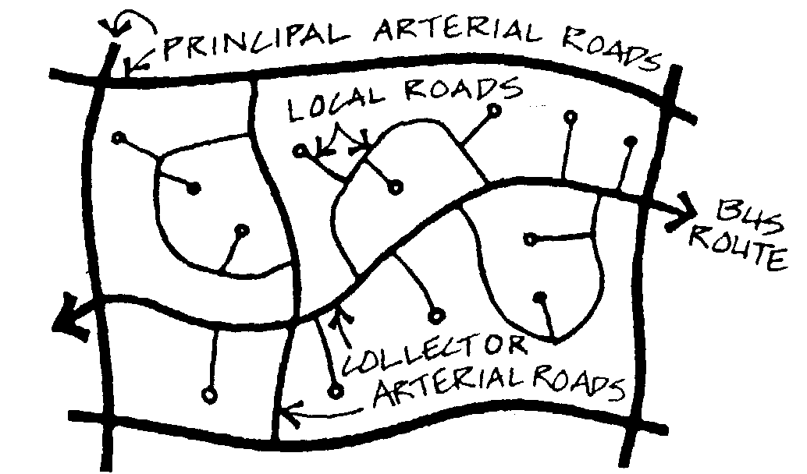
Notes:
http://futureuta.blogspot.com/2014/12/autonomous-rapid-buses.html

Slide 12
What’s the difference?
Suburban
vs
Modernist / Sprawl
Notes:
Dutton: “Suburbia,
originally situated as a distinct middle landscape
between city and country, has now become
the armature and model of growth everywhere. Its original dependence on the commercial, social, and civic life of the city has dissipated. Today suburbia has become autonomous and pervasive, invading both traditionally urban and rural areas.”
“The New Urbanists, in
particular, have freed the idea of sprawl from
its geographical moorings. For them, sprawl no longer implies merely the centrifugal development at the periphery, but rather a form of development pervasive everywhere. This form of development certainly has its most unadulterated
incarnations at the periphery, but it has
also become the convention for new development
anywhere, including within existing
metropolitan areas.”

Slide 13
Class Intros - Our Own Context
Pair Discussions – 10 min total
Describe a place you have lived in and know well
How does it match the description of sprawl vs. urbanism?
2 min ea / 5 min total
What was positive about the place you described?
What was negative about the place you described?
2 min ea / 5 min total

Slide 14
Class Intros - Our Own Context
Intros all around
Introduce yourself with name, school, major, why interested in this class, brief description of your place

