Slide 1
City 360 - Week 3

Slide 2
Agenda
Class Facilitation Assignment Overview & Signup
Assignment #1 – Hunting for sources
Modernism vs Traditional Urbanism lecture
Systems that New Urbanism interacts with – collaborative mindmap & discussion
Maybe: Image Dialogue & VPS Results

Slide 3
Assignment Stuff

Slide 4
Facilitation Assignment
Overview
Class Options
Details in Assignments instructions word doc on Moodle
5 options for which day → 14 students = 3 students on 4 days and 2 on 1 day
Find your group and give day preferences on form on Moodle
Do all readings for that day, including optional readings → prepare bullet point summaries to distribute
Make plan for class facilitation & meet with Prof Hurley to discuss
Facilitate class
Complete brief self-reflection (individually)
3/21 Environmentalism
4/4 Affordability
4/11 Transportation
4/18 Real Estate Development System
5/2 NU Practice Innovations & Last Class
Notes:
Small group discussion re sources

Slide 5
Perusall Annotations: Prompts
What logical argument or claim is the author trying to make? What evidence does she use to support that claim? Are there holes in the logical argument? Are there things that don’t make sense? How persuasive is the evidence? How legitimate are the sources of evidence?
How does this aspect of the reading resonate with or conflict with other material you have read?
How does this aspect of the reading resonate with or conflict with your direct personal experience?
How does this aspect of the reading relate to your case study or other cases you have heard about in class?

Slide 6
Assignment #1 Review DUE noon 2/14 – Present in class 2/15
Overview
Questions to Address
Short Presentation
Up to 20 slides (timed at 20 sec per)
No more than 6 minutes
Images – only text titles, labels
Goal: enough info to provide basis for class discussion
Include locator map / aerial photo
MUST include image sources
Location
History
Site info
Pricing & Affordability
Scale: region, neighborhood, block
Key Topics: Transportation, Affordability, Environment
Community engagement & development approval process
Key team members
What’s unique
Notes:
Small group discussion re sources

Slide 7
Assignment #1 – Hunting for Sources
CNU.org
Google Scholar
Google image search
Newspaper local to your site
Websites of key firms involved in project (developer, architect)
???

Slide 8
Modernism vs Traditional Urbanism

Slide 9
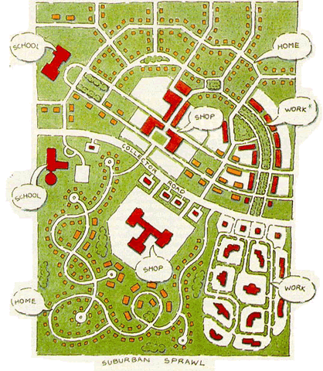
Traditional (Urbanism) vs. Modernist (Sprawl)
Tom Low, Duany Plater-Zyberk
Notes:
Holston:
“That Brasilia's design derives from ClAM proposals is easily
demonstrated. Its most Significant manifesto, The Athens Charter,
defines the objectives of city planning in terms of four functions:
"The keys to city planning are to be found in the four functions:
housing, work, recreation (during leisure) and traffic" (Le
Corbusier 1957 [1941]: art. 77). The last function, traffic,
"bring[s] the other three usefully into communication" (ibid.,
art. 81). A later ClAM meeting augmented these to include a
"public core" of administrative and civic activities. Planners
refer to the organization of these functions into typologies of
social activity and building form as zoning. What distinguishes
modernist zoning from its precursors is the conception that urban life may be understood for planning purposes in terms of
these four or five functions and, more important, that they
should be organized as mutually exclusive sectors within the
city. Together with circulation, this organization determines
both the internal order and the overall shape of the ClAM city.”

Slide 10
Traditional (Urbanism) Space | Modernist (Sprawl) Anti-Space
Human Scale | Auto Scale
Walkable / Pedestrian-Oriented | Auto-Oriented
High street connectivity (small blocks) | Dendritic street pattern (large blocks)
Mixed use, mix of housing types and sizes | Segregated uses, housing types and sizes
Extensive detailing and articulation (to keep interest at ped speed) | Limited detailing and articulation (not needed at auto speeds)
Buildings provide substantial sense of enclosure so that public spaces feel like “outdoor rooms” | Little or no sense of enclosure
Solid dominates | Void dominates
Private buildings provide background fabric | No background fabric buildings
Public-private figure-ground dialectic | Undifferentiated public and private buildings (space is always ground – all buildings are figure)
Full declension of public, semi-public, semi-private, and private space | Limited declension of public-private space (most space is fully public or fully private)
Full transect of distinct rural – urban spaces | Rural and urban conflated
Mix of densities, but generally higher density in built areas | Lower density everywhere
Range of retail formats and sizes, corresponding to intensity of neighborhood / center | Retail concentrated in large formats at intersections of large arterials and interstates
Mixed-use, multi-modal means that traffic generation is more complex | Segregated uses and auto-only mode mean that traffic generation can be forecasted
Notes:
Discernible centers vs ubiquitous sprawl

Slide 11
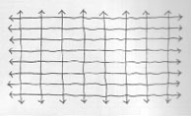
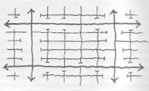
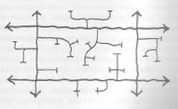
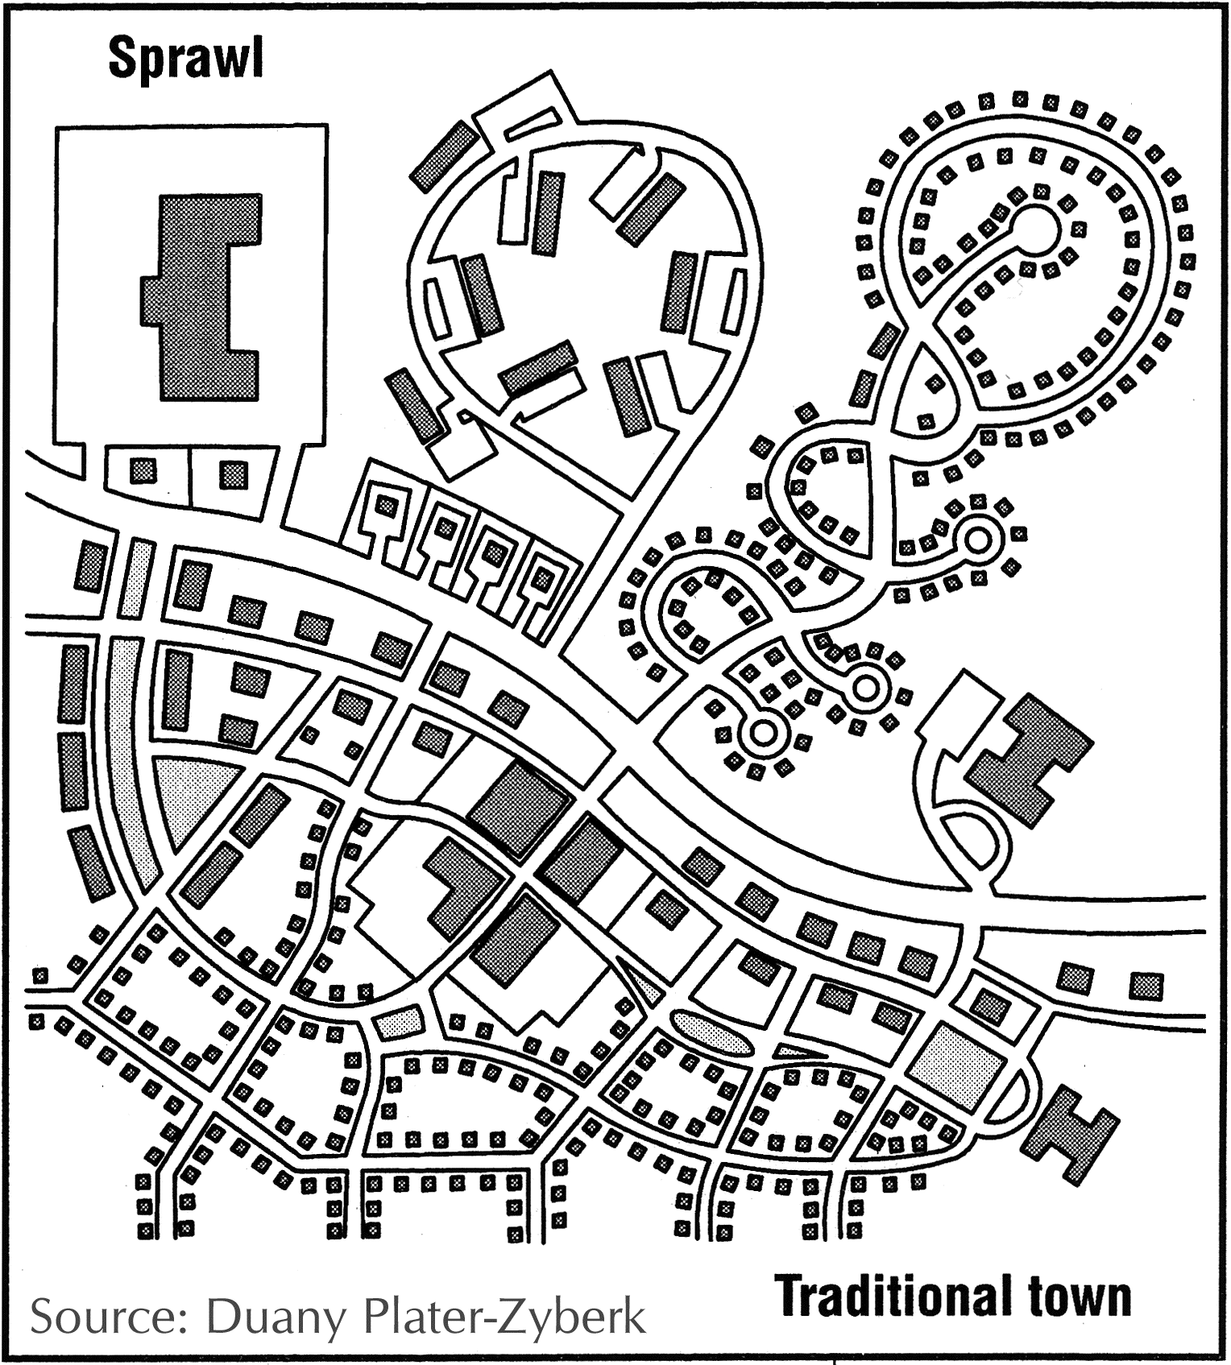
Permeability / Connectivity

Slide 12






Network Type

Slide 13
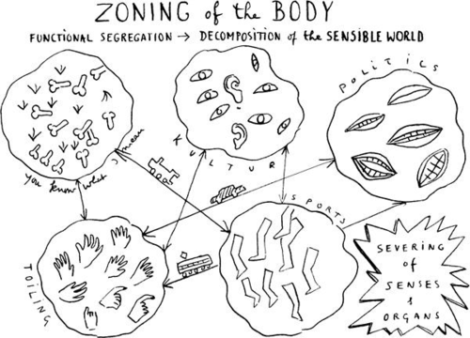
Mixed Use vs. Segregated Uses
Leon Krer
Notes:
Holston:
“That Brasilia's design derives from ClAM proposals is easily
demonstrated. Its most Significant manifesto, The Athens Charter,
defines the objectives of city planning in terms of four functions:
"The keys to city planning are to be found in the four functions:
housing, work, recreation (during leisure) and traffic" (Le
Corbusier 1957 [1941]: art. 77). The last function, traffic,
"bring[s] the other three usefully into communication" (ibid.,
art. 81). A later ClAM meeting augmented these to include a
"public core" of administrative and civic activities. Planners
refer to the organization of these functions into typologies of
social activity and building form as zoning. What distinguishes
modernist zoning from its precursors is the conception that urban life may be understood for planning purposes in terms of
these four or five functions and, more important, that they
should be organized as mutually exclusive sectors within the
city. Together with circulation, this organization determines
both the internal order and the overall shape of the ClAM city.”
Diversity also = mix of housing types, sizes, and price points
Image: tumblr_mht9wdqinW1qzlcoro1_500

Slide 14
The Athens Charter defines the objectives of city planning in terms of four functions: "The keys to city planning are to be found in the four functions: housing, work, recreation (during leisure) and traffic" (Le Corbusier 1957 [1941]: art. 77). The last function, traffic, "bring[s] the other three usefully into communication" (ibid.,art. 81). A later ClAM meeting augmented these to include a "public core" of administrative and civic activities. Planners refer to the organization of these functions into typologies of social activity and building form as zoning. What distinguishes modernist zoning from its precursors is the conception that urban life may be understood for planning purposes in terms of these four or five functions and, more important, that they should be organized as mutually exclusive sectors within the city. Together with circulation, this organization determines both the internal order and the overall shape of the ClAM city.”
Holston, The Modernist City

Slide 15
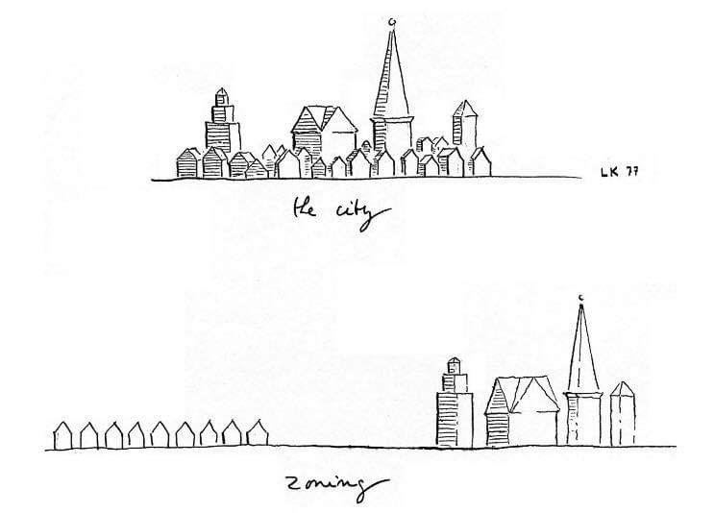
Leon Krier

Slide 16
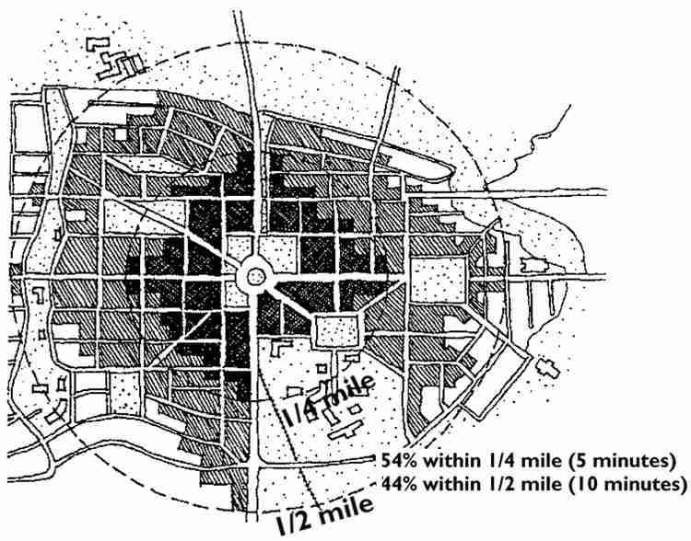
Pedestrian Shed
http://www.cnu.org/sites/files/CNU_Ped_Sheds.pdf
Notes:
¼ mile radius = 5 min walk = 125 acres
½ mile radius = 10 min walk = 500 acres
http://www.cnu.org/sites/files/CNU_Ped_Sheds.pdf

Slide 17
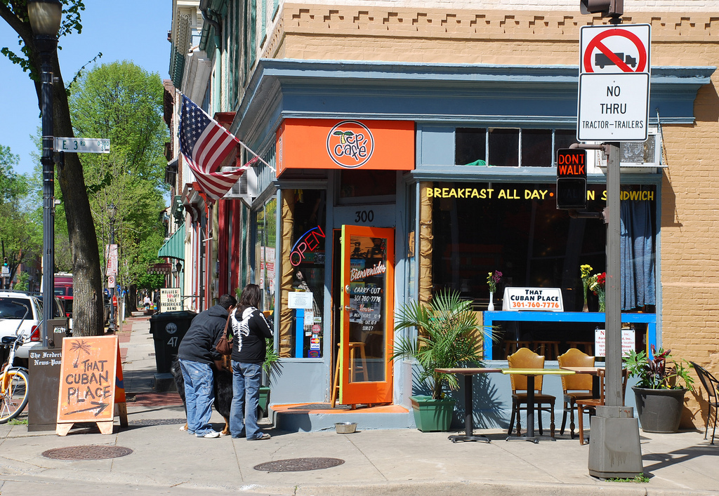
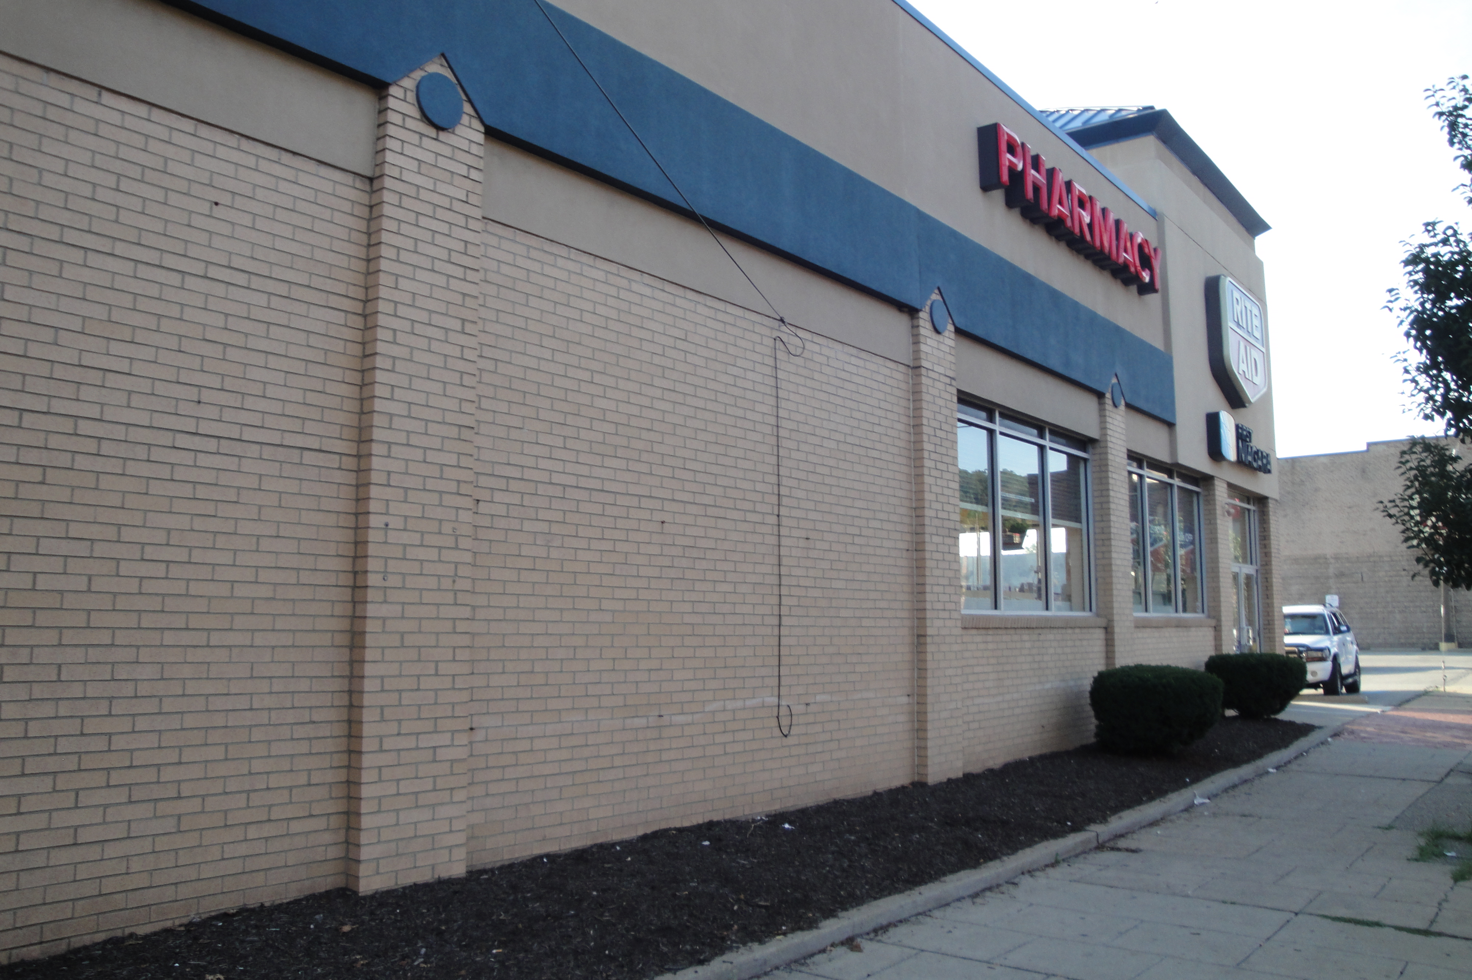
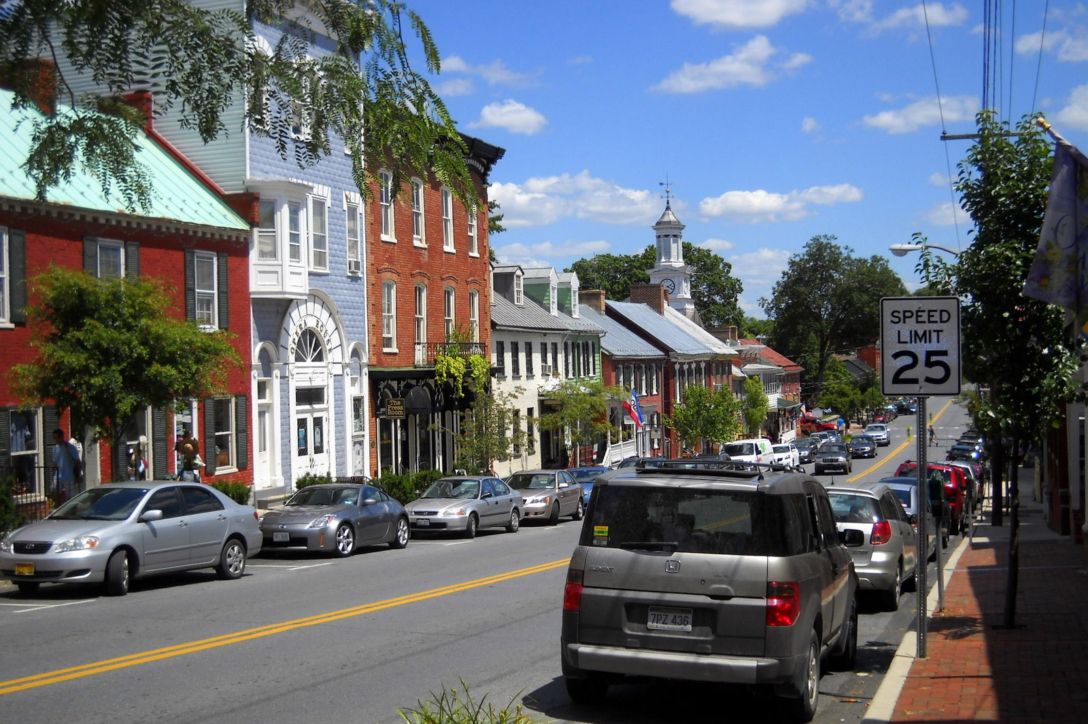
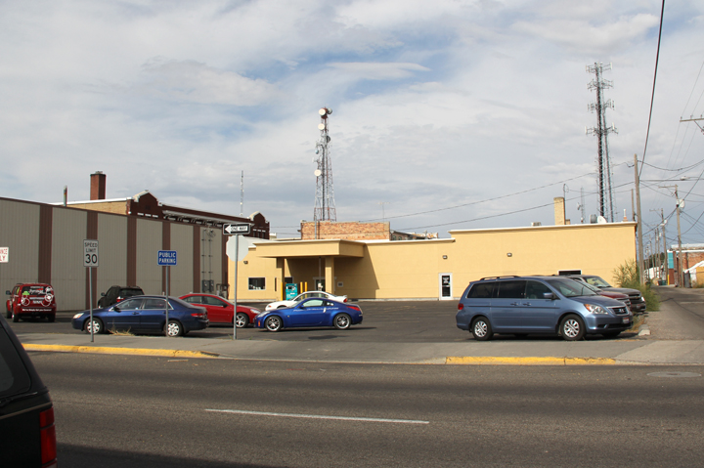
Detailing & Articulation
Traditional: Extensive
Modern: Limited
Notes:
tumblr_mht9wdqinW1qzlcoro1_500

Slide 18
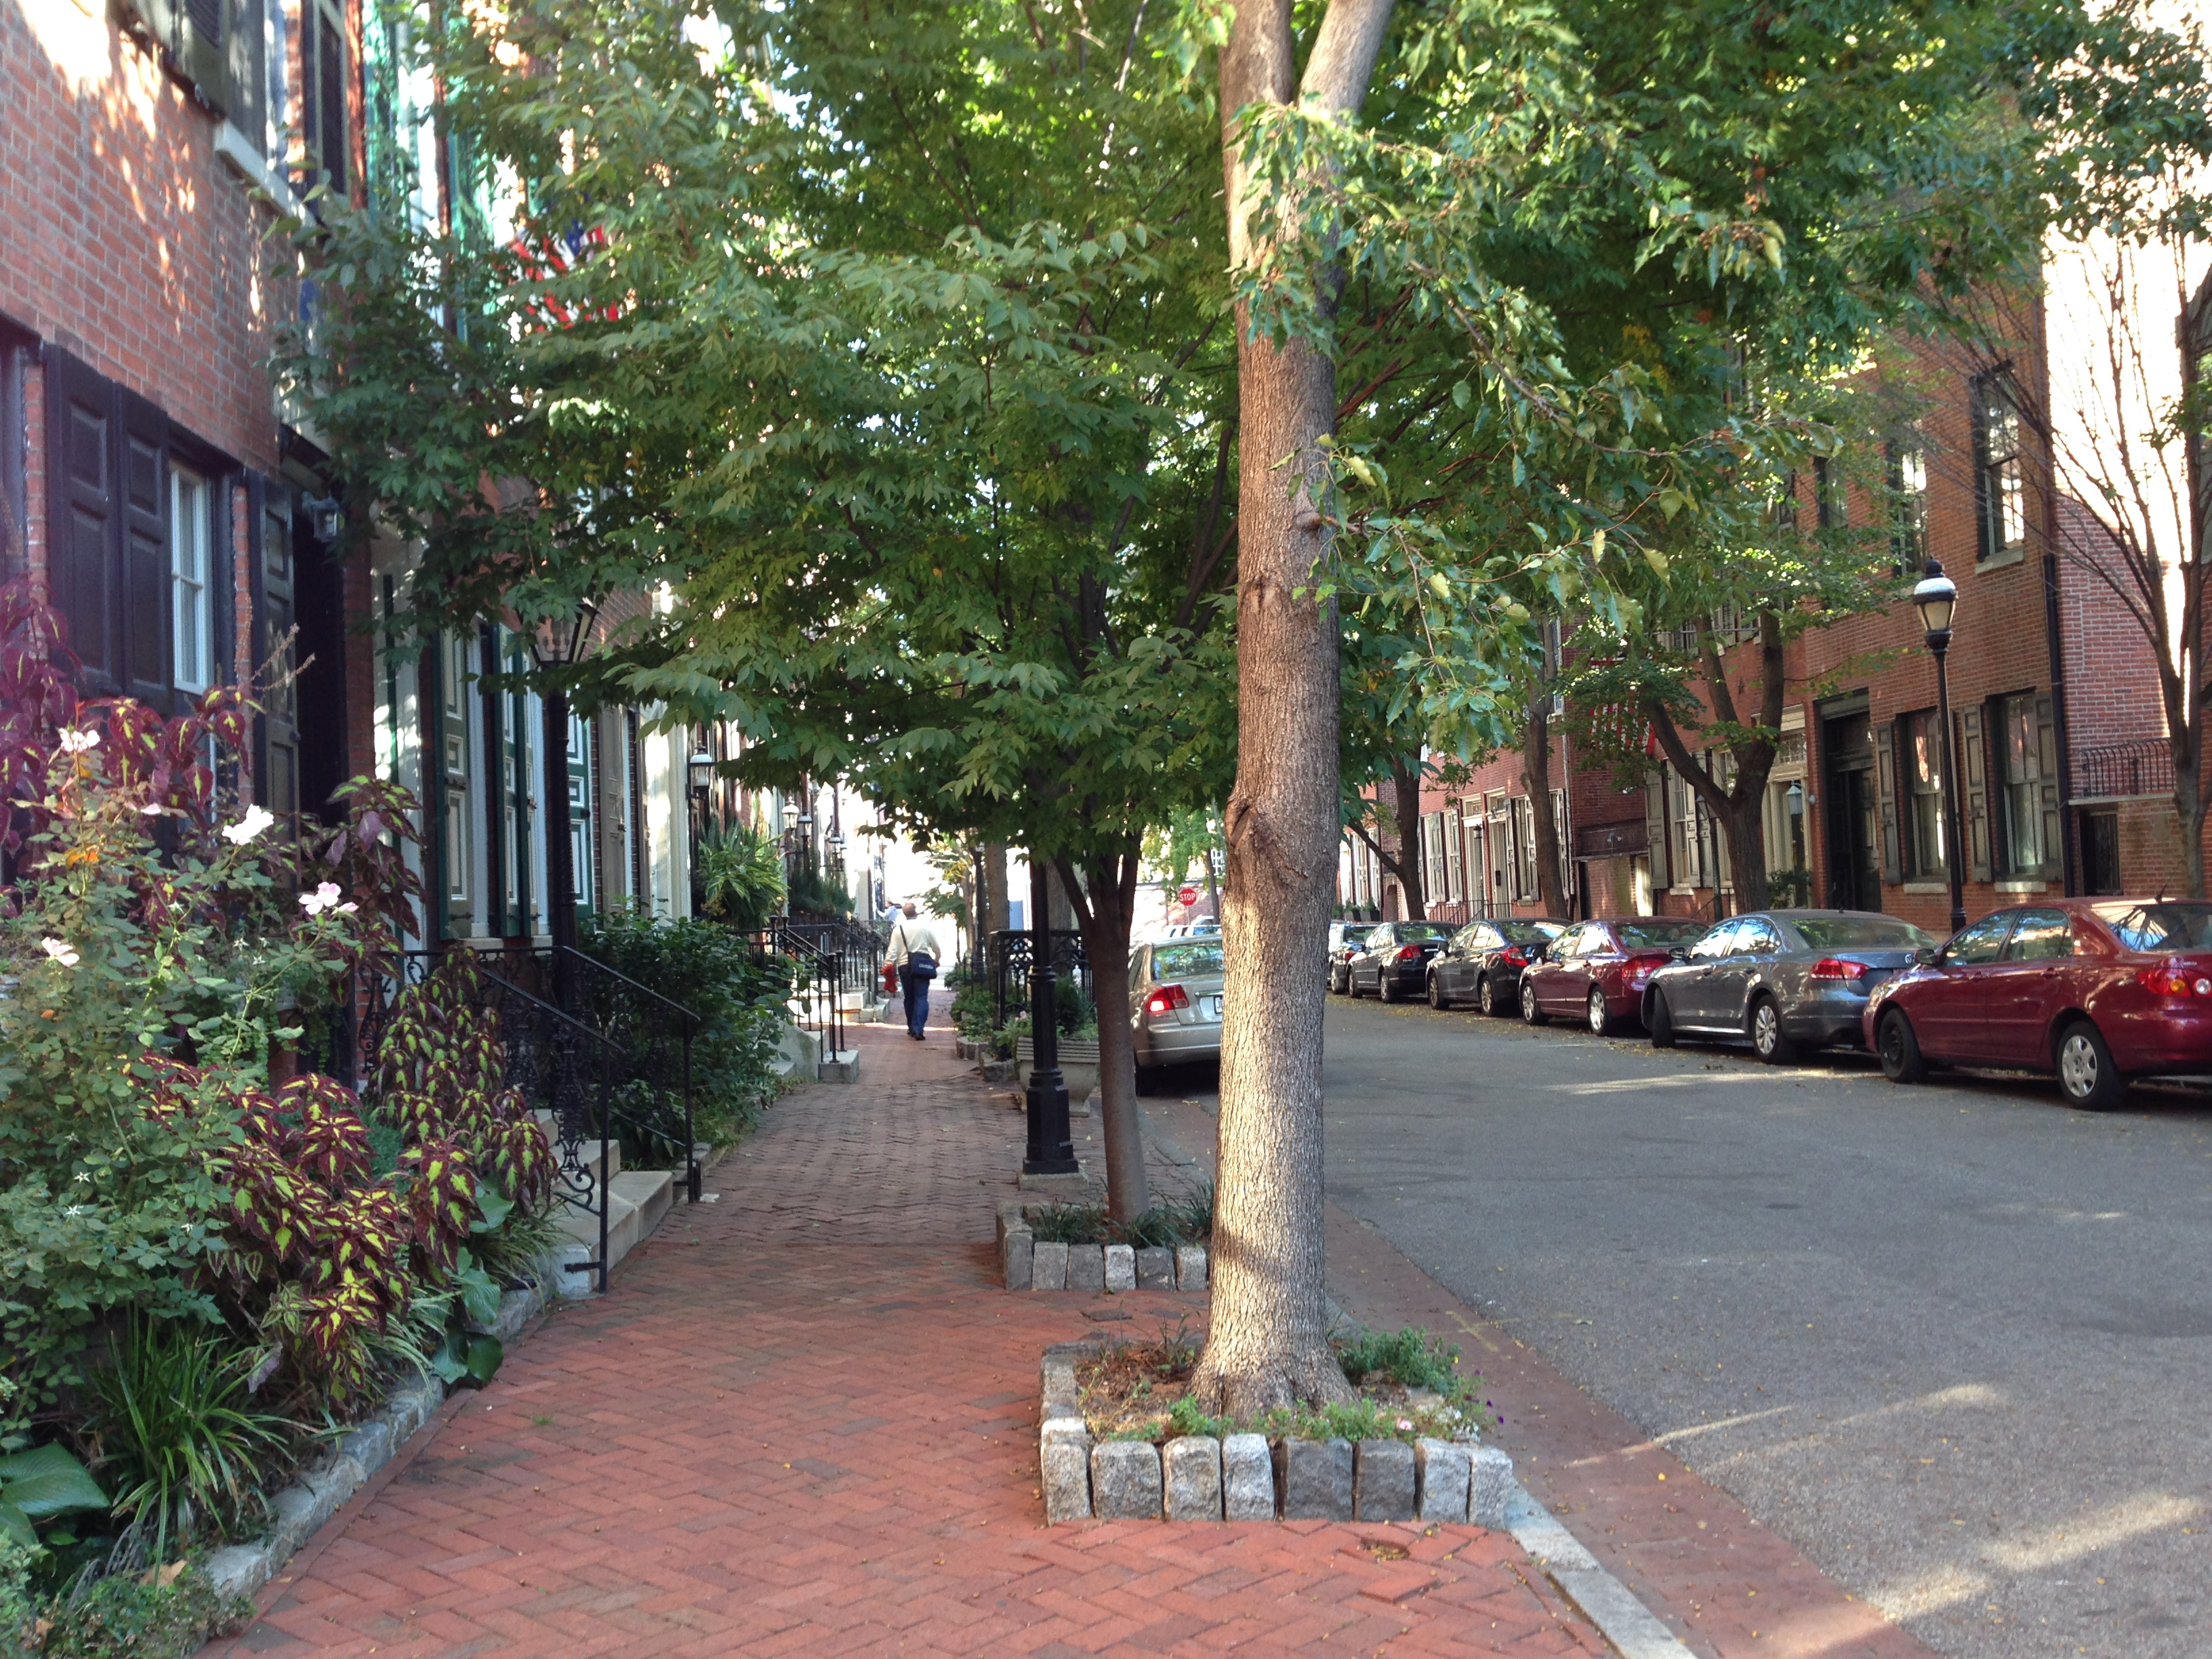
Sense of Enclosure
Traditional: “Outdoor Room”
Modernist: No Enclosure

Slide 19
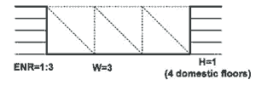
Enclosure
Accessed 2/19/07 at http://sccplugins.sheffield.gov.uk/urban_design/strategic_guidance_urban_creating.htm

Slide 20
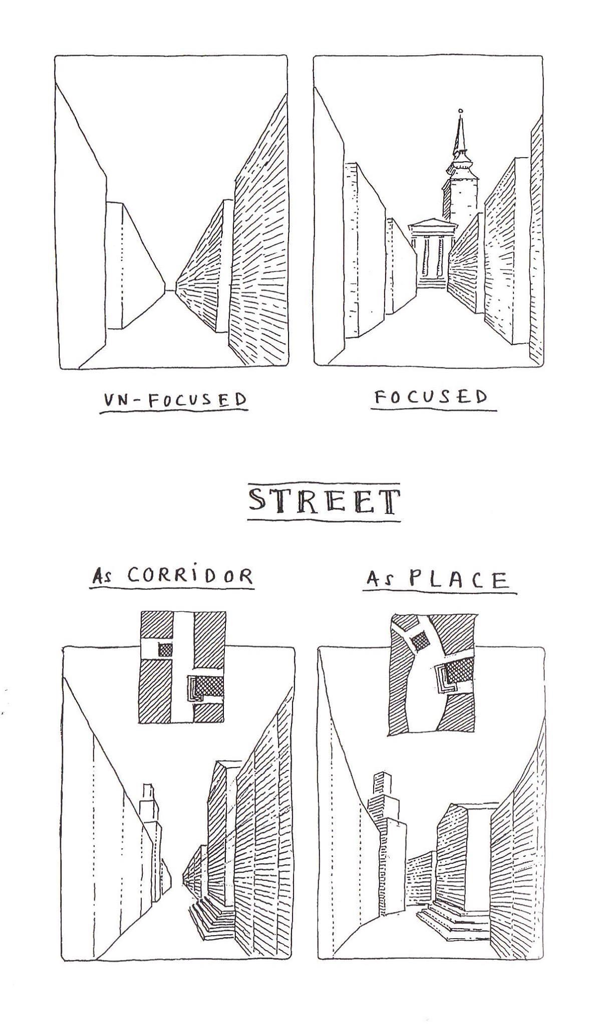
Enclosure from terminated vista
Leon Krier

Slide 21
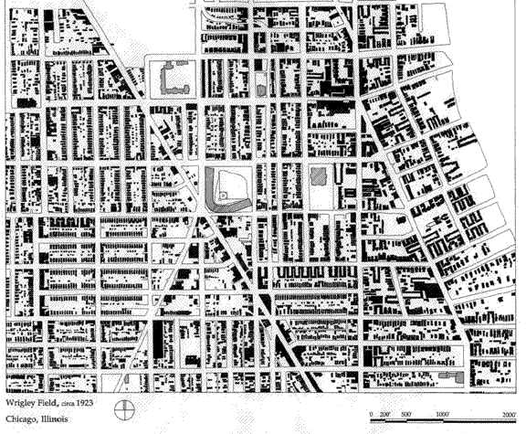
Figure - Ground
“The figure/ground relationship is a fundamental principle of perception. Figures are the elements within a field or ground. Ground is typically the background or the space within which the elements reside.”
Accessed 2/13/07 at http://www.jour.unr.edu/trumbo/VCsite/gestalt.html.
http://www.urbanphoto.net/wrigley/figure-ground.gif; Accessed 2/13/07.

Slide 22
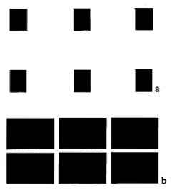
Figure - Ground
Solids can be either figure (object) or ground.
Holston. The Modernist City: An Anthropological Critique of Brasilia.

Slide 23
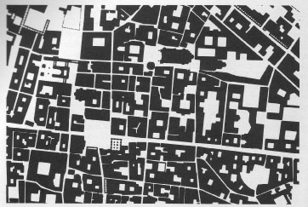

Traditional Space
Differentiated public and private buildings
Private buildings provide background fabric
Public buildings are objects
Majority is solid
Holston. The Modernist City: An Anthropological Critique of Brasilia.

Slide 24
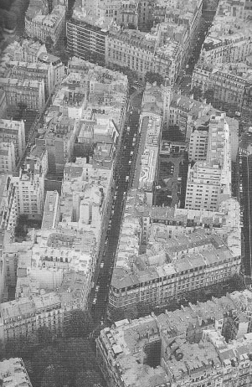
Traditional Space
CNU Charter: A primary task of all urban architecture and landscape design is the physical definition of streets and public spaces as places of shared use.

Slide 25
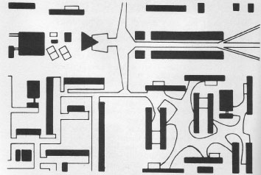

Anti-Space: Modernist
No hierarchy of buildings
No background buildings – all object buildings
Majority is void
Holston. The Modernist City: An Anthropological Critique of Brasilia.

Slide 26
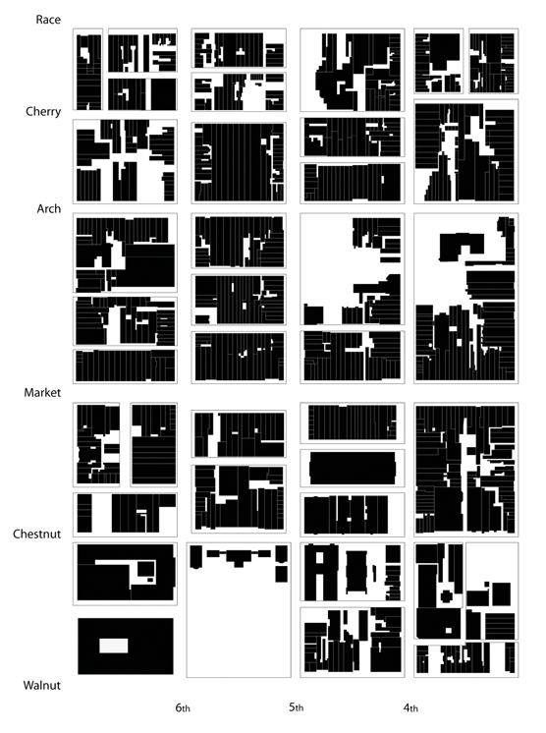
Independence
Mall Area
Philadelphia
1939
http://www.brynmawr.edu/iconog/uphp/indnoll2/IMAGES/1939%20large.jpg; Accessed 2/13/07

Slide 27
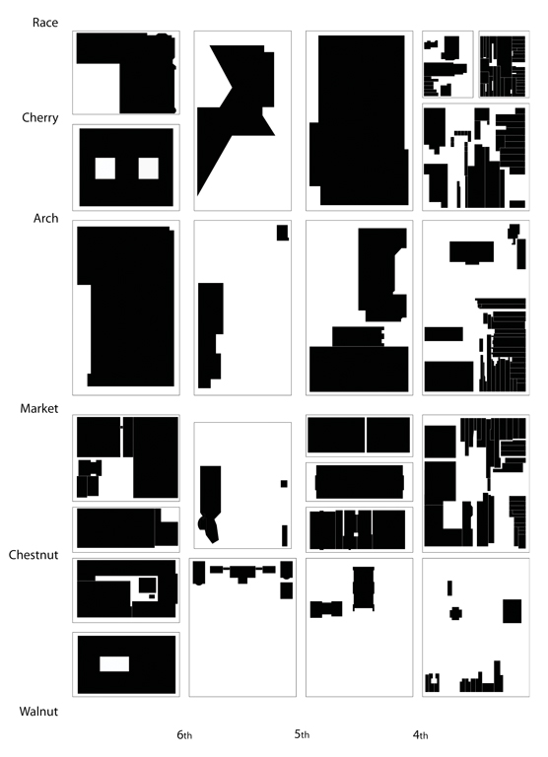
Independence
Mall Area
Philadelphia
2004
http://www.brynmawr.edu/iconog/uphp/indnoll2/IMAGES/2004%20large.jpg; Accessed 2/13/07

Slide 28
http://www.brynmawr.edu/iconog/uphp/indnoll2/IMAGES/1939%20large.jpg; Accessed 2/13/07
http://www.brynmawr.edu/iconog/uphp/indnoll2/IMAGES/2004%20large.jpg; Accessed 2/13/07

Slide 29
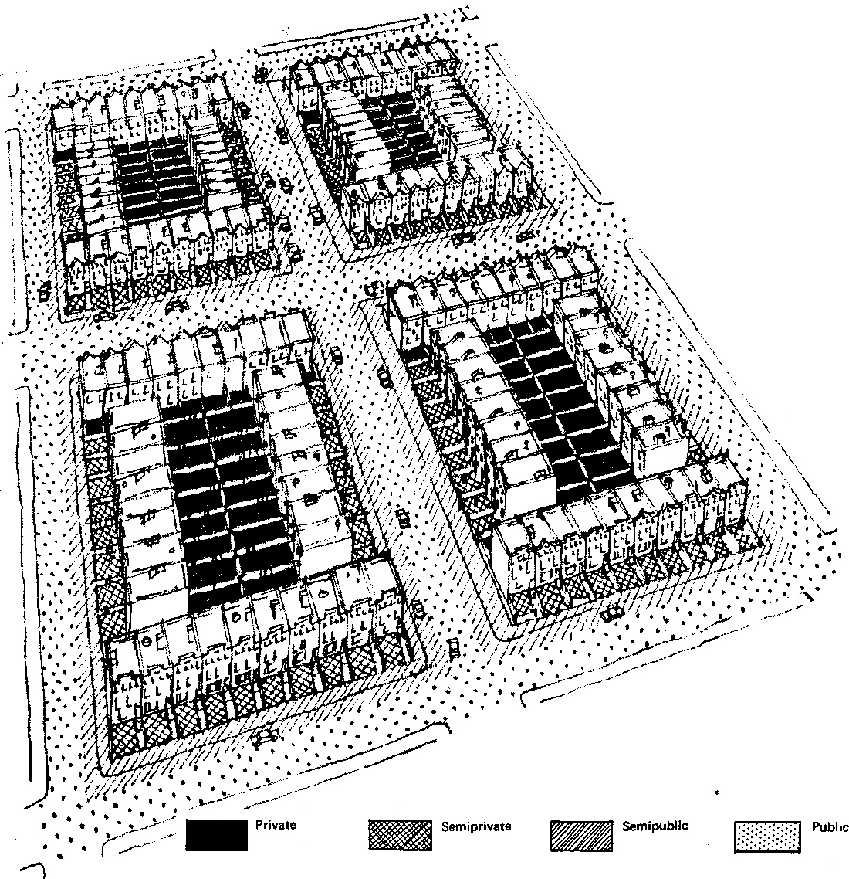
Public - Private Layers

Slide 30
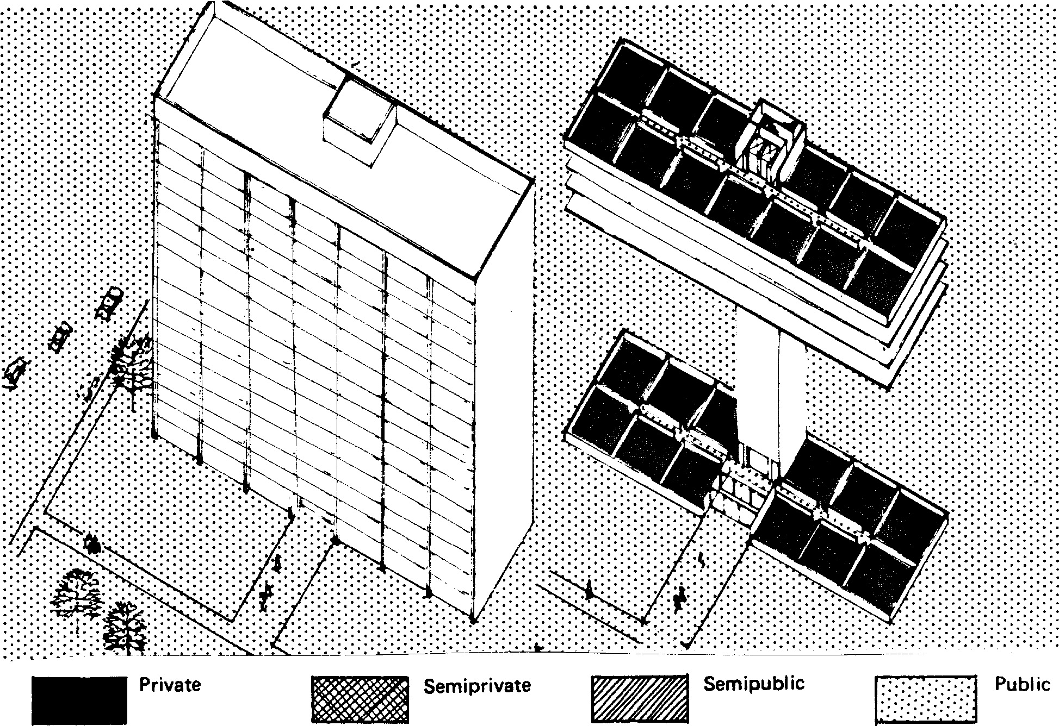
Public - Private Layers

Slide 31
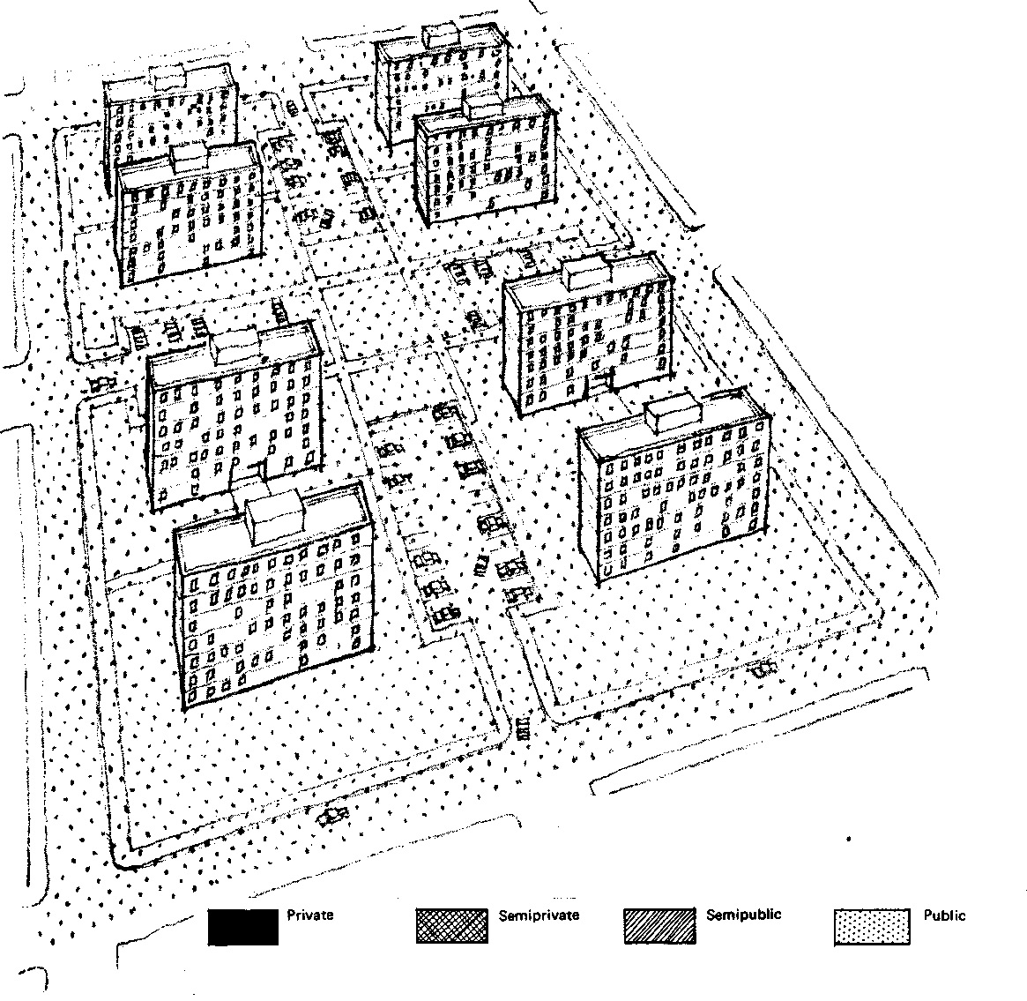
Public - Private Layers

Slide 32
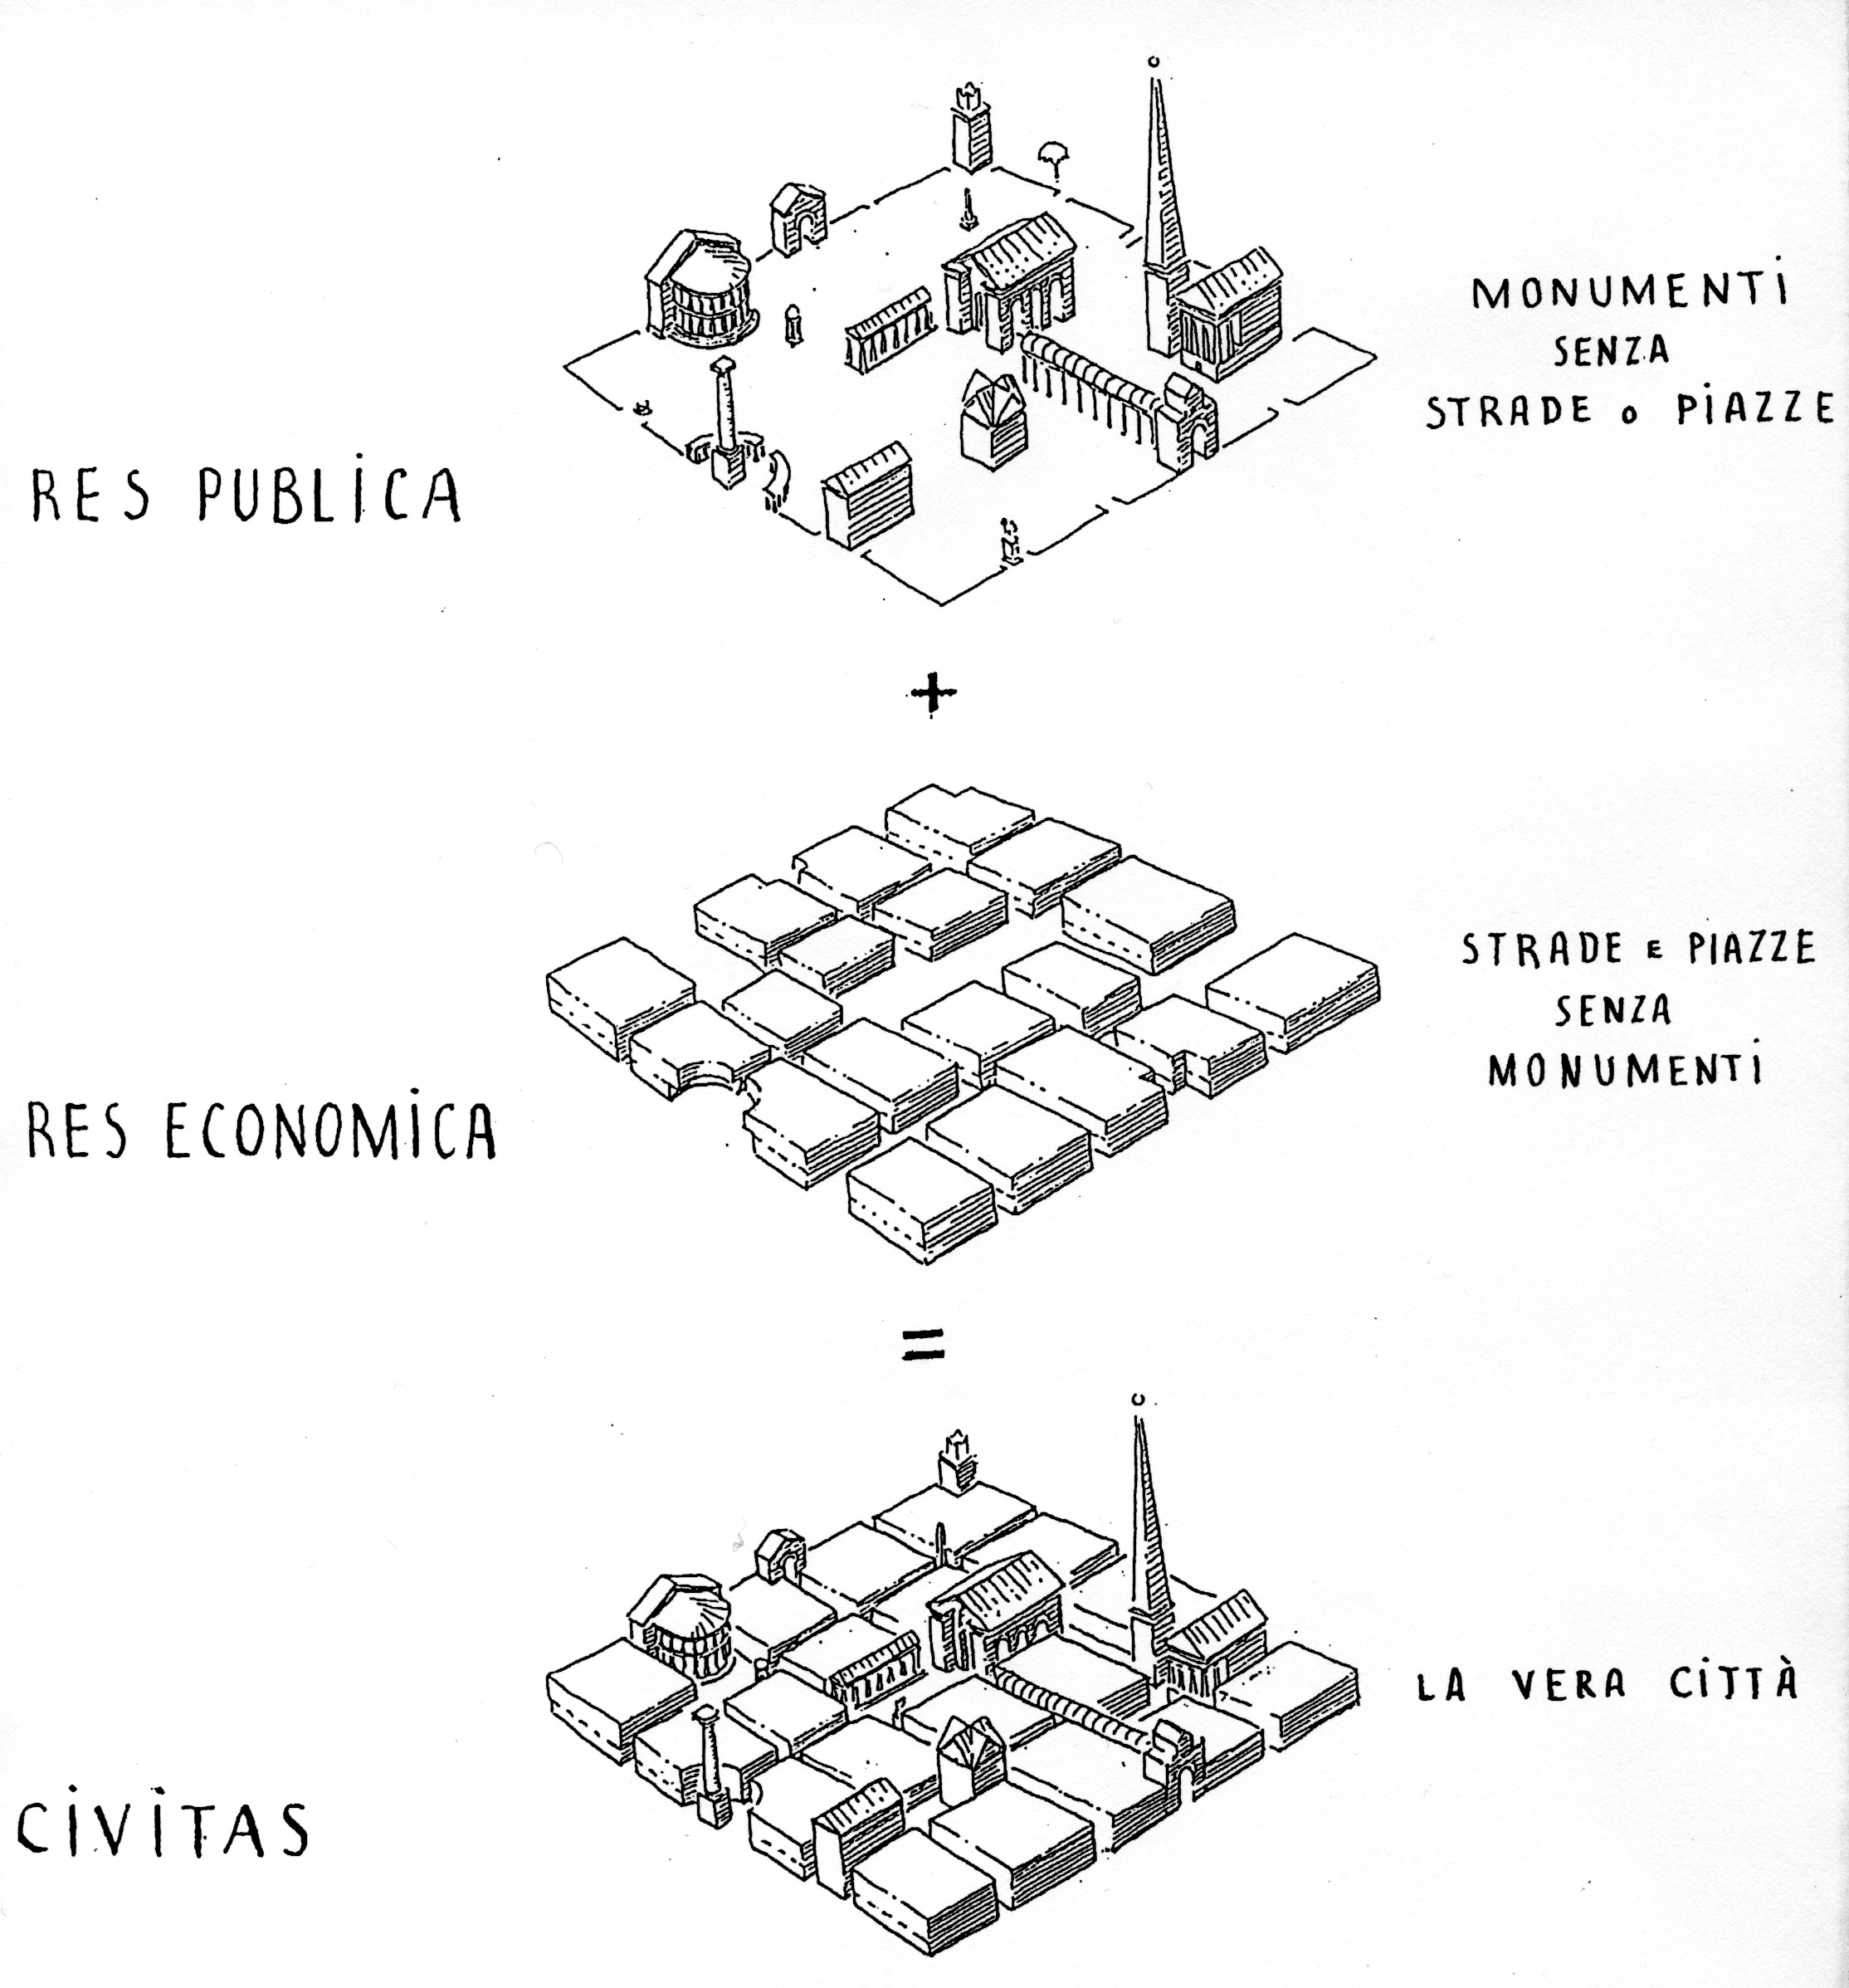
Role of Public Space
Leon Krer
Notes:
http://landiarchitetti.files.wordpress.com/2010/02/leon-3.jpg

Slide 33
Either system can work, BUT Do not mix
Traditional (Urbanism) Space | Modernist (Sprawl) Anti-Space
Requires high enough density to support mix of uses within ped or transit shed + public and private frontages designed to encourage walking | Requires easy availability of parking at each location + low enough densities to limit congestion + sufficient road infrastructure for free flowing traffic
= | =
Limited parking carefully hidden behind articulated facades | Large parking lots in front of buildings
+ | +
Tamed roads with few and narrow lanes with on-street parking and high intersection density | Wide roads with no on-street parking and low intersection density
Notes:
NU interventions remain almost exclusively:
Revitalizing existing traditional urbanism OR
Inserting relatively small pieces of traditional urbanism into the sprawl system
http://www.architectmagazine.com/urban-design/systems-not-icons.aspx
‘Waldheim, for his part, argues that New Urbanism suffers from a “fundamental inability to deal with contemporary culture.” ‘
‘For Corner, who has probably done more to change contemporary landscape practice—or at least the public perception of it—than anyone else, landscape urbanism “is a systems-based way of understanding an environment, where you understand the flows, energies, dynamics of an environment.”’
“You don’t make cities from individual buildings,” Prior argues. “You make them from the infrastructure and organization of place, and as we understand more about the sustainability of cities, then starting with a robust position on how these city systems work in relationship to the natural environment and relationships to the anticipated community, we find ourselves upstream from the actual building.”

Slide 34
What’s the problem with sprawl?

Slide 35
Problems of Sprawl
Fiscal costs of infrastructure
Individual costs of commuting
Environmental
Loss of natural & ag lands
Water quality
Energy use
Greenhouse gases
Species loss
Social
Economic Development

Slide 36
What’s the alternative to segregating uses?

Slide 37
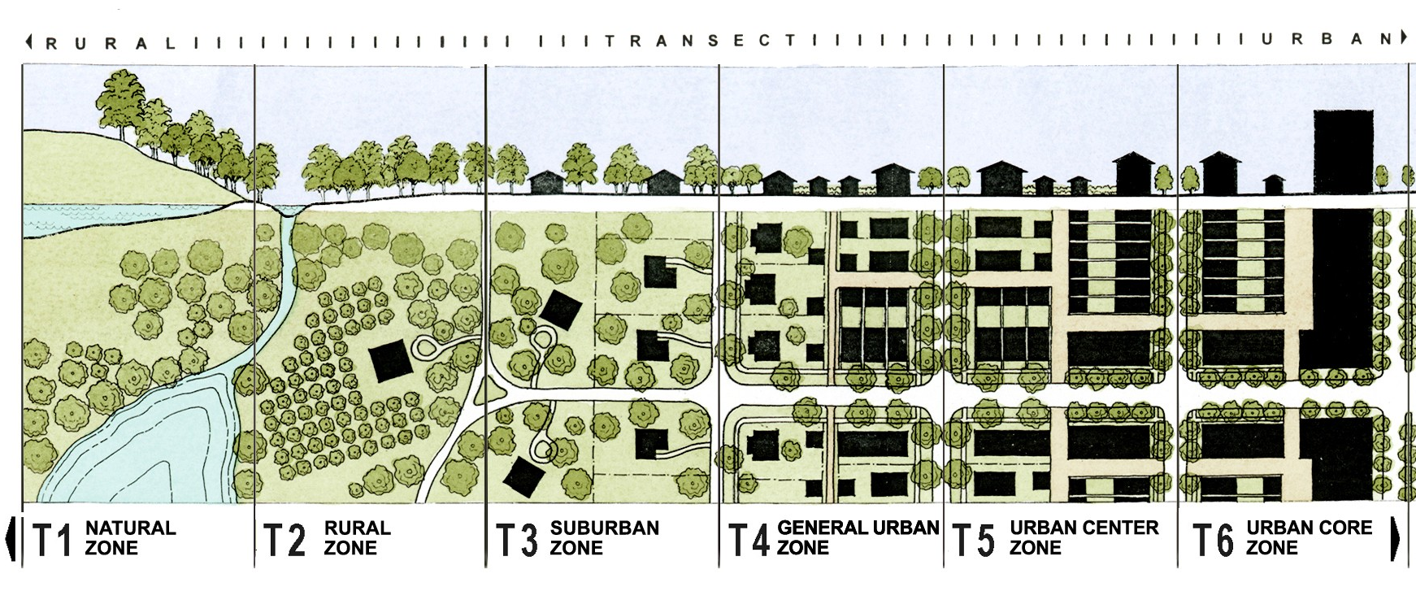
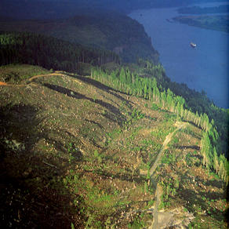
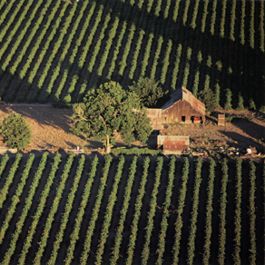
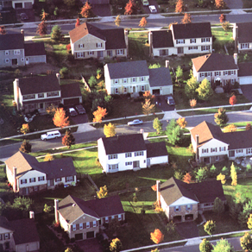
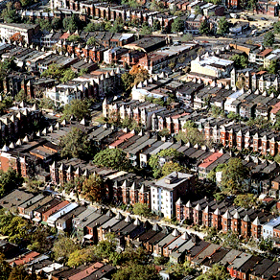
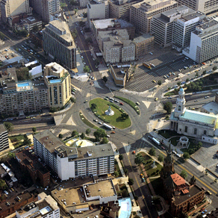
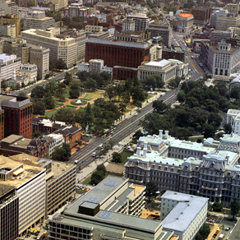
Rural to Urban Transect
Photo Source: Dhiru Thadani

Slide 38
Collaborative Mindmap – What systems doe new urbanism interact with?
OR, why change is so hard

Slide 39
Image Dialogue & VPS Results

Slide 40
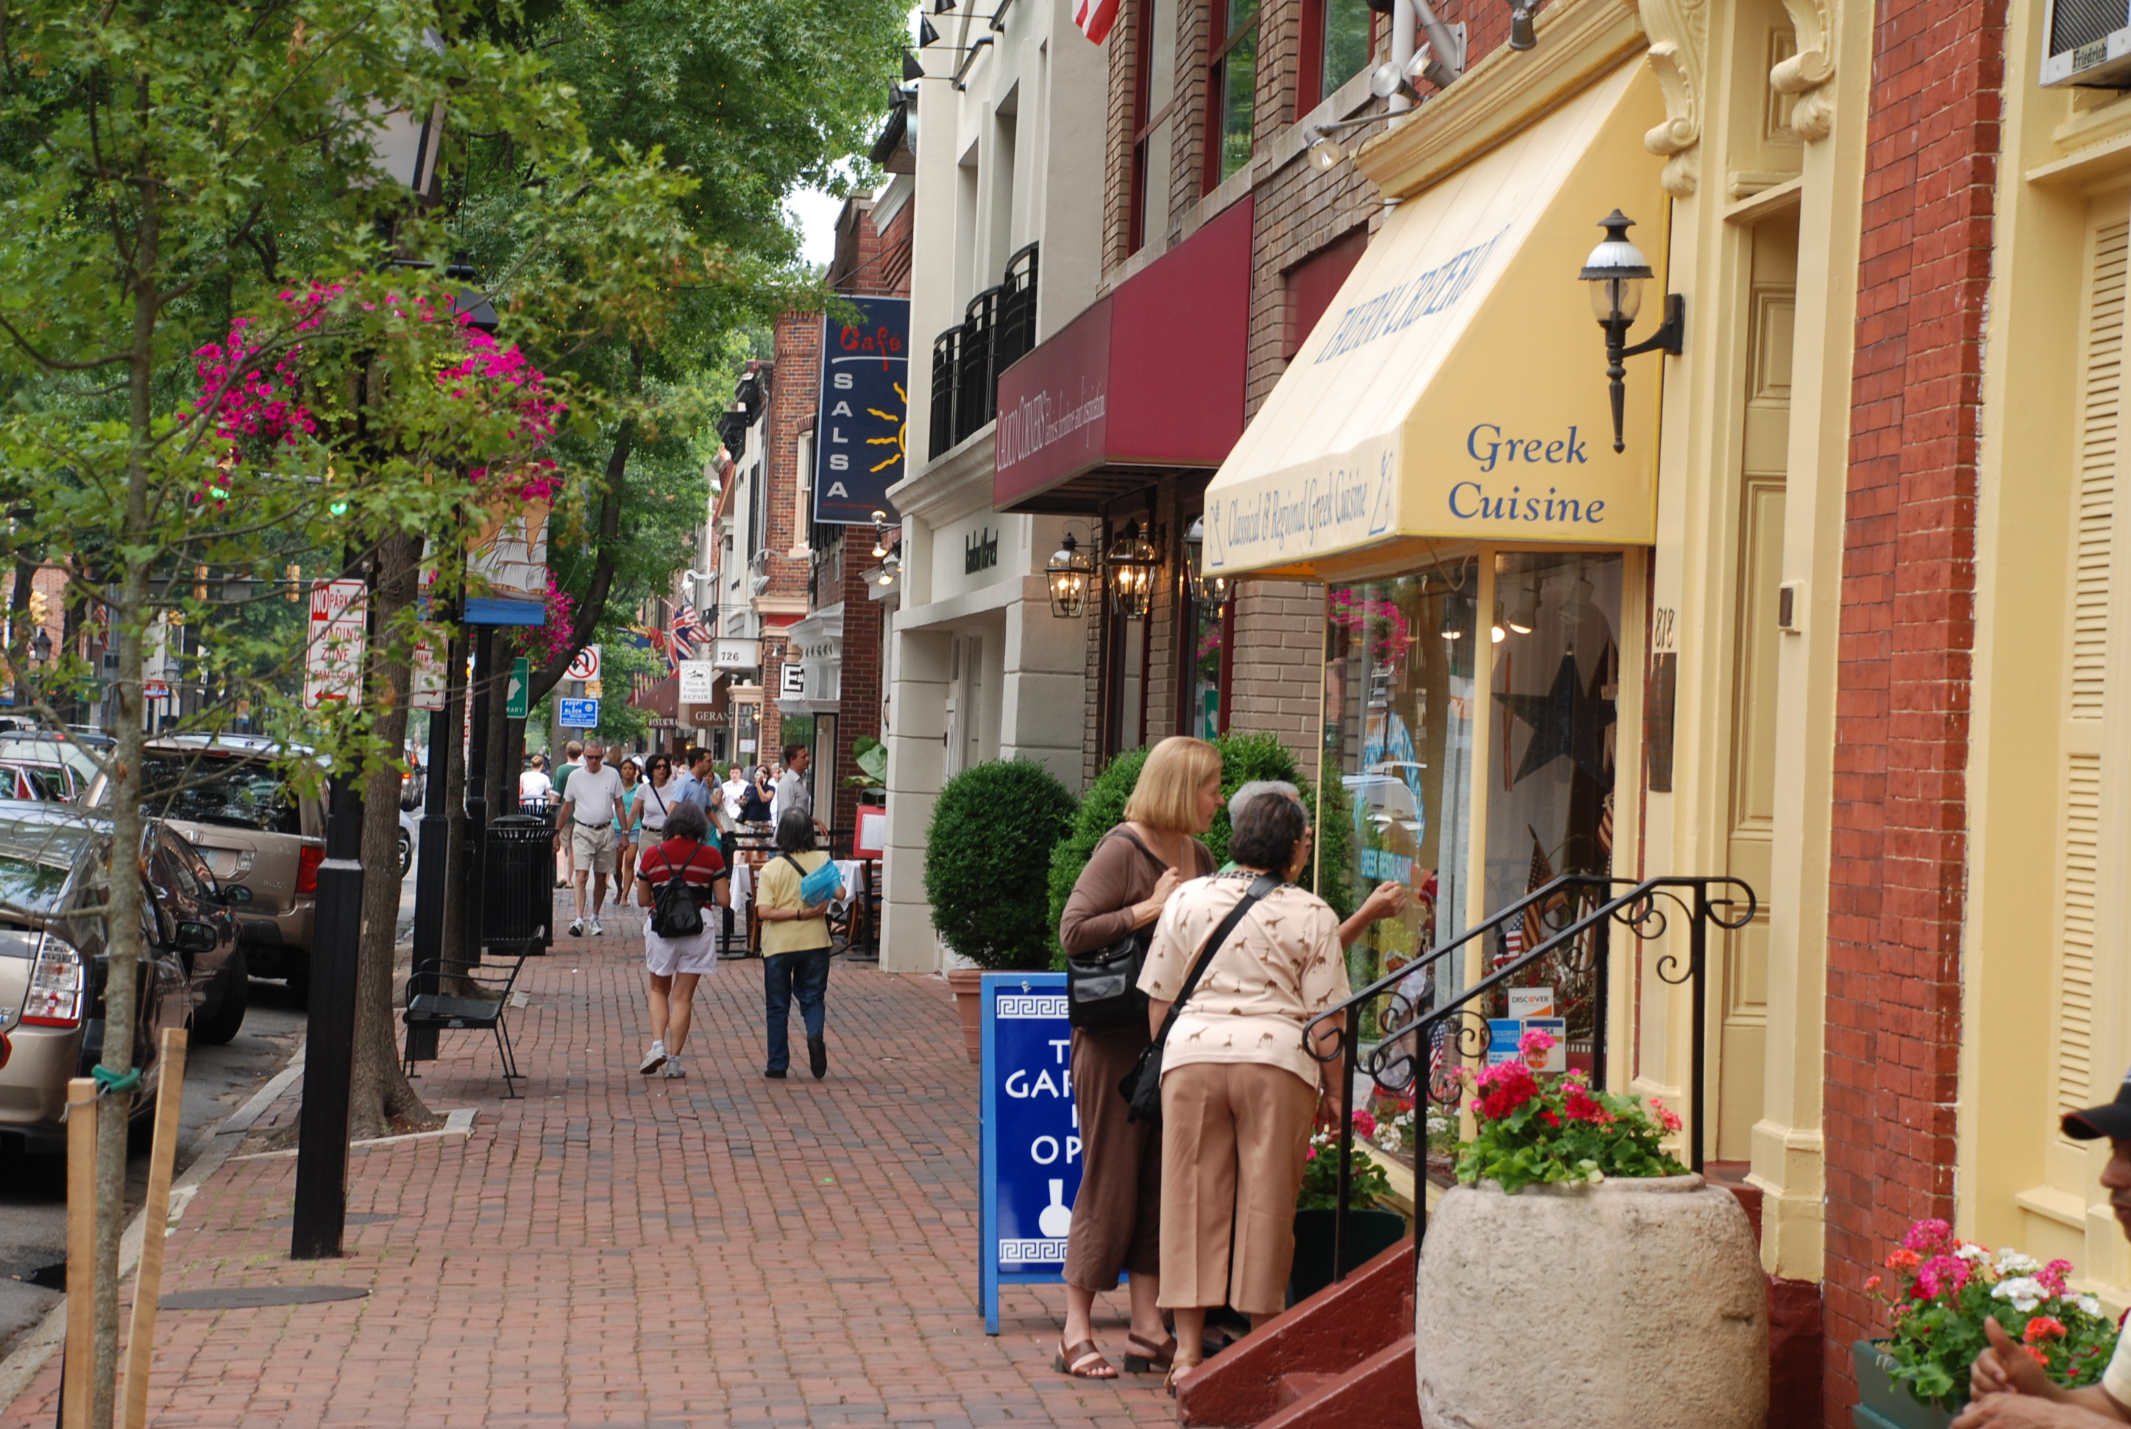
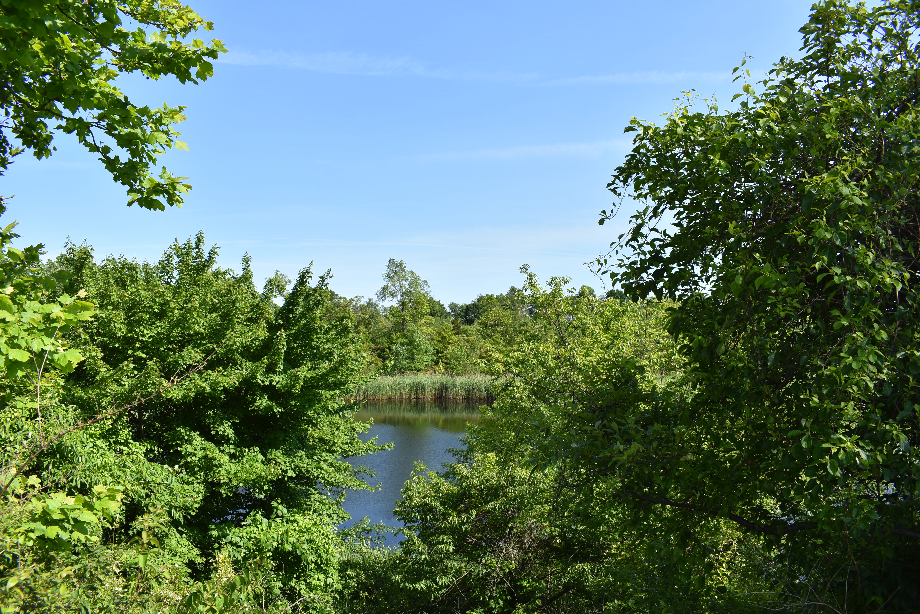
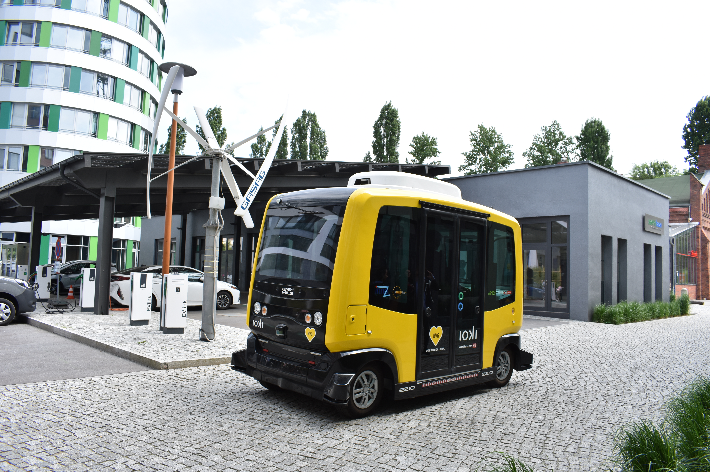
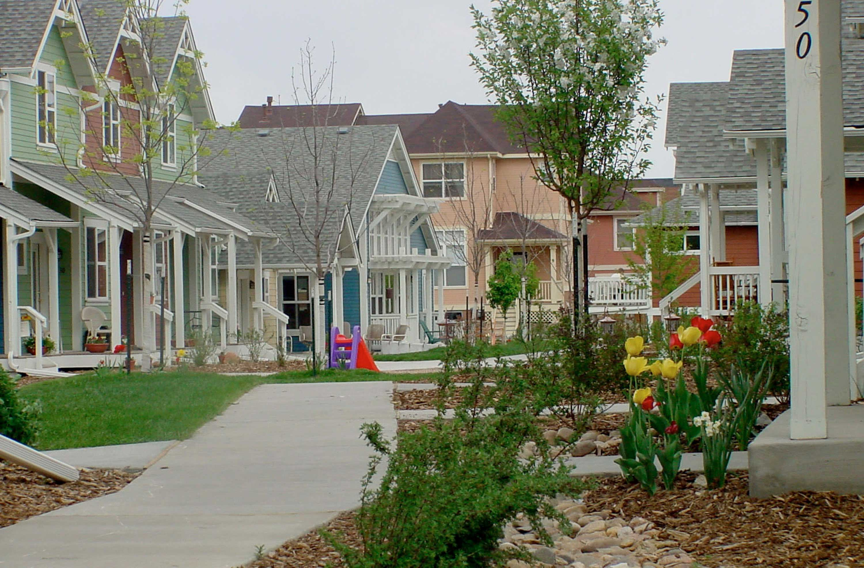
Student Favorites

Slide 41
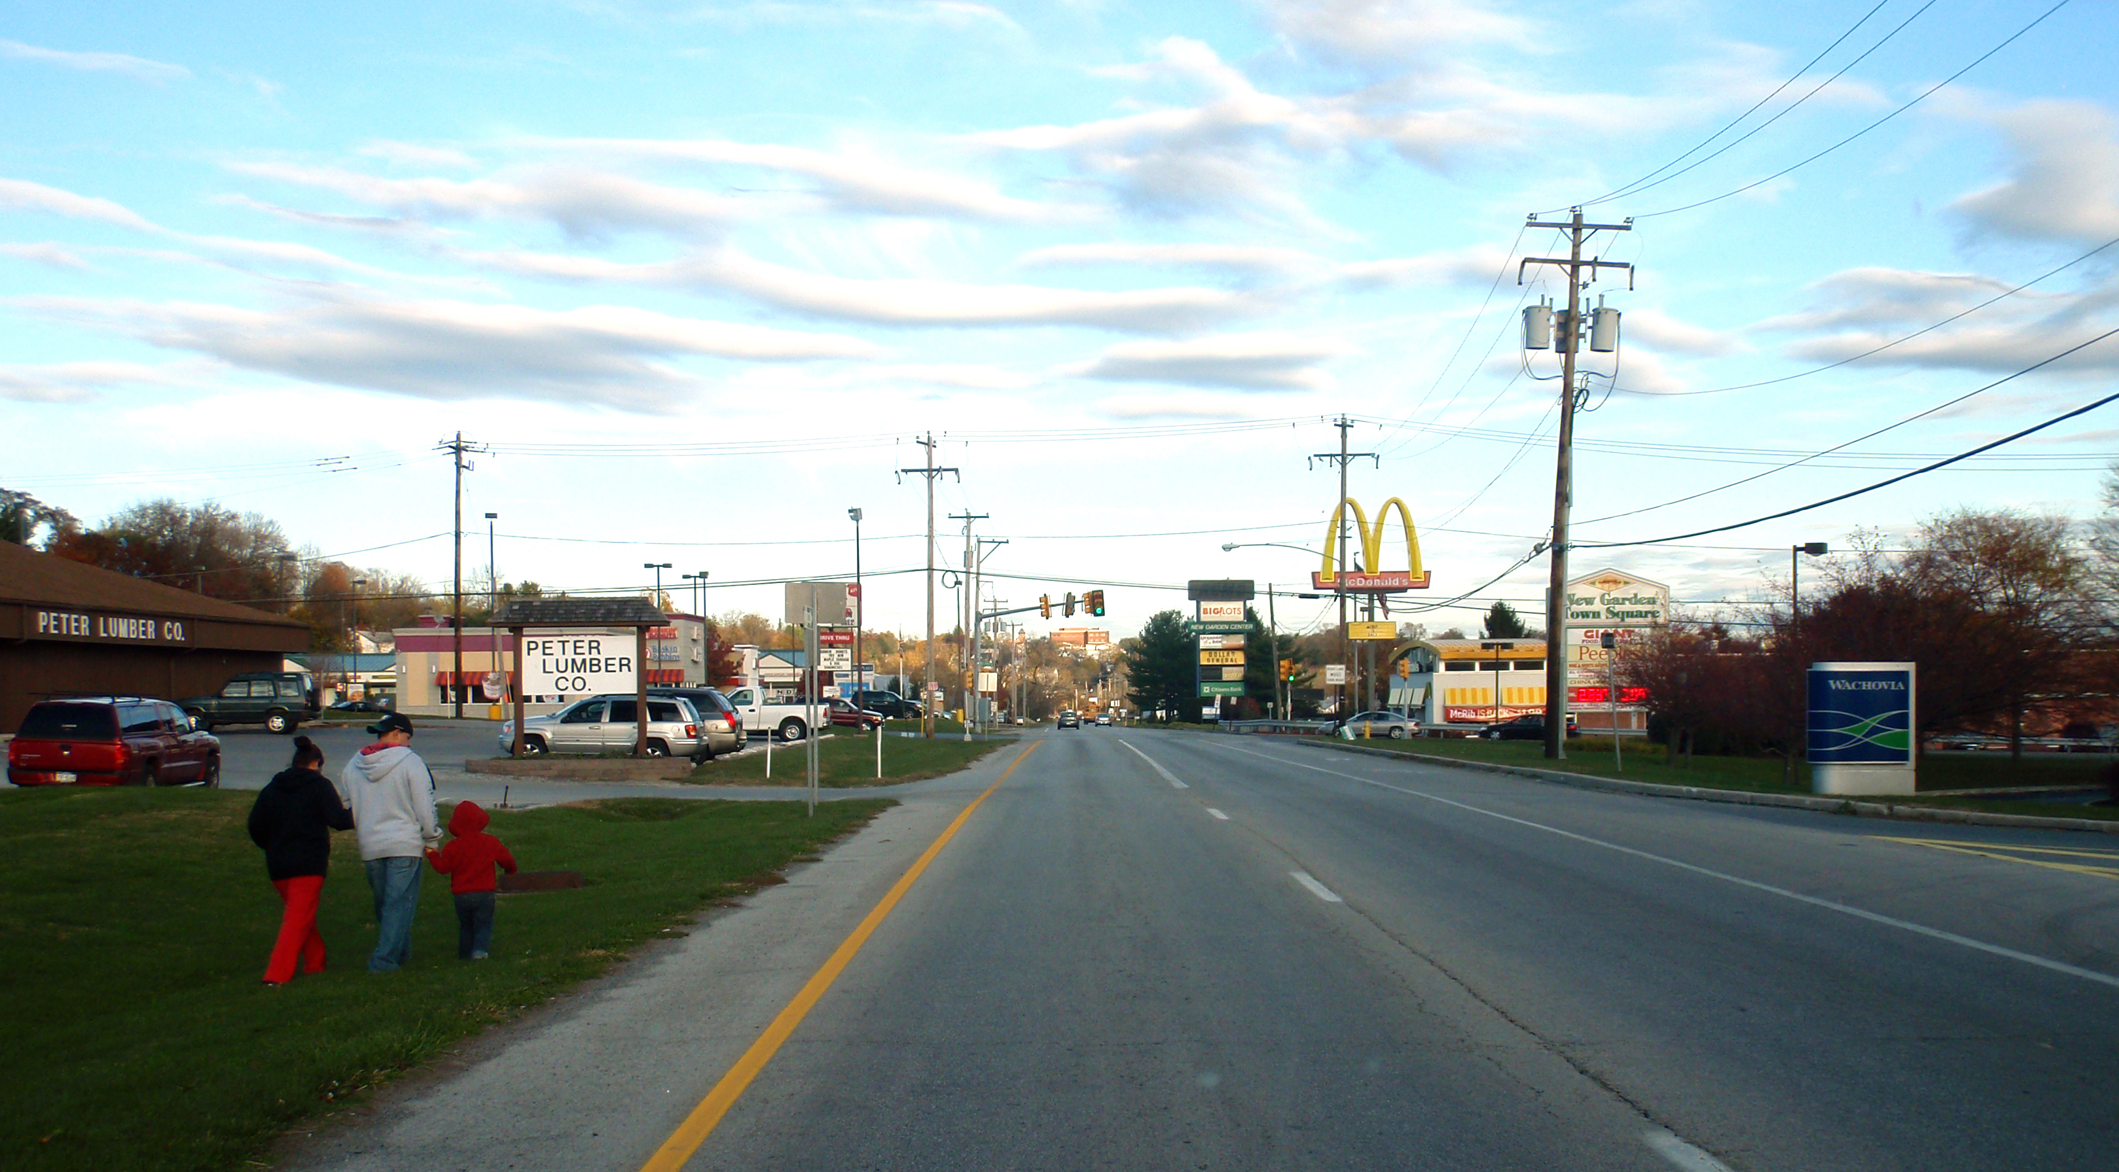
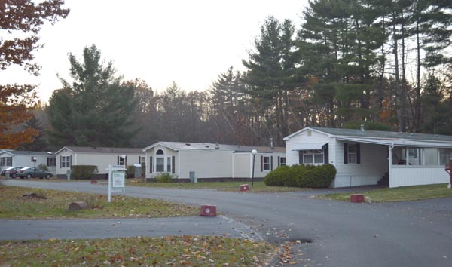
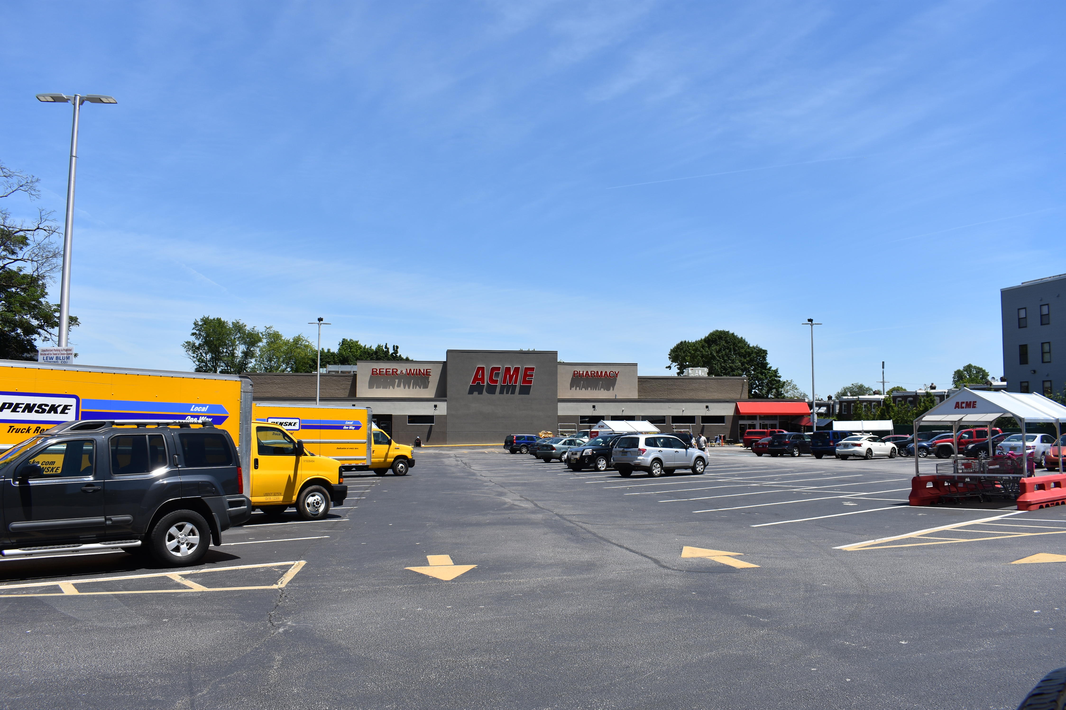
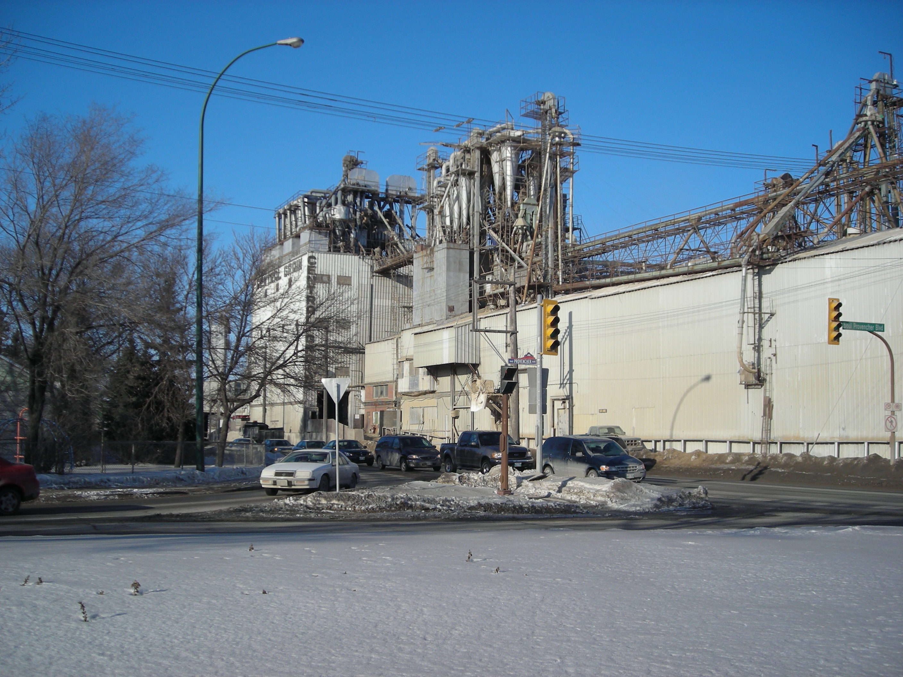
Student Least Favorites

Slide 42
Compare to New Castle County

Slide 43
Other Notes re Quantitative Visual Preference Survey
Not usually random sample, but study by Talen showed age and education variation: younger and more educated = more preference for urban
Scale typically used (-10 to 10) is difficult
Images bias results in many ways
No feedback on why people selected images the way they did
Notes:
Issues:
Not usually reliable random sample – but one random sample showed little variation except for age and education (younger and more educated = more preference for urban; note that race and ethnicity were not stratified well enough to evaluate and only a few images were used) [Talen]
Preference scale – 5 pt scale more commonly used in surveys, but many image pref surveys use 20-pt scale
Length of survey
Biased images
Known vs unknown
Quality
Green
Type
Photo vs illustration
Street level vs aerial
Biased names
Don’t know why people rated images they way they did

