Slide 1
Urban Design Concepts Overview + Kentlands Deep Dive
Growth and Structure of Cities
Bryn Mawr College

Slide 2
Region
DC to Kentlands:
35 min by car with no traffic
1-1.5 hr by metro + bus

Slide 3
Notes:
Donut hole is headquarters of National Institute of Standards and Technology (fed)

Slide 5
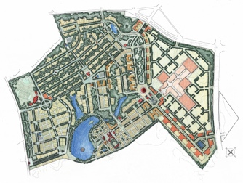

Slide 6
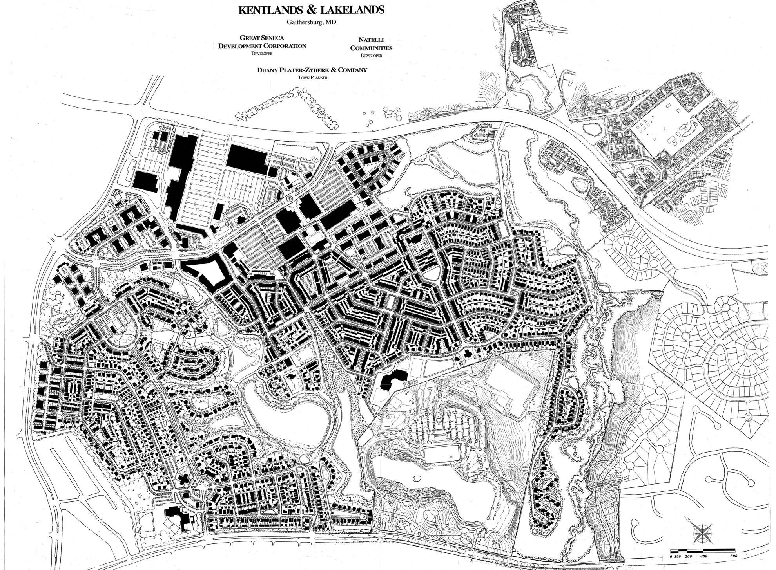

Slide 7
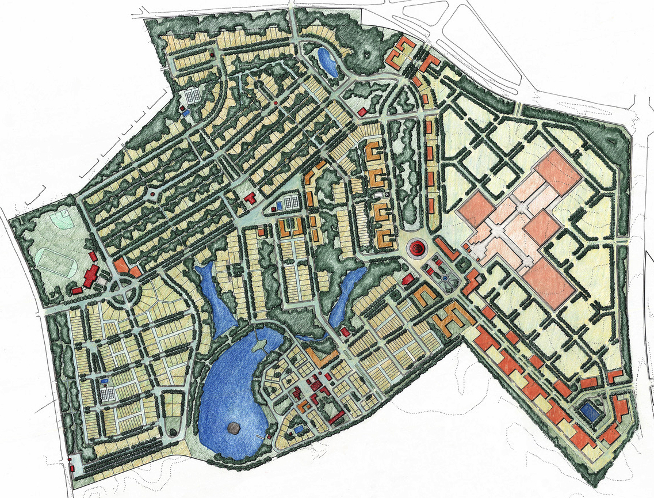

Slide 8
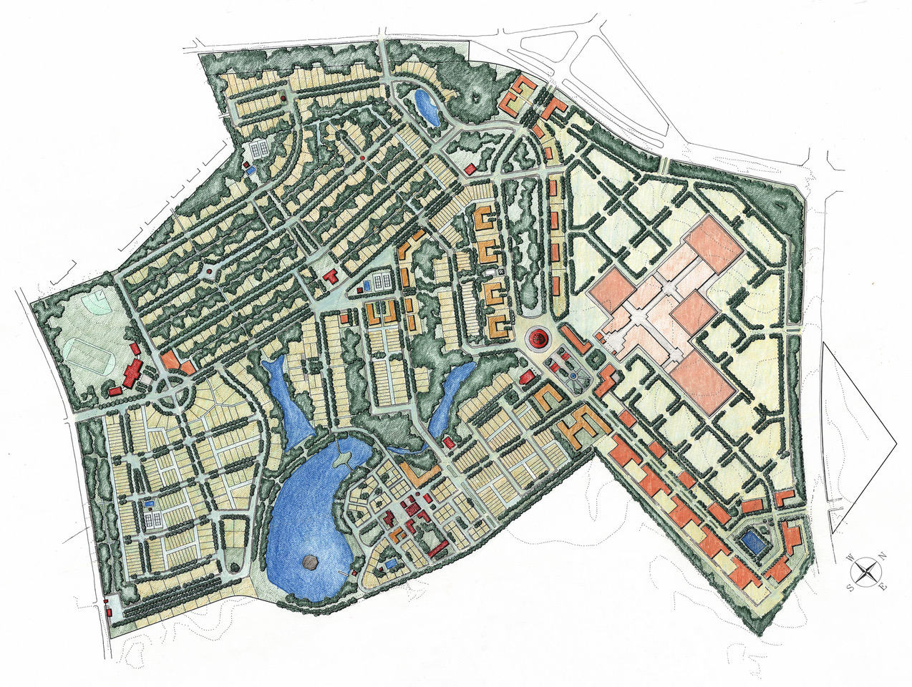

Slide 9
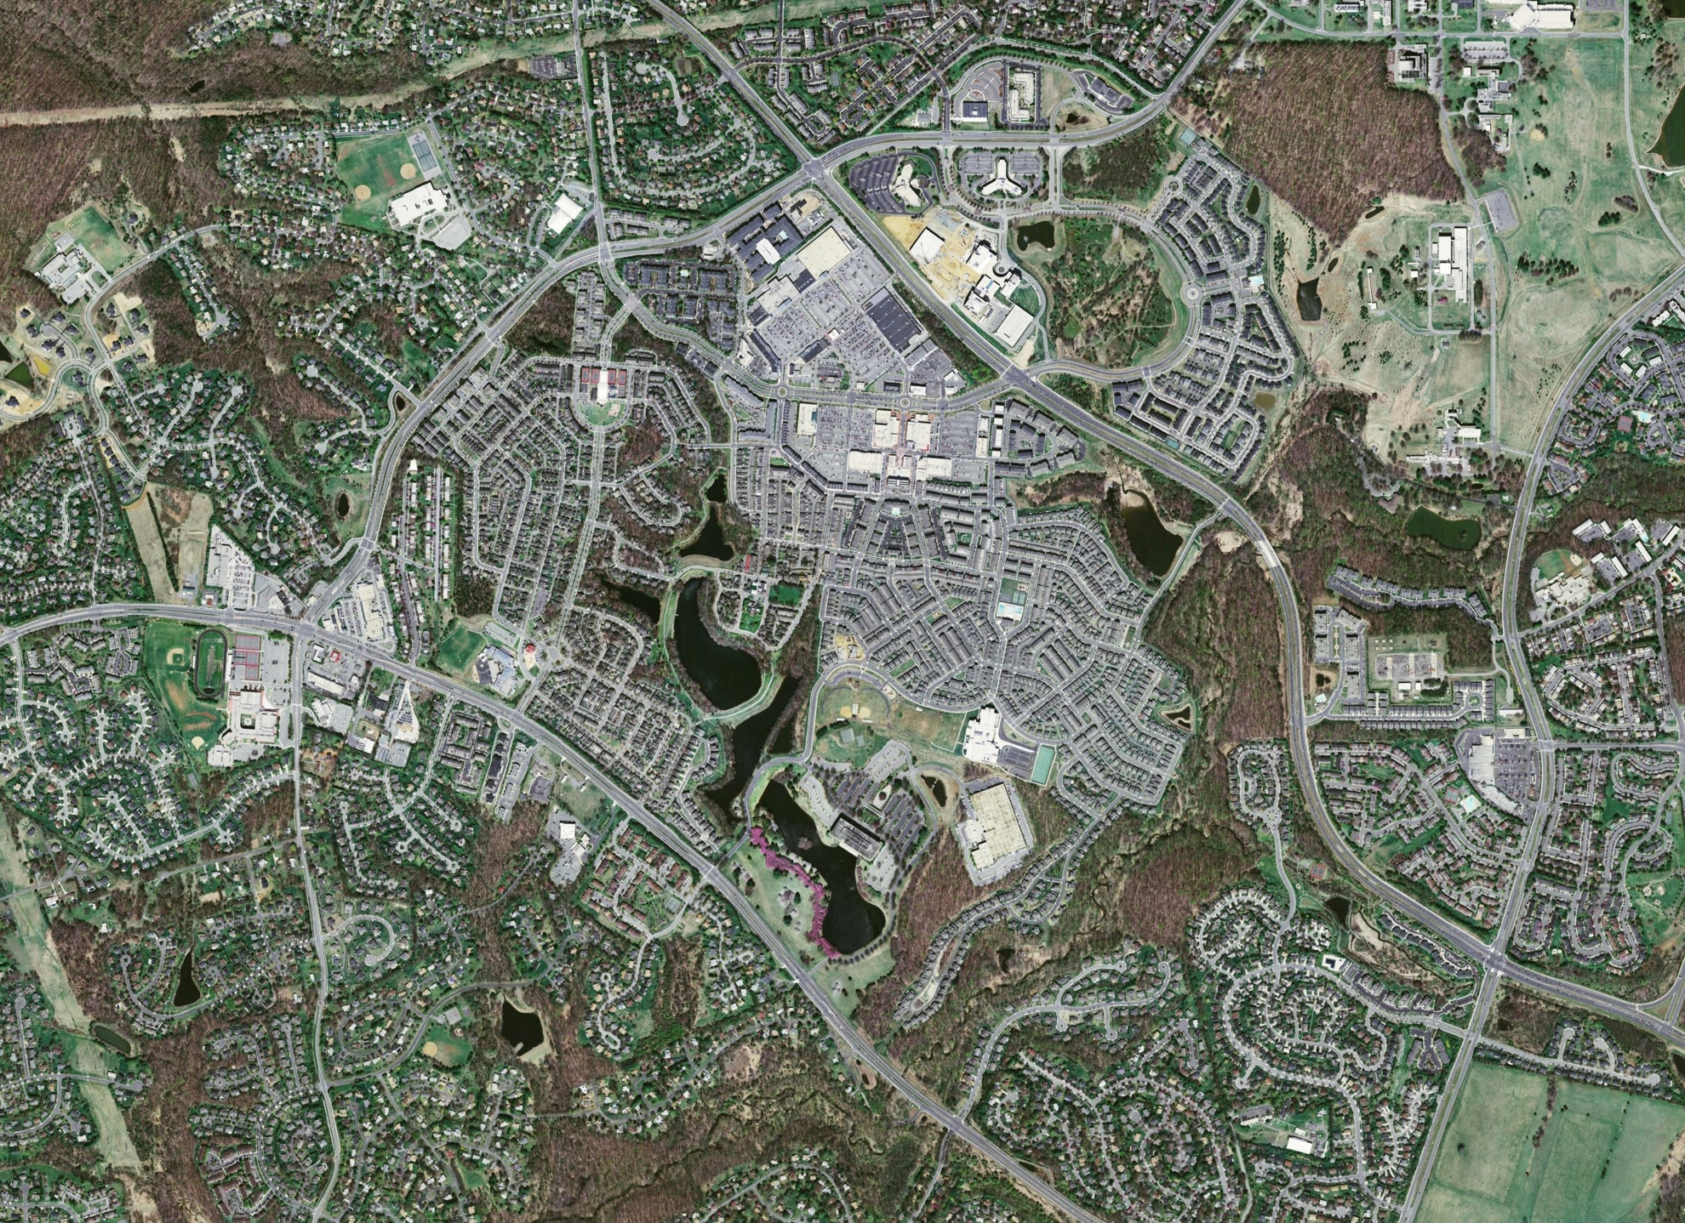

Slide 10
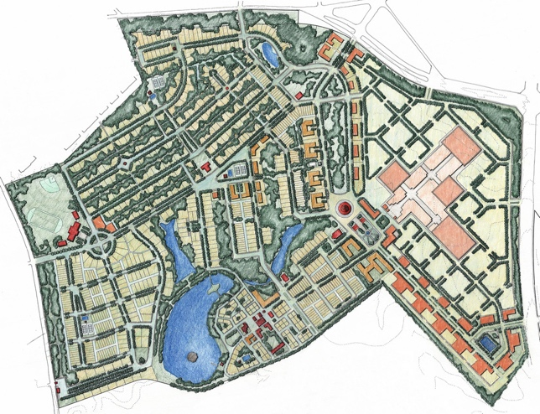

Slide 11
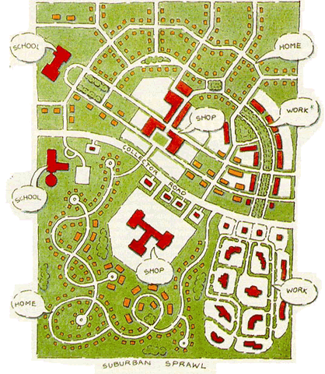
Traditional (Urbanism) vs. Modernist (Sprawl)
Tom Low, Duany Plater-Zyberk
Notes:
Holston:
“That Brasilia's design derives from ClAM proposals is easily
demonstrated. Its most Significant manifesto, The Athens Charter,
defines the objectives of city planning in terms of four functions:
"The keys to city planning are to be found in the four functions:
housing, work, recreation (during leisure) and traffic" (Le
Corbusier 1957 [1941]: art. 77). The last function, traffic,
"bring[s] the other three usefully into communication" (ibid.,
art. 81). A later ClAM meeting augmented these to include a
"public core" of administrative and civic activities. Planners
refer to the organization of these functions into typologies of
social activity and building form as zoning. What distinguishes
modernist zoning from its precursors is the conception that urban life may be understood for planning purposes in terms of
these four or five functions and, more important, that they
should be organized as mutually exclusive sectors within the
city. Together with circulation, this organization determines
both the internal order and the overall shape of the ClAM city.”

Slide 12
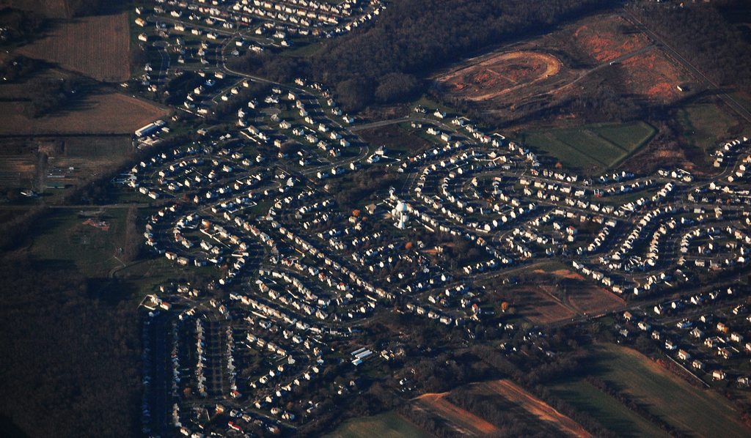
Sprawl: Residential
Notes:
http://www.njfuture.org/wp-content/uploads/2011/06/Aerial-Sub-Sprawl-RebeccaWilson.jpg

Slide 13
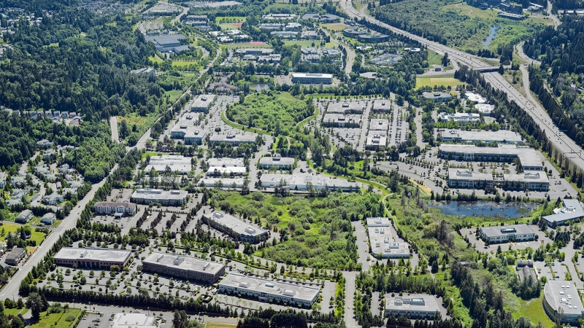
Sprawl: Office Park
Notes:
http://www.dci-engineers.com/sites/default/files/styles/project_image/public/projects/North%20Creek%20Office%20Park%202sm_s.jpg?itok=MYrTe0qI
http://www.njfuture.org/wp-content/uploads/2011/06/Aerial-Sub-Sprawl-RebeccaWilson.jpg

Slide 14
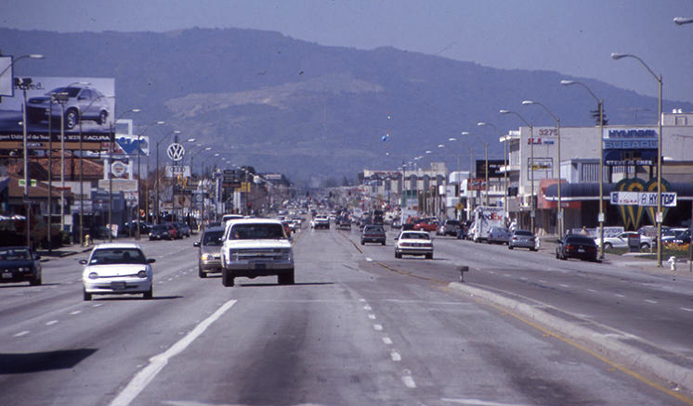
Sprawl: Strip Commercial
Notes:
http://h.fastcompany.net/multisite_files/fastcompany/imagecache/slideshow_large/slideshow/2014/02/3024987-slide-231-suburb-arterial-el-cam-real.jpg

Slide 15
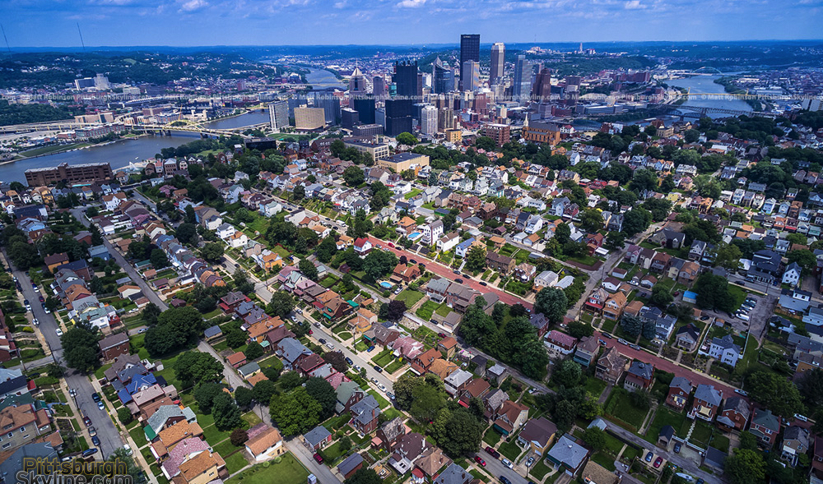
Traditional Urbanism
Notes:
http://images.pittsburghskyline.com/images/2015/08.18/july_2015_pittsburghskyline.com_02.jpg

Slide 16
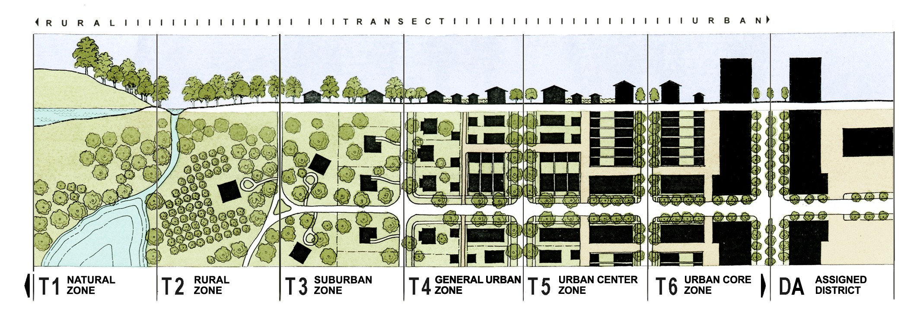
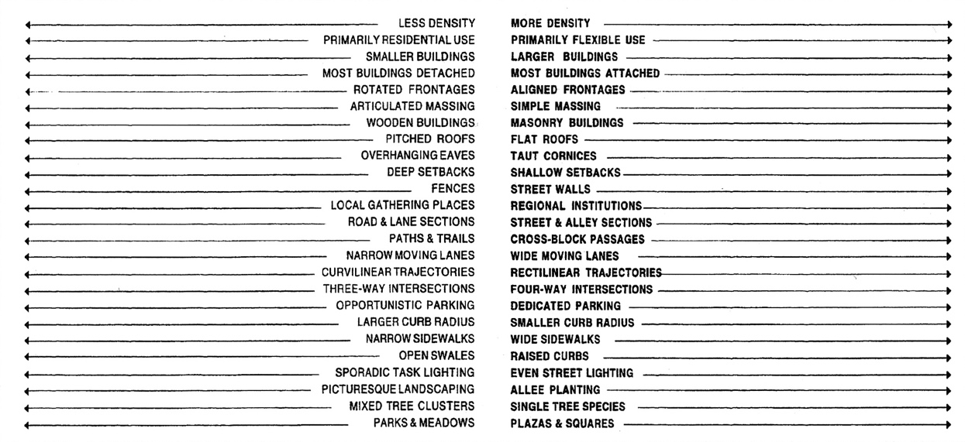
The Urban-Natural Transect

Slide 17
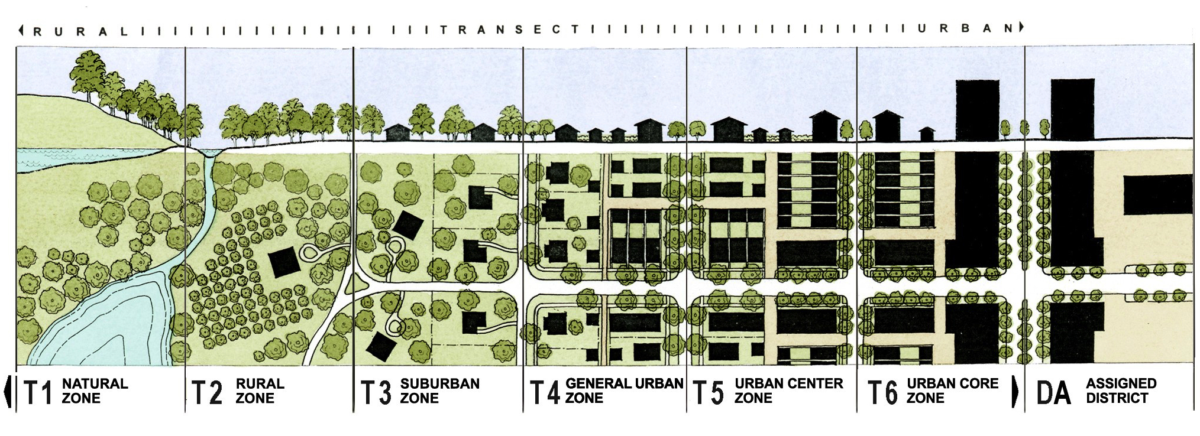
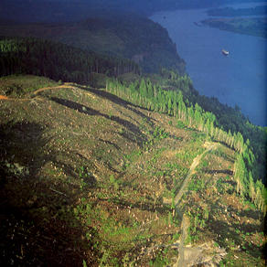
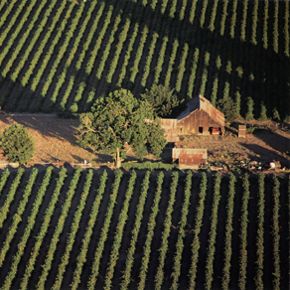
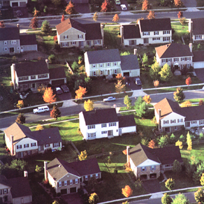
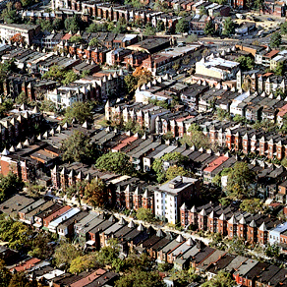
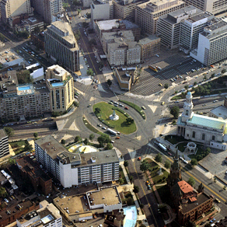
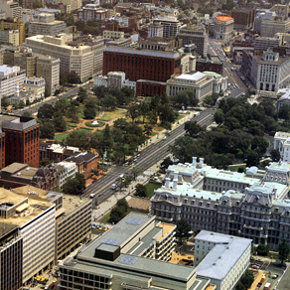
Visualizing the Transect
Source: Rick Bernhardt
Photo Source: Dhiru Thadani

Slide 18
Traditional (Urbanism) Space | Modernist (Sprawl) Anti-Space
High street connectivity (small blocks) | Dendritic street pattern (large blocks)
Mixed use, mix of housing types and sizes | Segregated uses, housing types and sizes
Buildings provide substantial sense of enclosure so that public spaces feel like “outdoor rooms” | Little or no sense of enclosure
Full transect of distinct rural – urban spaces | Rural and urban conflated
Mix of densities, but generally higher density in built areas | Lower density everywhere
Range of retail formats and sizes, corresponding to intensity of neighborhood / center | Retail concentrated in large formats at intersections of large arterials and interstates
Notes:
Holston:
“That Brasilia's design derives from ClAM proposals is easily demonstrated. Its most Significant manifesto, The Athens Charter, defines the objectives of city planning in terms of four functions: "The keys to city planning are to be found in the four functions: housing, work, recreation (during leisure) and traffic" (Le Corbusier 1957 [1941]: art. 77). The last function, traffic, "bring[s] the other three usefully into communication" (ibid., art. 81). A later ClAM meeting augmented these to include a "public core" of administrative and civic activities. Planners refer to the organization of these functions into typologies of social activity and building form as zoning. What distinguishes modernist zoning from its precursors is the conception that urban life may be understood for planning purposes in terms of these four or five functions and, more important, that they should be organized as mutually exclusive sectors within the city. Together with circulation, this organization determines both the internal order and the overall shape of the ClAM city.”
Discernible centers vs ubiquitous sprawl

Slide 19
Traditional (Urbanism) Space | Modernist (Sprawl) Anti-Space
Requires high enough density to support mix of uses within ped or transit shed + public and private frontages designed to encourage walking | Requires easy availability of parking at each location + low enough densities to limit congestion + sufficient road infrastructure for free flowing traffic
= | =
Limited parking carefully hidden behind articulated facades | Large parking lots in front of buildings
+ | +
Tamed roads with few and narrow lanes with on-street parking and high intersection density | Wide roads with no on-street parking and low intersection density
Notes:
NU interventions remain almost exclusively:
Revitalizing existing traditional urbanism OR
Inserting relatively small pieces of traditional urbanism into the sprawl system
http://www.architectmagazine.com/urban-design/systems-not-icons.aspx
‘Waldheim, for his part, argues that New Urbanism suffers from a “fundamental inability to deal with contemporary culture.” ‘
‘For Corner, who has probably done more to change contemporary landscape practice—or at least the public perception of it—than anyone else, landscape urbanism “is a systems-based way of understanding an environment, where you understand the flows, energies, dynamics of an environment.”’
“You don’t make cities from individual buildings,” Prior argues. “You make them from the infrastructure and organization of place, and as we understand more about the sustainability of cities, then starting with a robust position on how these city systems work in relationship to the natural environment and relationships to the anticipated community, we find ourselves upstream from the actual building.”

Slide 21
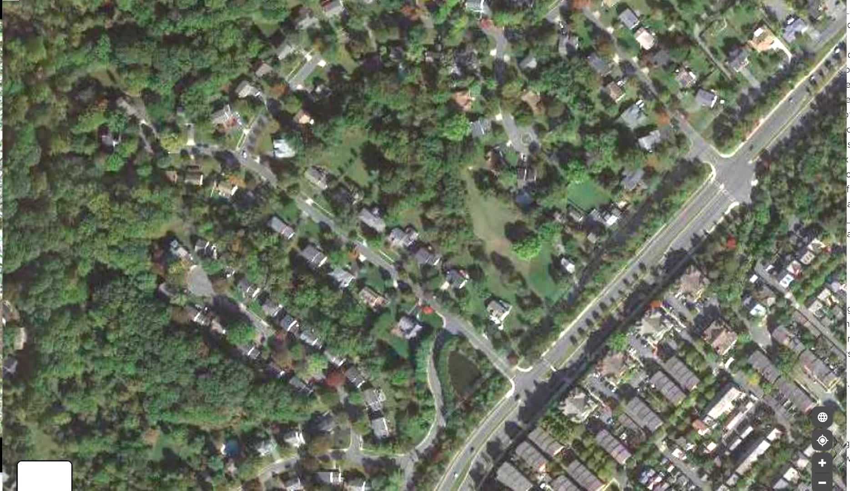
Sprawl Residential

Slide 22
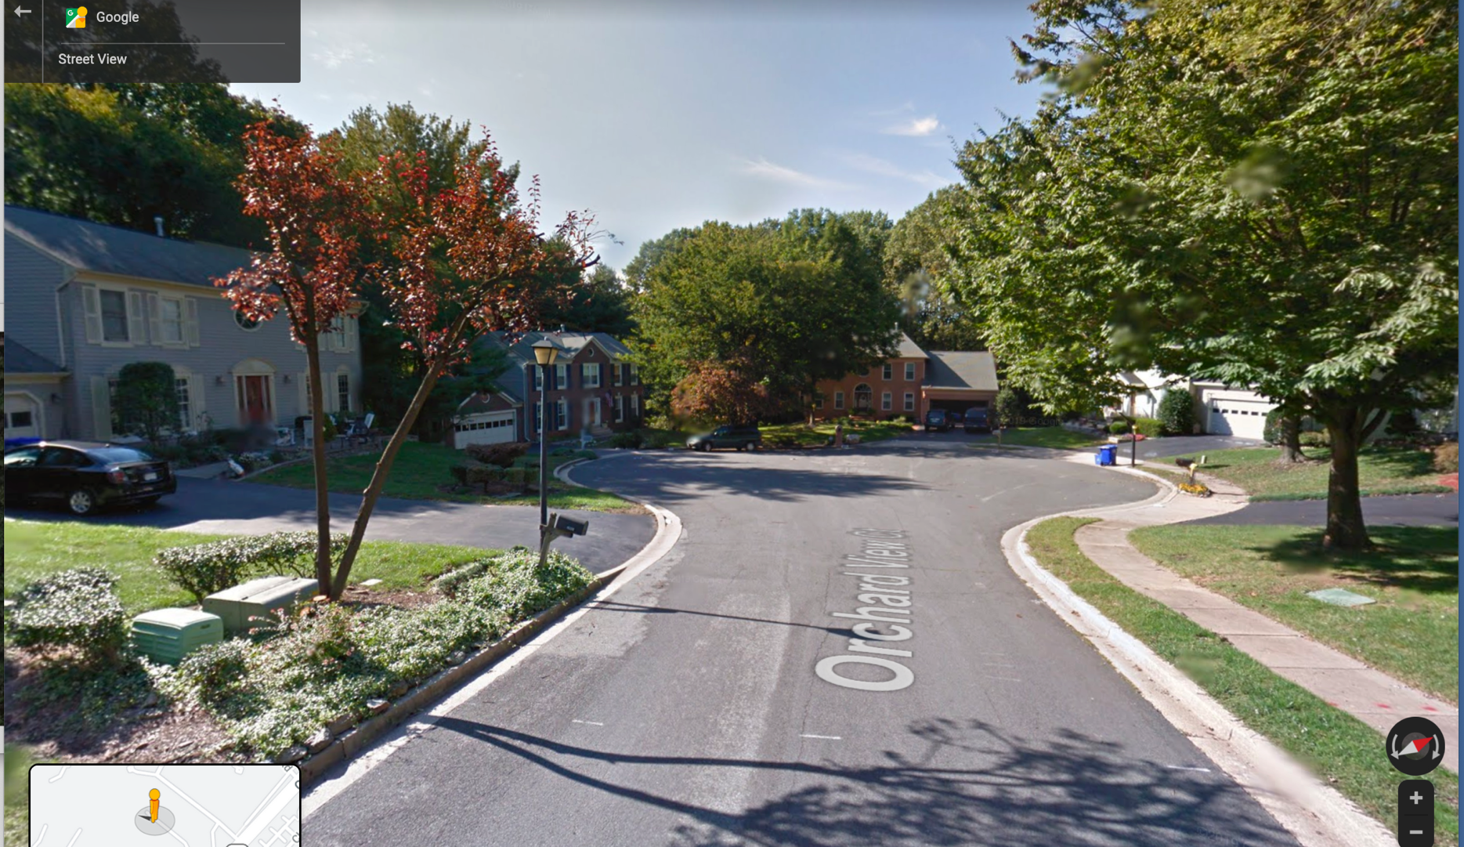
Sprawl Residential

Slide 23
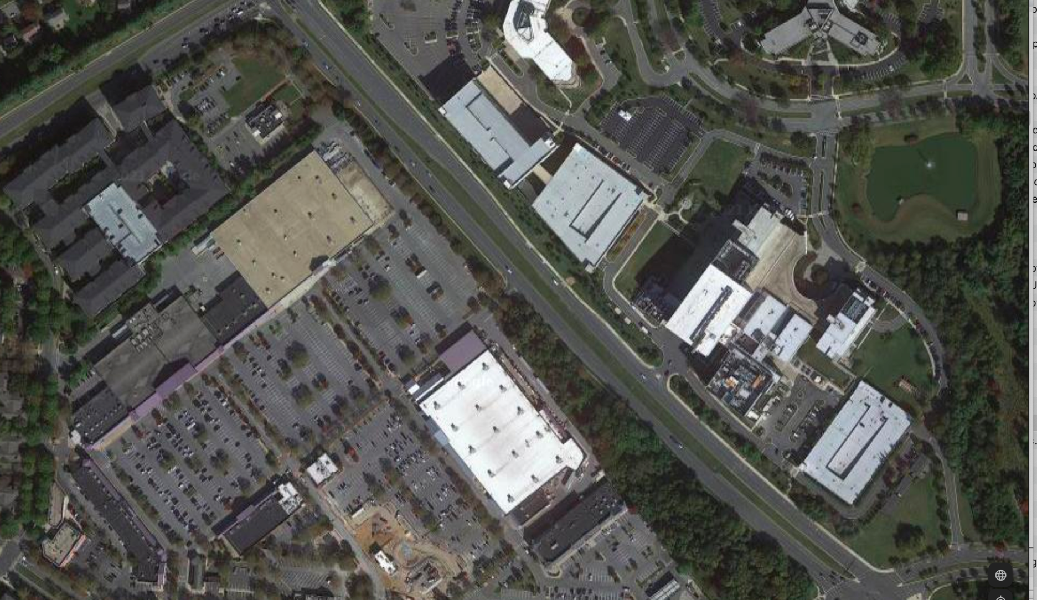
Sprawl Office & Commercial

Slide 24
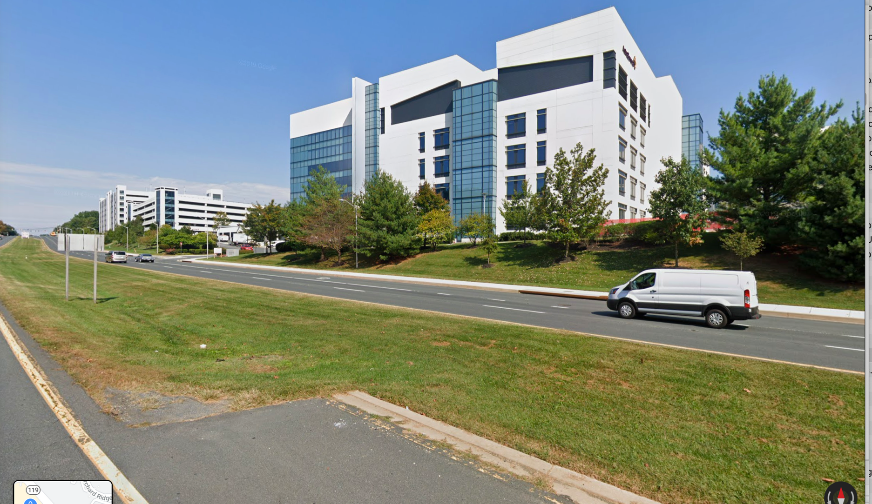
Sprawl Office & Commercial

Slide 25
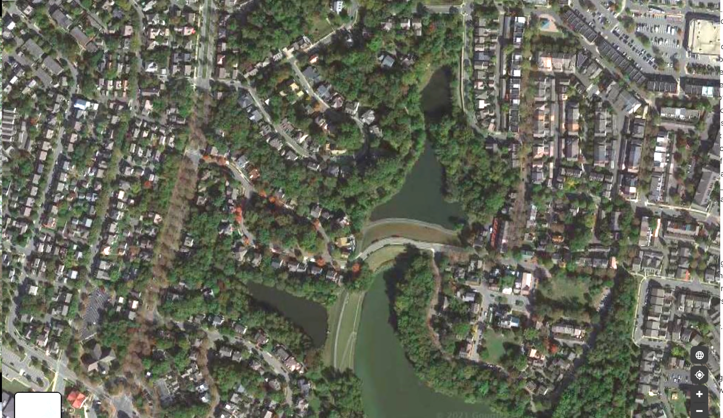
Traditional Urbanism

Slide 26
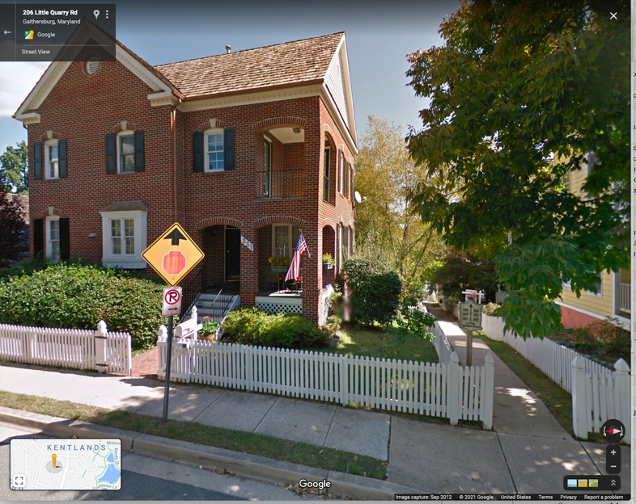
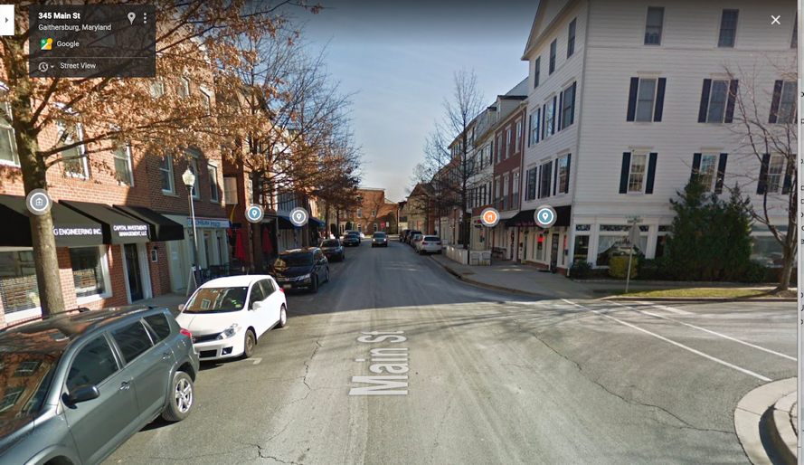
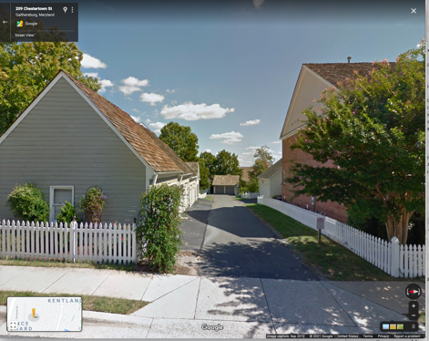
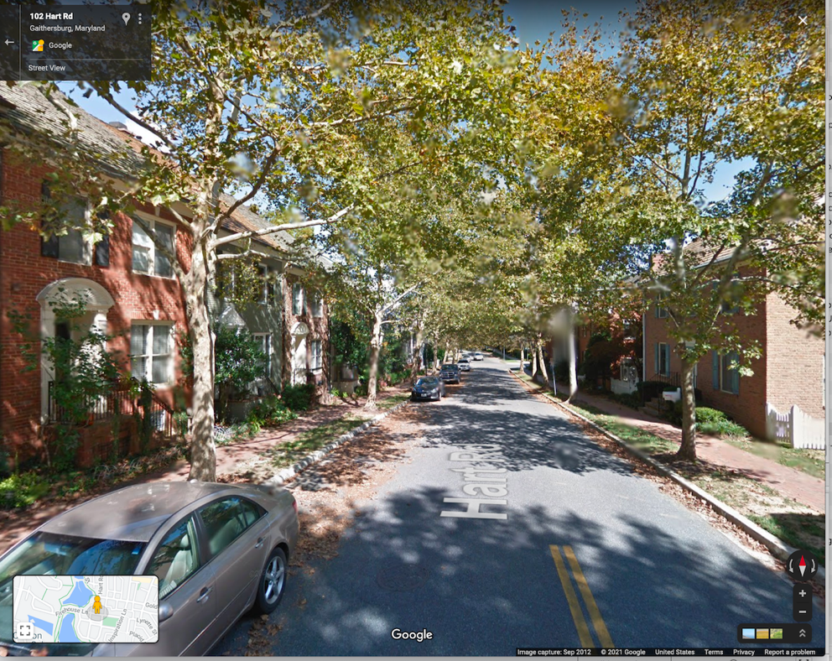
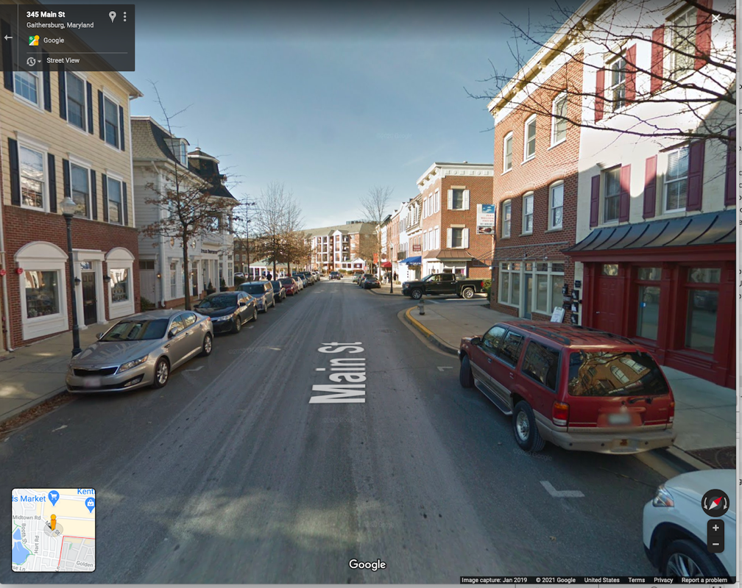
Traditional Urbanism - Kentlands

Slide 27
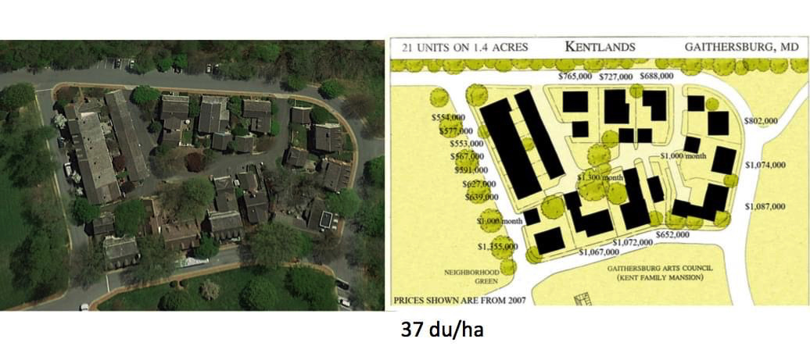
Traditional Urbanism - Kentlands
15 units/acre

Slide 28
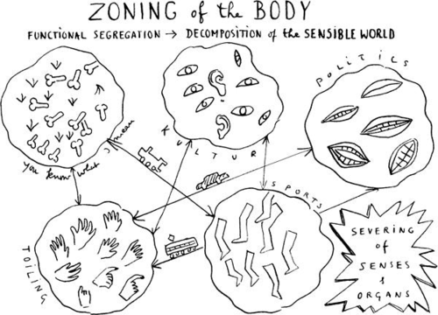
Mixed Use vs. Segregated Uses
Leon Krer
Notes:
Holston:
“That Brasilia's design derives from ClAM proposals is easily
demonstrated. Its most Significant manifesto, The Athens Charter,
defines the objectives of city planning in terms of four functions:
"The keys to city planning are to be found in the four functions:
housing, work, recreation (during leisure) and traffic" (Le
Corbusier 1957 [1941]: art. 77). The last function, traffic,
"bring[s] the other three usefully into communication" (ibid.,
art. 81). A later ClAM meeting augmented these to include a
"public core" of administrative and civic activities. Planners
refer to the organization of these functions into typologies of
social activity and building form as zoning. What distinguishes
modernist zoning from its precursors is the conception that urban life may be understood for planning purposes in terms of
these four or five functions and, more important, that they
should be organized as mutually exclusive sectors within the
city. Together with circulation, this organization determines
both the internal order and the overall shape of the ClAM city.”
Diversity also = mix of housing types, sizes, and price points
Image: tumblr_mht9wdqinW1qzlcoro1_500

Slide 29
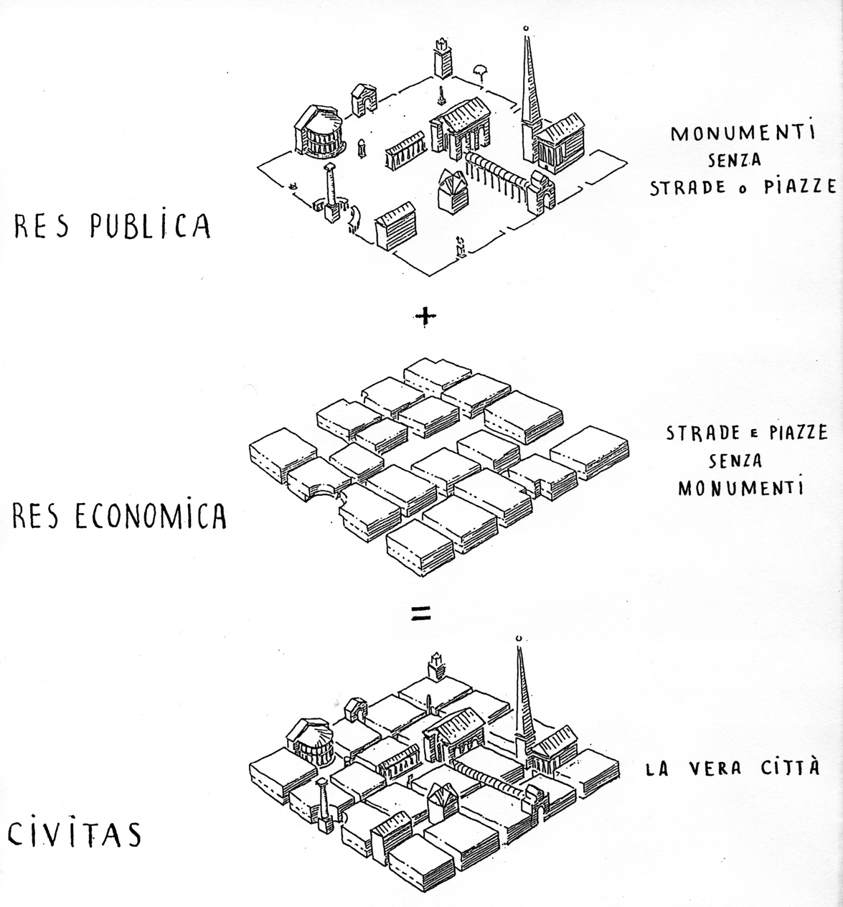
Role of Public Space
Leon Krer
Notes:
http://landiarchitetti.files.wordpress.com/2010/02/leon-3.jpg

Slide 30
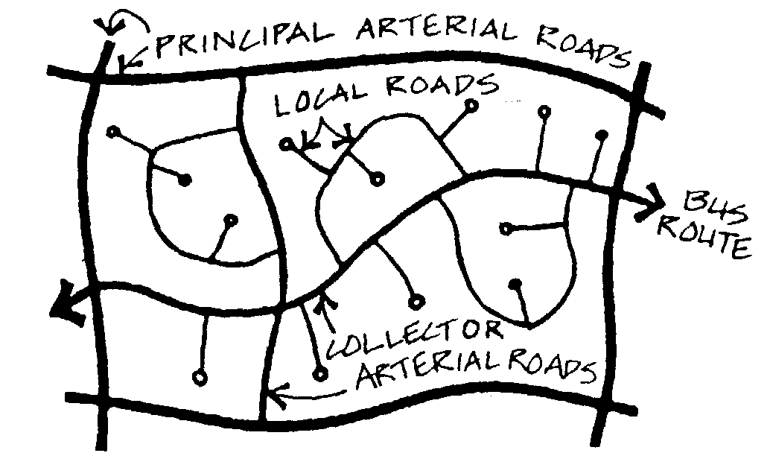
Notes:
http://futureuta.blogspot.com/2014/12/autonomous-rapid-buses.html

Slide 31
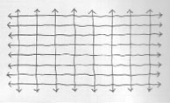
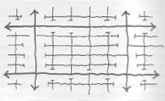
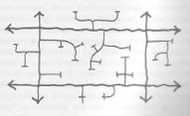
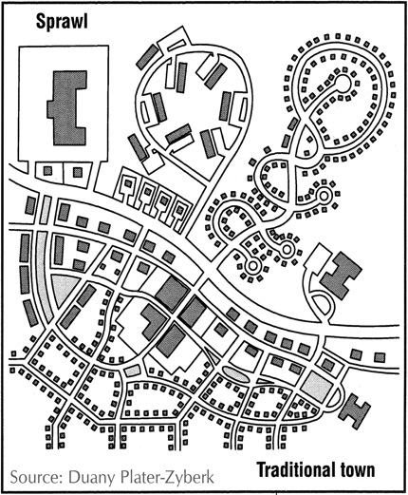
Permeability / Connectivity

Slide 32






Network Type

Slide 33
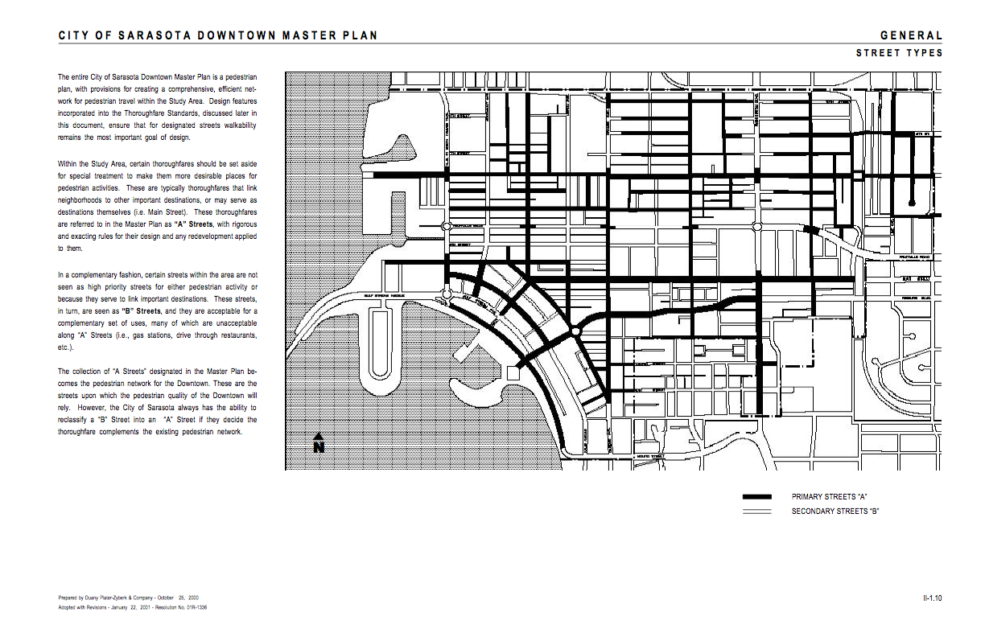
A/B Street Grid

Slide 34
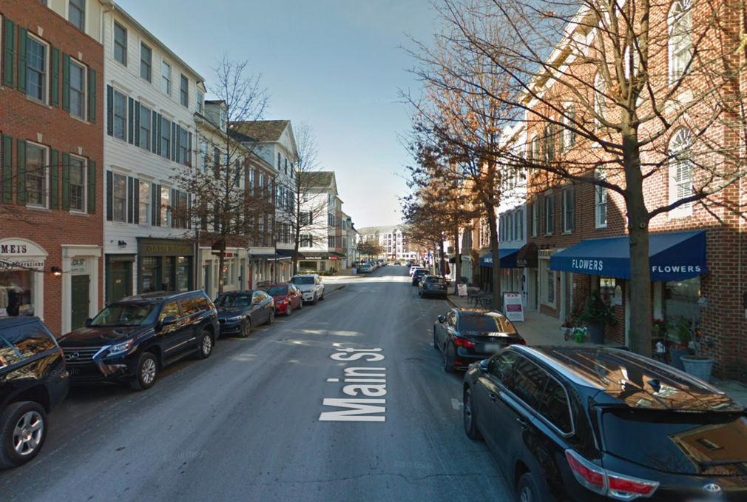
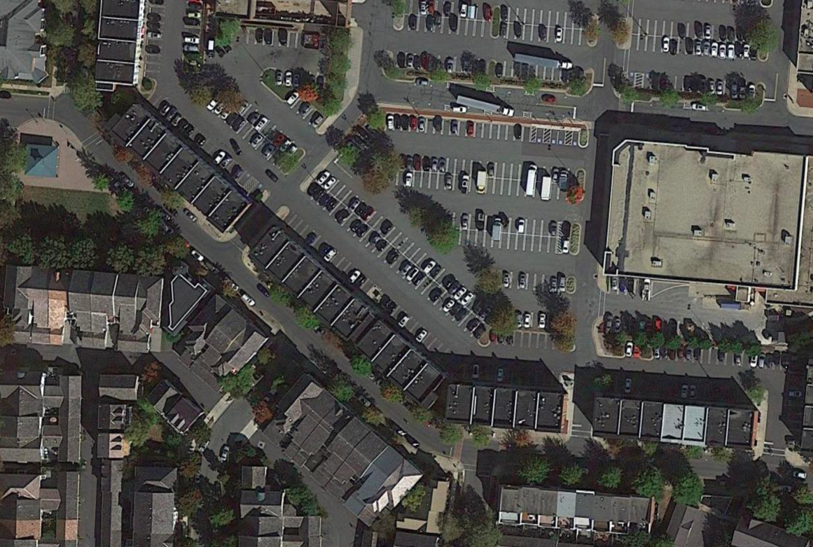
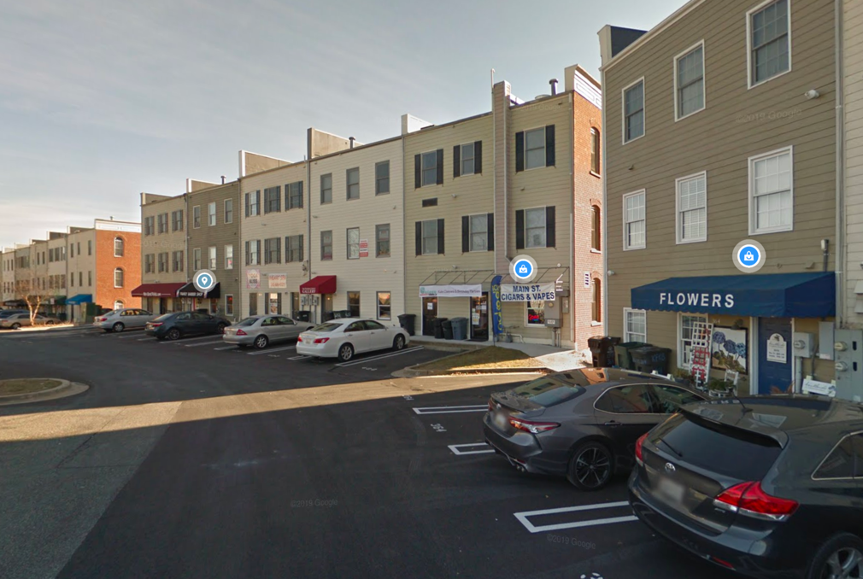
A/B Street Grid - Kentlands

Slide 35
What kinds of street networks does your case have? Is there an A/B grid?

Slide 36
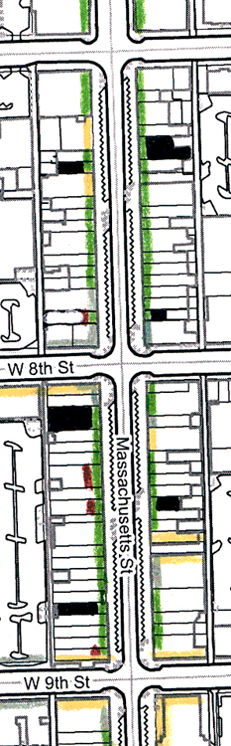
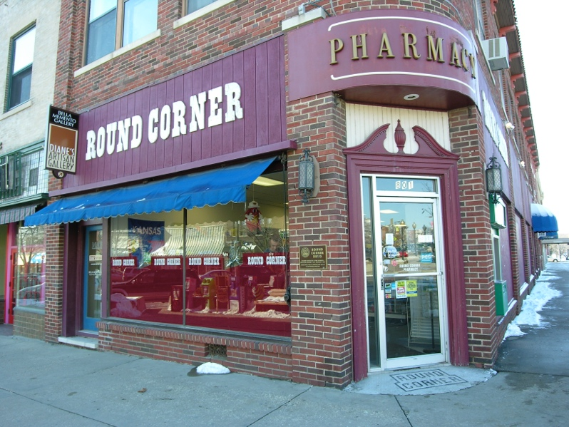
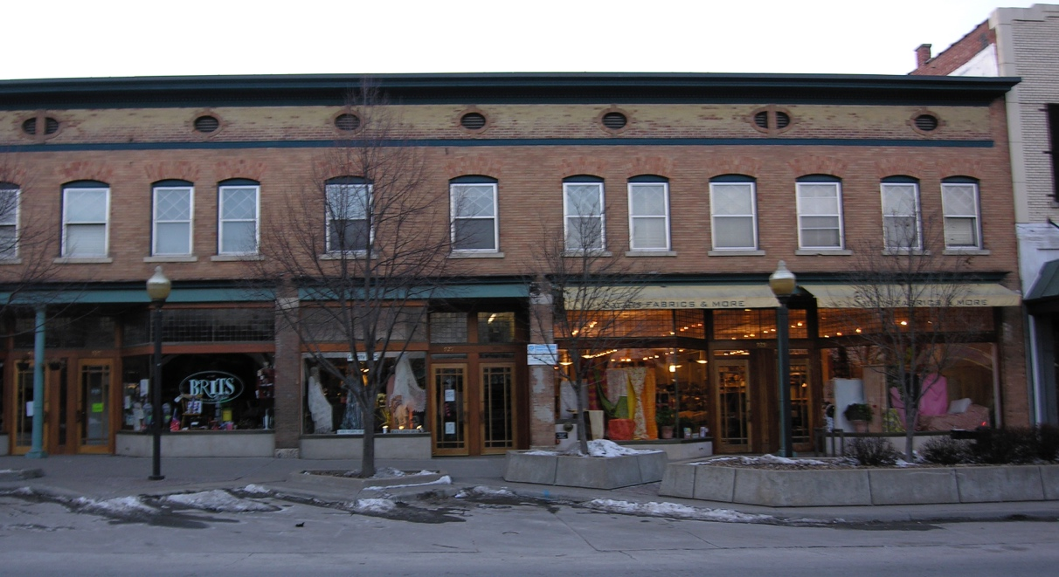
Retail Frontage Quality

Slide 37
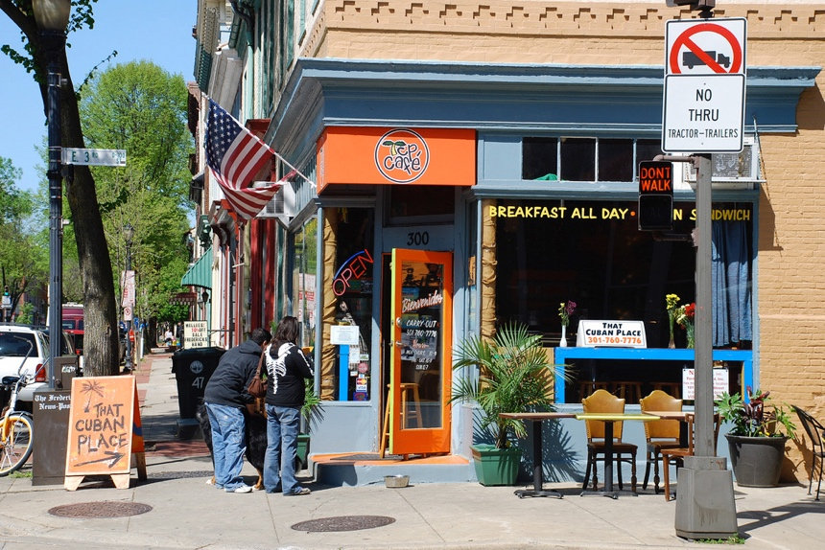
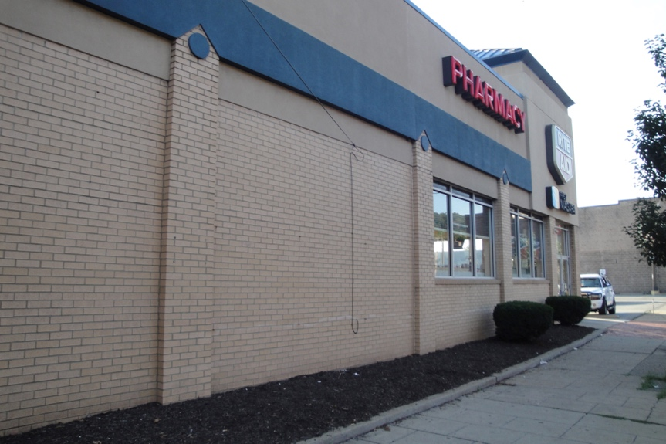
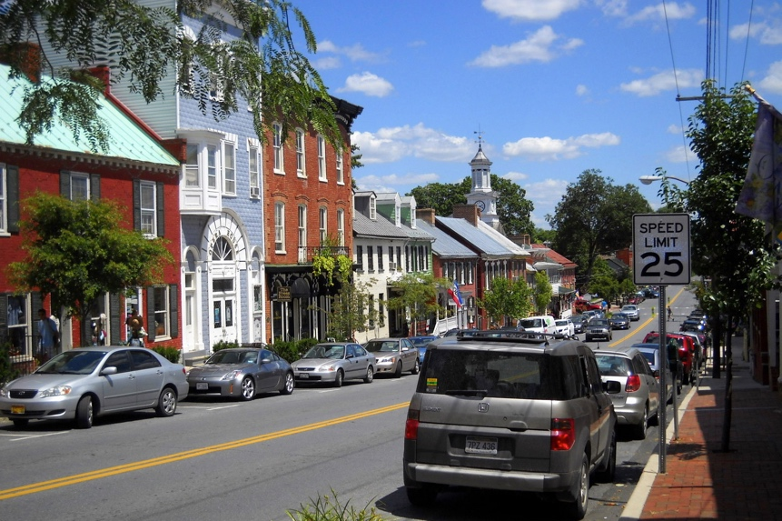
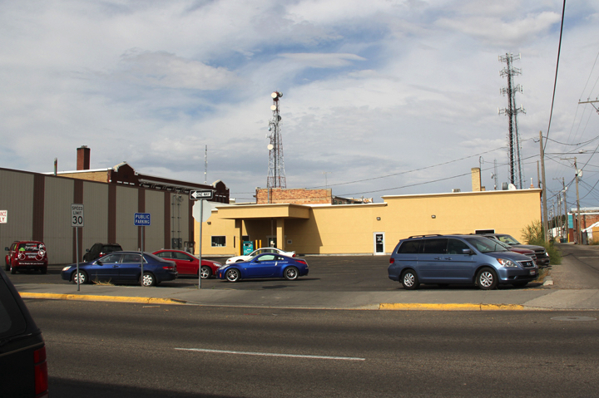
Detailing & Articulation
Traditional: Extensive
Modern: Limited
Notes:
tumblr_mht9wdqinW1qzlcoro1_500

Slide 38
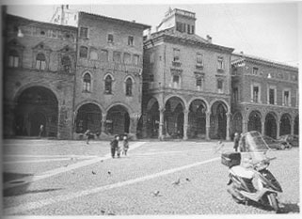
Articulation & Rhythm

Slide 39


Detail, Articulation, Rhythm - Kentlands
A Street
B Street

Slide 40


Sense of Enclosure
Traditional: “Outdoor Room”
Modernist: No Enclosure

Slide 41

Enclosure
Accessed 2/19/07 at http://sccplugins.sheffield.gov.uk/urban_design/strategic_guidance_urban_creating.htm

Slide 42
Enclosure - Kentlands

Slide 43
What articulation, rhythm, and sense of enclosure does your case have?

Slide 44

Figure - Ground
“The figure/ground relationship is a fundamental principle of perception. Figures are the elements within a field or ground. Ground is typically the background or the space within which the elements reside.”
Accessed 2/13/07 at http://www.jour.unr.edu/trumbo/VCsite/gestalt.html.
http://www.urbanphoto.net/wrigley/figure-ground.gif; Accessed 2/13/07.

Slide 45

Figure - Ground
Solids can be either figure (object) or ground.
Holston. The Modernist City: An Anthropological Critique of Brasilia.

Slide 46


Traditional Space
Differentiated public and private buildings
Private buildings provide background fabric
Public buildings are objects
Majority is solid
Holston. The Modernist City: An Anthropological Critique of Brasilia.

Slide 47

Traditional Space
CNU Charter: A primary task of all urban architecture and landscape design is the physical definition of streets and public spaces as places of shared use.

Slide 48


Anti-Space: Modernist
No hierarchy of buildings
No background buildings – all object buildings
Majority is void
Holston. The Modernist City: An Anthropological Critique of Brasilia.

Slide 49

Independence
Mall Area
Philadelphia
1939
http://www.brynmawr.edu/iconog/uphp/indnoll2/IMAGES/1939%20large.jpg; Accessed 2/13/07

Slide 50

Independence
Mall Area
Philadelphia
2004
http://www.brynmawr.edu/iconog/uphp/indnoll2/IMAGES/2004%20large.jpg; Accessed 2/13/07

Slide 51
http://www.brynmawr.edu/iconog/uphp/indnoll2/IMAGES/1939%20large.jpg; Accessed 2/13/07
http://www.brynmawr.edu/iconog/uphp/indnoll2/IMAGES/2004%20large.jpg; Accessed 2/13/07

Slide 52


Same Scale Comparisons
Ayers Saint Gross, accessed 2/19/07 at http://www.asg-architects.com/research/comparing/campuses/index.htm

Slide 53

Figure Ground - Kentlands

Slide 54
Where does your case have modernist (anti-)space, and where does it have traditional space?

Slide 55

Viewshed
http://www.westergard.com/architecture/terrace_rooftop_shots_62_preview.jpg; Accessed 2/13/07

Slide 56

Terminated & Deflected Vistas

Slide 57

Terminated Vista

Slide 58

Deflected Vista

Slide 59

Prospect / Refuge
http://www.iam.unibe.ch/~liwicki/web/best_of/2004-06%20PCDV1309%20Gruener%20Teich%20im%20Central%20Park.JPG; accessed 2/13/07

Slide 60



Vistas – Kentlands
Deflected Vista
Terminated Vista - not

Slide 61

Public - Private Layers

Slide 62

Public - Private Layers

Slide 63

Public - Private Layers

Slide 64

Public-Private Layers - Kentlands

Slide 65
Public-Private Layers - Kentlands
Inside House =
Private
Street
=
Public
Driveway
=
Semi-Public or Semi-Private?
Walled but visible Garden
=
Semi-Private
Sidewalk
=
Semi-Public

Slide 66
Legibility (Kevin Lynch)
Paths
Districts
Landmarks
Edges
Nodes

Slide 67
Urban Elements
Kevin Lynch:
Paths
Districts
Landmarks
Edges
Nodes
CNU Charter:
Corridors
Neighborhoods & Districts
Civic Buildings
Edges
Centers

Slide 68
Paths & Corridors
Kevin Lynch:
"the channels along which the observer customarily, occasionally, or potentially moves. They may be streets, walkways, transit lines, canals, railroads .."
CNU Charter:
1.The neighborhood, the district, and the corridor are the essential elements of development and redevelopment in the metropolis. They form identifiable areas that encourage citizens to take responsibility for their maintenance and evolution.
2. . . Corridors are regional connectors of neighborhoods and districts; they range from boulevards and rail lines to rivers and parkways.

Slide 69
Districts & Neighborhoods
Kevin Lynch:
"are medium-to-large sections of the city, conceived of as having two-dimensional extent, which the observer mentally enters inside of, and which are recognizable as having some common identifying character"
CNU Charter:
1.The neighborhood, the district, and the corridor are the essential elements of development and redevelopment in the metropolis. They form identifiable areas that encourage citizens to take responsibility for their maintenance and evolution.
2. Neighborhoods should be compact, pedestrian-friendly, and mixed-use. Districts generally emphasize a special single use, and should follow the principles of neighborhood design when possible.

Slide 70

Pedestrian Shed
http://www.cnu.org/sites/files/CNU_Ped_Sheds.pdf
Notes:
¼ mile radius = 5 min walk = 125 acres
½ mile radius = 10 min walk = 500 acres
http://www.cnu.org/sites/files/CNU_Ped_Sheds.pdf

Slide 71


Ped Sheds - Kentlands
Town Center
Orignal Farmhouse

Slide 72
Landmarks
Kevin Lynch:
”Landmarks and unique features are essential in helping people navigate and connect with their surroundings"
CNU Charter:
25. Civic buildings and public gathering places require important sites to reinforce community identity and the culture of democracy. They deserve distinctive form, because their role is different from that of other buildings and places that constitute the fabric of the city.

Slide 73
Edges
Kevin Lynch:
"are the linear elements not used or considered as paths by the observer. They are boundaries between two phases, linear breaks in continuity: shores, railroad cuts, edges of development, walls ... "
CNU Charter:
Metropolitan regions are finite places with geographic boundaries derived from topography, watersheds, coastlines, farmlands, regional parks, and river basins. The metropolis is made of multiple centers that are cities, towns, and villages, each with its own identifiable center and edges.

Slide 74
Nodes & Centers
Kevin Lynch:
"are points, the strategic spots in a city into which an observer can enter, and which are intensive foci to and from which he is traveling. They may be primary junctions, places of a break in transportation, a crossing or convergence of paths, moments of shift from one structure to another. Or the nodes may be simply concentrations, which gain their importance from being the condensation of some use or physical character, as a street-corner hangout or an enclosed square ... "
CNU Charter:
Metropolitan regions are finite places with geographic boundaries derived from topography, watersheds, coastlines, farmlands, regional parks, and river basins. The metropolis is made of multiple centers that are cities, towns, and villages, each with its own identifiable center and edges.

Slide 75
What are the
Paths – Corrisdors
Districts – Neighborhoods & Districts
Landmarks – Civic Buildings
Edges – Edges
Nodes – Centers
in your case?
Do they align more with Lynch’s conception or NU’s conception?

Slide 76
Urban Design Scale
CNU Charter:
Region: Metropolis, City, Town
Neighborhood, District, Corridor
Block, Street, Building

Slide 77

Layers by Rate of Change (Brenda Scheer)

Slide 78

Ideas travel . . .

Slide 79

First, Kentlands
1988

Slide 80

First, Kentlands
1988
then Lakelands
1996

Slide 81

First, Kentlands
1988
then Lakelands
1996
then Downtown Crown
2007

Slide 82



Downtown Crown
Notes:
Master Plan: Matthew Bell, Perkins Eastman

Slide 83
The Urban-Rural Transect

Slide 84
The Urban-Natural Transect

Slide 85

Origins: The Natural Transect
Notes:
Transect:
An ordering system deploying a geographic gradient to arrange the sequence of natural habitsts

Slide 86
Visualizing the Transect
Source: Rick Bernhardt
Photo Source: Dhiru Thadani

Slide 87

The Transect in Seattle

Slide 88
T1: Natural
Protected from development in perpetuity
Includes bodies of water, wetlands, public open space, and conservation easements

Slide 89
T2: Rural
Open space not protected from development
TDR sending areas
May include floodplains, steep slopes, and aquifer recharge areas

Slide 90
T3: Suburban
Least dense, most residential
Single-family detached houses
Office and retail on restricted basis
Maximum 2 stories
Open space, highways, and roads are rural in character

Slide 91

T3: Suburban Example

Slide 92
T4: General Urban
Primarily residential
Single-family detached houses and rowhouses on small-medium lots
Limited office buildings
Small-scale retail, typically at corners
Maximum of 3 stories
Open space consists of greens and squares

Slide 93

T4: Urban General Example

Slide 94
T5: Urban Center
Denser, fully mixed-use areas
Buildings include rowhouses, live-work flexhouses, apartment buildings, and offices above shops
Maximum of 5 stories
Open space consists of squares and plazas

Slide 95

T5: Urban Center Example

Slide 96
T6: Urban Core
Most dense, mixed-use concentration of a region
Buildings consist of rowhouses, apartment houses, office buildings, and department stores
Wide range of building lot sizes and heights
Surface parking lots not permitted on frontages
Open space consists of squares and plazas.

Slide 97


T6: Urban Core Examples

Slide 98
Which transect zones do you see in your case, where are they, and how do they relate to each other?

Slide 99
Key Qualities of the Transect
Form-based, not use-based
Each zone is immersive: all component elements reinforce each other to create and intensify a specific character; each zone is able to satisfy a different set of human needs and conditions
All zones incorporate principles of TND: mixed-use, walkable, importance of public realm
Locally defined: no single transect, but many transects defined by local vernacular
Incorporates planning goals directly into tools of implementation
Zones change over time (like secessional habitat)

Slide 100













The Transect of McDonald’s
T1 PRESERVE
T2 RESERVE
T3 SUB URBAN
T4 GENERAL
T5 CENTER
T6 URBAN CORE
T2
T3
T4
T5
T6

Slide 101











The Transect of Starbucks
T1 PRESERVE
T2 RESERVE
T3 SUB URBAN
T4 GENERAL
T5 CENTER
T6 URBAN CORE
T2
T3
T4
T5
T6

Slide 102
Key Qualities of the Transect
Form-based, not use-based
Each zone is immersive: all component elements reinforce each other to create and intensify a specific character; each zone is able to satisfy a different set of human needs and conditions
All zones incorporate principles of TND: mixed-use, walkable, importance of public realm
Locally defined: no single transect, but many transects defined by local vernacular
Incorporates planning goals directly into tools of implementation
Zones change over time (like secessional habitat)

Slide 103
Immersive Environments
“To create a strong sense of place, the surroundings must be all of a piece: space, mass, shapes, and materials must reflect the same sensibility”
—Witold Rybczynski

Slide 104

Transect of Streets

Slide 105
Key Qualities of the Transect
Form-based, not use-based
Each zone is immersive: all component elements reinforce each other to create and intensify a specific character; each zone is able to satisfy a different set of human needs and conditions
All zones incorporate principles of TND: mixed-use, walkable, importance of public realm
Locally defined: no single transect, but many transects defined by local vernacular
Incorporates planning goals directly into tools of implementation
Zones change over time (like secessional habitat)

Slide 106
Key Qualities of the Transect
Form-based, not use-based
Each zone is immersive: all component elements reinforce each other to create and intensify a specific character; each zone is able to satisfy a different set of human needs and conditions
All zones incorporate principles of TND: mixed-use, walkable, importance of public realm
Locally defined: no single transect, but many transects defined by local vernacular
Incorporates planning goals directly into tools of implementation
Zones change over time (like secessional habitat)

Slide 107

The Transect in Stockholm

Slide 108


Washington, DC Transect
T1 PRESERVE
T2 RESERVE
T3 SUB URBAN
T4 GENERAL
T5 CENTER
T6 URBAN CORE

Slide 109
Key Qualities of the Transect
Form-based, not use-based
Each zone is immersive: all component elements reinforce each other to create and intensify a specific character; each zone is able to satisfy a different set of human needs and conditions
All zones incorporate principles of TND: mixed-use, walkable, importance of public realm
Locally defined: no single transect, but many transects defined by local vernacular
Incorporates planning goals directly into tools of implementation
Zones change over time (like secessional habitat)

Slide 110

The Urban-Natural Transect: A Tool for Planning
Descriptive: What kind of neighborhoods do we have?
Normative: What kind of neighborhoods should we have?
Regulatory: How do we get the neighborhoods we want?

Slide 111
Using the Transect: Planning
“The transect approach is a planning strategy that seeks to organize the elements of urbanism — building, lot, land use, street, and all of the other physical elements of the human habitat—in ways that preserve the integrity of different types of urban and rural environments. These environments can be viewed relative to a continuum that ranges from rural to urban, varying in their urban intensity.”
— Emily Talen

Slide 112
Using the Transect Across Scales
Region: used to geographically allocate intensity of development v. level of environmental protection
Community: used to structure zoning categories
Building and Streetscape: used to ensure constituent elements reinforce the character of each zone

Slide 113

The Transect in Plan

Slide 114


















T1 PRESERVE
T2 RESERVE
T3 SUB URBAN
T4 GENERAL
T5 CENTER
T6 URBAN CORE

Slide 116
Appendix: KENTLANDS Images FOR EASY REFERENCE

Slide 117


Slide 119

DC to Kentlands:
35 min by car with no traffic
1-1.5 hr by metro + bus

Slide 120

Notes:
Donut hole is headquarters of National Institute of Standards and Technology (fed)

Slide 121


Slide 122


Slide 123


Slide 125


