Slide 1
URBAN CULTURE AND SOCIETY: WEEK 1

Slide 2
LEARNING HOW TO READ CITIES

Slide 3
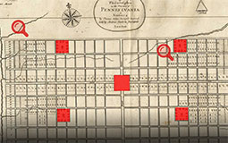
AND PHILADELPHIA

Slide 4
Perspectives on Rio

Slide 5
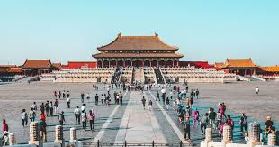
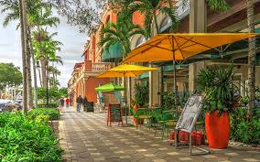
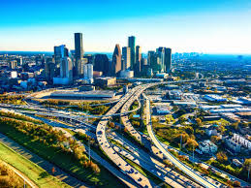
And other cities
AND YOUR HOMETOWN?

Slide 6
How do We Read Cities?
Observing
Studying/Reading
Using tools like counting, mapmaking, statistical data, surveys
Asking people in various ways
Thinking (Mumford)
Comparing
Imagining

Slide 7
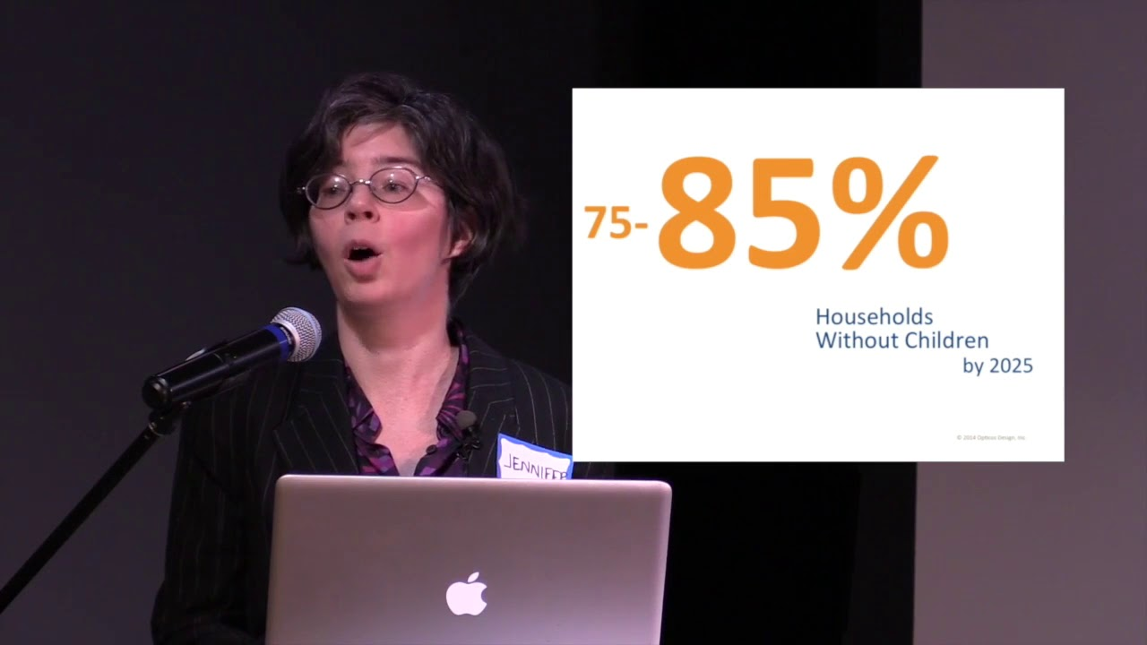
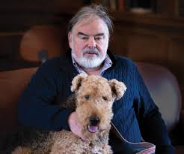
Who are we as readers?

Slide 8
How Do We Read Texts?
Two Primary Texts for Readings:
CITY READER
Janice Pearlman, FAVELA
Plus readings on Moodle
LOOK AT/SKIM TO PREPARE FOR THE WEEK. READ CAREFULLY BEGINNING WITH UNDERLINED TEXT. KNOW WHAT THEY SAY EVEN WHEN THE WORLD IS OVERWHELMING

Slide 9
How do we Commnicate?: Weekly Format
Topics and Readings are on Moodle although we will not post Perlman or CR readings. These should be prepared before class.
Lecture (40+ minutes with Q & A)
Discussion (30 minutes 15 people) M OR Th: there will be 4 different groups
Some days will be longer discussions on shared themes like education or policiing: After Break we will change format slightly with lecture and then general discussion on the topic.
Participation: Reading
  Questions and responses in Discussion
  Comments may be posted

Slide 10
Learning about Your Hometown: EXERCISE 1.1.1-1.5
Exercise 1.1 gets your writing started with an introduction and reading about classmates
1.2-1..5 is a cumulative exercise –look at 1.5 and build toward it by choosing a SPECIFIC place whose context in geography and social history will help you interpret it. For example, if a farmer’s market brings diverse people together, what does that say about the neighborhood? Or if a park is EMPTY or dominated by one group (seniors, families, etc) can we see that in the demographic context or connections it has? OR IF a statue has caused debates? Or even if your back yard is a neighborhood center? Assignments 1.2-1.4 should lead to 1.5.

Slide 11
“Exploring” Philadelphia: Building on History
Since we cannot explore the city in person, you will use remote tools to update studies from the 1990s and see how the city has grown and changed. These studies have mapped out institutions and populations, checking observations and interviews with census materials. You miss the rides on SEPTA (and getting lost in the city) but you can build on the work of others to see how Philadelphia has changed even in this class.

Slide 12
Going Home and Changing Place
AT THE END OF THE COURSE, we want you to take what you have learned and revisit your home town—where many of you will actually have returned for the final weeks. YOU CHOOSE the topic –education, environmet, transportation, security, divisions, real estate – and use the tools to examine an issue you want to grapple with.

Slide 13
How do we read?
Who was Lewis Mumford?
American thinker and essayist, 1898-1990. For many years, reached the public through the Skyline column in the New Yorker in which he championed a humanistic view of the city as a site of human culture but oe that could be destroyed by technology or power holders. READ THE CITY READER INTRO

Slide 14
Five Questions for reading and being rad by Mumford: (1) What is the city?
p.93” The city is a related collection of primary groups and purposive associations: the first, like family and neighborhood, are common to all communities and the second are especially characteristics of city life. These varied groups support themselves through economic organizations that are likewise of a more or less corporate, or at least publically regulated character; they are housed in permanent structures within a relatively limited area. The essential physical means of a city’s existence are a fixed site, the durable shelter, the permanent facilities for assembly, interchange and storage; the essential social means of a city’s existence are the social division of labor, which serves not merely the economic life but the cultural process. The city in its complete sense, then, is a geographic plexus, an economic organization, an institutional process, a theater of social action and an aesthetic symbol of collective unity”

Slide 15
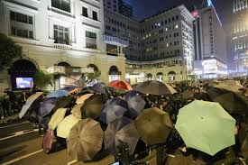
What is the “theater of the city”
P. 93The city in its complete sense, then, is a geographic plexus, an economic organization, an institutional process, a theater of social action and an aesthetic symbol of collective unity. The city fosters art and is art; the city creates the theater and is the theater. It is in the city, the city as theater, that man’s most purposive activities are focused and work out, through conflicting and cooperatibg personalities, events, groups, into more significant culminations.
Without the social drama that comes into existence through the focusing and intensification of group activity there is not a single function performed in the city that could not be performed –and has not been performed –in the open country. The physical organization of the city may deflate this drama or make it frustrate, or it may, through the deliberate efforts of art, politics, or education, make the drama more richly significant, as a stage-set, well-designed, intensifies and underlines the gestures of the actors and the action of the play”
THINK ABOUT THE L”ACK OF VARIETY” MANY OF YOU NOTED IN YOUR HOMETOWN AND HOW THIS IS CONFRONTED IN URBAN SPACES

Slide 16
What is the ideal size of the city?
Need for core social services – a university (what else?)
Limits beyond which contact is difficult. But different for children and workers
”Limitations on size, density and area are absolutely necessary to effective social intercourse” (p.94) CITIES HAVE BOUNDARIeS

Slide 17

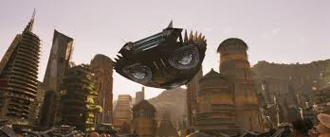
Are growth and technology “bad”?
How do highways and energy grow? “The emerging sources of power, transport and communication do not follow the old highway network at all. Giant power strides over the hills, ignoring the limitations of wheeled vehicles; the airplane, even more liberated, flies over swamps and mountains, and terminates its journey not in an avenue but in a field.” (p.94)
What does the internet mean?

Slide 18
Are suburbs “bad”?
”Through these convergent efforts, the principles of the polynucleated city have been well established. Such plans must result in fuller opportunities for the primary group, with all its habits of frequent direct meeting and face-to-face intercourse : they must also result in a more complicated pattern and a more comprehensive life for the region…To embody these new possibilities in city life, which come to us not merely through better technical organization but through acuter social understanding and to dramatize the activities in appropriate individual and urban structures, forms the task of the coming generation” (95)

Slide 19
Next Week: Building Private and Public (and post intro by Friday)

