Slide 1
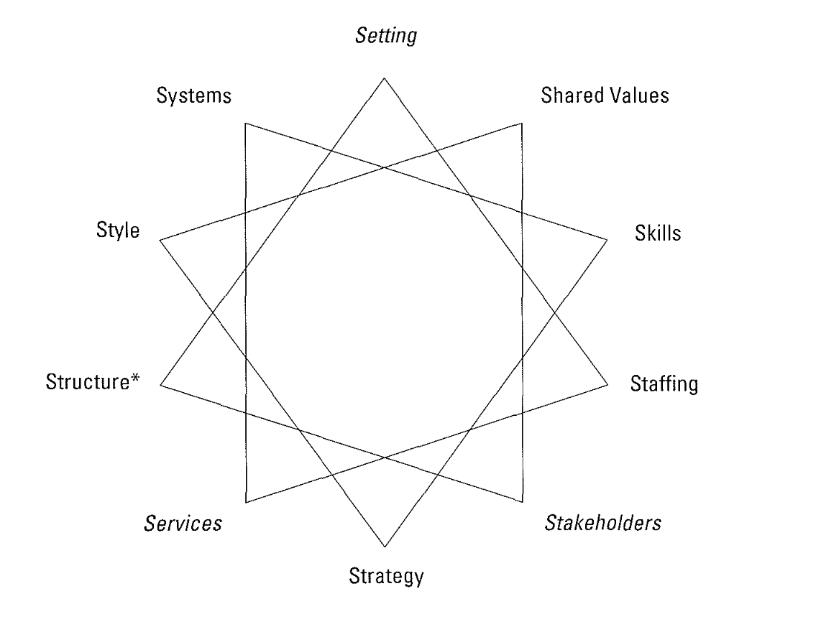
10-S Framework for Nonprofit Organizations
Setting – location and work environment
Systems – formal programs/plans/procedures that guide organizational functioning
Style – leadership style of the designated leaders
Structure – *refers to administrative and governance structure; how tasks are divided
Services – how the mission is operationalized within the community
Strategy – how the mission is operationalized within the organization
Stakeholders – individuals/groups with an interest in the organization
Staffing – paid and volunteer roles
Skills – basic organizational competencies
Shared Values – guiding concepts and fundamental values
Bailey & Aronoff, (2004)
Notes:
The diagram is arranged in a 10-point star. Each point is listed on the slide, with the definition.

