Slide 1
Emergent Multilingual Learners
Fall 2025

Slide 2

Checking In
What was a favorite game or toy from your childhood?

Slide 3

For Today
Checking In
For Next Session
Today’s Invitation
Assessment Validity
Performance Tasks
GRASPS in Action

Slide 4

For Next Session
Individual Inquiry Project Workshop Day!
Praxis #3 Due Sunday by Midnight

Slide 5
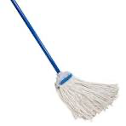
Today’s Invitation
Imagine a first-grade teacher assessing all of her students’ understanding of word-ending sounds. Ms. Aponte shows her student, Gao-Jer, a Hmong speaker at a beginning level of English language proficiency, the picture seen here.
Ms. Aponte asks Gao-Jer to identify what other word has the same ending sound: wish, hat, hop, or pan.
What may be standing in the way of this student demonstrating what she knows on this question?
What could the teacher do to make this assessment more valid for this student?

Slide 6
Assessment Validity
Type of Validity | Definition | Example for MLs
Construct Validity | The degree to which a test measures what it claims, or purports, to be measuring | A math test in which a teacher has reduced the linguistic load of word problems to ensure it is assessing mathematical knowledge rather than language proficiency
Content Validity | The extent to which an assessment represents all facets of tasks within the domain being assessed | A vocabulary quiz that is designed to measure not only MLs understanding of meaning but also their ability to use the words in context
Predictive Validity | The extent to which a score on an assessment predicts future performance | How well an emergent ML’s score on the annual state English language proficiency assessment predicts their performance on the state English language arts assessment.

Slide 7
Consider…
Assessment Instructions
Ensure that these are clear and easy to understand (consider having translations, when appropriate)
Linguistic Accessibility
Look for opportunities to reduce the linguistic load in all areas that aren’t being directly addressed.
Format and Use of Technology
The assessment should be in a familiar format and not use technology that has not been introduced.
Cultural Bias
Select content that is something familiar to all students’ shared experience, not topics students may not have had access to in their culture, education, or life experience.
Scoring
Grade on the tested construct only
Scaffolds
EMMLs need appropriate scaffolds based upon their ELP
Should be on the assessed construct only

Slide 8
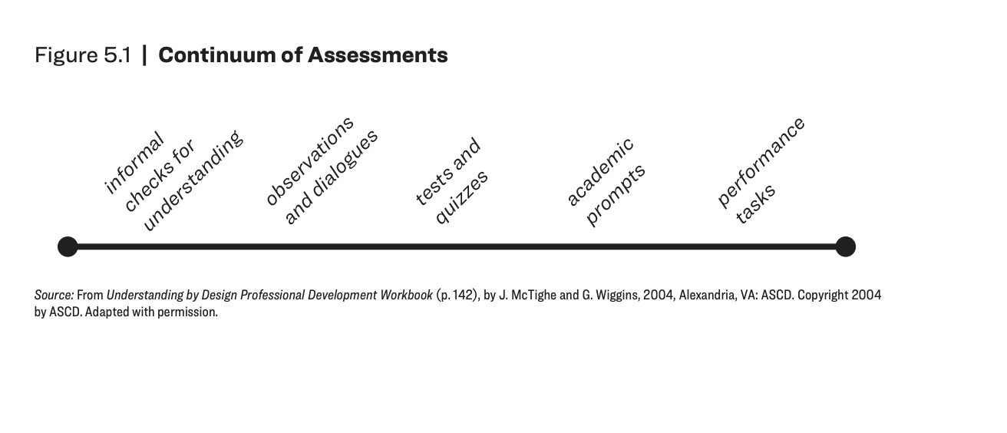

Slide 9
Performance assessments (Gottlieb, 2017)
Represent students’ identities, languages, and cultures
Consists of authentic tasks with real-life application, ideally that take on social action
Requires hands-on student engagement, preferably in collaboration with peers
Exemplifies original student work that includes multiple modalities
Is built from features of universal design for learning
Connects to students’ lives, interests, and experiences
Offers evidence for learning-based on standards-referenced criteria for success

Slide 11
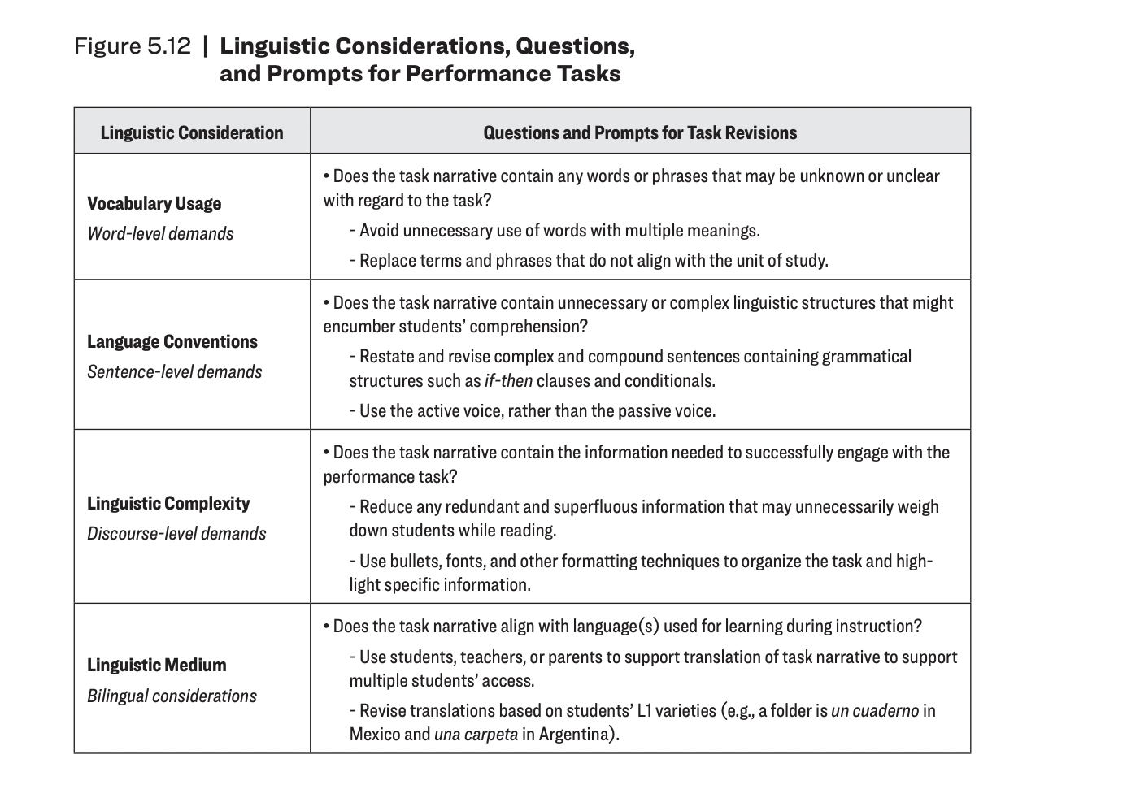
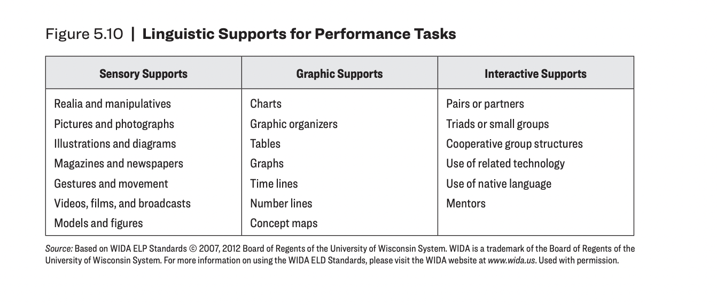

Slide 12
Class Context
6th grade food and nutrition class at Sí Se Puede Middle School.
This school serves 300 students in 6-8 grade, of whom 58% self-identify as Hispanic/Latinx, 30% Black/African-American, 5% white, and 4% Asian.
99% are “economically disadvantaged” based on eligibility for free or reduced-price lunch.
The school is a traditional (publicly-funded and -run) neighborhood school.
There are 22 students your class, with one lead teacher, two part-time dedicated aides, and a rotating cast of specialists who pull students in small groups for extra academic support and occasionally push-in to the classroom to provide individual social-emotional and behavioral support.
Four students in the class are early emergent multilingual learners (English Language Proficiency Level 2).
At least half of the class is multilingual. Languages spoken include English, Spanish, Haitian Creole, Hindi, and several other Indian languages.

Slide 13
GRASPS Me!
SWBAT evaluate the nutritional value of a given meal.
SWBAT interpret nutritional information on food packaging.
*** How can you make this culturally relevant?

