Slide 1
Paragraph Development Workshop
Presented by The Lincoln Center Writing Center

Slide 2

Introduction Paragraph
An introduction should generally contain (1) a hook, (2) background information, and (3) a thesis.
Hook: a way to grab your reader’s attention and introduce them to your topic.
Types of hooks to consider: a historical review, an anecdote, a surprising statement, a famous person, a declarative, or a thought-provoking question
Types of hooks to avoid: the “Merriam Webster,” or “from the dawn of human history”
Background Information: a space to provide relevant information on your topic and a more specific overview of what you will be covering.
Thesis: the main topic of the paper phrased as an arguable claim.

Slide 3
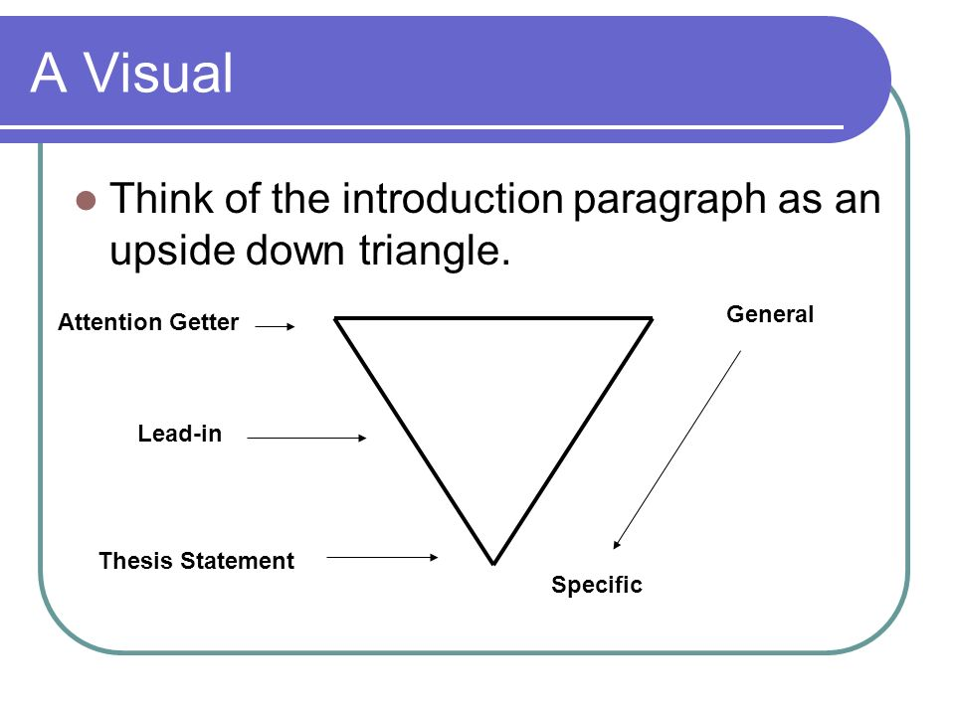

Slide 4
Sample Student Introduction
(1) Taylor Swift has changed lovers, hairstyles, and musical genres, but her love of New York City has remained constant. (2) Swift reveals the influence the city has had on her both in interviews and album materials, most clearly in the songs “Mean,” “Holy Ground,” “Come Back...Be Here,” “Welcome to New York,” and “Delicate.” In her music, from early in her career to the present, New York City is a beacon of escape, opportunity, and individual freedom, a place to which she is drawn and which she loves. (3) These songs’ consistent connection to love and passion work to build a meta-narrative where while Swift’s personal relationships change, her relationship to New York City will remain stable because of the liberation and opportunity she finds here.

Slide 5
Topic Sentences
Much like your whole paper, a paragraph should be concerned with only a single topic. If it begins with one major point of discussion, it should not end with another. Like the thesis statement at the beginning of your paper, the topic of a paragraph should be introduced by a topic sentence.

Slide 6
Topic Sentence at the Beginning
The following paragraph, from an essay in which a professor of physiology compares Darwin and Freud, begins with a topic sentence.
“To begin with, Darwin and Freud were both multifaceted geniuses with many talents in common. Both were great observers, attuned to perceiving in familiar phenomena a significance that had escaped almost everyone else. Searching with insatiable curiosity for underlying explanations, both did far more than discover new facts or solve circumscribed problems, such as the structure of DNA: they synthesized knowledge from a wide range of fields and created new conceptual frameworks, large parts of which are still accepted today. Both were prolific writers and forceful communicators who eventually converted many or most of their contemporaries to their positions.”
--Jared Diamond

Slide 7
Explanation of Topic Sentence at the Beginning
The first sentence announces the topic the rest of the paragraph will develop--the talents Darwin and Freud had in common. Each sentence that follows this topic sentence develops or amplifies it by considering one of the talents the two men shared. The second sentence concerns their powers of observation. The third sentence concerns their curiosity and “underlying explanations” and their ability to create “new conceptual frameworks.” Note also the logical order of subtopics in the paragraph: The discussion moves from observation, to analysis, synthesis, and to communication.

Slide 8

Evidence
The body of the paragraph should be a presentation of concrete evidence, whether in the form of examples, quotations, or facts. Make sure that your main points are clear and well supported with good evidence.
Notes:
Tamara

Slide 9
Types of Evidence
- examples (specific and brief or detailed and extended)
- facts and statistics (precise, quantitative details from authorities in your field)
- paraphrasing
- quotations
Notes:
Tamara

Slide 10
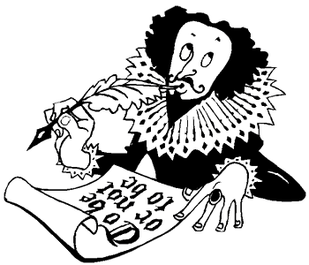
Using Quotations
Your claims require evidence to support them, and you can think of quotations as the raw material upon which your arguments are based. You should always ask yourself two questions when selecting a quotation to use as evidence:
- How relevant is the quotation to the point I am trying to make?
- What parts of it are most essential and speak most directly to my point?
Asking yourself these questions will help you to identify the statements that are most central to your argument and select quotations that deal most directly with those points. Quotations should be relevant to your argument and the topic of the paragraph.
Notes:
Steph

Slide 11

The Quotation Sandwich
When using a quotation (or any kind) of evidence, there are three basic steps that should be considered:
1. Give context for the quotation (Who is speaking?, What is the context in which it is being said?).
2. Your own words + quotations must flow as a complete, coherent sentence. You can test the sentence’s coherence by (temporarily) removing the quotation marks and then reading it out loud. You can also edit with brackets.
3. After inserting the quotation, you must provide an interpretation. Explicitly state how the quotation supports your point.
Notes:
Steph

Slide 12
Sample Student Text
In his article “Narrating Pain: The Power of Catharsis,” Richard Kearney asserts that remembering and retelling trauma is a method for cathartic release. Kearney writes, “The recounting of experience through the formal medium of plot, fiction or spectacle permits us to repeat the past forward” (51). Kearney argues that the very act of repeating a narrative allows an emotional release, or catharsis, for the audience. He also writes that “in the play of narrative re-creation we are invited to revisit our lives--through the actions and personas of others--so as to live them otherwise” (51). In this way, films that create a new ending for a mirror narrative allow their audiences to undergo catharsis.

Slide 13

Transitions!
Reasons to Transition
(to a new sentence OR new paragraph)
WHERE/WHEN do we transition?
HOW? WHAT do we say to transition?

Slide 14
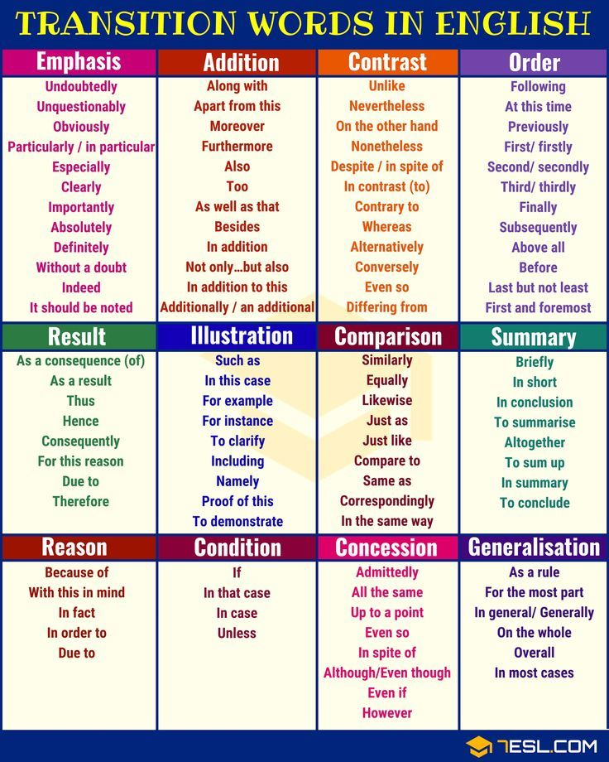
Transition Words/Phrases
Function:
To link/connect ideas
Guiding Question:
What is the relationship between my ideas?

Slide 15



Basic vs. Advanced Transitions
BASIC:
Explicit Connectors
Best used sparingly
Good to insert if shift in ideas is abrupt
A word of caution
Not all transition words/phrases within a category can be used interchangeably.
Some words, such as “moreover” and “in addition” have subtle differences.
ADVANCED:
Content-Based Links
Key words repeated from preceding text.
More nuanced link between ideas
A continuum of strength
Repeating words or phrases from previous sentence
Connecting an idea from a previous paragraph

Slide 16
Internal Transitions
Internal Transitions demonstrate relationships between ideas, phrases, and sentences. They can help to develop your argument within a paragraph and to connect ideas.
BASIC: signal words (then, next, after, furthermore, therefore)
ADVANCED: connecting by logical development
Examples:
“Add to this…” (15)
“ In particular…” (15)
“Another definition of the word ‘big’ is ‘popular.’ Using this definition, Swift’s…” (20)
“At the same time, however…” (29)
“However, subsequent comparisons directly contradict this position image.” (30)

Slide 17
Paragraph Transitions
Paragraph Transitions demonstrate relationships between ideas and paragraphs, and they can highlight a paragraph’s shape and intent.
BASIC: repeating a word or clause from the previous paragraph
ADVANCED: connecting an idea from the previous paragraph
“...she saw the city as ‘a place of endless potential and possibilities,’ and moved there with wide-eyed optimism.”
Swift’s ‘wide-eyed optimism’ about urban life…” (20)
“Swift continues the ideas…” (20)
“Thus, American death is characterized by the enormous bliss of a willed ignorance absorbed from television.
The excesses of consumerism provide another source of artificiality.”

Slide 18
Conclusion Paragraph
Generally, a conclusion should:
Restate your topic and why it is important
Restate your thesis/claim
Address opposing viewpoints and explain why readers should align with your position
Call for action or overview future research possibilities
-Purdue Online Writing Lab

Slide 19
What is a Conclusion in an Essay?
“The end of an essay should therefore convey a sense of completeness and closure as well as a sense of the lingering possibilities of the topic, its larger meaning, its implications: the final paragraph should close the discussion without closing it off.”
-Harvard Writing Center
“Your conclusion is your chance to have the last word on the subject. The conclusion allows you to have the final say on the issues you have raised in your paper, to synthesize your thoughts, to demonstrate the importance of your ideas, and to propel your reader to a new view of the subject. It is also your opportunity to make a good final impression and to end on a positive note.”
-UNC-Chapel Hill Writing Center

Slide 20
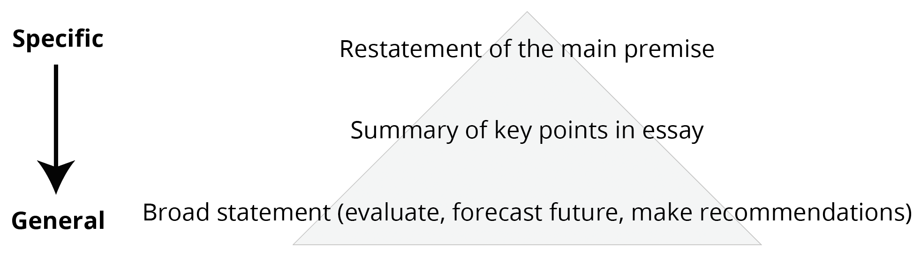
Conclusion Paragraph Structure

Slide 21
Sample Conclusion
Restatement of Premise
A national service program, for the reasons presented, is an excellent way to add both economic and social value to United States citizen and the states in which they live. Above all else, we need a more accessible way to break down socioeconomic and cultural divides and work towards a common goal. It is a win-win solution that helps us fight the loss of community while adding economic value to the participants and the country. The cultural change that would come with a program like the ones discussed here cannot be underestimated. Giving our time to a cause greater than ourselves simply makes us better people. (17)
Broad Statement
Summary of Points

Slide 22

To schedule an appointment with a Writing Center tutor please visit https://fordham.mywconline.com/

