Slide 1

Active Critical Reading
Why how you engage with a text matters

Slide 2


Active Reading
Reading that is effective is dynamic.
You must articulate what you are thinking as you read by physically interacting with the text.
Notes:
We generally think of reading as passive. What are you usually doing when, how do you normally engage with a book, with social media?
Sitting, silent, absorbing it in….
So how might we make reading dynamic? What do you think I mean by active or dynamic reading?
Have you ever read something that made you mad? That you disagreed with? What’d you do?
….
So how do we do that? How do we physically interact with a text?

Slide 3
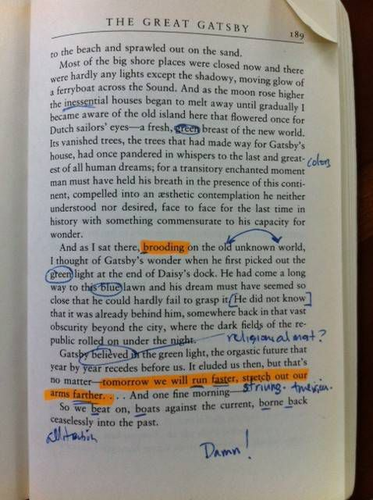
Annotation as Pre-Writing
Engaging with the text fully by making notations while you read:
Highlight or underline
Summarize main points
Ask questions
  Answer the questions if you can
Make note of connections to other texts
Comment – add your own thoughts to the text
Notice patterns
Note new words
Notes:
Depends on university access- software like Perusall can be integrated into most LMSs

Slide 4
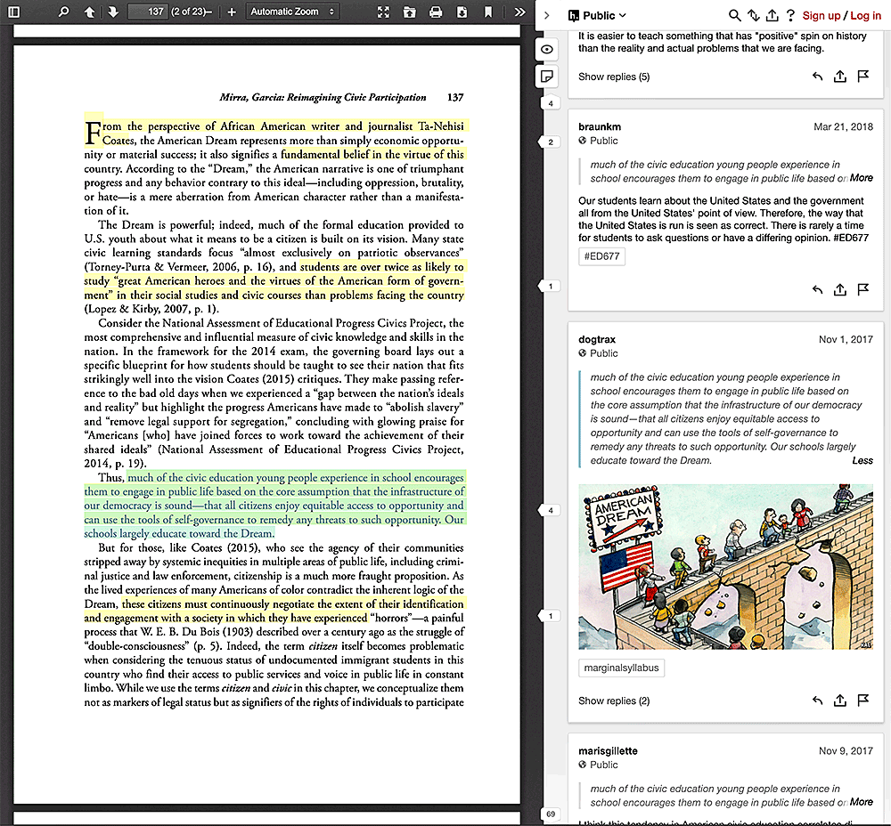
Annotation as
Conversation

Slide 5

Question the Text
Do you agree or disagree with the text? How or why?
Are the claims based in fact or opinion? Test them.
Do they hold up?
(This will help you do this to your own writing as well.)
Does the text have weasel words?
(Words that negate the claims and make them hollow)
virtually, helps, fights, might, and can be.

Slide 6

Expand Upon the Text
Look for ideas that are implied but not explicitly stated.
Compare with other texts or media
Consider Intertextuality
Consider what has been left out, and what is missing, from the text?

Slide 7
Why is Effective reading essential?
The texts you engage with:
-are the basis for your ideas
-provide evidence that supports your thesis
-give a you firm grasp of your subject
Synthesis
Adding to the conversation

Slide 8

Burke's "Unending Conversation"
Kenneth Burke writes:
Imagine that you enter a parlor. You come late. When you arrive, others have long preceded you, and they are engaged in a heated discussion, a discussion too heated for them to pause and tell you exactly what it is about. In fact, the discussion had already begun long before any of them got there, so that no one present is qualified to retrace for you all the steps that had gone before. You listen for a while, until you decide that you have caught the tenor of the argument; then you put in your oar. Someone answers; you answer him; another comes to your defense; another aligns himself against you, to either the embarrassment or gratification of your opponent, depending upon the quality of your ally's assistance. However, the discussion is interminable. The hour grows late, you must depart. And you do depart, with the discussion still vigorously in progress.
The Philosophy of Literary Form. Berkeley: University of California Press, 1941.110-111
Notes:
Link to summary---

Slide 9
Wider Context
But it’s not just as two-dimensional as entering into a conversation…
The wider culture around the conversation impacts it as well.
Reader
Writer
Text
Context
All these elements interact forming what we call the Rhetorical Situation. They impact our response to what we read and how we might add to the conversation.

Slide 10
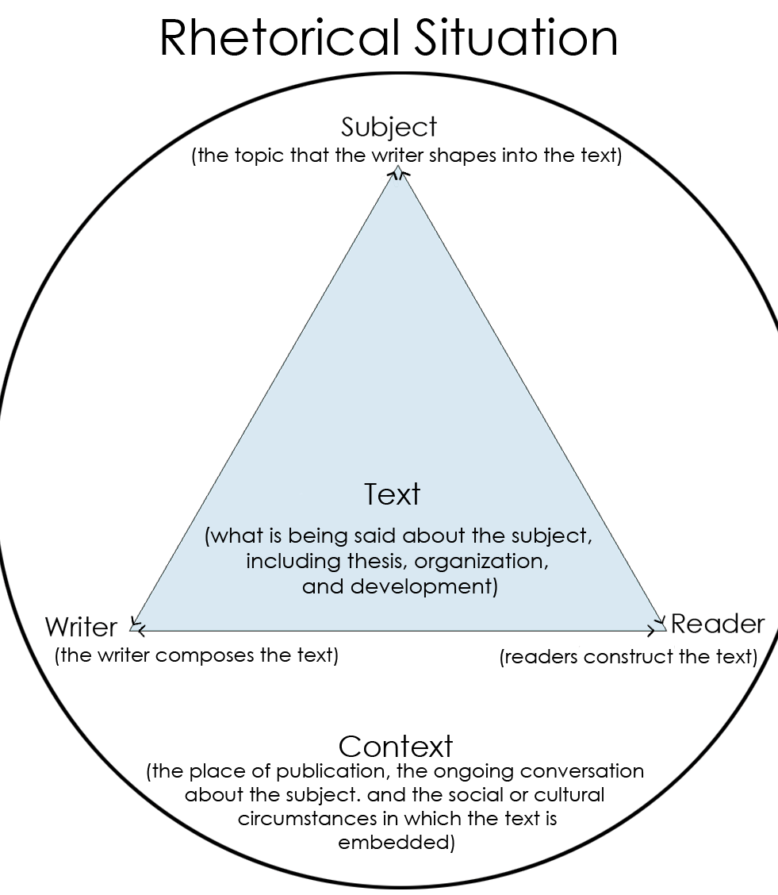
Another part of active reading is asking questions about the rhetorical situation, questions about the writer, reader, subject, and text.
Who is the author?
What makes them credible?
Where and when was the writing published?
Who was the intended audience?
What other circumstances or events were occurring when the document was published that might have influenced it?
How does the author draw on and utilize those events or texts?

Slide 11

Writing is a Process
& a Conversation that starts with Active Reading
Notes:
So, whenever you pick up a text to read you need to also pick up your pen, keep all these possibilities in mind because, in this class, reading is pre-writing.

Slide 12
Intertextuality
“The practice of relating one’s own text to the texts of other published texts by citing, quoting, paraphrasing, and summarizing”
“A conversation that a text records with other texts”
“The way writers relate the findings of other texts with their own texts”

Slide 13

Active Reading
Think-Pair-Share
1) Actively read LeGuin’s Preface (handout)
2) Respond to one of the Prompts:
LeGuin argues that, “Science fiction is not predictive; it is descriptive”(No Page), why might that matter when reading Science Fiction about nonhuman intelligence (AI, Aliens, Cyborgs, Sapient Animals)?
What do you think LeGuin means when she writes, “The only truth I can understand or express is, logically defined, a lie. Psychologically defined, a symbol. Aesthetically defined, a metaphor”(No Page).
3) Chat in Small Groups about your response
4) Larger Class Discussion

Slide 14
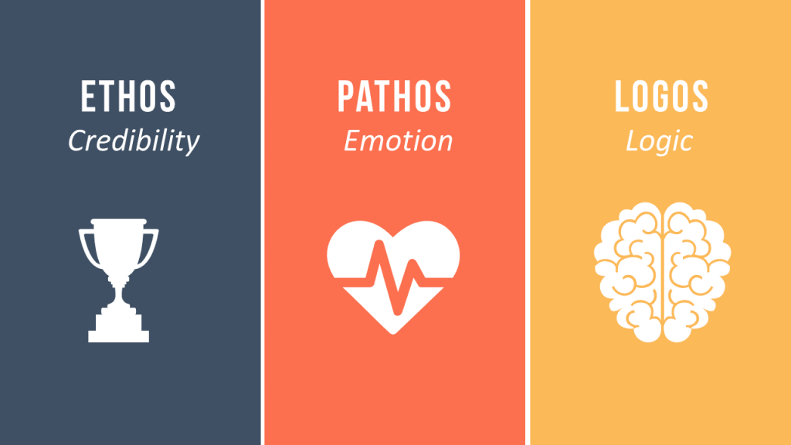
Rhetorical Appeals
Pathos, Ethos, Logos

Slide 15

Pathos-
Emotional Appeal
“generates emotions (fear, pity, love, anger, jealousy) that the writer hopes will lead the audience to accept the claim” ( Lunsford et al. 26).

Slide 16


Ethos-
Ethical Appeal
“When writers or speakers come across as trustworthy, audiences are likely to listen and accept their arguments” (Lunsford et al. 27).

Slide 17
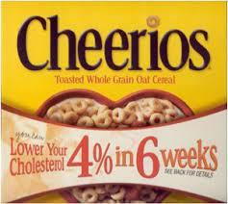

Logos- Logical Appeal
“The use of reason and evidence- to present the facts, statistics, credible testimony, cogent examples” (Lunsford et al. 27)

Slide 18

What is a Good Source?

Slide 19
According to the Purdue OWL:
You can ask the following questions to determine if a source is credible.
Who is the author?
How recent is the source?.
What is the author's purpose?
What type of sources does your audience value?
Be especially careful when evaluating Internet sources!

Slide 20
Primary Sources
First hand testimonial or Direct evidence
Documents created at the time of the event or subject of interest, documents written by a witness or survivor.
Oral Histories
Autobiographies
Memoirs
Diaries
Artifacts
Recordings (Audio or Visual)
Government Documents

Slide 21
Secondary Sources ~ Interpretations and evaluations of primary Sources
Journal Articles
Biographical works
Commentaries, criticisms
Histories
Periodicals - magazine and newspaper articles

Slide 22

Tertiary Sources
Dictionaries
Encyclopedias
Textbooks
When is it okay to use them?
Often only in the introduction where you are clarifying the general information of the subject. You may define a word using the OED for clarity, so that the reader knows exactly how you approach that word in your paper. There is nothing in-depth about a tertiary source so they do not help you add to the academic conversation. That is why you are sometimes cautioned against or even forbidden to use them.

Slide 23

Once you have a Credible & Relevant Source it’s time to Actively Read it.
This means preparing yourself to paraphrase, summarize and quote from the source in a way that supports your argument.

Slide 24
Ask questions of the text.

