Slide 1
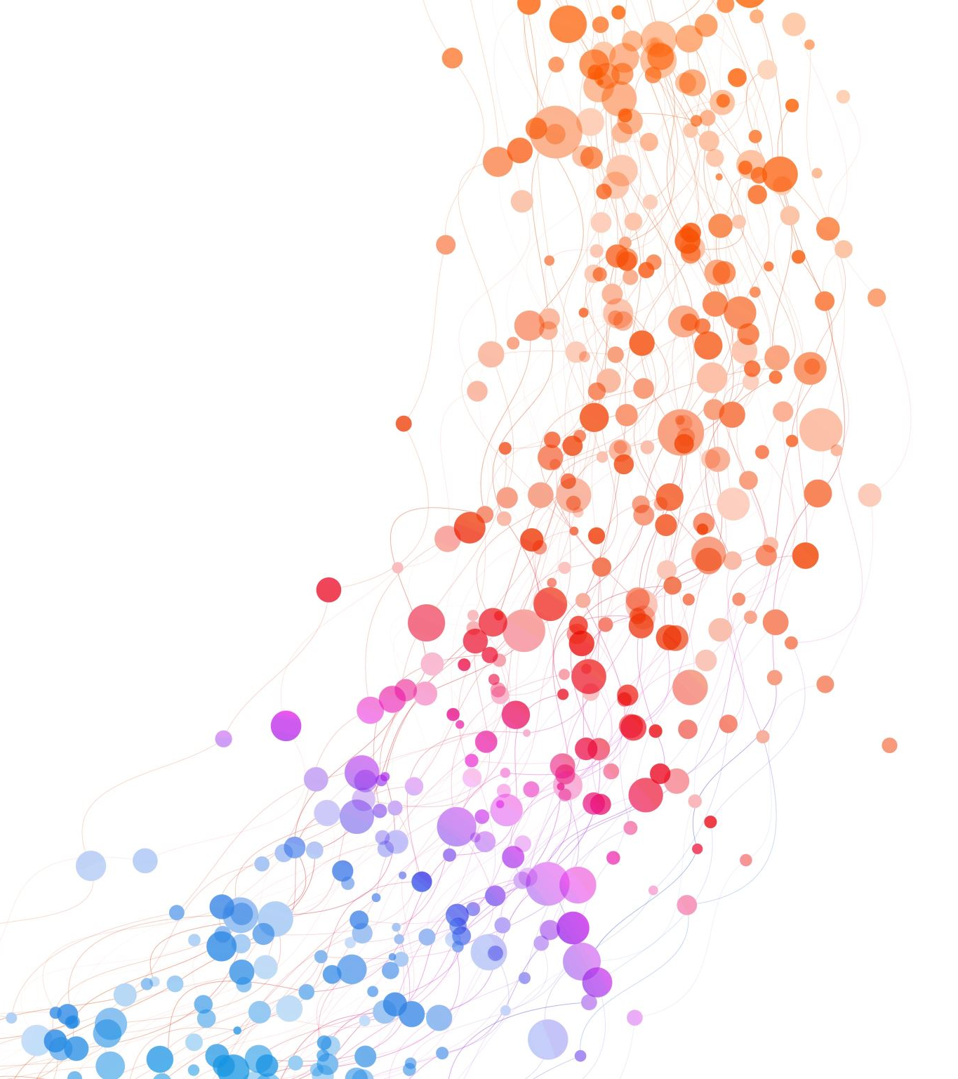
Plagiarism
To present someone else’s work or ideas as one’s own.

Slide 2
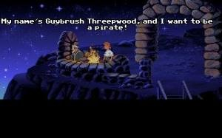
Cite when directly quoting more than two words
The etymology of the word plagiarism gives us an interesting way of perceiving the concept of plagiarism:“plagiarus means “kidnapper” in Latin; in antiquity, plagiarii were pirates who sometimes stole children” (Harvey 37).

Slide 3

What Is Plagiarism?
Using someone else’s ideas, words, or imagery in your own work is not wrong.
Not acknowledging who actually had the idea or did the work is.
In short, if you GIVE CREDIT TO THE SOURCE then it is not plagiarism. When you do not acknowledge a source, you are plagiarizing.
Whether or not it is an oversite or accident, it is still plagiarism.

Slide 4

Specific Examples of Plagiarism in Academic Writing:
Copying and pasting the full source text or a full block of text
Failing to cite where you borrowed from
Not using quotation marks around someone else’s words
Changing a few words and not citing
Paraphrasing and not citing
Using someone’s idea and not giving them credit for the idea explicitly

Slide 5

Plagiarism is Easy to spot
It does not clearly indicate borrowing from someone else.
Full of facts, observations, and ideas you could not have developed on your own.
Stylistic differences from your own.

Slide 6
How do you avoid Plagiarism?
In-text citation
This is where you integrate the source text with your own through the use of:
1) Quotations- (“put the words you copied in them”)
2) Paraphrasing-restate the source’s ideas in a way you find more accessible (then cite whose ideas they are in parentheses or the sentence itself with a phrase like, “According to Dr. Smith…”)
3) Summary- put forth the main ideas of your source (cite like paraphrasing)
Works Cited page
This is the final page of a chapter or book that lists the sources.

Slide 7
Types of Plagiarism:
Direct: copying word for word
Borrowing work from other students: Your friends essay used at another university is borrowed work. It is plagiarism.
Vague Citation: does not clearly indicate where borrowing ends and begins
Paraphrases and Summaries: Must be noted as such
To summarize the work of Dr. Smith:
Dr. Smith’s work is based on their idea that…
Patchwriting: rewording small blocks of the text and not citing. You can reword and use quotes around the bits you keep…think of these quotes as little sound bites, but you must cite your source

Slide 8

When not to cite- Common Knowledge
If it is your idea or it is something widely to be held as fact then you do not need to cite it. For instance, we all know that planes fly or that the Wright brothers invented the first plane. You do not need to cite this as it is common knowledge. However, if you did not know that they had created the first plane and you read an article about their methodology, then you would cite the source where you learned about them.

Slide 9
Proper Use of Sources
Go to https://owl.english.purdue.edu/owl/
Click on the style you are working with if it is MLA or APA. For other styles, like Chicago, just type the style name in the search bar.
The OWL will then break it down further on the lefthand side with options like In-text, Formatting Guidelines, Works Cited basics.
The OWL also has a YouTube page!
https://www.youtube.com/user/OWLPurdue

Slide 10

AI Rules Specific to this Class
Response paragraphs
AI cannot be used in weekly paragraphs at all. These must be handwritten, and I am far less concerned with minor errors in grammar and spelling than I am with critical thought, organizational structure, and MLA Citation. The goal is for you to develop the skills without assistance in small weekly low-stakes assignments. And for you to have enough experience to reflect on the cognitive difference that occurs when you handwrite versus when you type.
In Essays & Group Projects:
Use of Generative AI will be considered a violation of the Honor Code.
AI can only be used in an assistive manner-checking for grammar and spelling errors. But, be careful, many “assistive” AI resources like Grammarly have started to function in more generative ways that homogenize your voice and blur the line between Assistive and Generative.
Acknowledge Assistive AI in the Works Cited
  Note what program and version
  Note what prompt was used
Cite as correspondence or interview
  AI-generated text is non-recoverable

Slide 11

AI Policy in this Class
A primary learning goal in this course is to develop your skills in conveying complicated ideas in simple ways in writing and when speaking. Conveying ideas simply requires a strong understanding of concepts as well as clear and effective writing. These skills take time to develop and require repeated practice to hone. Emerging AI tools such as ChatGPT may assist someone who has not fully developed these skills, but using AI before giving yourself a chance to develop skills on your own takes away opportunities for learning and growth. For this reason, you may not use generative AI tools of any kind in this course.
All work submitted in this course must be your own. Contributions from anyone or anything else, including assistive AI sources, must be properly quoted and cited every time they are used. Failure to do so constitutes an academic integrity violation, in accordance with the College’s Honor Code.

Slide 12
Bryn Mawr Honor Code (2025)
Section IV.A.2f
Generative AI tools should not be used in the completion of any course assignments, exams, or written work, including laboratory work, unless an instructor for a given course has specifically and explicitly authorized their use for the assignment in question. Presenting AI-generated content as original student work, submitting AI-generated content without citing its source in artificial intelligence tools, and relying on generative AI tools for closed-book quizzes, tests, and exams all constitute violations of the Honor Code.

Slide 13
Works Cited
UL Lafayette. Freshman Guide to Writing. 7th ed. Fountainhead Press, 2016.
Harvey, Gordon. Writing with Sources: A Guide for Students. Hackett Publishing, 2017.

