Slide 1
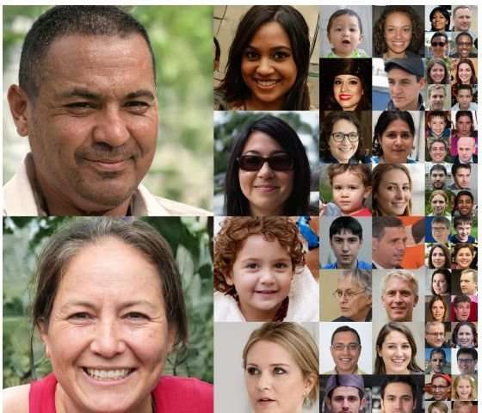
Being Human
Notes:
In order to understand what it is to be posthuman, we must understand what it is to be human.

Slide 2

Writing Prompt
How would you define “Human”? What do you think it means to be human?
Who has access to “humanity” and what are some examples of human beings being denied “humanity”?
Is humanity (humaness) different from personhood? And can these be granted to non-humans?
At this point, what do you think Posthuman means?

Slide 3
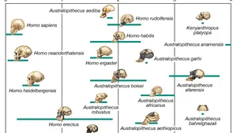
Etymology of “Human”(OED)
Origin: Of multiple origins. Partly a borrowing from French. Partly a borrowing from Latin. Etymons: French humain; Latin hūmānus.
Etymology: < (i) Anglo-Norman humeigne (feminine), humane (feminine), Anglo-Norman and Middle French humain, humayn (French humain ) of or belonging to people (as opposed either to animals or to God) (1119 in Anglo-Norman), having human nature or characteristics (c1170), composed of people (c1174), benevolent (c1175), having people (as opposed to God) as its subject (1552 in letres humaines)

Slide 4
“Human” A. adj. 1.
a. Of the nature of the human race; that is a human, or consists of human beings; belonging to the species Homo sapiens or other (extinct) species of the genus Homo.
1st noted use:
?c1450 tr. Bk. Knight of La Tour Landry (1906) 143 (MED) For the gret compassion and pitee that he hadde upon all humaigne lynage

Slide 5

“Human” (cont.)
b. Chiefly figurative. Designating a person who takes on the appearance or form, or who performs the function of a specified (esp. inanimate) thing; (also) designating a person who assumes the appearance, role, or abilities of a specified creature.
Frequently (esp. in the past) in the context of popular entertainment such as a circus or sideshow: Human Cannonball
Notable early usage:
[1746 Brit. Mag. Nov. 344/1 There is, in short, a Person..who calls himself the Man Ostrich; intending to shew himself for a Sight, as he can do like the Ostrich, eat and digest Iron.]

Slide 6

“Human” (cont.)
2. Of, relating to, or characteristic of humans as distinguished from God or gods; secular, not divine; (also) of or relating to the abilities or sphere of activity of human as opposed to supernatural beings; mundane, worldly; imperfect, fallible.
1st use: c1475 Life St. Anne (Trin. Cambr.) (1928) 492 When the moder of good, blessyd mary, That day she sprang in oure nature humayne.

Slide 7
3. Of, relating to, or distinctive of people as distinguished from other animals; of, relating to, or characteristic of the species Homo sapiens or other (extinct) species of the genus Homo.
Notable early use: 1575 E. Hake Commemoration Raigne Lady Elizabeth sig. C We were..brutishe as beastes in the olde age at the first callinge home of our grand Auncestors to human ciuilitye.

Slide 8
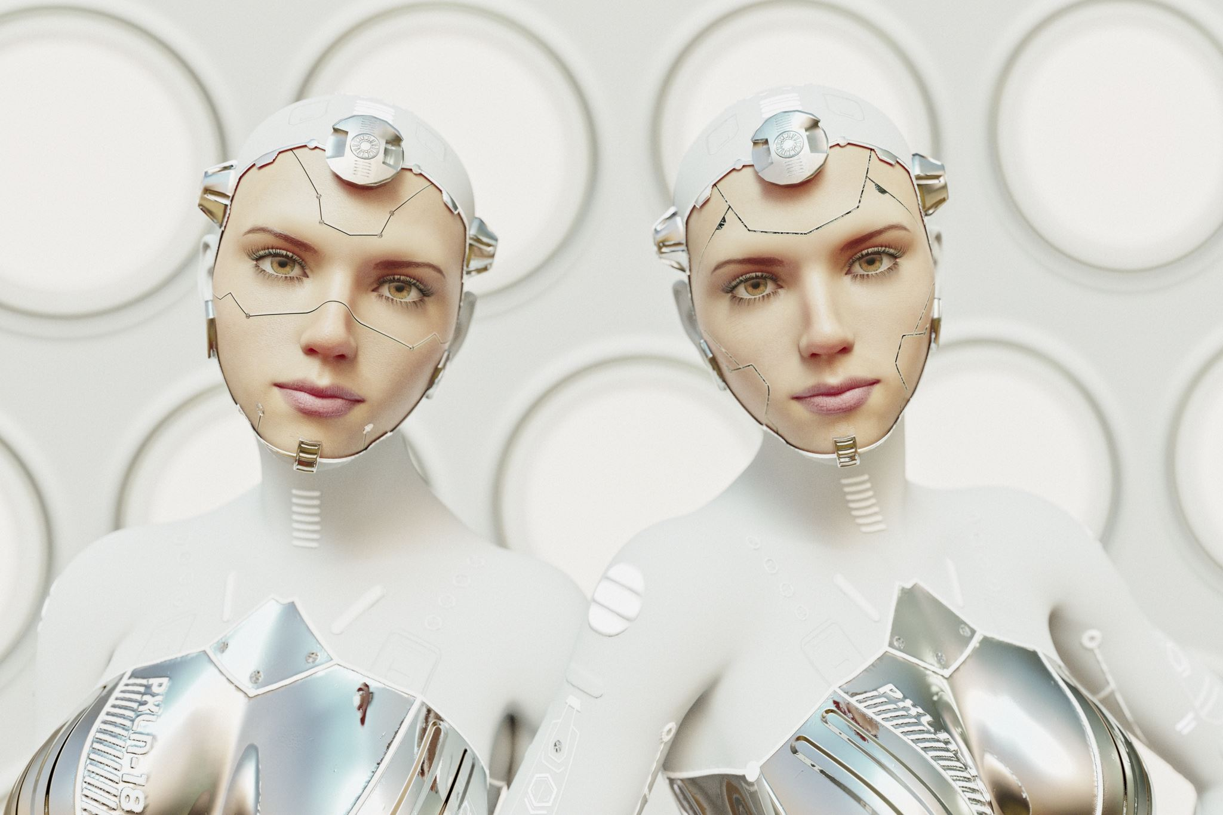
Enter Thinking Machines
Summary of the Prologue (xi–xiv)
A summary is a brief, concise explanation of a larger chunk of text. It should not contain evidence or quotes. In academic writing t’s useful for orienting your reader to a text they may not have read or don’t really remember.
Summarize in 2-4 sentences what you think the central idea is in the Prologue.
You can use the reading.
Notes:
Hayles posits that consciousness is impacted by its embodiment but also acknowledges disjunction and the impact of social constructs in the interpretation of performance. She argues that embodiment does not secure gender or personhood, but it is important to identity and lived experience-it can’t be totally disregarded.
Hayles argues that how we define what a human is necessarily shifts with advances in technology and cybernetics creating thinking machines. She explores how the boundaries between human/machine, mind/body, male/female, and material/virtual have become increasingly blurred which challenges the humanist ideology that places humans as the pinnacle of moral and intellectual capacity. The tension between virtual and material existence is also at the core of this text in her consideration of embodiment and performance.

Slide 9

Performance & Embodiment
What does it mean to “pose questions that can distinguish verbal performance from embodied reality[emphasis mine]”( Hayles xi)?
How does this connect to our current world? Can you always distinguish when you are talking to a bot vs. a real person? Does having to navigate the “are you human” question impact how you read and right in social spaces?

Slide 10
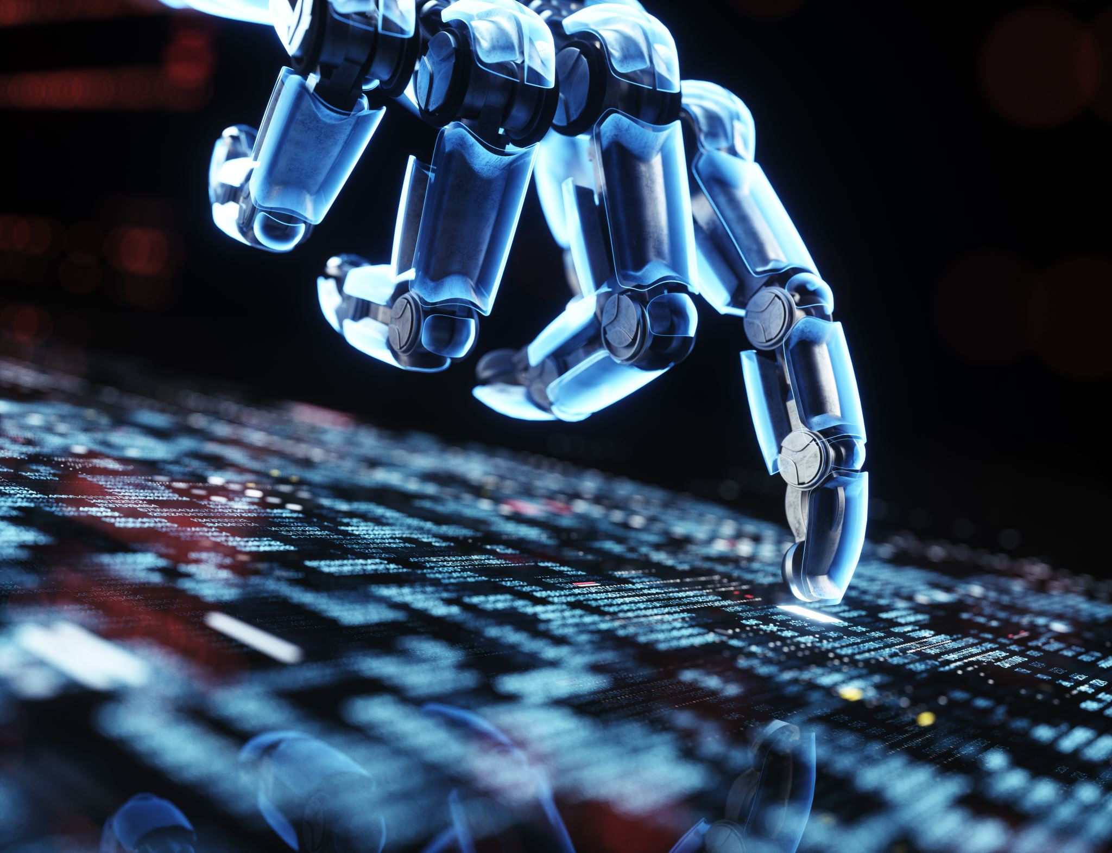
The Turing Test
We have been trying to achieve Thinking Machines since the 1950s. Is the Turing Test still valid? Would you agree we can no longer distinguish the “intelligent” (used liberally-AI is an algorithm) machine from an intelligent human? How do you think this test has limitations?

Slide 11
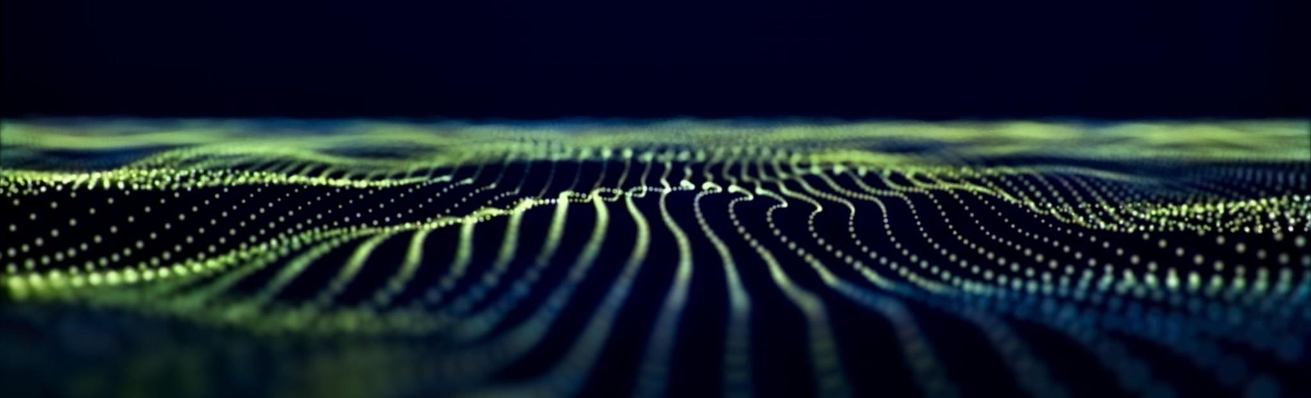
Disembodied Conceptual Information
Can information truly exist independently of its material form?
Moravec “proposed that human identity is essentially an informational pattern rather than an embodied enaction” (Hayles xii).
Do you agree?

Slide 12

Hodge’s Misreading & “Tension”
Hayles takes Hodge’s reading of Turing apart, partially (xiv).
How does she disagree with Hodge’s reading?
What does she think Hodge gets right and how is that central to her point?

Slide 13
Cyborgs
& the (potentially) changing definition of Human
Define Cyborg.
How do you interface with technology, with the “cybernetic circuit”?
Is your real world augmented with a virtual world?
Are we already cyborgs?
Does the “existence of thinking machines impact (or not impact) “what being human means” (Hayles xiv)?

Slide 14

Literature
Why might literature be important in understanding technological and philosophical shifts like the move toward posthumanism?

Slide 15
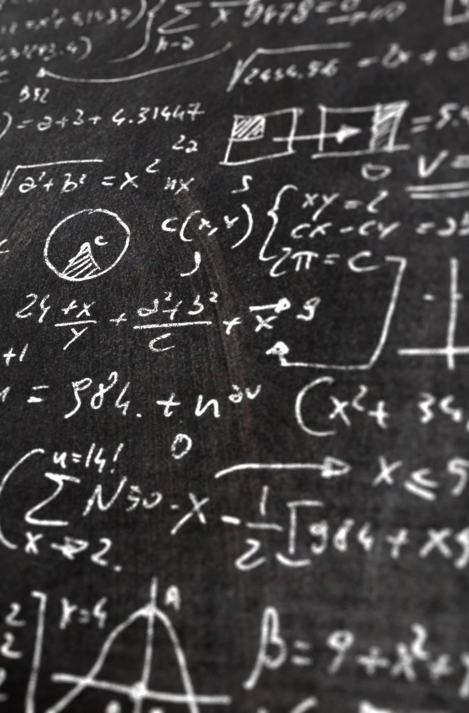
Journal -Hayles
Take any part of this discussion you want.
Locate and write a quote from Hayles as textual evidence to support your idea, include an MLA citation.
Ask Dr. Harper for help with MLA if you need it.

Slide 16
Works Cited
Hayles, N. Katherine. "How We Became Posthuman: Virtual Bodies in Cybernetics, Literature, and Informatics." (2000): 464.

