Slide 1
Geologic Time and The Solar System

Slide 2
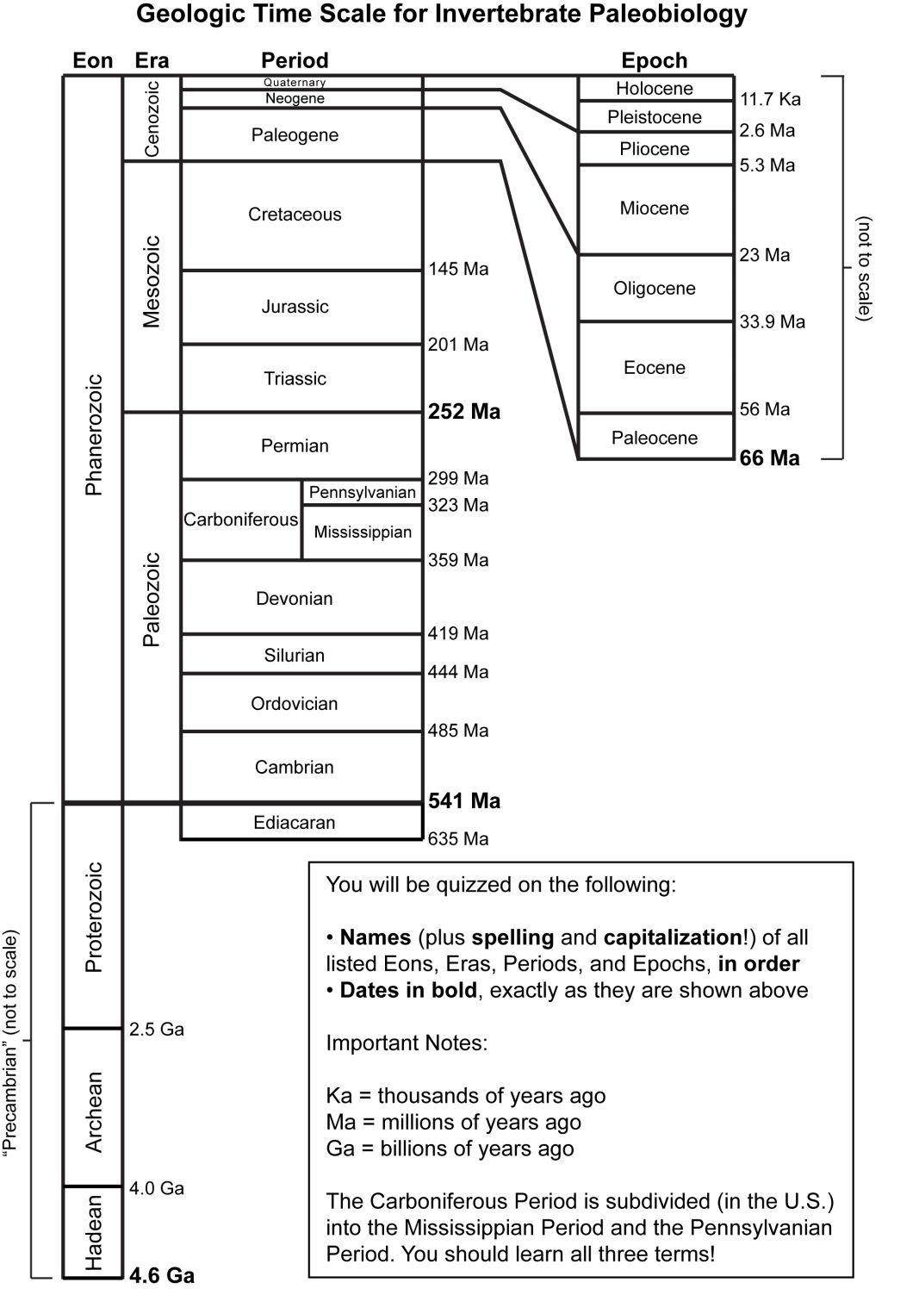
Geologic Time Scale
Required for GEOL 203:
  Eon names
  Era names
  Period names
  Epoch names
  dates
Spelling and capitalization count!

Slide 3
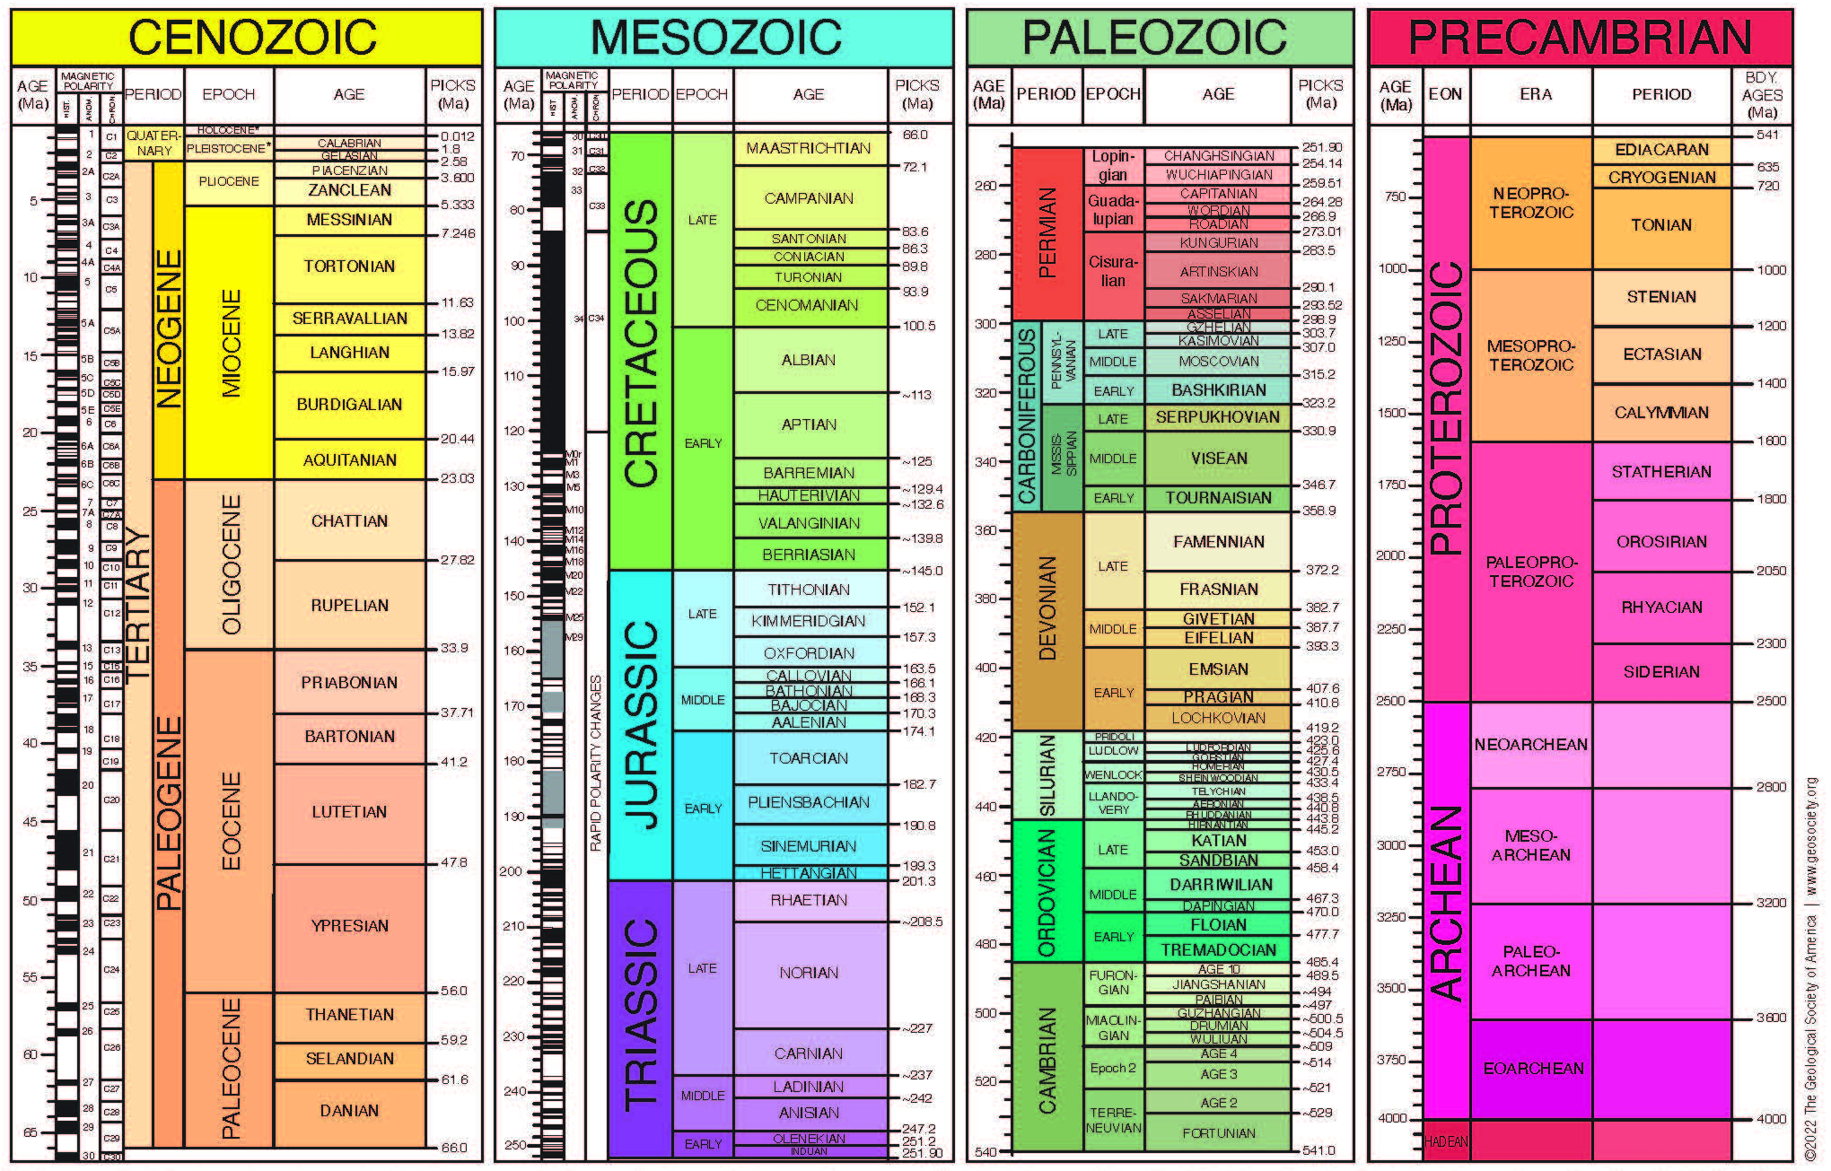
Phanerozoic Eon (Greek: “visible life”)
Notes:
Above is the 2022 Geologic Time Scale published by the Geological Society of America (PDF available at www.geosociety.org). There is much information on this chart—you can see numbers (dates) and a variety of time designations given unique names. The dates were determined using radiometric dating, which was only first utilized successfully in the mid 20th century with the invention of the mass spectrometer. However, for centuries before the discovery of radioactivity, geologists were able to construct the geologic timescale above without numbers by making stratigraphic correlations using fossils. The principle of biologic succession was based on the observation that similar fossil assemblages were found in different places. Rocks above these fossil assemblages contained different suites of fossils that could also be correlated to higher rocks in other places. It was assumed that the characteristic fossil assemblages were living at approximately the same time, and thus rocks with similar fossils must have been formed at about the same time. This is how the field of biostratigraphy was born. Without dates, the geologic time scale was constructed only using biostratigraphy.
Prior to the use of radiometric dating, fossils had not been found in rocks underlying the rocks from the Cambrian period. These fossil-less rocks were collectively known as “Precambrian”. Rocks Cambrian and younger were referred to as Phanerozoic, which in Greek means “visible life”. The Phanerozoic was then divided into the Paleozoic (“early animal life”), the Mesozoic (“middle animal life”), and the Cenozoic (“new animal life”). Fossils have since been found in late Precambrian rocks in what we now call the Neoproterozoic, or “new earlier life.” (Proterozoic means “earlier life”.)
Without fossils for correlation, the Precambrian is largely subdivided based on dates. There is more to come on that in subsequent slides.

Slide 4
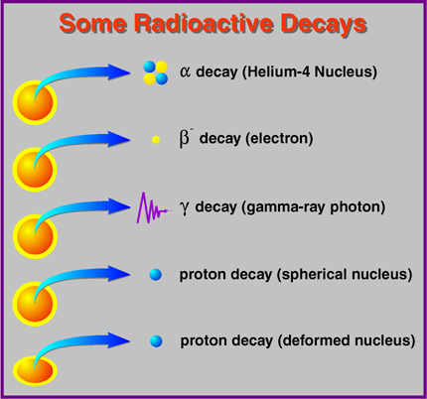
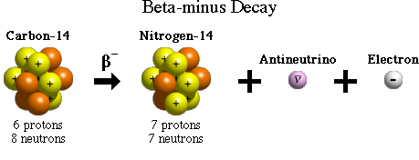
How we get dates: radioactive (unstable) isotopes
unstable
stable
Radioactive isotopes decay at steady, predictable rates.
Notes:
Radioactive isotopes are not stable isotopes because they can undergo decay. This decay will ultimately result in an atom that is stable. For example, ¹⁴C (which has 6 protons and eight neutrons) undergoes beta-minus decay in which a neutron turns into a proton and an electron—the electron is ejected out of the nucleus as radiation but the proton remains. The resultant nucleus now has 7 protons instead of 6 and now has 7 neutrons, which means that it is now an atom of nitrogen with a mass of 14. ¹⁴N does not undergo further decay and is thus considered stable.

Slide 5
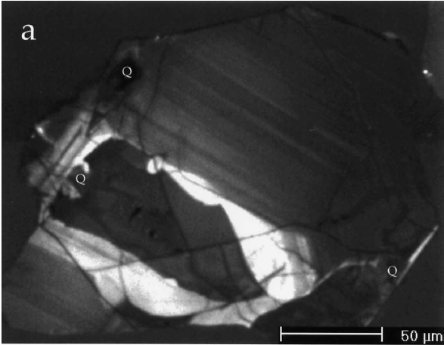
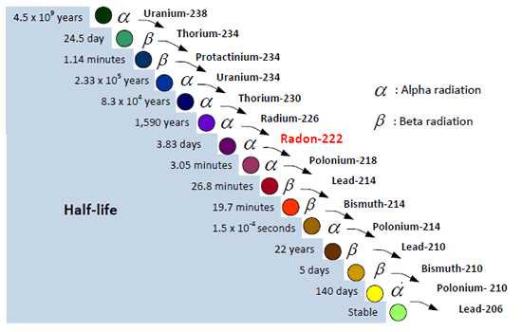
Radioactive (unstable) isotopes
Zircon (ZrSiO₄)
  when forming from a cooling igneous melt, allows U into crystal structure but not Pb
  U then decays to Pb with a half life of 4.5 billion years
  can measure ratio of U to Pb atoms to estimate how many half lives (or fractions thereof) have elapsed since the crystal formed
https://www.cnsc-ccsn.gc.ca/eng/resources/fact-sheets/radon-fact-sheet/
Notes:
Radioactive isotopes are not stable isotopes because they can undergo decay. This decay will ultimately result in an atom that is stable. For example, ¹⁴C (which has 6 protons and eight neutrons) undergoes beta-minus decay in which a neutron turns into a proton and an electron—the electron is ejected out of the nucleus as radiation but the proton remains. The resultant nucleus now has 7 protons instead of 6 and now has 7 neutrons, which means that it is now an atom of nitrogen with a mass of 14. ¹⁴N does not undergo further decay and is thus considered stable.

Slide 6
Where do we start?

Slide 7
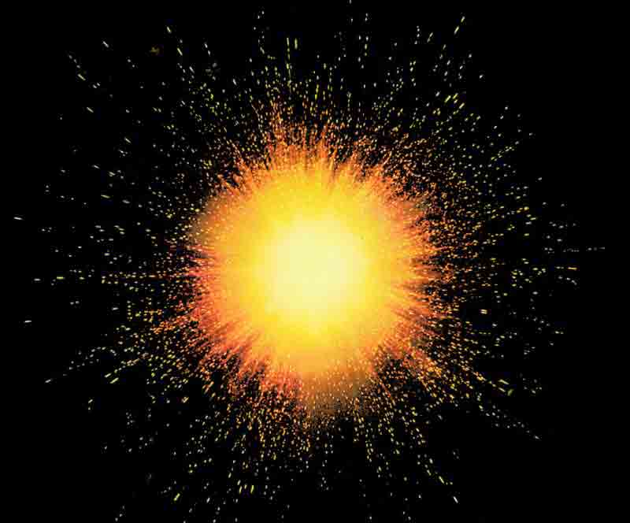
Origin of the Universe (“Big Bang”) ~13.7 Ga
+1 millionth of a second: protons (H nuclei, which make up ~74% of matter in the universe), neutrons, electrons become stable
+5 minutes: helium nuclei (which make up ~24% of matter in universe)
No heavier elements form until first stars appear ~1 billion years later

Slide 8
Origin of the Universe (“Big Bang”) ~13.7 Ga
How did/do heavier elements form?

Slide 9
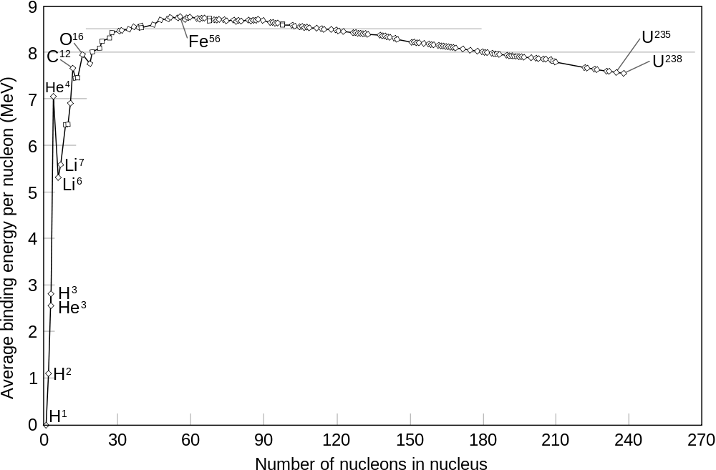
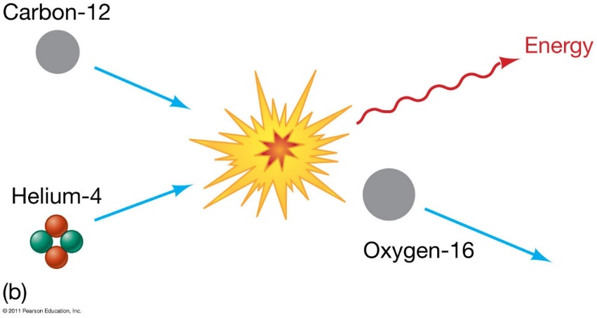
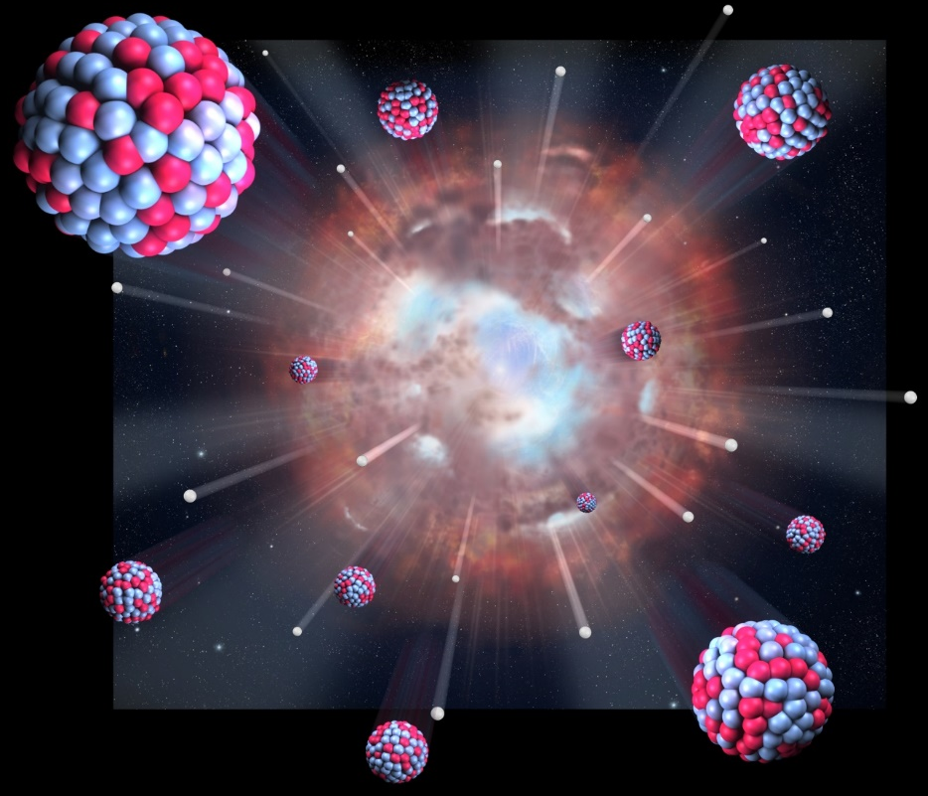
How did/do heavier elements form?
Nuclear fusion in stars (atoms colliding to form bigger atoms)
Neutron capture in stars and during supernovas (a nucleus captures one or more neutrons, which then changes into a proton via radioactive decay)
  the heaviest elements in existence form during supernovas
Notes:
Nuclear binding energy is how much energy is necessary to fully separate an atomic nucleus into its constituent protons and neutrons (nucleons). In the graph above, the relatively flat region of the curve includes larger nuclei in which the attracting and repelling forces are nearly in balance. This is why the trend does not continue to increase steeply, as it does for the smaller nuclei. As the nuclei become very large, the binding energy decreases because electromagnetic repelling forces overcome the strong nuclear (attracting) force. Iron and nickel have the highest binding energies of all naturally-occurring elements; atoms/isotopes of these elements are produced in large abundance during supernovas, which is why they are so commonly found in the cores of planets.

Slide 10
What happens in our Sun?
Our sun is hot and massive enough to burn hydrogen to produce helium via nuclear fusion.
The Sun uses neutron capture to produce heavier elements, up to Bismuth-209, but not the heaviest elements.

Slide 11
The Solar System

Slide 12
Solar system forms ~4.56 Ga (based on chondritic meteorites)
An ancient star went supernova, leading to a massive cloud of matter and heat
Neutron capture during this explosive event led to the formation of even the heaviest elements in our solar system
Notes:
Formation of a solar system may be triggered by the explosion of a supernova. Our solar system formed when an ancient star went supernova. The matter released from the explosion eventually coalesced into a disk and then into a central star and planets.

Slide 13
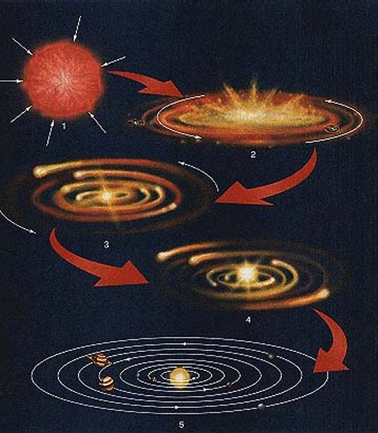
Solar system forms ~4.56 Ga (based on chondritic meteorites)
Very hot (1000s K) near center of spinning disk. Materials with high boiling/sublimation points (e.g. Fe, Ni) concentrated near center (the sun). Nuclear fusion of H began when temp reached ~10,000,000 K
The edge of the disk was cooler such that water, ammonia, and methane ices made up the outer planetary materials
Ultimately metal-rich planets ended up near Sun, silicate- (SiO₂)-rich in the middle, and gas-rich at outer edges of solar system due the Sun’s gravity
Notes:
Formation of a solar system may be triggered by the explosion of a supernova. Our solar system formed when an ancient star went supernova. The matter released from the explosion eventually coalesced into a disk and then into a central star and planets.

Slide 14
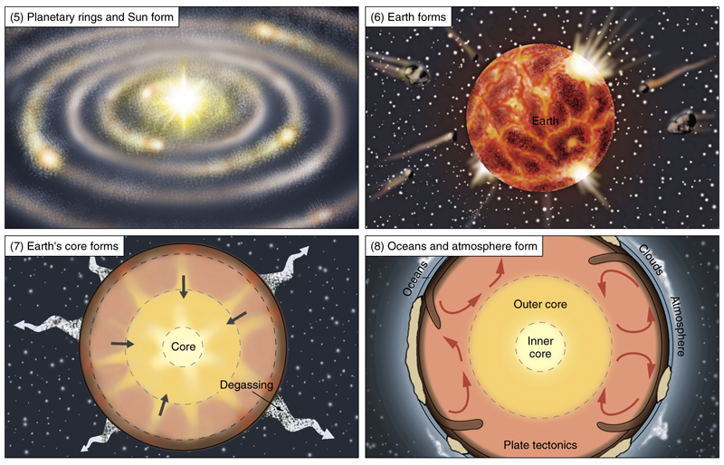
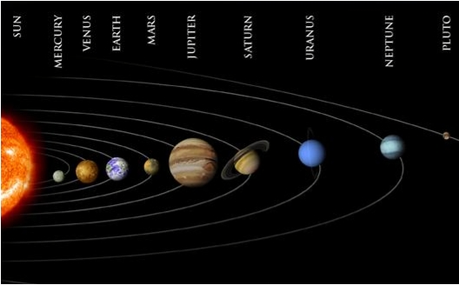
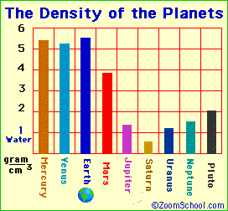
Formation of Planets 4.56 Ga
We end up with a divide between the inner rocky planets and the outer gaseous planets.
The inner planets are much denser than the outer planets.
Inner rocky
Outer gaseous
Notes:
In a geologic sense, the planets formed into distinct bodies shortly after the formation of the sun. Because of the Sun’s gravitational pull, the inner planets are formed from much denser material than the outer four planets—these are the inner rocky planets and outer gaseous planets, respectively.

Slide 15
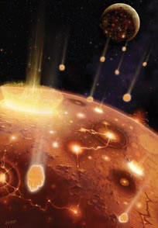
Formation of Planets 4.56 Ga
The early Earth was constantly bombarded by extraterrestrial material. These collisions would have brought new energy to Earth and kept its surface in a molten state (no crust).
Notes:
When Earth was first formed, it was constantly being bombarded by extraterrestrial material, which brought enough energy to the planet to keep it in a molten state, without a crust.

Slide 16
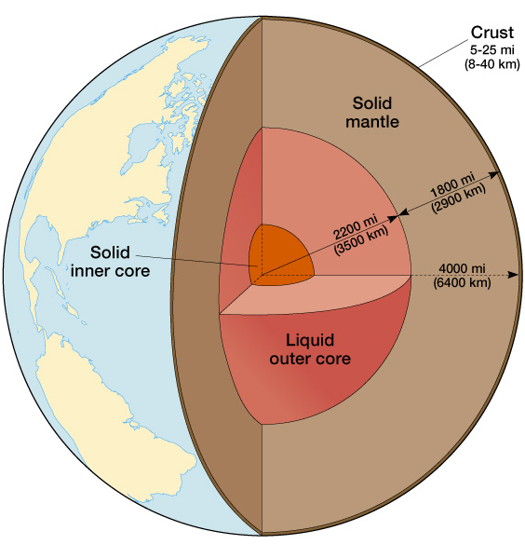
Differentiation of inner Earth ~4.5 Ga
O, Si
Over time, the denser material on Earth moved to the center of the planet, forming a core made of iron and nickel and a mantle made of oxygen, silicon, and magnesium (no crust yet, but rather a magma ocean)
X
O, Si, Mg
Fe, Ni
Notes:
Over time, a distinct core formed from the denser of the abundant elements on Earth.

Slide 17
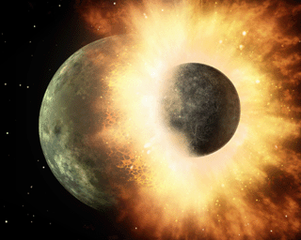
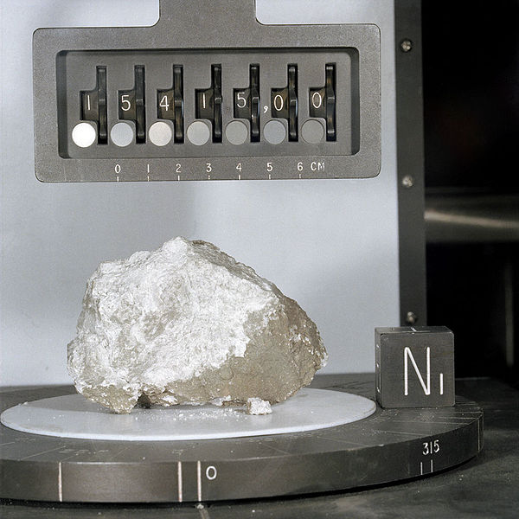
Formation of the Moon 4.46 Ga
The moon was likely formed by the collision of a Mars-sized object with Earth. Molten material from Earth’s magma ocean or thin early crust (and possibly the impactor’s mantle) were ejected into space and captured by Earth’s gravity.
We know this because the Moon’s surface is largely made up of a rock called anorthosite, which is almost entirely plagioclase feldspar. Geologists think anorthosite is much less likely to form now that Earth is fully differentiated into layers (the majority of anorthosite found on Earth is billions of years old).
http://en.wikipedia.org/wiki/File:Giantimpact.gif
Anorthosite moon rock
Notes:
Sometime around 4.5 billion years ago, while the Earth’s magma ocean was starting to cool to form a crust, a large planetary body the size of Mars or larger is believed to have crashed into Earth. Material from the impactor’s mantle was ejected into space. This ejected material subsequently condensed under its own gravity to form the Moon, which was kept in orbit around Earth by Earth’s gravity. Supporting evidence for this hypothesis are rocks brought back from the moon which can be classified as anorthosite, an igneous rock consisting of a high abundance of plagioclase feldspar. The only rocks on Earth today that are anorthosite are Archean and Proterozoic in age—billions of years old. It is believed that melts that formed anorthosite ceased to exist after the Earth fully differentiated itself into core, mantle and crust. The moonrocks themselves have been dated to 4.46 Ga. It is thought that the energy from the impact melted the thin crust that had just started to form.

Slide 18
Formation of the Moon 4.46 Ga
In magmas, plagioclase is among the first minerals to form. Because plagioclase crystals are less dense than other chemical components, they tend to float to the top of the magma. Because most magmas are turbulent, plagioclase usually gets mixed and diluted by other minerals before the magma solidifies. However, in the case of a magma ocean, plagioclase would float to the top and accumulate near the surface, eventually becoming lithified as anorthosite.
http://en.wikipedia.org/wiki/File:Giantimpact.gif
Anorthosite moon rock
Notes:
Sometime around 4.5 billion years ago, while the Earth’s magma ocean was starting to cool to form a crust, a large planetary body the size of Mars or larger is believed to have crashed into Earth. Material from the impactor’s mantle was ejected into space. This ejected material subsequently condensed under its own gravity to form the Moon, which was kept in orbit around Earth by Earth’s gravity. Supporting evidence for this hypothesis are rocks brought back from the moon which can be classified as anorthosite, an igneous rock consisting of a high abundance of plagioclase feldspar. The only rocks on Earth today that are anorthosite are Archean and Proterozoic in age—billions of years old. It is believed that melts that formed anorthosite ceased to exist after the Earth fully differentiated itself into core, mantle and crust. The moonrocks themselves have been dated to 4.46 Ga. It is thought that the energy from the impact melted the thin crust that had just started to form.

Slide 19
Formation of the Moon 4.46 Ga
If the moon had merely been a space rock captured by Earth’s gravity, there would have been no mechanism on it to produce anorthosite.
The prevalence of anorthosite on the Moon’s surface strongly suggests that the Moon once had a magma ocean, which would have been the case if it had cooled from an accumulation of impact ejecta.
http://en.wikipedia.org/wiki/File:Giantimpact.gif
Anorthosite moon rock
Notes:
Sometime around 4.5 billion years ago, while the Earth’s magma ocean was starting to cool to form a crust, a large planetary body the size of Mars or larger is believed to have crashed into Earth. Material from the impactor’s mantle was ejected into space. This ejected material subsequently condensed under its own gravity to form the Moon, which was kept in orbit around Earth by Earth’s gravity. Supporting evidence for this hypothesis are rocks brought back from the moon which can be classified as anorthosite, an igneous rock consisting of a high abundance of plagioclase feldspar. The only rocks on Earth today that are anorthosite are Archean and Proterozoic in age—billions of years old. It is believed that melts that formed anorthosite ceased to exist after the Earth fully differentiated itself into core, mantle and crust. The moonrocks themselves have been dated to 4.46 Ga. It is thought that the energy from the impact melted the thin crust that had just started to form.

Slide 20
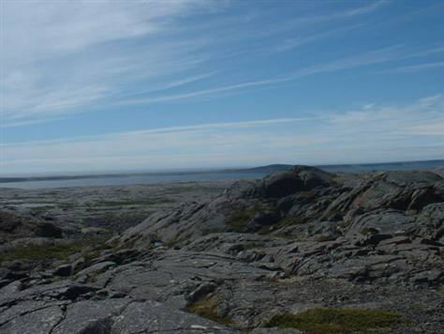
Oldest Rock
The oldest rock is dated between 3.8 and 4.28 Ga from the Nuvvuagittuq greenstone belt (metamorphic rocks) in Hudson Bay, Quebec.
The former oldest rock was a 3.96 Ga gneiss from Canada.
Thus, we place the base of the Archean at about 4 Ga to mark the origin of Earth’s rocky crust.
Phanerozoic
0.5 Ga
Proterozoic
2.5 Ga
http://www.msnbc.msn.com/id/26890176/
3.8-4.28 Ga (Sm-Nd)
Nuvvuagittuq greenstone belt
Hudson Bay, Quebec
Archean
4.0 Ga
Hadean
4.6 Ga
Notes:
The oldest rocks have been dated as 3.8 to 4.28 Ga using Samarium-Neodymium dating from the Nuvvuagittuq greenstone belt (metamorphic rock) in Quebec.
The former oldest rock was dated as almost 4 billion years old. It is a 3.96 billion year old gneiss from Canada that contains datable zircons. For this reason, the base of the Archean is put at around 4 Ga.

Slide 21
Atmosphere, Crust and Ocean earlier than 4 Ga
Historically, it was thought that Earth had a crust by about 4 Ga because the oldest rocks are about that age. Thus, 4 Ga became the boundary between the Hadean (when Earth was thought to have been molten) and the Archean. But….
Phanerozoic
0.5 Ga
Proterozoic
2.5 Ga
Archean
4.0 Ga
Hadean
4.6 Ga
Notes:
The base of the Archean is approximately four billion years ago, when the Earth first formed an atmosphere, crust and ocean. The crust formed as the surface layer of the Earth cooled to form rock. The gases to form the atmosphere came from the Earth’s molten interior in the form of volcanic degassing.

Slide 22
Jack Hills Zircons: suggest crust and water during Hadean
Phanerozoic
0.5 Ga
Detrital zircons (minerals weathered from pre-existing rocks) have been dated to 4.36 Ga (error within 4.0 and 4.4 Ga)
Geochemical analyses suggest these zircons formed from recycling of crust that had been exposed to liquid water. What does this mean for the age of the oldest crust?
Proterozoic
2.5 Ga
Archean
4.0 Ga
Oldest zircons: 4.36 Ga from W. Australia, obtained from a 3.0 Ga sandstone
Hadean
4.6 Ga
Notes:
During the Hadean, the Earth had not yet cooled down to form a solid crust and ocean. However, detrital zircons (i.e., transported sediments) in a 3.0 Ga sandstone give an age of greater than 4.0 but less than 4.4 Ga, suggesting that there was a crust and hydrosphere by the late Hadean. This data was controversial and most geologists still placed the formation of the crust and the base of the Archean (~4.0 Ga) until 2014 when a new study demonstrated that the age of the zircon was indeed robust.

Slide 23
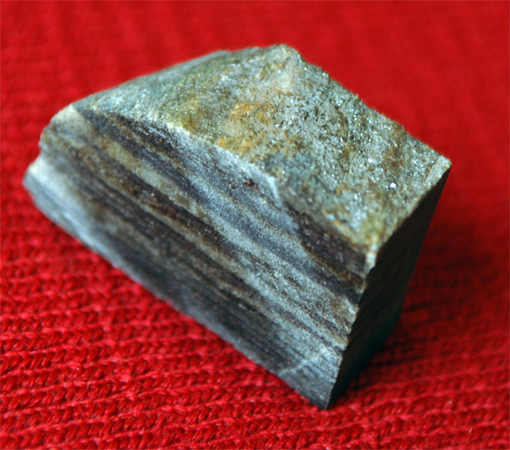
The oldest sedimentary rock is a 3.75 Ga banded iron formation from Canada.
Why should we care about the oldest sedimentary rock?
Phanerozoic
0.5 Ga
Proterozoic
2.5 Ga
Archean
4.0 Ga
Hadean
4.6 Ga
Notes:
The age of the oldest known sedimentary rock is of extreme importance because sedimentary rocks are the only rocks that can contain fossils, and thus the search for the earliest life on Earth is constrained by the earliest sedimentary rocks.

Slide 24
Where did the gases in the atmosphere come from?
Atmosphere, Crust and Ocean earlier than 4 Ga
Phanerozoic
0.5 Ga
Proterozoic
2.5 Ga
Archean
4.0 Ga
Hadean
4.6 Ga
Notes:
The base of the Archean is approximately four billion years ago, when the Earth first formed an atmosphere, crust and ocean. The crust formed as the surface layer of the Earth cooled to form rock. The gases to form the atmosphere came from the Earth’s molten interior in the form of volcanic degassing.

Slide 25
Where did the gases in the atmosphere come from?
  Volcanism
It is thought that water could accumulate as soon as the crust formed.
  Where did Earth’s water come from?
Atmosphere, Crust and Ocean earlier than 4 Ga
Phanerozoic
0.5 Ga
Proterozoic
2.5 Ga
Archean
4.0 Ga
Hadean
4.6 Ga
Notes:
The base of the Archean is approximately four billion years ago, when the Earth first formed an atmosphere, crust and ocean. The crust formed as the surface layer of the Earth cooled to form rock. The gasses to form the atmosphere came from the Earth’s molten interior in the form of volcanic degassing.

Slide 26
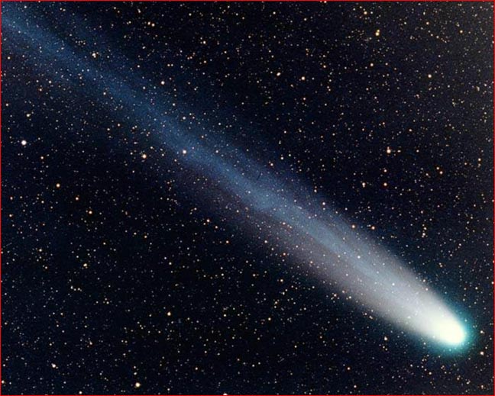
Oceans?
One hypothesis is that Earth’s water also came from volcanism.
Most Earth scientists now believe that most of Earth’s water likely came from a combination of comets (which are made of ice) and volcanism.
Ice from comets? Water from volcanoes?
Notes:
The water to form the ocean came mostly from bombardment of the Earth by comets, which are made of ice.

Slide 27
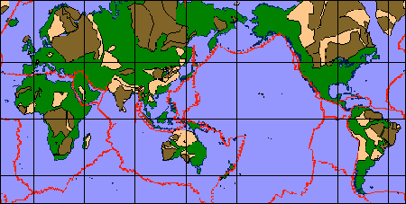
Formation of continents
We know that by the Archean, the oldest parts of the continents had formed. These old rocks are now found in the interiors of the continents and are dated to the Archean and Proterozoic.
What does the green represent?
Cratons
Brown = Archean
Tan = Proterozoic

Slide 28
Formation of continents
We know that by the Archean, the oldest parts of the continents had formed. These old rocks are now found in the interiors of the continents and are dated to the Archean and Proterozoic.
What does the green represent?
  The green is younger material that was accreted onto the continents by plate tectonics.
Cratons
Brown = Archean
Tan = Proterozoic
Notes:
The continents as we know them today have not always contained the same amount of material. Rather, all continents consist of an ancient root known as the craton which contains rocks that are billions of year old. It is believed that the cratons are the earliest formed continental material to which plate tectonics has been adding material for billions of years.

