Slide 1
Biosignatures: What is life?

Slide 2
The Origin Of Life
Phanerozoic
0.5 Ga
Proterozoic
?
Review some important dates about early Earth
2.5 Ga
Archean
4.0 Ga
Hadean
4.6 Ga

Slide 3
The Origin Of Life
Phanerozoic
0.5 Ga
The search for the origin of life on Earth is constrained to the past ~3.8 billion years because of the age of our oldest sedimentary rock.
It is possible that life existed earlier, as long as there was a crust and a hydrosphere.
Proterozoic
?
2.5 Ga
Archean
(3.8-3.5)
4.0 Ga
Hadean
4.6 Ga

Slide 4
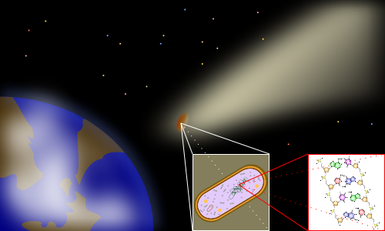
Panspermia
The Panspermia hypothesis is that life evolved elsewhere in space and was brought to Earth by comets and meteorites.
We know that microbes are very hardy and can likely survive in space.
Although there are some proponents, panspermia is not widely accepted.

Slide 5

The Primordial Soup - the Heterotrophic Theory

Slide 6
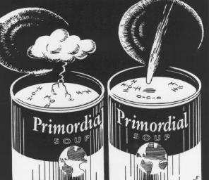
The Primordial Soup - the Heterotrophic Theory
Originally proposed in the 1920s separately by Oparin (USSR) and Haldane (UK). Argues that there were inorganic compounds on early Earth that could have reacted to form the organic compounds that form the building blocks of life.
“When ultra-violet light acts on a mixture of water, carbon dioxide, and ammonia, a vast variety of organic substances are made, including sugars and apparently some of the materials from which proteins are built up. [...] before the origin of life they must have accumulated till the primitive oceans reached the consistency of hot dilute soup.” – Haldane, “The Origin of Life,” 1929

Slide 7
The Primordial Soup - the Heterotrophic Theory
In this theory, heterotrophs evolved first (before photosynthesis) and ate the organic compounds in the primordial soup. Photosynthesis evolved later as a more complex metabolism.

Slide 8
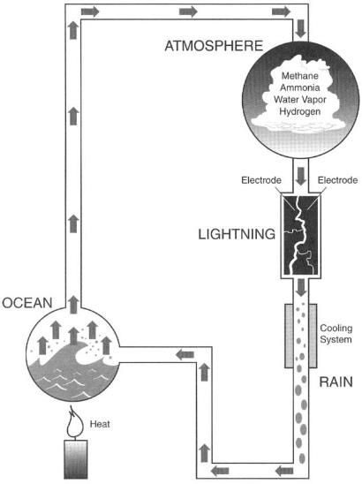
Miller-Urey experiment
1953
In 1953, Harold Urey and Stanley Miller performed a landmark experiment wherein they were able to synthesize organic compounds under conditions that are believed to have existed on the early Earth: a methane-rich atmosphere with ammonia, water vapor and hydrogen.
They hypothesized that lightning (in the laboratory they used electrodes to produce a current) could have provided sufficient energy to synthesize the building blocks of life on the early Earth.

Slide 9
Miller-Urey experiment
1953
The experiment produced amino acids, which are the building blocks of proteins.
They were not able to synthesize the more complex building blocks of DNA/RNA.
Amino acids produced!
(BUT… no DNA/RNA building blocks)

Slide 10

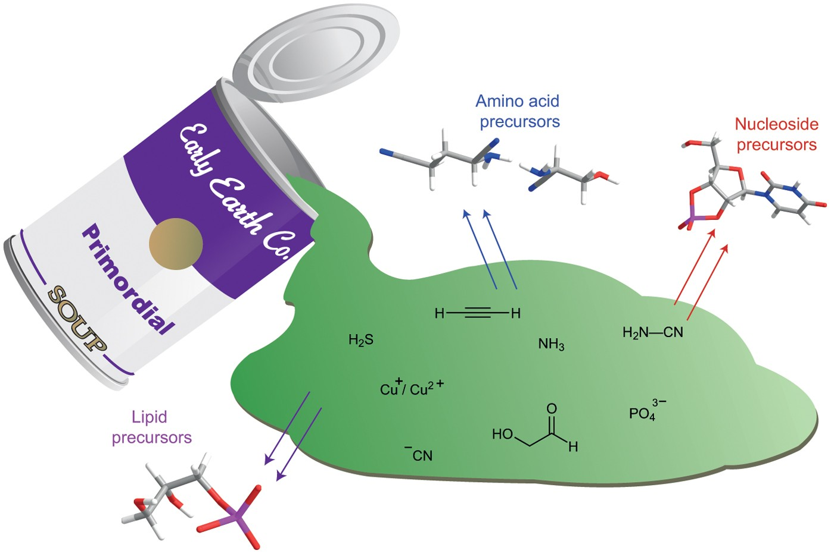
A 2015 Primordial Soup Update
A problem with evolving the first life was how to generate the different types of compounds required for life from the same soup: information molecules (nucleic acids), structure molecules (proteins), energy molecules (lipids).
In 2015, Patel et al. showed that precursors of nucleic acids (e.g. RNA, DNA), plus amino acids and lipids, can be generated from the following simple ingredients:
  Hydrogen cyanide (HCN), abundant in comets
  Hydrogen sulfide (H₂S), likely abundant on early Earth (e.g., volcanic gas)
  Ultraviolet (UV) light, plentiful at Earth’s surface
  Metal-bearing minerals as catalysts for reactions
Patel et al., 2015
Figure from Bracher 2015, Nature Chemistry
https://www.nature.com/articles/nchem.2219

Slide 11
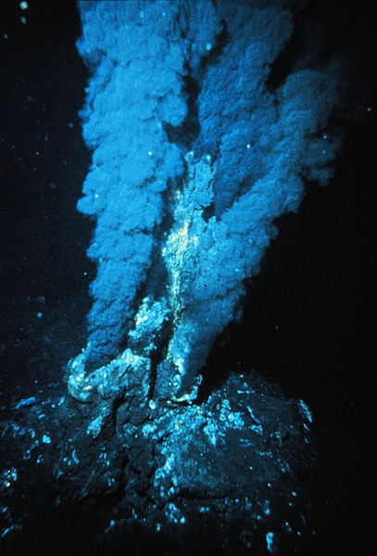
Hydrothermal Vents at Mid-Ocean Ridges
There is also the question of where life evolved. Hot springs on continents? Caves? Ocean hydrothermal vents?
One issue life had to overcome was the abundant UV radiation that would have been present before the atmosphere was fully formed.
Ocean hydrothermal vents would be places where UV could not penetrate.

Slide 12
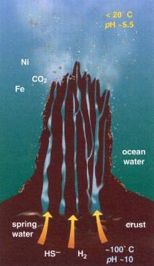
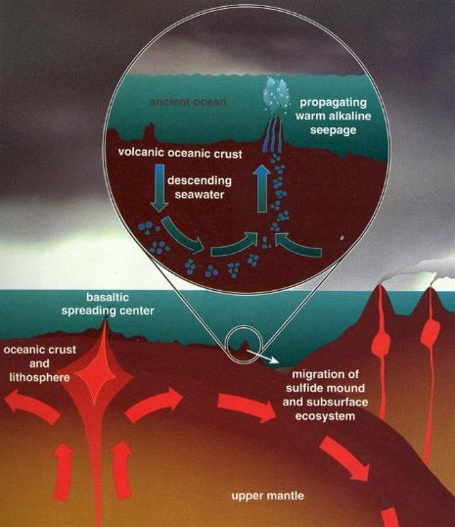
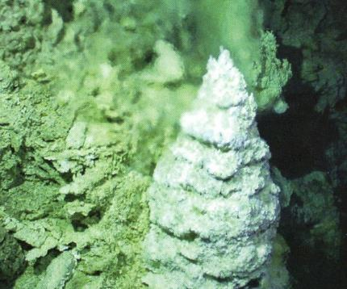
Hydrothermal Vents
(2-20°C)
At mid-ocean ridges, seawater flows into cracks in the young basaltic seafloor and gets heated by the magmatism associated with spreading. The hot fluids interact with the basalt and leach chemicals from it. The waters then return to the surface of the seafloor where the sudden decrease in temperature causes minerals to precipitate.
(100-464°C)

Slide 13
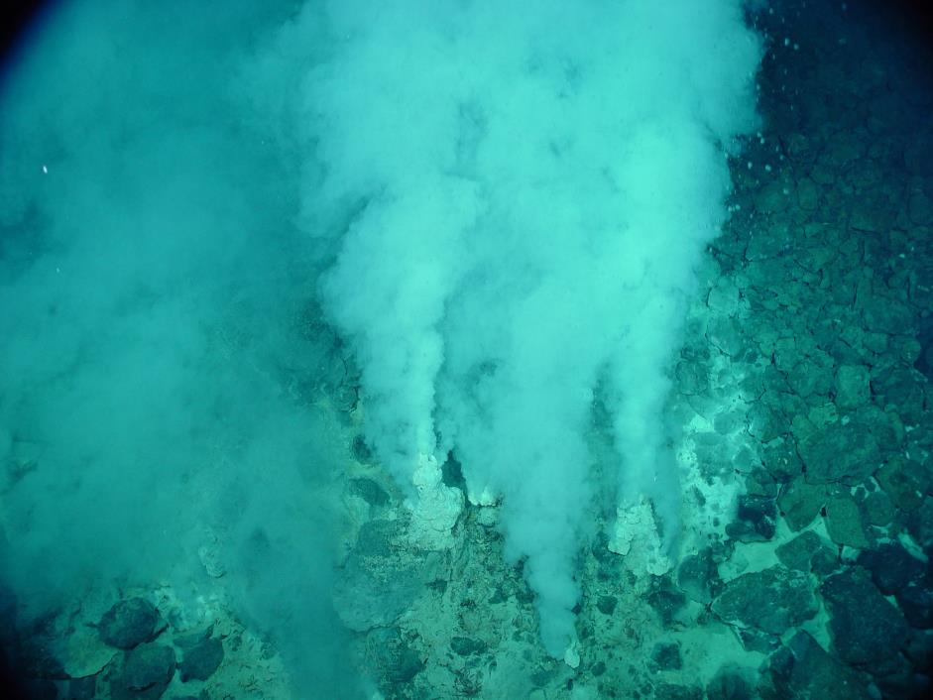
The new minerals form chimneys that spew “smoke” (not really smoke, just minerals precipitating) that is either black or white.
White smokers form gypsum (CaSO₄) and barite (BaSO₄).
Black smokers produce dark minerals like pyrite (FeS₂) and manganese oxides.
Chimney

Slide 14
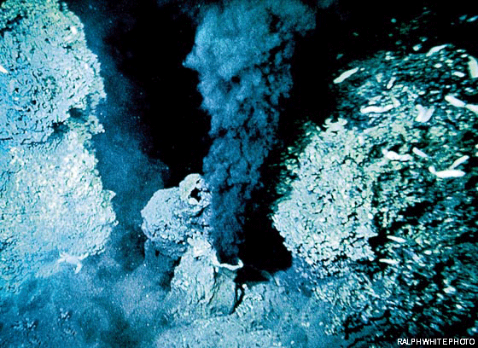
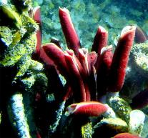
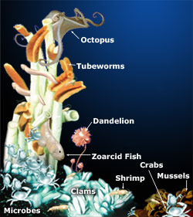
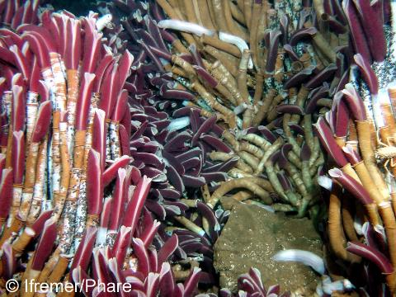
Did Life Start at Hydrothermal Vents?
Diverse ecosystems exist at modern ocean vents. They are based on chemosynthesis, not photosynthesis.
E.g, 18H₂S + 6CO₂ + 3O₂ → C₆H₁₂O₆ (carbohydrate) + 12H₂O + 18S
Microbes get energy from this or other reactions and become the base of the food chain.
If this metabolism evolved first, photosynthesis would have come later…but how?

Slide 15
Evidence for earliest life?

Slide 16
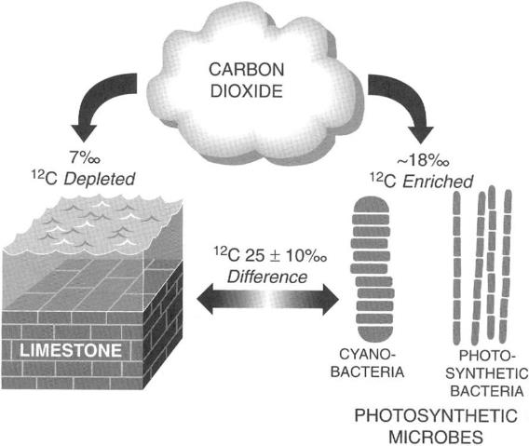
During photosynthesis, inorganic carbon in the form of carbon dioxide is consumed by organisms and converted into organic carbon. The photosynthesis reaction has a strong preference for the lighter isotope, ¹²C, meaning that organic matter is highly enriched in ¹²C and highly depleted in ¹³C, the heavier isotope. This isotopic fractionation is anywhere from 15-35 permil (‰, or parts per thousand).
Geologists can look for this signature of photosynthesis in ancient rocks by analyzing the carbon isotopic composition of inorganic carbon and organic matter in limestones.
Higher δ¹³C
Lower δ¹³C
Δδ¹³C=25‰
We can measure δ¹³C of both inorganic carbon (carbonate minerals) and organic carbon (organic matter), both of which are preserved in limestones.

Slide 17
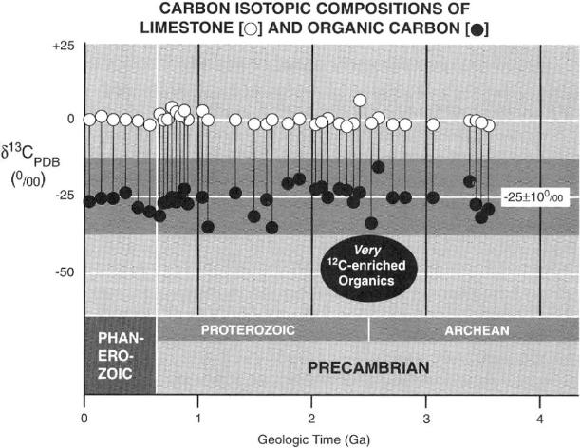
The chemical signature for photosynthesis is detected in rocks going back to 3.5 Ga. There is questionable data from 3.8 Ga that suggests that photosynthesis may have existed that far back—questionable because there is no limestone preserved from that age, so there is no white dot in the figure. However, the ratio of carbon in the organic matter from that age is similar to that of younger rocks.
Phanerozoic
0.5 Ga
Proterozoic
2.5 Ga
Archean
(3.8?-3.5)
Chemical signature for photosynthesis:
at least 3.5 Ga
4.0 Ga
Hadean
4.6 Ga

Slide 18
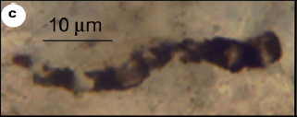
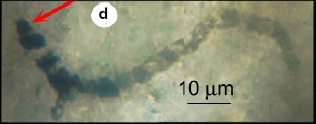
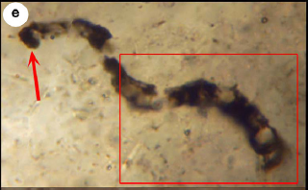
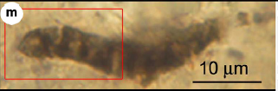
First body fossils?
The oldest putative body fossils are cyanobacteria-like fossils from the Australian craton.
Phanerozoic
0.5 Ga
Proterozoic
Cyanobacteria-like microfossils
3.465 Ga Apex Chert, Australia
Controversial!
2.5 Ga
These fossils have been interpreted as pseudofossils by some, but so far they have withstood criticism.
(3.5 Ga)
Archean
4.0 Ga
Hadean
4.6 Ga

Slide 19
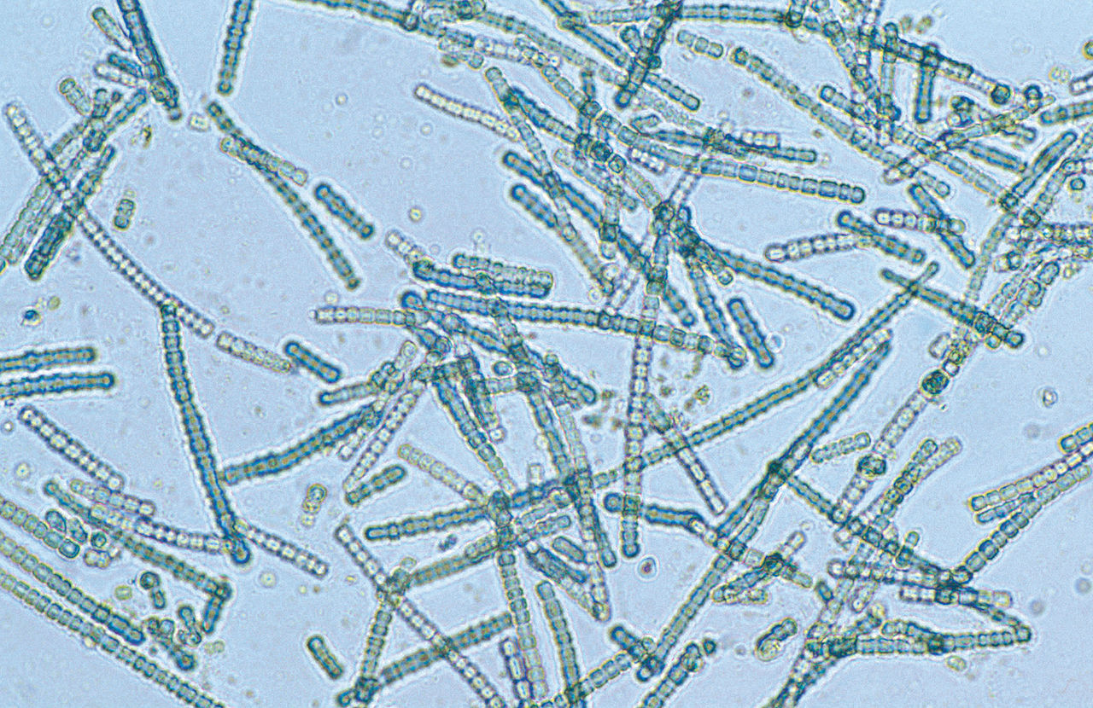
Cyanobacteria-like microfossils
3.465 Ga Apex Chert, Australia
Modern cyanobacteria
Photo by CSIRO, CC BY 3.0, https://commons.wikimedia.org/w/index.php?curid=35480947
Critics pointed out that some of the fossils (not included in the original publication) appeared to branch, unlike known cyanobacteria. The proponents developed new microscopy techniques to demonstrate that “branches” were actually one individual folded over on itself.
Proponents then used new geochemical techniques to show that the fossils had a much higher abundance of organic carbon than the surrounding rock.

Slide 20
The main critics of the Apex Chert fossils have their own candidates for first life…also from Australia, but slightly younger.
Phanerozoic
0.5 Ga
Proterozoic
(Wacey et al., 2011 Nature Geoscience)
2.5 Ga
The Strelley Pool Chert (3.4 Ga) contains spherical and tube-like structures preserved in part with pyrite crystals that may have formed due to a metabolism that consumes sulfate to make sulfide, called sulfate reduction. The walls of these structures also have elevated levels of carbon and nitrogen, which could indicate that they are biogenic.
However, there are other ways to generate such forms.
(3.4 Ga)
Archean
4.0 Ga
Hadean
4.6 Ga

Slide 21
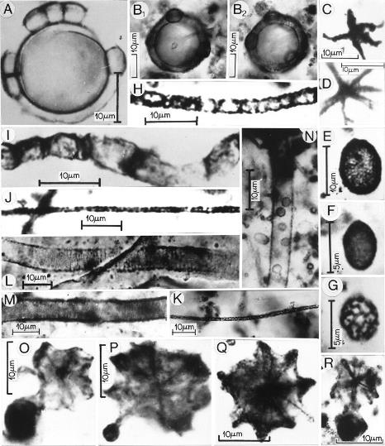
Oldest non-controversial body fossils
Phanerozoic
0.5 Ga
A diverse set of microfossils from the 2.1 Ga Gunflint Chert of Canada are the oldest non-controversial body fossils.
Proterozoic
(2.1 Ga)
2.5 Ga
Archean
4.0 Ga
Hadean
4.6 Ga

Slide 22
New candidate for oldest non-controversial body fossils
Phanerozoic
0.5 Ga
Unusually large microfossils have been discovered in lake deposits of the 2.7 Ga Tumbiana Formation of Western Australia.
This geologic formation also contains exceptionally well-preserved evidence of the existence of microbial communities, plus some geochemical evidence for photosynthesis.
Proterozoic
(2.7 Ga)
2.5 Ga
Archean
4.0 Ga
Hadean
Ouyang et al., Geology, 2026
4.6 Ga

Slide 23
Microbialites

Slide 24
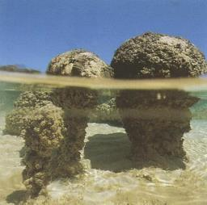
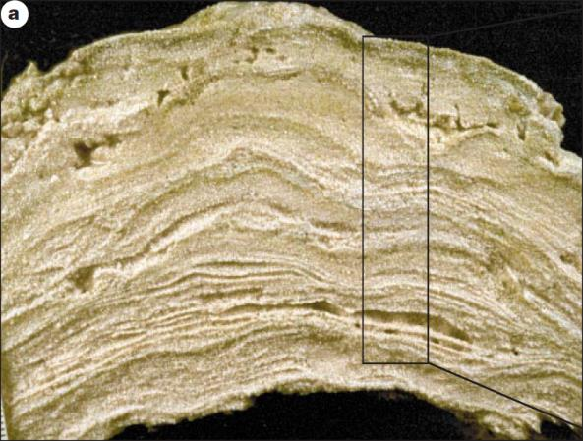
Microbialites
Modern Stromatolites
Sedimentary rock structures thought to have been formed by the activities of microbial communities
Stromatolites
  laminated, organo-sedimentary structures OR
  laminated, accretionary away from a point
Thrombolites
  Microbialites with disrupted lamination and clotted fabric
1cm

Slide 25
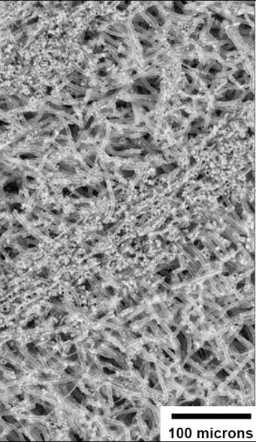
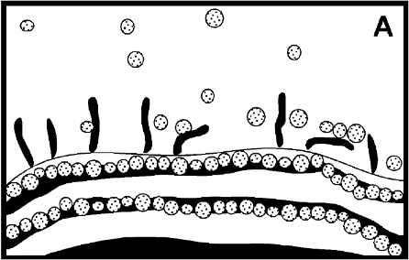
Modern Stromatolites
Form by trapping and binding activities of filamentous cyanobacterial mats. The top layer is alive and green. The cyanobacteria point up and photosynthesize. As sediment falls on the mat, it gets trapped between the filaments. Photosynthesis consumes CO₂, which makes it easier for CaCO₃ to precipitate around the sheaths, binding the sediment particles together.
Modern Stromatolites

Slide 26
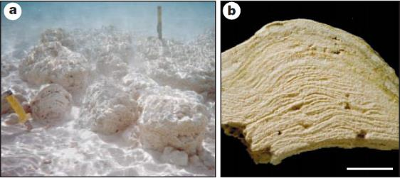
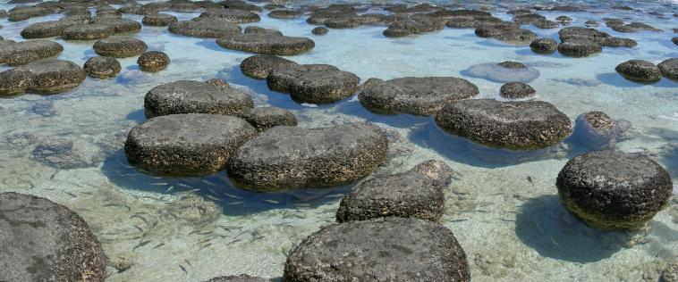
Modern Stromatolites
There are many different shapes of stromatolites, but most are dome-shaped. Ancient stromatolites exhibit much more morphological diversity and include columnar, conical and branching forms.
Today, stromatolites are only found in places where there are few animals, such as hypersaline and/or high temperature environments.

Slide 27
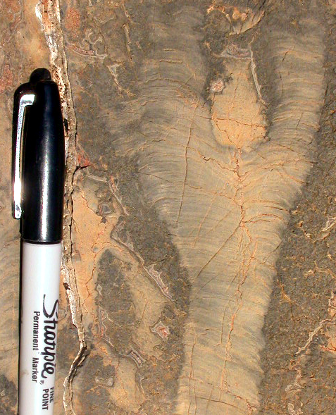

Modern vs. ancient?
5cm
5cm
What differences do you see between the ancient (left) and modern (right) stromatolites?

Slide 28
Modern vs. ancient?
We use modern stromatolites to interpret ancient stromatolites, but in truth, Precambrian stromatolites look very different from younger ones.
  They are much more diverse in their morphology
  They are much more finely laminated
  They occur in more types of environments
We will revisit this when we discuss “The Rise of Animals.”
5cm
5cm

Slide 29
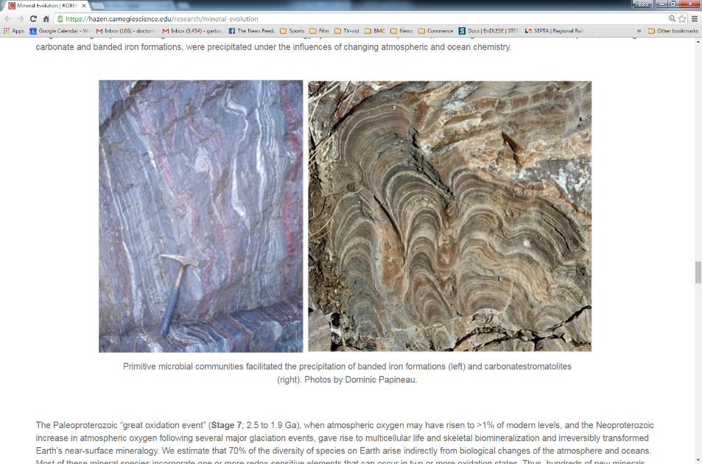

Slide 30
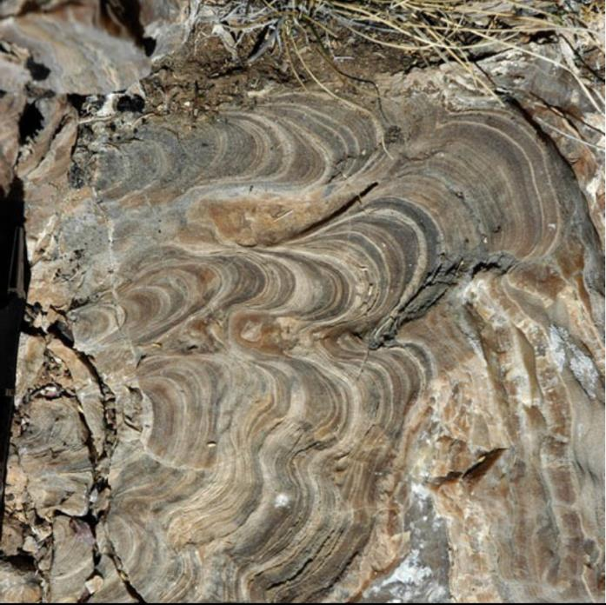
There are structures that look like stromatolites but are not microbial. In fact, some argue that many Precambrian stromatolites were not biological in origin.
We need to consider this when looking for evidence of early life.
(This is an abiogenic feature that resulted from minerals growing horizontally into a crack.)

Slide 31
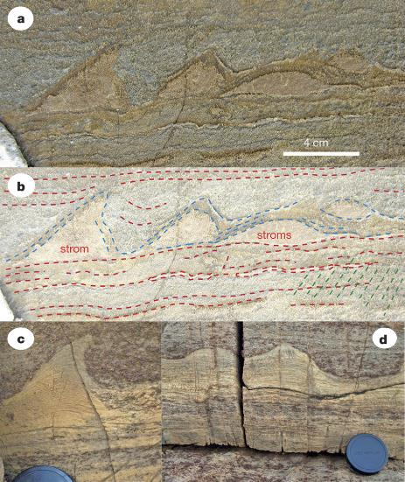
3.7 Ga Stromatolites?
Features found in metamorphosed rocks of the Isua Supercrustal Belt, Greenland, 3.7 Ga.
The authors interpreted these small structures as the first stromatolites and thus the first fossil evidence for life.
Phanerozoic
From Greenland, published in September 2016, extremely controversial
0.5 Ga
Proterozoic
2.5 Ga
Archean
(3.7 Ga)
4.0 Ga
(Nutman et al., 2016)
Hadean
4.6 Ga

Slide 32
3.7 Ga Stromatolites?
A more thorough, three-dimensional study showed that these were actually produced by tectonic shear forces, not microbial mats.
Phanerozoic
0.5 Ga
Proterozoic
(Allwood et al., 2018, Nature)
2.5 Ga
Archean
(3.7 Ga)
4.0 Ga
Hadean
4.6 Ga

Slide 33
The oldest widely-accepted stromatolites are from the 3.4 Ga Strelley Pool Chert in Australia, the same formation as some putative sulfate reducing microfossils.
These were studied by the main critic of the Greenland pseudo-stromatolites, Abigail Allwood.
Phanerozoic
3.4 Ga Strelley Pool Stromatolites
0.5 Ga
Proterozoic
(Allwood et al., 2006, Nature)
2.5 Ga
(3.4 Ga)
Archean
4.0 Ga
Hadean
4.6 Ga

Slide 34
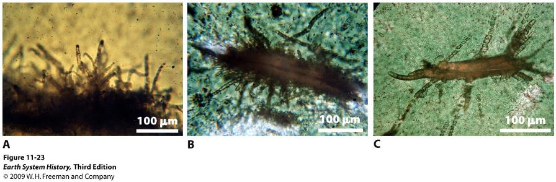
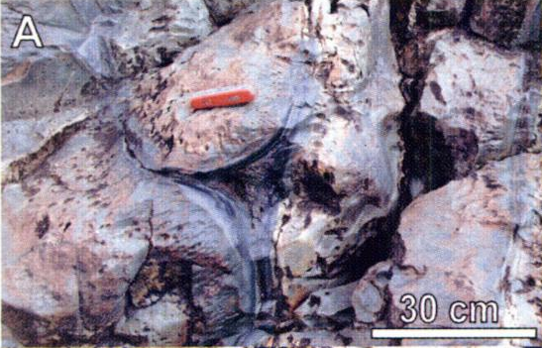
Another contestant for the earliest fossil evidence of life is found in the Barberton pillow basalts of South Africa.
Phanerozoic
0.5 Ga
These rocks are thought to have formed underwater 3.5 Ga. Within these pillow basalts are etchings that resemble those made by modern microbes in basaltic rocks. The microbes “eat” the basalt by dissolving it and consuming the elements released.
The mineral that filled the etchings (titanite) has recently been radiometrically dated, using Uranium-Lead, to 3.34 Ga.
These structures, if biogenic, would be considered trace fossils because they record the activity of organisms.
Proterozoic
2.5 Ga
Furnes et al., 2004 in Science
3.34 Ga
Archean
4.0 Ga
Hadean
4.6 Ga

Slide 35
Evidence for Early Life: Summary
Phanerozoic
0.5 Ga
Body fossils: ~3.5 Ga, 3.4 Ga, 2.7 Ga, 2.1 Ga
Trace fossils: 3.34 Ga
Stromatolites: 3.7(?), 3.4 Ga
Geochemistry: 3.8(?)-3.5 Ga
Proterozoic
2.5 Ga
Archean
Red means controversial, black means not controversial.
4.0 Ga
Hadean
4.6 Ga

