Slide 1
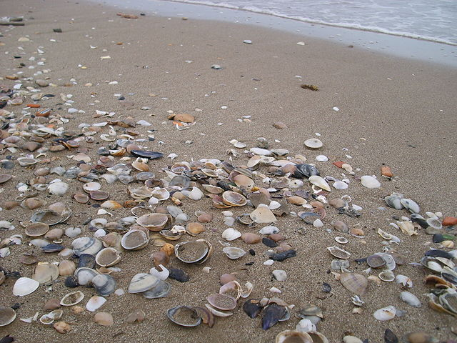
Taphonomy – Part 2

Slide 2
Taphonomy
Greek: “taphos + nomos” = “burial laws”
  Includes all processes that occur between death and discovery (by humans) of an organism
  Biostratinomy: processes that occur before final burial within sediment or other preserving medium
  Diagenesis: processes that occur during/after burial
    Organism may be buried and “exhumed” repeatedly before final burial

Slide 3
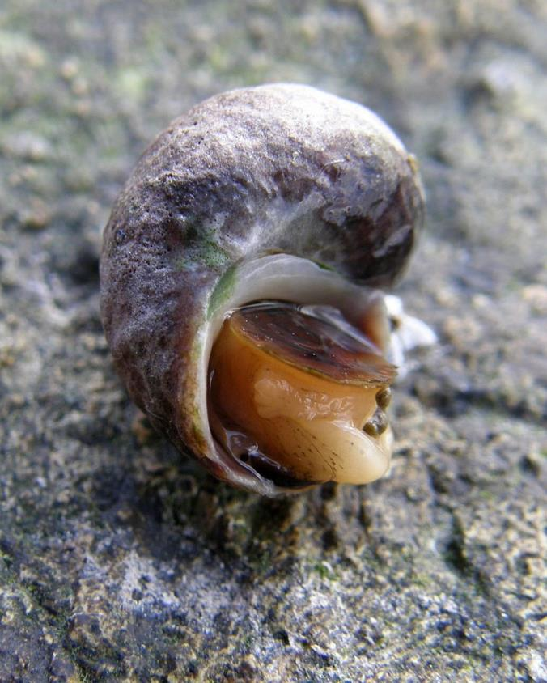
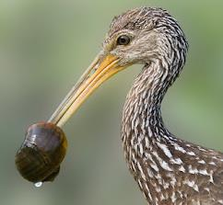
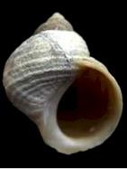
Biostratinomy: Soft parts removed
Scavenging
Decay
(via microbes)

Slide 4
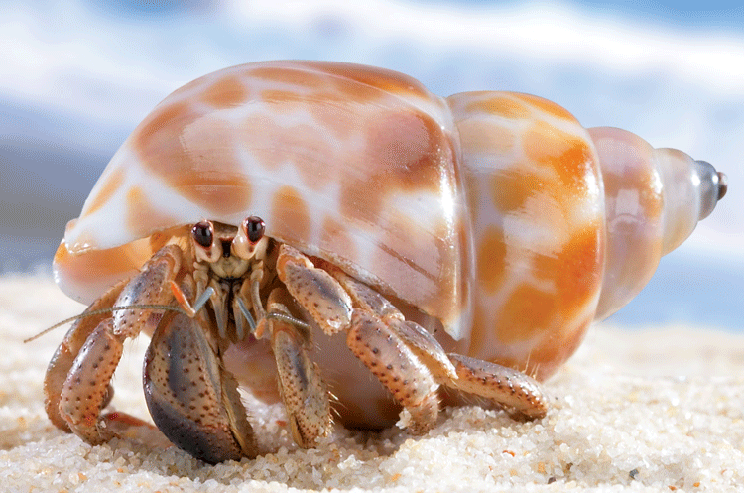
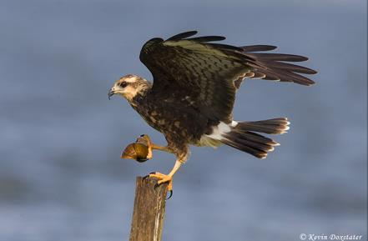
Biostratinomy: Movement by a biological agent(s)
Hermit crab
Osprey

Slide 5
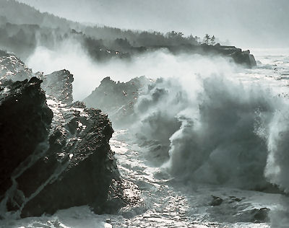
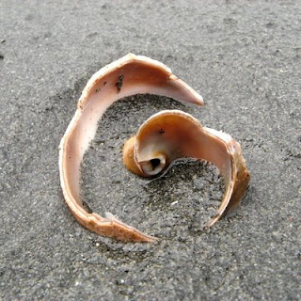
Biostratinomy: Alteration/movement by a mechanical process(es)
Wind, waves, currents – abrasion & breakage

Slide 6
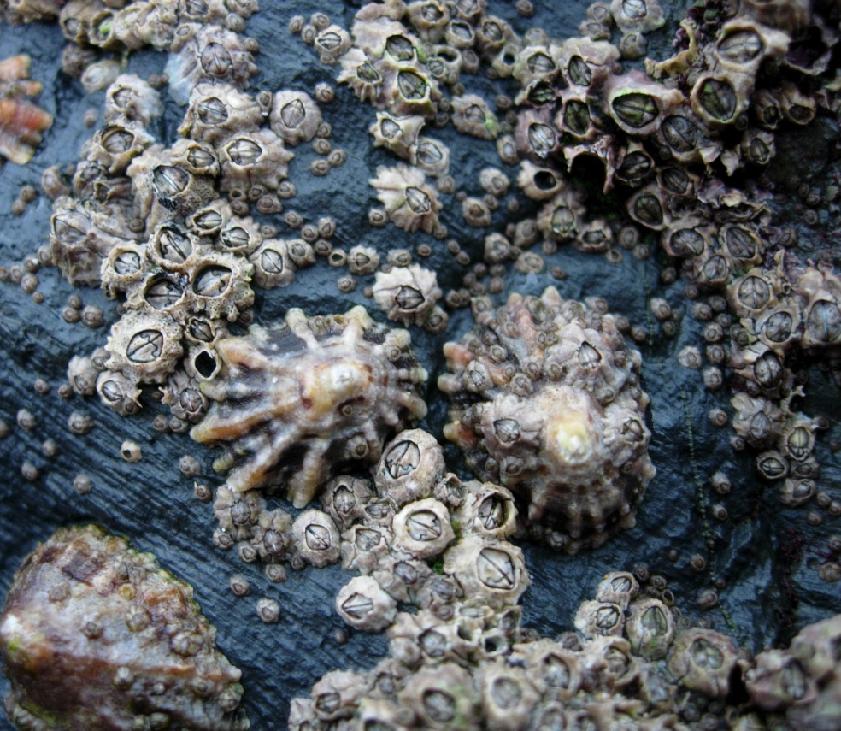
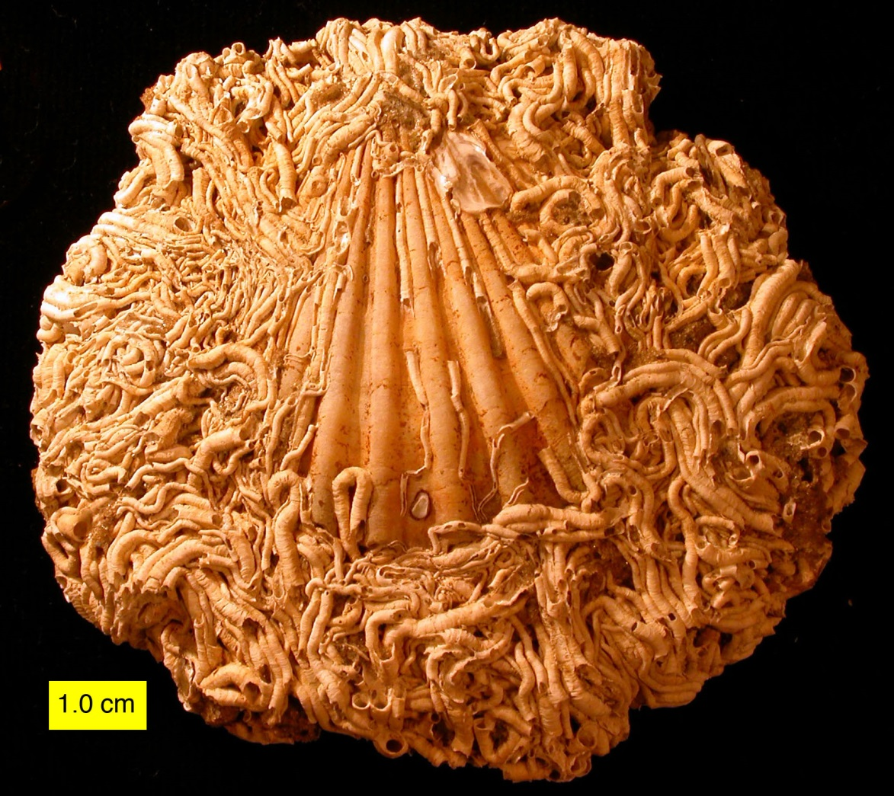
Biostratinomy: Alteration by a biological agent(s)
Encrusters – add new material (minerals)
(Process: Encrustation)
Both images: http://commons.wikimedia.org/wiki/User:Wilson44691

Slide 7
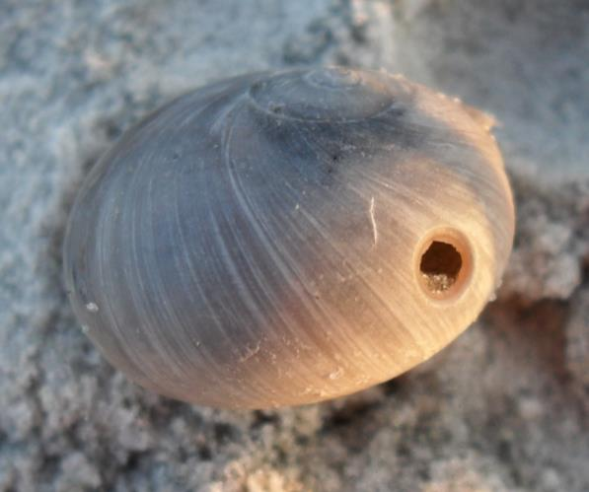
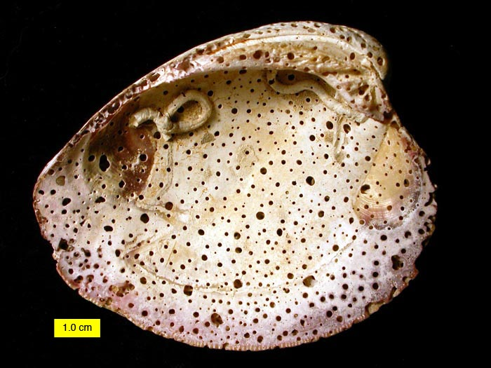
Biostratinomy: Alteration by a biological agent(s)
Borers/Bioeroders – remove existing material
(Process: Bioerosion)
http://commons.wikimedia.org/wiki/File:BoredEncrustedShell.JPG

Slide 8
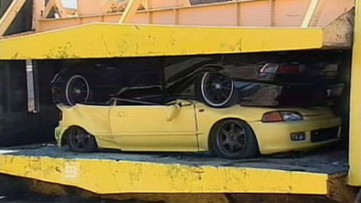
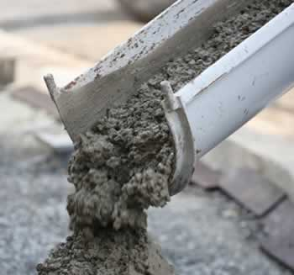
Diagenesis: During/After Burial
Involves Physical and/or Chemical Changes:
Compaction/distortion (physical alteration)
Cementation (additional of minerals: chemical alteration)
“Remineralization” (changes in minerals: chemical alteration)
Notes:
Diagenetic processes can include compaction/distortion, cementation (i.e., minerals can fill existing spaces within the fossil skeleton and/or cement the fossil to other fossils or rock fragments), and alteration or replacement of existing minerals.

Slide 9
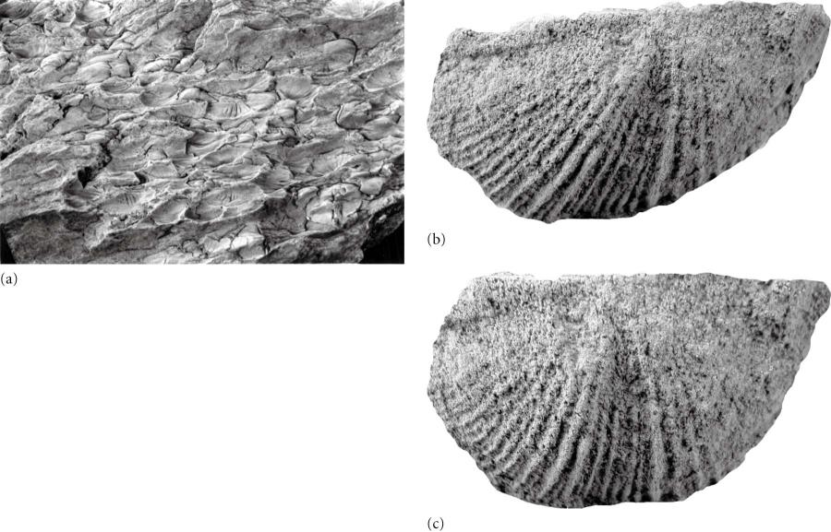
Diagenesis: During/After Burial
Compaction/distortion
Fossils & Tectonics: Determining degree of strain and direction of stress
Digitally “retrodeformed” fossil (restored to its original shape)
Benton and Harper e-textbook, fig. 3.7

Slide 10
Preservation Potential
Hard parts (mineralized skeletal/shell material) = high
Soft parts (tissues, organs) = low
Rapid burial provides best chance of fossilization
  Why?
    Burial protects biological material from biostratinomic processes, especially decay

Slide 11
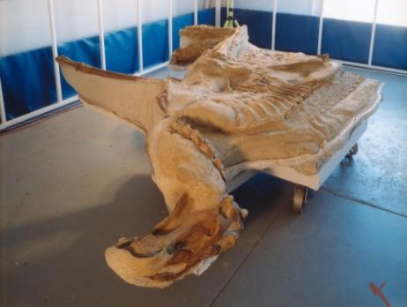
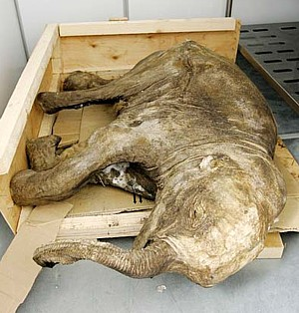
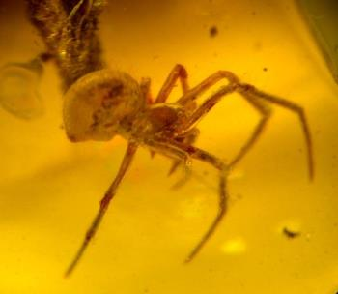
Modes of preservation: Soft Parts
Original soft parts (via freezing, mummification, etc.)
  very rare!
Notes:
Original soft-part preservation requires that the biological material be removed (and sealed off from) decay processes almost immediately after death. This can be accomplished via entombment in snow/ice, sand, and amber (plant sap).
Upper left photo is of a “dinosaur mummy,” preserved in sand (now sandstone), that was discovered in 2000 and nicknamed “Leonardo”: https://www.sciencenews.org/article/dear-mummy-rare-fossil-reveals-common-dinosaurs-soft-tissue. Lower left photo is of a spider preserved in amber. Lower right photo is of a juvenile wooly mammoth that was entombed in permafrost (frozen sediment) in Siberia for 42,000 years until its discovery in 2007: https://en.wikipedia.org/wiki/Lyuba_(mammoth).

Slide 12
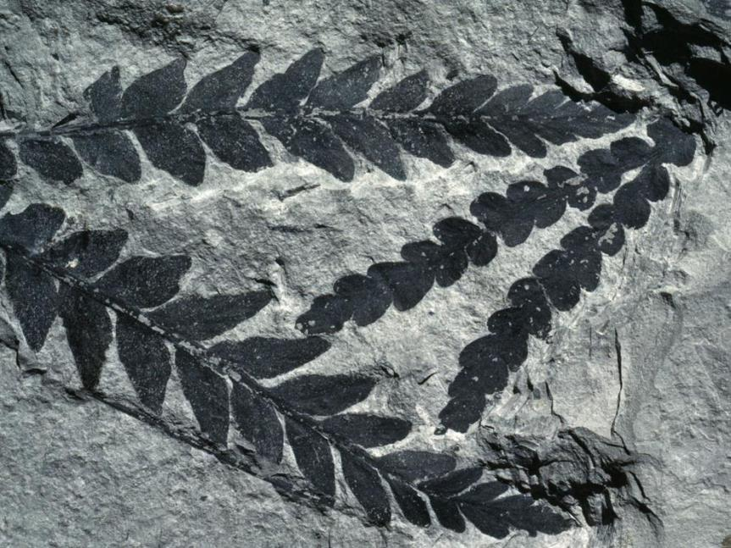
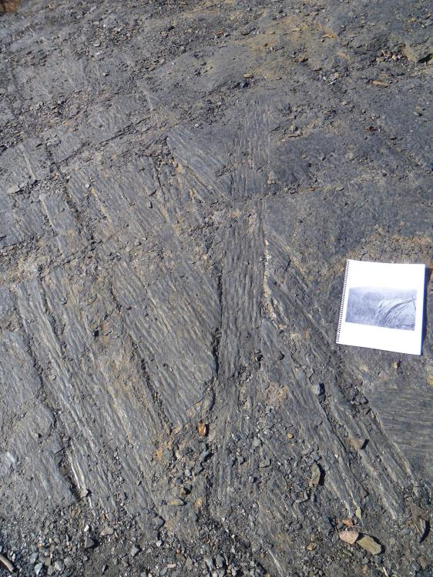
Modes of preservation: Soft Parts
Altered soft parts: Carbonization
  Plants are compressed, carbon (stable) is left behind
Plant tissues are often preserved this way
Notes:
When plants are buried, they are subjected to considerable pressure from the overlying layers of rock. This pressure forces out volatiles and other unstable chemical components of the plant’s tissues and leaves behind a thin film of very stable carbon. This thin film of carbon preserves, often intricately, the external features of the plant.

Slide 13
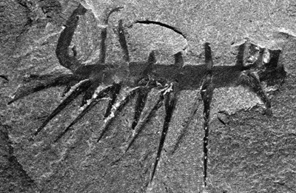
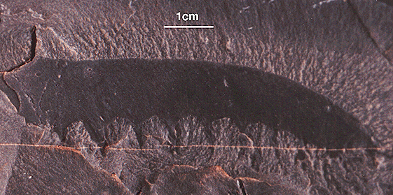
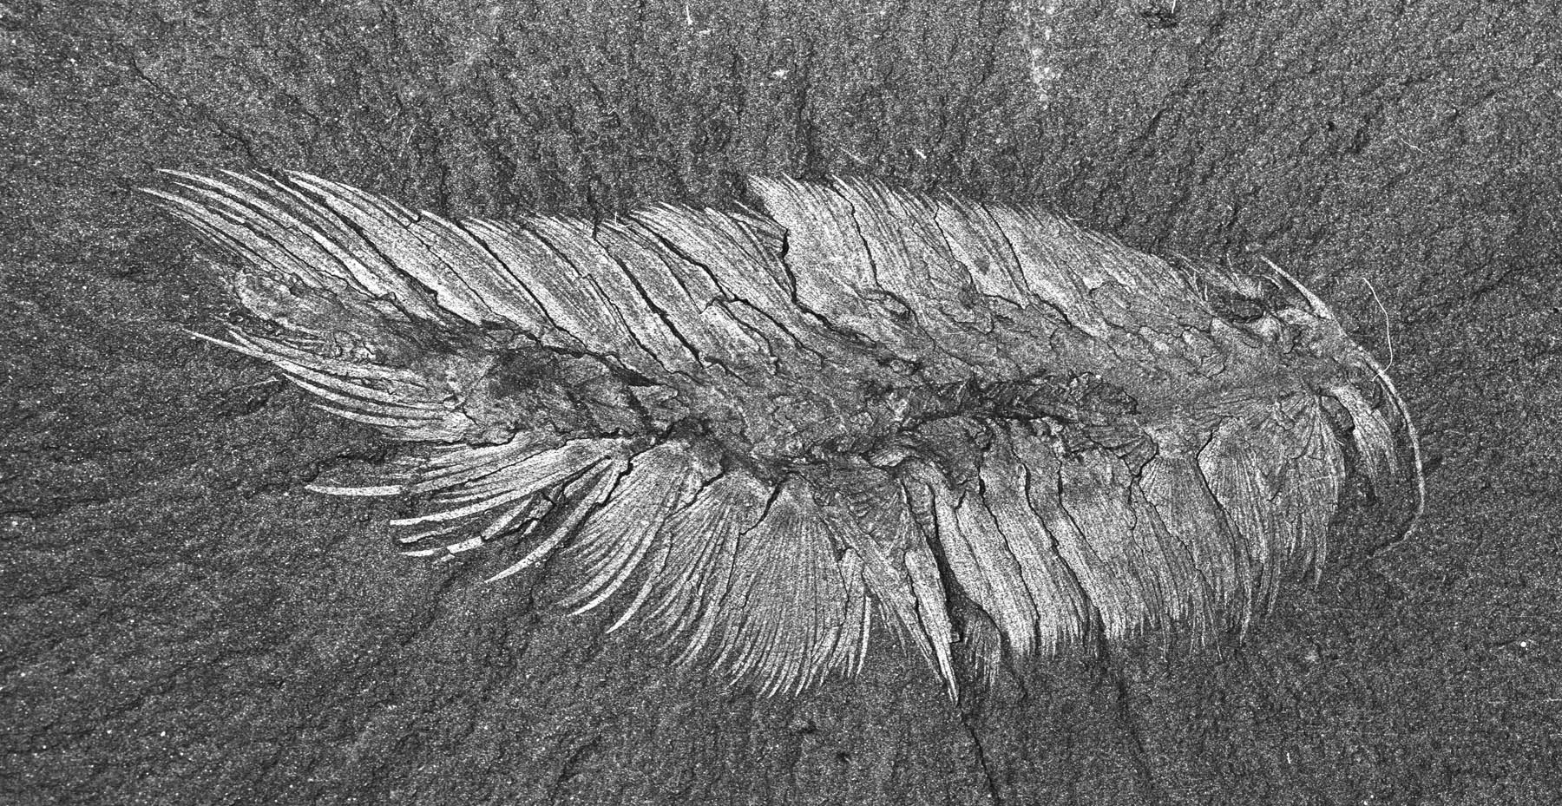
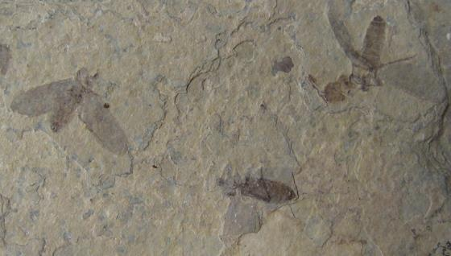
Modes of preservation: Soft Parts
Altered soft parts: Clay mineral replacement
  Tissues are compressed, clay minerals are chemically substituted for them, sometimes with aid of microbes
Notes:
The process of clay mineral replacement shares many similarities with carbonization, but instead of a thin film of carbon, animal fossils are preserved as thin films of stable clay minerals. Upper left: Hallucigenia (a Burgess Shale animal); lower left: Canadia (a Burgess Shale animal); upper right: one of the two head appendages of Anomalocaris (another Burgess Shale animal); lower right: fossil insects.

Slide 14
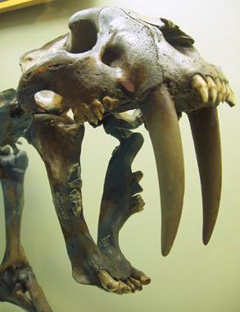
Modes of preservation: Hard Parts
Original (unaltered) hard parts
  Common minerals:
  Calcite (CaCO₃): many invertebrate shells; stable during diagenesis but can be altered
  Aragonite (CaCO₃): many invertebrate shells; less stable, often recrystallizes to calcite
  Calcium phosphate (CaHPO₄): most bones, teeth; some invertebrate shells; stable
  Opal silica (SiO₂*H₂O): some microfossils and sponges; less stable, can become chert

Slide 15
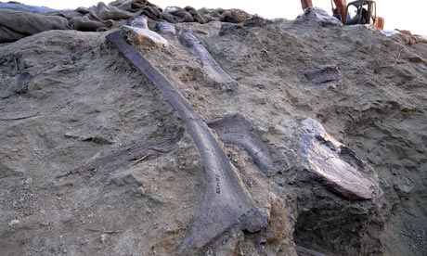
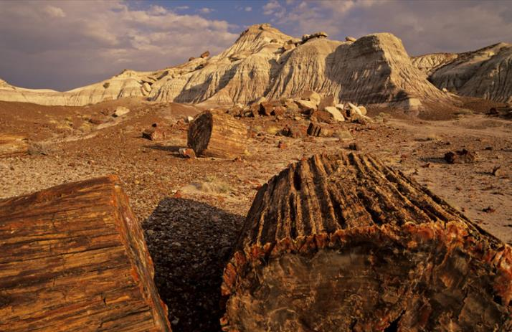
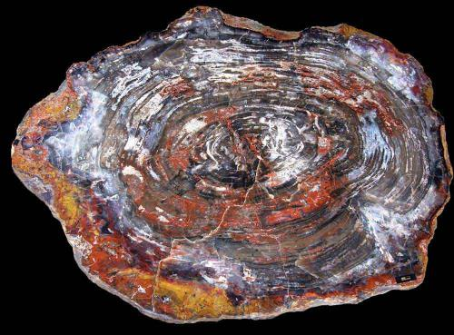
Modes of preservation: Hard Parts
Altered hard parts
  Permineralization (or “petrification”)
    Affects porous materials (e.g., bones, wood, some shells): mineral crystals fill open spaces

Slide 16
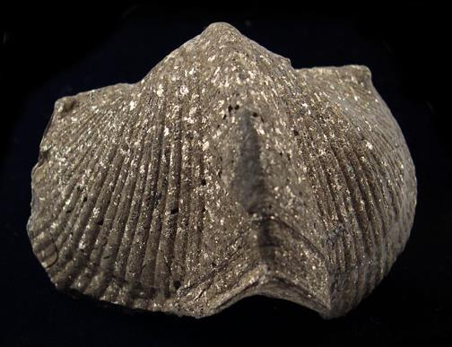
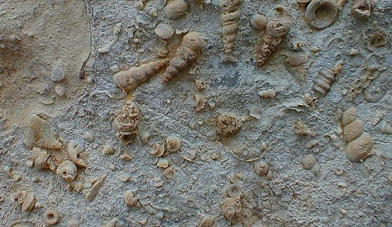
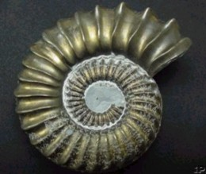
Modes of preservation: Hard Parts
Altered hard parts
  Replacement by a different mineral (e.g., by pyrite, silica)
  Starting material is usually CaCO₃; product is a cast
Pyritization
Silicification
Notes:
In replacement, the original minerals making up the shell are completely replaced by different minerals.

Slide 17
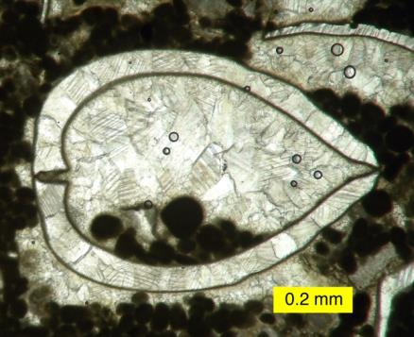
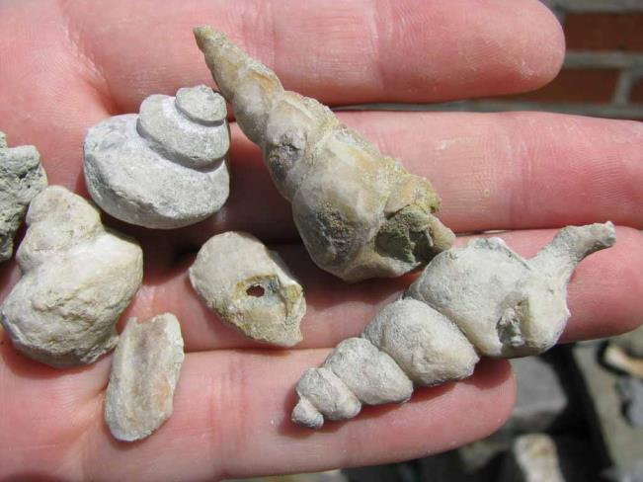
Modes of preservation: Hard Parts
Altered hard parts
  Recrystallization: same chemical composition before and after, but crystal structure changes
  Most common: aragonite to calcite (both CaCO₃)
  Often results in a loss of detail in the fossil
  Product: cast
Recrystallization typically results in larger, blockier crystals than were found in the original shell.
Notes:
In recrystallization, minerals comprising a shell are altered so that the crystals become larger but retain the same chemical composition. This process may occur through dissolution (dissolving the original shell) followed by precipitation of the same kind of mineral crystals, or through in-place transformation of the original crystals into larger, blockier ones.

Slide 18
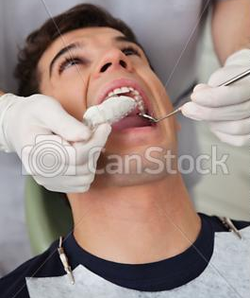
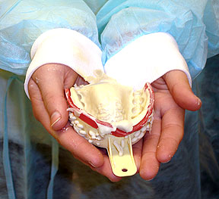
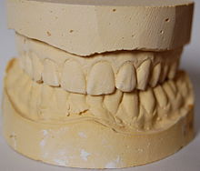
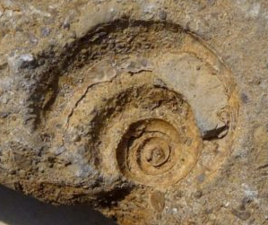
Modes of Preservation: Molds and/or Casts
Cast – has positive relief
Looks like a copy!
Mold – has negative relief

Slide 19
Casts
Cast - replacement
The products of replacement, recrystallization, and sometimes permineralization are casts
  original shell material is no longer present
  cast is a “replica” of the shell, often with only the external features intact
Change in chemical composition
Cast - recrystallization
CaCO₃
No change in chemical composition

Slide 20
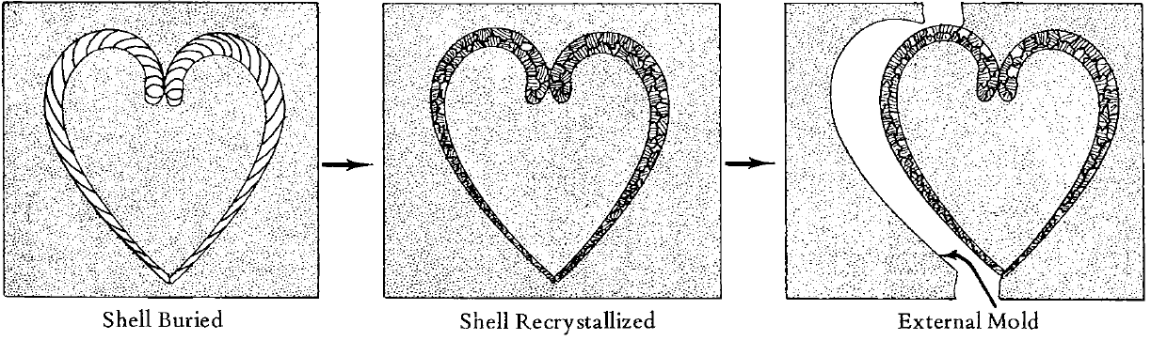
Modes of preservation: Molds
Molds: composed of sediment or (less commonly) of minerals; have negative relief
Negative relief: gives appearance of the shell having been “turned inside out.”
Features normally found on a convex surface are preserved on a concave surface, for example.

Slide 21
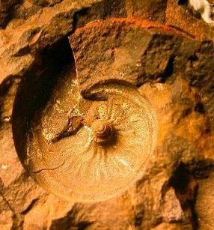
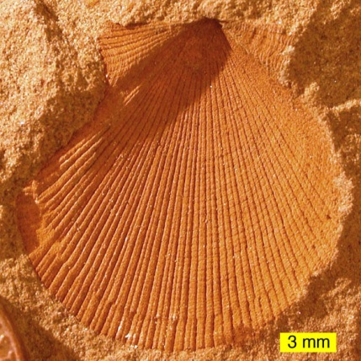
External molds
Negative relief: External features of a shell are preserved on a surface that is often concave.

Slide 22
Internal molds

Slide 23
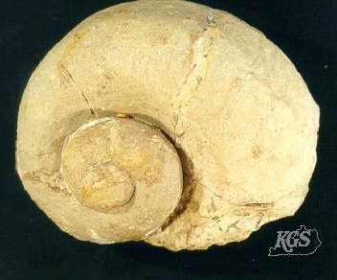
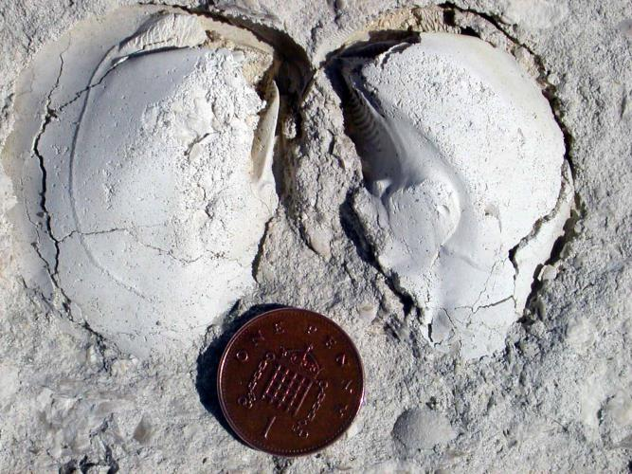
Internal molds
Negative relief: Internal features of a shell are preserved on the exterior surface (often convex) of internal molds

Slide 24
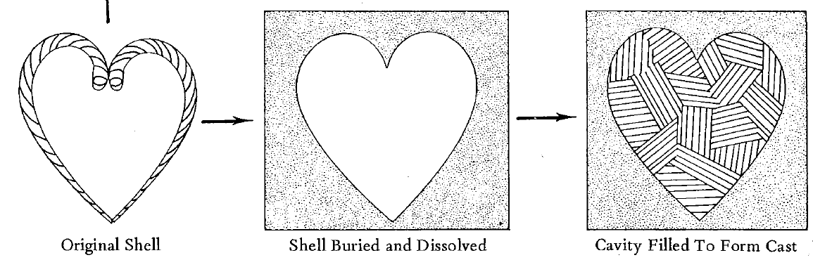
Modes of preservation: Casts
Casts: composed of sediment or crystals that fill an external mold; have positive relief
external
mold
Positive relief: looks like a copy of the original shell; exterior features of shell are preserved on exterior of cast (like normal!); internal features usually aren’t visible.

Slide 25
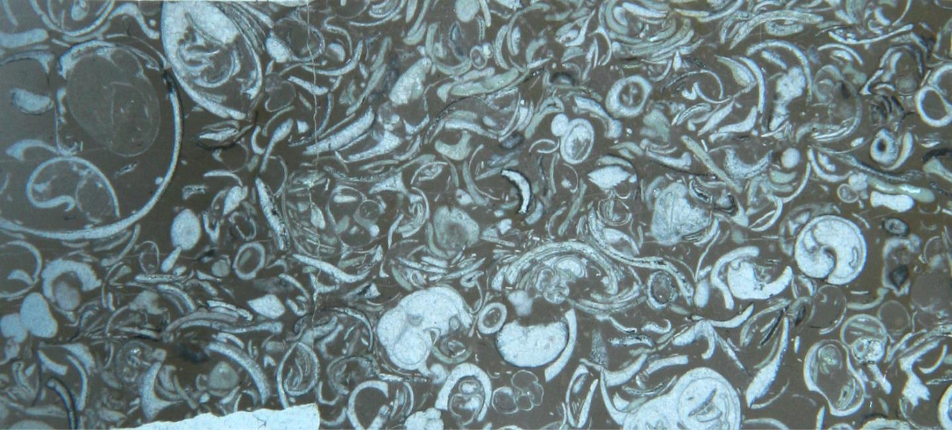
Fossil Assemblage:
The fossils found preserved together in a particular layer or unit of rock or sediment.

Slide 26
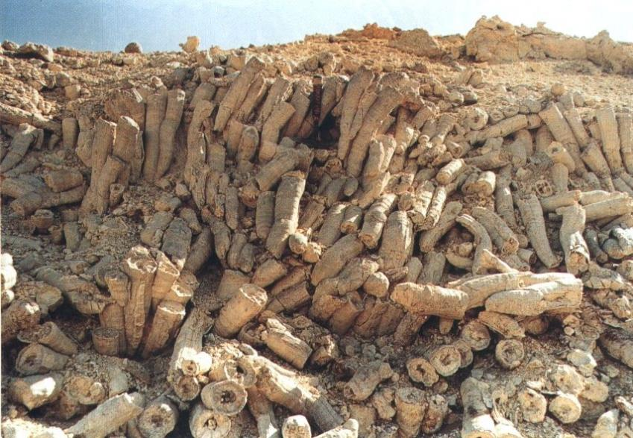
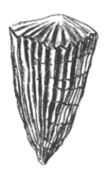
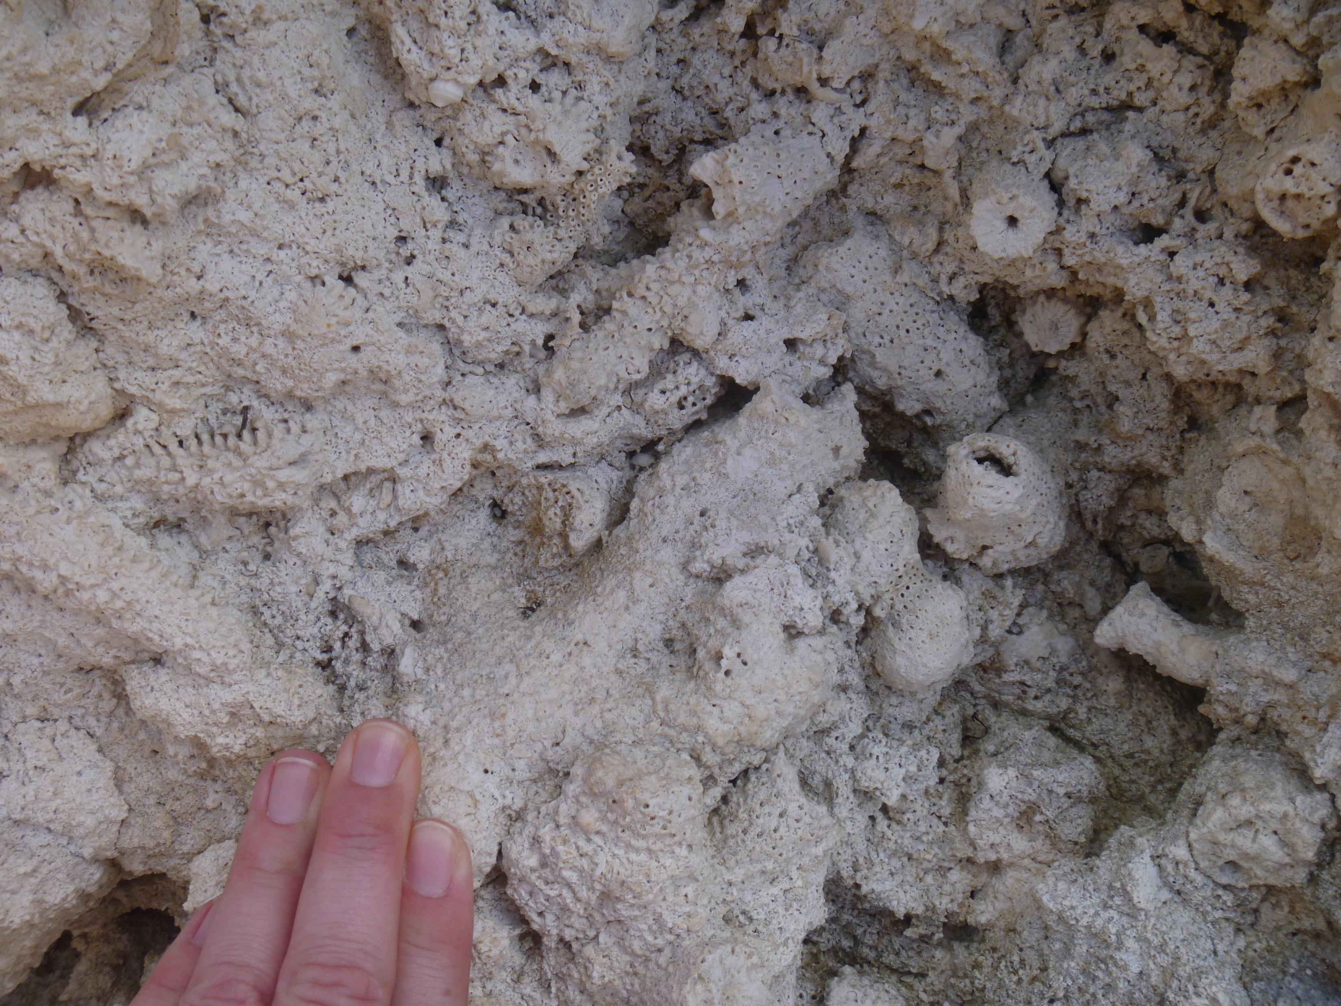
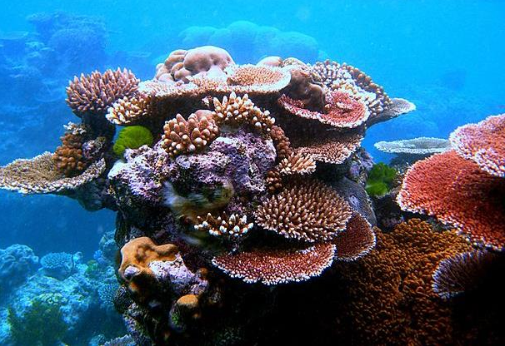
Life Assemblages
Rudist bivalve reef, Cretaceous, Jamaica
Fossils are preserved together in place and in life position; living spatial relationships are preserved
Examples: Coral reefs, rudist bivalve reefs
Fossil coral reef, Pleistocene, Bahamas
Modern coral reef

Slide 27
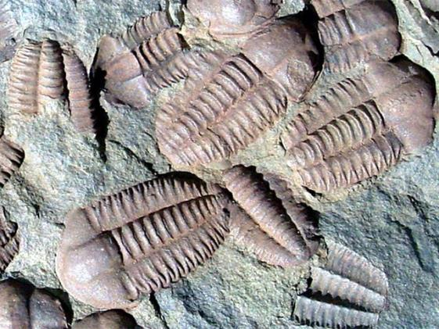
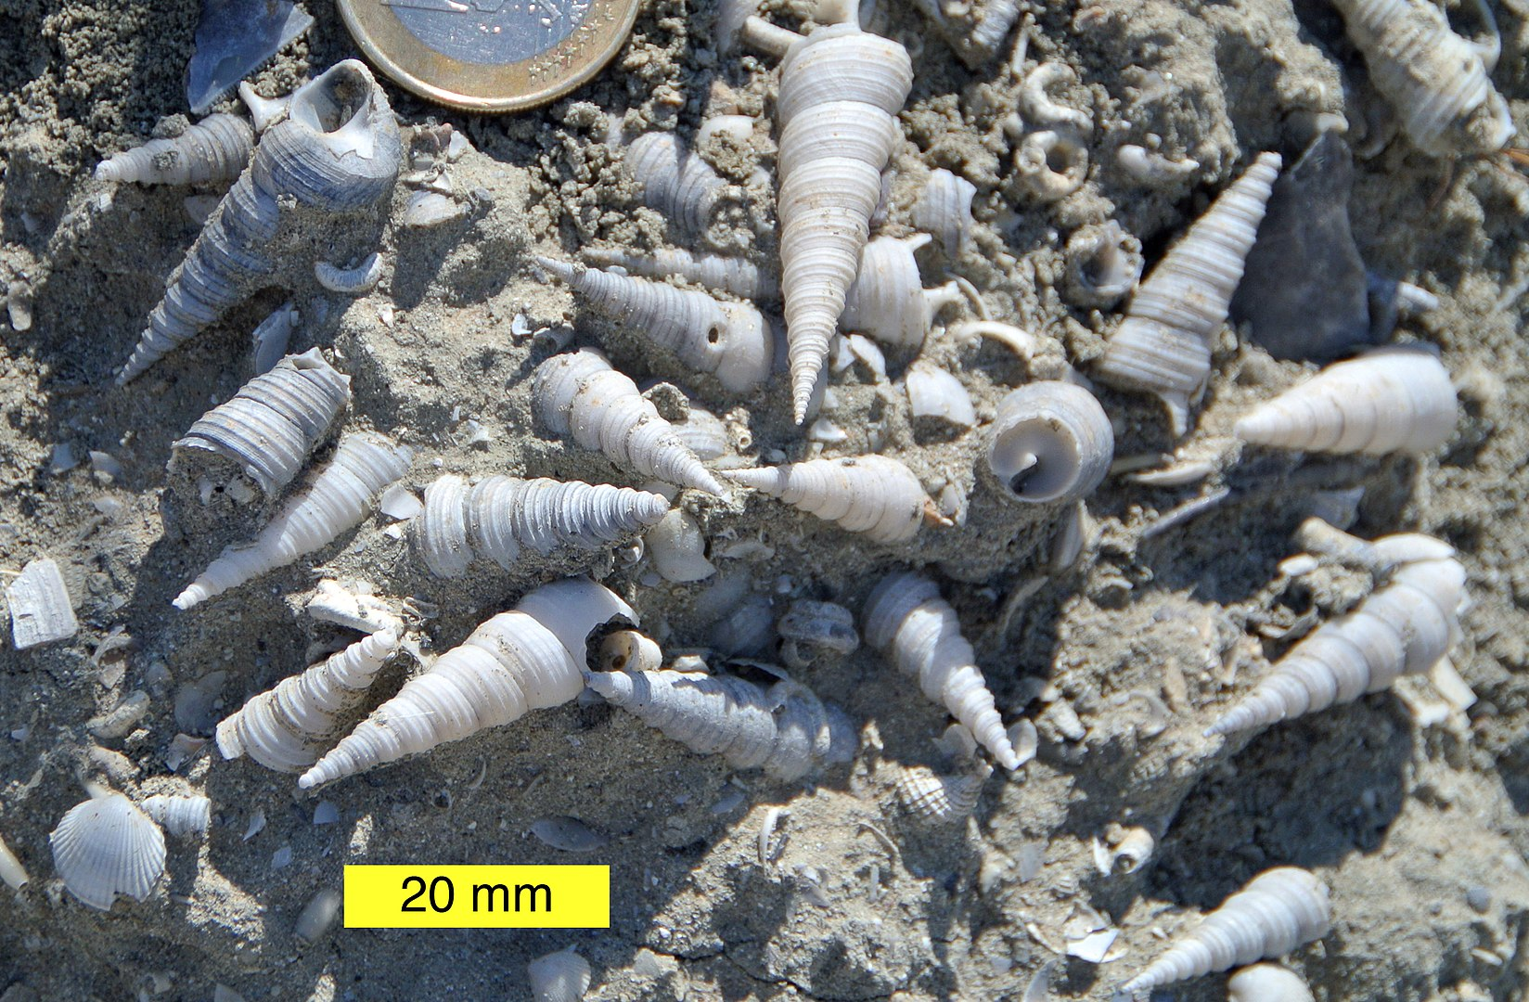

Death assemblages
Fossils are preserved together but show evidence of biostratinomic processes (damage, disarticulation, transport, etc.) and are not preserved in life position; living relationships are not preserved.

