Slide 1
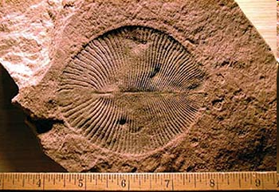
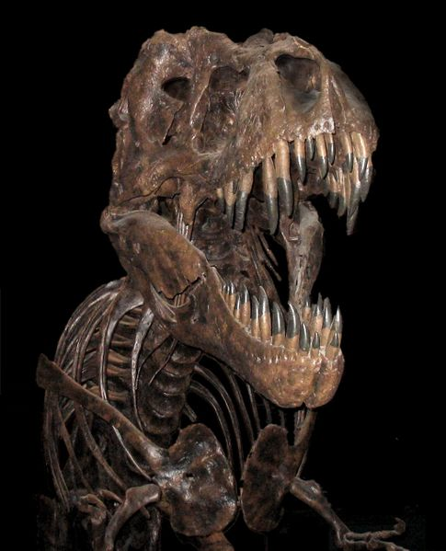
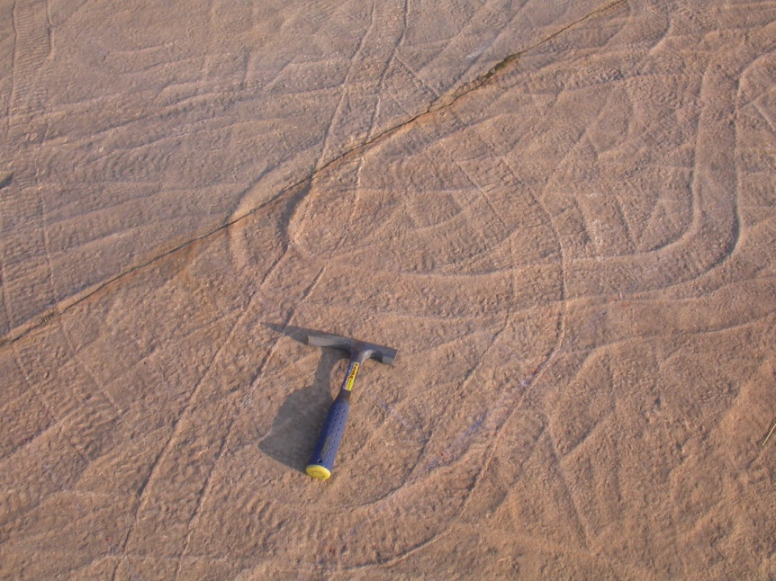
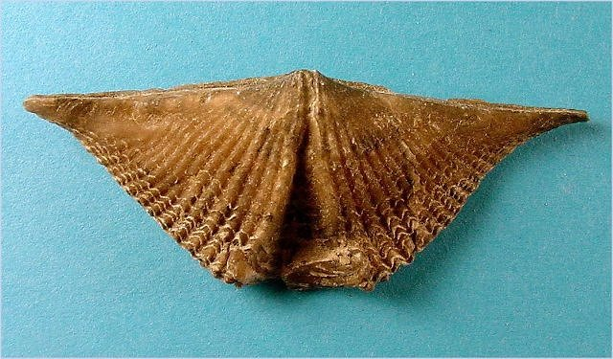
What are fossils?
Preserved evidence of once-living organisms (usually >10,000 years old)

Slide 2
Type 1: Body Fossils
A preserved representation of the organism itself
  Original skeletal material (bone, shell, etc.)
        OR
  Molds or casts of body structures
  Made of sediment/minerals

Slide 3
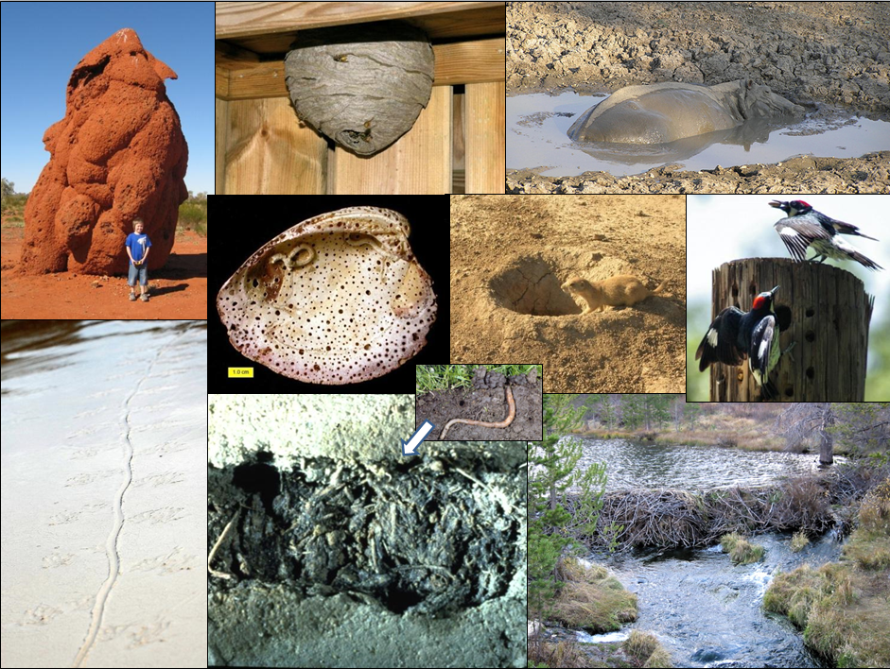
Type 2: Trace Fossils
Evidence of the activities/behaviors of life
  Burrows
  Trails
  Tracks
  Borings
  Etc.!

Slide 4
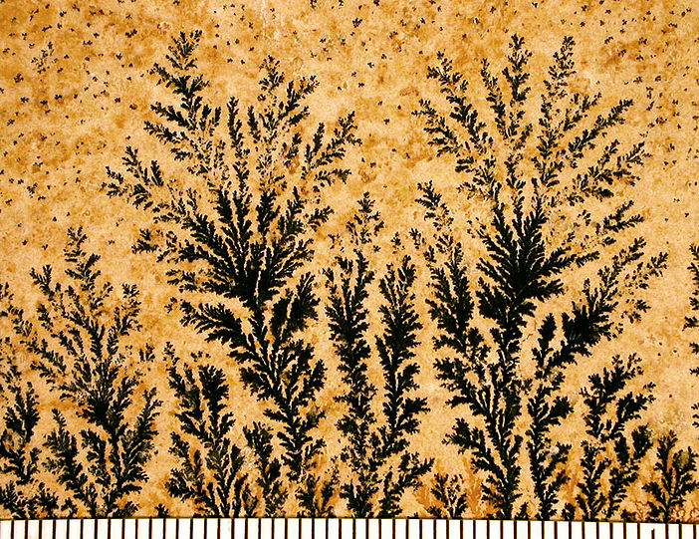
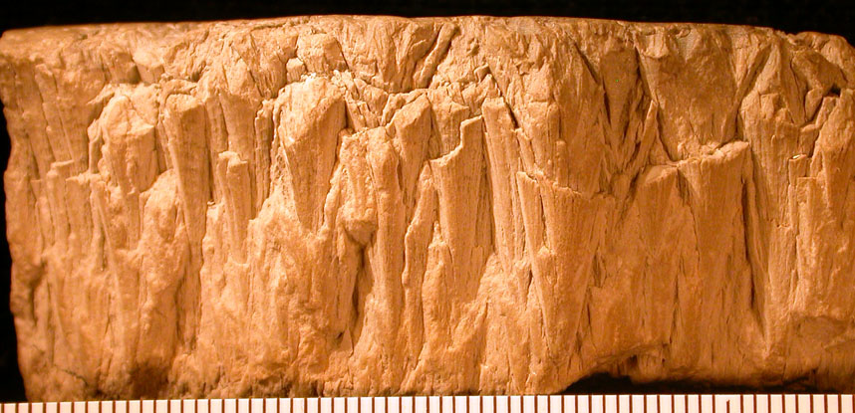
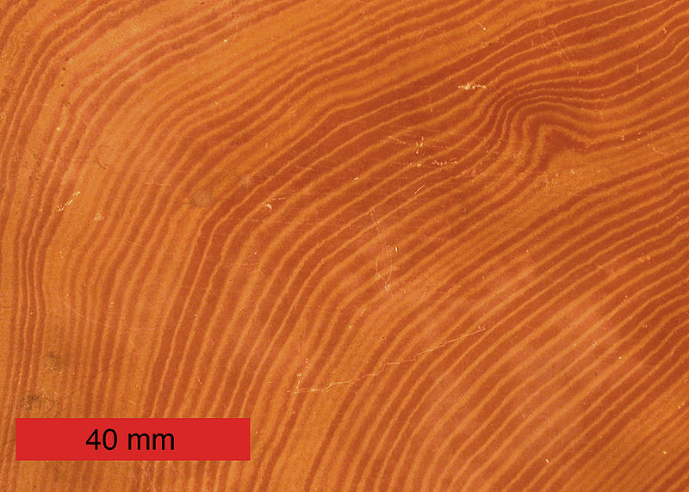
Pseudo-fossils (don’t be fooled!)
Examples:
Dendrites (upper right)
Concretions (lower right)
Shatter cones (lower left)

Slide 5
Fossil or Not?

Slide 6
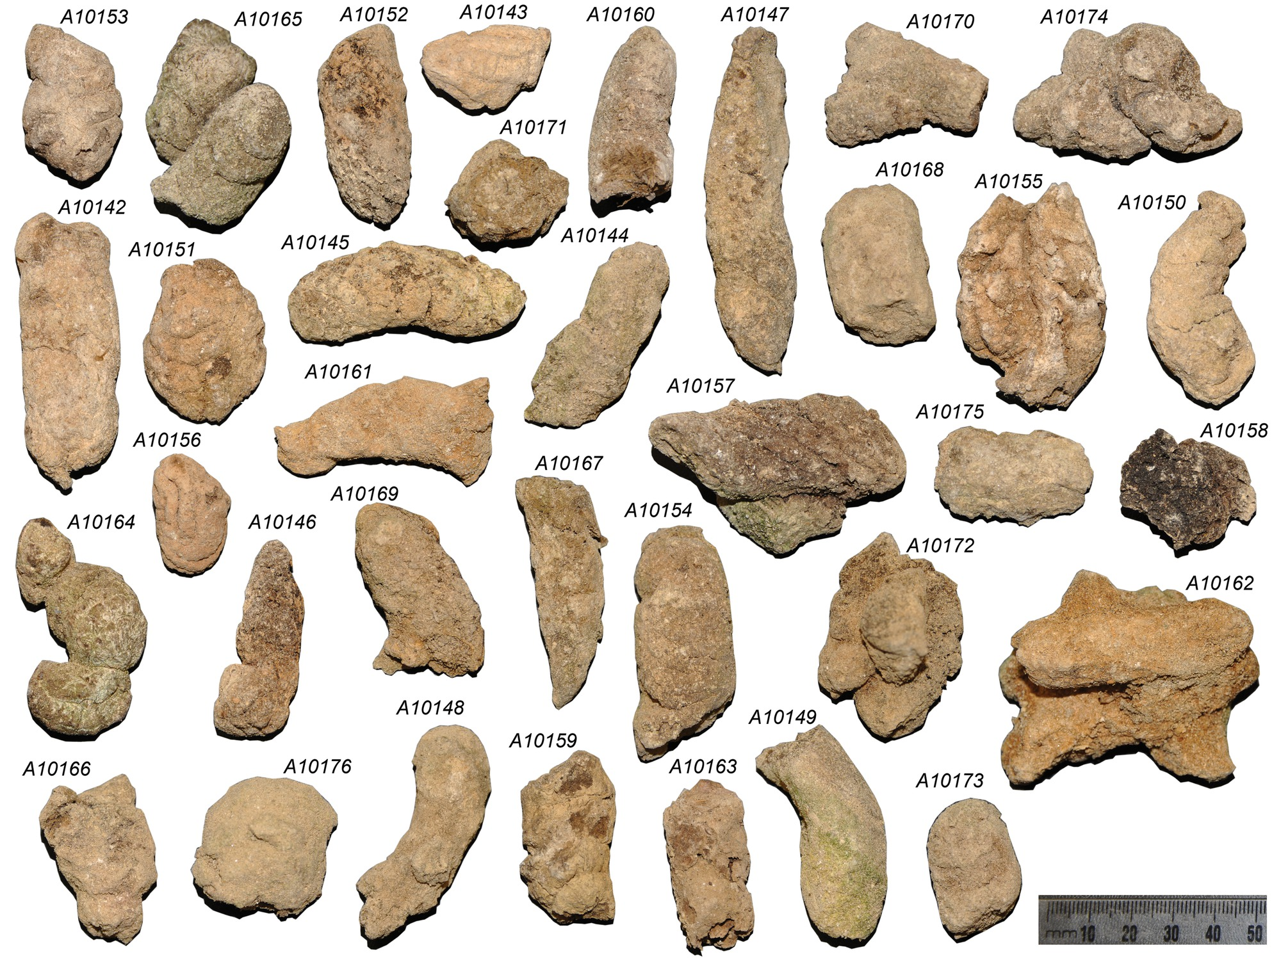
Real coprolites (from the extinct Moa bird)

Slide 7
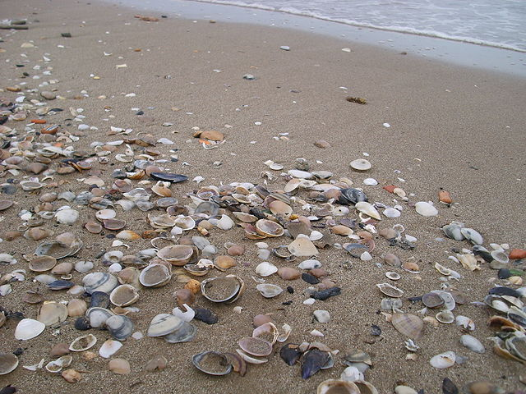
Taphonomy

Slide 8
Taphonomy
Greek: “taphos + nomos” = “burial laws”
  Includes all processes that occur between death and discovery (by humans) of an organism

Slide 9
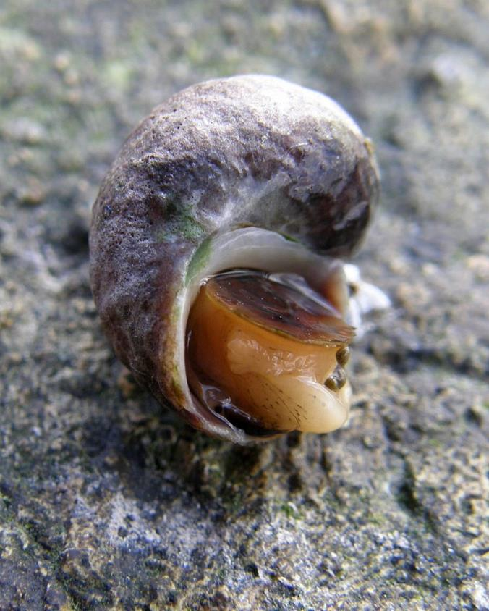
Example: Death of a snail

Slide 10
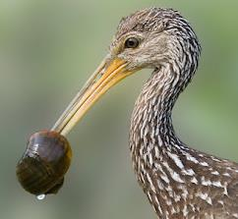
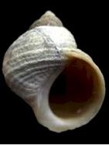
Soon after death: Soft parts removed
Scavenging
Decay
(via microbes)

Slide 11
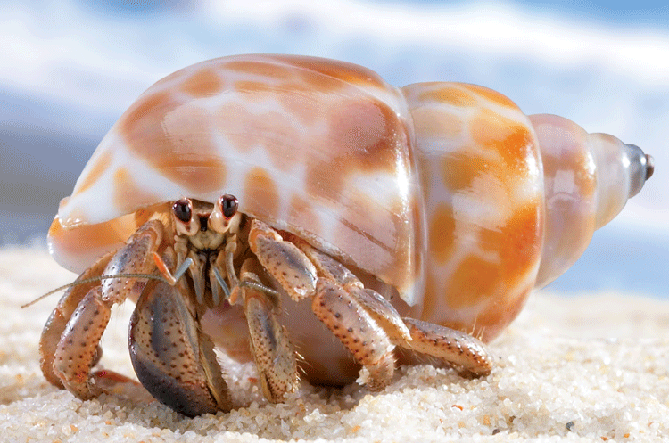
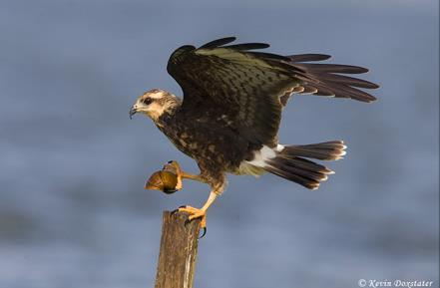
Shell might be moved by a biological agent(s)
Hermit crab
Osprey

Slide 12
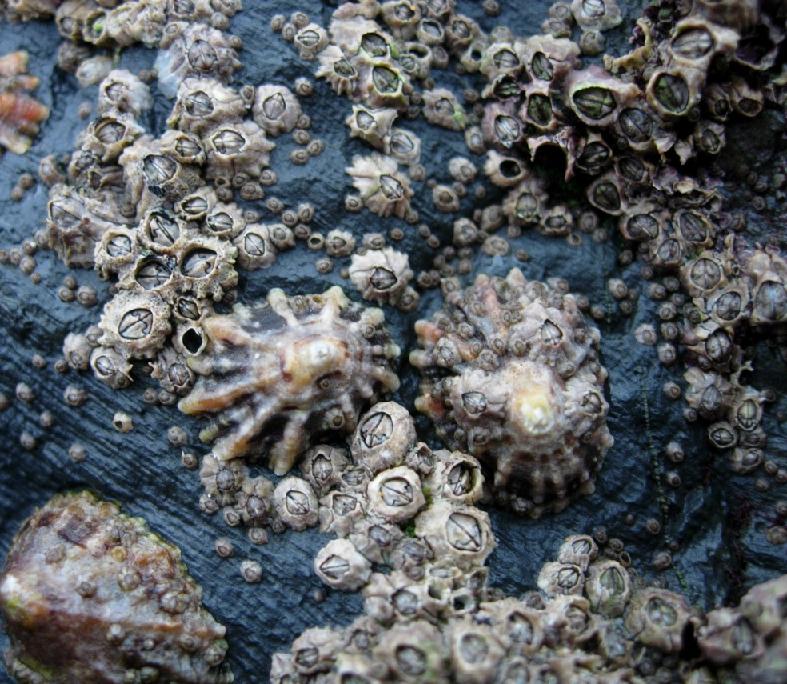
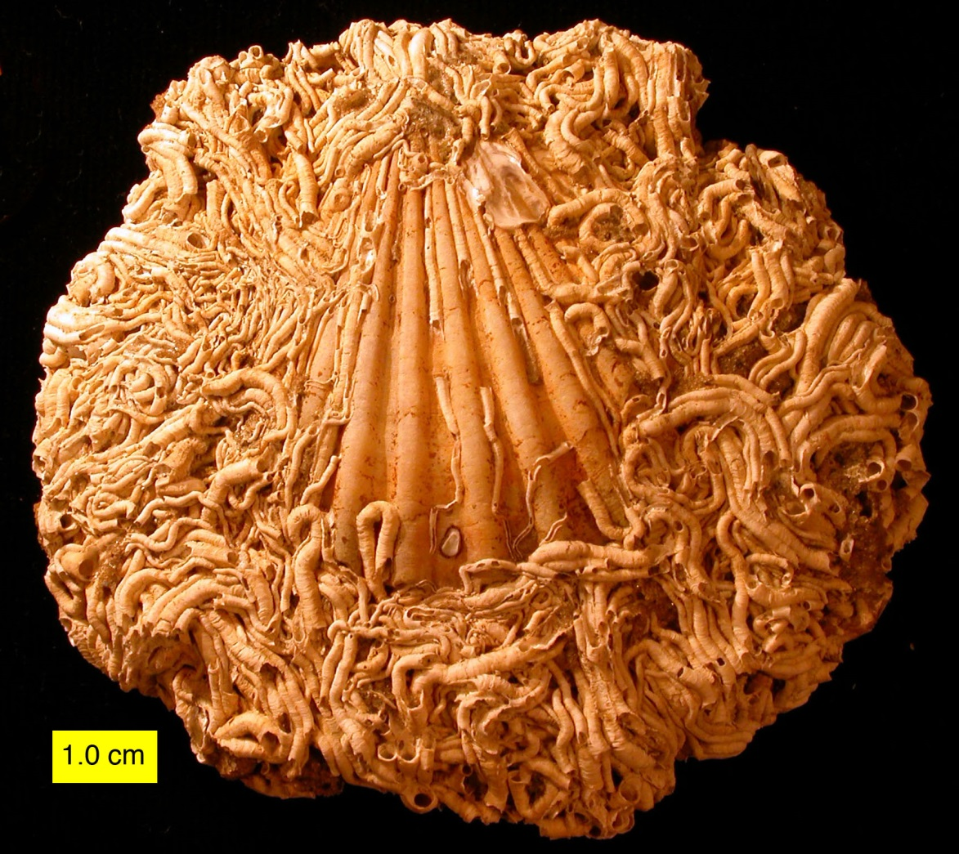
Shell might be altered by a biological agent(s)
Encrusters – add new material (minerals)
(Process: Encrustation)
Both images: http://commons.wikimedia.org/wiki/User:Wilson44691

Slide 13
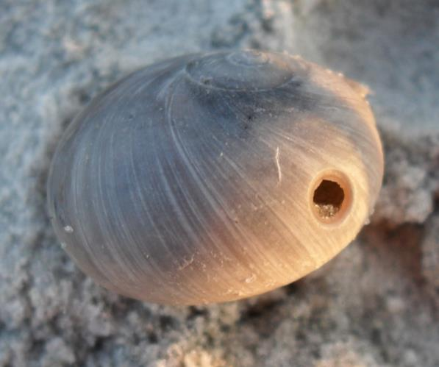
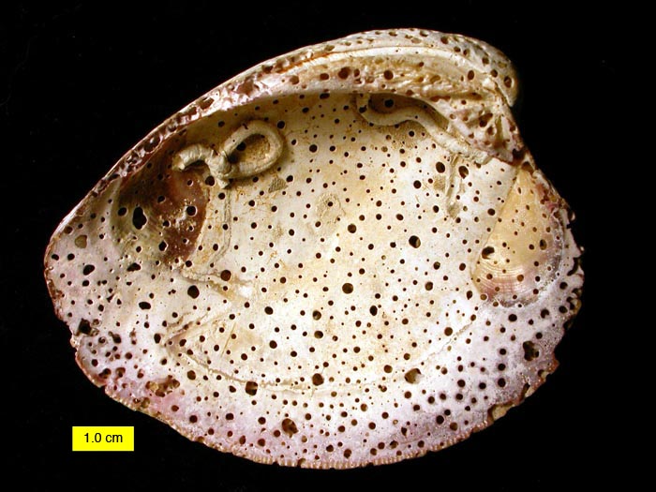
Shell might be altered by a biological agent(s)
Borers/Bioeroders – remove existing material
(Process: Bioerosion)
http://commons.wikimedia.org/wiki/File:BoredEncrustedShell.JPG

Slide 14
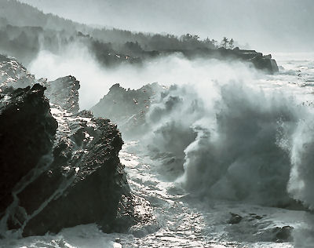
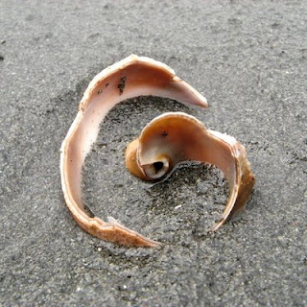
Shell might be altered/moved by a mechanical process(es)
Wind, waves, currents – abrasion & breakage

Slide 15
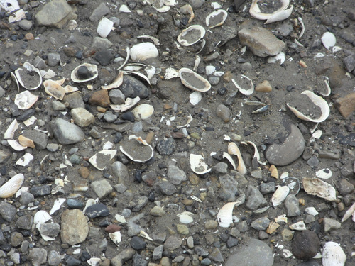
Next: Shell undergoes initial burial in sediment

Slide 16
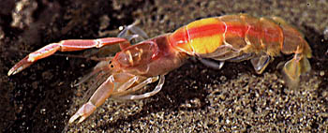
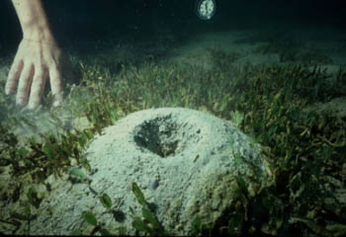
Shell might be exhumed after initial burial
Via “reworking” of sediment
  Can occur via water currents OR the burrowing activities of animals such as ghost shrimp

Slide 17
Next: Diagenesis
Usually Occurs in Sediment, After Burial

Slide 18
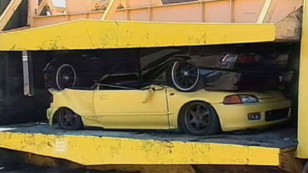
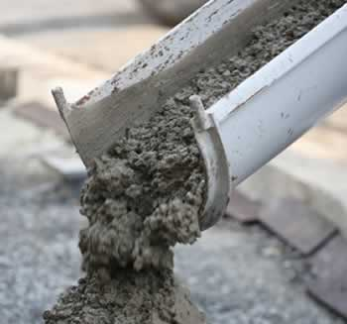
Diagenesis: Physical and/or Chemical Change
Compaction/distortion (physical alteration)
Cementation (additional of minerals: chemical alteration)
“Remineralization” (changes in minerals: chemical alteration)
Notes:
Diagenetic processes can include compaction/distortion, cementation (i.e., minerals can fill existing spaces within the fossil skeleton and/or cement the fossil to other fossils or rock fragments), and alteration or replacement of existing minerals.

Slide 19
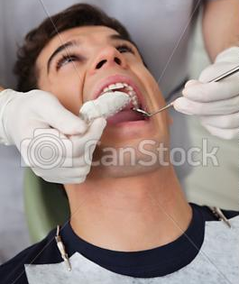
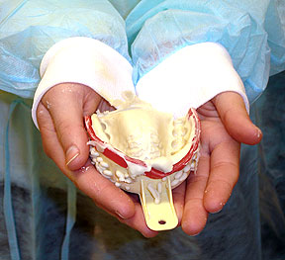
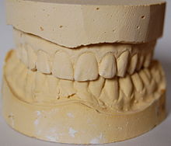
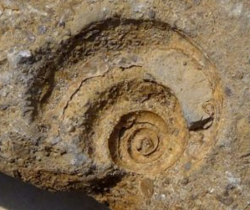
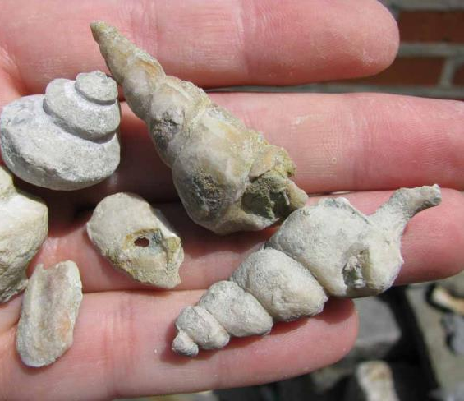
Preservation as Molds and/or Casts
Mold – has negative relief
Cast – has positive relief

Slide 20
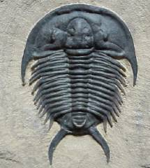
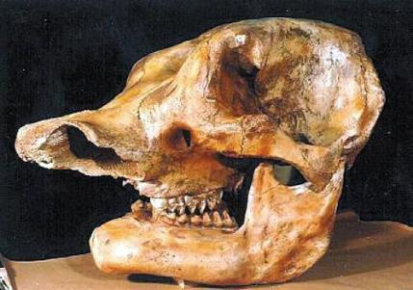
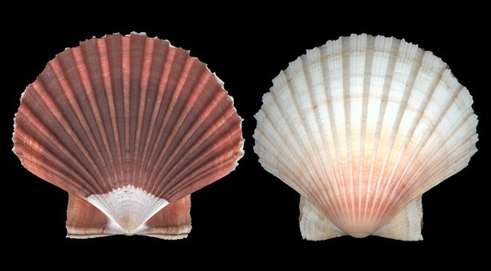
Preservation Potential
Hard parts (skeletal/shell material, which is made of minerals) = high preservation potential

Slide 21
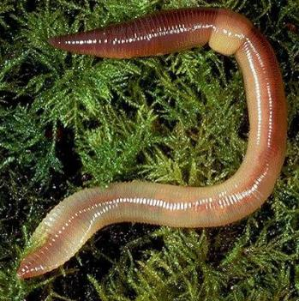
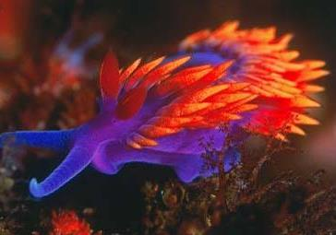
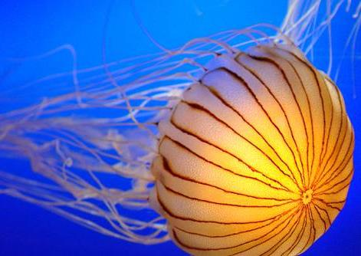
Preservation Potential
Soft parts (tissues, organs) = low preservation potential

Slide 22
Preservation Potential
Rapid burial provides best chance of fossilization
  Why?
    Burial protects biological material from many early-stage taphonomic processes, especially decay

