Slide 1
Asian American Art and Visual Culture
Fall 2026
Professor David L. Eng, Penn English and American Studies
Professor David Y. Kim, Penn Art History
Professor Homay King, Bryn Mawr History of Art and Film Studies

Slide 2
INTRODUCTION
Origins of Class
Introductions
Course Requirements
Notes:
INTRODUCTION
ORIGINS of class: 2026 first ASAM class never been an ASAM art history course
Why is this important?
Whitney Bienale
PMA American 1000+ works and by our count it seems that there are fewer than 4-5 artists
University
Why are we teaching this class?
25% of students are ASAM, 50% international students
Representation as Vetretung vs. Darstellung
Visual Representation vs. Political Representation
Our Backgrounds (art historian vs. )
This class is possible because

Slide 3
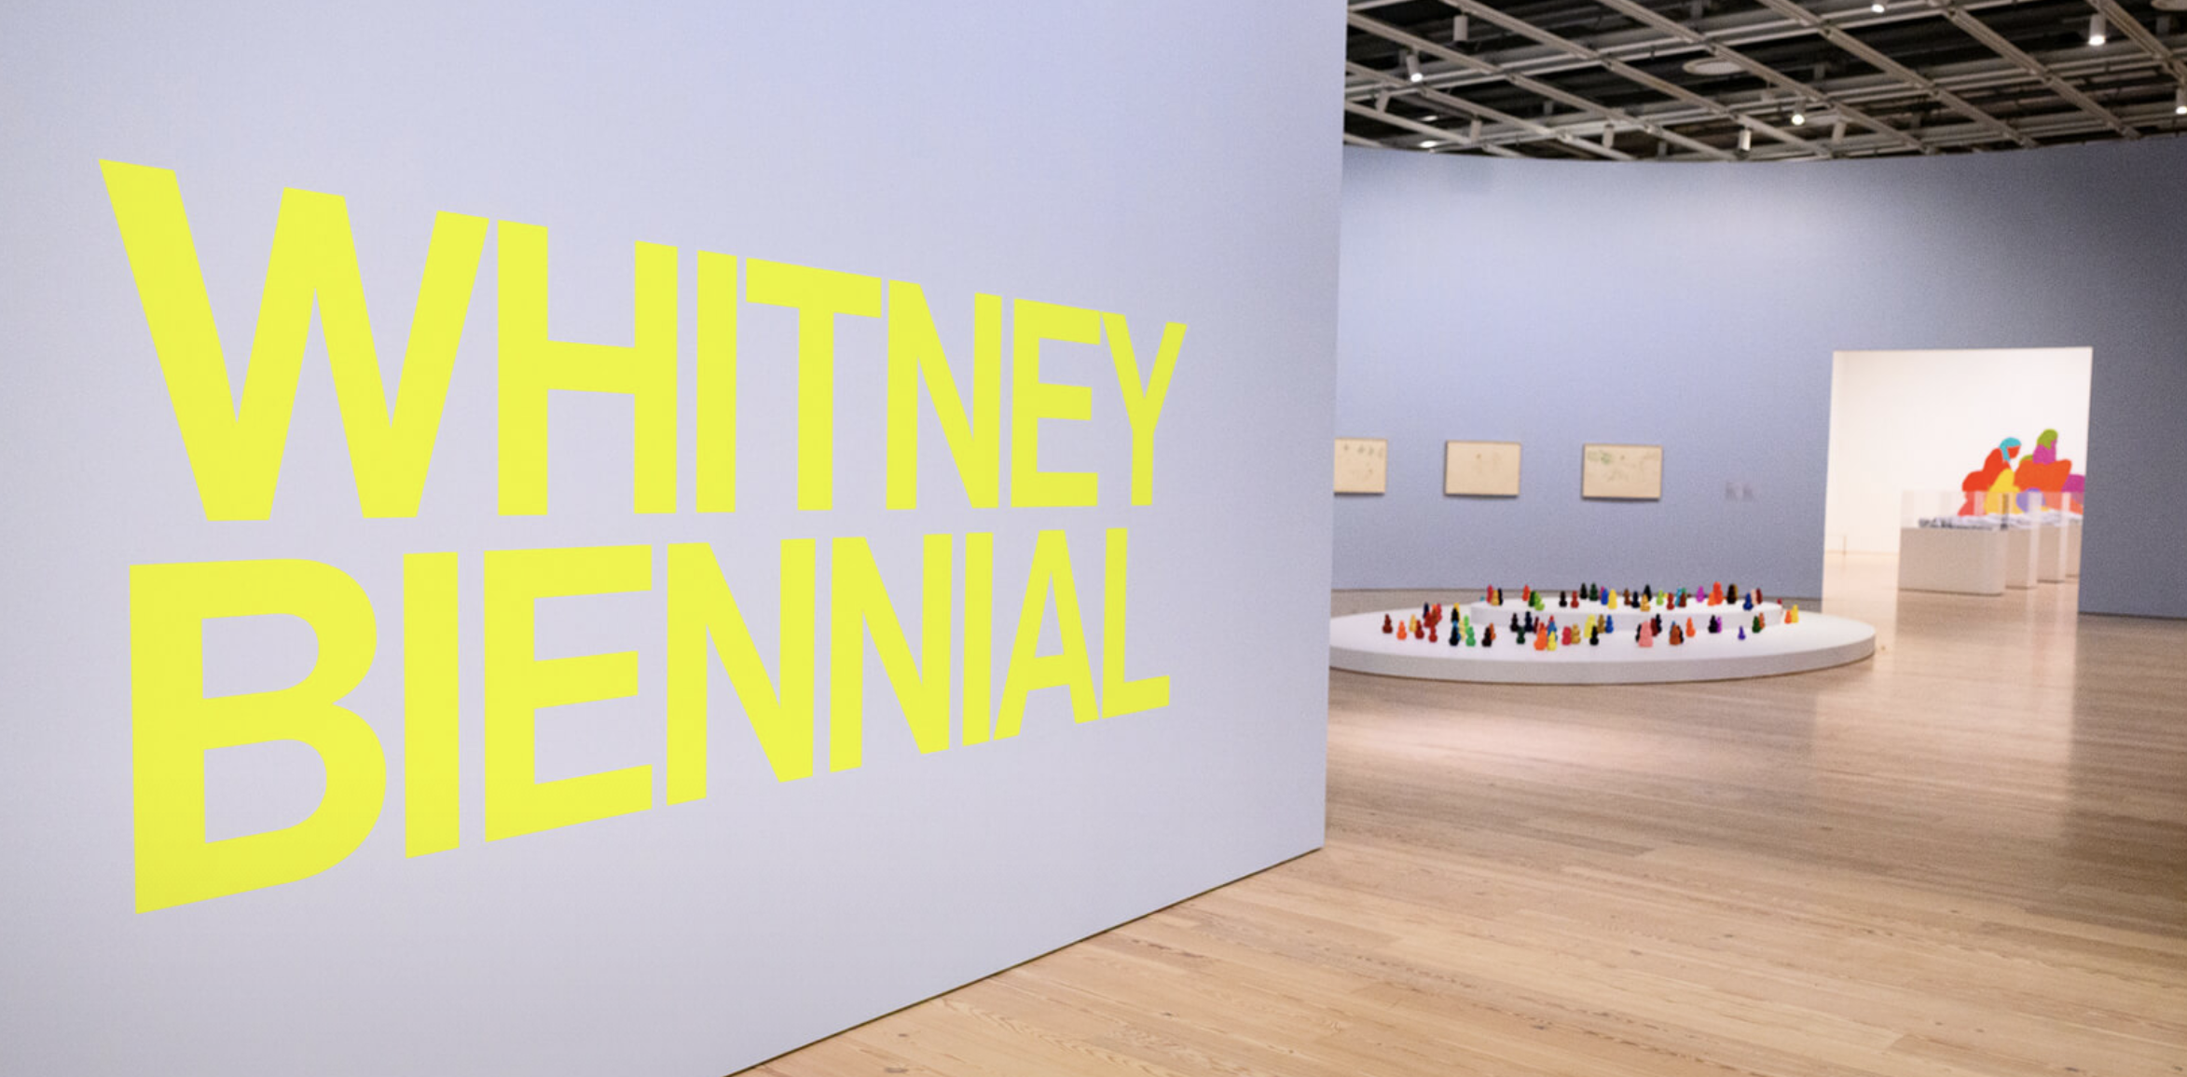

Slide 4
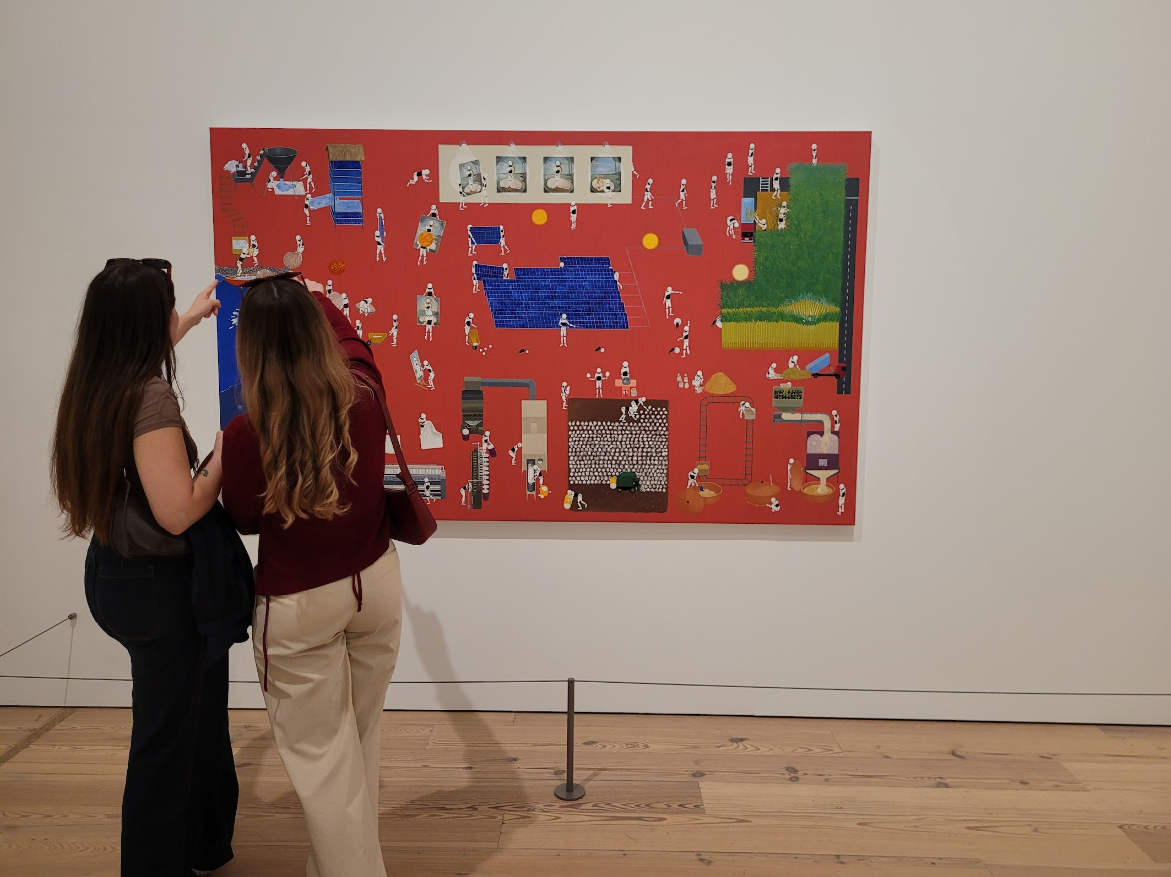
Akira Ikezoe, Robot Stories Around Solar Panels, 2025
Notes:
Akira Ikezoe paints elaborate circular systems, narratives with no beginning or end. They often include power sources—the sun, a nuclear power plant, and methane from cow feces. Energy flows from these sources throughout the compositions according to Ikezoe’s own imaginative logic, illuminating connections between humanity and nature.

Slide 5
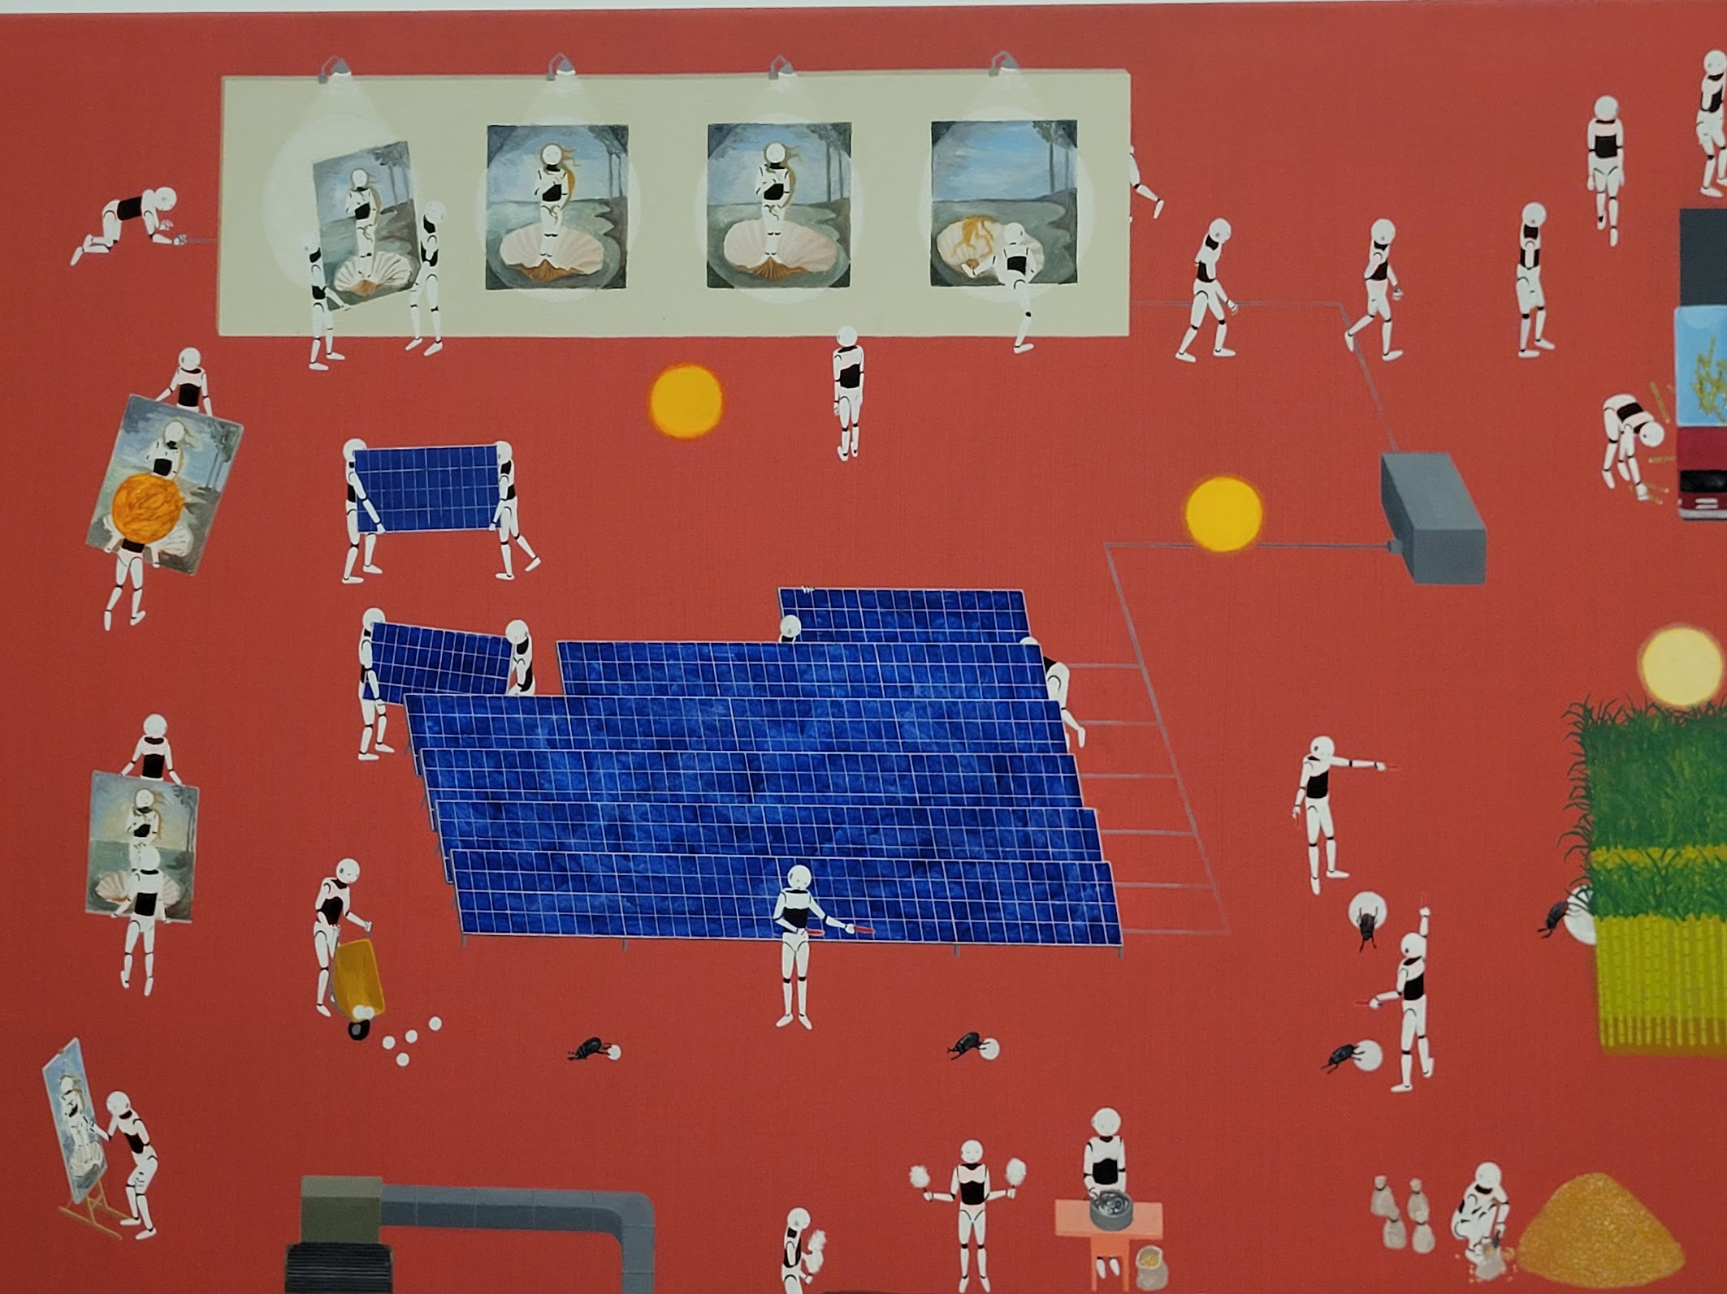

Slide 6
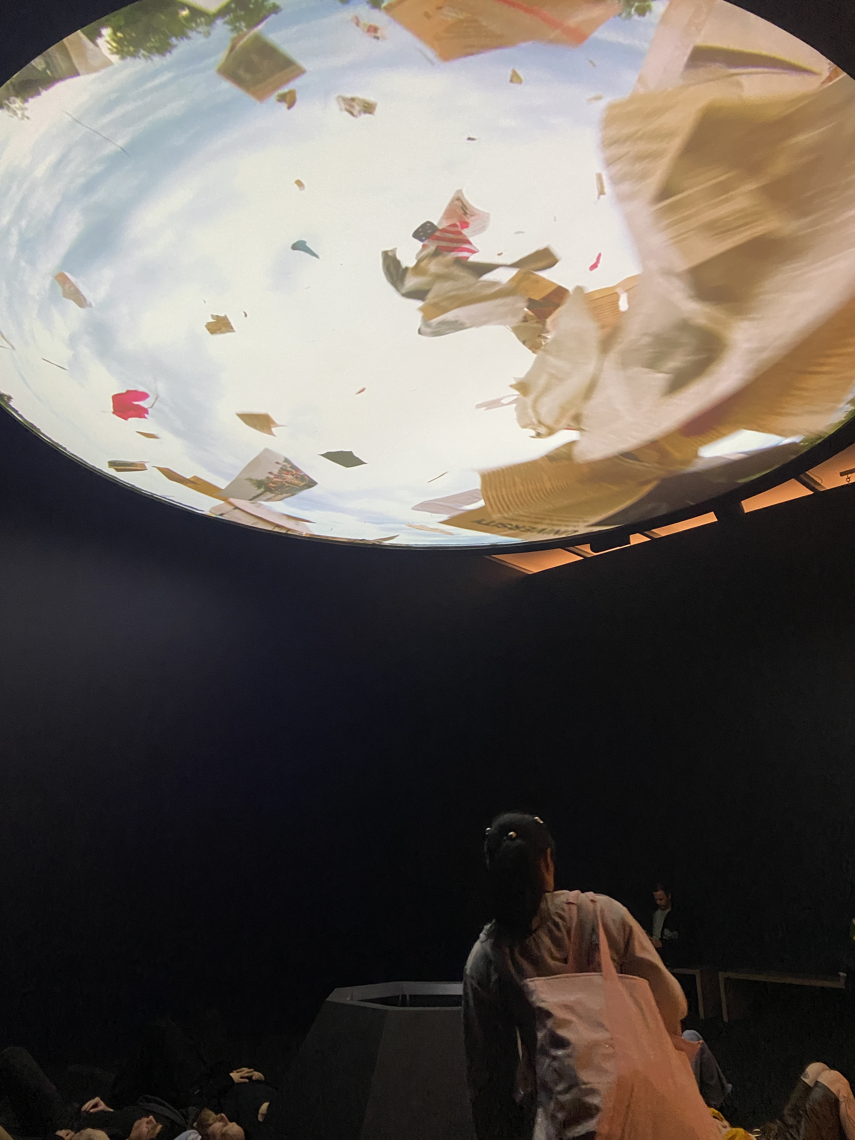
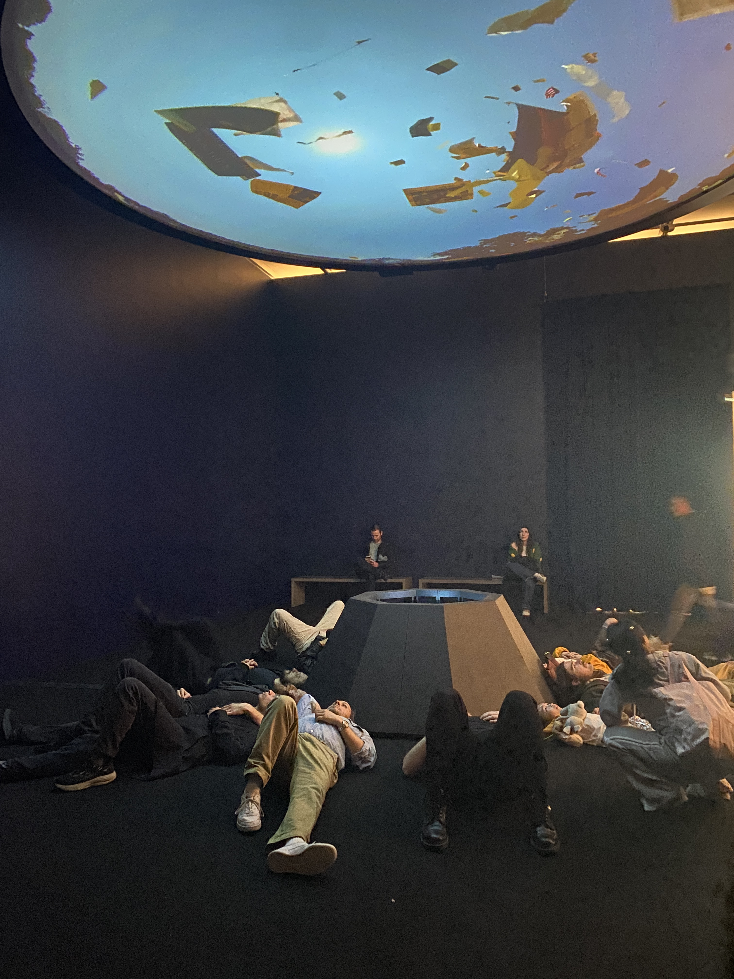
Michelle Lopez, Pandemonium, Whitney Biennial 2026

Slide 7
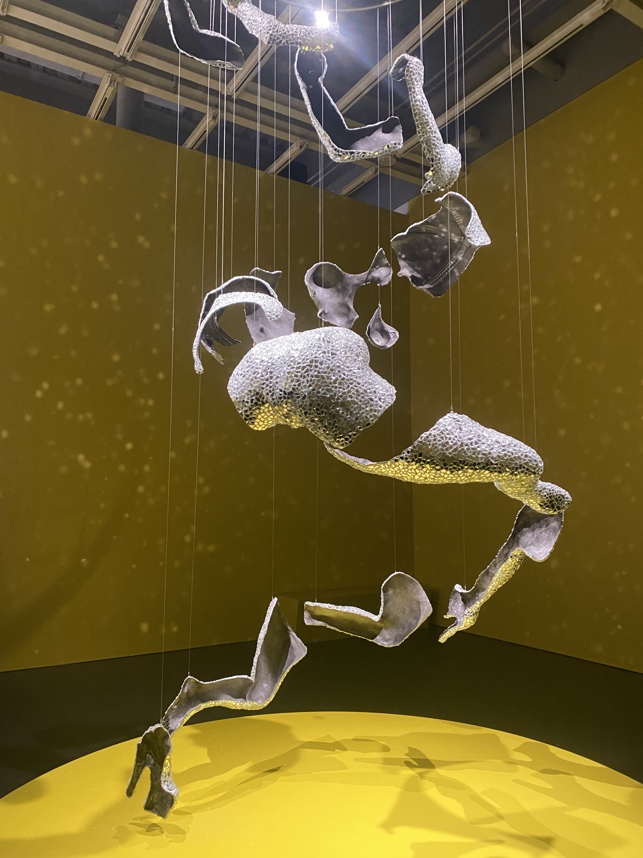
Young Joon Kwak, Whitney Biennial 2026

Slide 8
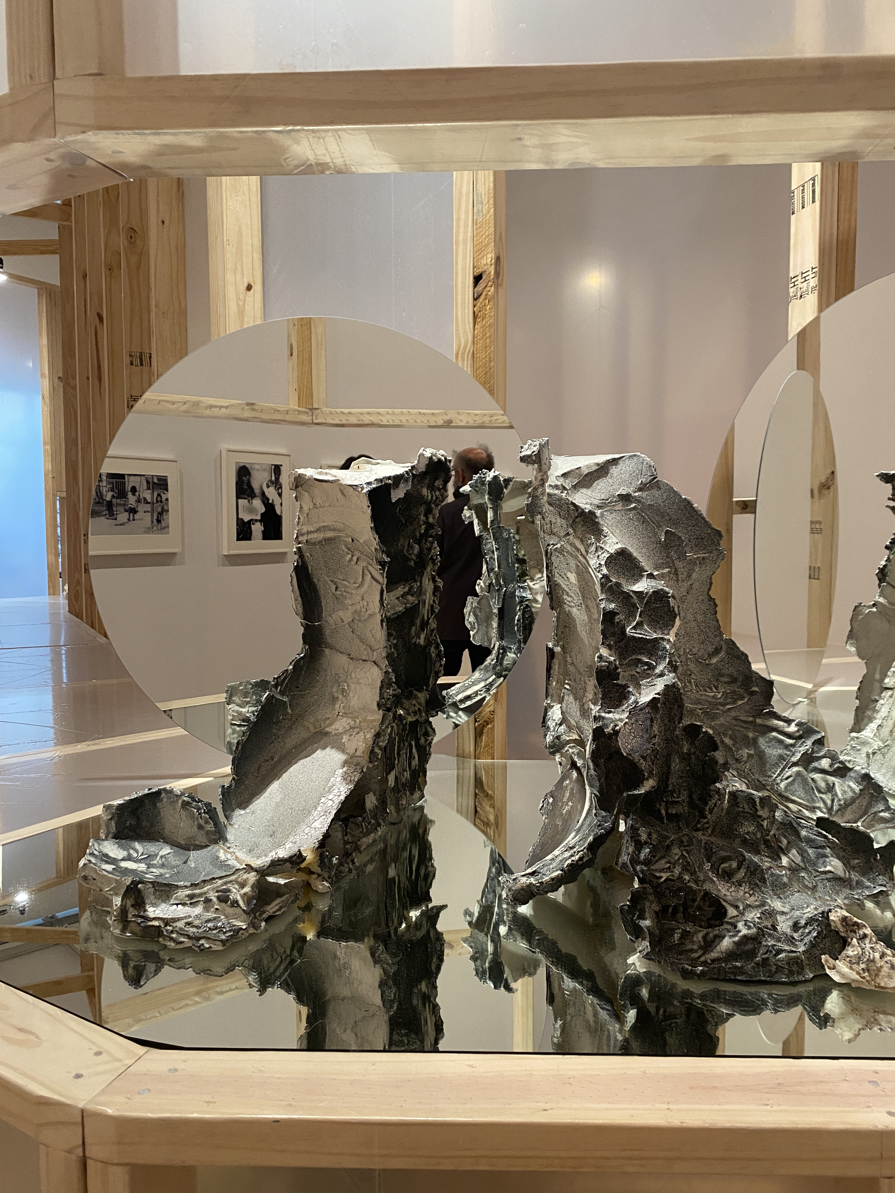
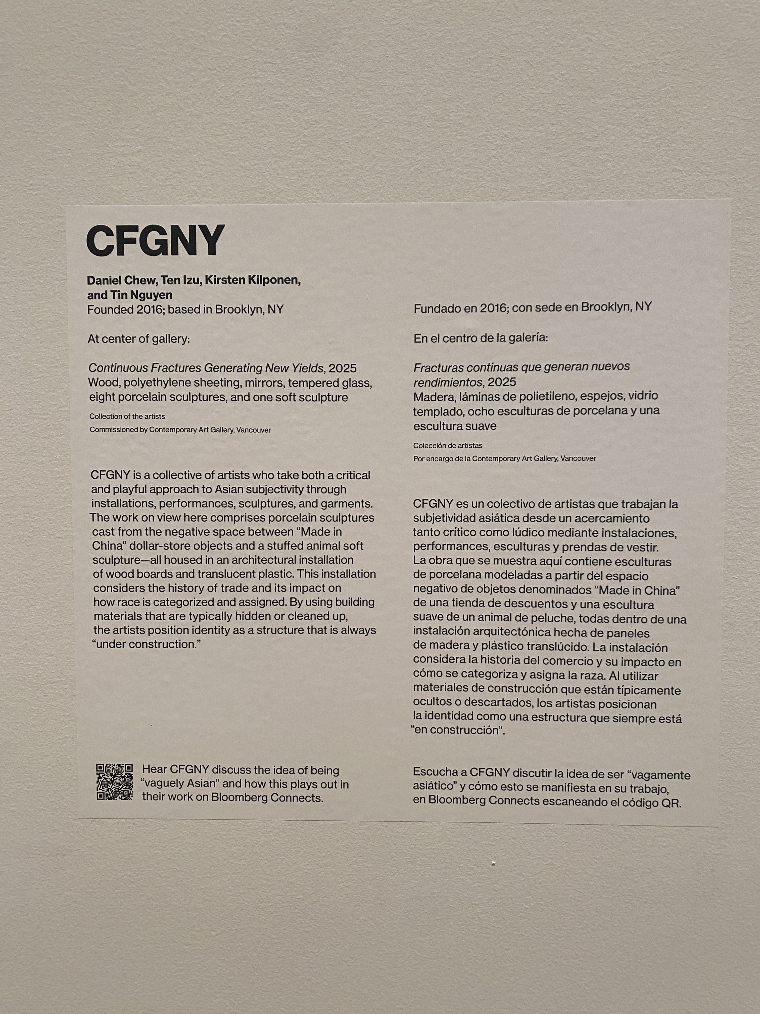
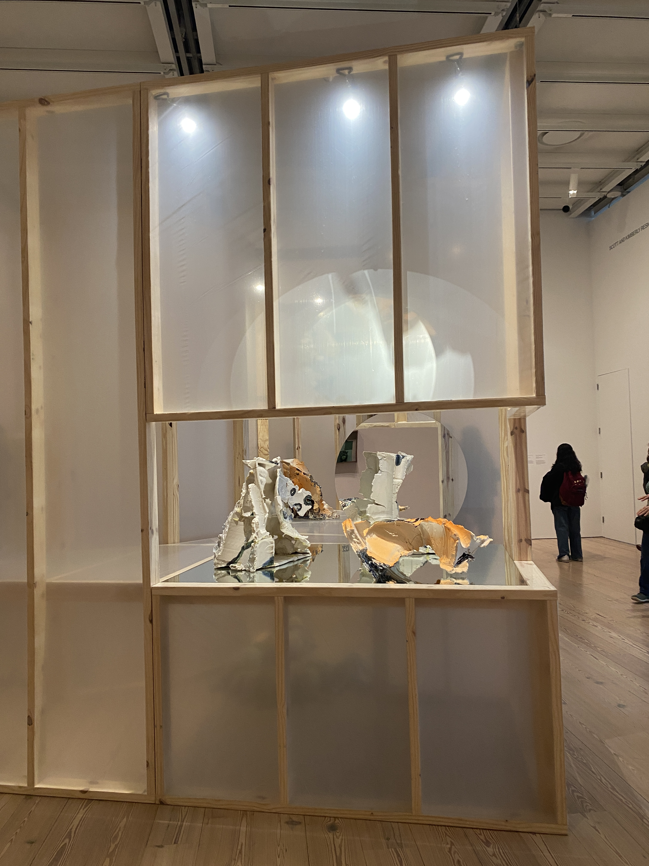
Concept Foreign Garments New York, Whitney Biennial 2026

Slide 9
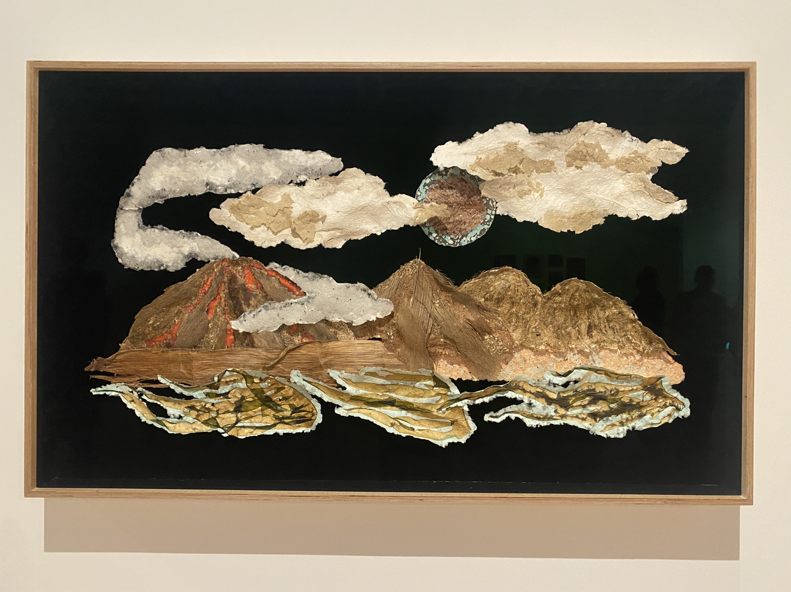
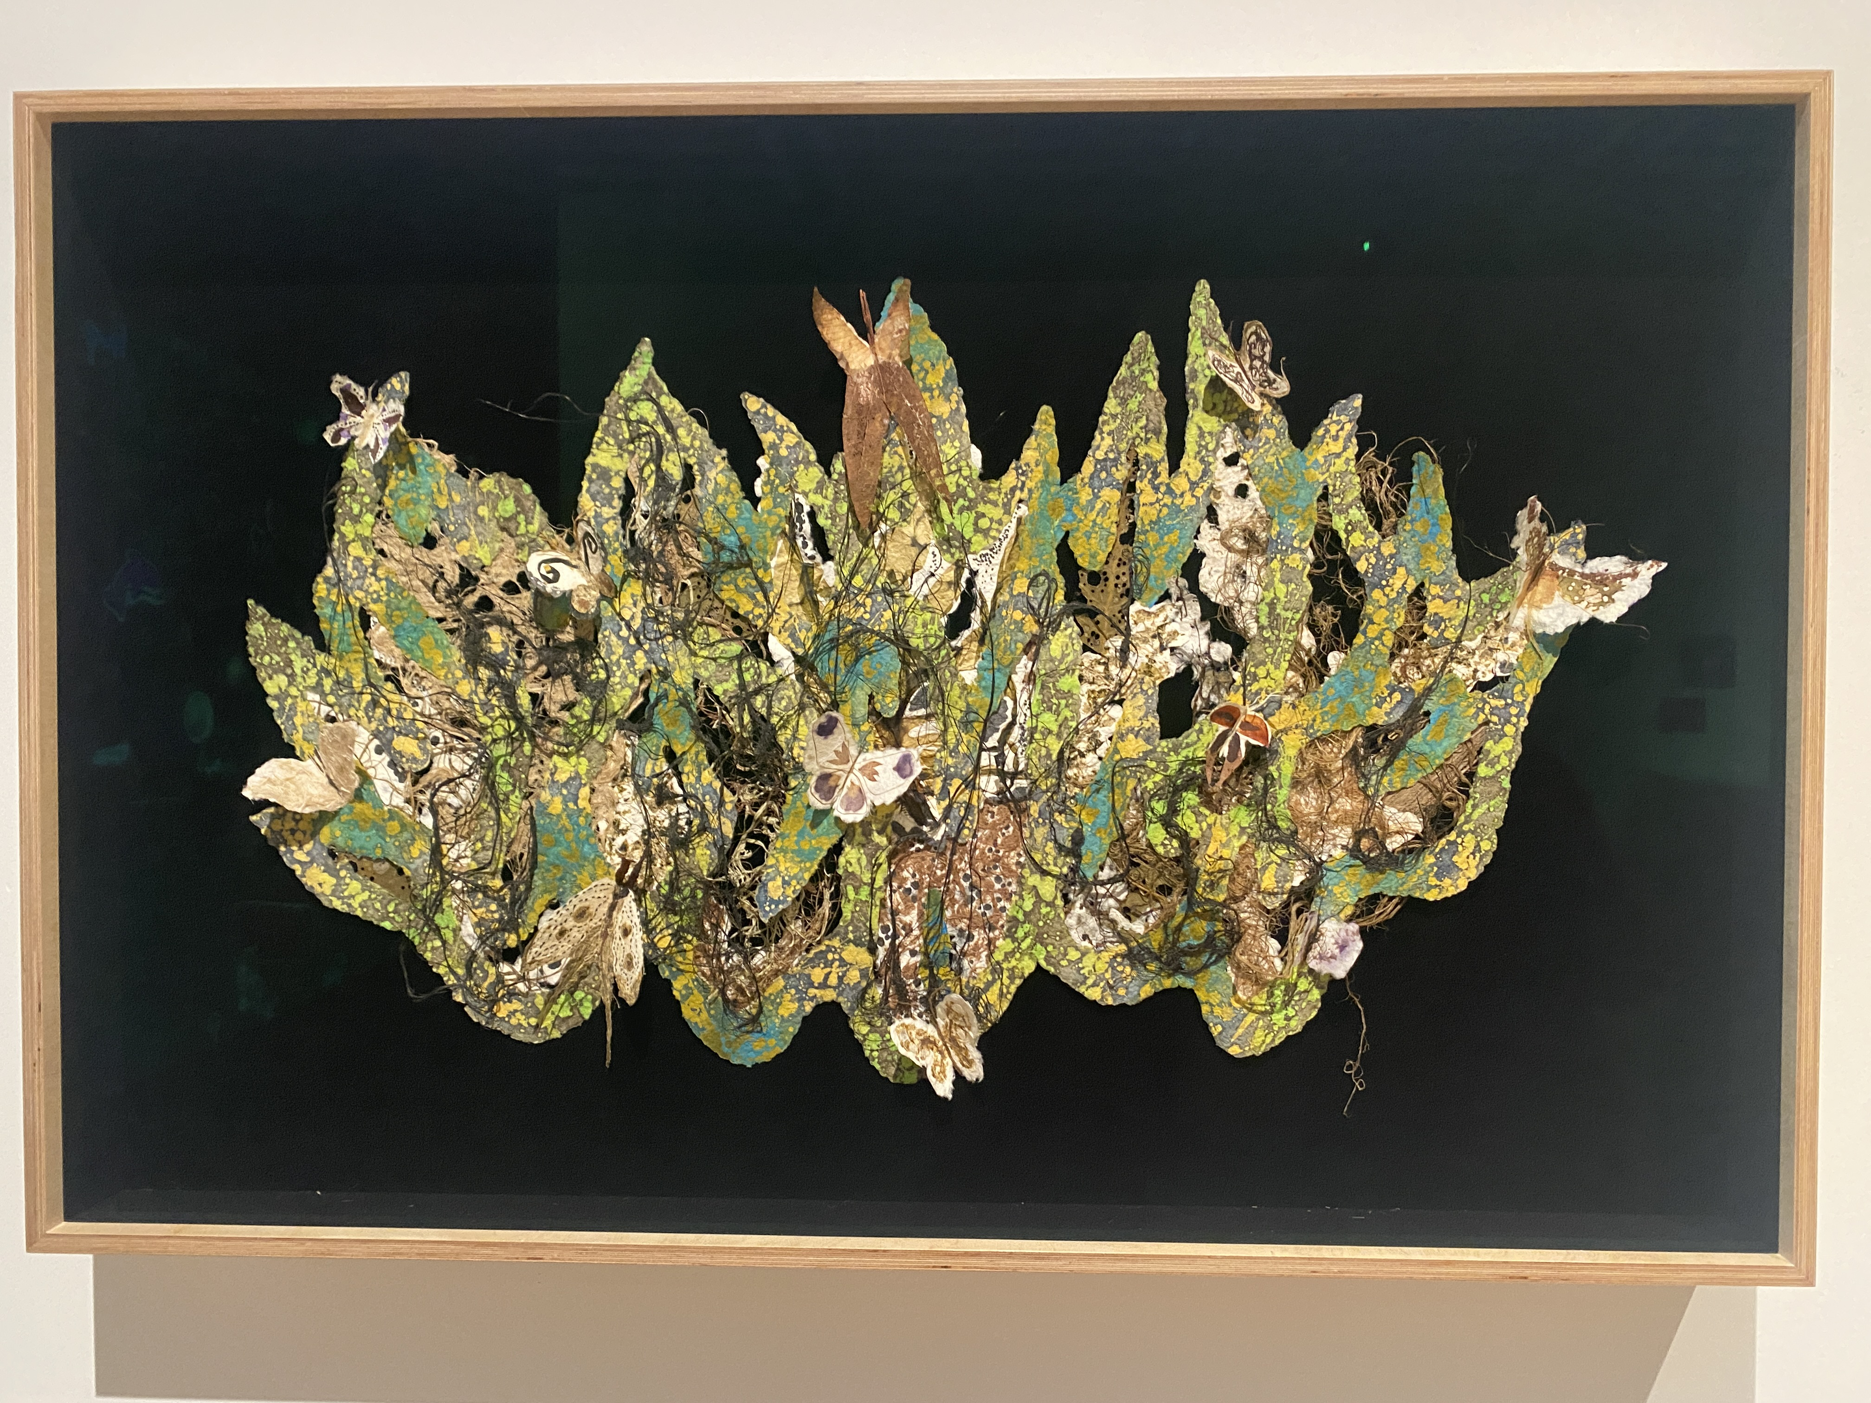
Enzo Camacho and Ami Lien, Whitney Biennial 2026

Slide 10
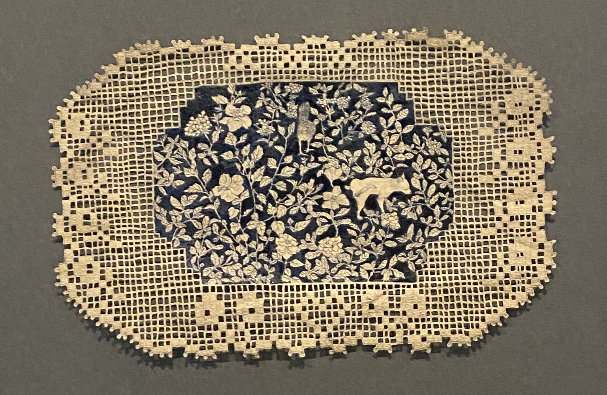
Jasmin Sian, Whitney Biennial 2026​

