Slide 1
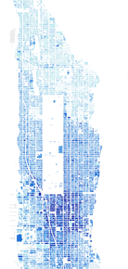
Principles of Mapping and Representation
FALL 2023, WEEK 2
Dr. Dirk Kinsey
dkinsey@brynmawr.edu
Office Hours: Tues 12-1pm and Thurs 1-2pm

Slide 2
https://www.nytimes.com/interactive/2022/12/13/climate/climate-footprint-map-neighborhood.html

Slide 3
Today’s Agenda
Lab Report instructions
Lecture: Principles of mapping and representation, Part A
Launch Lab 1
Quiz 1 will be Next Tuesday – (content from first two weeks of class lectures + 1st week reading [Bolstad Ch 1])

Slide 4
This Week
Read Bolstad, Chapter 4
  (focus on pp. 147-156 & 181-190)
Start Lab 1 – due M 9/17 (11:59PM)

Slide 5
Lab Reports
Format Matters!
Word [.doc or.docx] only
Upload to Moodle
Approximately 3-5 pages in length (of text), double spaced, 12-point font, with one-inch margins all around
  Times New Roman, Arial, or Calibri – email me if you have a reason for using another font
Use the following naming convention for all your lab reports: Lab#_YourFullName (e. g. Lab2_LeaBrown)

Slide 6
Full Lab Report
6 Sections:
  Introduction
  Methods
  Results
  Discussion
  Tables and Figures
  Summary of Operations
Introduction
  Goal of the GIS analysis, NOT the assignment learning objective
    What question is this analysis trying to answer

Slide 7
Lab Report
Methods
  HOW you did the analysis
  What operations did you use?
  Use GIS jargon to demonstrate you are learning the material
  Helps me figure out what went wrong
  Bullet points are fine for this section
Results
  Description of the results of your analysis
  NOT the maps or tables (those go at the end) – a written (text) description of the patterns or relationships you found
  Usually 1-2 paragraphs
  NOT commentary or opinion – just the facts

Slide 8
Lab Report
Discussion
  Most substantial part of the report
  Where you interpret your results and put them in context
  Answer several subtopics (see Lab Report instructions for specific questions):
    Limitations to the data and analysis
    Extensions to the analysis
    Application for decisionmakers
  This is where you can have commentary and opinion
Tables and Figures
  Insert the maps, tables, etc. that you created as part of your analysis
  Make sure they are clearly legible – bigger is better than smaller
Summary of Operations
  Make a table in your lab report that copies the table at the end of your lab instructions
  Fill out the description of operation and steps to complete operation for each of the operations listed – this will become your “cheat sheet” reference throughout the semester

Slide 9
Slim Lab Report
The Slim Lab Report has only 3 sections:
  Results
  Tables and Figures
  Summary of Operations
Lab 1: Full Report required
Lab 2: Slim Report only
Labs 3-6: 2 Full & 2 Slim – your choice which is which
Lab 7: Slim Report only
Lab 8: Full Report required (this final lab has an extra credit option)

Slide 10
Maps as Models
Maps are models of reality
They emphasize some aspects of reality in a cartographic representation while ignoring or greatly simplifying other aspects of reality.
All models are wrong – some are useful!

Slide 11
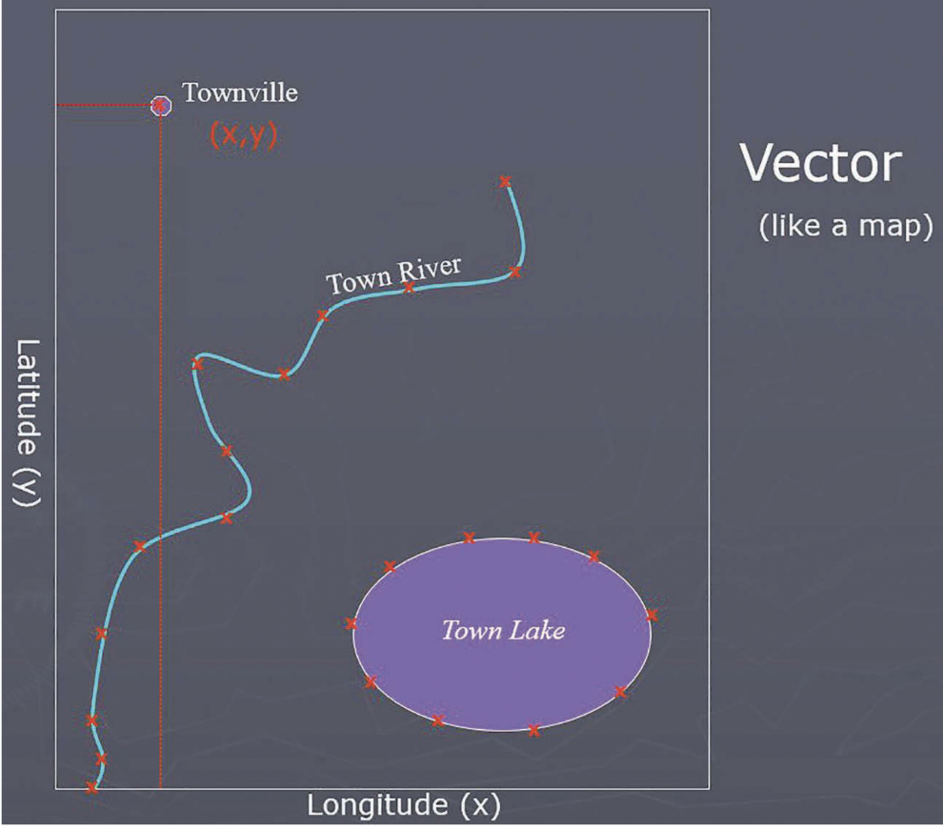
Geometric Representation
A point is composed of one coordinate pair representing a specific location in a coordinate system (eg. x,y)
A line or polyline is composed of a sequence of two or more coordinate pairs called vertices.
A polygon is composed of three or more line segments whose starting and ending coordinate pairs are connected. Polygons represent both length (i.e. the perimeter of the area) and area

Slide 12
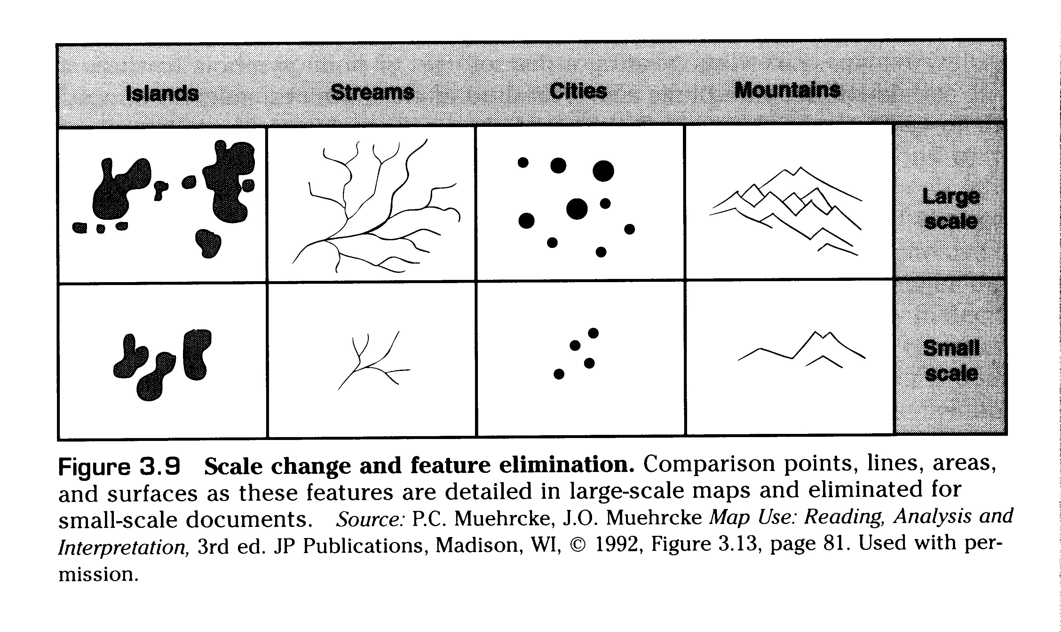
Generalization
Human and Natural environments are hyper-complex and full of infinite detal.
Maps work by reducing detail and grouping phenomena together.
Smoothing, combining, simplifying, selecting, ect.

Slide 13
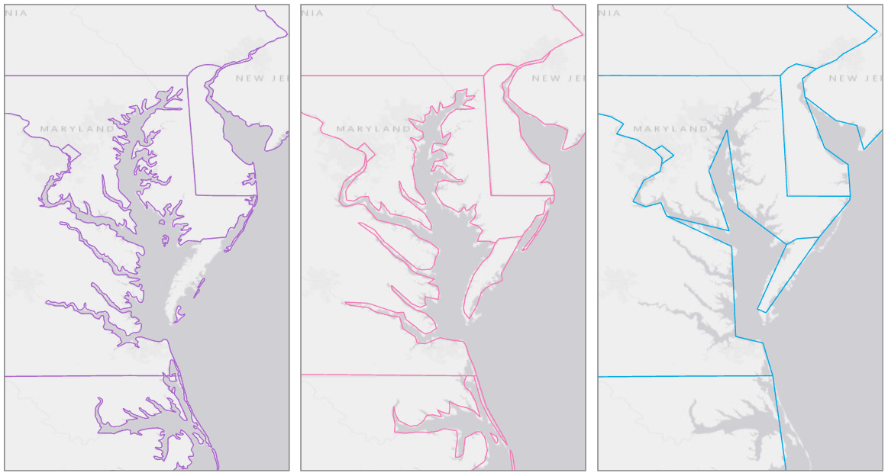
Generalization

Slide 14
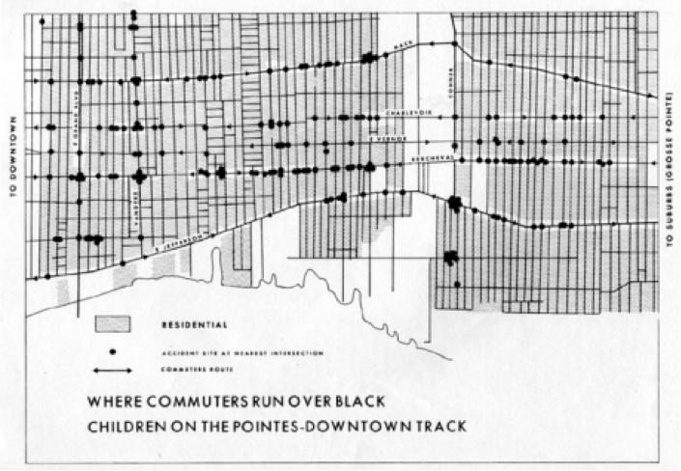

Slide 15
Scale
What is scale?
The relationship between distance on the map and distance on the ground
The amount of reduction in the representation of a real world geographic phenomenon on a map: the ratio of map distance to earth distance

Slide 16
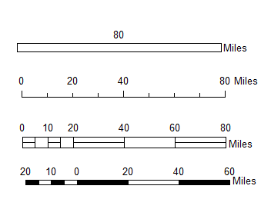
Expressing Scale
Scale Bar

Slide 17
Expressing Scale
Verbal/Written Scale
Simply states what distance on the map is equal to what distance on the ground
1 inch = 2000 feet
One inch equals 200 feet

Slide 18
Expressing Scale
Representative fraction
A representative fraction indicates ratio between the number of units on the map to the number of units on the ground.
Note that the units are the SAME in the numerator and denominator
1: 24,000
Map Distance
Ground Distance

Slide 19
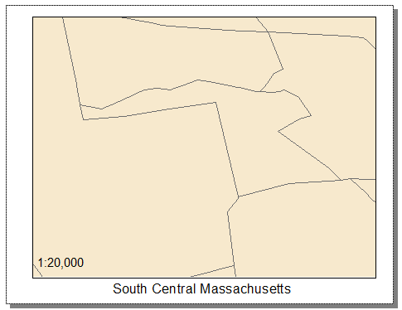
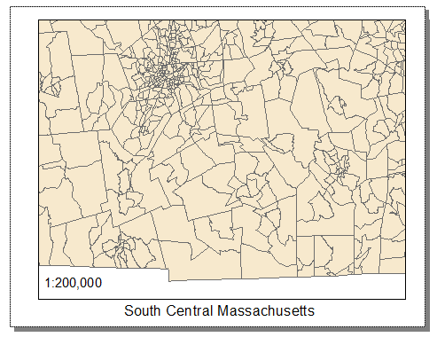
Large vs. small scale
Cartographic Convention for expressing scale
Large Scale
vs.
Small Scale
1:20,000
1:200,000
Large scale maps show a smaller amount of area with a greater amount of detail. The geographic extent shown on a large scale map is small. A large scaled map expressed as a representative scale would have a smaller number to the right of the ratio.
Small scale maps show a larger geographic area with few details on them. The RF scale of a small scale map would have a much larger number to the right of the colon.
https://www.gislounge.com/understanding-scale/

Slide 20
Large vs. small scale
Cartographic Convention for expressing scale
Large Scale
(Fine details)
Small Scale
(Coarse details)
Large scale = larger fraction = zoomed in
– think LARGE features
1:20,000
Small scale = small fraction = zoomed out
– think small features
1:200,000

Slide 21
Scale and Extent
Map Extent or Scope
Limit of the geographic area shown on a map
In GIS: defines the geographic boundaries for displaying information within a data frame
Viewed area
In the same size frame, larger scale = smaller extent

Slide 22
Levels of Measurement
Nominal: equivalence
e.g. land cover (residential, industrial, forest)
Ordinal: ranking
e.g. city size (small to large)
Interval: ratio assuming an arbitrary 0 value
e.g. temperature in degrees F or Celsius or time on a 12-hour clock
Ratio: ratio assuming a true 0 value
e.g. rainfall in inches

Slide 23
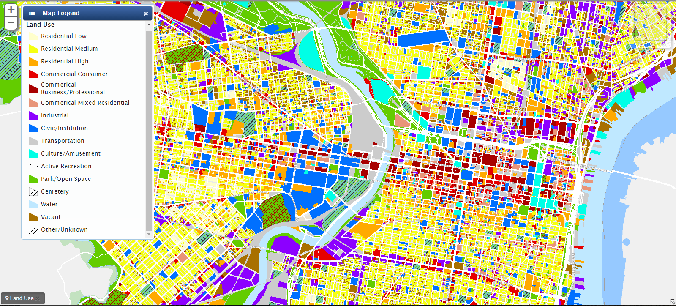
Nominal Data
Categorical data (qualitative)
Qualitative measurements-- used to distinguish one object from another (e.g. zoning and land cover)
Nominal scale data that has only two categories (e.g. male /female) is called dichotomous

Slide 24
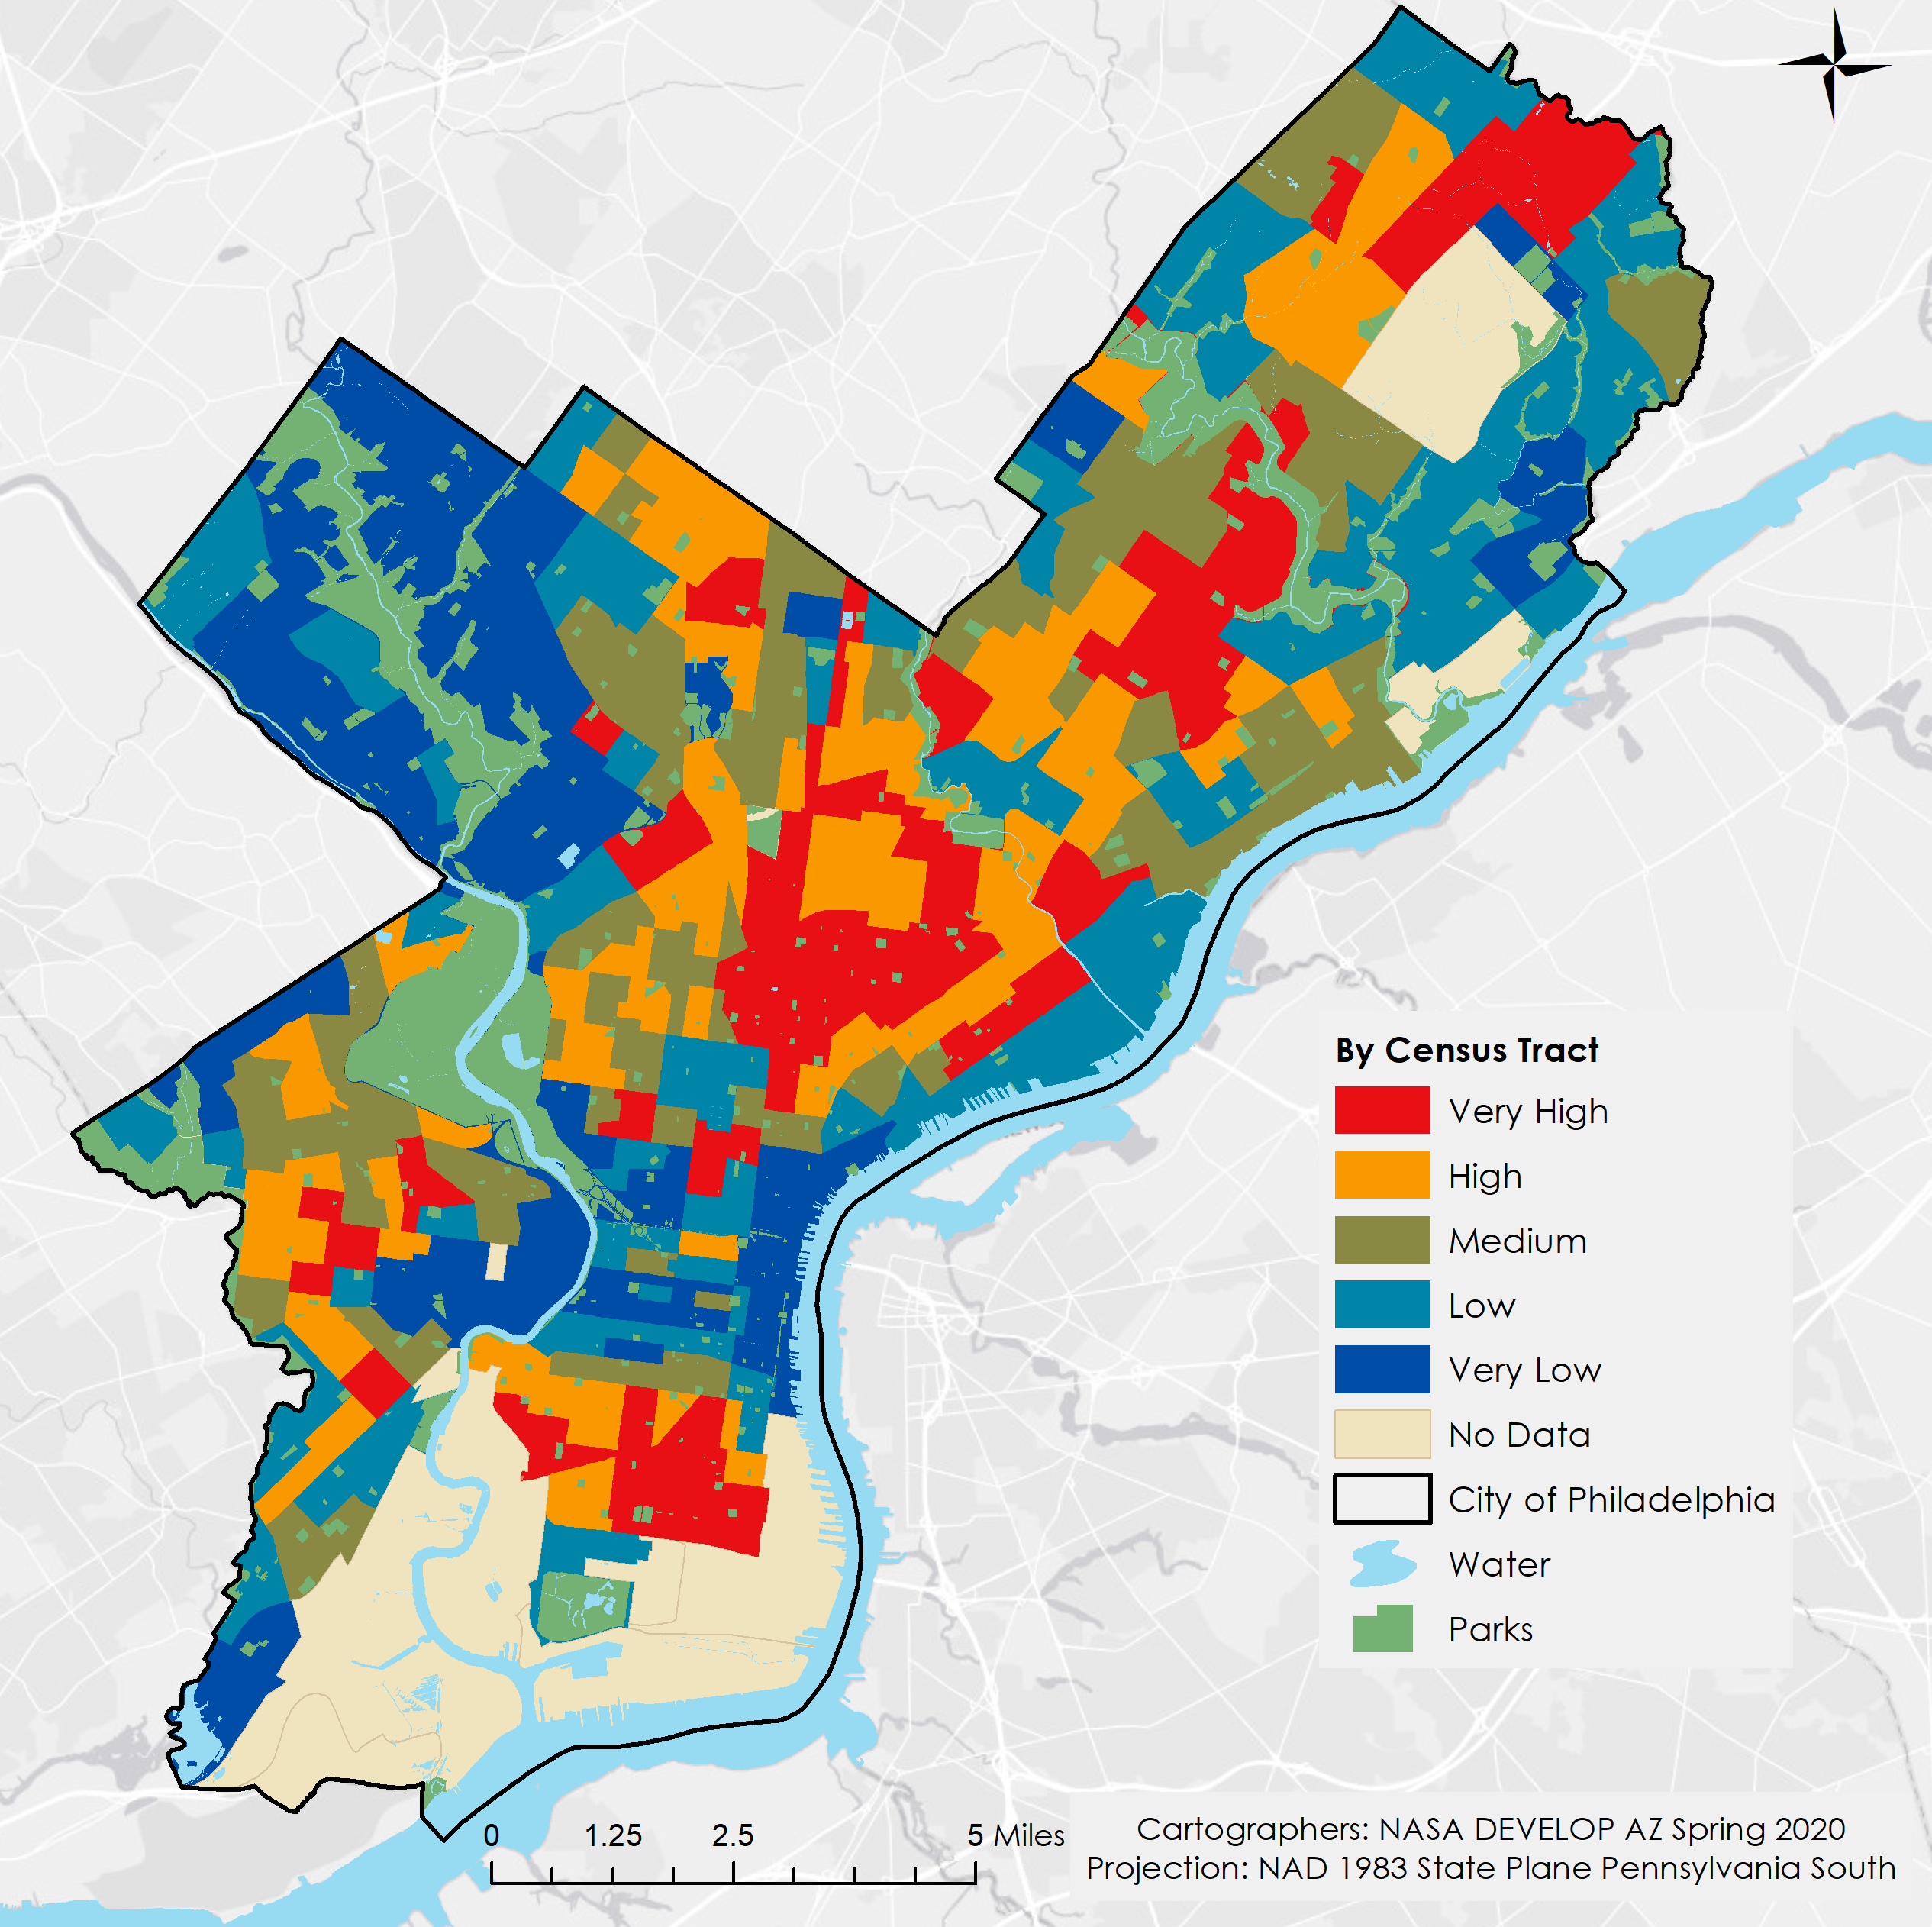
Ordinal Data
Ranking data (quantitative measurement): a rank order or scale by values

Slide 25
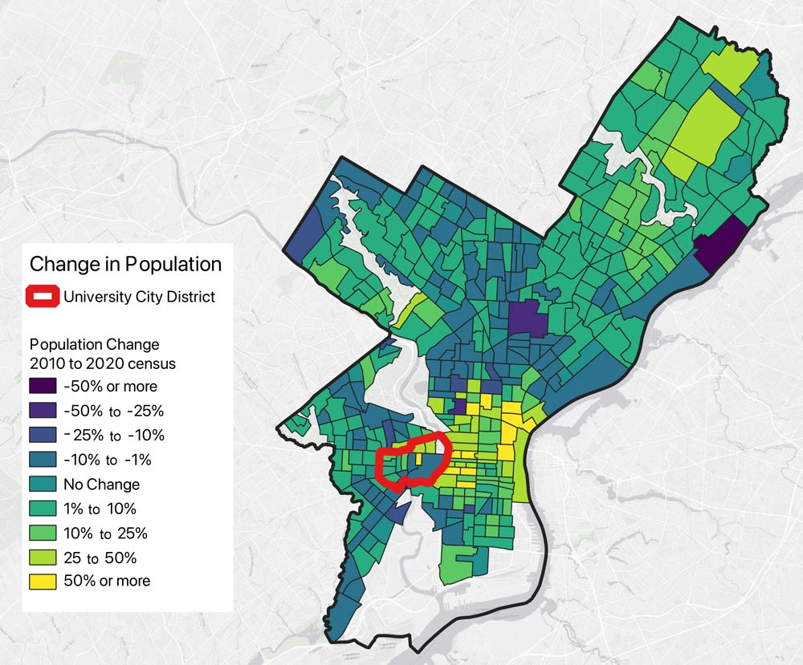
  Interval Data
Numeric measurement along a continuous scale (quantitative)
Reflect order and differences between values

Slide 26
  Ratio Data
    Quantitative measurements:
    Reflect order, differences between values make sense, and there is an absolute zero (zero indicates absence of phenomenon).

Slide 27
Types of Maps
Reference Map
Thematic Map
  Qualitative
  Quantitative
    Dot Density
    Isarithmic Map
    Cartogram
    Proportional Symbol
    Choropleth Map

Slide 28
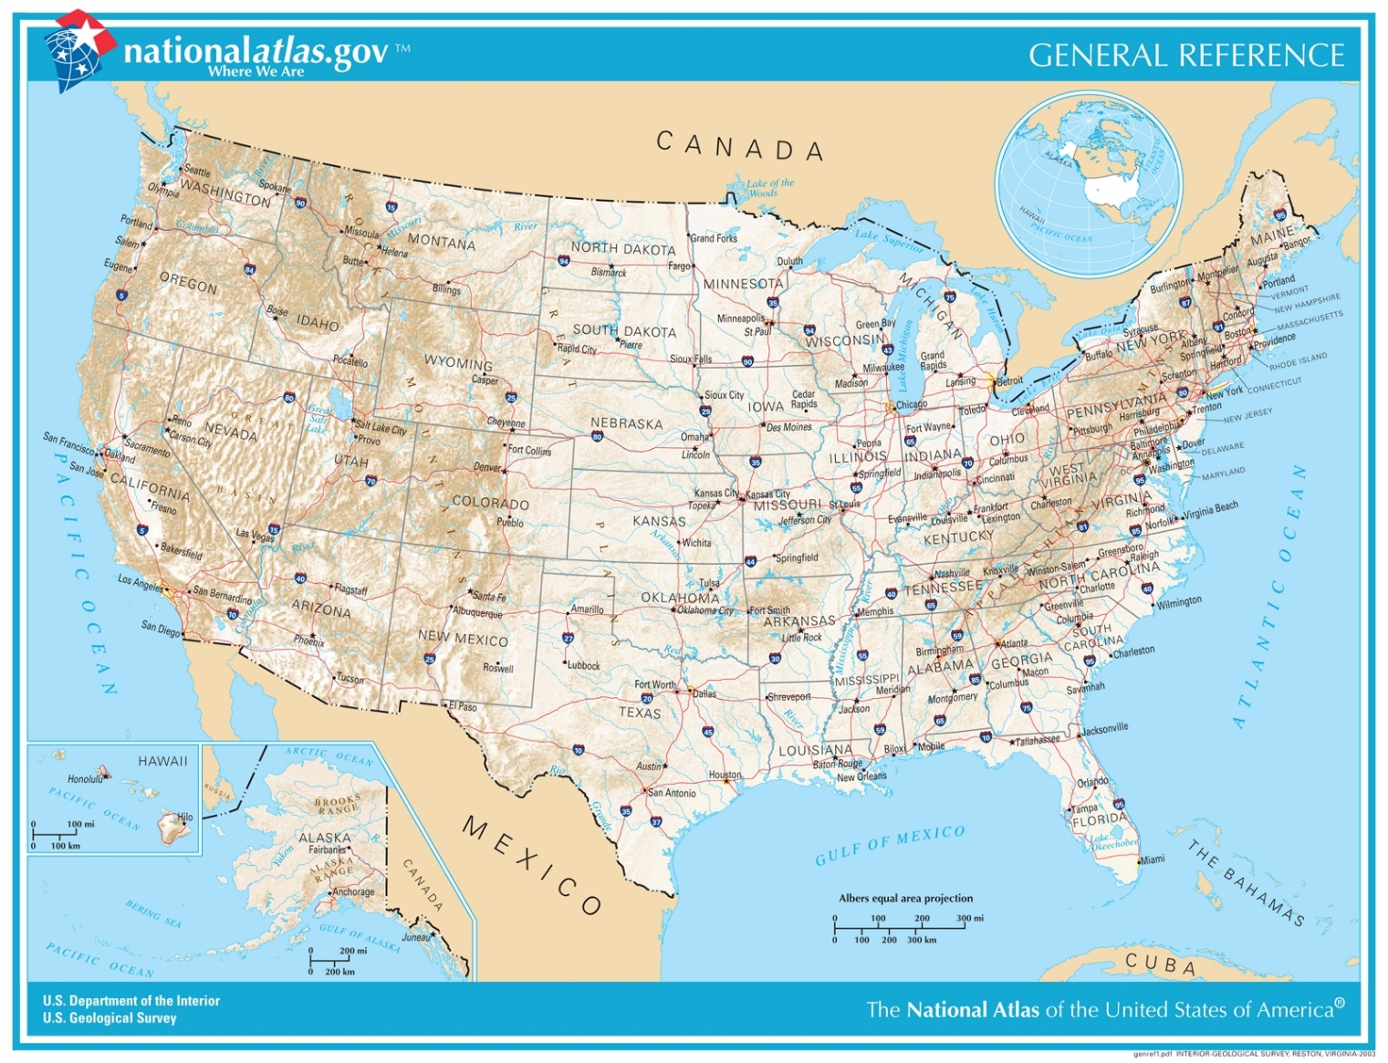
Reference
Designed to show where geographic features are in relation to each other
Simple - showing important physical (natural and human-made) features in an area (e.g. street and tourist maps)

Slide 29
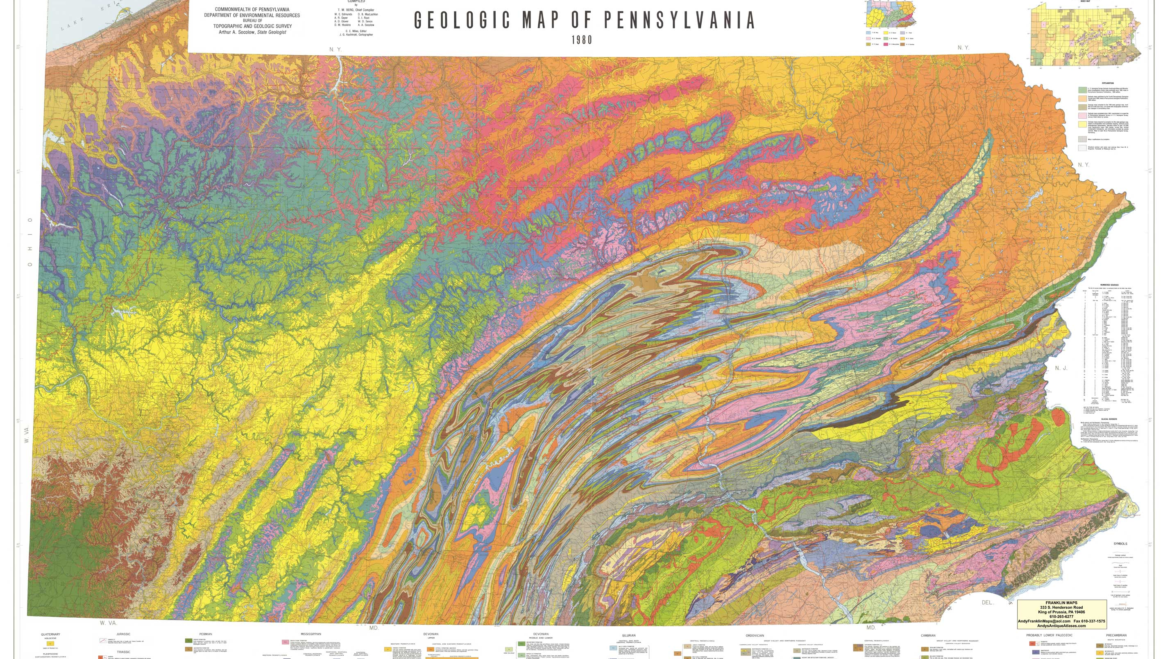

Slide 30
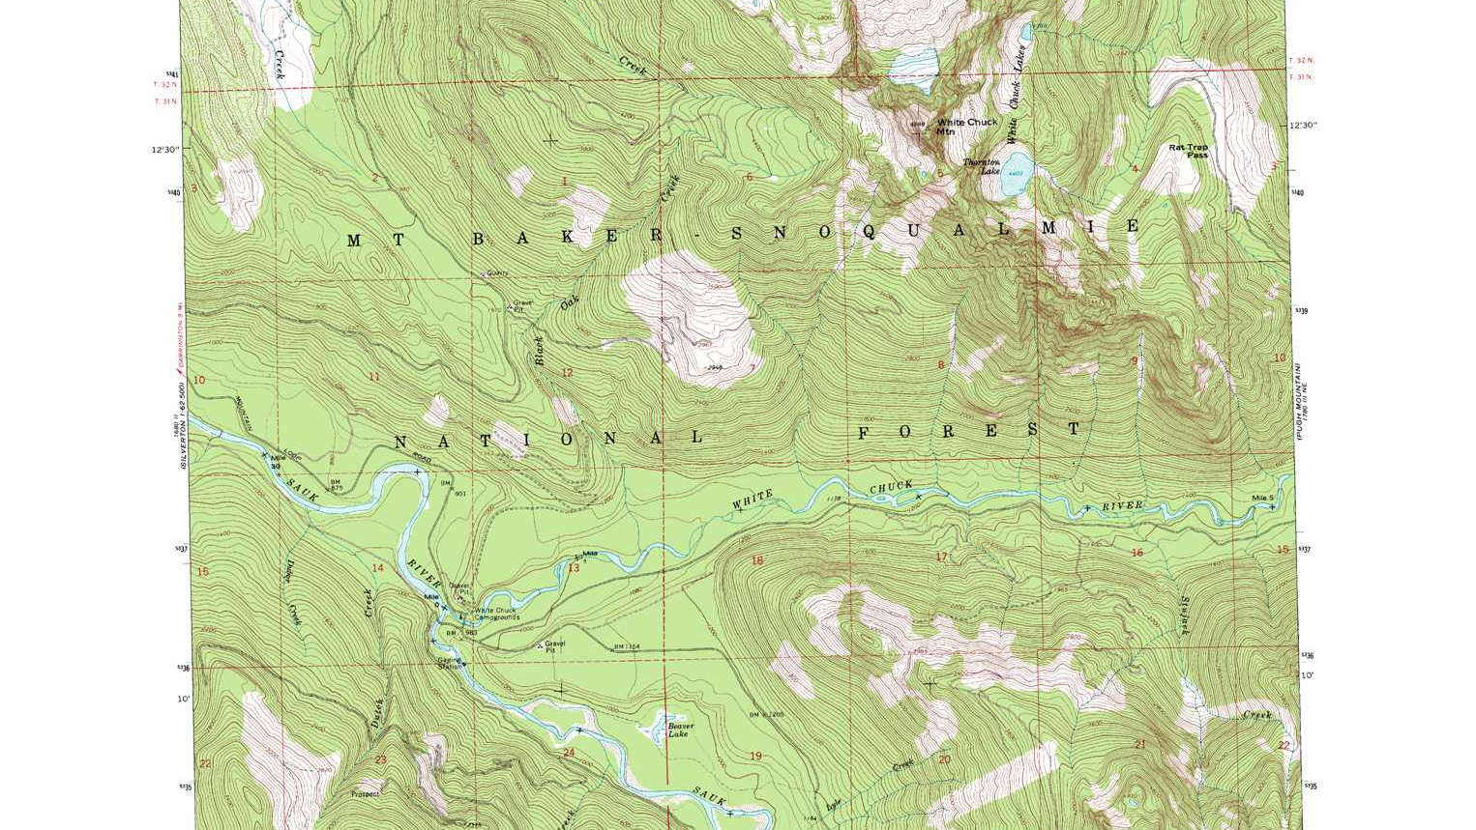

Slide 31
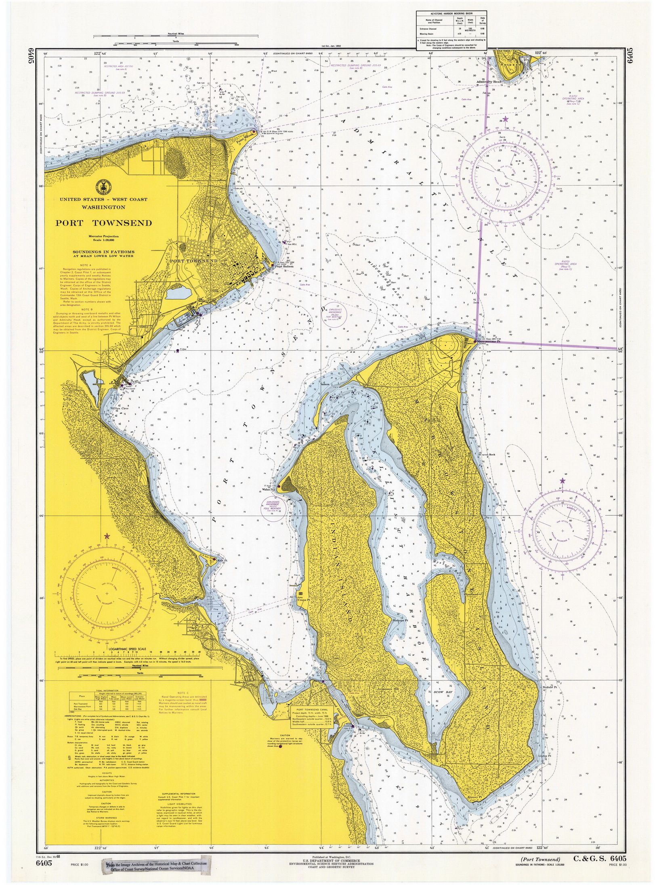

Slide 32
Thematic Maps
Thematic maps focus on a specific theme.
They pull together relevant information of the subject (Covid cases, election results, income distribution, etc.) and represent the data spatially to understand the relationship between these themes and their geographic locations.
Types of thematic maps
  Dot Map
  Isopleth Map
  Cartogram
  Proportional Symbol
  Choropleth Map

Slide 33
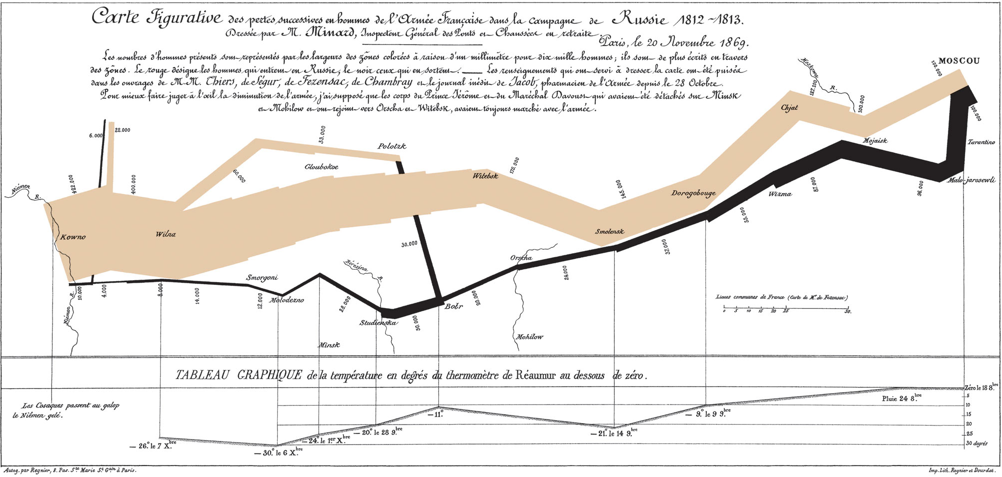
Notes:
Minard's 1869 flow map of Napoleon's invasion of Russia in 1812–1813. Early example of a thematic map. Notice all of the different kinds of data represented (spatial, temporal, weather, troop size). Does the map do a good job of representing a lot of data? Is all that data necessary or does it detract?

Slide 34
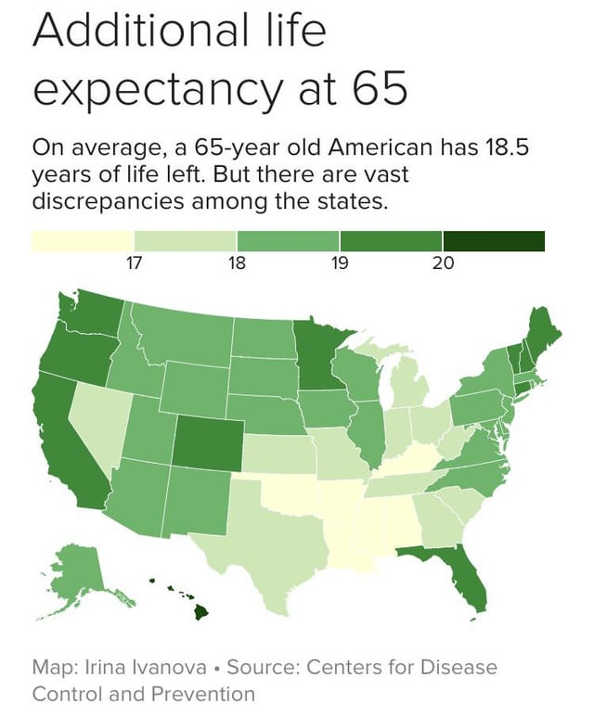
Choropleth
Uses color to represent statistics proportionally to its location.
The visual tends to generalize the data over an area.
Geographical spaces aren’t uniform so some areas may appear overrepresented.
Notes:
Notice how the generalization of the map tends to obscure any potential variation in life expectancy within a state

Slide 35
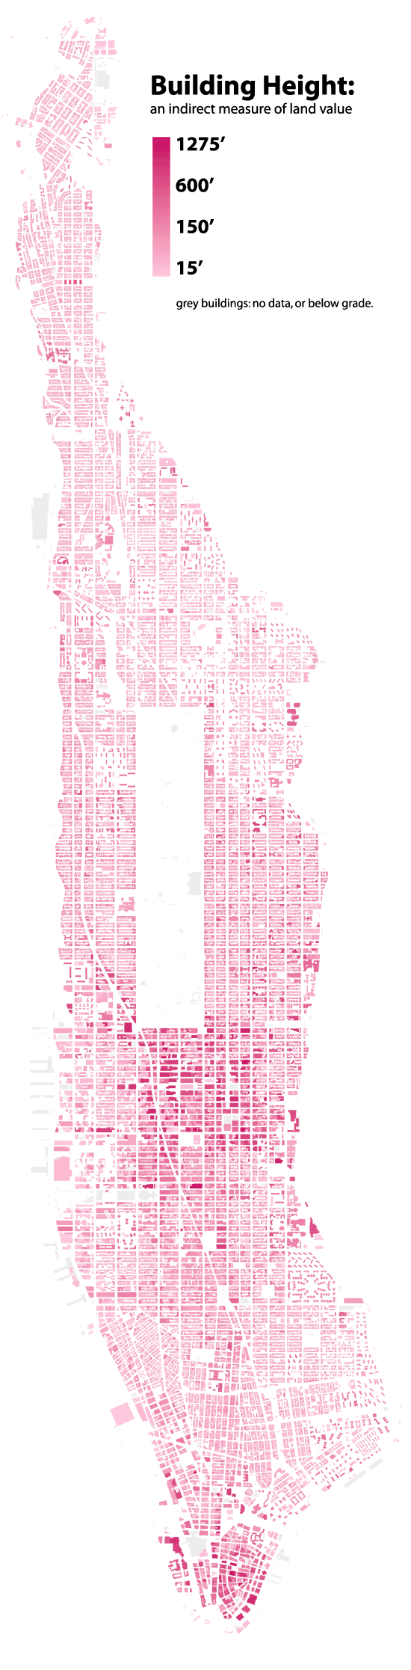
Notes:
Map shows both building height, but also implies something about wealth inequality and the relative distribution of capital within Manhattan. Color ramp continuous, no classes. What purpose does that serve?

Slide 36
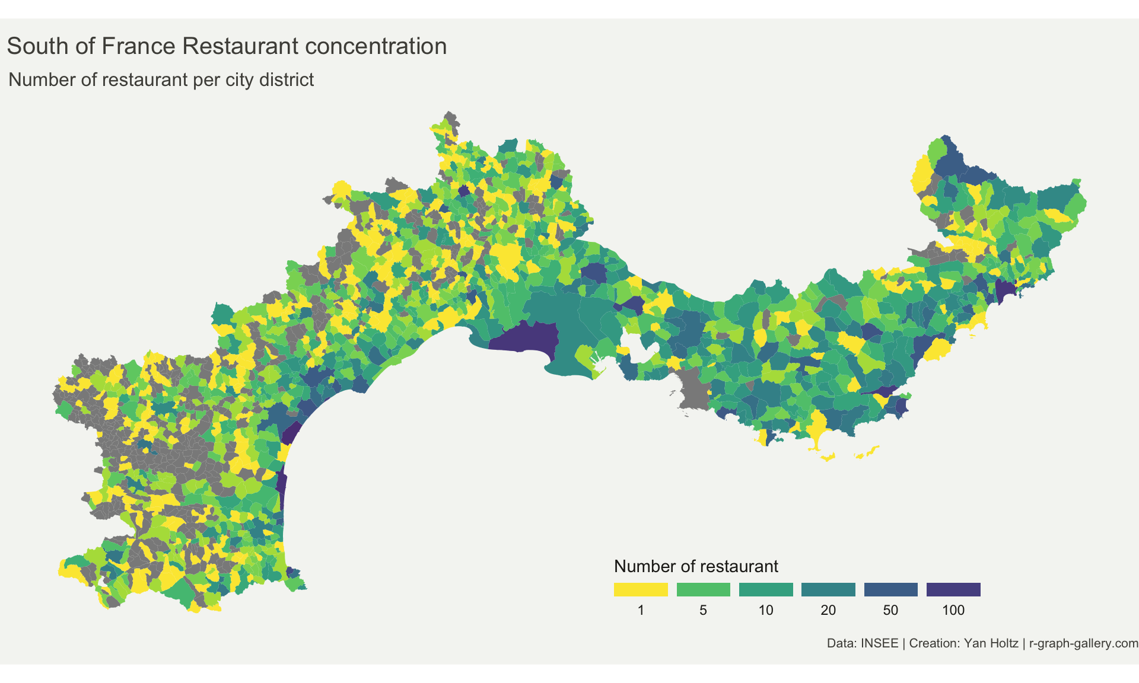

Slide 37
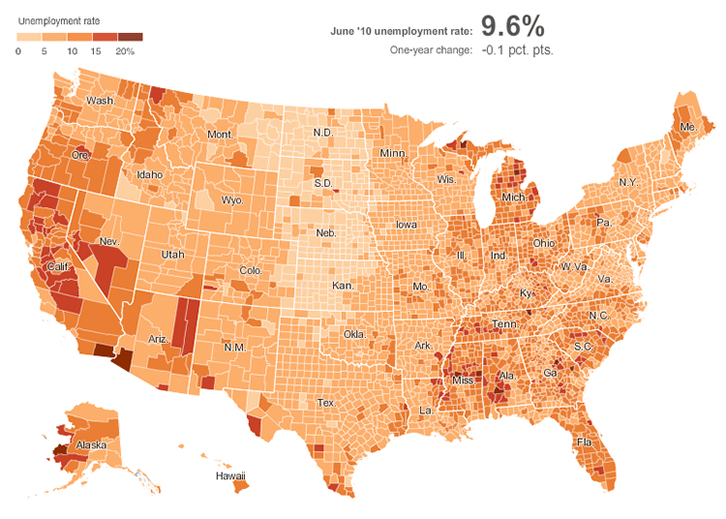

Slide 38
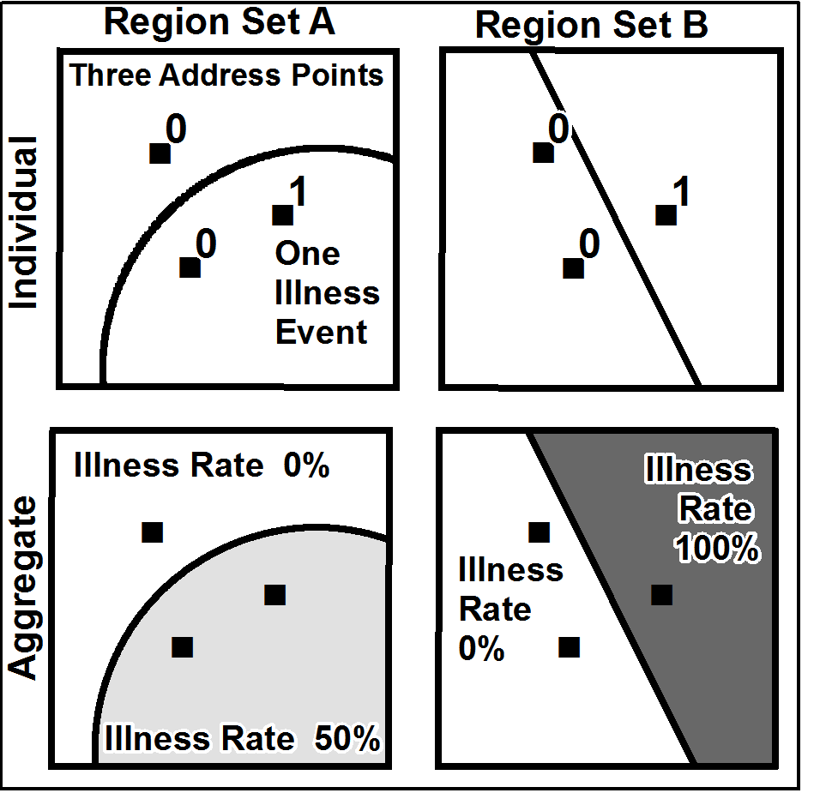
Ecological Fallacy and MAUP
Ecological Fallacy
Is a formal fallacy in the interpretation of statistical data that occurs when inferences about the nature of individuals are deduced from inferences about the group (or geography) to which those individuals belong.
Ecological fallacies occur when we try to draw conclusions about individuals based on data collected at the group level.
Modifiable Areal Unit Problem (MAUP)
A census choropleth map calculating population density using state boundaries will yield radically different results than a map that calculates density based on county boundaries. Furthermore, census district boundaries are also subject to change over time, meaning the MAUP must be considered when comparing past data to current data.
Analyzing the same spatial phenomenon using different scales of areal units i.e., “modifiable areal units” of analysis, can produce differing analytical results.

Slide 39
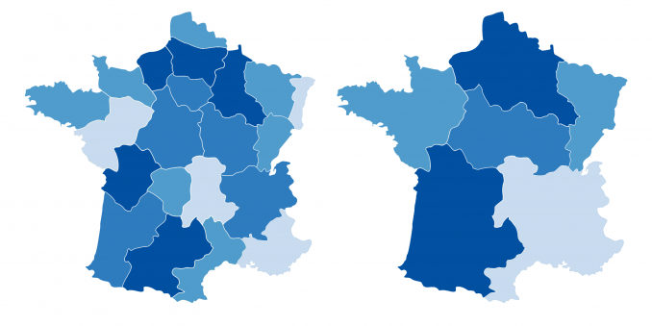

Slide 40
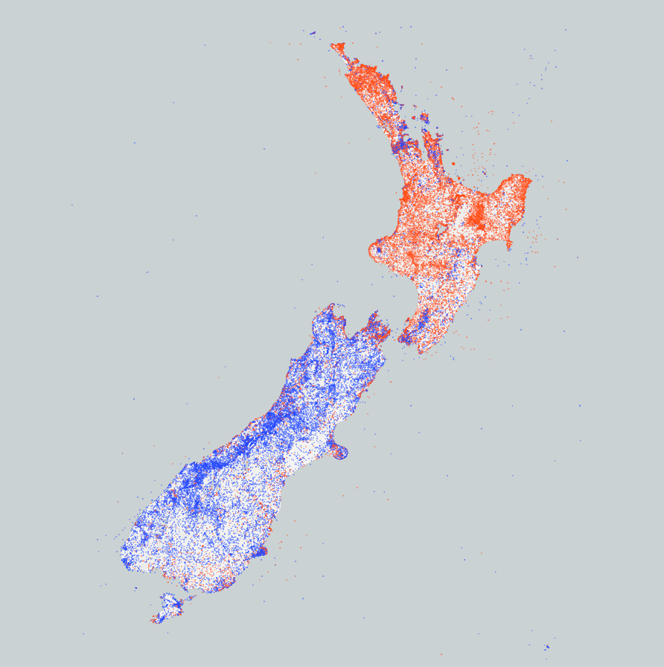
Dot Density/Dot Distribution
The best way to visualize spatial distribution.
An effective way to represent different categories using colors.
Generated points might differ from one iteration to another.
If the map doesn’t have borders drawn, we don’t know exactly where these points are located.

Slide 41
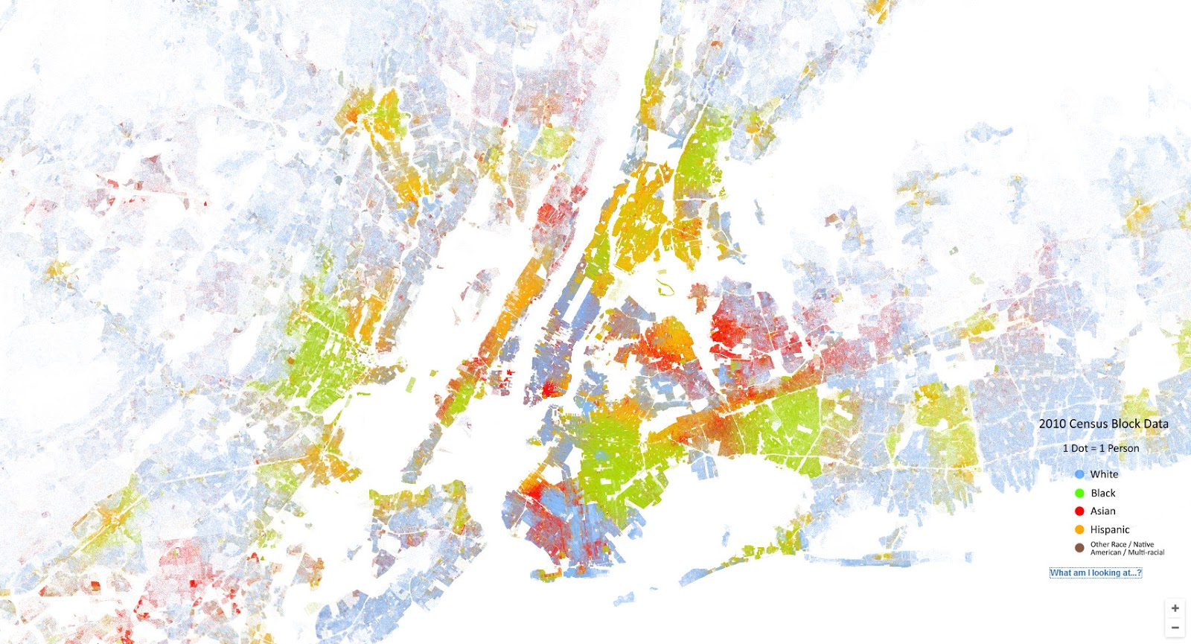

Slide 42
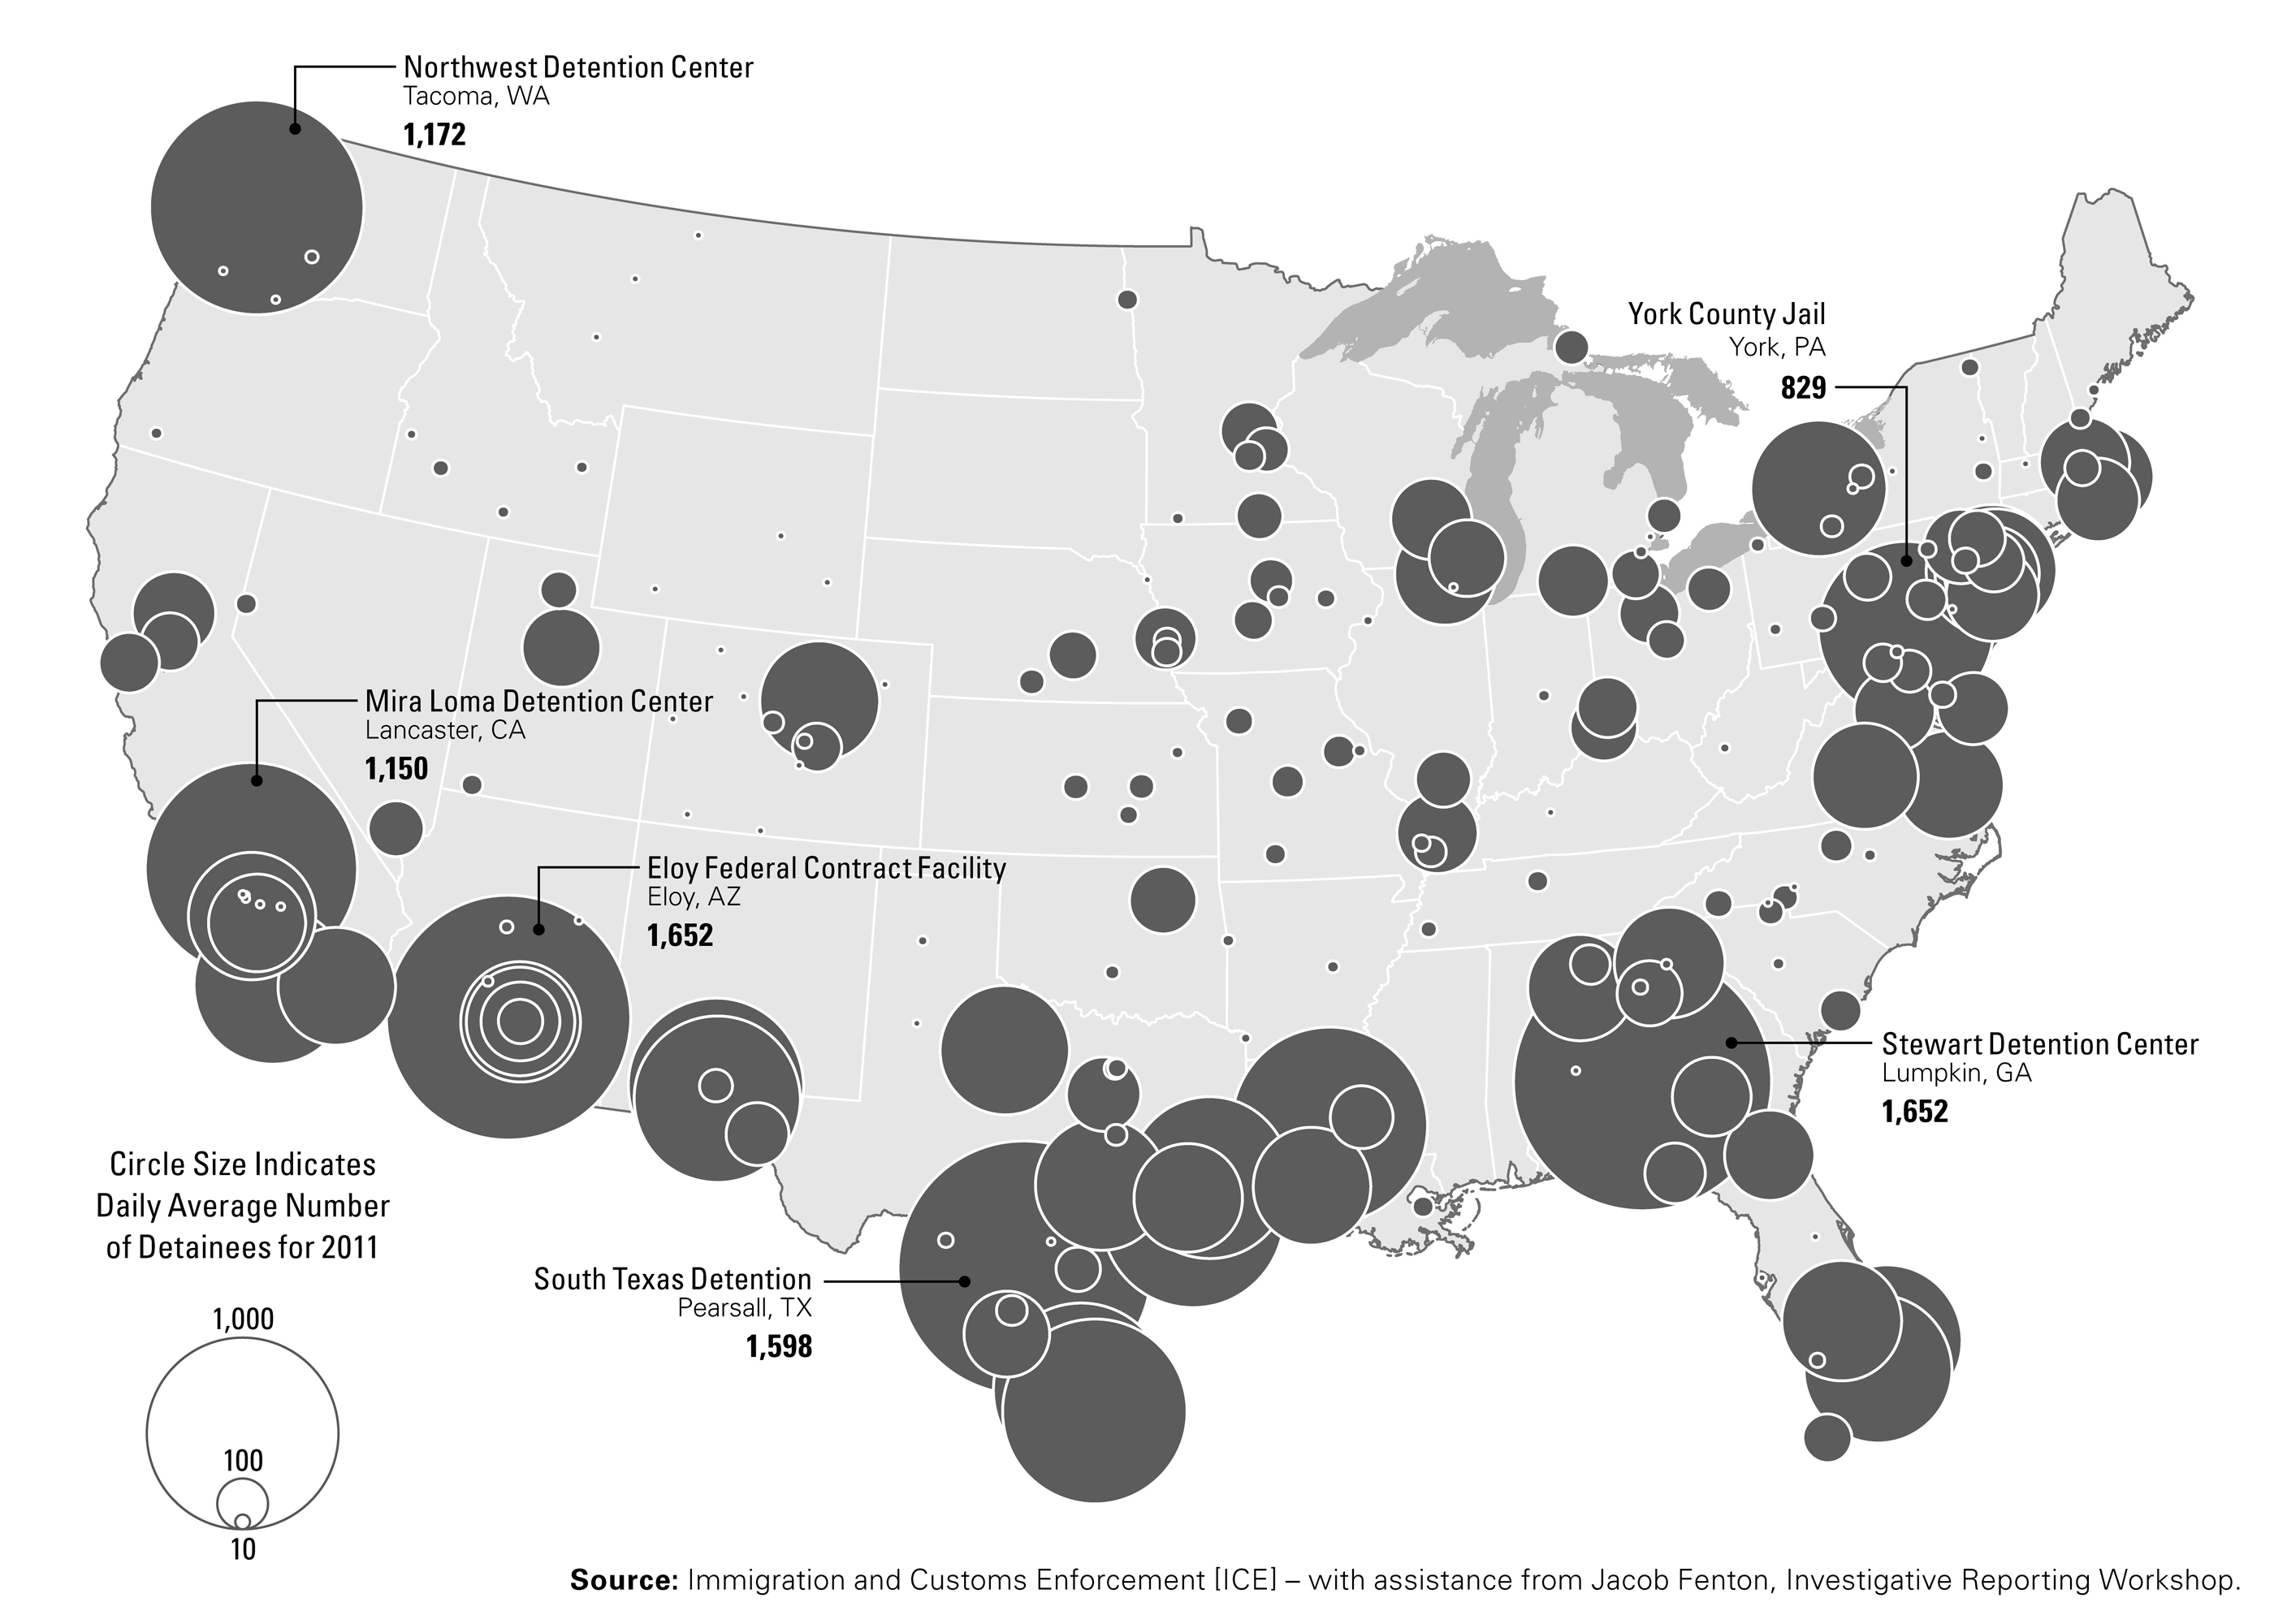
Graduated Symbol/Proportional Symbol
This does a better job showing raw quantities (rather than densities as we saw with choropleth maps).
They clearly convey where and how much (quantities).
They are less exact in terms of displaying distribution.
Overlapping symbols can cause confusion.
Location of private immigration detention centers in the US, 2011

Slide 43
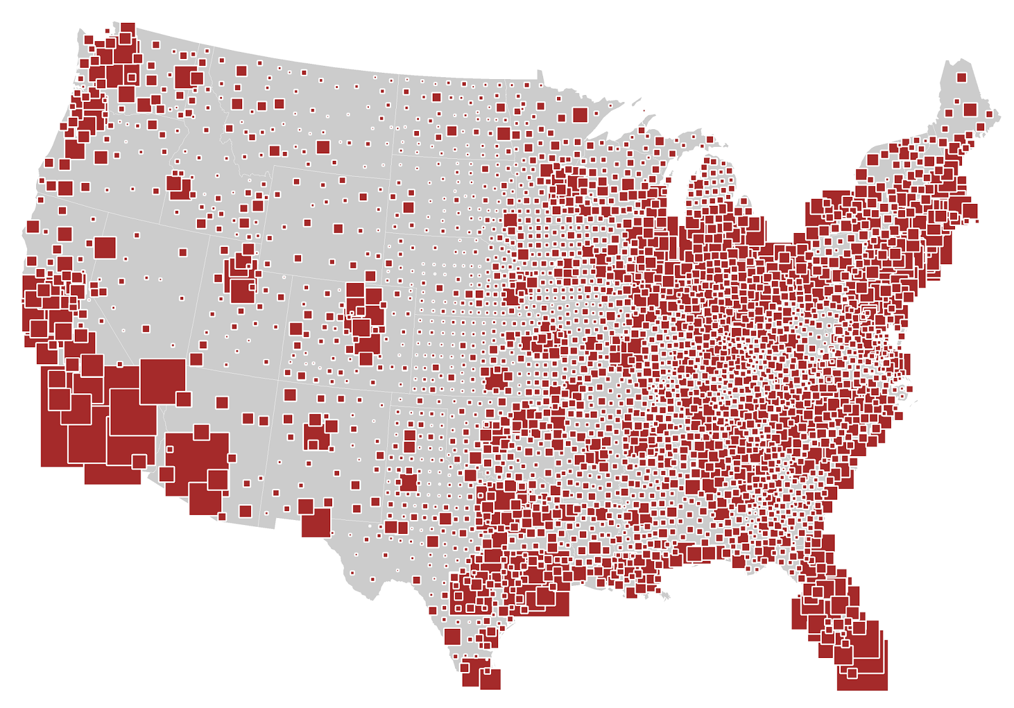

Slide 44
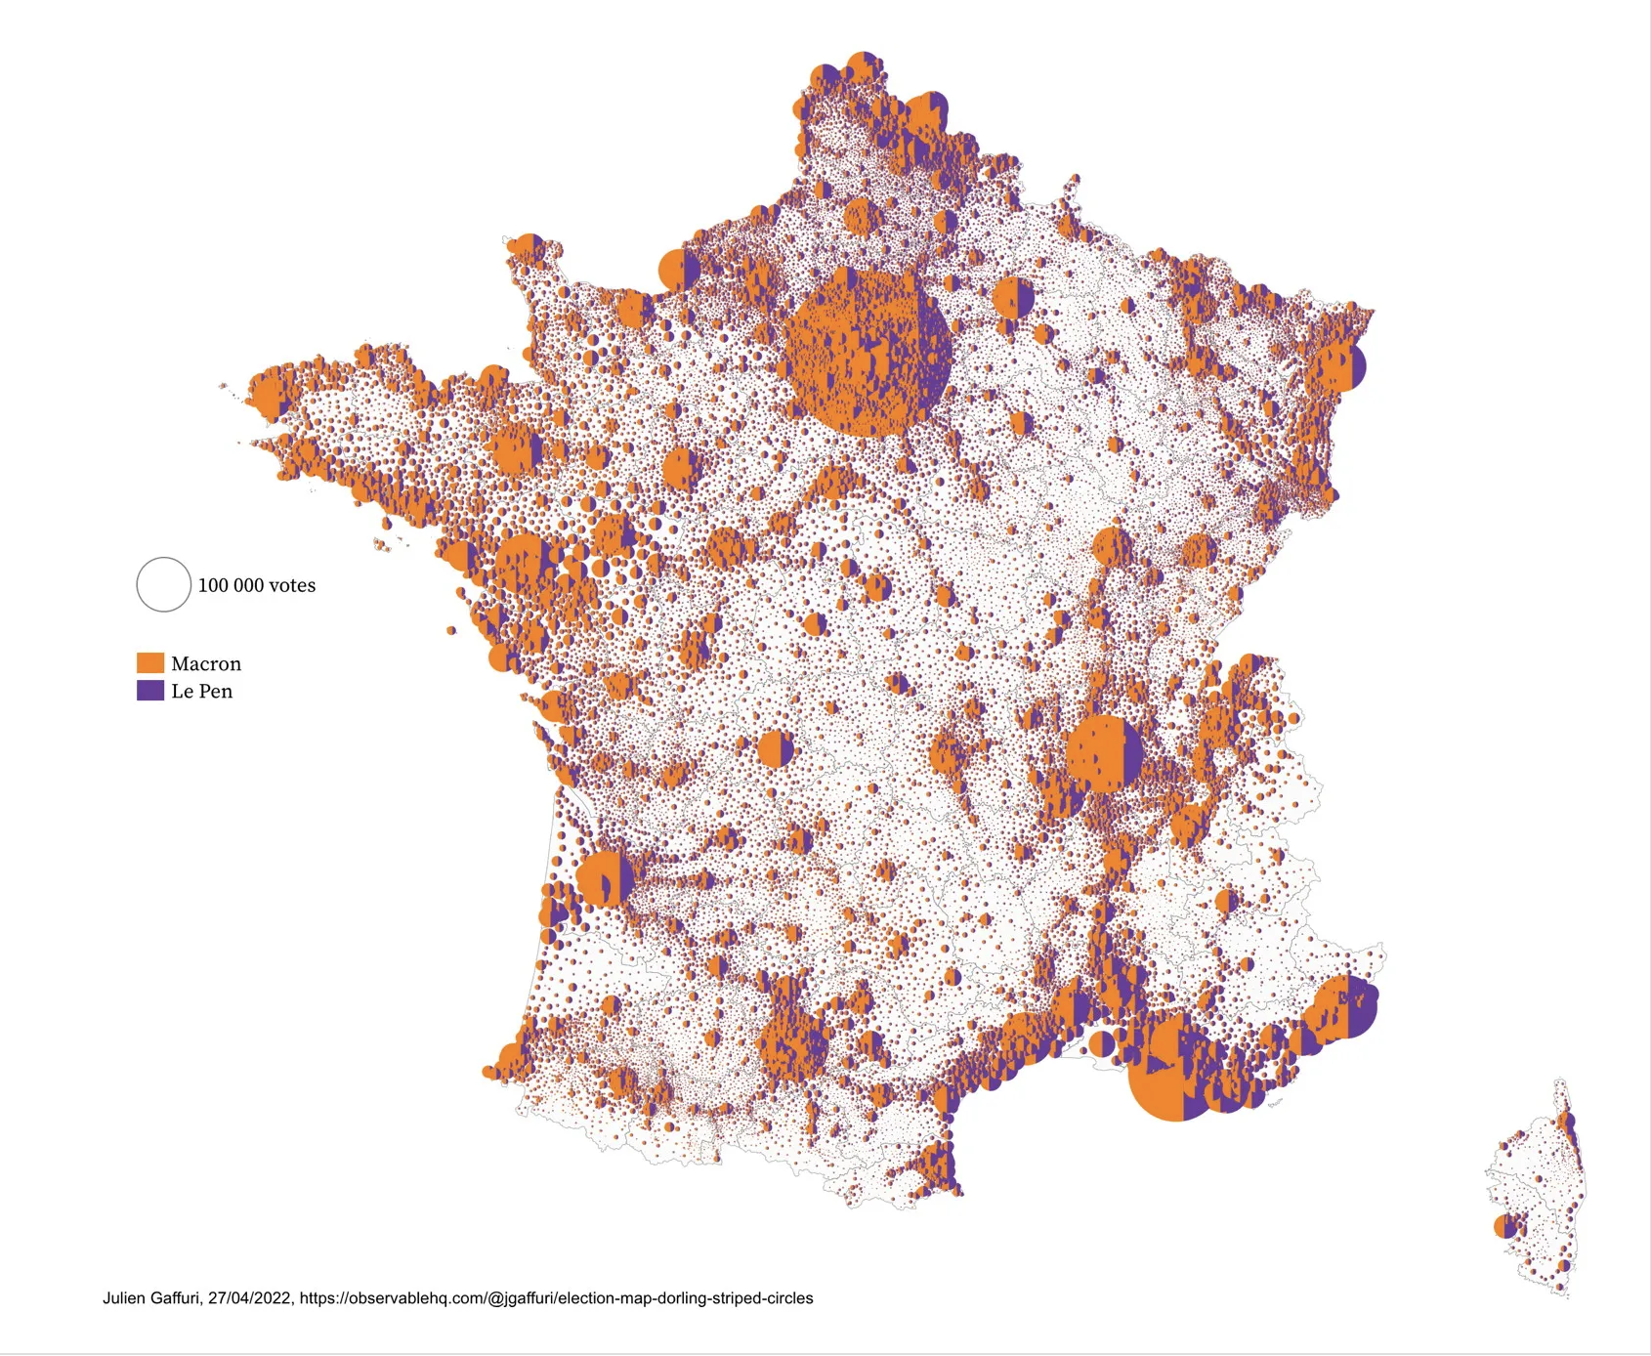

Slide 45
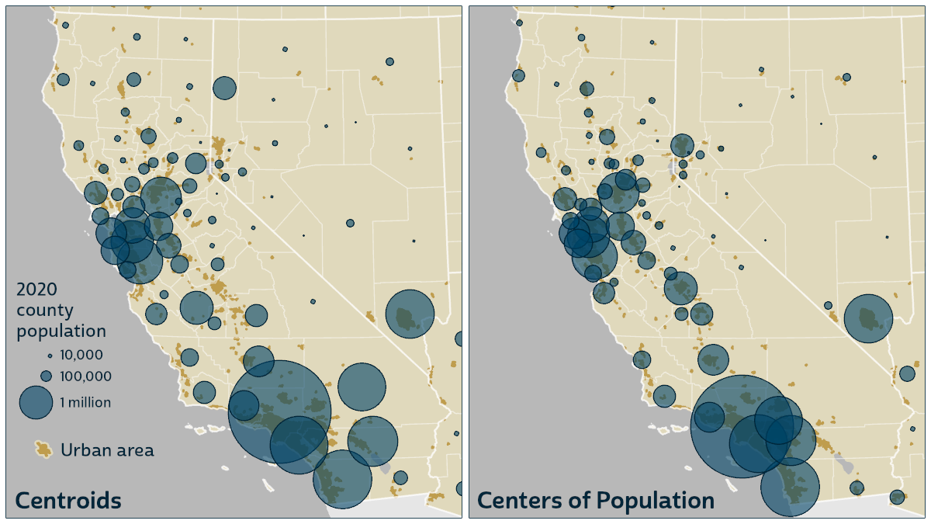

Slide 46
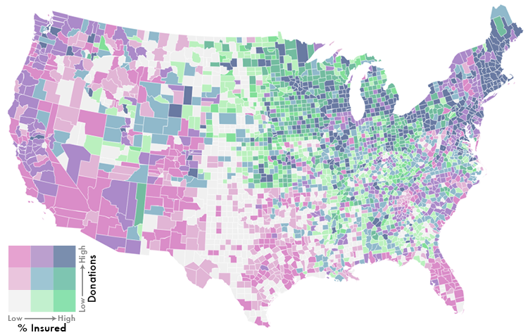
Bivariate/Multivariate
You can visualize two themes at once.
They’re aesthetically pleasing.
They can be complex and hard to read.
It’s hard to have an interactive version of a bivariate map.

Slide 47
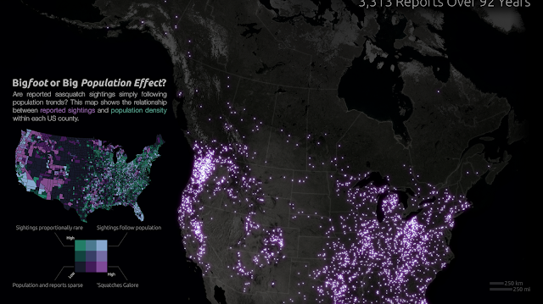

Slide 48
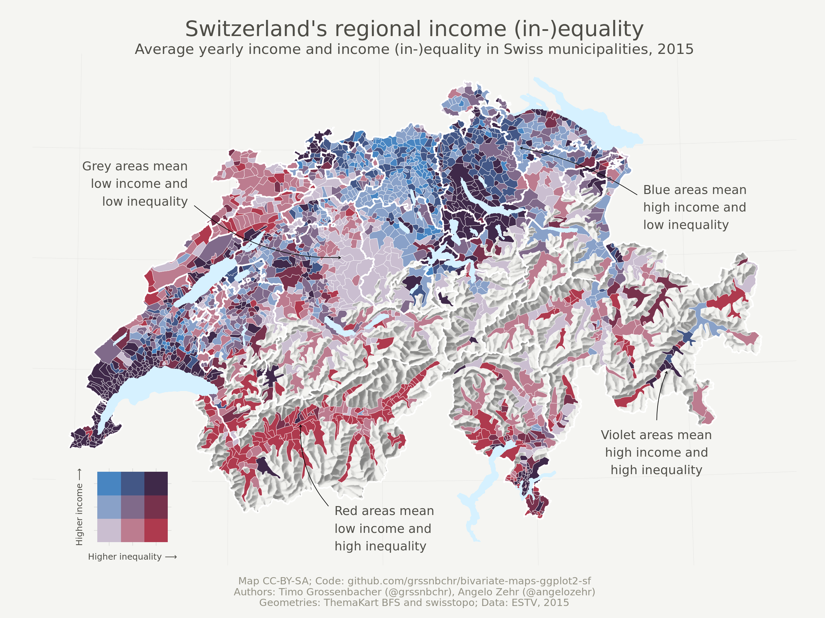

Slide 49
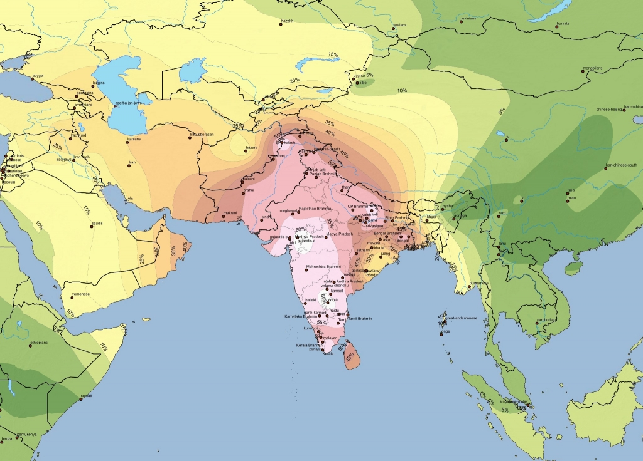
Isopleth Maps
Isopleth maps use colors and shades to represent data, similar to choropleth maps. However, they differ in that data isn’t grouped within predefined boundaries such as census tracts, counties, or states.
Instead, contoured lines divide the map into different areas and show where data levels change.
Well-suited for large-scale analysis, allowing you to map data without boundaries like state, county, zip code, etc..

Slide 50
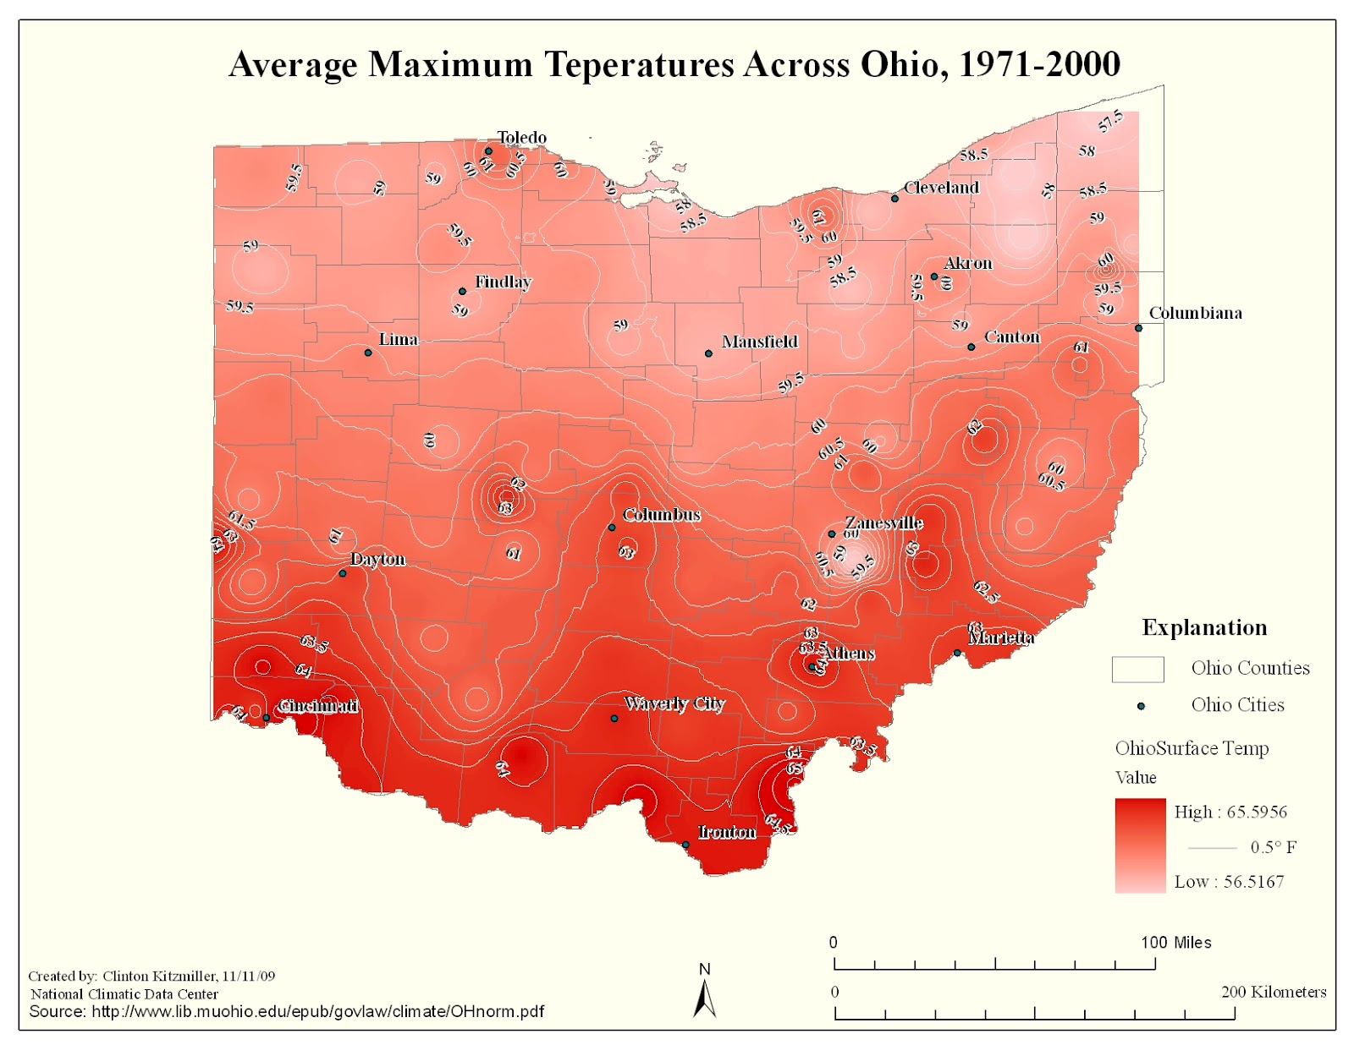

Slide 51
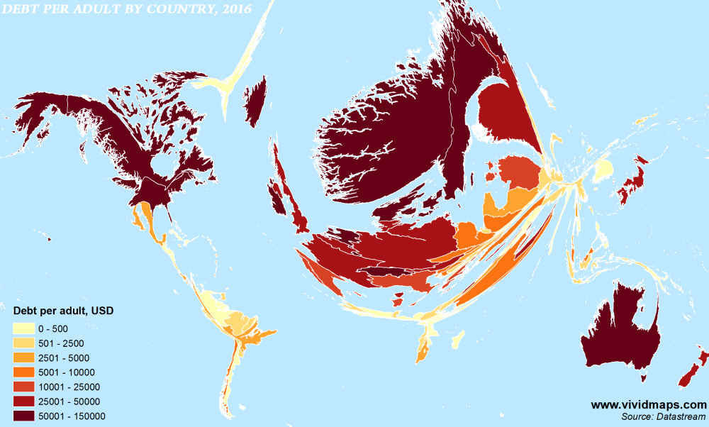
Cartograms
Cartograms visualize the concentration of data in a boundary by distorting its shape and size relative to other geographic areas on a map.
While good for presenting the variance in density of data, cartograms tend to be hard to read.

Slide 52
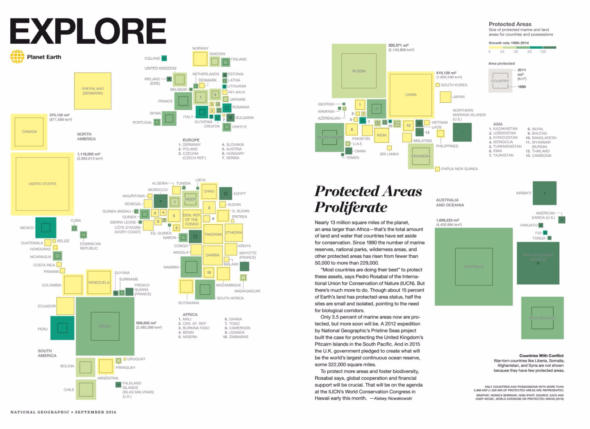

Slide 53
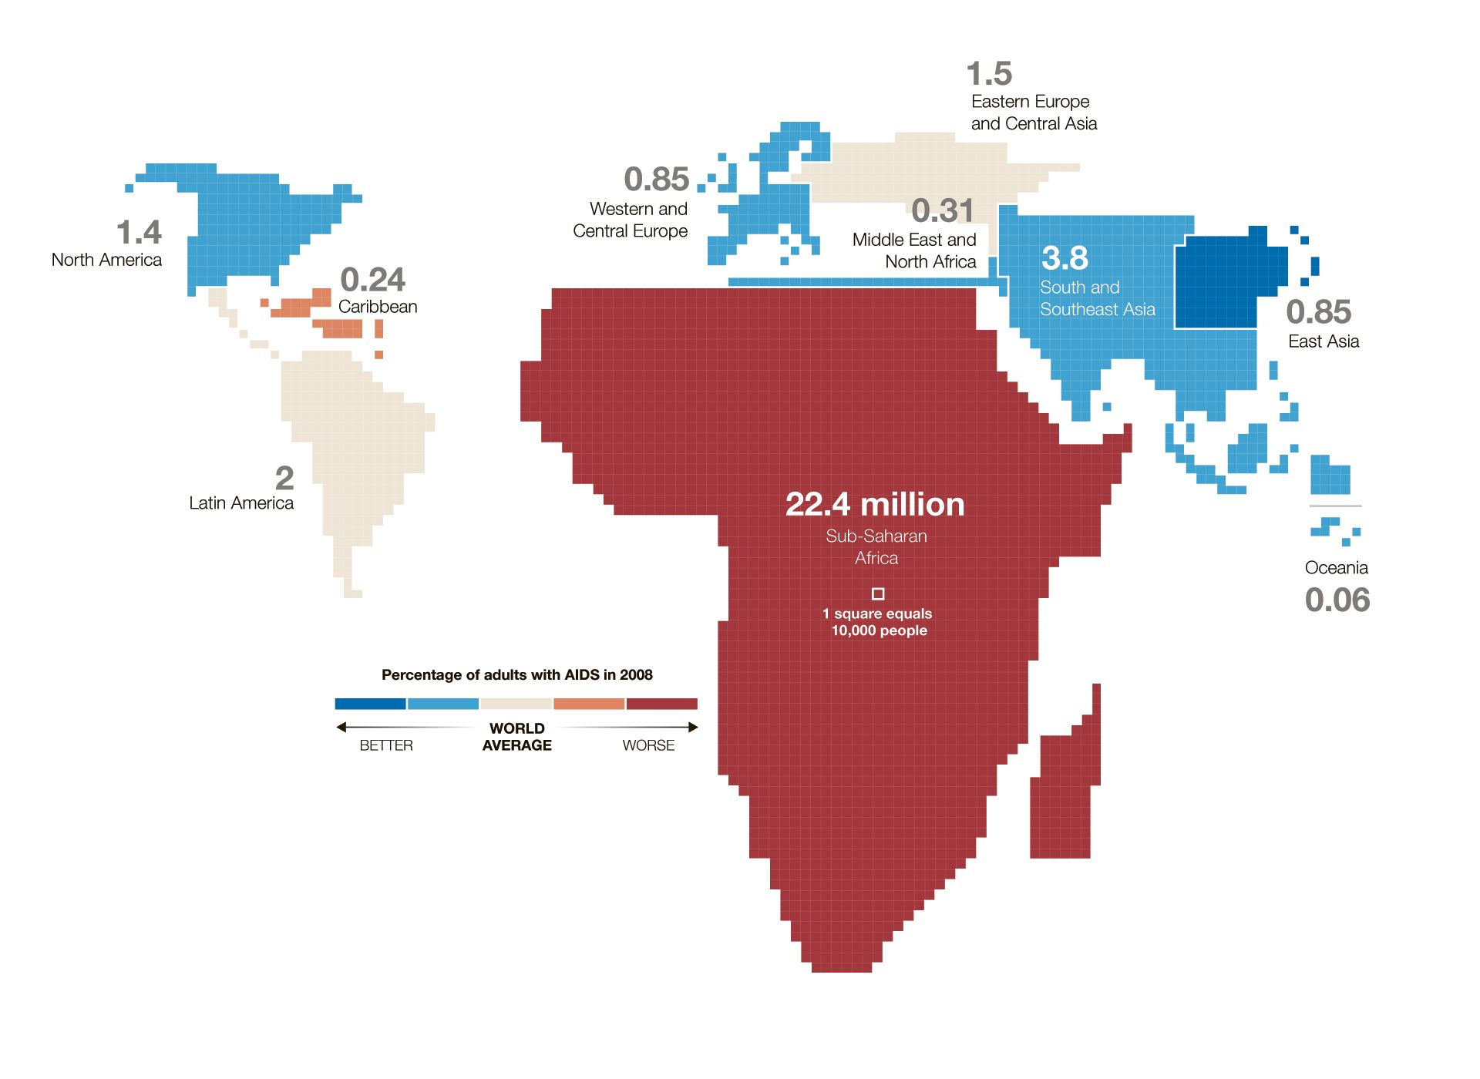

Slide 54
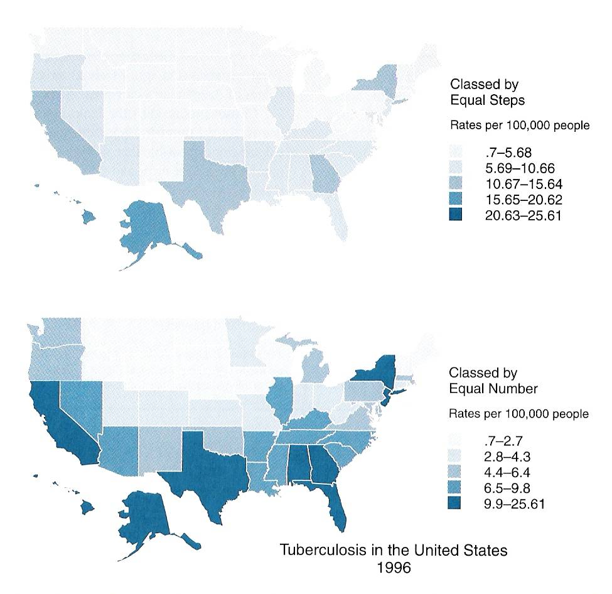
Classification in Choropleth Mapping
Equal Interval: Each interval has the same range
Quantile:
Each interval has the same number of observations

Slide 55
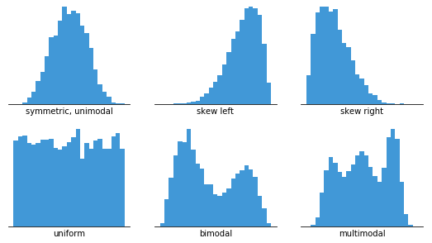
Classification in Choropleth Mapping
We use classification in order to make maps more clear and easier to interpret
If every unit had a different value and was assigned a different hue we might have a tough time interpreting patterns.
Pay attention to your data distribution to choose your classification method

Slide 56
Equal Interval
This classification scheme divides the range of attribute values into equal-sized subranges.
For example, if observations have attribute values ranging from 0 to 300 and you have three classes, each class represents a range of 100 with class ranges of 0–100, 101–200, and 201–300. Here, the class range is held constant while the number of observations per class is allowed to vary.
Do not account for data distribution and may result in most data values falling into one or two classes. It's best applied to familiar data ranges, such as percentages OR to call attention to outliers

Slide 57
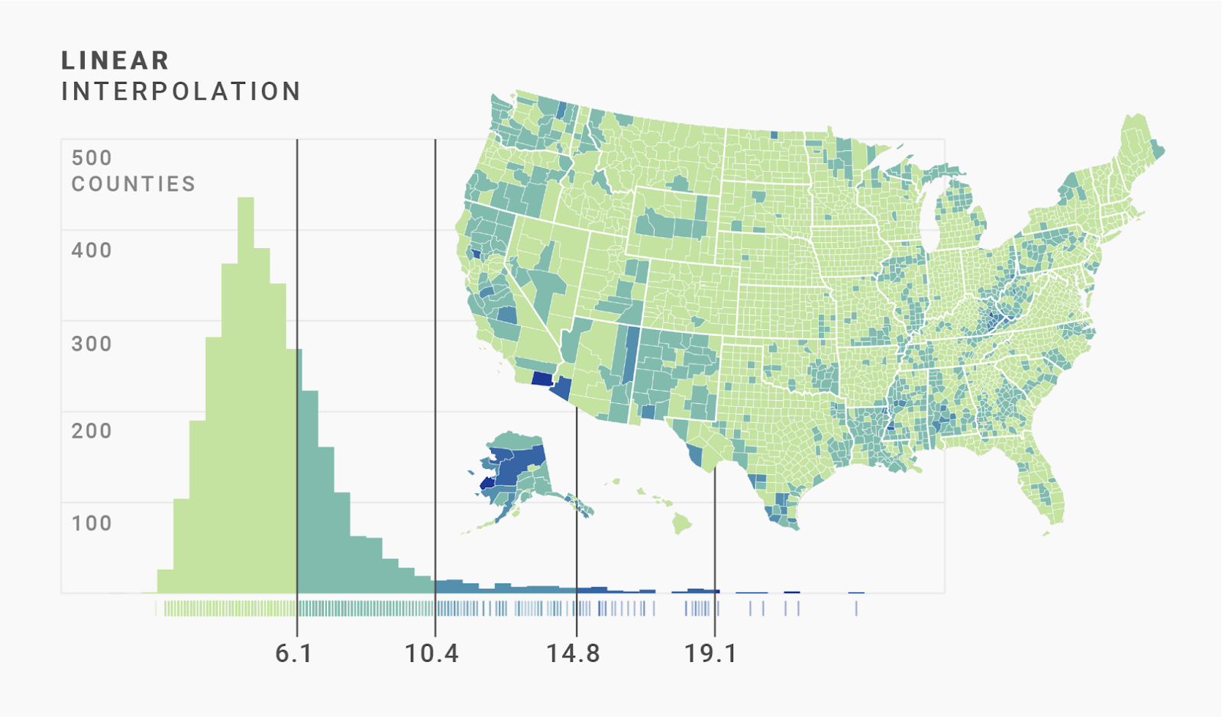
Equal Interval
Number of observations per interval will vary, and interval ranges will be constant.

Slide 58
Quantile
Each class contains an equal number of features.
For example, if you have 100 observations and 5 classes, there will be 20 observations in each class. Here, the number of observations per class is held constant while the class range for each class is allowed to vary.
The problem is that they often place similar values in different classes or very different values in the same class.

Slide 59
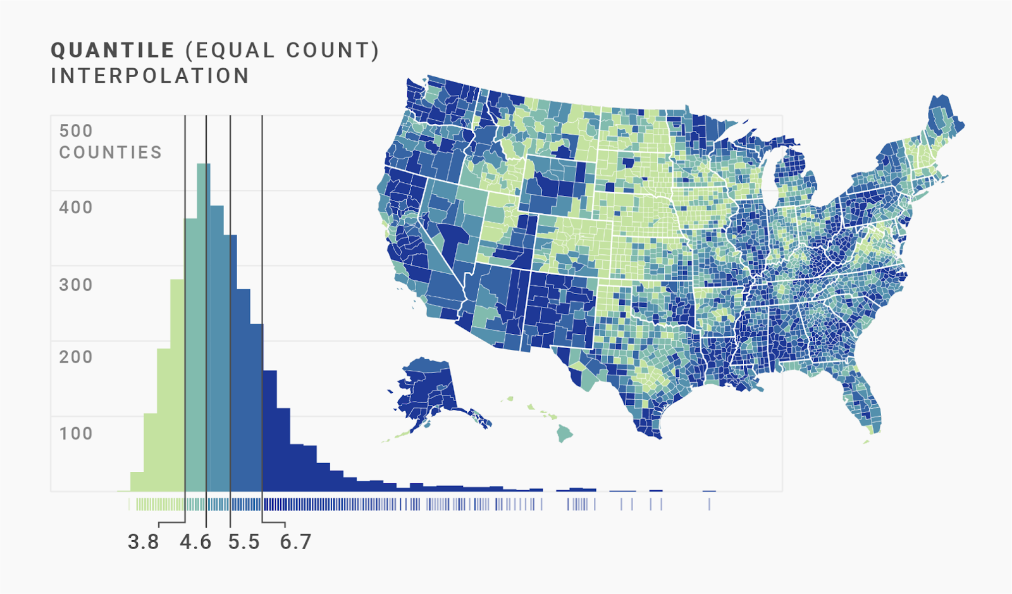
Quantile
Number of observations per interval will be constant, and interval ranges will vary.

Slide 60
Natural Breaks
Classes are based on natural groupings inherent in the data.
Class breaks are chosen that best group similar values and maximize the differences between classes. The features are divided into classes whose boundaries are set where there are relatively big jumps in the data values.
Both the number of observations per interval and interval ranges will vary.

Slide 61
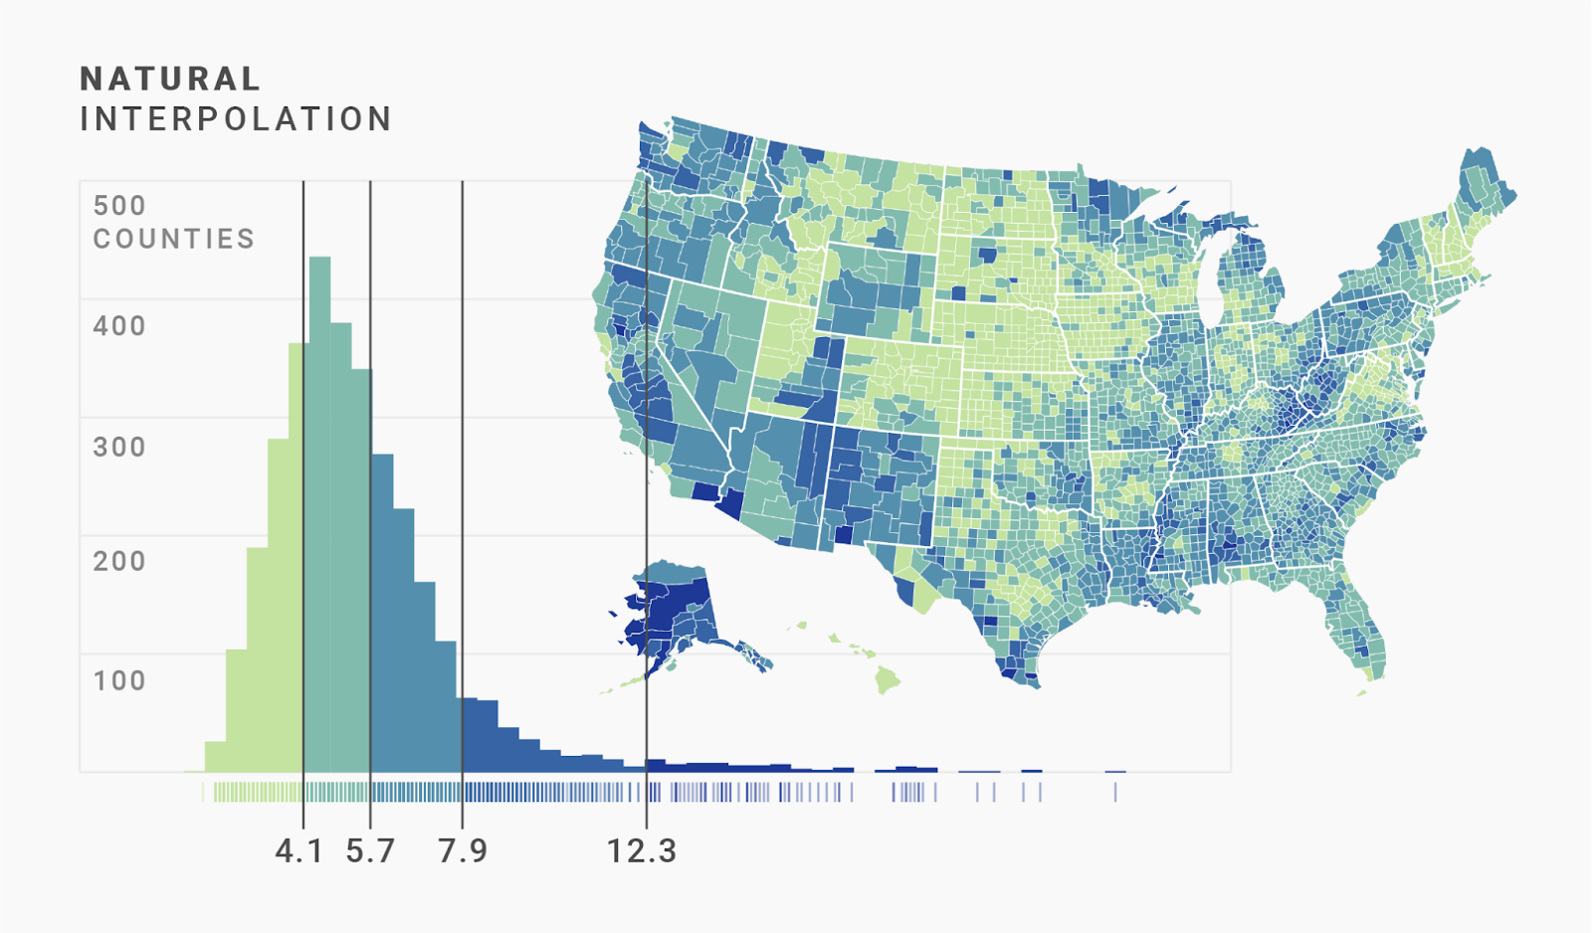
Natural Breaks
Great choice for a default classification scheme because it takes into account characteristics of the data distribution.

Slide 62
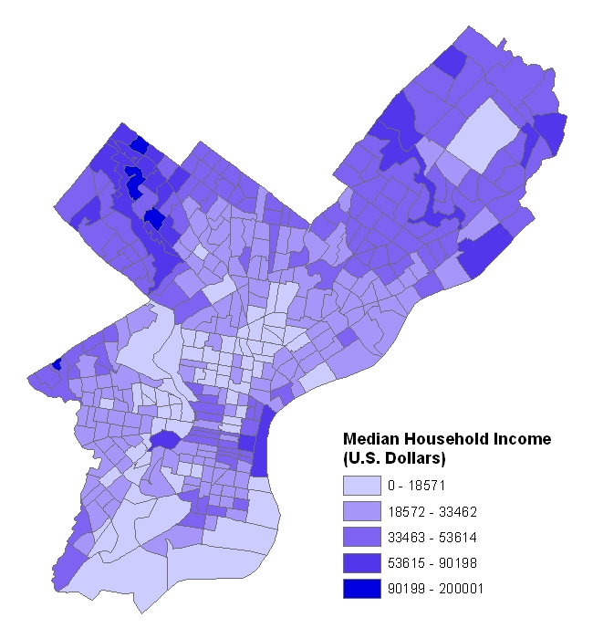
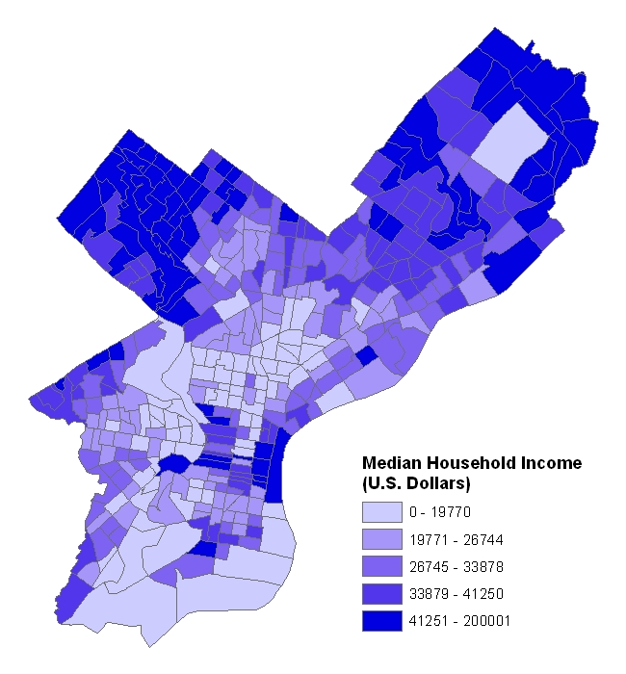
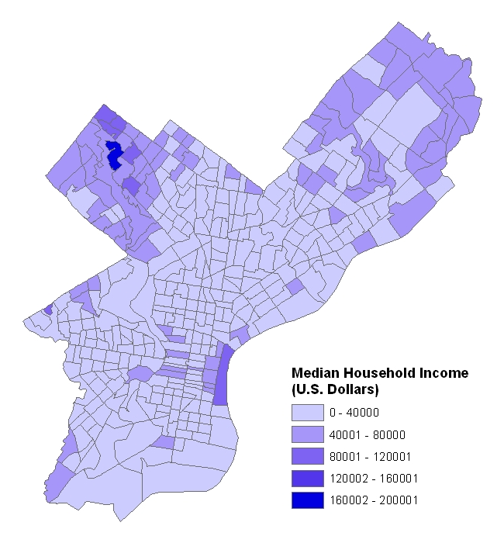
Comparing Data Classification
Natural Breaks
Equal Interval
Quantile

Slide 63
Color Schemes
Sequential
  Appropriate for ordered data that progresses from low to high
  Typically, light colors represent low values; darker colors represent high values
Diverging
  Appropriate for ordered data that progresses from low to high
  Places emphasis on extreme high, extreme low, and middle range values
From Cindy Brewer:
http://www.personal.psu.edu/cab38/GEOG321/04_color02/color5.html

Slide 64
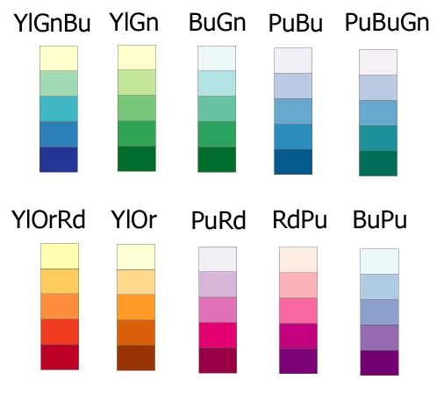
Sequential Color Schemes

Slide 65
Sequential Color Scheme

Slide 66
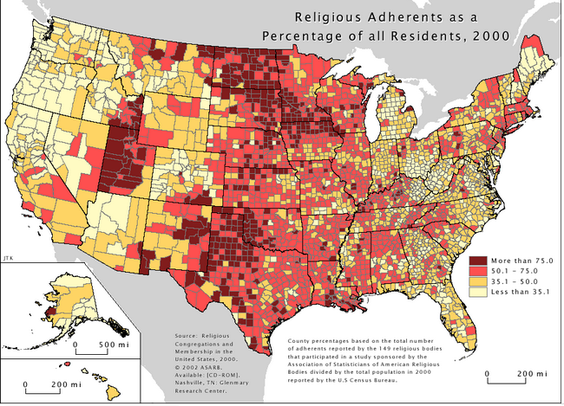
Sequential Color Scheme

Slide 67
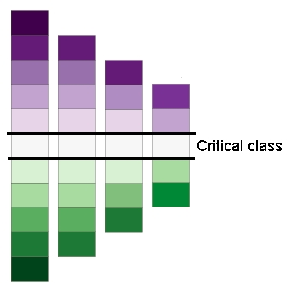
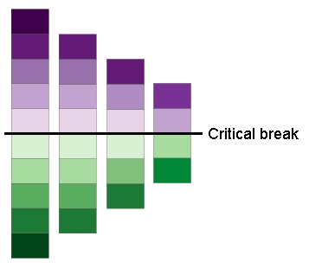
Diverging Color Scheme

Slide 68
Diverging Color Scheme

Slide 69
Bivariate Color Scheme: Sequential-Sequential

Slide 70
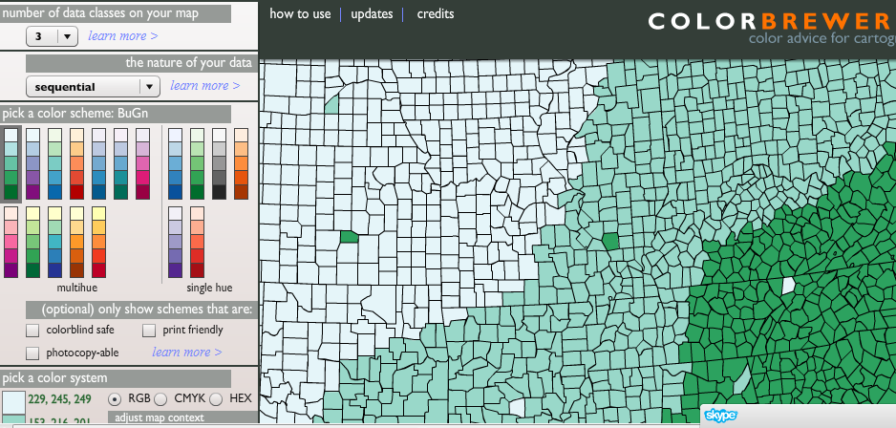
Need help deciding what colors to use?
Check out the ColorBrewer!
http://colorbrewer2.org/

Slide 71
Thematic Map Elements
Title
Legend
Scale
Credits
Mapped areas
Borders
Map symbols
Place names and labeling

Slide 72
Lab Reminder
Pay close attention to the specific details of the analysis task – What do you have to produce? And what steps will get you there?

Slide 73
Let’s get started

