Slide 1
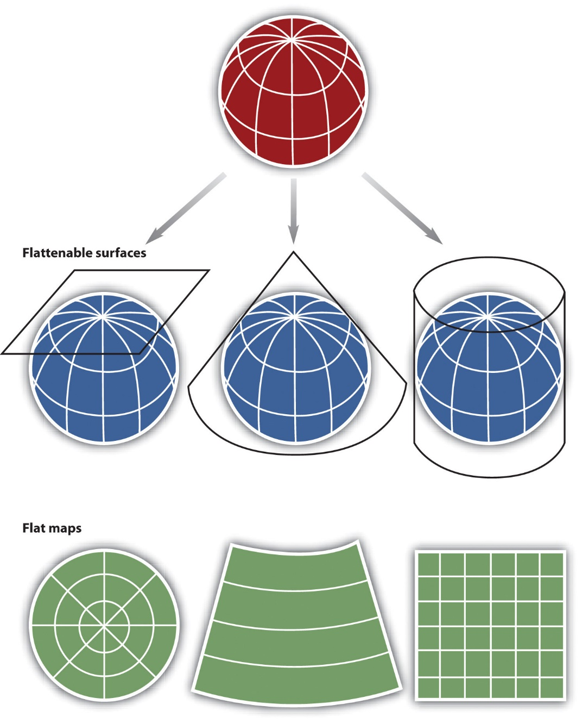
Projections and Coordinate Systems
FALL 2025, WEEK 4
Dr. Dirk Kinsey
dkinsey@brynmawr.edu

Slide 2
BIG IDEAS
Geodesy, the math of where
The Earth is a geoid, an imperfect 3D object.
An ellipsoid is a slightly squished down sphere that approximates our geoid-shaped Earth.
Mapping things requires a system for locating those things (georeferencing), typically based on a pair of coordinates.
    Latitude and longitude are based on 3D earth. Other systems operate in a projected 2D world.
    Geoid, ellipsoid, datum, projection=mathematical models for representing earth’s surface.

Slide 3
Geoid
Datum
Geographic Coordinate System
Projection
Ellipsoid

Slide 4
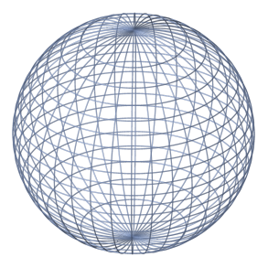
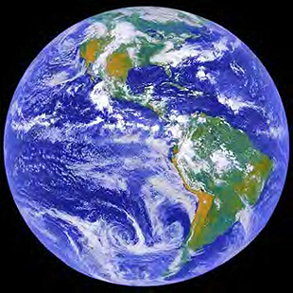
Representing the shape of the earth as a sphere
Earth as a sphere

Slide 5
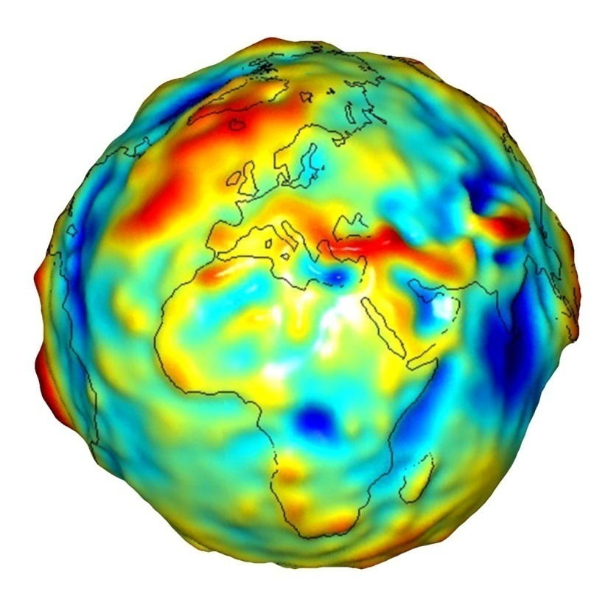
The earth as a geoid
Bulges and depressions result from variations in local gravity
The shape that the ocean surface would take under the influence of the gravity and rotation of Earth alone, if other influences such as winds and tides were absent
A model that accounts for more regional bulges and depressions on the Earth than an ellipsoid – irregular shape that defines zero elevation
More here - https://oceanservice.noaa.gov/facts/geoid.html

Slide 6
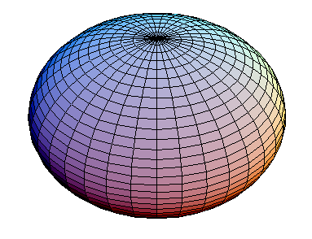
Representing the shape of the earth as an Ellipsoid
We commonly represent the geoid shaped Earth as an oblate spheroid aka ellipsoid
An ellipsoid is a model of the Earth as a slightly ‘flattened’ sphere
Mapping things requires LATITUDE and LONGITUDE, meaning a grid system. To map things we place a gird system on top of a 3D model aka Ellipsoid

Slide 7
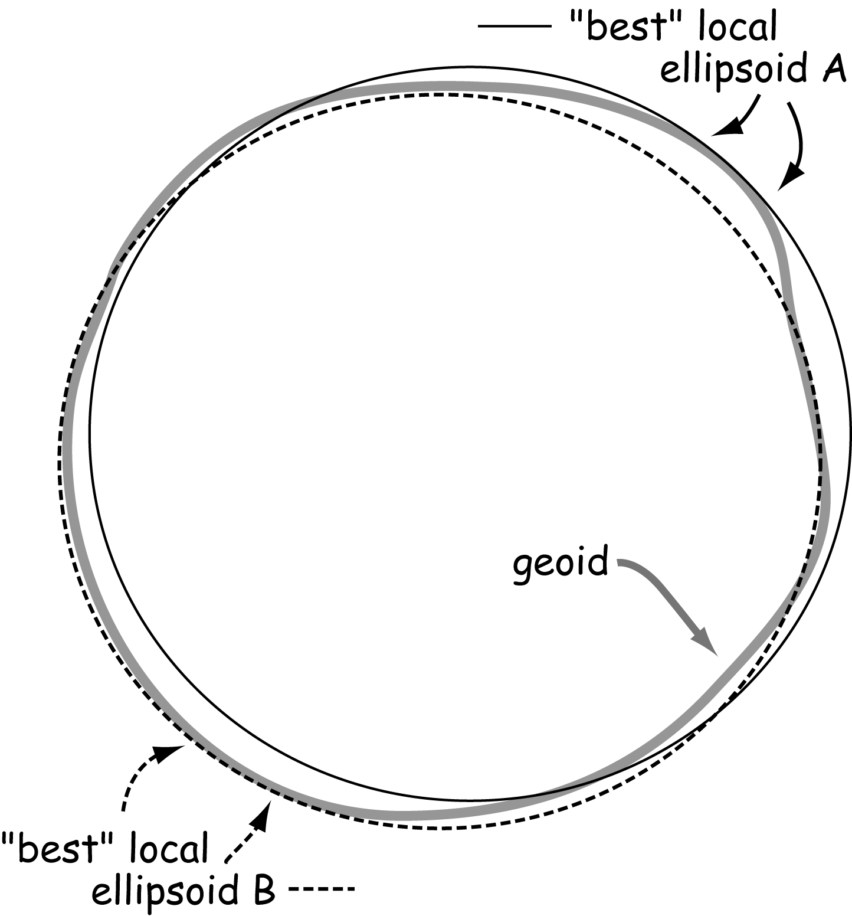
What do we use for mapping?
We use ellipsoids and shift them relative to the geoid to determine best-fit.
There is a diversity of ellipsoids that we can use to serve as an approximation of our earth.
Many ellipsoids were created to best suit specific countries.
Datasets based on different ellipsoids will not work together.
For another explanation: https://www.youtube.com/watch?v=ThtQwbi8UVo

Slide 8
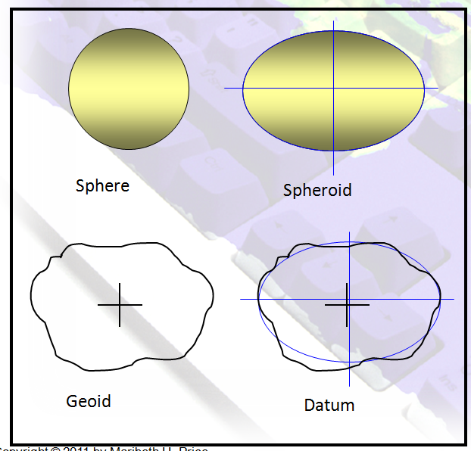
Representing the shape of the earth
Geodetic Datum (aka Datum)
Global reference frame for precisely representing positions on Earth (or other planets) by means of geodetic coordiantes (latitude, longitude, & height)
Hundreds of geodetic datums are in use around the world
The Global Positioning System is based on the World Geodetic System 1984 (WGS-84)

Slide 9
Datum
Specifies which ellipsoid is used as model of the earth & at what location that ellipsoid aligns with the earth's surface
Hundreds of geodetic datums are in use around the world
The Global Positioning System is based on the World Geodetic System 1984 (WGS-84)
Allows us to place a coordinate system and identify geographic features locations with the help of coordinates

Slide 10
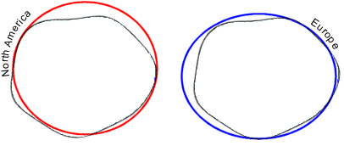
Datum
Defines the origin and orientation of the geographic coordinate system (i.e. latitude and longitude lines)
A Datum has two parts
  A specified ellipsoid and well measured set of points in spherical coordinates
Allow us to determine the distance and angle of any other point on the earth
Provides a frame of reference for measuring locations on the surface of the earth
The datum allows us to assign locations to points on a spheroid (also called georeferencing)

Slide 11
Common Datums used in North America
North American Datum 1927 (NAD 1927 or NAD27)
  Based on Clarke 1866 spheroid, common until the 1980s and still used for some data sets.
North American Datum 1983 (NAD 1983 or NAD83)
  Current popular datum for most mapping. GRS80 spheroid.
  First choice if you must assume an unknown datum for a set of undocumented data.
North American Datum 1983 HARN (NAD 1983 HARN)
  Updates NAD83 with a High Accuracy Regional Network of fitted points
World Geodetic Survey 1984 (WGS84)
  The Global Positioning System (GPS) is based on the World Geodetic System 1984 (WGS-84)

Slide 12
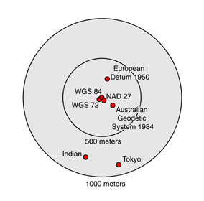
Different Datums
Changing the datum of the geographic coordinate system changes the coordinate values of your data
The position of the Texas Capitol Dome Horizontal Benchmark in several different coordinate systems. You can see that position shifts (from the baseline position of WGS 84) for commonly used North American datums (e.g., NAD27) are relatively small, shifts from other datums can be quite substantial.
Credit: After Dana, 1994
More on datums - https://www.youtube.com/watch?v=kXTHaMY3cVk&list=PLsyDl_aqUTdFY6eKURmiCBBk-mP4R10Dx

Slide 13
World Geodetic System
The reference coordinate system used by GPS
Coordinate origin is center of Earth’s mass, with uncertainty <2cm
Developed by US Dept of Defense starting in 1950s to create first unified geodetic system for the whole world – WGS 60
WGS 84 Geocentric and globally consistent within ±1 m
BUT, WGS is global, so regional systems are still more accurate within their region

Slide 14
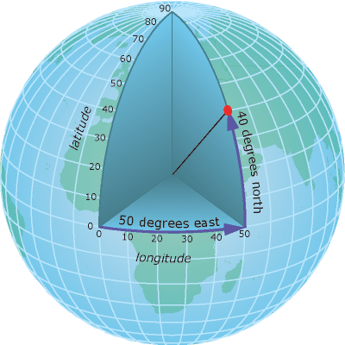
Coordinate Systems
Provide a spatial referencing system to locate points on the earth surface
  Based on a datum (a reference point)
When map data is projected onto a planar surface, we can no longer use a spherical (or geographic) coordinate system (i.e. lat./long.) that is based on angular measurements
We now need to use a planar (or Cartesian) coordinate system (i.e. x, y) to reference features on the map

Slide 15
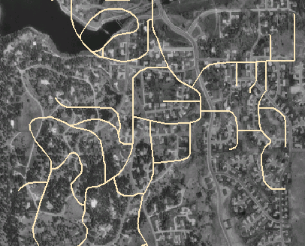
Projections and datums
Every projection is based on a geographic coordinate system
Every geographic coordinate system has a datum
So, every projection has a datum
  Projections based on different datums will be offset from one another
  Amount of offset depends on region
  Typically 0 – 300 mete
UTM Zone 13 NAD 1983 ≠ UTM Zone 13 NAD 1927!
Photo in NAD27
Roads in NAD83

Slide 16
Geoid
Datum
Geographic Coordinate System
Projection
Ellipsoid

Slide 17
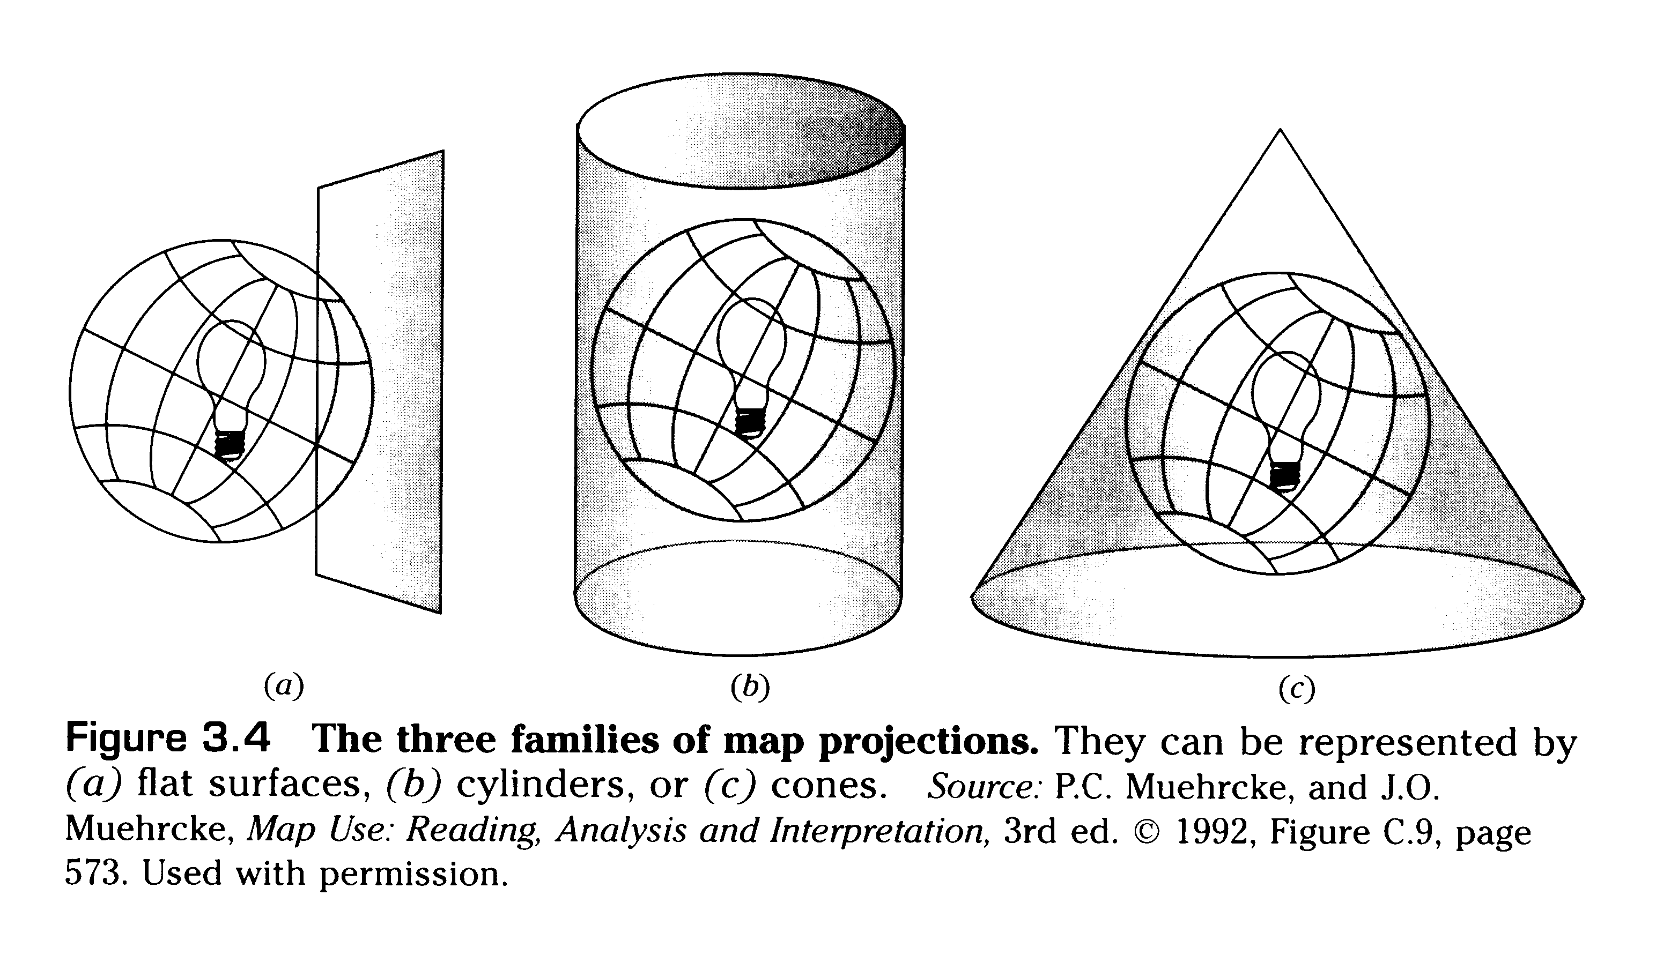
Datum
Geographic Coordinate System
Projected Coordinate System (Projection)

Slide 18
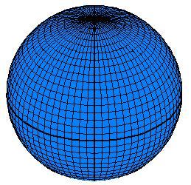
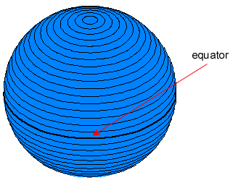
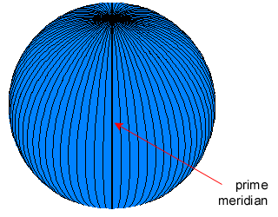
Geographic Coordinate Systems
Starts with a representation of the earth as a spherical globe
Positions on a globe are measured by angles
  Lines of latitude and longitude
  Longitude: measured as the number of degrees from the prime meridian
  Latitude: measured as the number of degrees from the equator
Parallels of latitude (Y)
Meridians of longitude (X)
Graticular network

Slide 19
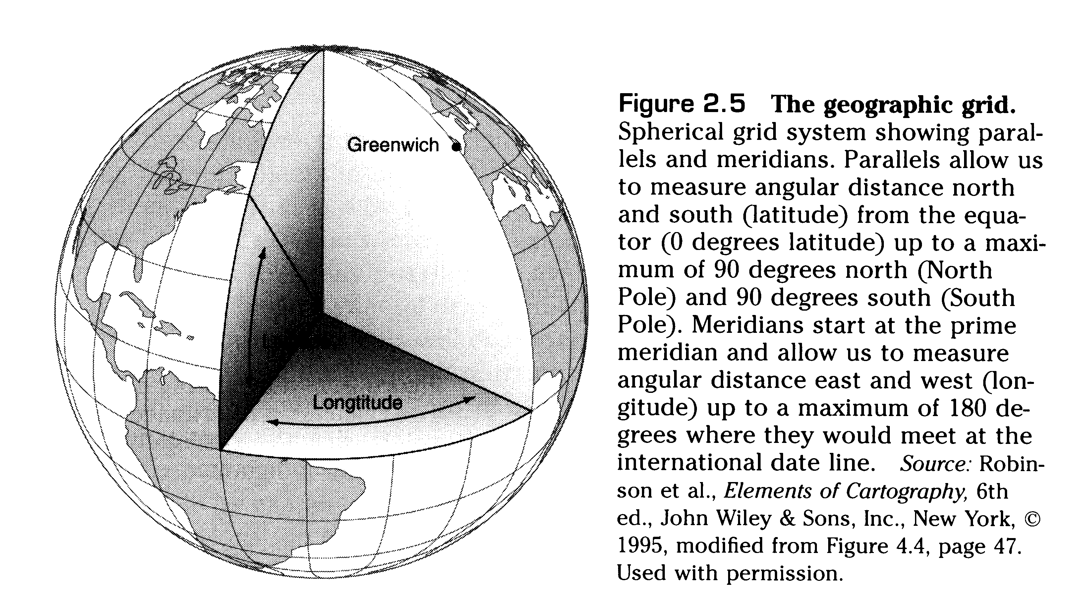
Spherical (or Geographic) Coordinate System
latitude and longitude
  parallel: lines parallel to equator
  meridian: lines going from pole to pole

Slide 20
Geographic Coordinate System
Consists of latitude and longitude lines
Lines of longitude run north–south
  Measure the number of degrees east or west of the prime meridian
  Values range from -180° to +180°.
Lines of latitude run east–west
  Measure the number of degrees north or south of the equator
  Values range from +90° at the North Pole to -90° at the South Pole

Slide 21
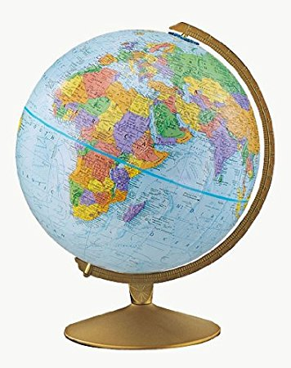
Why not just carry around a globe?

Slide 22
Several drawbacks with globes…
  Large & cumbersome
  Scale is often unsuitable to our purposes
    (usually we want to see more detail than is possible to be shown on a globe)
  The latitude-longitude spherical coordinate system can only be used to measure angles, not distances or areas (at least directly – various mathematical formulas can get us there, but it’s cumbersome)
  Therefore, we need map projections
  Mathematical models that transform spherical coordinates (latitude and longitude) to planar coordinates (x and y)

Slide 23
“Strike flat the thick
rotundity o’ th’ world!”
William Shakespeare, King Lear

Slide 24
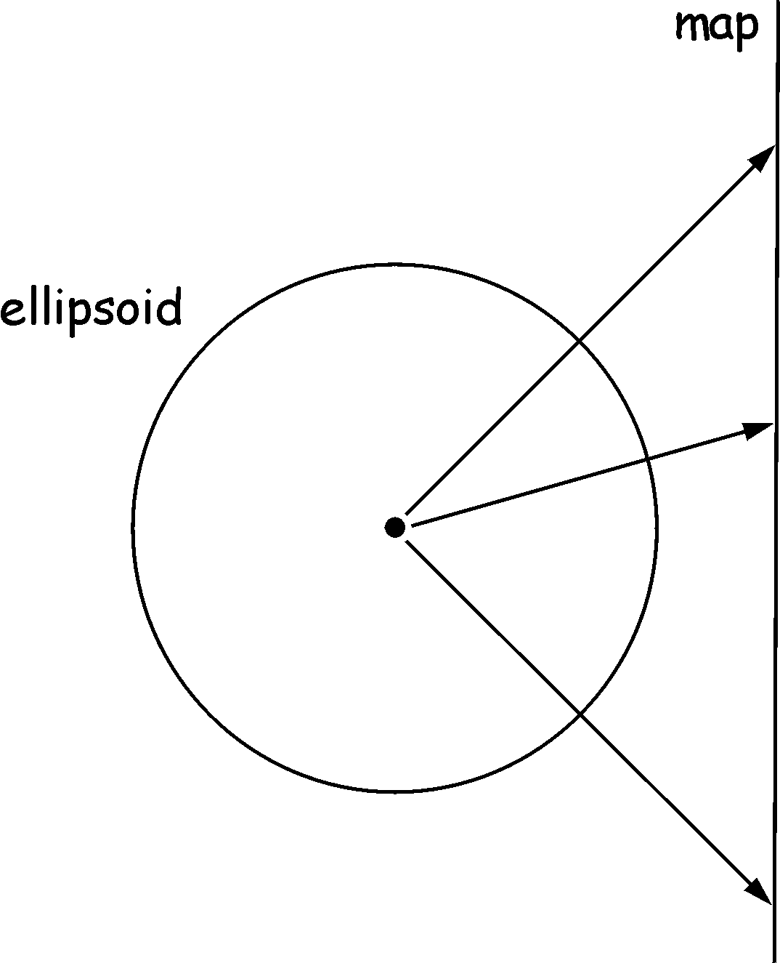
Map Projections
A means to depict the spherical earth on a two dimensional medium
Cannot simultaneously preserve all of these properties of the earth in two dimensions:
    shape (of a region)
    distance (between two points)
    direction (bearing from one point to another)
    area (of a region)

Slide 25


Slide 26
Projections
All map projections introduce distortion in one or more of the following measurement properties:
  Shape
  Distance
  Direction
  Area
Many different map projections exist, but they all introduce distortion - it’s unavoidable
Distortion is minimized at the place on the projection surface that is closest to the sphere and increases as you move away from it

Slide 27
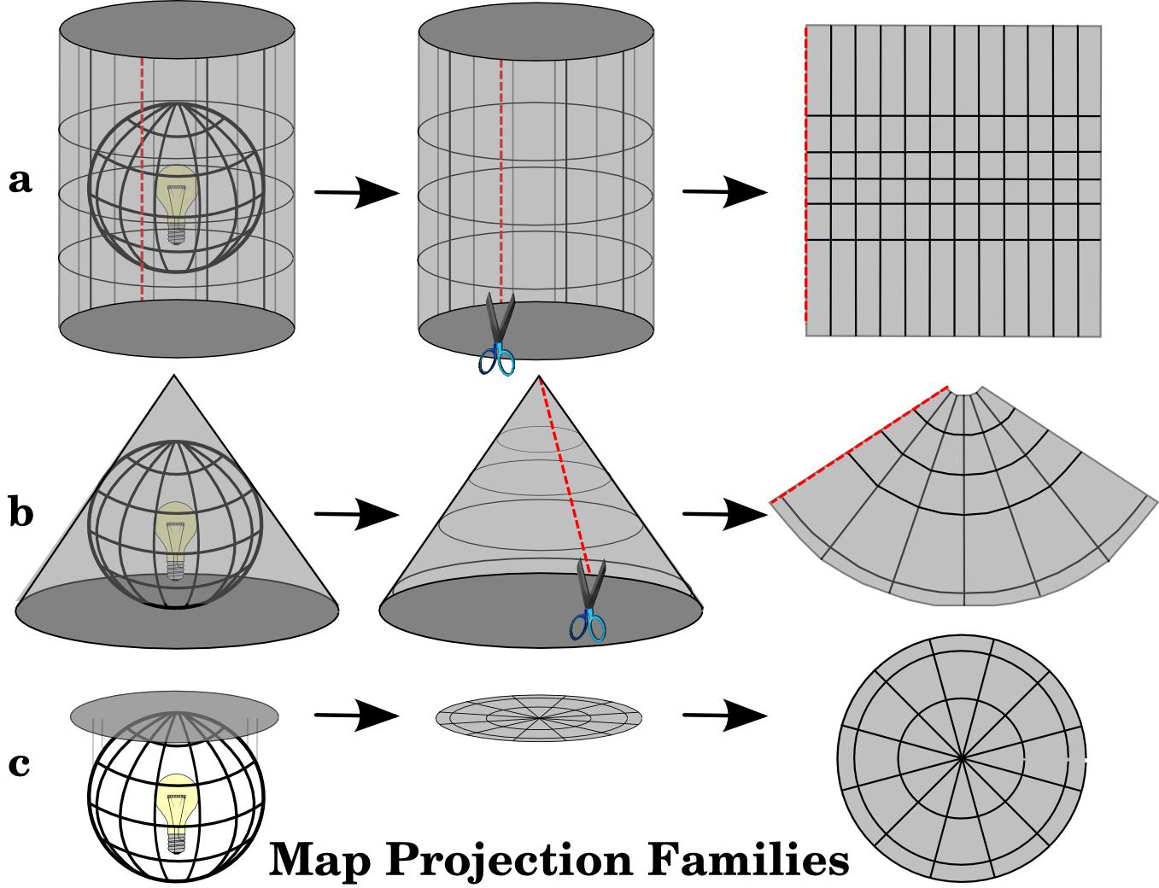
a) cylindrical projections
b) conical projections
c) planar projections

Slide 28
Projection
Depending on the projection (and also scale and spatial extent mapped) distortion in shape, distance, direction and area will vary
Minimizing distortion in one property goes hand in hand with increases in the distortion of one or more of the other properties
Projections that … are called … projections
  minimize distortion in shape and angles > conformal
  minimize distortion in distance > equidistant
  minimize distortion in area > equal-area
  minimize distortion in direction > true-direction

Slide 29
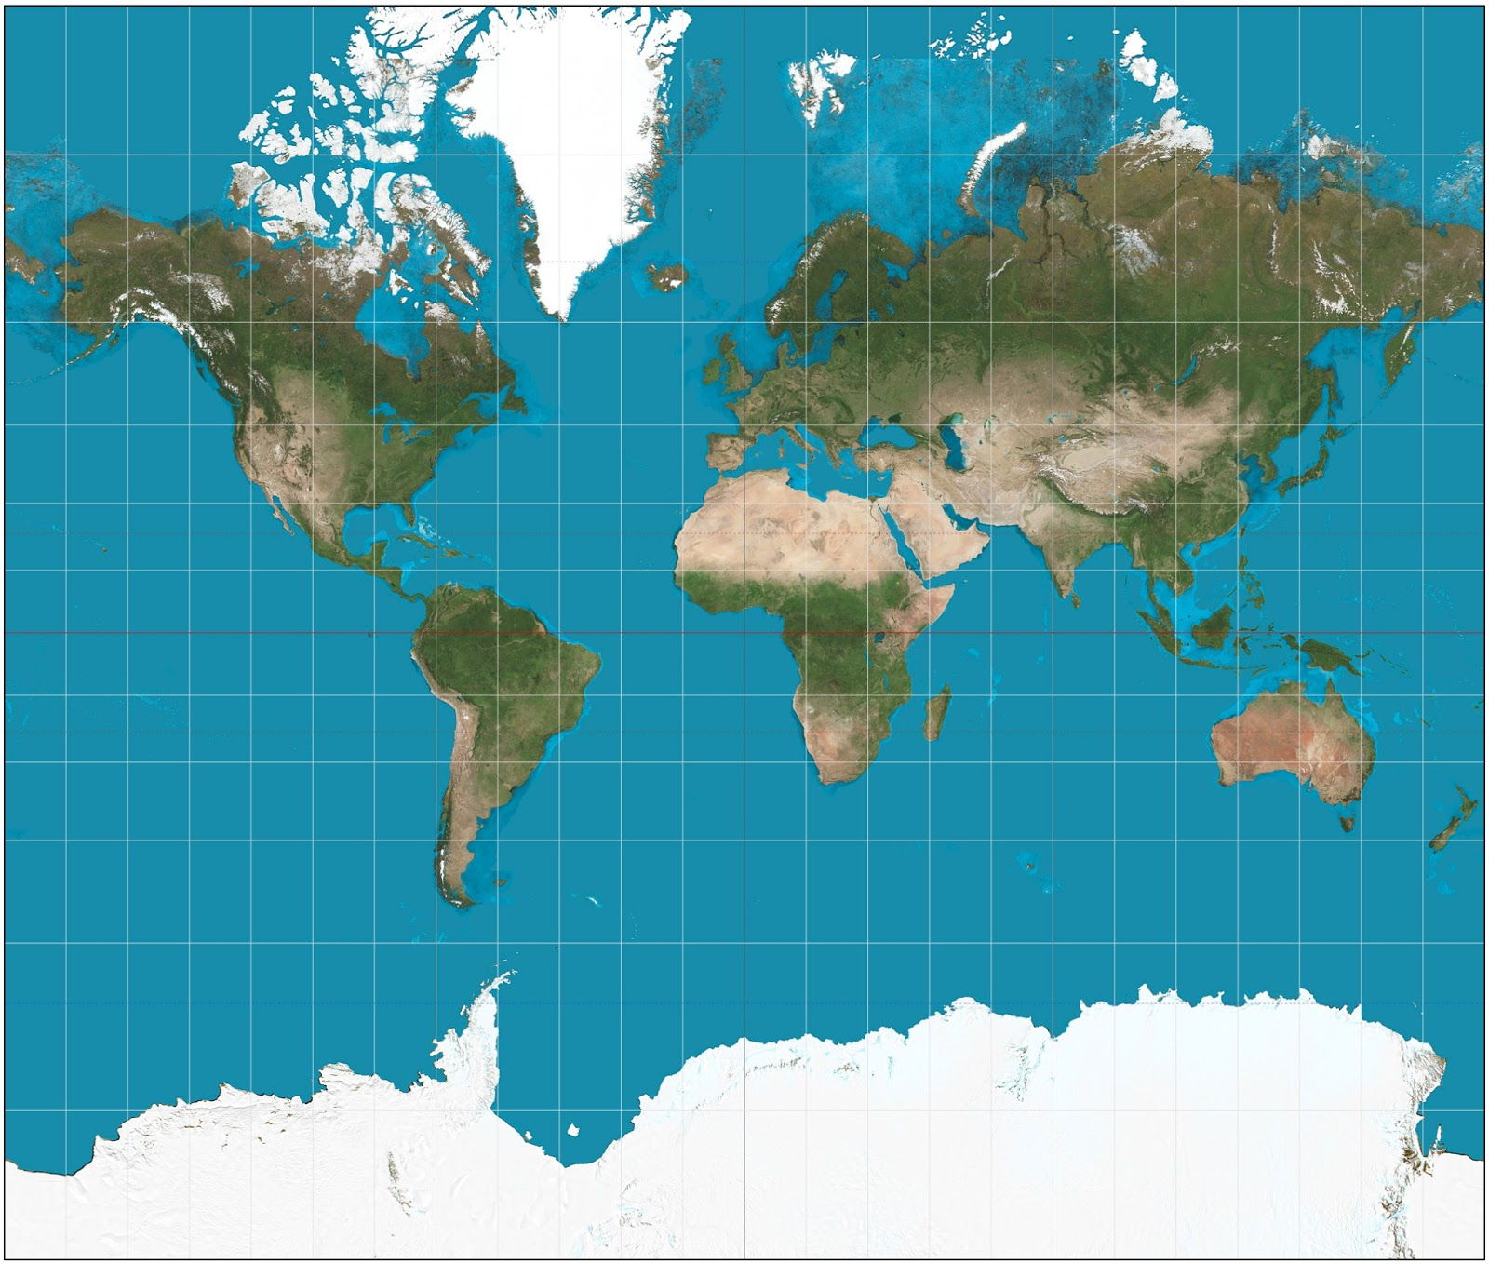
Classic Africa/Greenland Mercator Problem
Mercator Projection Distorts size the farther you move from the equator
Africa = 30,370,000 km²
Greenland = 2,166,086 km²

Slide 30
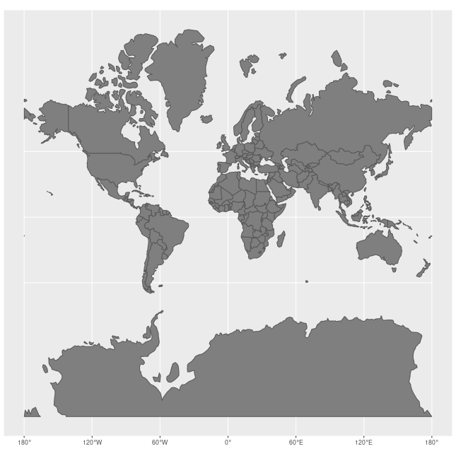
Classic Africa/Greenland Mercator Problem
Gerardus Mercator in 1569
Mercator Projection Distorts size the farther you move from the equator
Africa = 30,370,000 km²
Greenland = 2,166,086 km²

Slide 31
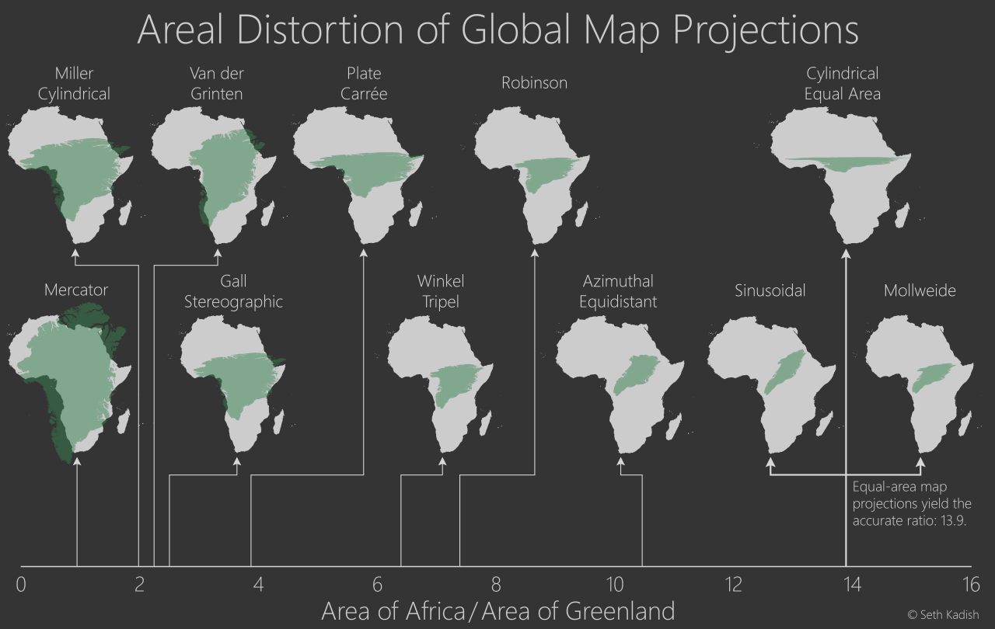

Slide 32
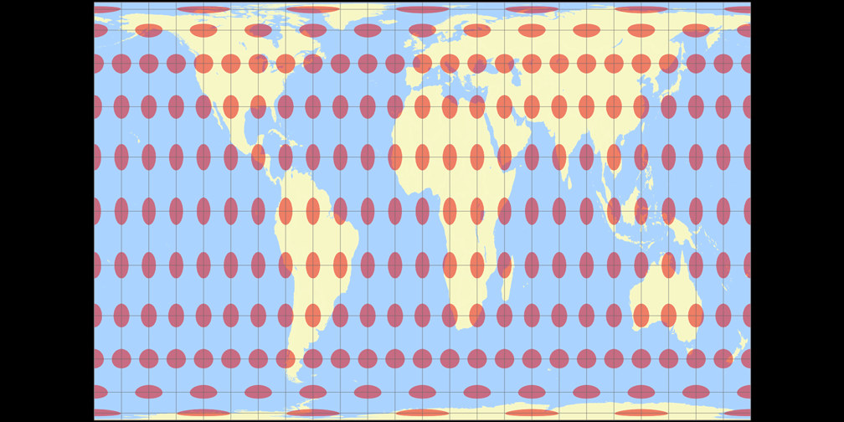
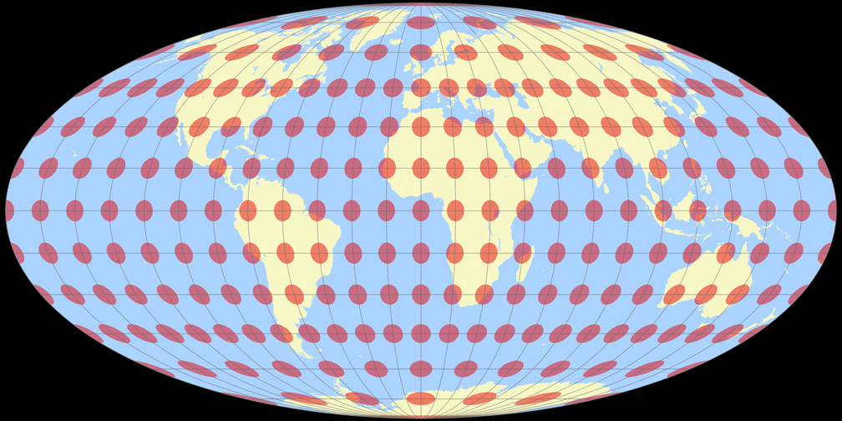
Preserving Size (Equal Area)
Some projections preserve area, meaning areas of the same size on the globe have the same size on the map
Mollweide
Gall-Peters

Slide 33
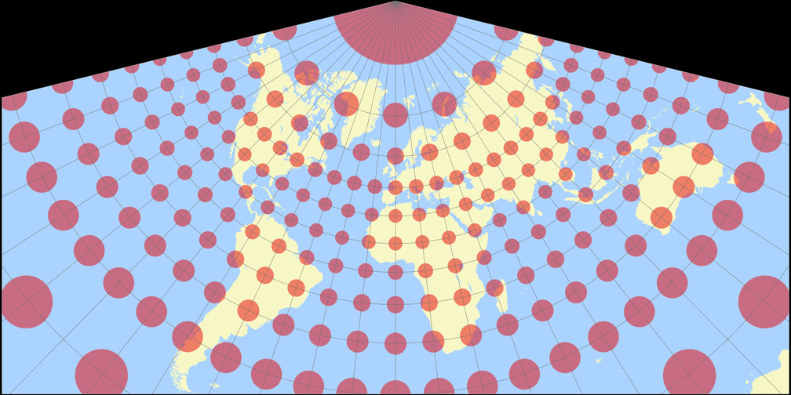
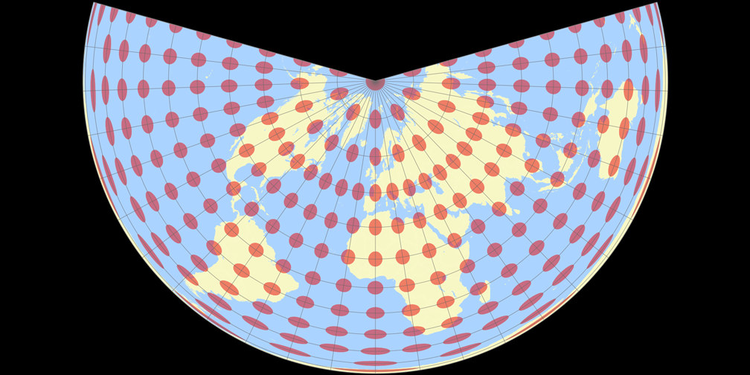
Preserving Shape (Conformal)
Conformal projections preserve angles and therefore shape in small areas.
Great for mapping regions and conteinents (sub global scales)
Lambert Conformal
Lambert equal-area

Slide 34
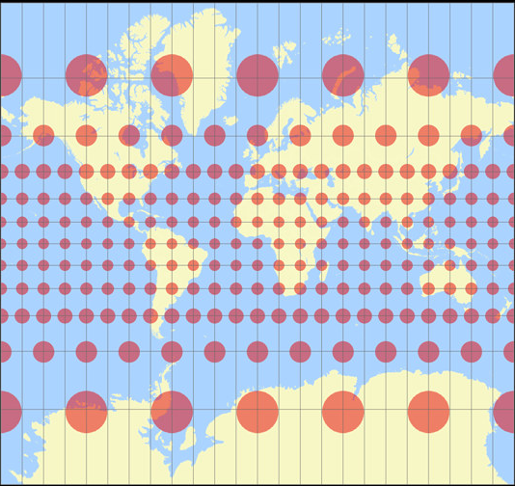
Mercator
One of the few conformal world projections
Distorts size badly, but good for equatorial areas and good for maps of small areas
Google Mercator is the most commonly used projection globally as it’s used for most web maps

Slide 35
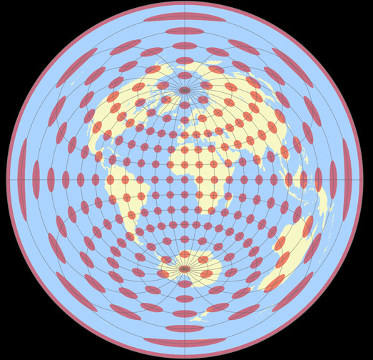
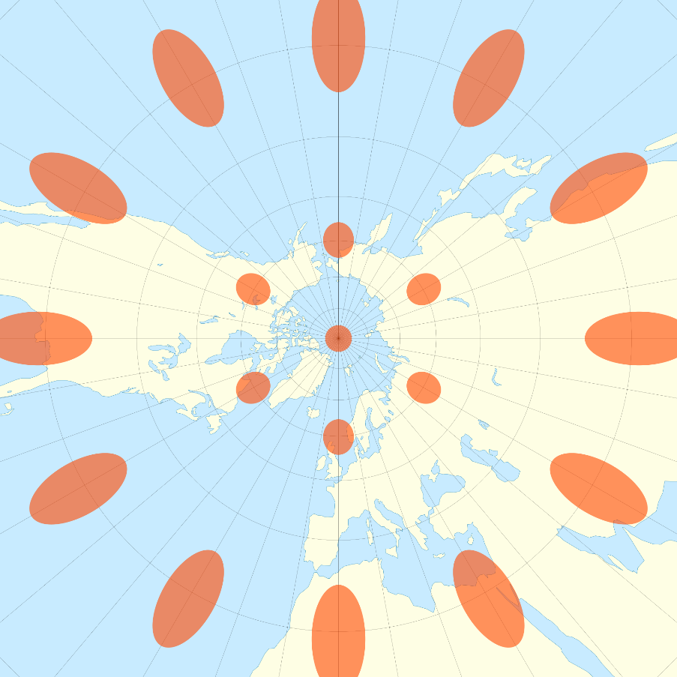
Preserving Distance and Direction (equidistant/true direction)
Azimuthal (Planar) projections preserve direction, great for navigation to a particular point, bad for most other things
Gnomonic preserve distance, ideal for determining shortest distance between two points, bad for showing anything but distances
Azimuthal
Gnomonic

Slide 36
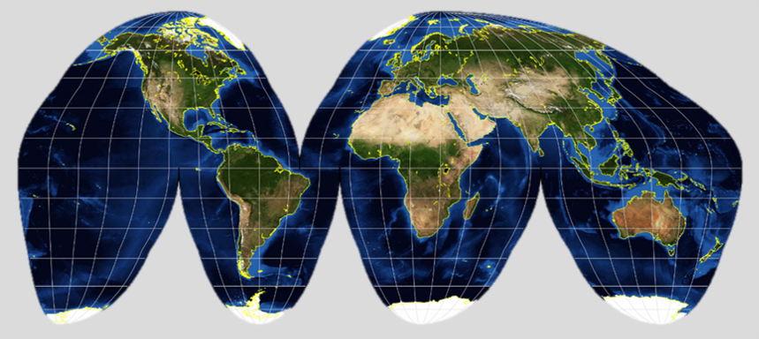
Preserving Interruptions (or continuities)
Goodes Homolosine

Slide 37
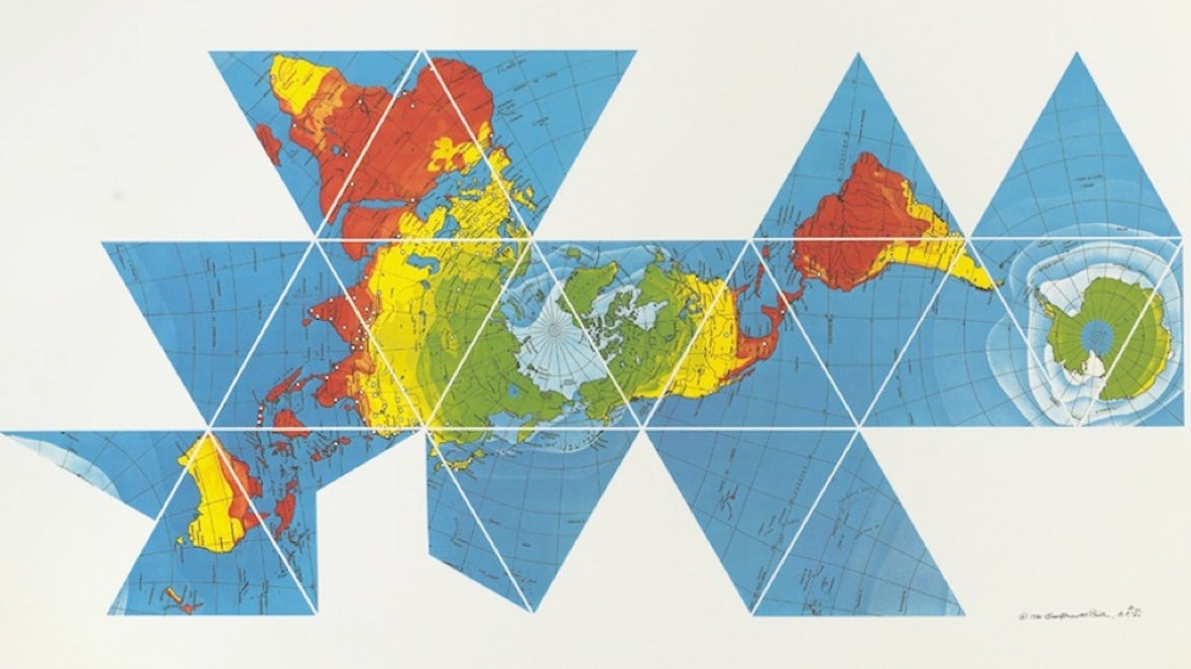

Slide 38
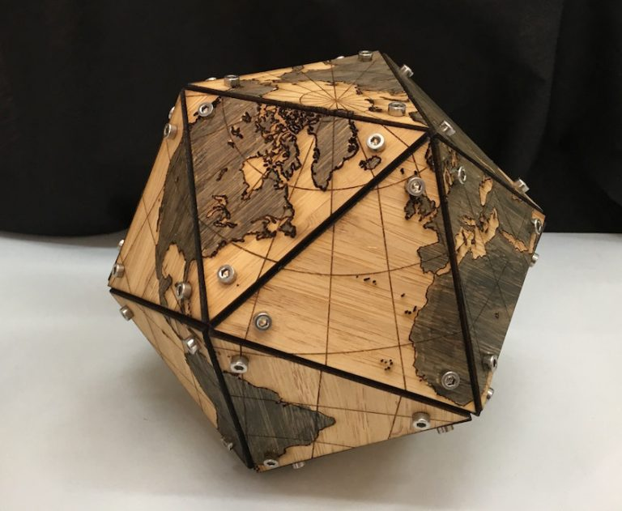

Slide 39
Coordinate Systems
Provide a spatial referencing system to locate points on the earth surface
Based on a datum (a reference point)
When map data is projected onto a planar surface, we can no longer use a spherical (or geographic) coordinate system (i.e. lat./long.) that is based on angular measurements
We now need to use a planar (or Cartesian) coordinate system (i.e. x, y) to reference features on the map
Unprojected
  Based on spherical globe coordinates
  Degrees of latitude and longitude
Projected
  Converts spherical coordinates to planar
  Set of mathematical equations
  Projects 3D coordinates to 2D map

Slide 40
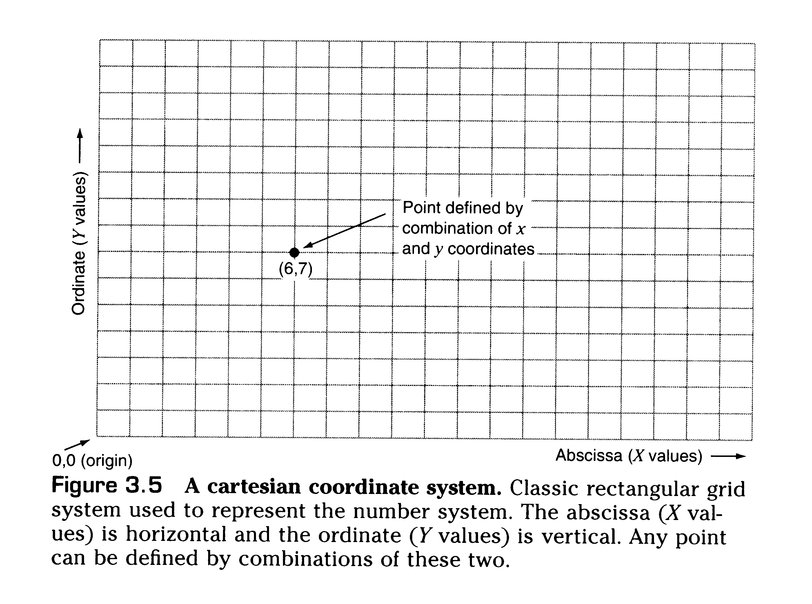
Geographic vs Projected Coordinate Systems
Geographic (Spherical)
Planar / Cartesion (Projected)

Slide 41
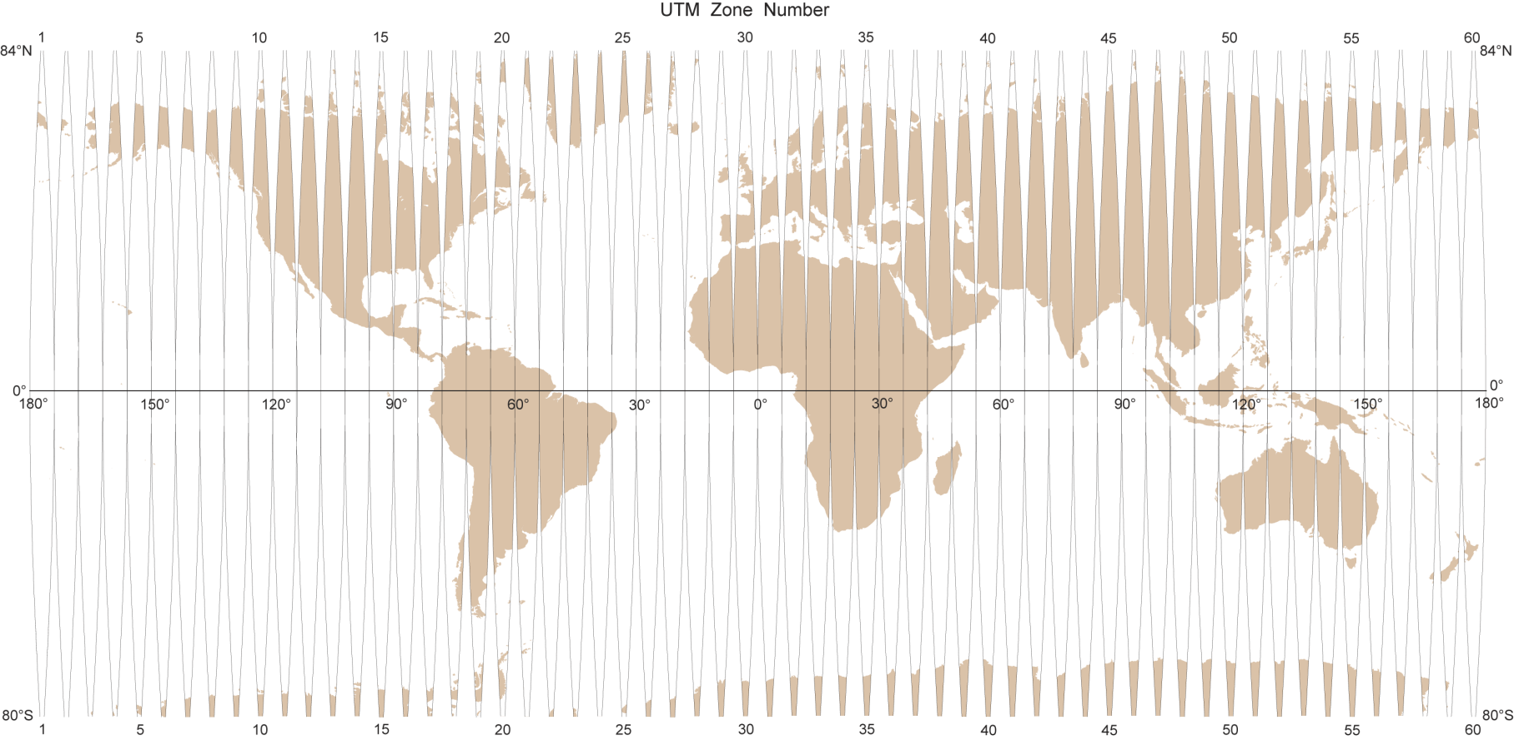
Planar Coordinate System
UTM is not a particular projection or co-ordinate system, but rather defines a set of map projections and co-ordinate systems designed for large scale mapping in all parts of the world.
It comprises 60 different Transverse Mercator projections.
Universal Transverse Mercator (UTM) includes enough zones to ensure geometric accuracy

Slide 42
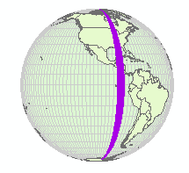
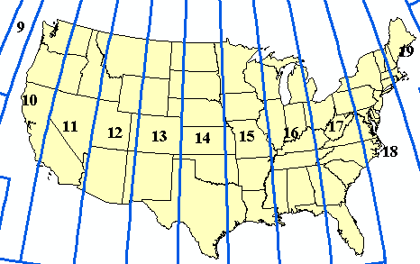

Universal Transverse Mercator
Zone 16
Based on Transverse Mercator (cylindrical) projection
World divided into 60 zones 6 degrees wide
Distortion is minimal within each zone
Maps of different areas use best zone
Best for maps covering small area in one zone

Slide 43

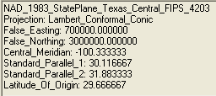
State Plane System
States divided into one or more zones identified by a unique FIPS number
A projection and parameters are established for each zone to achieve desired accuracy
  Transverse Mercator, Lambert Conformal Conic, and Oblique Mercator are standard projections used
Several varieties in common use
  State Plane NAD 1927 uses feet
  State Plane NAD 1983 uses meters
  Some choose to use NAD 1983 (feet)

Slide 44
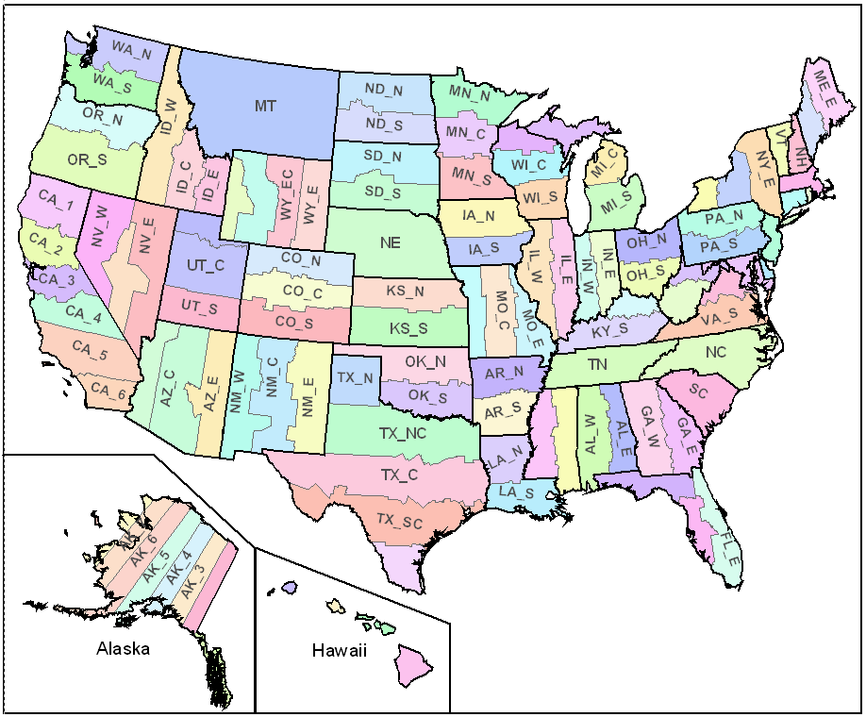


State Plane Zones
N-S zones usually Transverse Mercator
East-west zones typically Lambert Conformal Conic
Oblique Mercator

Slide 45
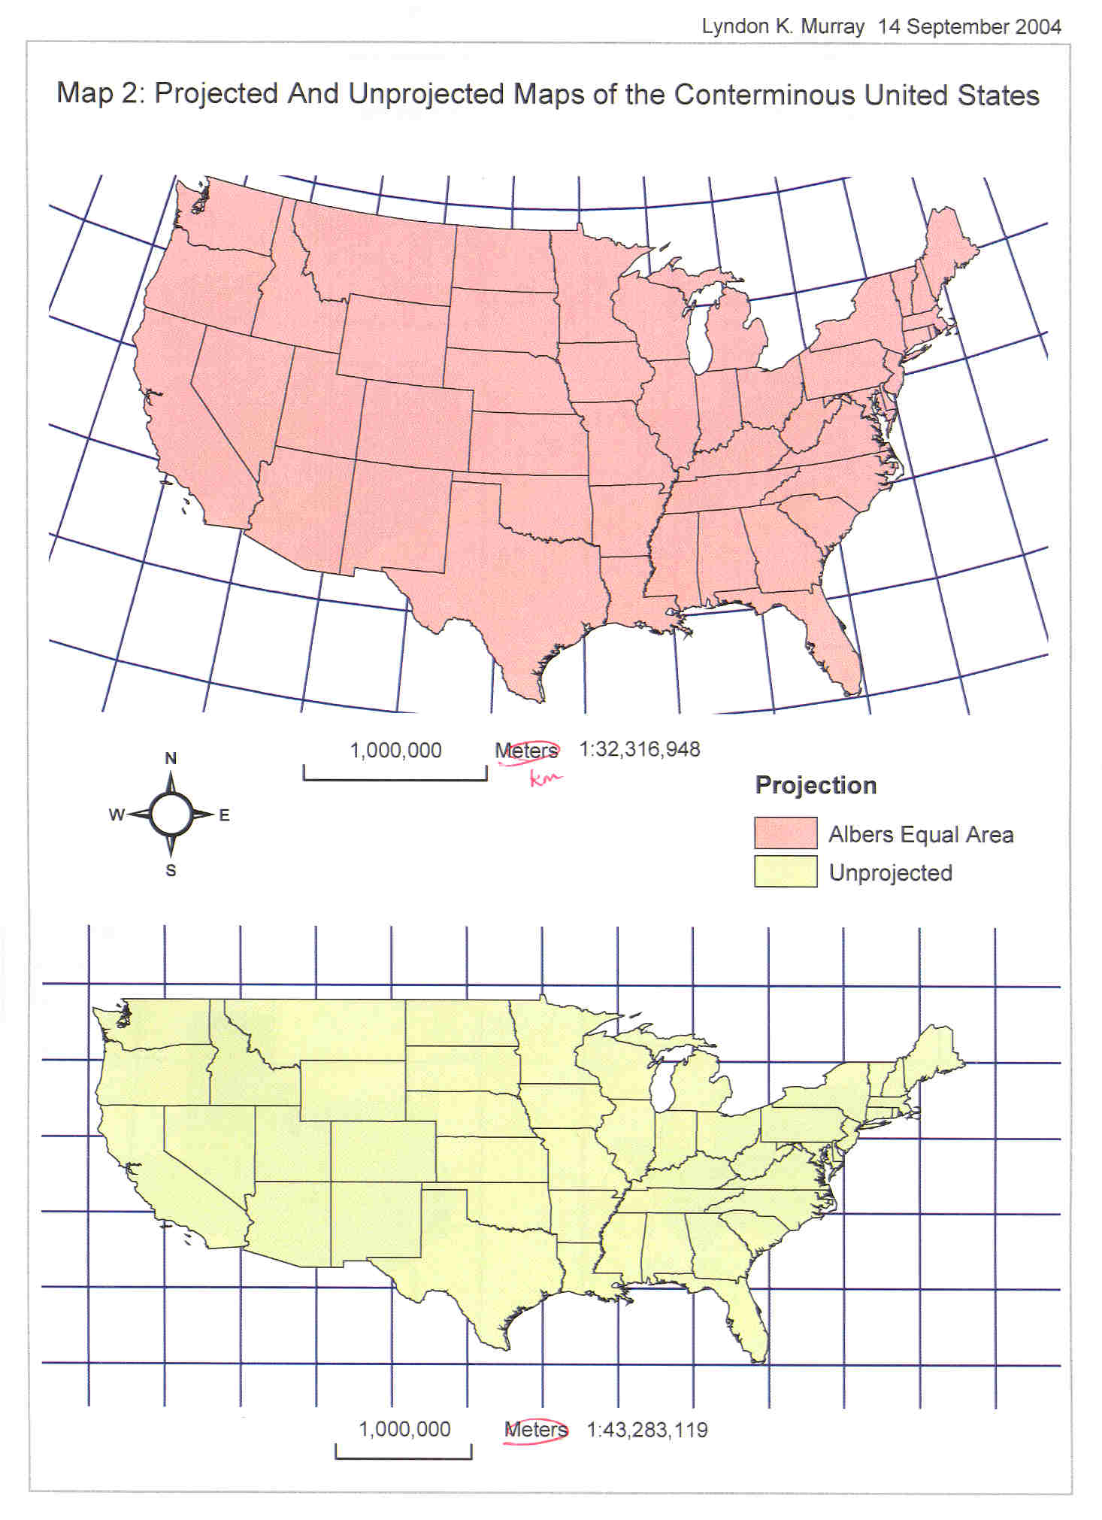

Slide 46
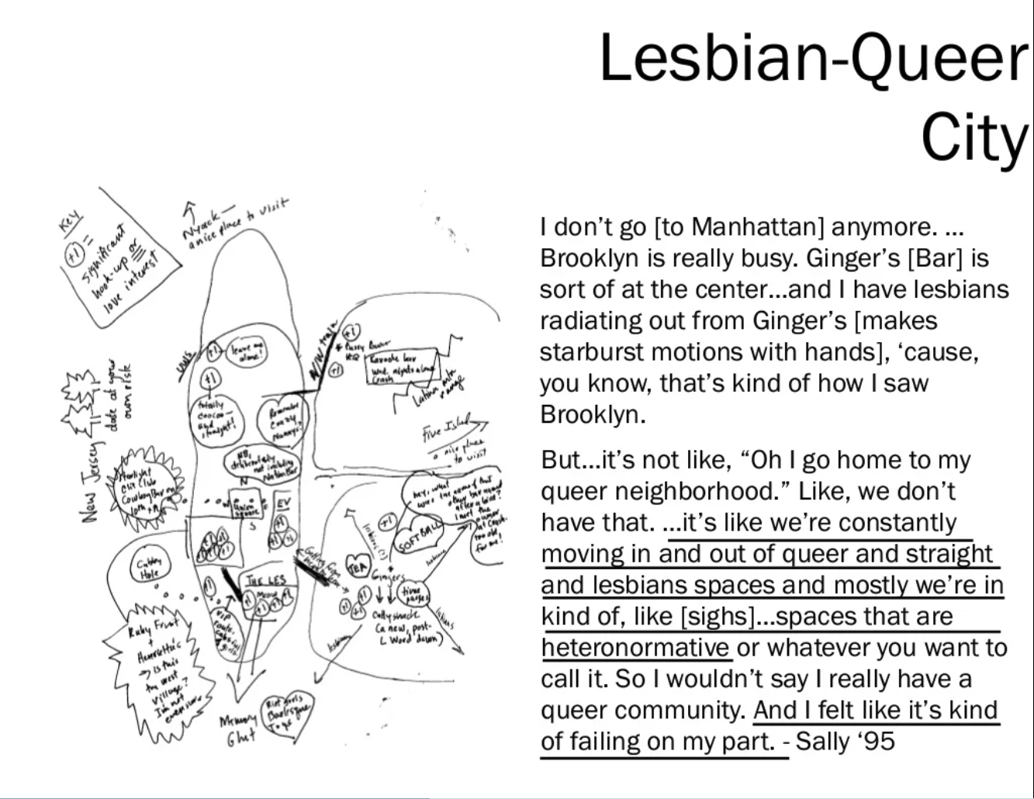
Do we really need projections?

Slide 47
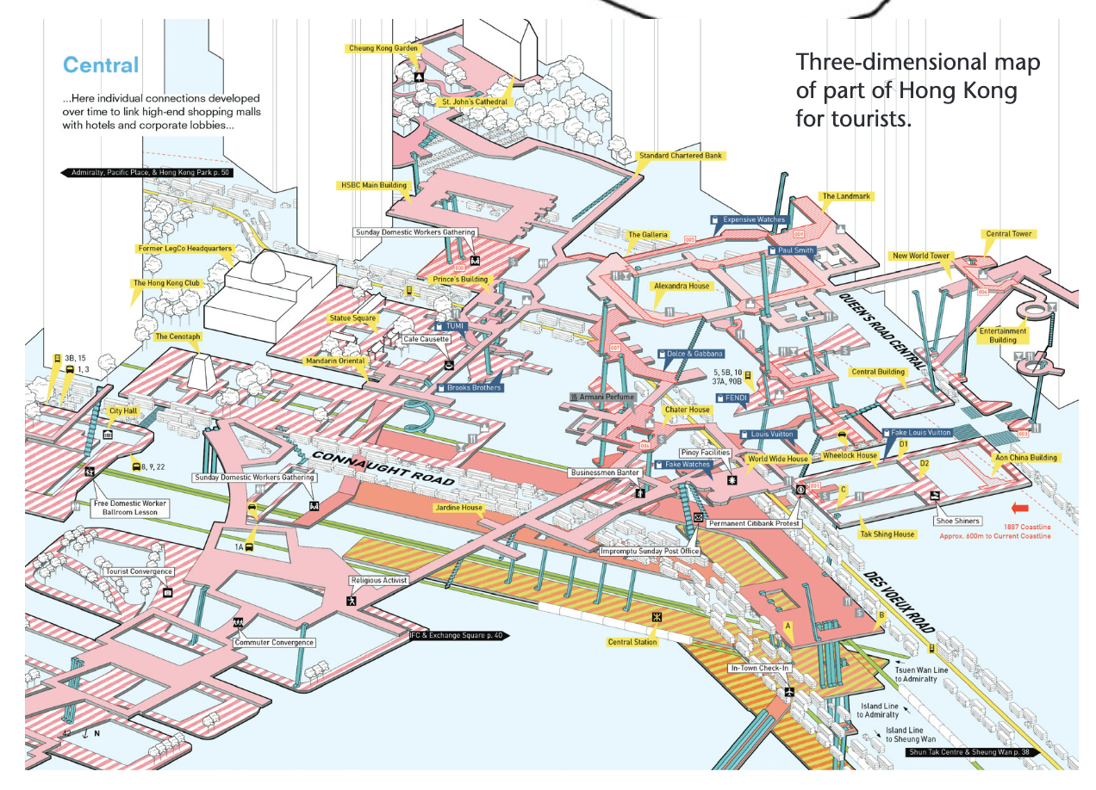

Slide 48
BIG IDEAS
All projections distort, all projections preserve. It’s up to you the cartographer as to what you want to preserve and you’re willing to distort.
Two types of coordinate systems, 2D and 3D.
A lot of the time when we’re mapping we’re working at a scale that doesn’t require us to be too concerned about choosing the right projection eg. we can’t see the different distortions.
But you still need a projection, so choose a locally appropriate projection and keep it simple.

Slide 49
Lab Prep

Slide 50
“Define Projection” vs “Project” in Arcmap
Arcmap has 2 tools related to projection that have similar names, so it can be confusing
Define Projection Tool
Project Tool
What you use when the data has no defined coordinate system
When you run the “Define Projection” tool, the tool does not change the projection. It only changes the metadata describing the current projection of the dataset.
BUT, You have to know what projection the data is in to run this tool
Converts the projected coordinate system of your data to another coordinate system
This is the tool to use if your data is currently in latitude and longitude and you want to project it to a Projected Coordinate system OR if it is in one projected coordinate system (like State Plane) and you want it in another (like UTM)

Slide 51
Lab 2 operations
Insert Map Layout
Insert Map Frame
Insert Scale bar, legend, north arrow
Insert dynamic and fixed text
Edit legend text
Insert inset map
Save project file
Export to PNG
Define Coordinate System
Transform Projections
Sort attribute table
Symbology:
  Graduated Colors
  Classification
  Normalization
  Color Schemes
Using ArcGIS Help

