Slide 1
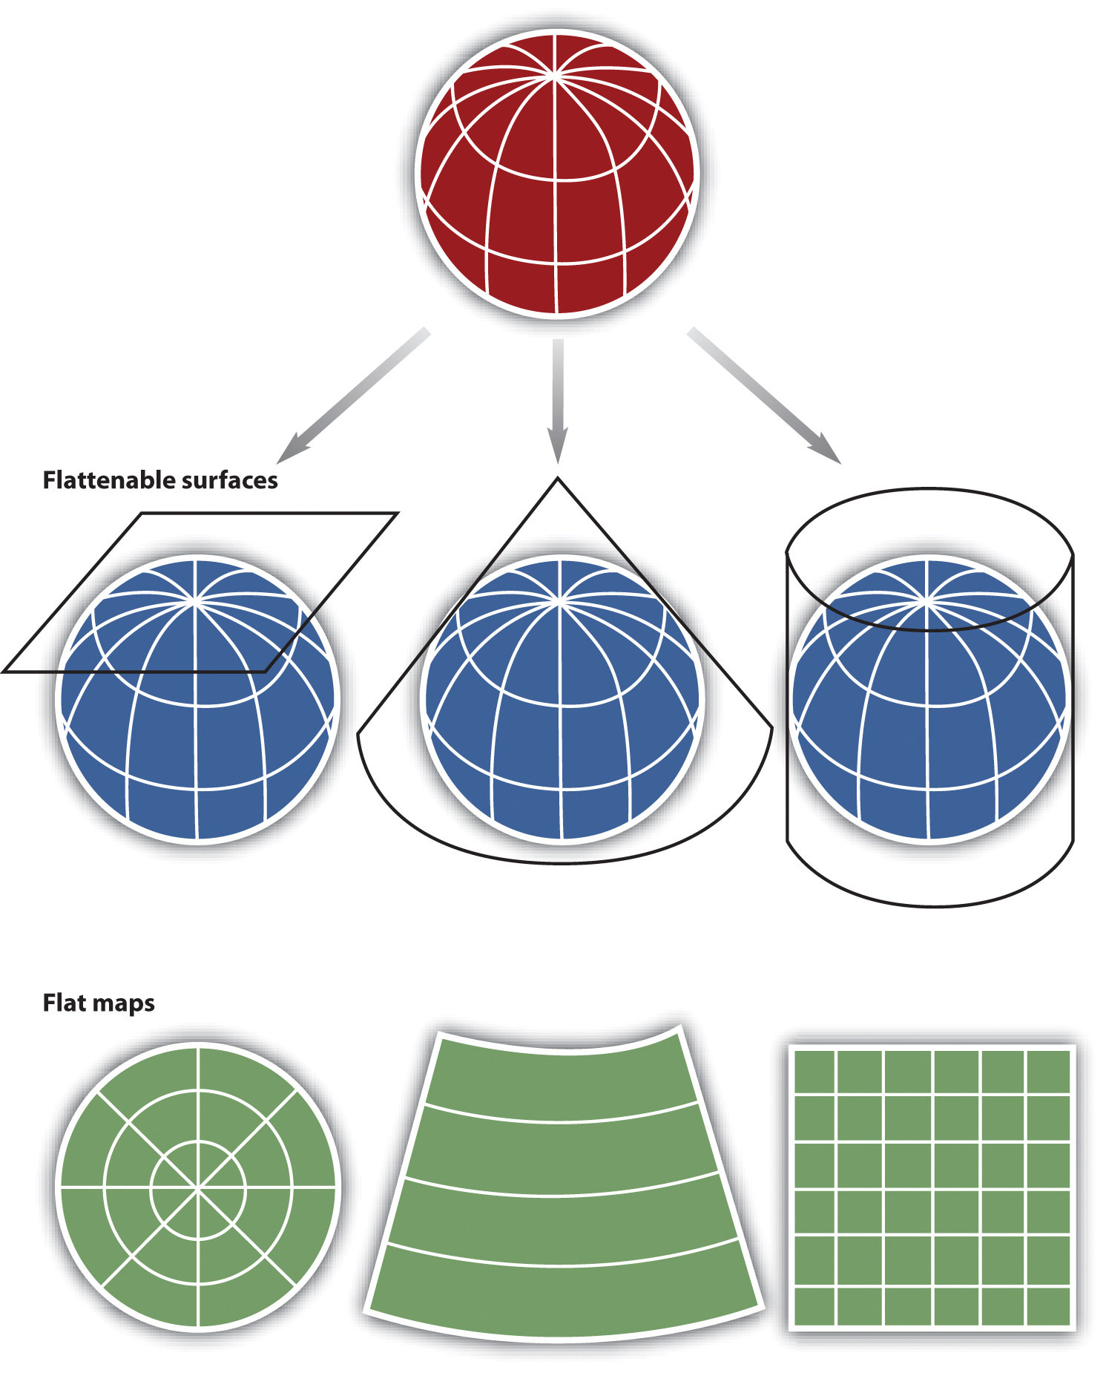
Projections and Coordinate Systems
Spring 2025, WEEK 4
Dr. Dirk Kinsey
dkinsey@brynmawr.edu

Slide 2
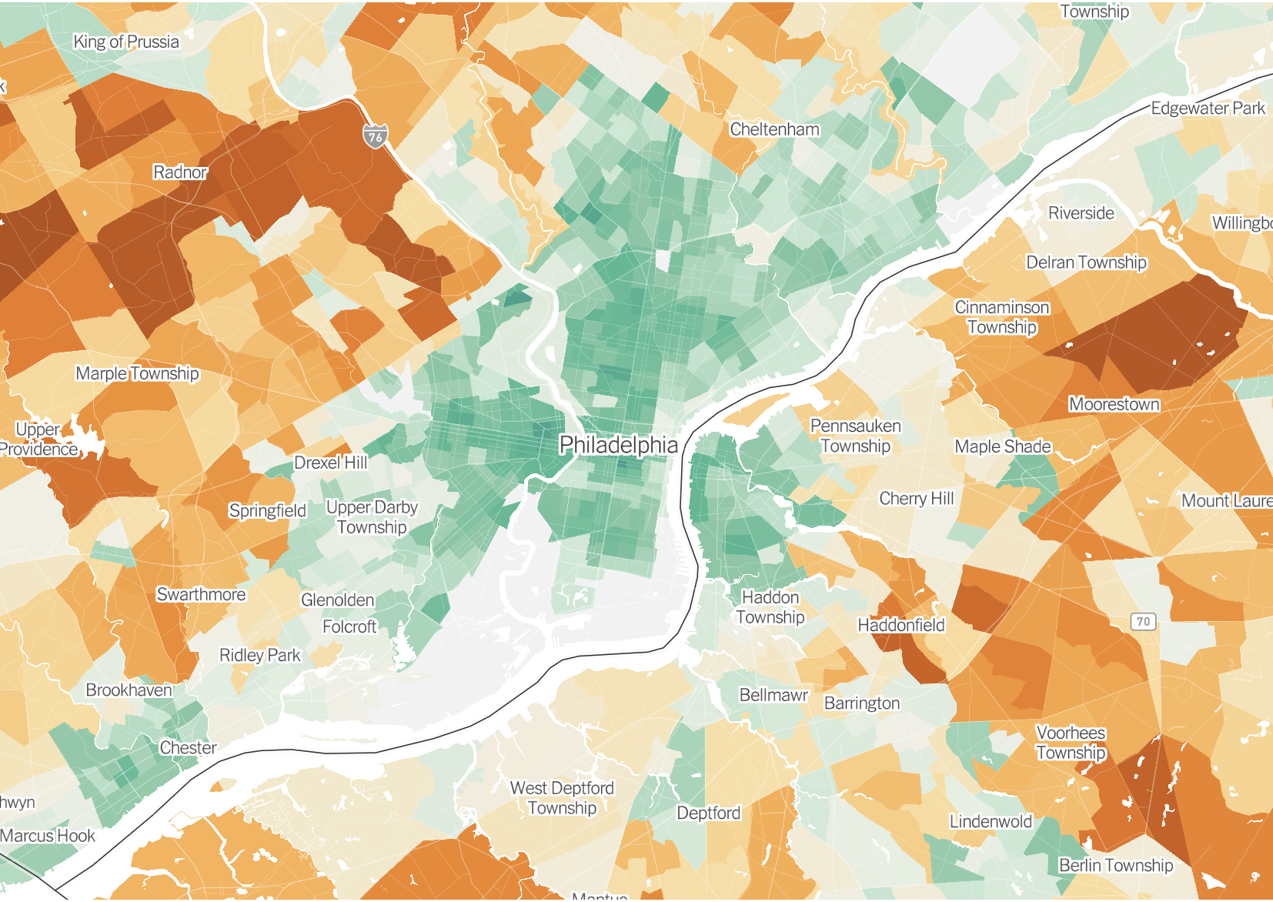
Data Classification
Data classification= a method of putting boundaries between classes between
Data classification used to break features of the map into similar groupings (ie. classes)
In general, features in the same class should be more similar than dissimilar; features in different classes should be more dissimilar than similar.

Slide 3
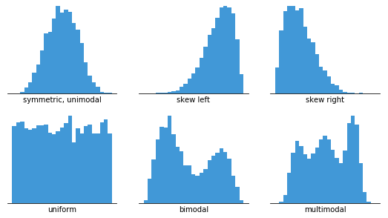
Classification in Choropleth Mapping
We use classification in order to make maps more clear and easier to interpret
If every unit had a different value and was assigned a different hue we might have a tough time interpreting patterns.
Pay attention to your data distribution to choose your classification method

Slide 4
Data Classification
How many classes do I need?
  Depends on the story you’re telling.

Slide 5
Equal Interval
This classification scheme divides the range of attribute values into equal-sized subranges.
For example, if observations have attribute values ranging from 0 to 300 and you have three classes, each class represents a range of 100 with class ranges of 0–100, 101–200, and 201–300. Here, the class range is held constant while the number of observations per class is allowed to vary.
Do not account for data distribution and may result in most data values falling into one or two classes. It's best applied to familiar data ranges, such as percentages OR to call attention to outliers

Slide 6
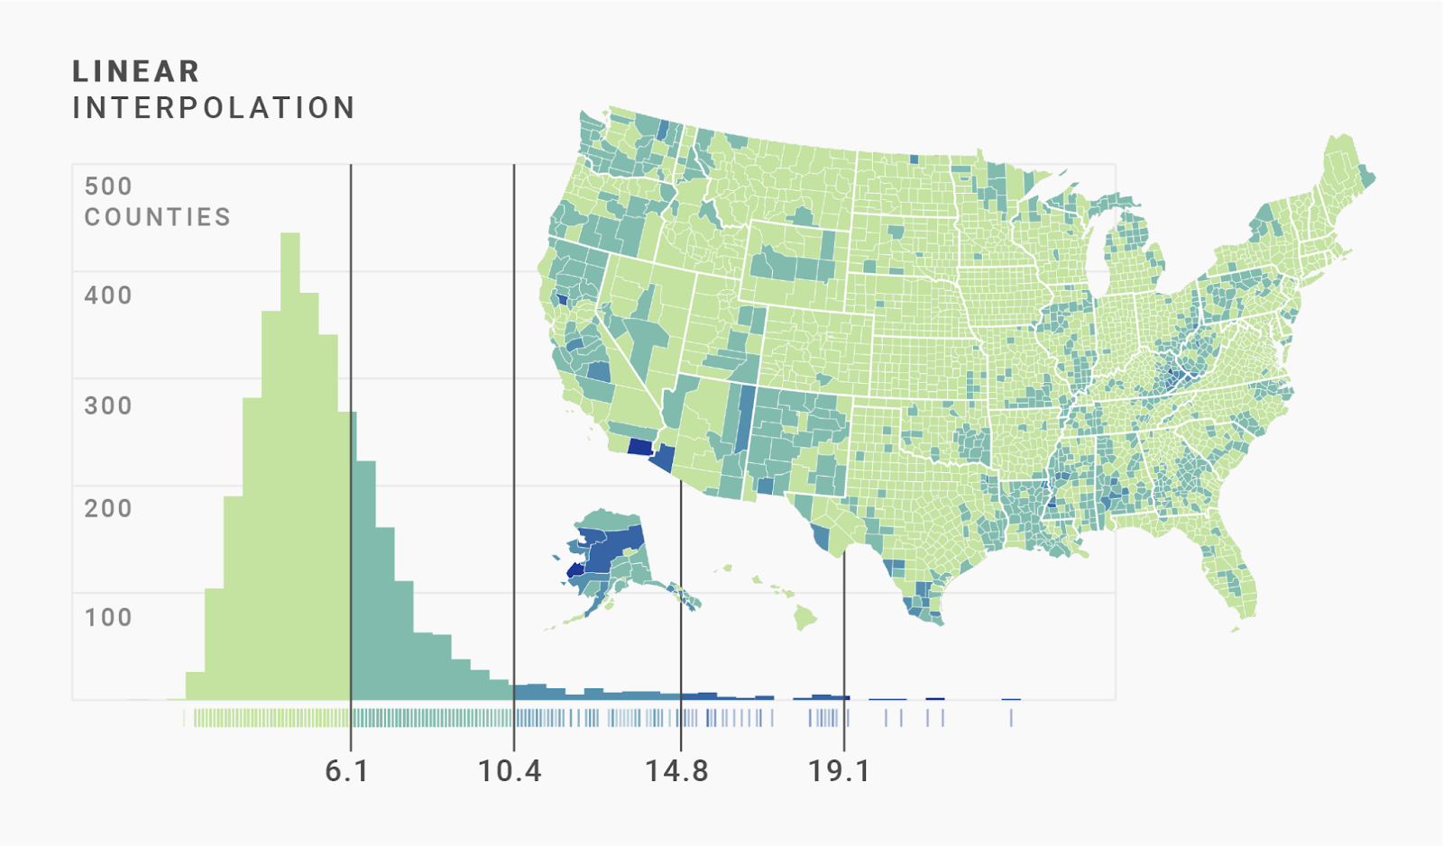
Equal Interval
Number of observations per interval will vary, and interval ranges will be constant.

Slide 7
Quantile
Each class contains an equal number of features.
For example, if you have 100 observations and 5 classes, there will be 20 observations in each class. Here, the number of observations per class is held constant while the class range for each class is allowed to vary.
The problem is that they often place similar values in different classes or very different values in the same class.

Slide 8
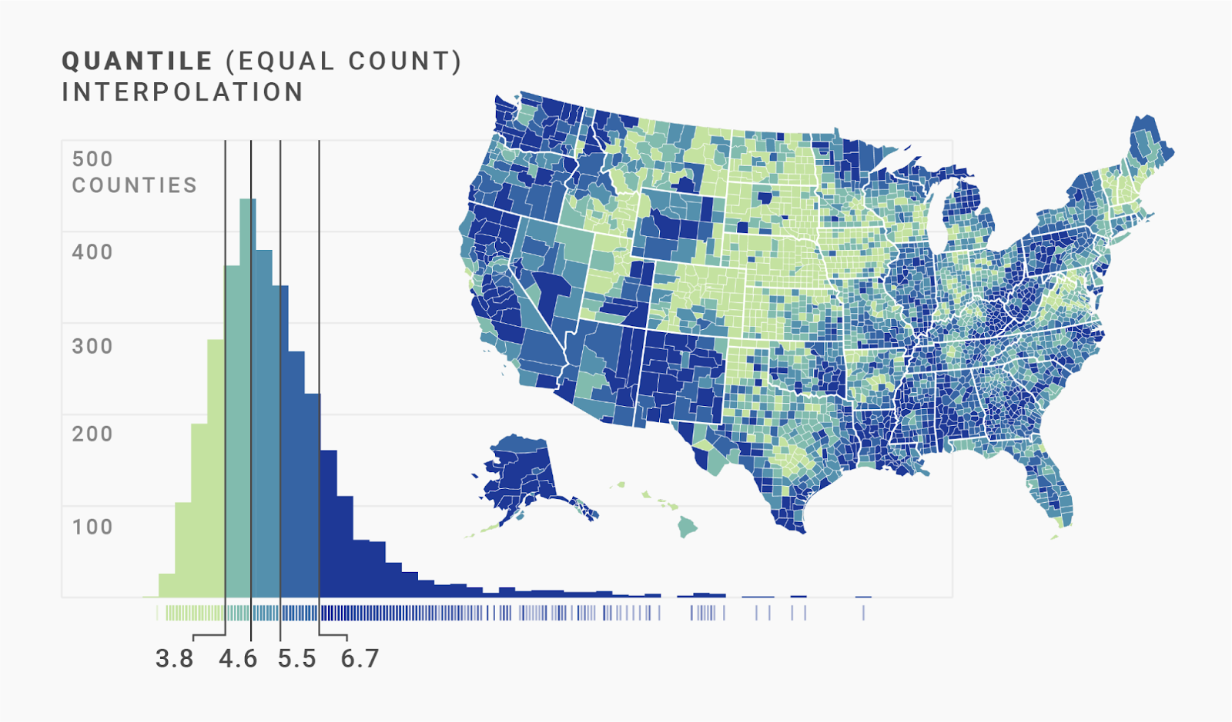
Quantile
Number of observations per interval will be constant, and interval ranges will vary.

Slide 9
Natural Breaks
Classes are based on natural groupings inherent in the data.
Class breaks are chosen that best group similar values and maximize the differences between classes. The features are divided into classes whose boundaries are set where there are relatively big jumps in the data values.
Both the number of observations per interval and interval ranges will vary.

Slide 10
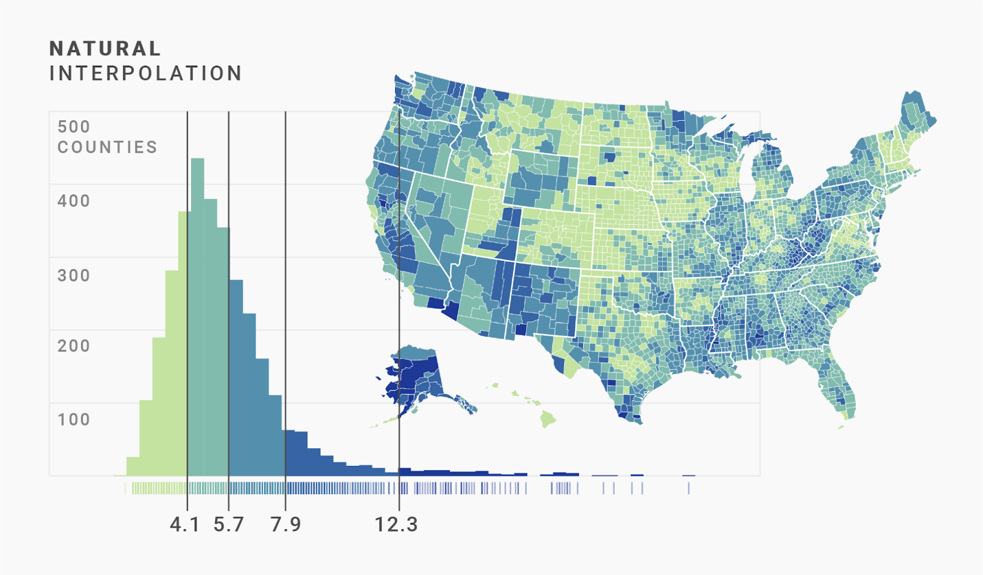
Natural Breaks
Great choice for a default classification scheme because it takes into account characteristics of the data distribution.

Slide 11
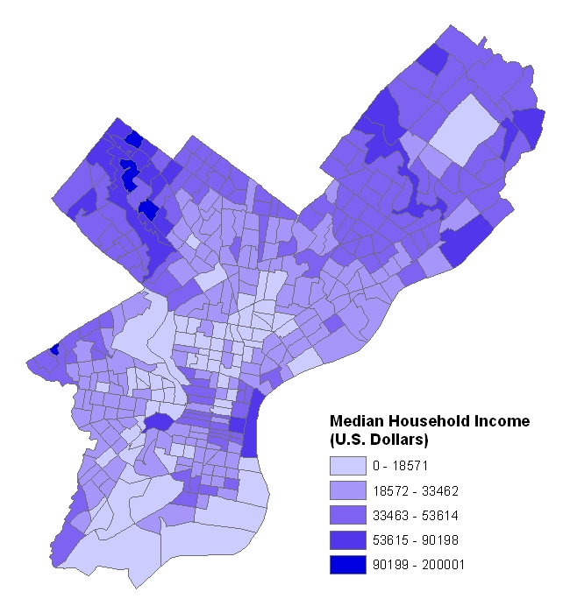
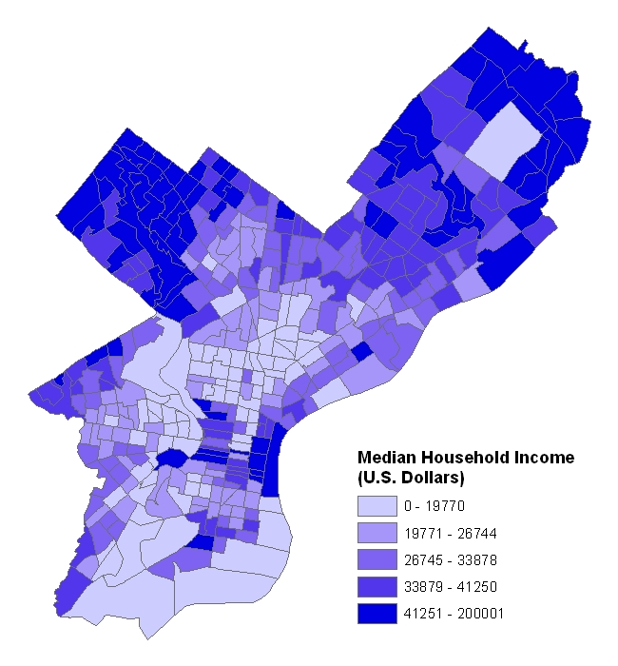
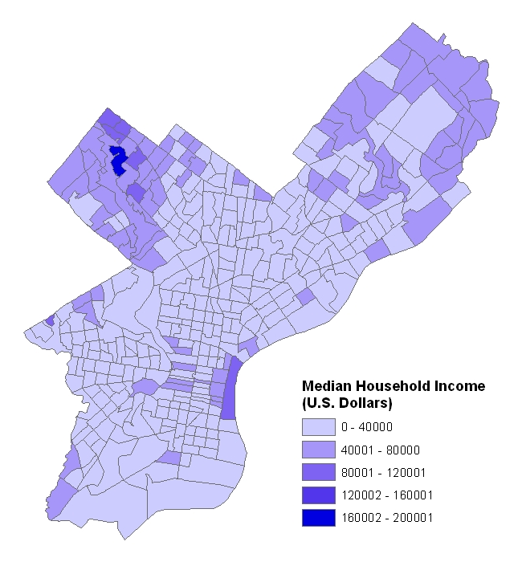
Comparing Data Classification
Natural Breaks
Equal Interval
Quantile

Slide 12
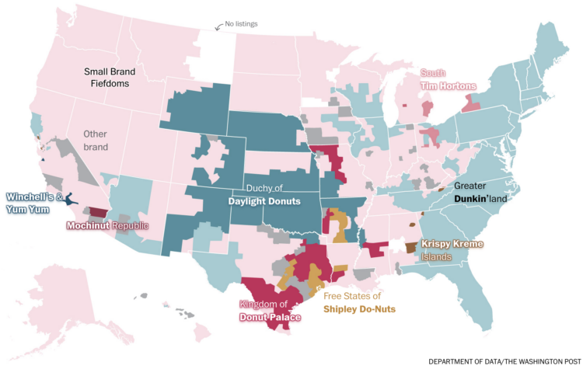

Slide 13
Color Schemes
Sequential
  Appropriate for ordered data that progresses from low to high
  Typically, light colors represent low values; darker colors represent high values
Diverging
  Appropriate for ordered data that progresses from low to high
  Places emphasis on extreme high, extreme low, and middle range values
From Cindy Brewer:
http://www.personal.psu.edu/cab38/GEOG321/04_color02/color5.html

Slide 14
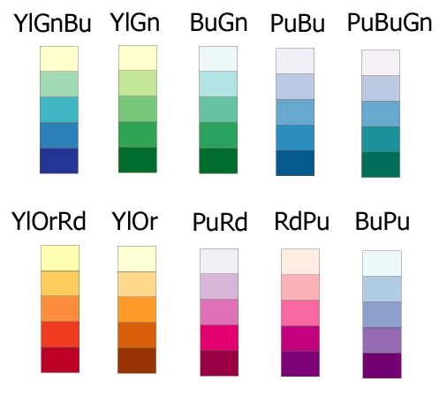
Sequential Color Schemes

Slide 15
Sequential Color Scheme

Slide 16
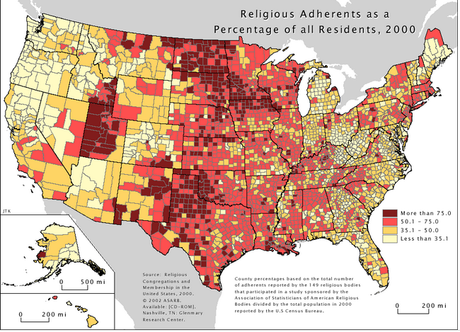
Sequential Color Scheme

Slide 17
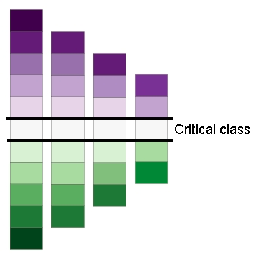
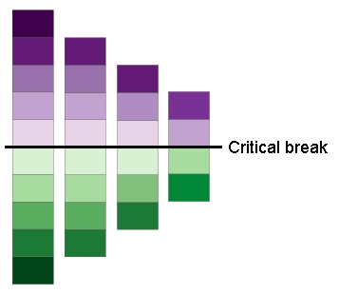
Diverging Color Scheme

Slide 18
Diverging Color Scheme

Slide 19
Bivariate Color Scheme: Sequential-Sequential

Slide 20
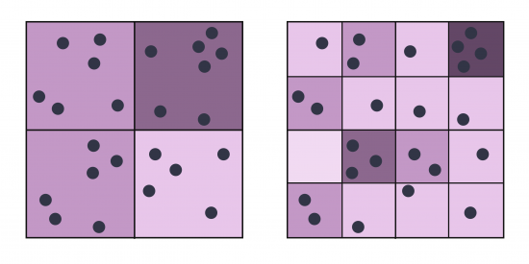
Ecological Fallacy and MAUP
Modifiable Areal Unit Problem (MAUP)
A census choropleth map calculating population density using state boundaries will yield radically different results than a map that calculates density based on county boundaries. Furthermore, census district boundaries are also subject to change over time, meaning the MAUP must be considered when comparing past data to current data.
Ecological Fallacy
Is a formal fallacy in the interpretation of statistical data that occurs when inferences about the nature of individuals are deduced from inferences about the group (or geography) to which those individuals belong.

Slide 21
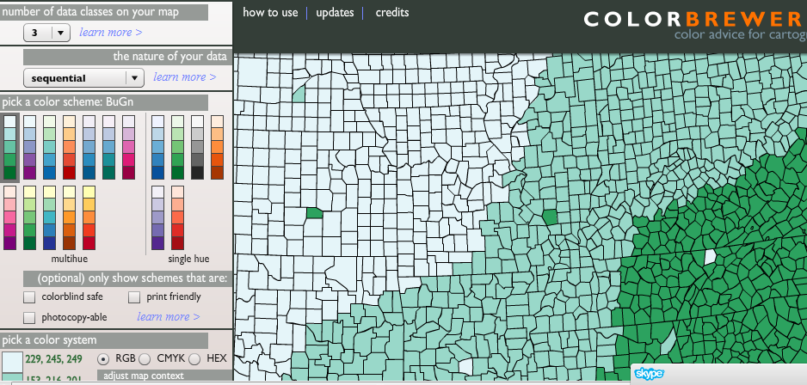
Need help deciding what colors to use?
Check out the ColorBrewer!
http://colorbrewer2.org/

Slide 22
Thematic Map Elements
Title
Legend
Scale
Credits
Mapped areas
Borders
Map symbols
Place names and labeling

Slide 23
Lab Prep

Slide 24
“Define Projection” vs “Project” in ArcGIS
ArcGIS has 2 tools related to projection that have similar names, so it can be confusing
Define Projection Tool
Project Tool
What you use when the data has no defined coordinate system
When you run the “Define Projection” tool, the tool does not change the projection. It only changes the metadata describing the current projection of the dataset.
BUT, You have to know what projection the data is in to run this tool
Converts the projected coordinate system of your data to another coordinate system
This is the tool to use if your data is currently in latitude and longitude and you want to project it to a Projected Coordinate system OR if it is in one projected coordinate system (like State Plane) and you want it in another (like UTM)

Slide 25
Lab 2 operations
Define Coordinate System
Transform Projections
Sort attribute table
Symbology:
  Graduated Colors
  Classification
  Normalization
  Color Schemes
Using ArcGIS Help
Insert Map Layout
Insert Map Frame
Insert Scale bar, legend, north arrow
Insert dynamic and fixed text
Edit legend text
Insert inset map
Save project file
Export to PNG

