Slide 1
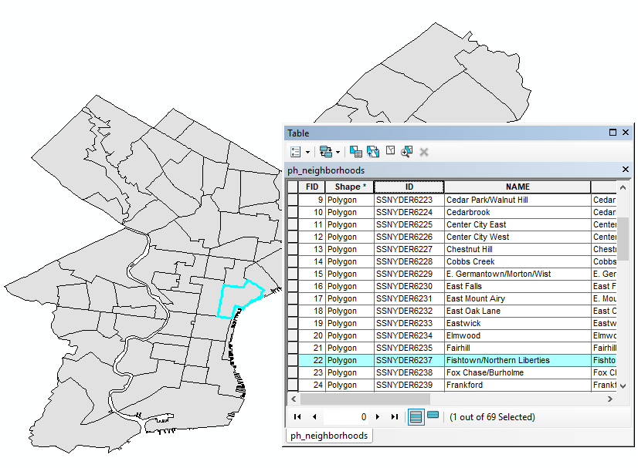
Databases/ attribute data and tables
FALL 2025, WEEK 4
Dr. Dirk Kinsey
dkinsey@brynmawr.edu
Office Hours: Mon 11-12pm and Wed 11-12pm

Slide 2
This Week
Today
  Paper Presentation
  Map critique
  Lecture (working with tables/intro to census data)

Slide 3
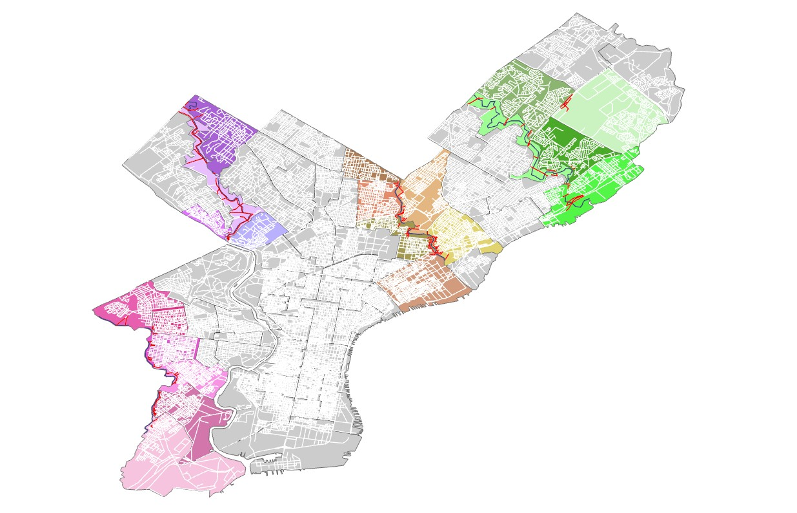

Slide 4
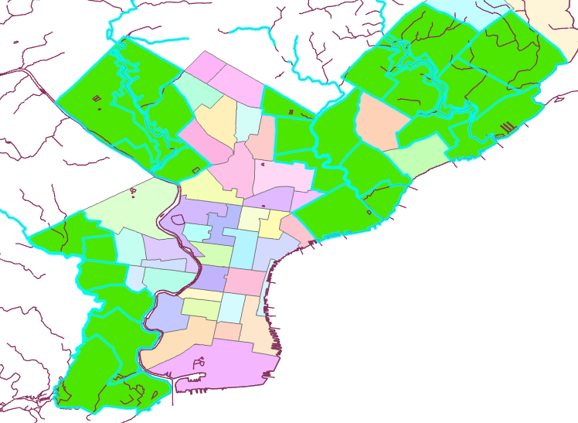

Slide 5
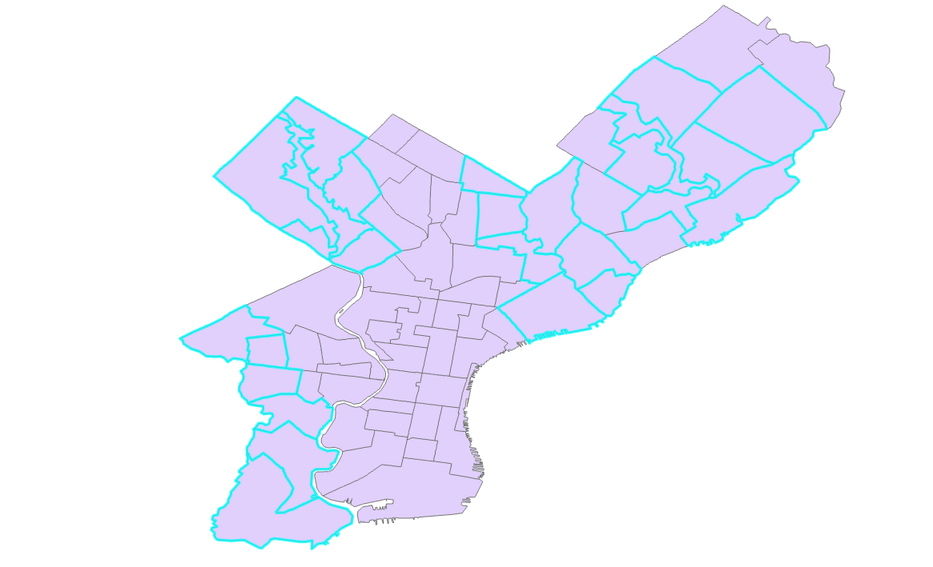
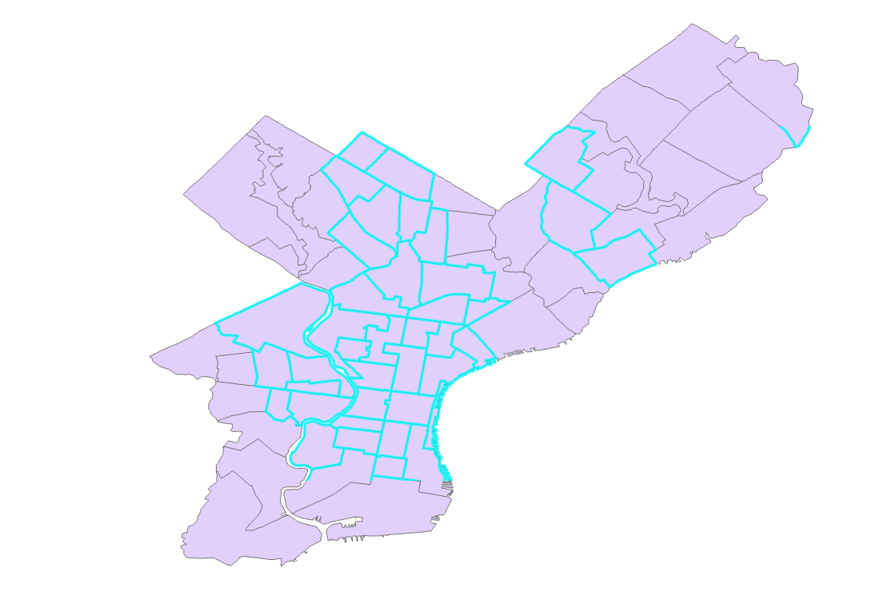

Slide 6
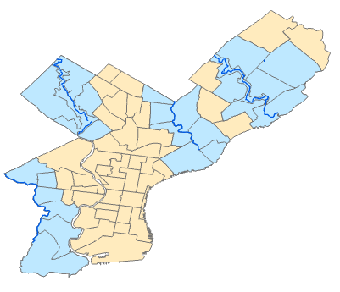

Slide 7
General Thoughts
Show only what’s necessary/helps tell the story
  Do you need to show all the counties, roads, and streams? Which are important to telling your story, which are superfluous?
Possible ways of doing this
  Exclude layers you don’t need
  Cover areas you don’t want to see with white: Add counties file to your map>Properties>Symbology>Make Phila county clear and all other counties white with no outline for all
  Clip Data Frame: In Layout View – Right Click data frame to get Data Frame Properties>Data Frame tab>Clip Options – Clip to shape – Specify shape>Outline of Features – select layer
  Create a layer from selected features: Right click the layer with the feature or features you want to show>Selection>Make layer from selected feature>Give it a new name that makes sense

Slide 8
General Thoughts
Group important features using color
Showing all the features using different colors can make it difficult for us to know what is important. Visually prioritize the most important features eg. give neighborhoods a color that corresponds to the stream they boarder.
Think about extent
  How much do you need to show to be effective? How much is too much? How much is too little? Do you need to see neighboring counties?

Slide 9
Spatial and Attribute Data
Data in a GIS are often split into two components
Spatial Data
Attribute data
Coordinate information that describes the geometry of the object
Non-spatial characteristics of each cartographic object
  e.g. name, total population and median household income of each census tract

Slide 10
Relational database management systems (RDBMS)
Composed of a set of tables connected by relations
Records (rows) in the table are called tuples
Fields (columns) in the table are called domains
Records RELATE to fields and Tables can be RELATED or joined based on common attribute values in relational databases
We use GIS terms attribute tables, records, and fields

Slide 11
Field Types
When adding a new field (column) to a table in GIS software, you will be prompted to choose a data type for the field.
There are three main data types: text, date, and number.
  Text(String)-Any set of alphanumeric characters of a specified length.
  Date/Time- For ordering data temporally, not doing calculations.
  Numbers—Can be one of the following numeric data types:
    Short = Whole numbers, a few digits
    Long = Whole numbers, a lot of digits
    Float = fractional values, a few decimal places
    Double = fractional values, a lot of decimal places
    Big integers = the name says it all
  Object ID—An object identifier is a unique integer field that cannot have null values and is added when a geodatabase table or feature class is created in ArcGIS. This object ID field stores a unique ID for each row in the table and is created in tables and feature classes

Slide 12
Field Types
What data type you should use depends on the type of data, whether there are fractional values, and the possible range of numerical values. For example, a short integer is inadequate to store populations of large cities, since the largest possible value with a short integer is 32,767.

Slide 13
Joining Tables
It is often necessary to join or relate tables in GIS. Table join is a fairly common task.
Examples
  Mapping unemployment rate by county from a excel file containing unemployment rates.
  Combing data from a previous visit to a field site in table form with the most current observations which have been recorded as GPS points
  Adding historical record data to a map of addresses
Table join appends attributes of a source table ( unemployment rate) to the end of a target table ( county boundary).

Slide 14
Joining Tables
Joining Tables can be tricky!
Answering the following questions will help you use table join properly:
  Do the two tables share the same attribute values?
  Are those common attributes of the same data types?
  What is the relationship between the two tables?
  In what direction should you perform table join?
Presence of common attribute: Two tables should share the attribute values on which a table join will be based.
Data type of a common key: If the data types of two tables to be joined do not belong to the same category ( number, text, date), table join cannot be used.
Relationship between tables: Relationship refers to how many rows in one table are associated with rows in another table.
Direction of table join: Table join can be used in two directions. That is, you can join table A to the table B or vice versa. Since a source table is appended to a target table, it is always a good idea to join a one side table to a many side table to avoid losing any information.

Slide 15
Table Joins
Presence of common attribute
The values of the last column zipcode in the TRI table are the same as those of the first column zipcode in the Cancer table. Hence, two tables can be joined based on the condition TRI.zipcode = Cancer.zipcode.

Slide 16
Table Joins
Data type of a common key:
If TRI. zipcode is the text data type, then Cancer.zipcode should also be the text data type for table join to work. If TRI.zipcode is a numerical data type ( short, long, float, double), then Cancer.zipcode should also be the numerical data type.

Slide 17
Table Joins
Relationship between tables:
Relationship refers to how many rows in one table are associated with rows in another table. One zipcode contains many TRI facilities.

Slide 18
Table Joins
Relationship between tables:
Relationship refers to how many rows in one table are associated with rows in another table. One zipcode contains many TRI facilities. Therefore, there is one- to many relationship between the Cancer by zipcode and the TRI table.

Slide 19
Table Joins
Direction of table join:
If you join Cancer ( one side) to TRI (many side), then all the data from the source table ( Cancer) will be preserved after the table join. If you join TRI ( many side) to Cancer ( one side), some data from the source table will be lost. That is, either 1 or 2 ( not all) for the first row with zipcode 60001 will be saved

Slide 20
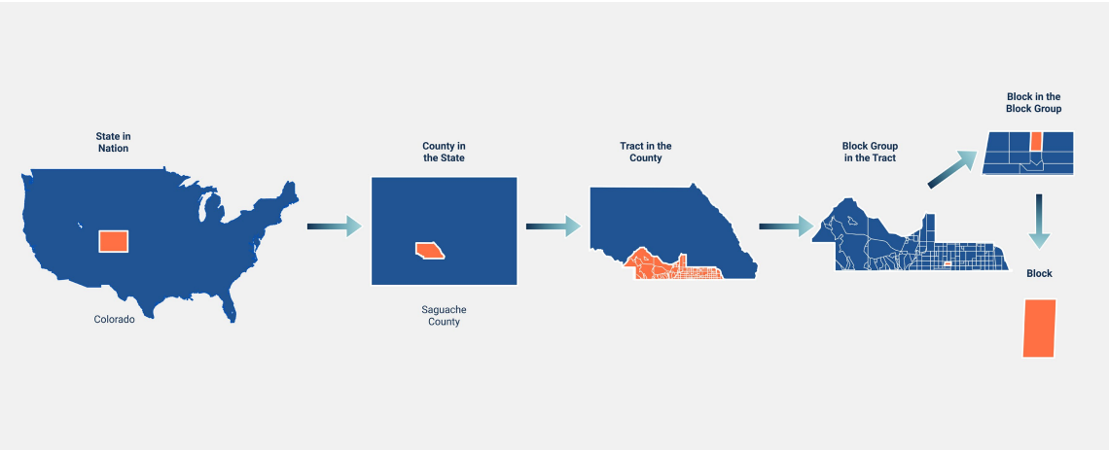
Working With Census Data

Slide 21
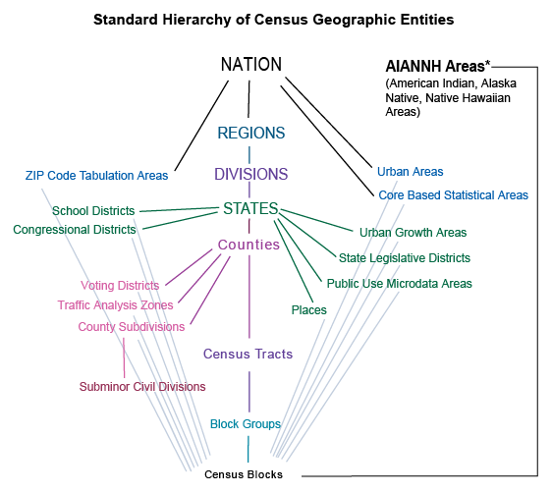
Census Geography
Census Geographical Units are organized (more or less) hierarchically.
http://mcdc.missouri.edu/geography/sumlevs/

Slide 22
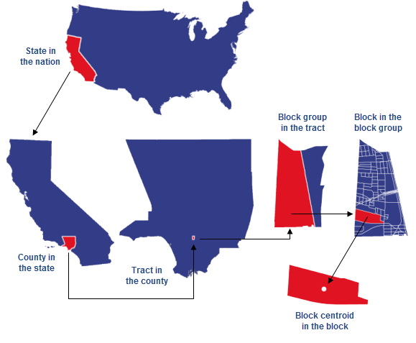
Census Geography
  140: Tract
  A statistical subdivision of a county for purposes of census data collection. Census tracts generally have a population size between 1,200 and 8,000 people, with an optimum size of 4,000 people. Tract boundaries are relatively permanent, so tracts may be compared across different census years or data products
  150: Block Group
  A statistical subdivision of a census tract. Block groups generally contain 600–3,000 people, and never cross state, county, or census tract boundaries.
  101: Block
  The smallest statistical unit of the U.S. Census. Census blocks cover the entire territory of the United States, Puerto Rico, and the Island Areas. Census blocks nest within all other tabulated census geographic entities and are the basis for all tabulated data. BUT, ACS and short-form data is not reported at the block level.

Slide 23
Key Census Datasets
Decennial Census (Summary File 1 & 2, formerly the “Short Form”)
  1790 – Present
  100% count taken every 10 years
  Basic variables such as gender, age, race, households, housing occupancy and tenure
  Data available for all geographic areas in the US down to individual census blocks
American Community Survey (Formerly Summary File 3 from the “Long Form”)
  sample surveys of the population taken throughout the year
  More socio-economic variables relative to the Decennial census
  ACS figures are estimates that are reported with margins of error
    Reported annually for areas with more than 65,000 people
    Reported as five year averages for areas down to census tracts
https://guides.newman.baruch.cuny.edu/us_census/datasets

Slide 24
GEOIDs/FIPS
In US census data, the FIPS ( Federal Information Processing Standard) code is used to uniquely identify administrative units such as county and tract.
We store FIPS codes as text ( string) because we can manipulate that data using the field calculator tool.
For example, the FIPS code for the census tract 102.01 in Cook County, Illinois is 17031010201, where the first two characters (17) represents a state, the next three characters (031) represents a county, and the next six characters ( 010201) represent a tract. A string function Left ([fips], 2) can be used to extract the first two characters ( state) from the field [fips] in a field calculator tool.
17 031 010201
State
County
Tract

Slide 25
Accessing Census Data for GIS
Use local data clearing houses (e.g. OpenData Philly)
  Many times data clearing houses like this will have shape file with basic census demographic data
Practice using Census.gov
  Can be confusing, not a great user interface
Social Explorer
  Much easier user interface, available in Pro Version to Bryn Mawr/Haverford Students
  Download table data and join it to the appropriate TigerLine shp
NHGIS (National Historical GIS)
Always, always ask a librarian if you’re totally stumped.

Slide 26
Lab 3
Lab #3 Slim Lab Report
Objective
The objective of this assignment is to explore the distribution of poverty rate in southeast Pennsylvania as it relates to school districts.
Deliverables
Turn in a report addressing this objective. Refer back to your Lab Report Instructions for direction about the key sections of your report—introduction, methods, results, discussion, tables and figures, and summary of operations.
  Your report must include a tract-level chloropleth map of the poverty rate (the percentage of persons living below the poverty line) in southeast Pennsylvania.
  This tract-level map should also display school district boundaries.
  Moreover, you should report the STFIDs of the tracts with the five highest poverty rates. Also, report the school districts that intersect these five tracts and include a map that identifies them.

Slide 27
Lab 3
Getting Started
First, think through the analysis steps for this task. Which data layers or tables will you need? Make sure all of your files are in UTM projection.
Do you have all of the variables you need, or will you have to create new variables?
Hint: The sf3_tracts file has information on poverty rate. The field P087001 encodes the number of
people for whom poverty status was checked. The field P087002 encodes the number of people with
income below the poverty level. Thus, the poverty rate for each tract can be calculated as:
P087002 (i.e. number of people with income below poverty line) divided by P087001 (i.e.
number of people for whom poverty status was checked) or (P087002/P087001).
Another hint: Remember algebra - is it possible to divide by zero? In order to calculate a poverty rate,
you must first select those tracts for which the poverty level has been checked for at least 1 person
(P087001>0)—you should get 980 records out of 994 total—then continue with your calculation.

