Slide 1
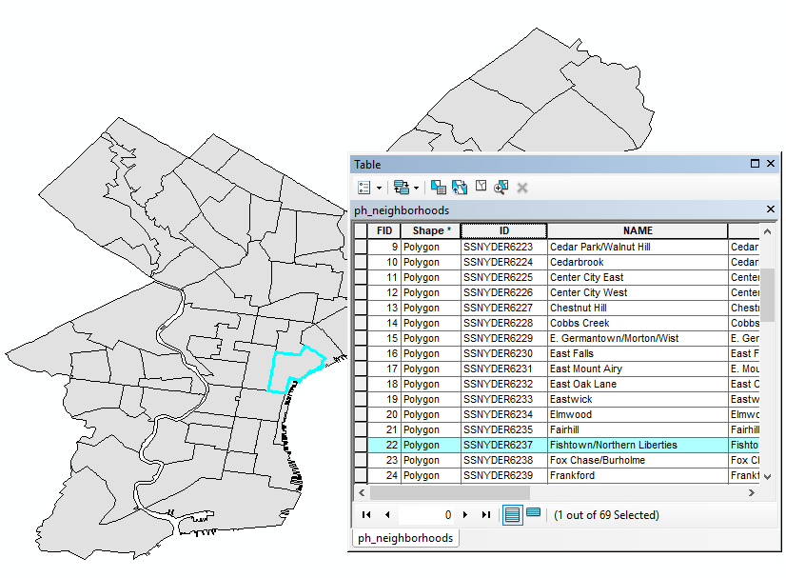
GIS for Environmental Research/
Vector Data Model
FALL 2025, WEEK 5
Dr. Dirk Kinsey
dkinsey@brynmawr.edu
Office Hours: Mon 11-12pm and Wed 11-12pm

Slide 2
First Impressions
COMMON ISSUES
  Most common problems were with The Discussion Section
  Almost no one explored name variations of rivers
  No one mentioned the difference between a polygon and a line
  Tables and Figures should have titles (not just Figure numbers), and the title goes above the Table/Figure, not below it (explanatory notes, if used, go below the Table/Figure)

Slide 3
Introduction
Not just WHAT the analysis task is, but WHY (relates to your discussion section)
But no more commentary (like public policy implications – that goes in Discussion)
For this lab:
  Identify which neighborhoods have streets that cross specific creeks because we are interested in flooding

Slide 4
Methods
Select by Attribute: Creek name – Use Unique Names and/or Sort Attribute Table to identify name variations/missing name data
Select by Location: Streets that INTERSECT with SELECTED creeks
Select by Location: Neighborhoods that INTERSECT with SELECTED streets
Look at Neighborhoods layer Attribute Table to see which Neighborhood names are selected
Then 1 map with all neighborhoods + separate table/list for each creek

Slide 5
Methods– fine to use bullets
Doesn’t have to be extensive, but must be clear so I can tell what you did
Example:
Open the attribute table for the rivers layer and click the Select by Attributes icon.
Enter "FENAME" = 'Pennypack Creek' and hit apply to select the Pennypack Creek.
Open Selection > Select By Location.
Use the “select features from” selection method with the streets layers as the target and the rivers layer as the source.
Change the neighborhoods layers to be the target and the streets layer to be the source. This will select the neighborhoods that are spatially coincident with the intersecting streets.
Open the attribute table for the ph_neighborhoods layer and hit the “Show selected records” button to view a list of the selected neighborhoods. Note these neighborhoods down by highlighting all the rows and columns and copying and pasting to an Excel spreadsheet or getting a screenshot.
Right click on the map and clear the selection.
Repeat steps 1-7 for Tacony Creek, Cobbs Creek, and Wissahickon Creek.
Repeat selection steps entering all of the names of the 4 creeks to get a map showing all affected areas.
NOTE: You don’t need counties for this analysis task.

Slide 6
Results
Yes, you can state the number of neighborhoods or list their names, but what PATTERN do you see in the map?
  Some waterways affect more neighborhoods than others
  None in Center City
  Some continue into neighboring counties
  Some neighborhoods have the creek, but no streets crossing the creek, so were not selected

Slide 7
Results Example
“In total there were 27 neighborhoods with streets that crossed Pennypack, Tacony, Cobbs or Wissahickon Creek. There are eight neighborhoods with streets that cross Pennypack Creek (see Figure 1), seven neighborhoods with streets that cross Tacony Creek (see Figure 2), six neighborhoods with streets that cross Cobbs Creek (see Figure 3), and six neighborhoods with streets that cross Wissahickon Creek (see Figure 4). All four creeks and therefore all the clusters of neighborhoods around those creeks are outside the center of the city with Pennypack and Tacony Creek in the northeast, Cobbs Creek in the southwest, and Wissahickon Creek in the northwest (see Figure 5). The center of the city does not interact with these four creeks.”

Slide 8
Limitations to Data Analysis
Good to comment on issues beyond the specific assignment (limitations to the way the task was defined, policy implications), but the first step is to discuss limitations to the analysis for the task you were given with the data you have
For Lab 1:
Missing data in rivers file (some segments have no name)
No direction on how to handle name variations and branches (so you had to make assumptions – state what those are)
No direction on what counts as a “street” – is it just the segment immediately intersecting the river, or is it all of the street with that name? (you have to make an assumption)
Leaves out neighborhoods that have the creeks but not streets intersecting those creeks + Leaves out secondary streets
Size of neighborhoods – visual perception may give distorted view of risk
Streets are in very small segments, so the small portion of street selected by this method likely understates how far flooding might extend on a street, potentially affecting additional neighborhoods
Age of data – streets & rivers from 2000 census
“Intersecting” creek and street may not actually connect to each other
Rivers and streets are both lines, not polygons
Layers not projected properly, so there were possible differences depending on what order you loaded the data layers into the map file
Don’t forget your data dictionary!

Slide 9
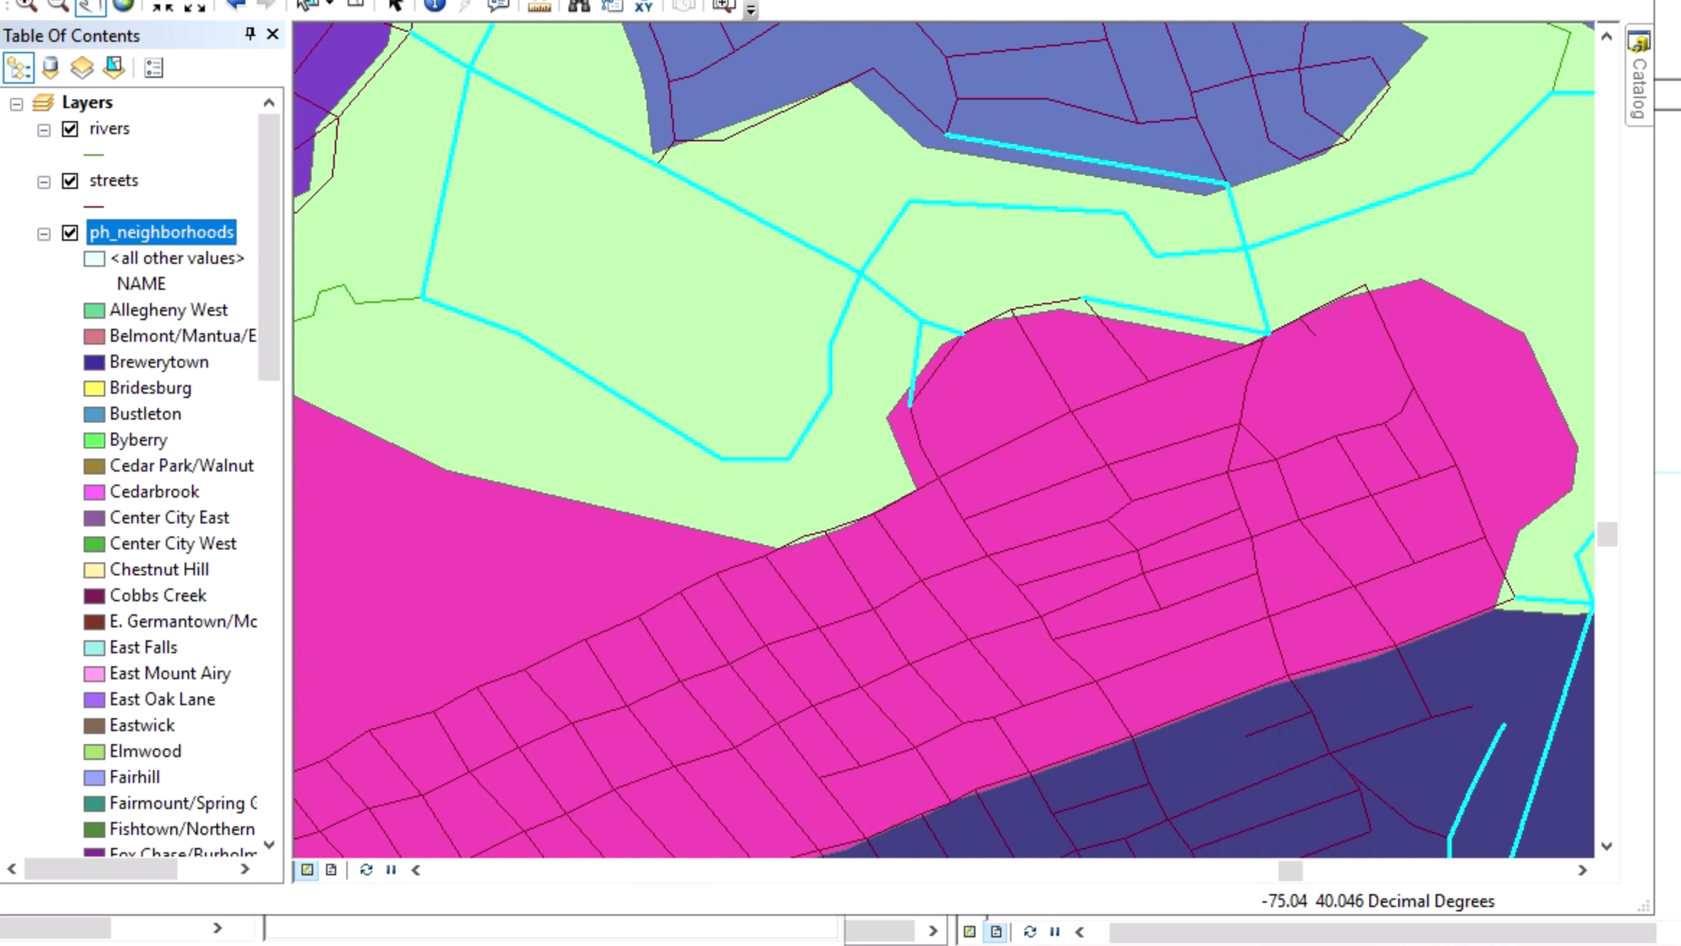
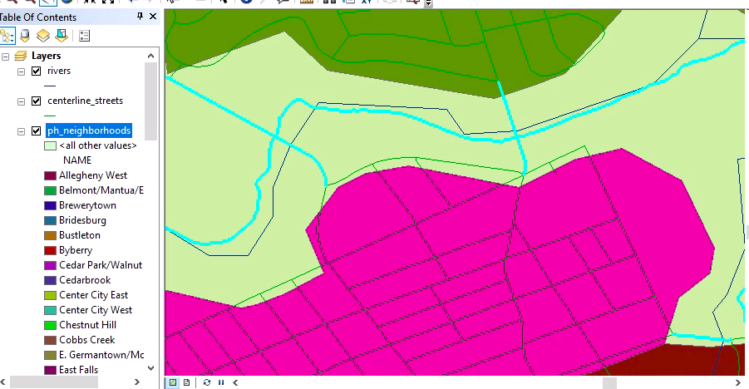
Which street file you used mattered
Streets file from Tiger Folder
Centerline file from Philadelphia Folder

Slide 10
Further Data Analysis
AFTER you discuss the specific limitations of the analysis you were given with the data you have, then move on to broader questions:
Extensions (need at least 3-4): If you are concerned about flooding, what else might you need to consider?
  Elevation of streets, flooding history, impact of tides, evacuation routes, limited vehicle access, limited transit access, transit routes, locations of bridges and tunnels, condition of stormwater infrastructure, density of housing nearby
  Limitations to looking at Philadelphia neighborhood boundaries as the key differentiator – what about about houses very close to a street that floods but that happen to be across a neighborhood boundary? Or parts of the creeks that extend beyond City boundaries?
  Limitations to looking at these creeks – why these creeks?
  Statistical analysis of relationship between past flooding and specific physical features

Slide 11
Decisionmaker Applications
Applications (need at least 2-3): How could decisionmakers use this kind of analysis?
  Specific to this kind of data:
    Evacuation routes for flood events
    Target emergency communications or flood prevention campaigns
    Where to direct funds for transportation or stormwater infrastructure improvements
  Using this kind of analysis with different kinds of data:
    Intersection of designated bike routes with high crash rates

Slide 12
Asking Questions
Two basic questions in spatial approaches
  What and Where is it?
  Why is it there?
    Where are certain conditions satisfied?
    What has changed in place over time?
    What spatial patterns exist or have existed?
    Where do variables interact?

Slide 13
Asking Questions
Identify existing locations— “Show me all the lots that are suitable for a shipping distribution center.”
Find locations anywhere in your study area that are suitable for a particular use. “Show me all the areas that are suitable mountain lion habitat.”
Rate locations as more or less suitable. “Show me the most and least suitable locations for wave power generators.”
Find the best path or corridor between two locations. “Show me the path for a new transmission line that costs the least to construct while minimizing environmental impacts.”
How have things changed overtime “Where have marshland habitat been lost between 2000 and 2020”?

Slide 14
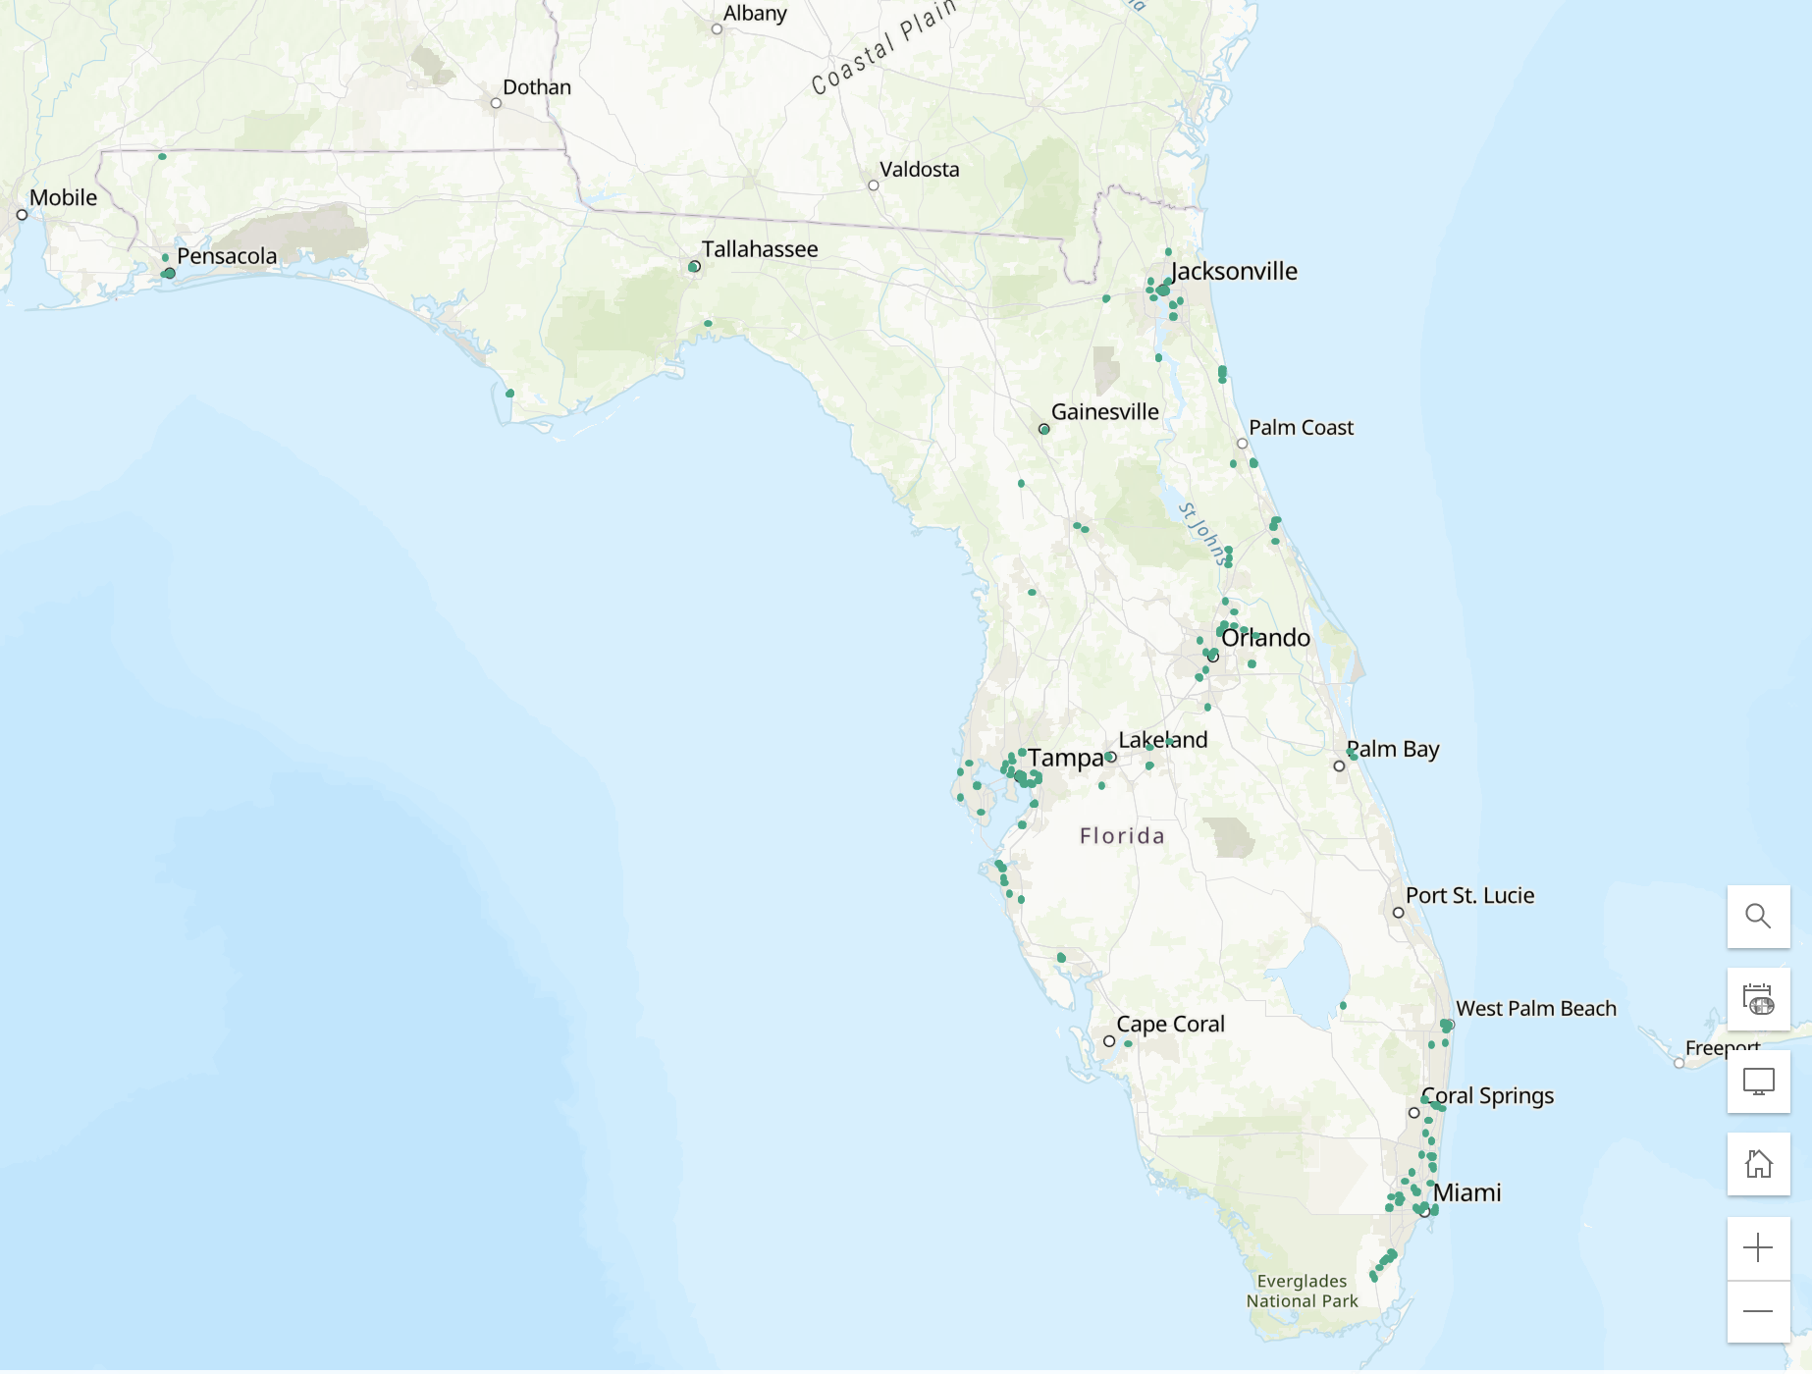
Identify existing locations

Slide 15
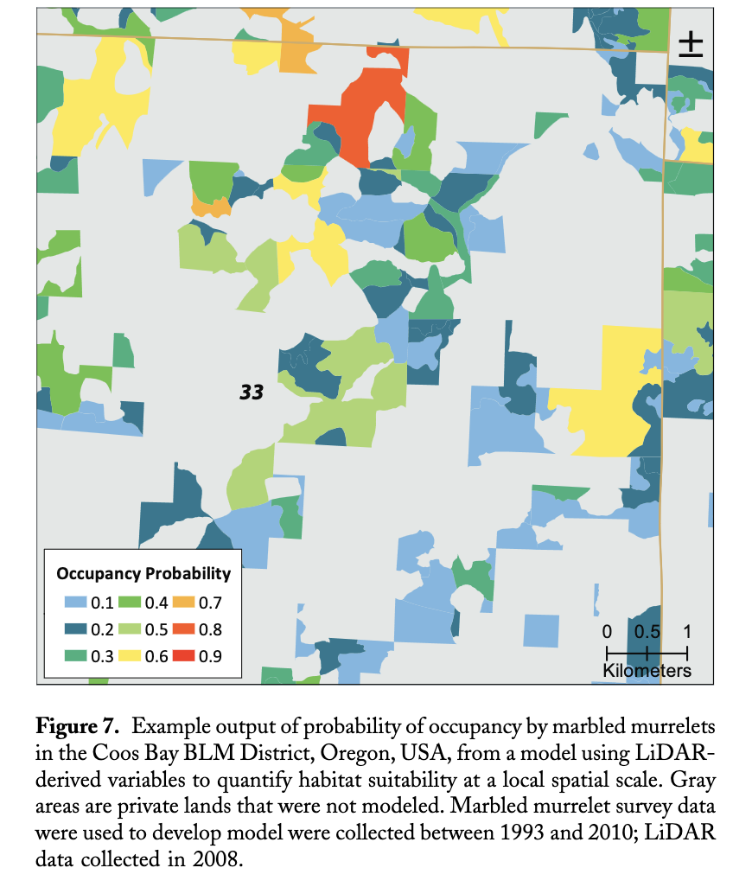
Find locations anywhere in your study area that are suitable for a particular use

Slide 16
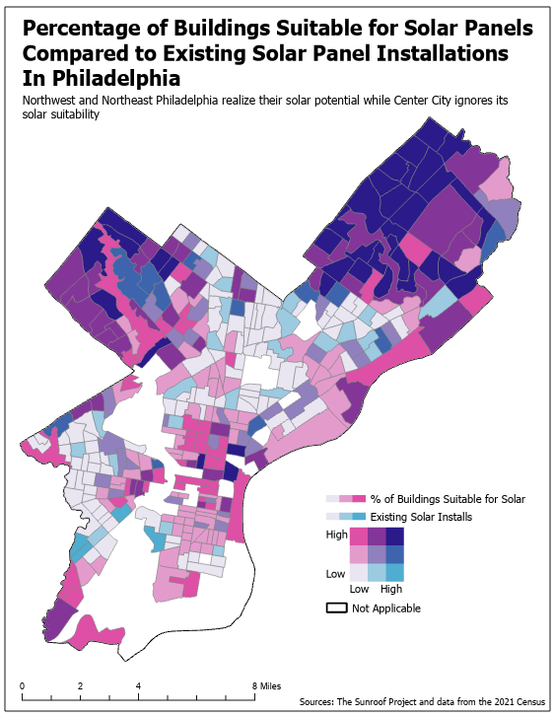
Rate locations as more or less suitable

Slide 17
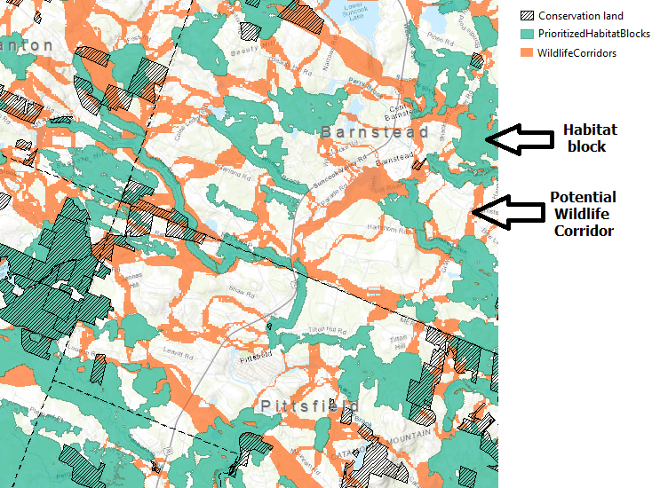
Find the best path or corridor between two locations

Slide 18
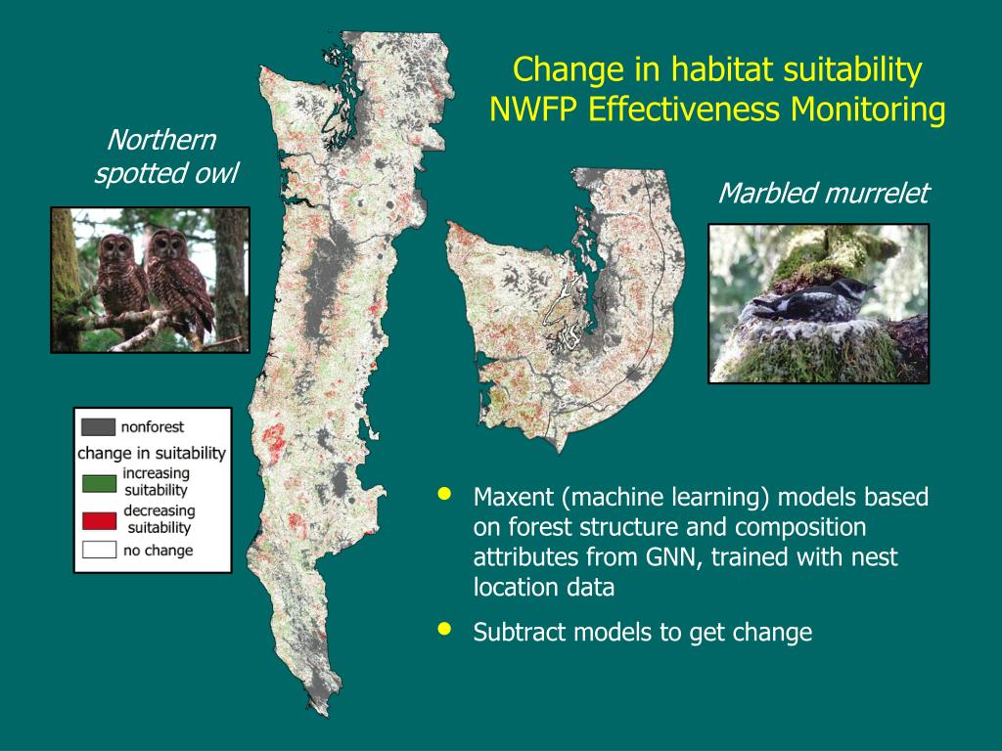
Changes over time

Slide 19
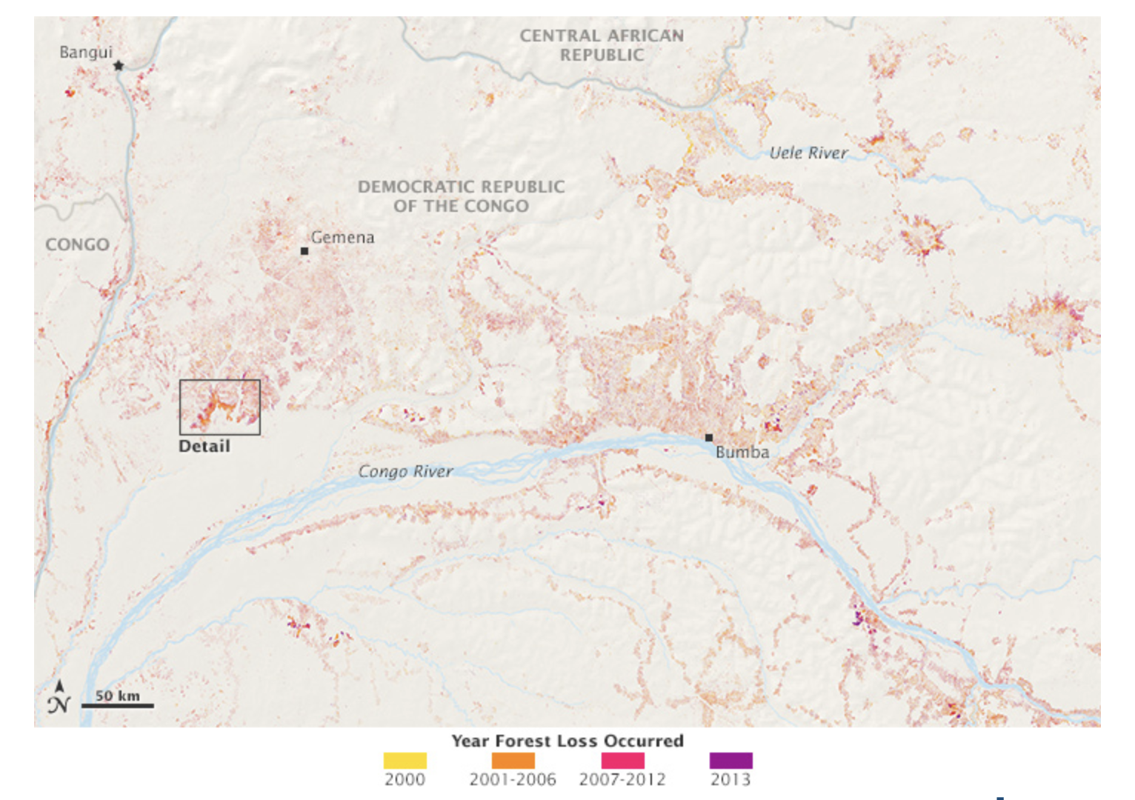

Slide 20
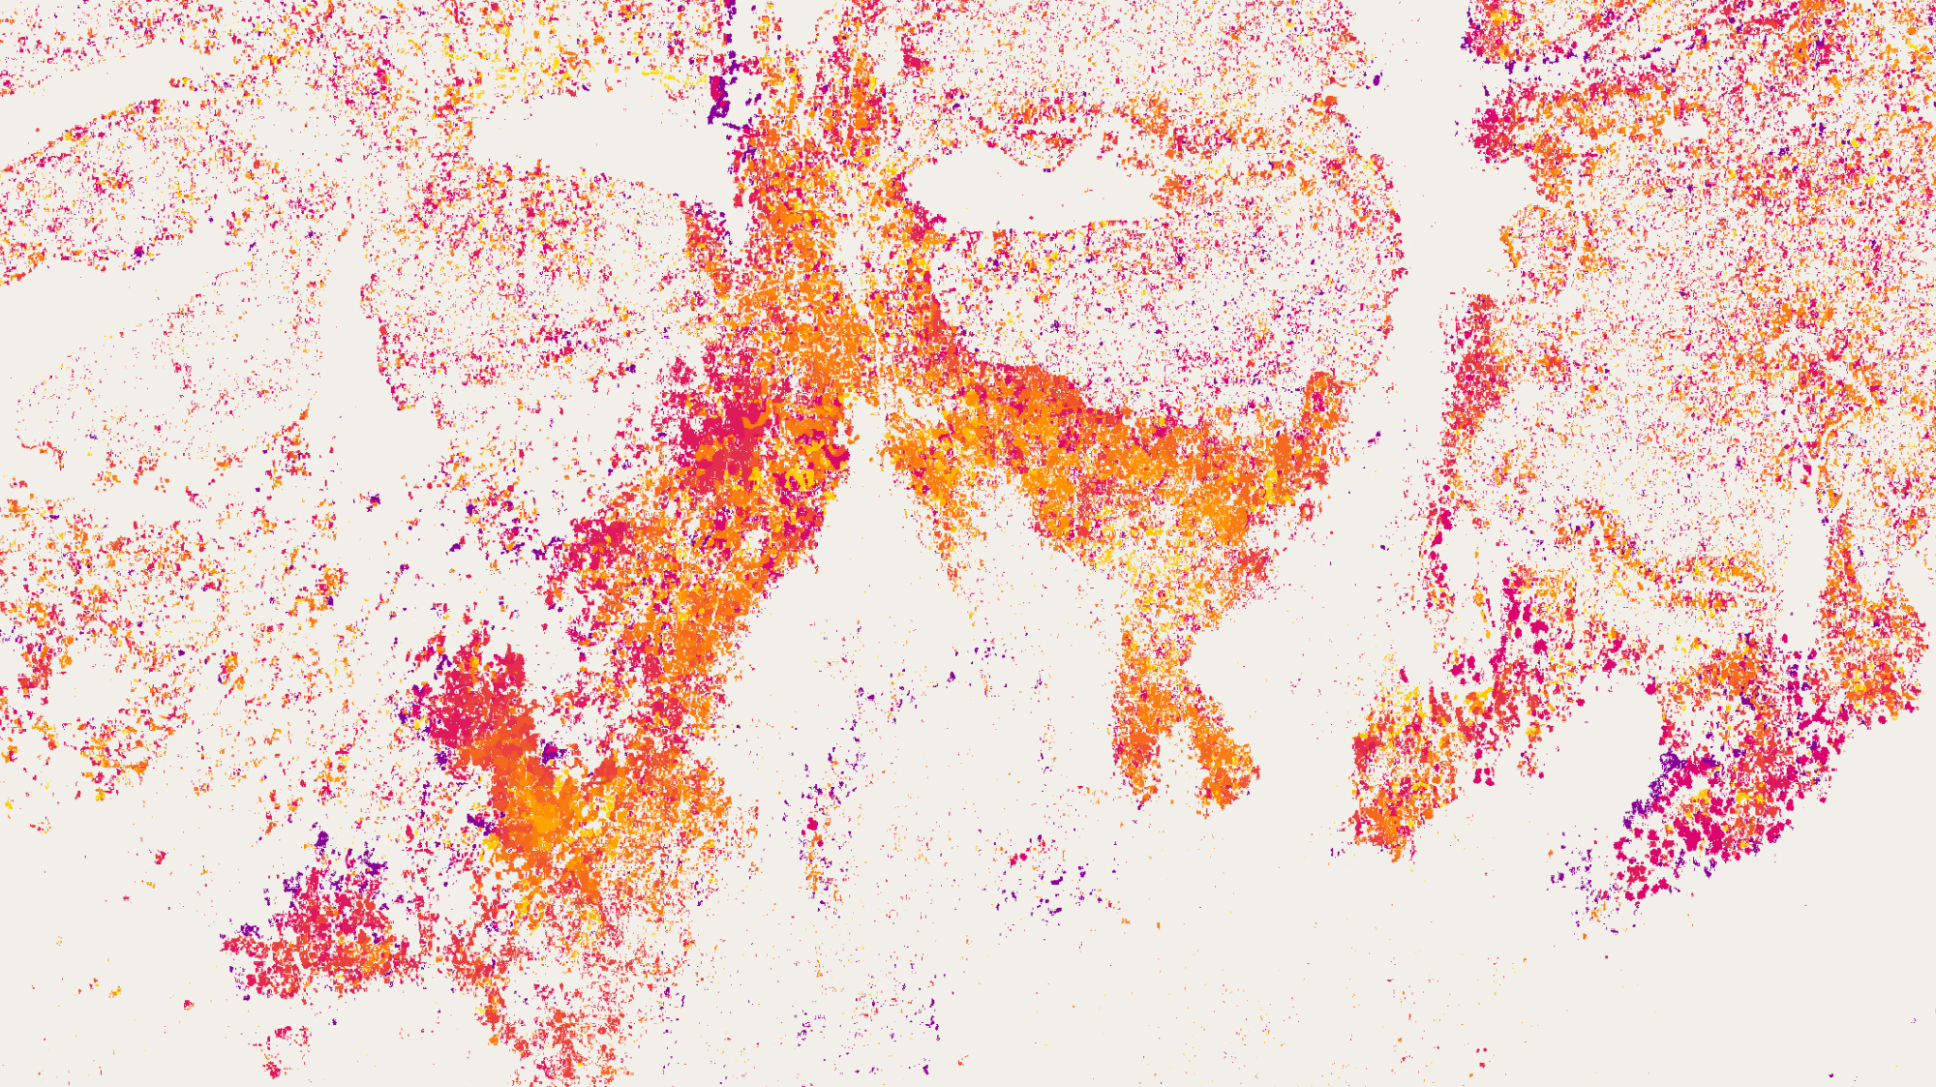

Slide 21
Data Resources
https://www.epa.gov/geospatial/epa-geospatial-data
https://www.usgs.gov/centers/geosciences-and-environmental-change-science-center/science/global-ecosystems-global-data
https://www.epa.gov/enviroatlas/enviroatlas-data
https://coast.noaa.gov/digitalcoast/data/home.html
https://www.movebank.org/
https://www.usgs.gov/core-science-systems/ngp/national-hydrography
http://www.cec.org/tools-and-resources/climate-change-portal/north-american-portal-climate-pollutants

Slide 22
How is GIS used in EJ research?
Academic Studies
  Trying to understand casual relationships
  Looking for unidentified EJ issues
Communities
  Demonstrate injustice and advocate for change in policy
Regulatory Agencies
  Evaluate claims of injustice, regulate
  Evaluate proposed policies for potential EJ concerns
  Prioritize inspections and regulatory intervention

Slide 23
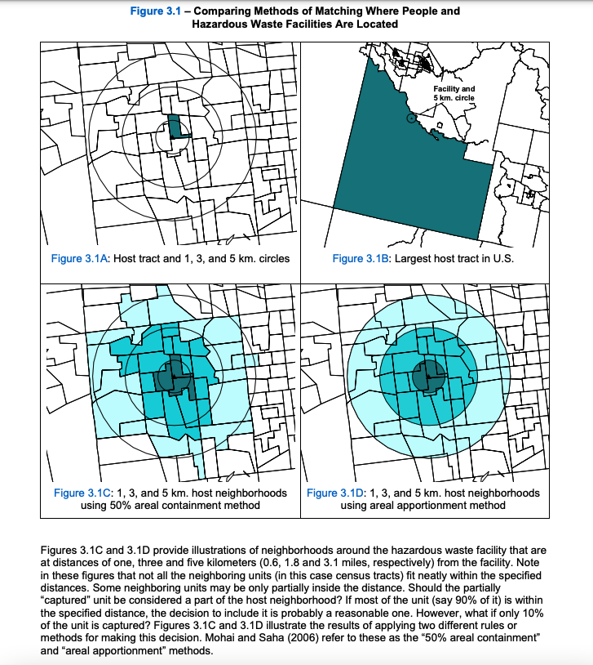
Complexities in EJ Mapping
When mapping with geographic enumeration units (counties, tracts, etc) it is easy conflates hazard exposure with the geographic unit mapped.
Unit-hazard coincidence vs. | Distance
Assumes that the population “exposed” to a nuisance coincides with those people living in the same geographic unit as the nuisance, such as a census tract or zip code | An alternative approach to measuring pollution exposure looks at the population within some distance of a site (or, alternatively, the nuisances or emissions near an arbitrarily drawn geographic unit).

Slide 24
Common GIS Methods employed in EJ Research
Containment or ‘point-in-polygon’
Buffers
Distance
Areal interpolation
Thiessen polygons
Kernel density
Cartography

Slide 25
Complexities in EJ Mapping
When mapping with geographic enumeration units (counties, tracts, etc) it is easy conflates hazard exposure with the geographic unit mapped.
Unit Hazard Coincidence is problematic because (see Banzhaf 2019, p191):
implicitly assumes that exposure to hazards is distributed equally within the geographic unit.
when nuisances are located near geographical boundaries, unit-hazard coincidence ignores exposures in adjacent areas that may be quite close by, while assigning exposure to parts of the coincident geographic unit that may be far from the nuisance.
Third, when geographic units like tracts are assumed to be fairly homogenous, the unit-hazard approach will mechanically extend local correlations to wider areas.

Slide 26
Containment or ‘point-in-polygon’
Simplistic way to assess exposure or access (eg. a neighborhood with a landfill is exposed, a census tract with a park has access)
Easy to achieve using a spatial join
Highly vulnerable to MAUP, for example interpreting exposure is dependent on the size and boundary of location units.

Slide 27
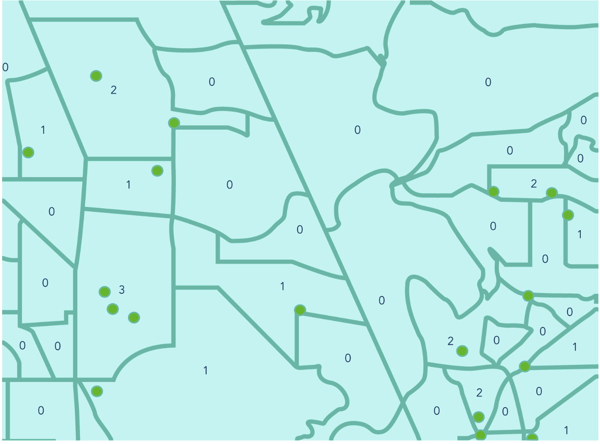

Slide 30
Buffers
Another way to estimate exposure or access
Creates polygons of certain radii around points (e.g
sources of pollution or parks) or lines (e.g. highways).
Also can be used in conjunction with a spatial join to capture how many polluting features lie within a given distance of a spatial unit (eg. neighborhood).

Slide 31
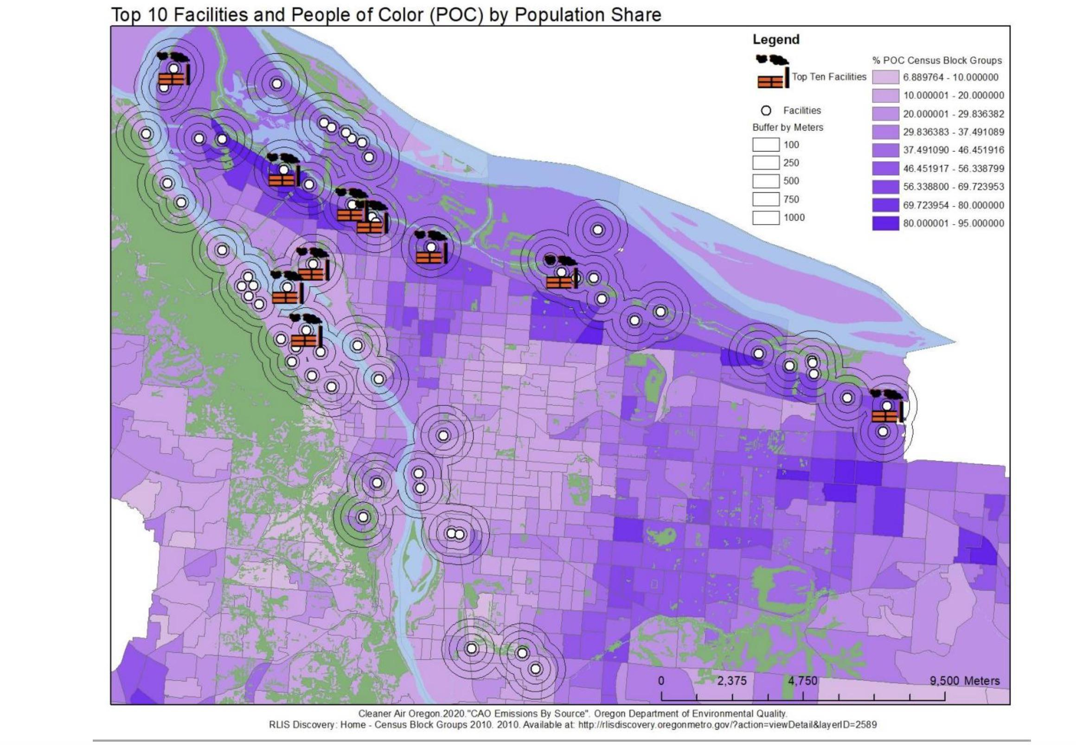

Slide 32
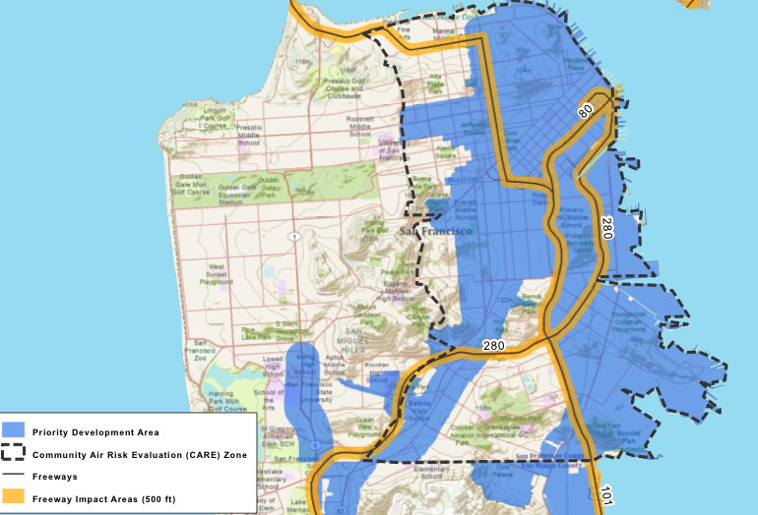

Slide 33
Distance
Literally calculating the distance between pollution source and neighborhood
Distances can be calculated as straight-line (Euclidian) or as a network.

Slide 34
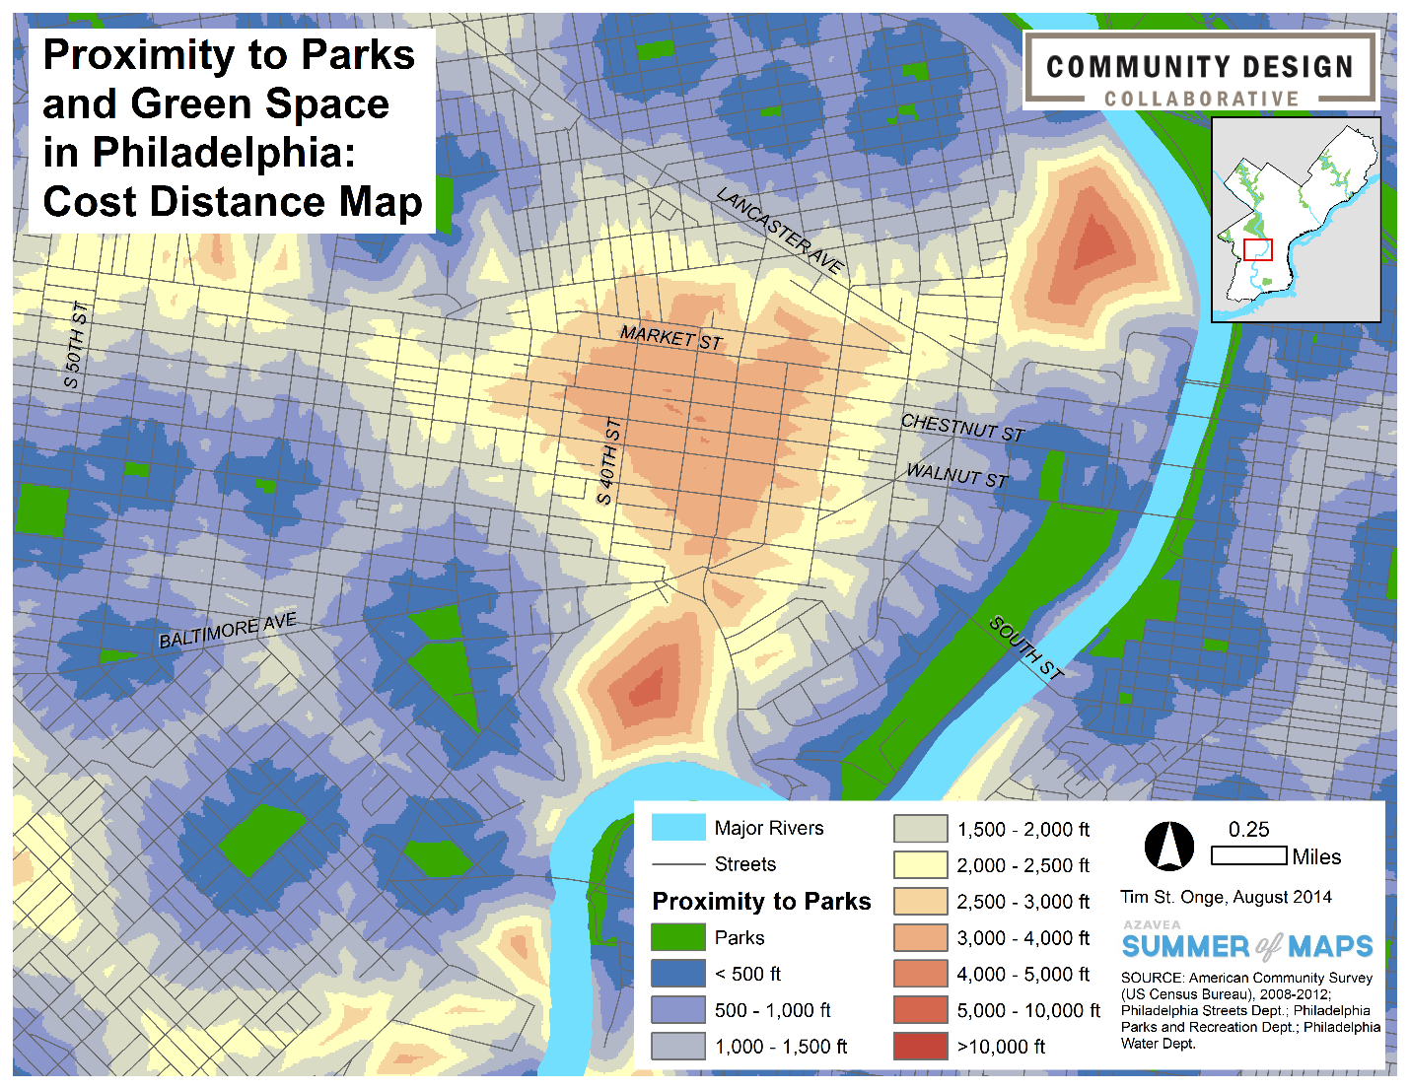
Euclidean distance is the straight line (distance between locations). Cost Distance explores the movement of a traveler over a landscape. The cost distance tools are generally used to create the least-costly path or corridor between a source and a destination.
This map uses both the parks (polygons) and streets (lines) to determine both how far and how easily a person could travel to the nearest park.

Slide 35
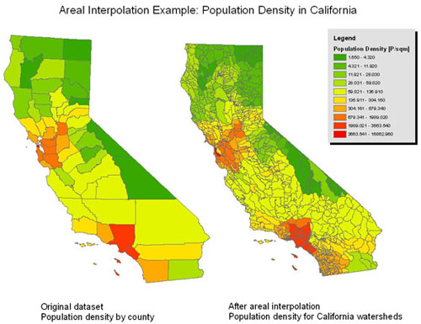
Areal interpolation
Used to estimate the percent of a population in a given spatial unit that might be exposed.
We don’t generally know how population is
distributed within a polygon, but areal interpolation allows us to assume that a population density is the same a shared geographic area.

Slide 36
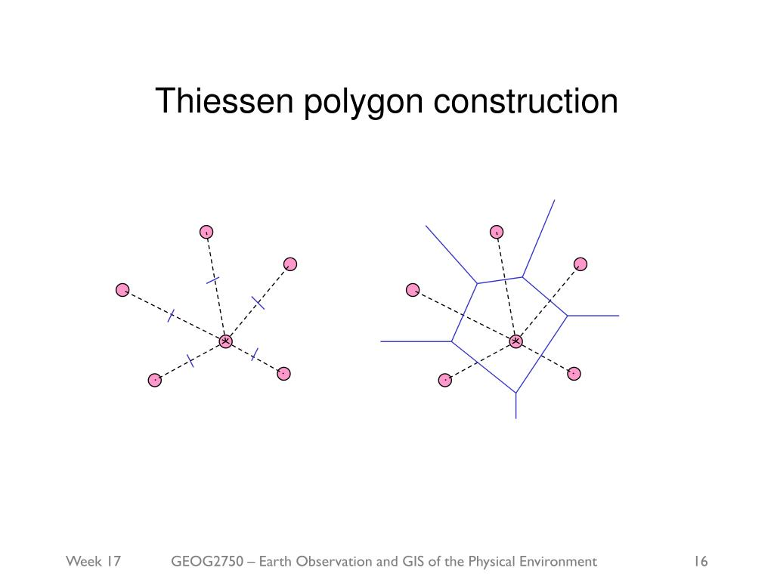
Thiessen polygons
Used for determining access and ‘service areas’
Starting from a set of points, the GIS can generate a set of
polygons such that borders demarcate areas closest to
each point.

Slide 37
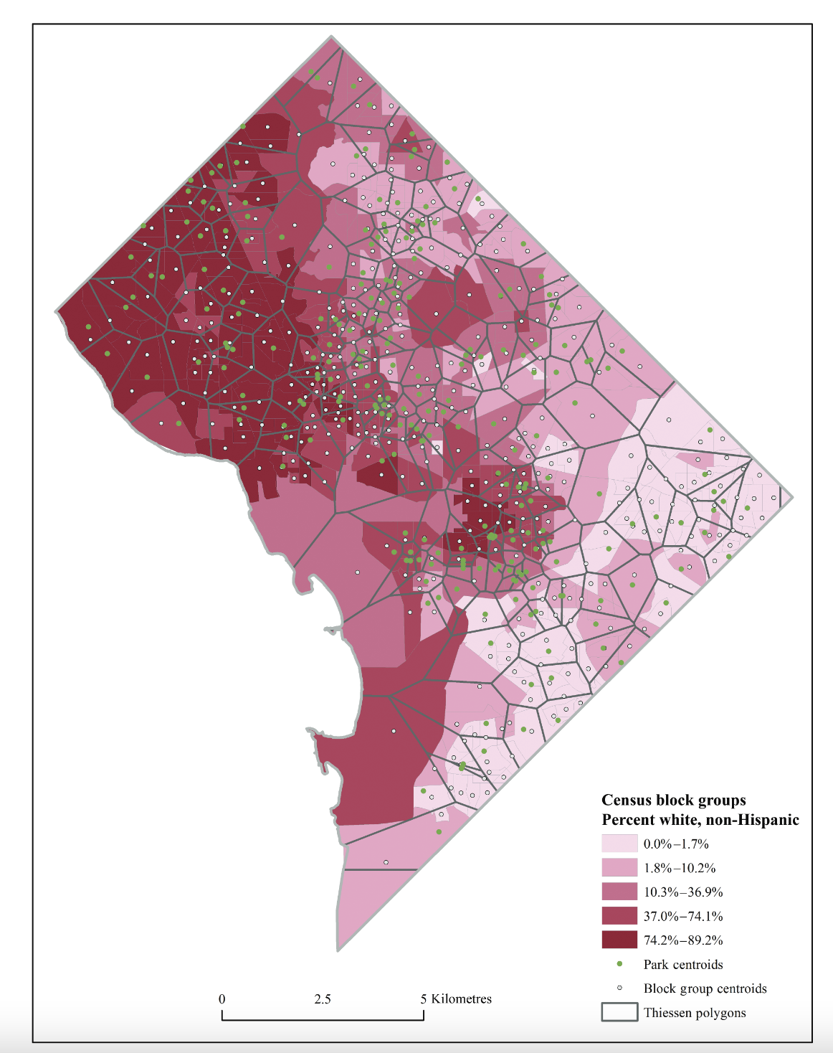

Slide 38
Kernel density
Determines density over an area based on distribution of points
Continuous, rather than discrete data
Measure of overall exposure/access for each neighbourhood.

Slide 39
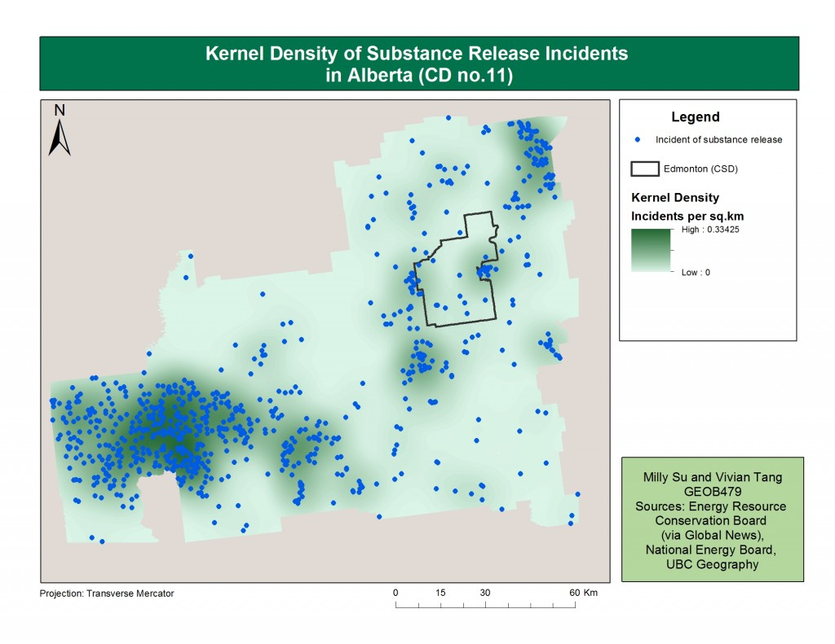

Slide 40
In class activity
Write a research question related to an environmental issue or topic to be answered by using GIS.
Specify
  A location
  A kind of analysis (site selection, comparing time periods, comparing sites, suitability analysis)
  Data you might use
  Any specific GIS operations that would come in handy
  Make a slide as a group with your question
  Extra points (bragging rights) for best looking slide
  https://docs.google.com/presentation/d/1HS8JjGLc35FVdbzaJgFF7xojOheTLIvIE9oE2yttkKA/edit?usp=sharing

