Slide 1
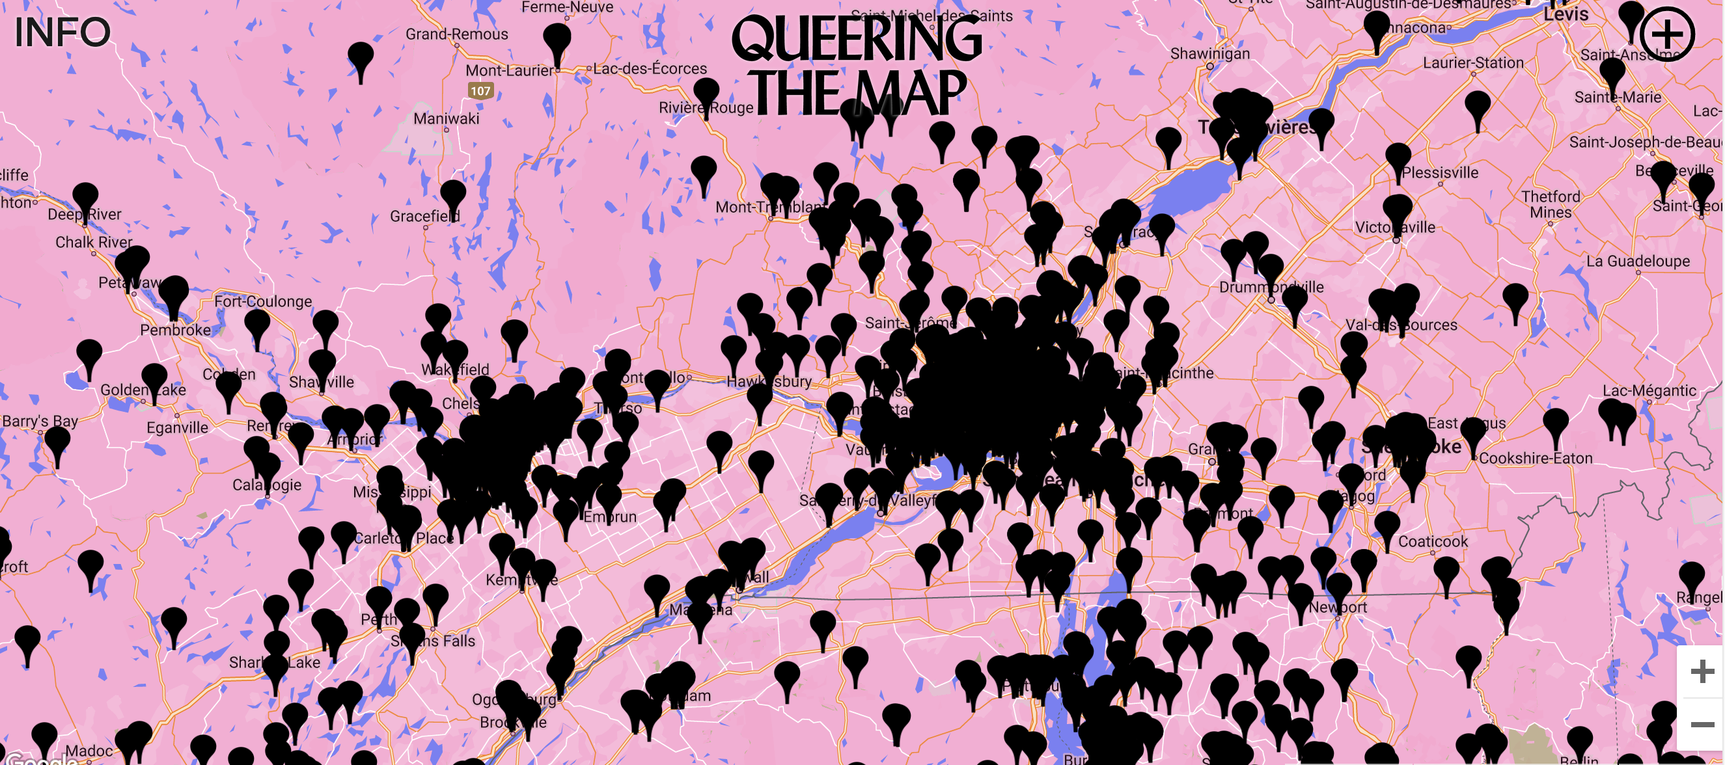
Feminist GIS and
Queering the Map
Dr. Dirk Kinsey
Bryn Mawr College, Growth and Structure of Cities
Columbia University, Department of Epidemiology

Slide 2

What is GIS?
Think of sandwich. But a weird sandwich where you can ask questions about each individual ingredient and the relationships between the different ingredients.
What % of tomato overlaps cheese?
How many pieces of carrot are touching how many pieces of onion?
What’s the total area of lettuce?
How recently was each cucumber slice cut?

Slide 3
    LINES
    DO
    WORK
EXCLUDE
INCLUDE
DIVIDE
DIFFERINTIATE
CREATE THINGS
ERASE THINGS

Slide 4
  Space as a social construct, space as produced
    Interactions
    Interconnections
    Implications
  The way that maps describe space defines spatial relationships with material implication
MAPS
DESCRIBE
SPACE
MAPS
PRODUCE
SPACE
MAPS
DESCRIBE
SPACE
MAPS
PRODUCE
SPACE

Slide 5
Feminist/Queer Geography/Geographies
Description
Epistemology
Methodology
Political Project

Slide 6
Feminist Geographies
Queer Geographies

Slide 7

Feminist critiques of (GI)Science
Donna Harraway
Situated Knowledges
  The notion that all forms of knowledge reflect the particular conditions in which they are produced, and at some level reflect the identities and social locations of knowledge producers.
  Put otherwise, all knowledge is situated
  Direct challenge to positivist notions of objectivity.
“God Trick”
  objectivity understood as impartiality and a "view from above, from nowhere”
  hides a very specific position (male, white, heterosexual, human) and thus makes this position universal.

Slide 8
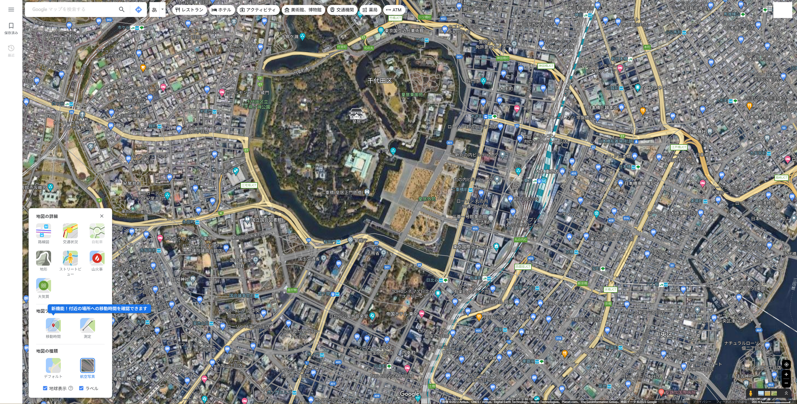

Slide 9
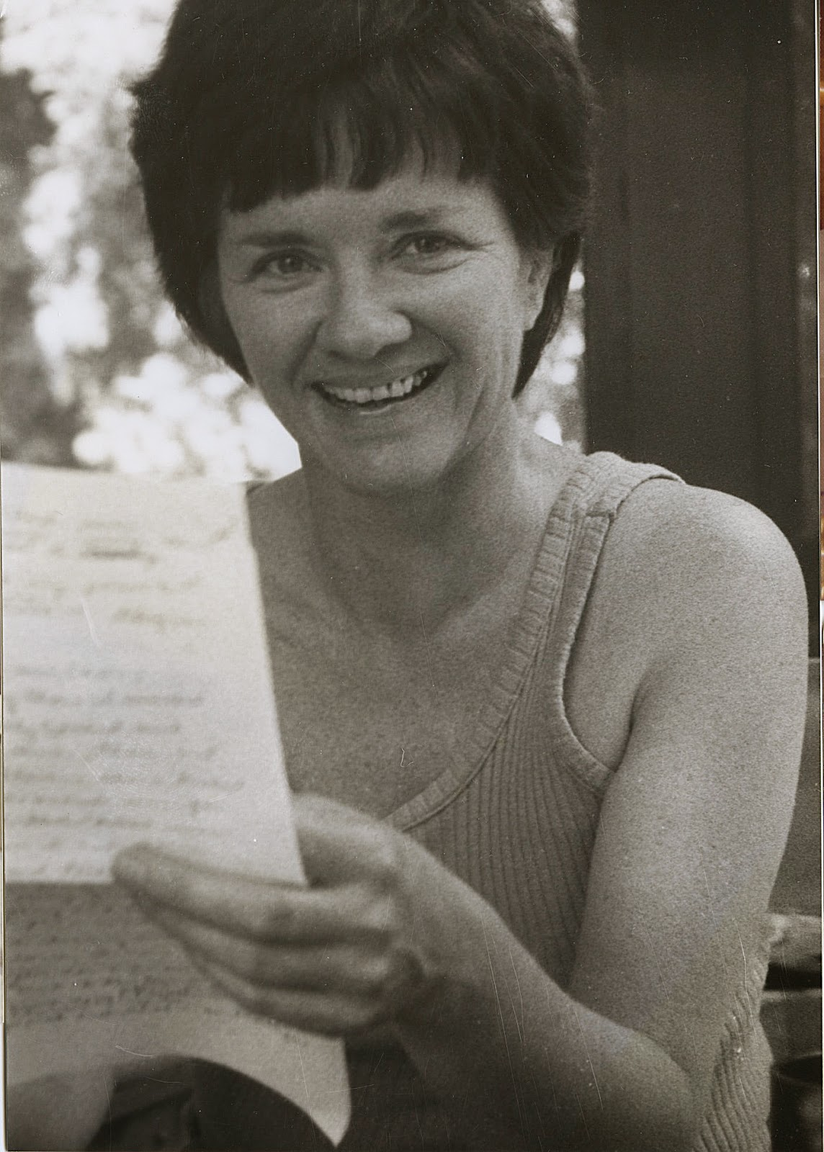
Feminist critiques of (GI)Science
Sandra Harding
Standpoint Theory
  Argues for the importance of starting from the experiences of those who have been traditionally left out of the mainstream institutional production of knowledge
Strong Objectivity
  Argues that knowledge that is produced from the point of view of subordinated groups may offer stronger objectivity due to the increased motivation for those groups to understand the views or perspectives of those in positions of power.

Slide 10
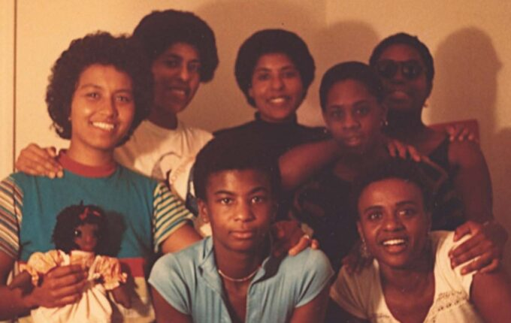
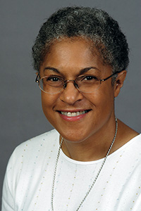

Feminist critiques of (GI)Science
Black Feminist perspectives
Combahee River Collective (“interlocking systems of oppression” 1977)
Kimberlee Crenshaw (“intersectionality” 1989 & 1990)
Patricia Hill Collins (“matrix of oppression” 1992)

Slide 11
A very brief history…
Feminist interactions with GIS started in the 1990s in the form of strong critiques against GIS inspired by feminist and constructivist theories.
  Highlighting a perceived epistemological dissonance between GIS and feminist scholarship.
  GIS was accused of being shaped by positivist and masculinist epistemologies, especially due to its emphasis on vision as the principal way of knowing.
  Feminist critiques claimed that GIS was largely incompatible with positionality and reflexivity, two core concepts of feminist theory.
  Feminist critiques of GIS also discussed power issues embedded in GIS practices, including the predominance of men in the early days of the GIS industry and the development of GIS practices for the military and surveillance purposes.

Slide 12

Feminist critiques of (GI)Science
Gillian Rose
Geographic fieldwork in the western tradition privileges sight and seeing as modes of observation
Visual observation of the landscape (eg. GIS) maintains distance between the observer and the observed and therefore reinforces a subject/object binary.

Slide 13
A very brief history…
At the beginning of the 21st century…
  Feminist geographers reexamined those critiques and argued against an inherent epistemological incompatibility between GIS methods and feminist scholarship.
  Advocated for a reappropriation of GIS by feminist scholars in the form of critical feminist GIS practices.
  The critical GIS perspective promotes critiques of dominant approaches of knowledge production, implementing GIS in critically informed progressive social research, and developing post-postpositivist techniques of GIS.
  Inspired by those debates, feminist scholars did reclaim GIS and effectively developed feminist GIS practices.

Slide 14
How can GIS be feminist? How can GIS be Queer?
How can integrating these approaches into geospatial data, map design, and GIS processes help address emerging social and environmental challenges?

Slide 15

https://theconversation.com/women-have-disrupted-research-on-bird-song-and-their-findings-show-how-diversity-can-improve-all-fields-of-science-142874

Slide 16
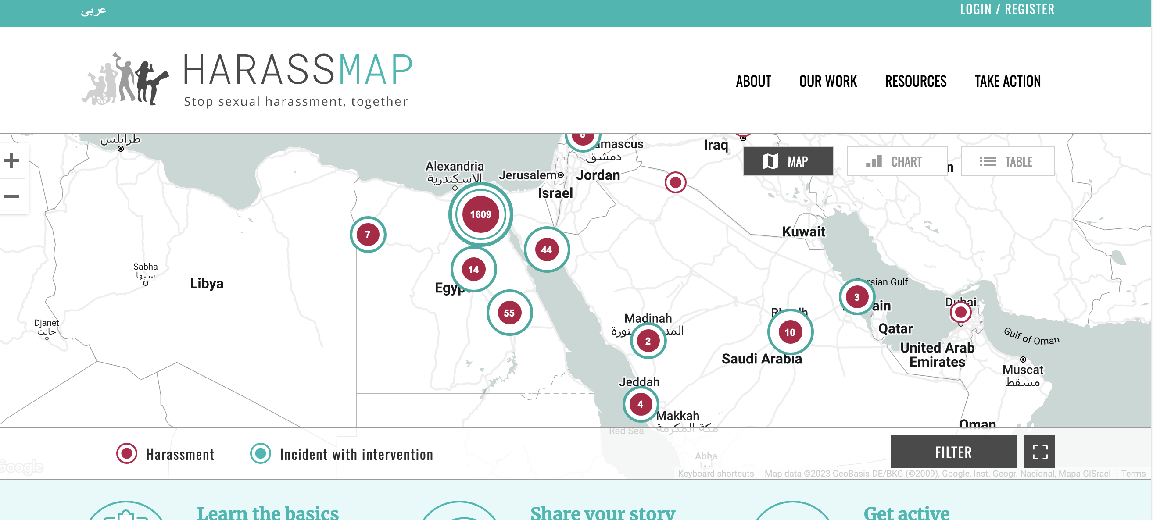
https://harassmap.org/en/

Slide 17
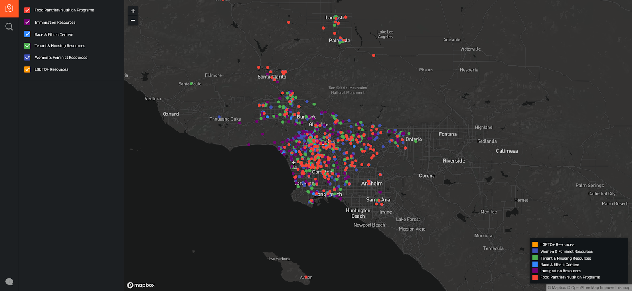

Slide 18
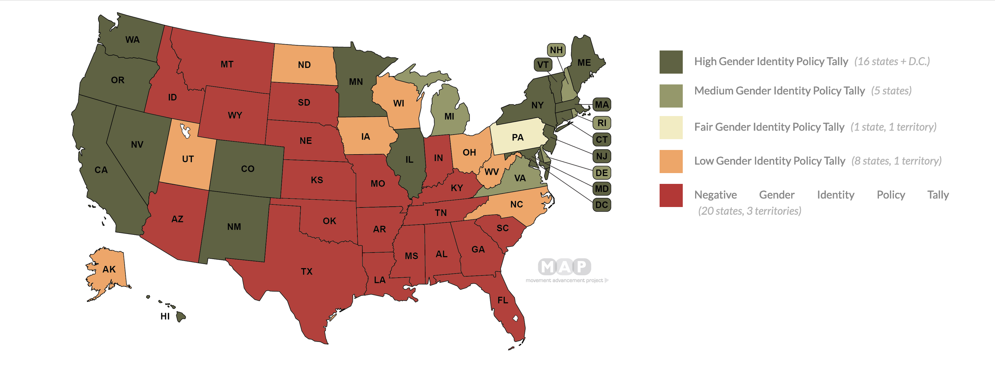

Slide 19
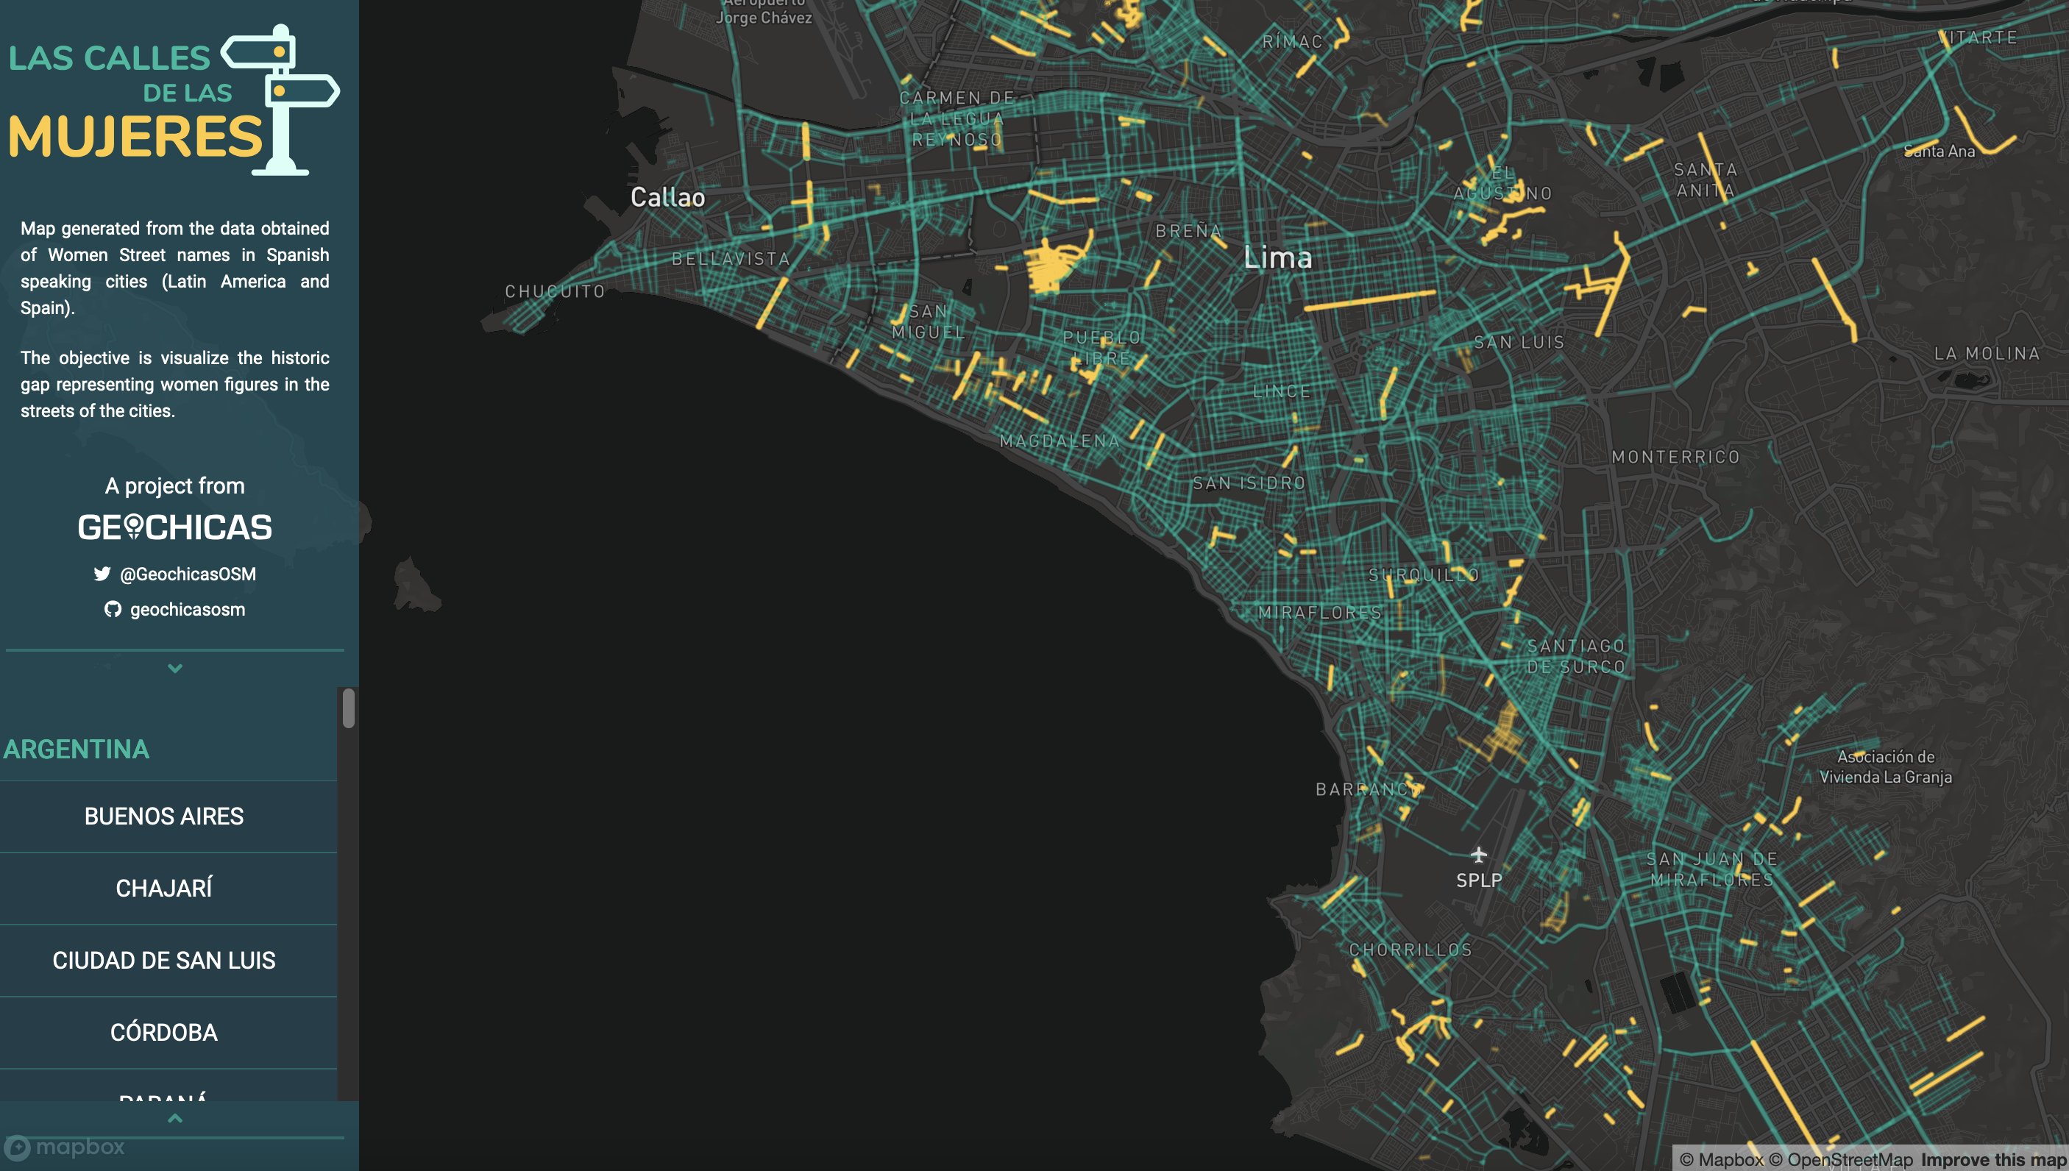

Slide 20

Feminist Principles
Power
  Examine power and Challenge power
Context and Situated Knowledge
  No data is neutral or objective, rather products of unequal social relations
Pluralism
  The most complete knowledge come from synthesizing voices
Emotion and Embodiment
  Value the knowledge that comes from people as living feeling bodies in the world
Binaries and Hierarchies
  Challenge the gender binary and binary systems of counting and classification
Labor and Reflexivity
  Make labor visible and be clear as to who is laboring

Slide 21
Feminist Principles
Power
Context and Situated Knowledge
Pluralism
Uncertainty
Emotion and Embodiment
Binaries and Hierarchies
Labor and Reflexivity

Slide 22
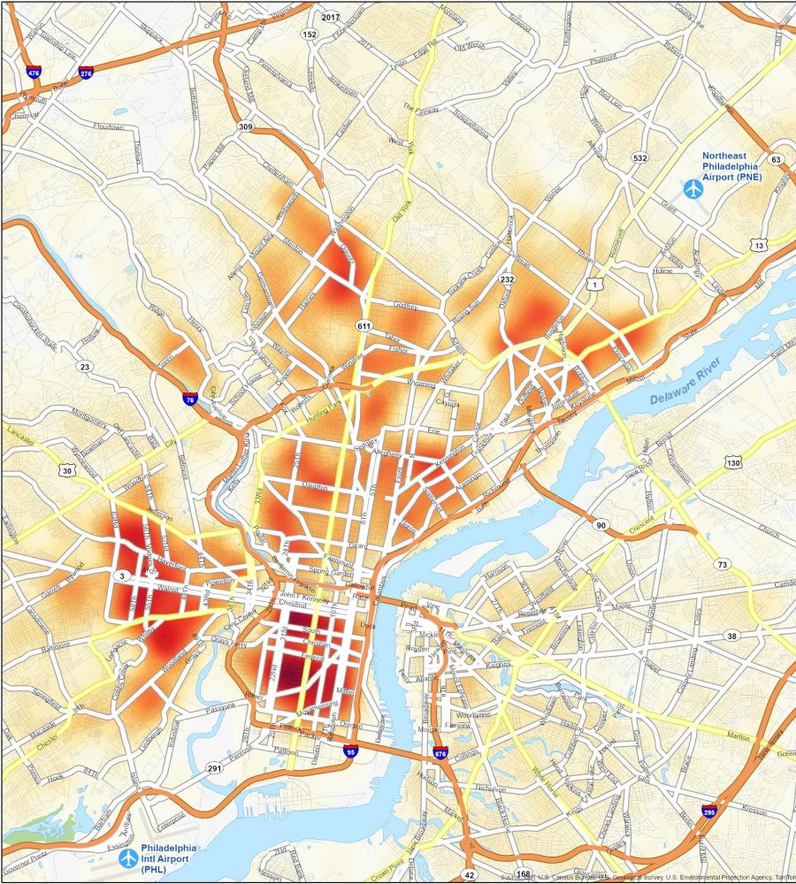
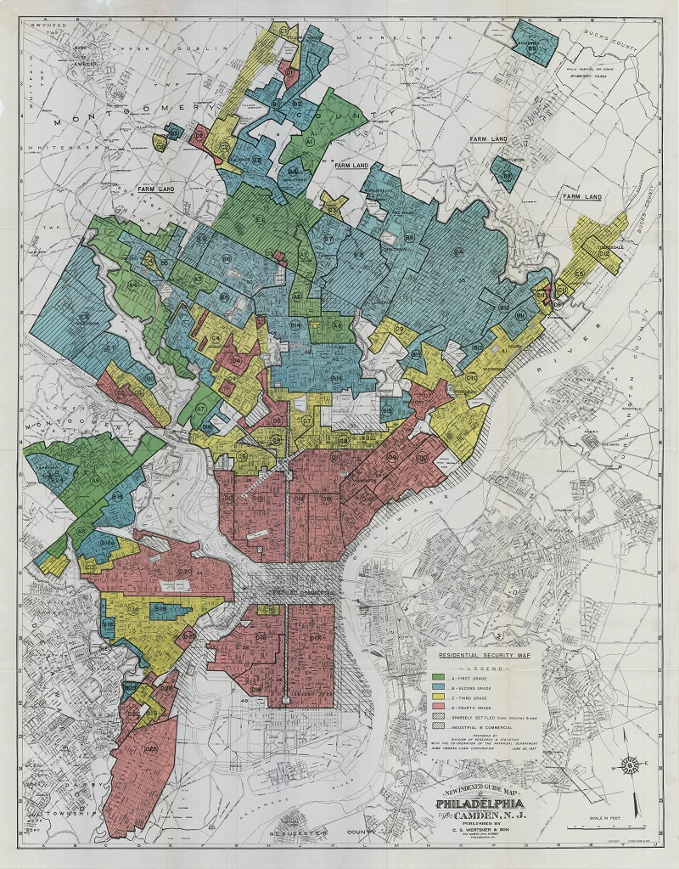
Power

Slide 23
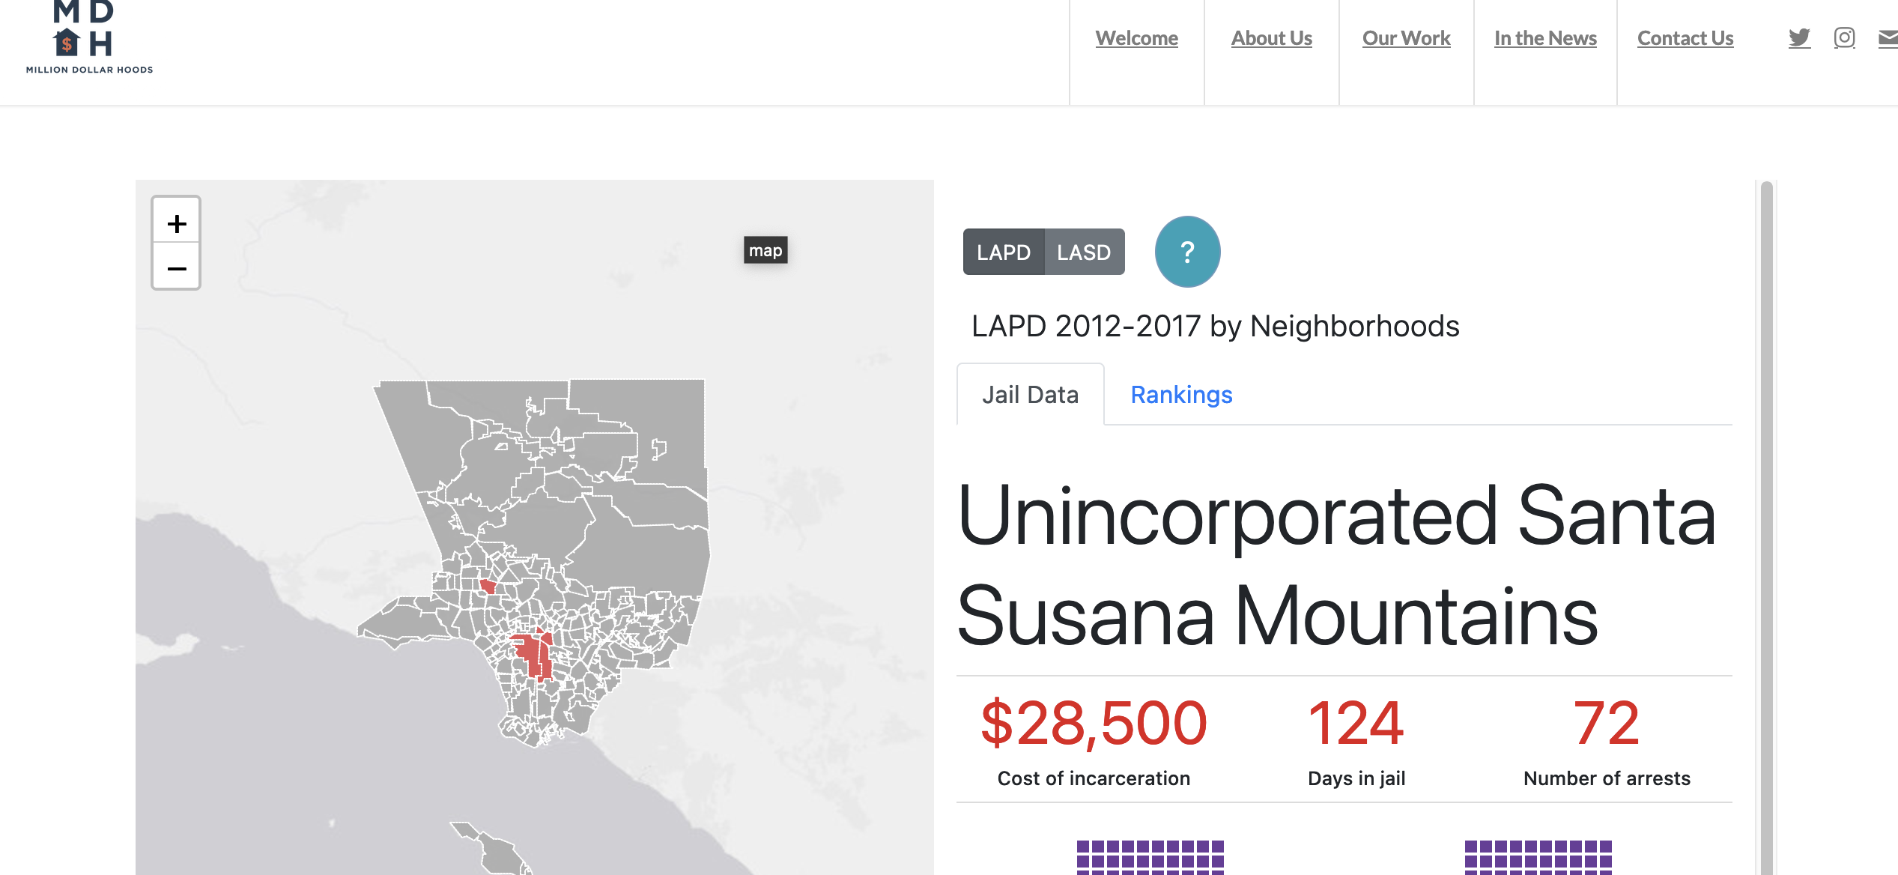
https://milliondollarhoods.pre.ss.ucla.edu/test-iframe-2/

Slide 24
Power
        Examine Power
        Revealing biases and limitations of existing datasets, considering who created the data and for what purpose
  Avoiding an uncritical reliance on data brokers and digital mapping platforms
  Contest

Slide 25
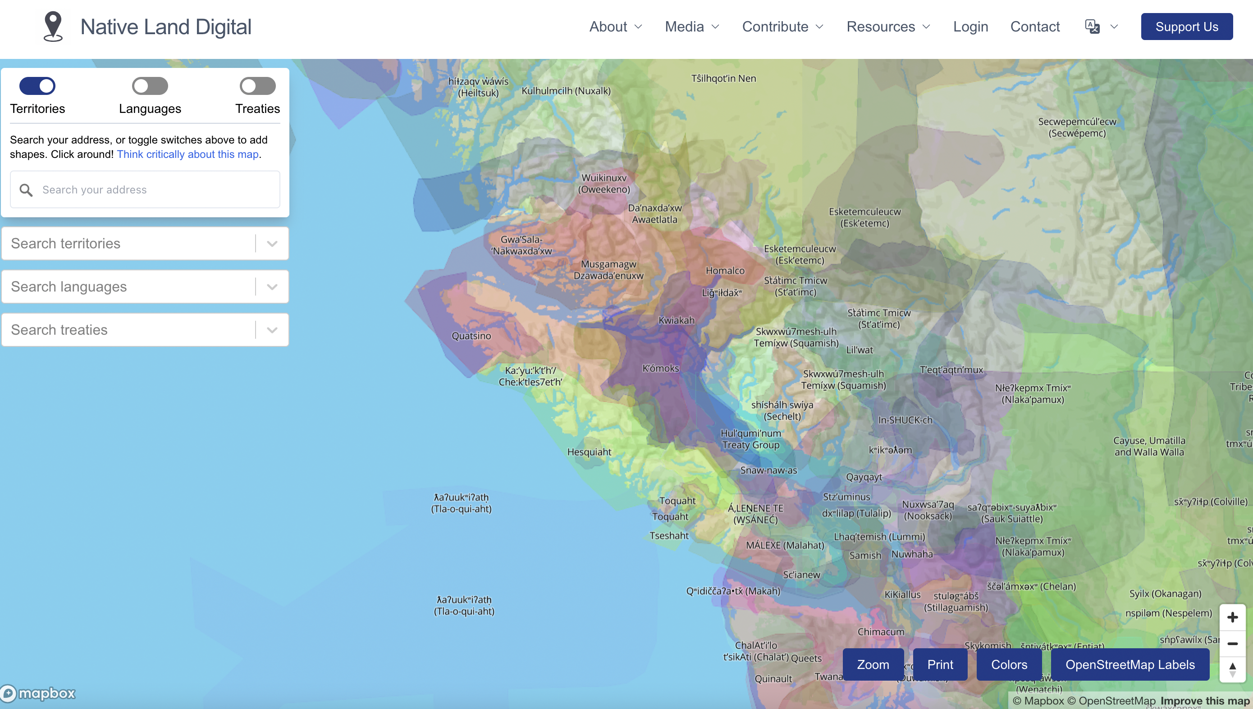
Counter-mapping
Counter-mapping: Mapping practices that set out to question, trouble, or contest dominant power relations in society through the act of mapping and/or the maps produced.
Whose views, experiences, understandings, expressions, values, sensibilities, etc are represented?

Slide 26
https://native-land.ca/

Slide 27
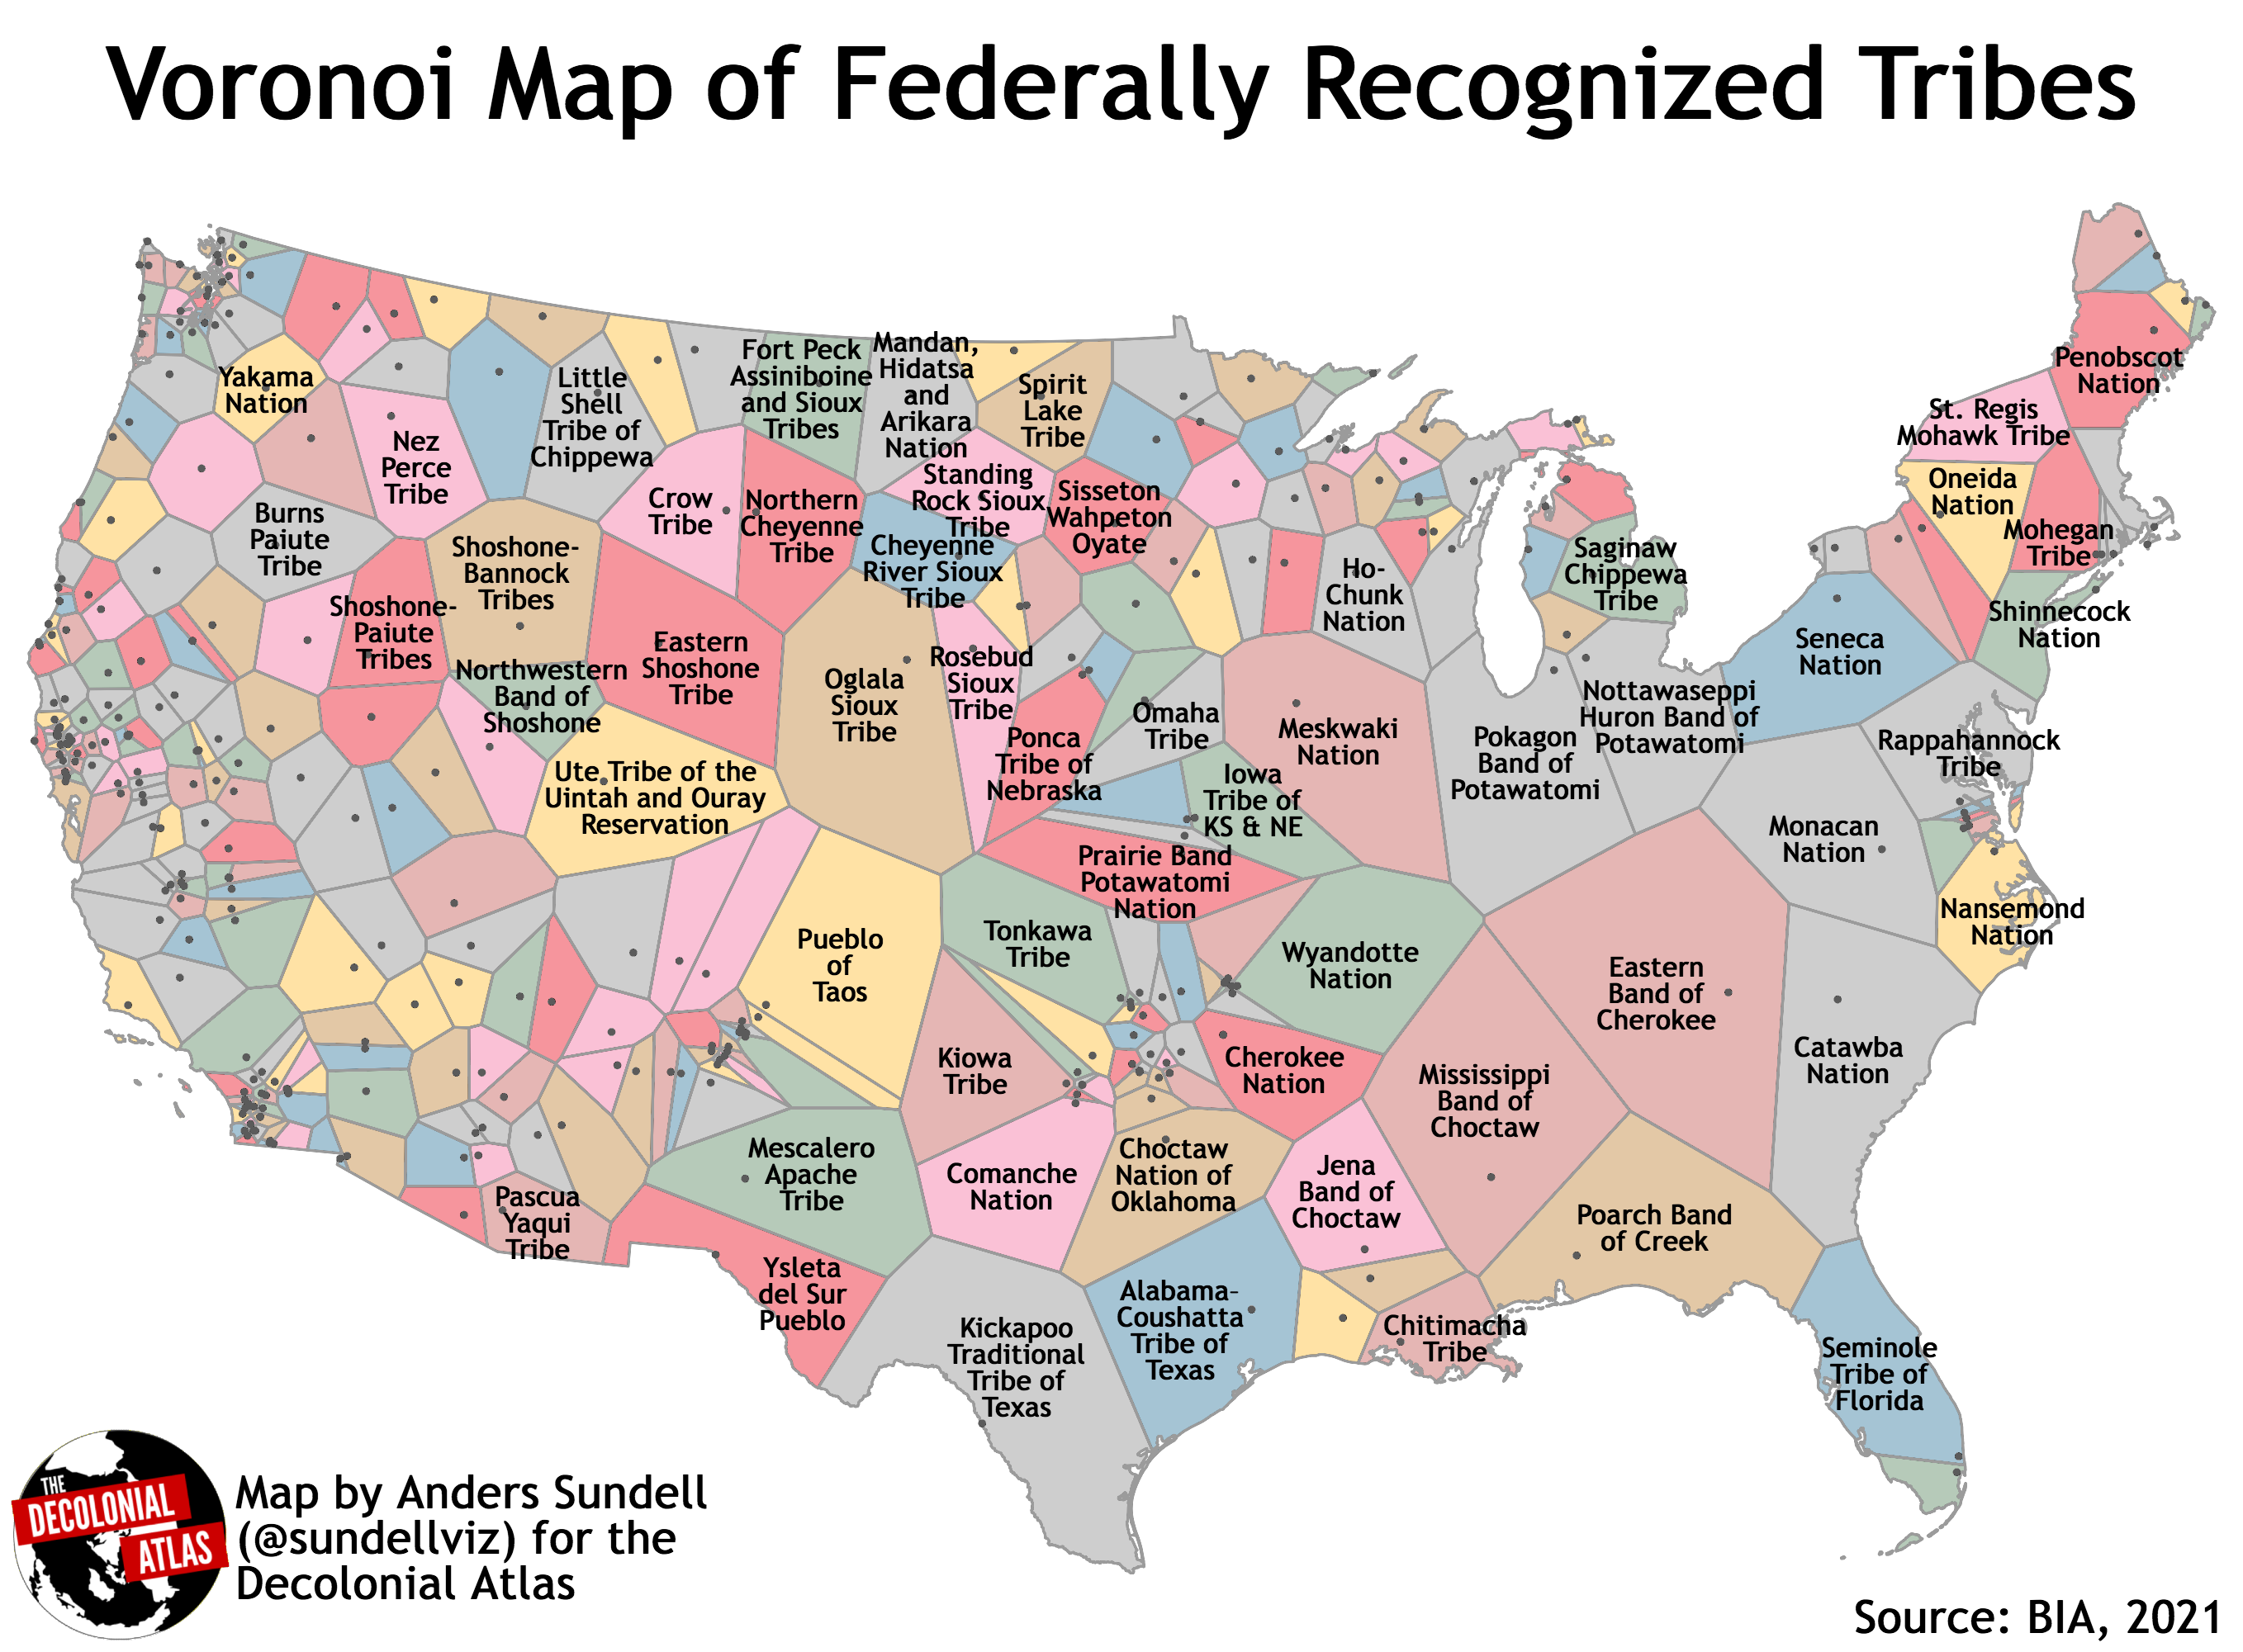

Slide 28
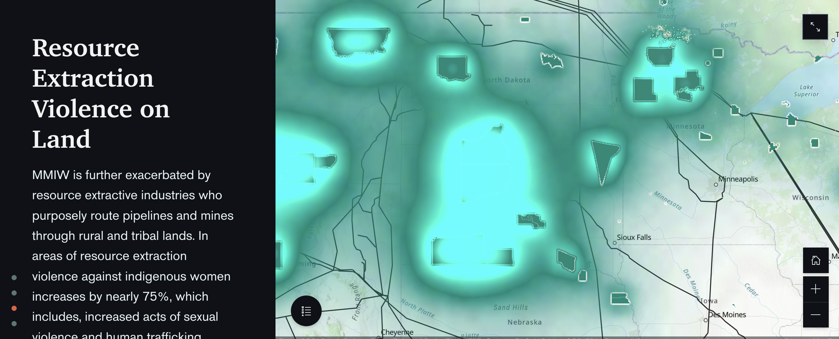
Context and Situated Knowledge
https://storymaps.arcgis.com/stories/da680b91fbf8413095643172d4e358c9

Slide 29
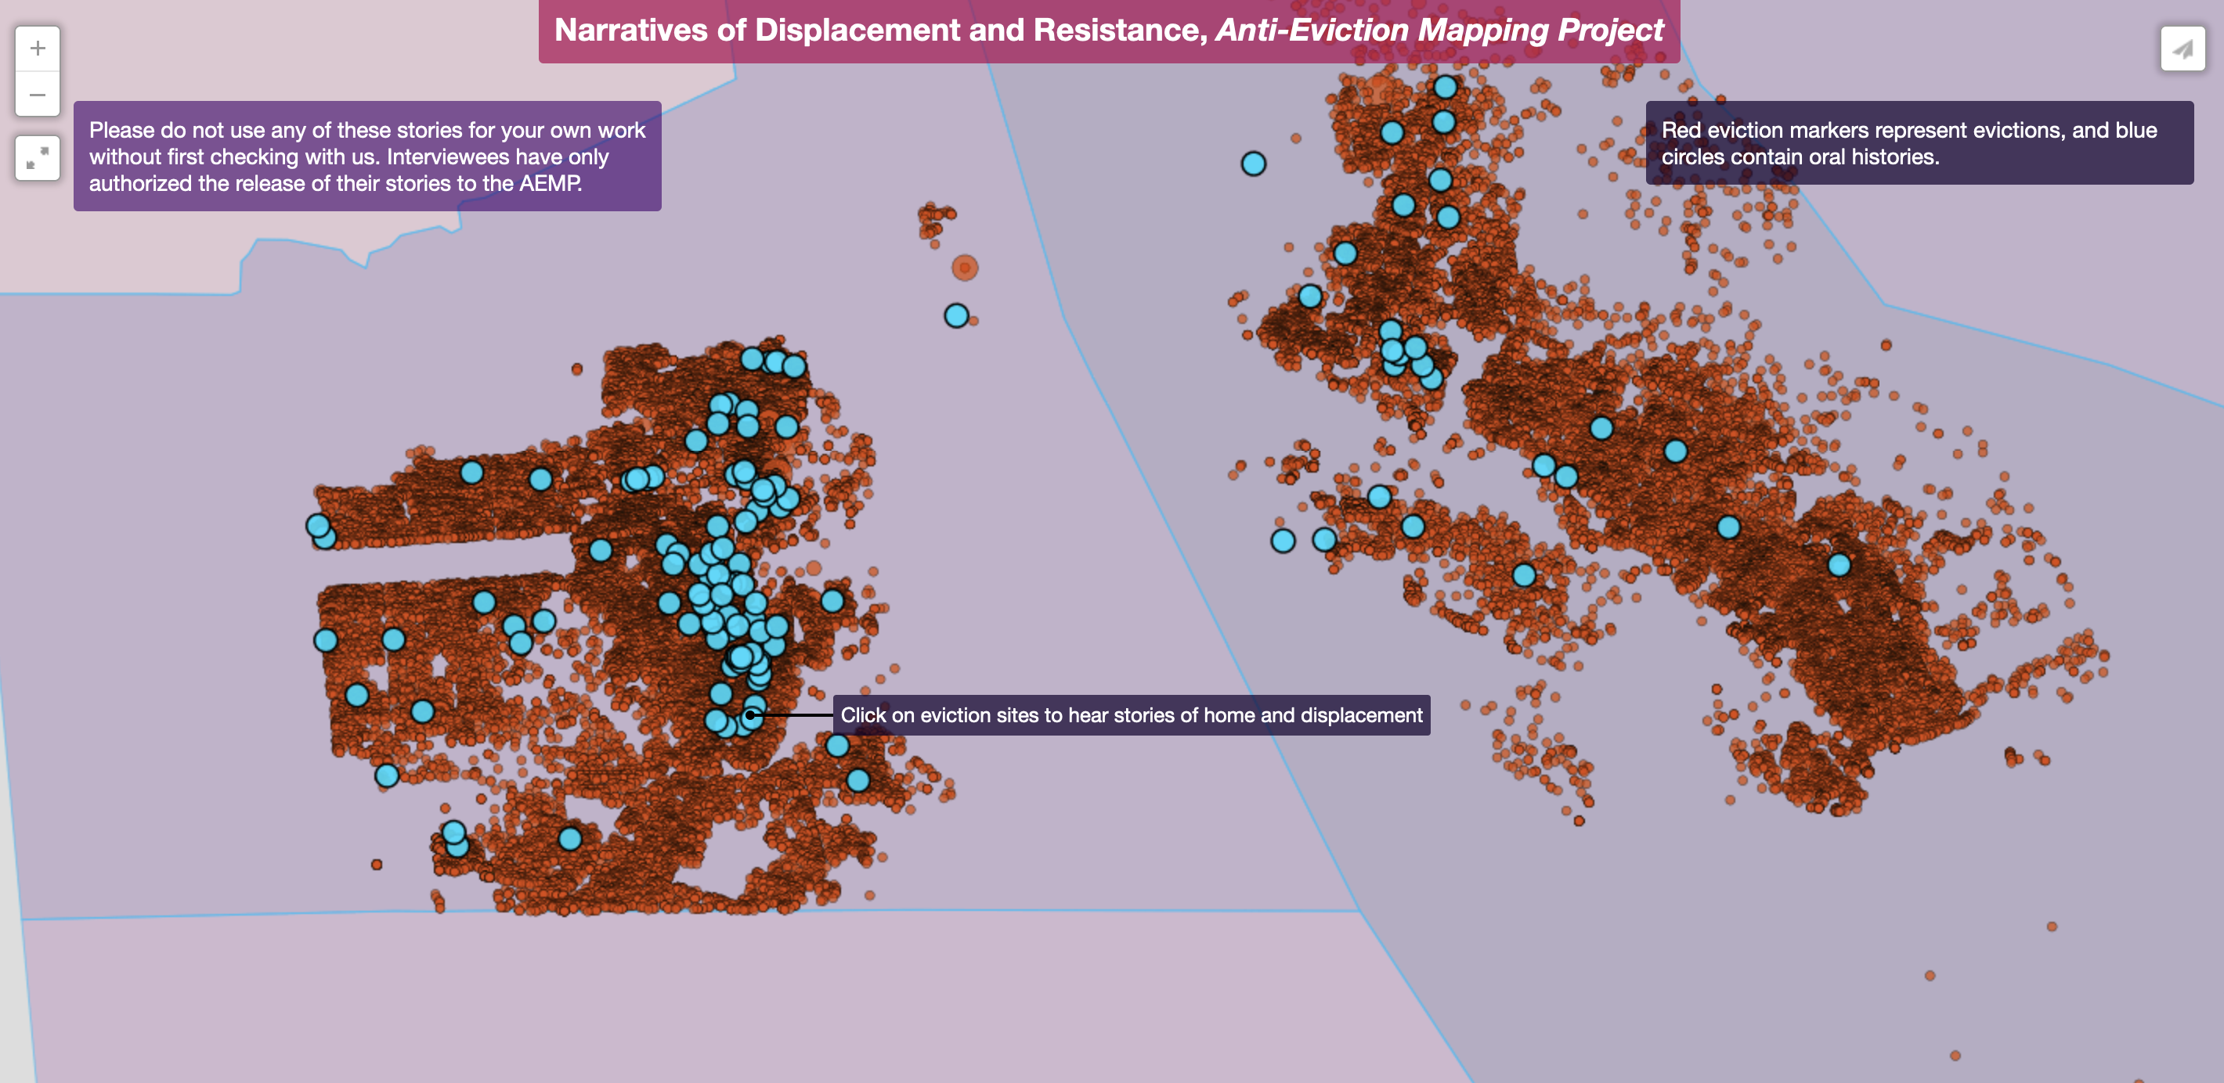
Context and Situated Knowledge/Qualitative GIS(QGIS)
http://antievictionmappingproject.net/narratives.html

Slide 30
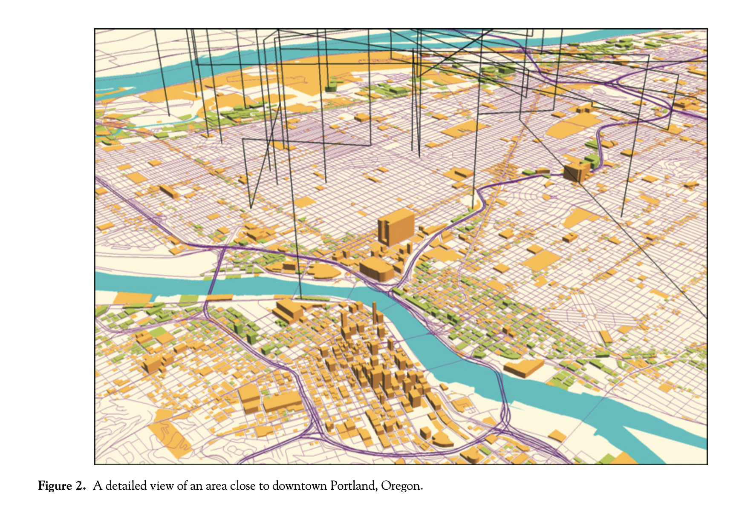

Slide 31
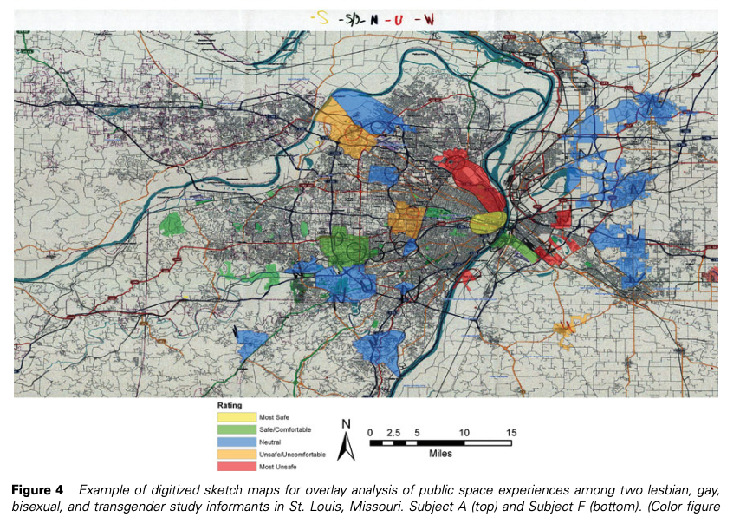
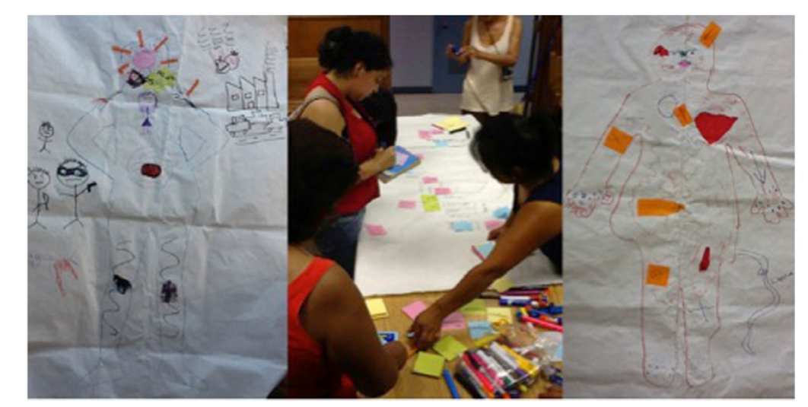
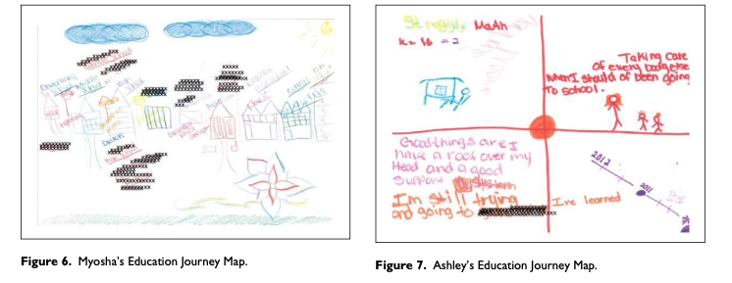
Emotions, Affect,
Embodiment
E. Eric Boschmann & Emily Cubbon (2014) Sketch Maps and Qualitative GIS: Using Cartographies of Individual Spatial Narratives in Geographic Research, The Professional Geographer, 66:2, 236-248
Elizabeth L. Sweet & Sara Ortiz Escalante (2017) Engaging territorio cuerpo-tierra through body and community mapping: a methodology for making communities safer, Gender, Place & Culture, 24:4, 594-606
Annamma, S. A. (2018). Mapping consequential geographies in the carceral state: Education journey mapping as a qualitative method with girls of color with dis/abilities. Qualitative Inquiry, 24(1), 20-34.

Slide 32
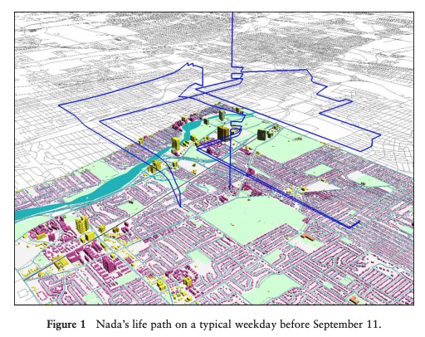
Kwan, M. P. (2008). From oral histories to visual narratives: Re-presenting the post-September 11 experiences of the Muslim women in the USA. Social & Cultural Geography, 9(6), 653-669.
http://meipokwan.org/Paper/SCG_2008.pdf

Slide 33
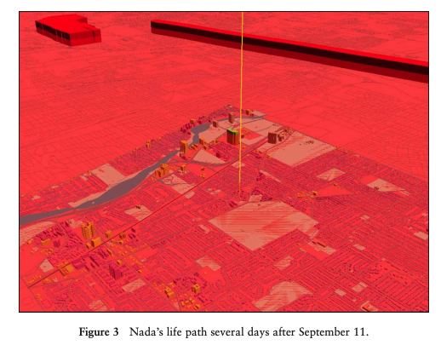

Slide 34
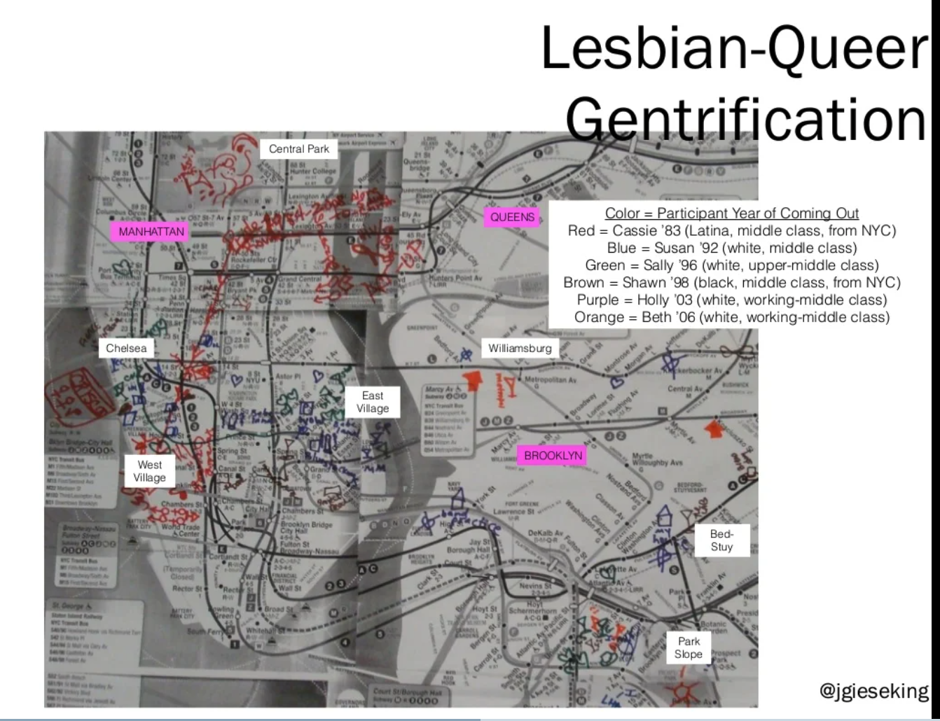
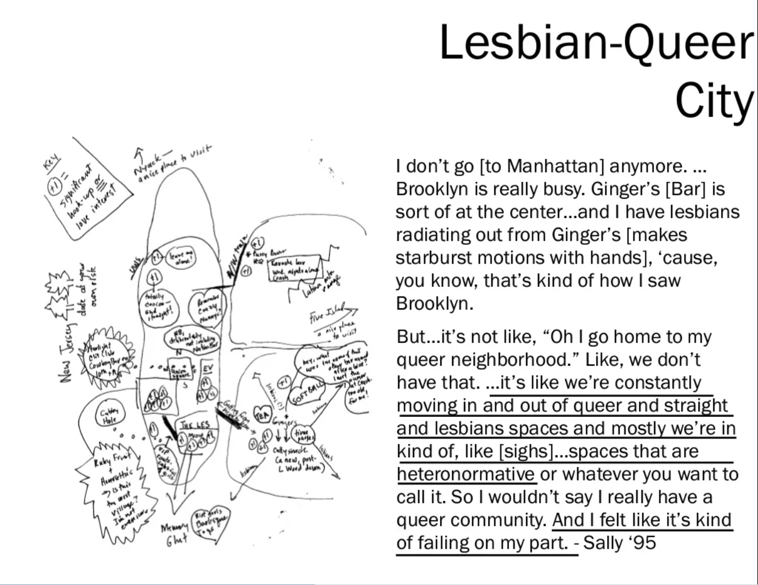
Qualitative Sketch Mapping
Gieseking, J. J. (2016). Crossing over into neighbourhoods of the body: urban territories, borders and lesbian‐queer bodies in New York City. Area, 48(3), 262-270

Slide 35
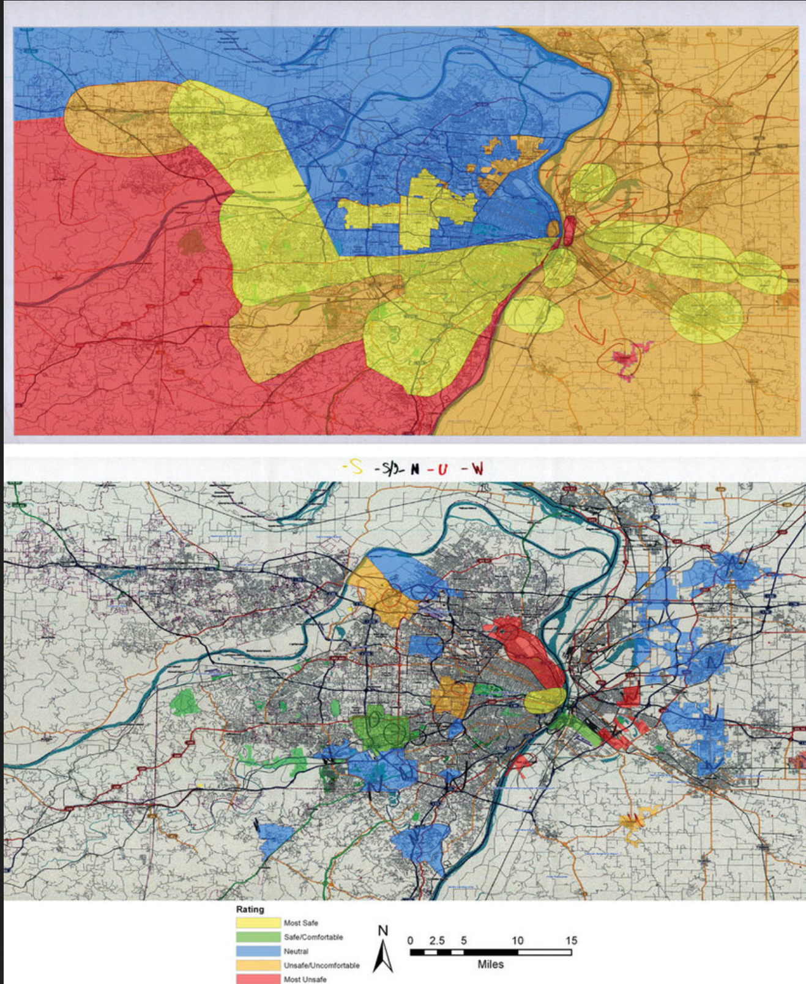
Example of digitized sketch maps for overlay analysis of public space experiences among two lesbian, gay, bisexual, and transgender study informants in St. Louis, Missouri.
E. Eric Boschmann & Emily Cubbon (2014) Sketch Maps and Qualitative GIS: Using Cartographies of Individual Spatial Narratives in Geographic Research, The Professional Geographer, 66:2, 236-248

Slide 36
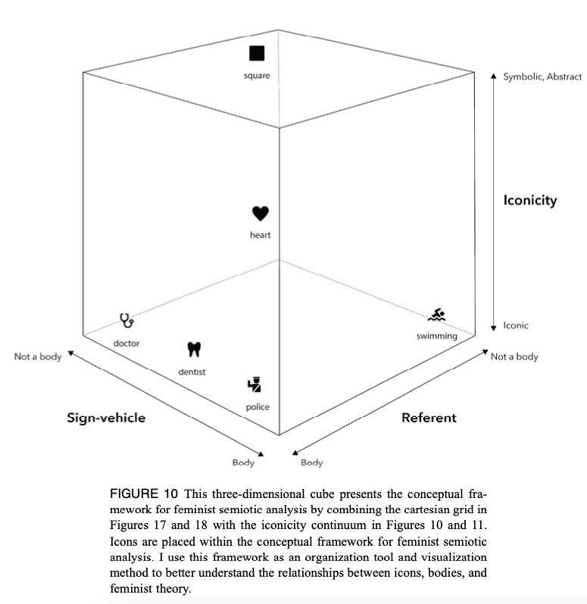




Feminist Visualization
Kelly, M. (2021). Mapping Bodies, Designing Feminist Icons. GeoHumanities, 7(2), 529-557.

Slide 37
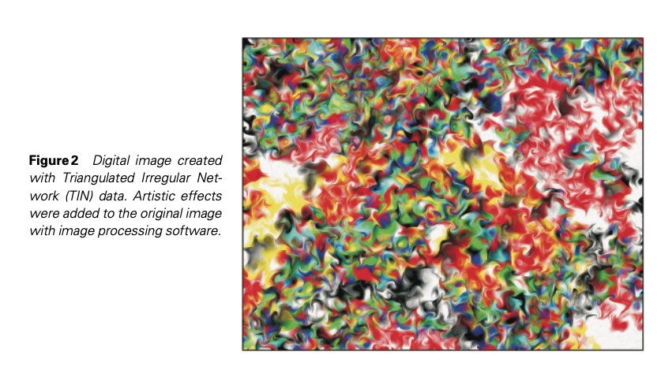
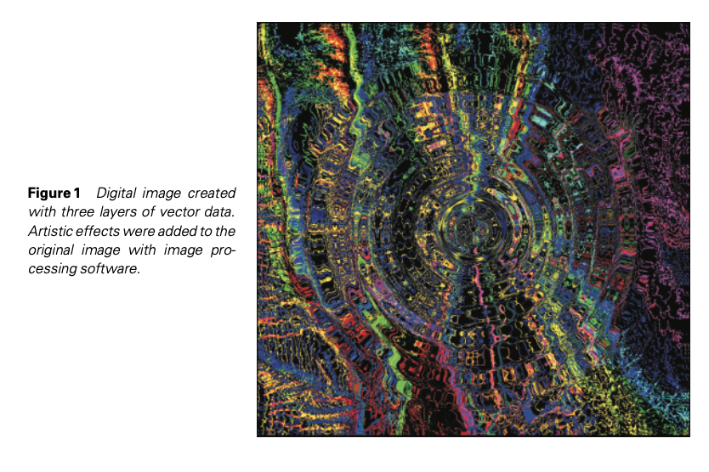
retooling GIS
Mei-Po Kwan (2007) Affecting geospatial technologies: Toward a feminist politics of emotion. The Professional Geographer, 59(1): 22-34

Slide 38
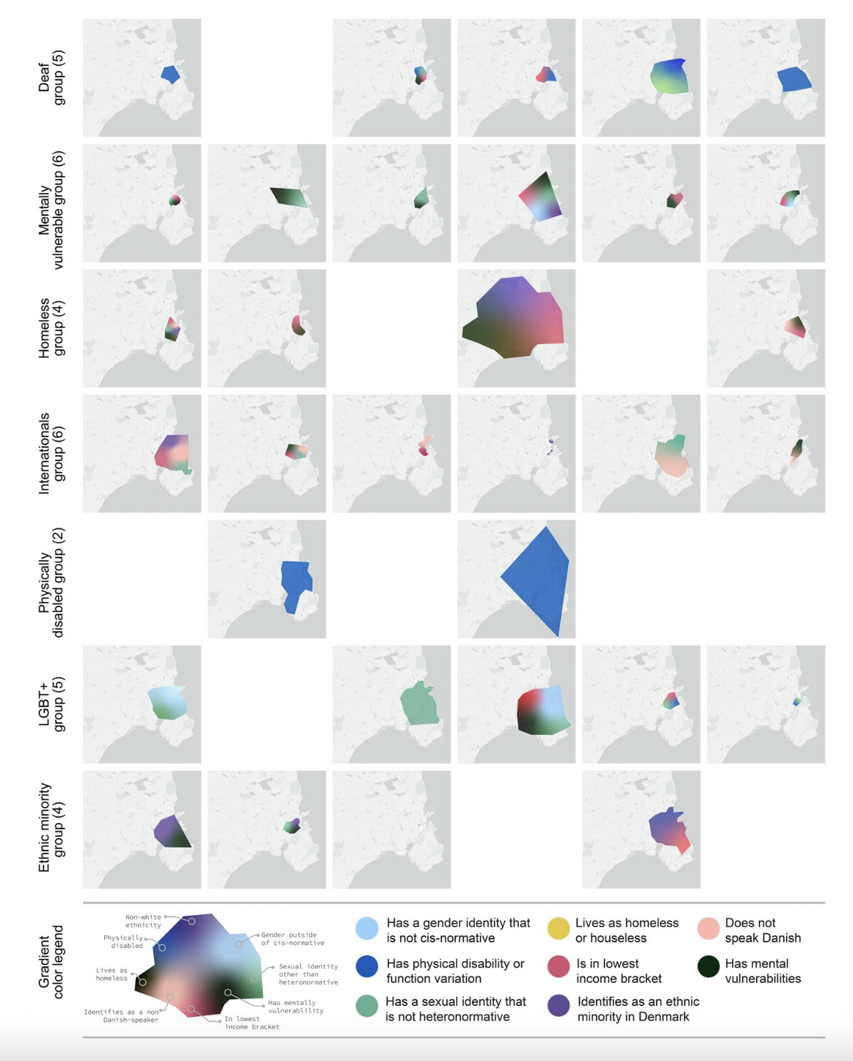
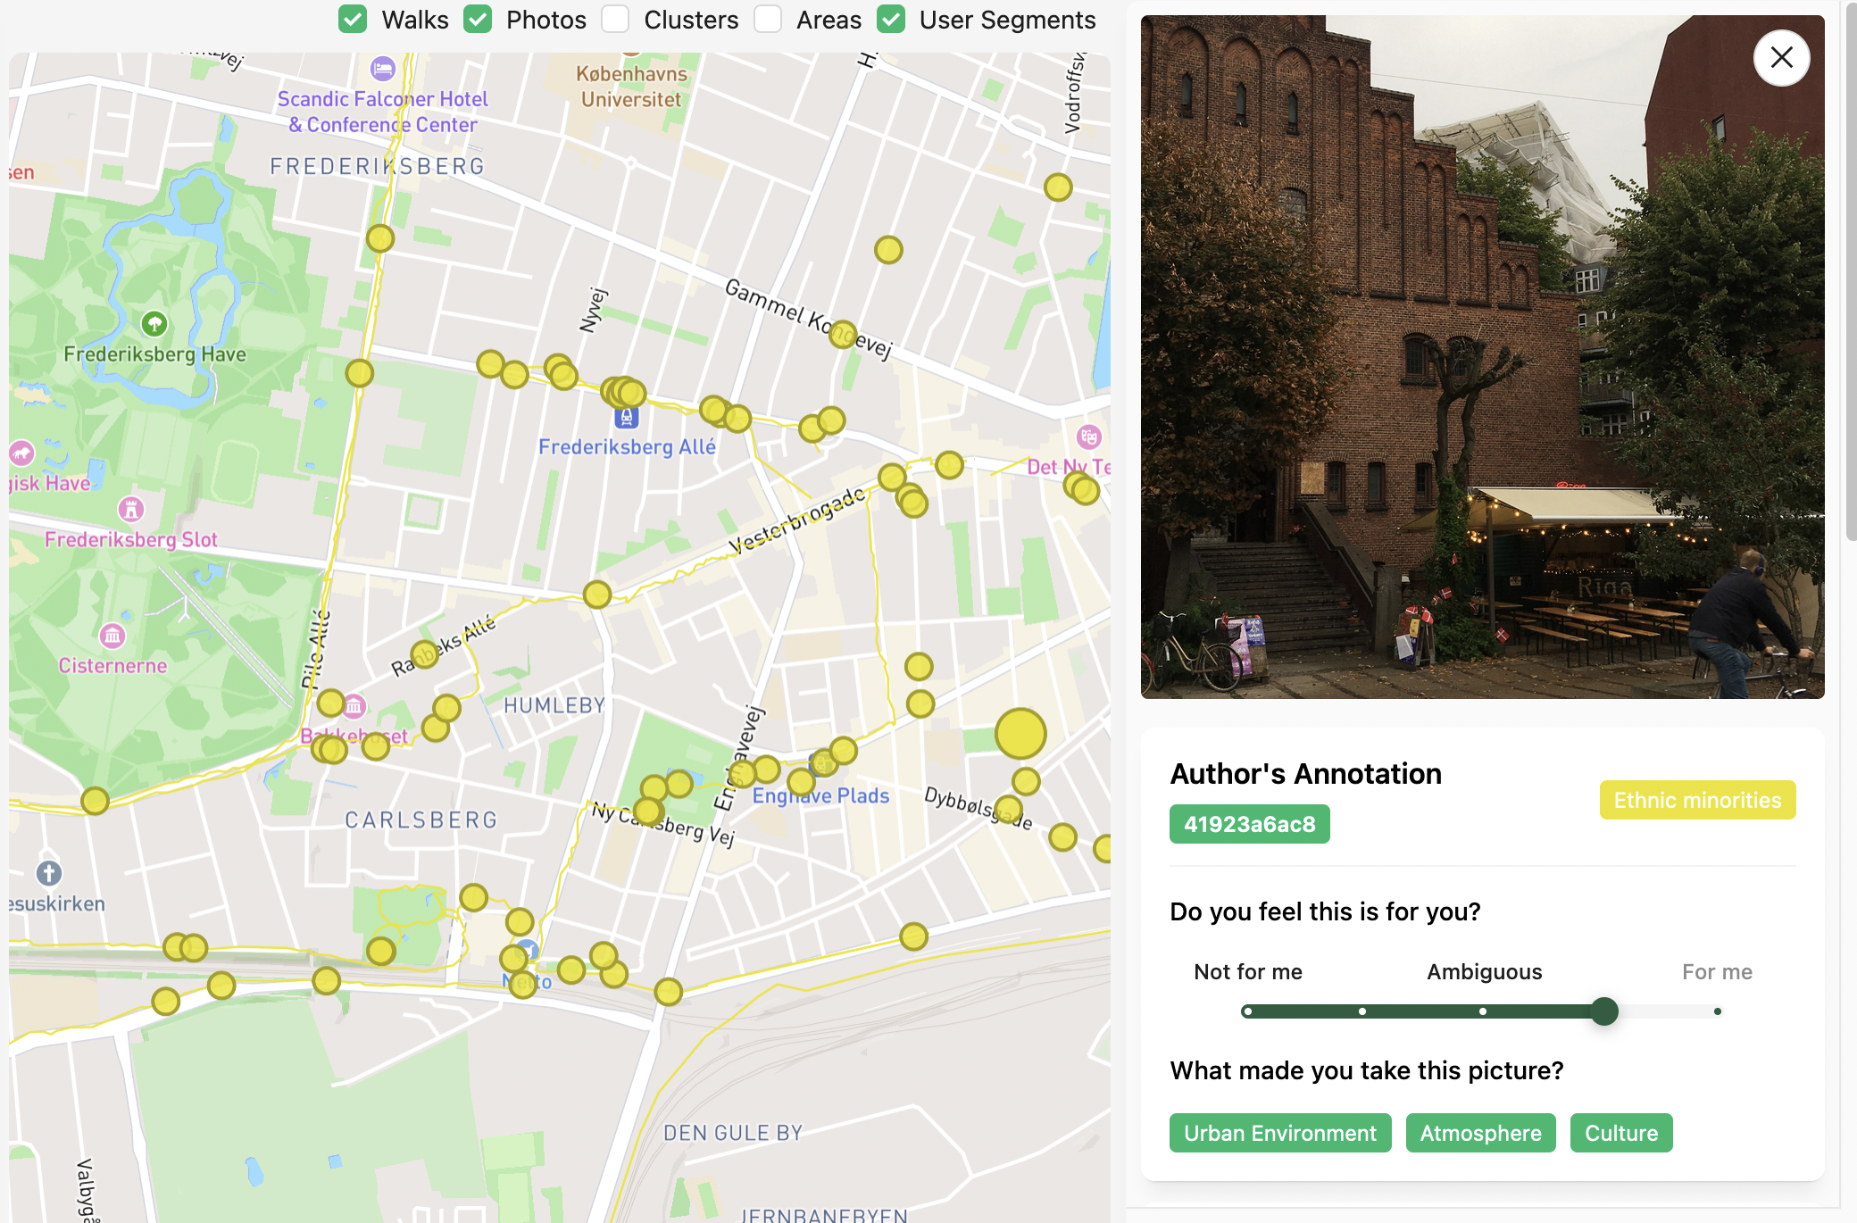
Urban Belonging Project
Burgos-Thorsen, S. (2024). Data feminism in action: mapping Urban Belonging in Copenhagen with experimental visualization and participatory GIS. Gender, Place & Culture, 1-26.

Slide 39
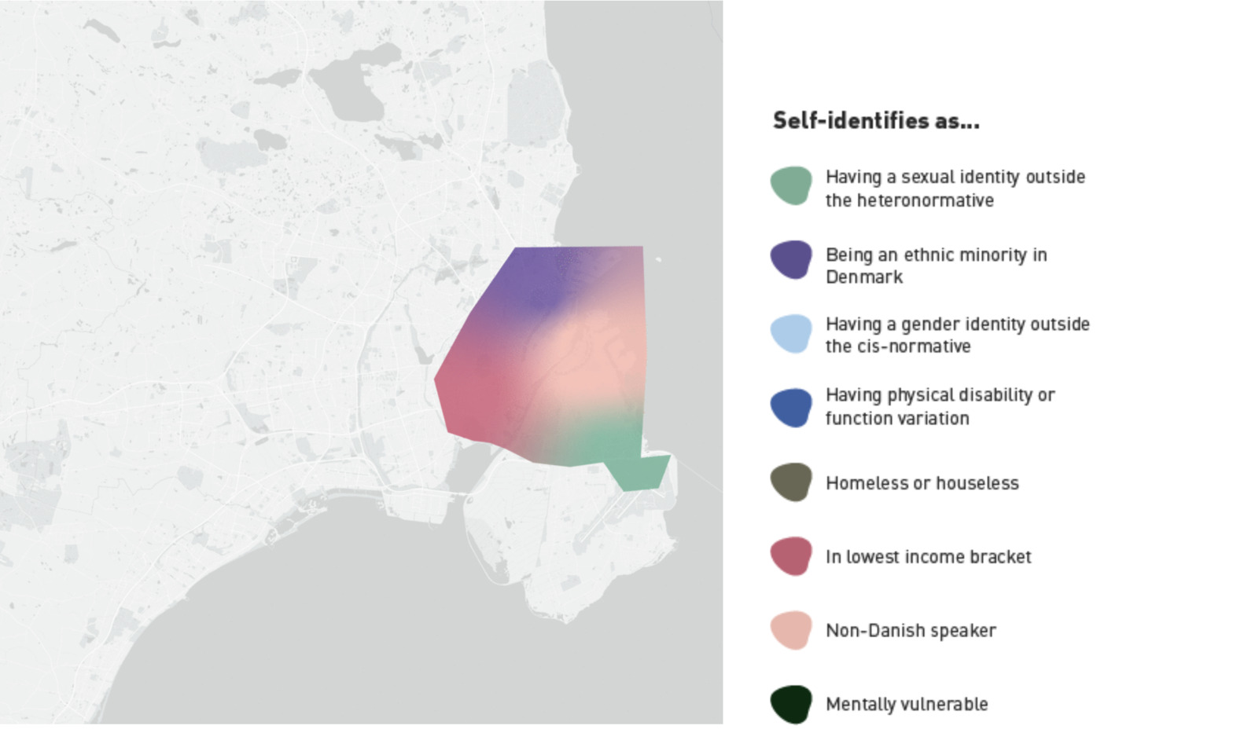

Slide 40
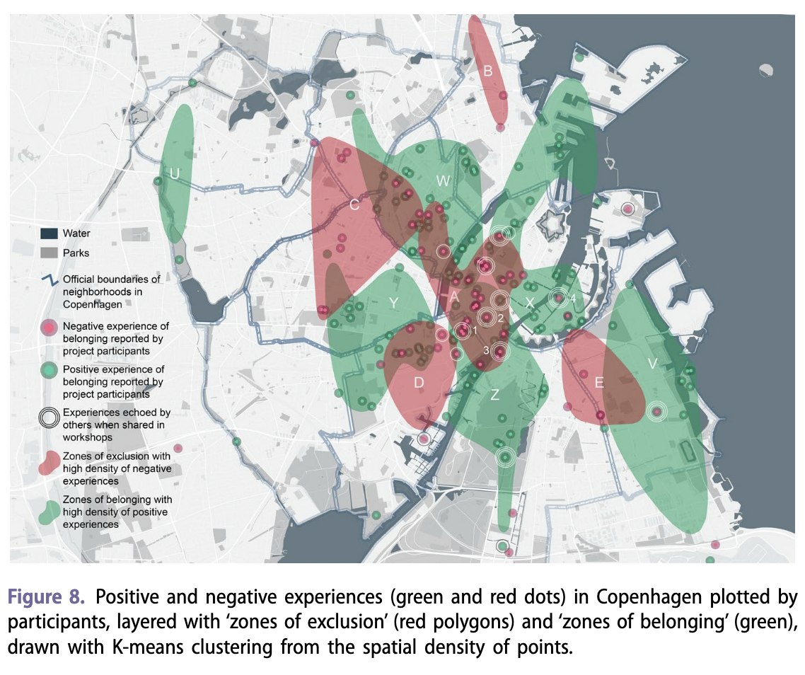

Slide 41
Geospatial Technology and Gender
How has gendered regimes of labor changed with advances in Geospatial Technology?
How have daily acts of social reproductive labor changed?
What does geospatial technology mean for gender violence or experiences of fear/safety?

Slide 42
“We also note that collisions between the epistemologies underlying our critical and ethnographic methods and epistemologies more easily (and typically) anticipated by GIS technologies, were absolutely crucial moments in our process. These moments facilitated the production of multiple and hybrid forms of data that were then translated into fixed points on the map. So in this case GIS, rather than necessarily privileging certain kinds of knowledge and data over others, in fact mediated between epistemologically and ontologically dissonant ways of knowing.”
--Brown and Knopp “Queering the Map”

Slide 43
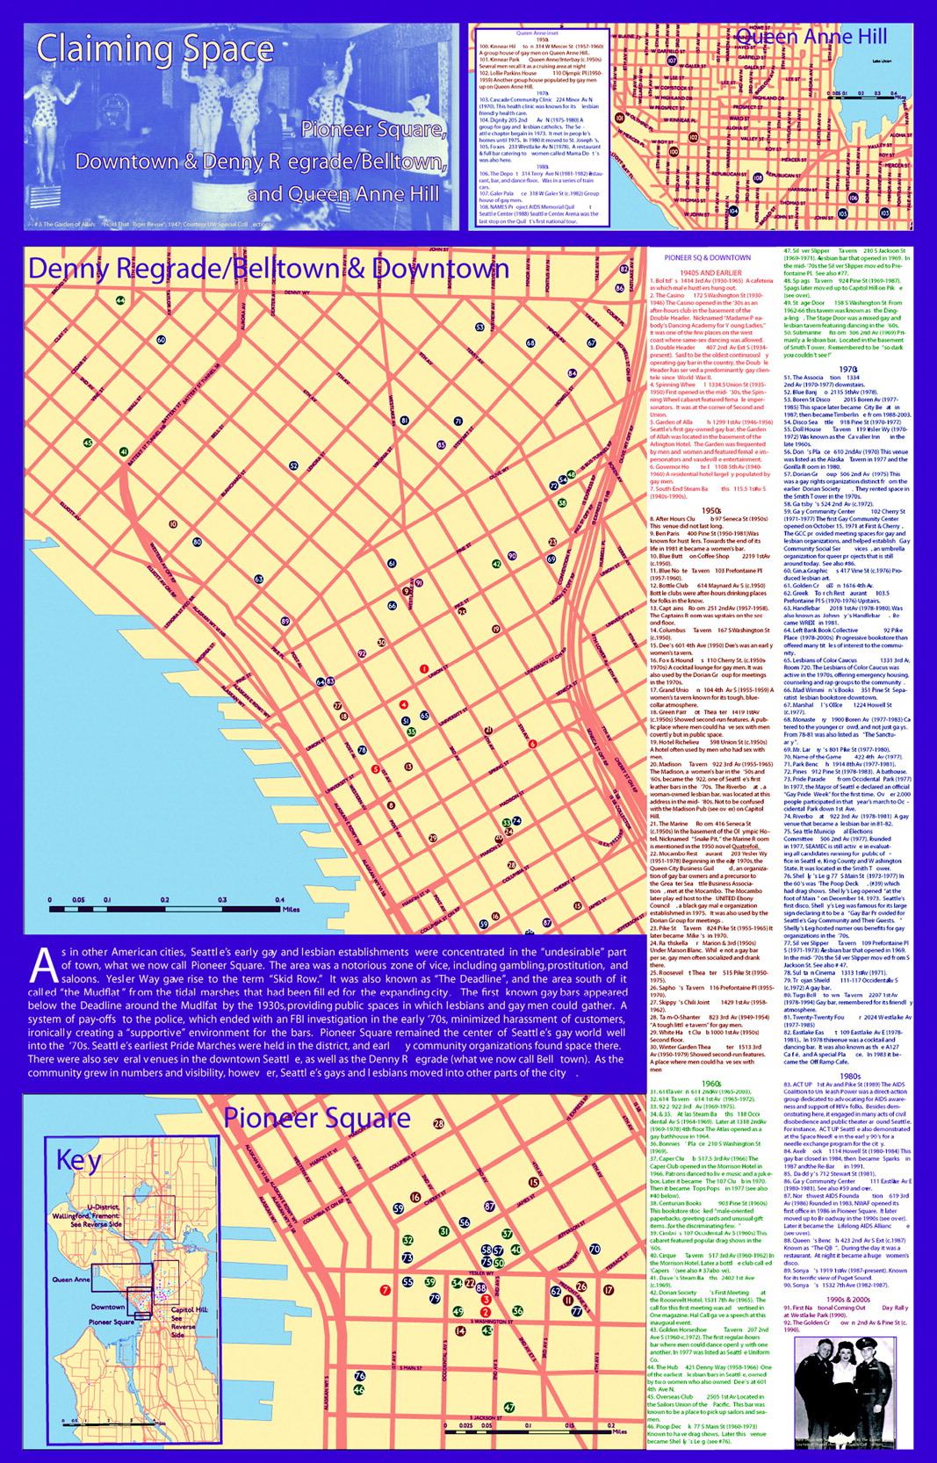
Queering the Map
Brown, M., & Knopp, L. (2008). Queering the map: The productive tensions of colliding epistemologies. Annals of the association of American Geographers, 98(1), 40-58.
colliding epistemologies
attempts to represent the unrepresentable
productive pragmatics
the contingencies of facts and truths
power relations

Slide 44
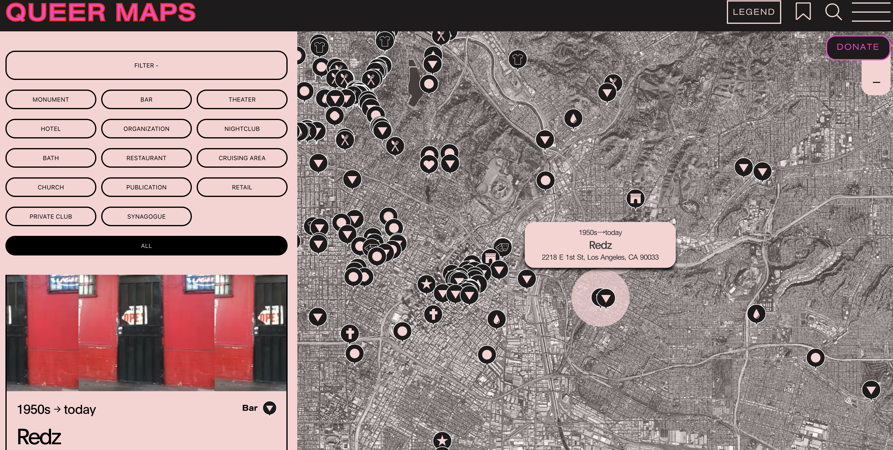
https://www.queermaps.org/

Slide 45
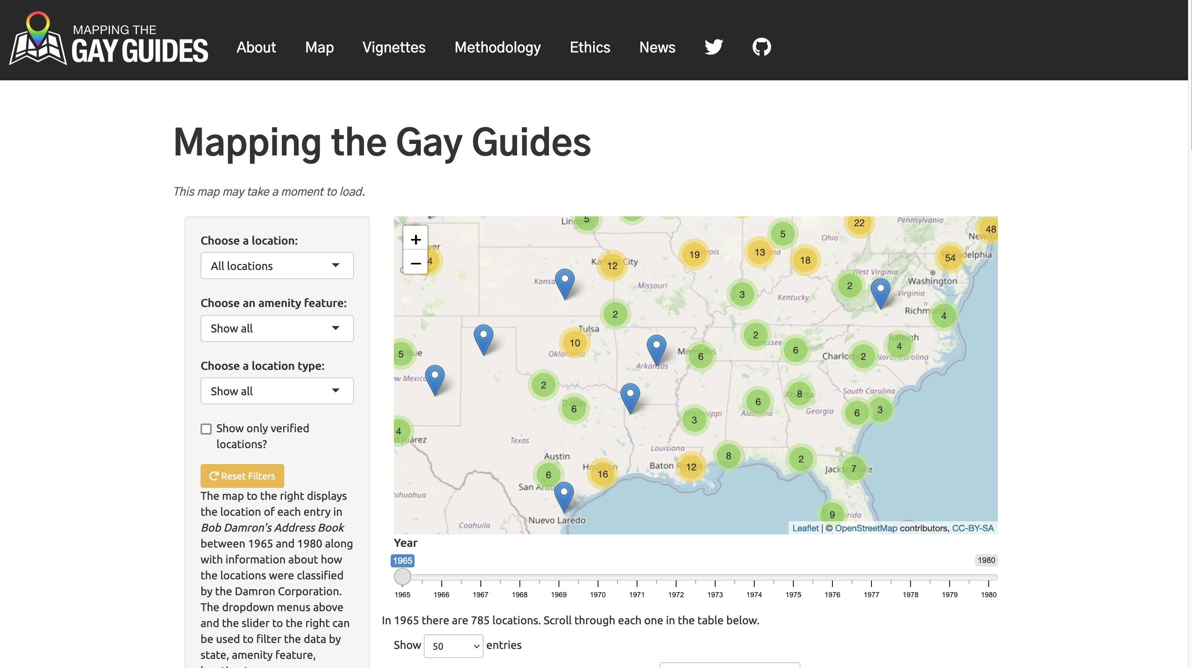

Slide 46
https://www.queeringthemap.com/

Slide 47
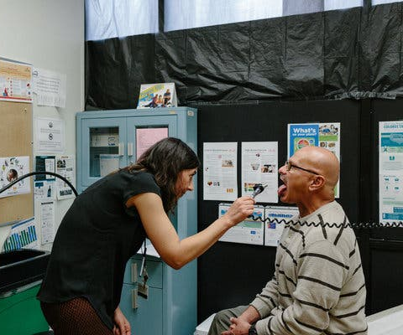
Health and Wellbeing Impacts of Supervision
Higher rates of many chronic conditions and physical disabilities among parole and probation population.
Barriers to housing, services, medical care and employment associated with supervision are strong predictors of health outcomes.
Prisons and jails are a source of exposure to infectious disease
Strong association with psychosocial pathways (eg. chronic stress)
Notes:
Among the many gaps in our knowledge is an understanding of the relationships between mass supervision and negative health outcomes experienced by those individuals and communities impacted by these systems. Higher rates of many chronic conditions and physical disabilities among parole and probation population. Barriers to housing, services, medical care and employment associated with supervision are strong predictors of health outcomes.
Existing health conditions tend to worsen under supervision, and the high rates of exposure to infectious disease during incarceration remain a concern for formerly incarcerated people over the entirety of their life course. One likely hypothesis relates to psychosocial pathways, as experiences of chronic stress are associated with a variety of negative health outcomes.
We are so far lacking strong data regarding the impact of Covid-19 on people under supervision, but it’s clear that the punitive nature of supervision separate individuals from the social safety nets necessary for health and wellness.

Slide 48
Health and Disability Characteristics by Community Supervision Status—United States, 2015/2016 (Winkelman et al. 2020)
 | Community Supervision | General Population | p Value
Self-reported Fair/poor health | 15.7% | 12.0% | <.001
One or more chronic conditions | 35.1% | 31.0% | .003
COPD | 5.0% | 3.1% | .02
Hepatitis B or C | 3.2% | 1.2% | <.001
Kidney disease | 2.5% | 1.2% | .05
Any disability | 23.1% | 15.7% | <.001
IADLs | 7.6% | 4.2% | <.001
*Adjusted estimates control for age, sex, race/ethnicity, educational attainment, marital status, and any illicit substance use in the past year

Slide 49
Health and Disability Characteristics by Community Supervision Status—United States, 2015/2016 (Winkelman et al. 2020)
 | Community Supervision | General Population | p Value
Self-reported Fair/poor health | 15.7% | 12.0% | <.001
One or more chronic conditions | 35.1% | 31.0% | .003
COPD | 5.0% | 3.1% | .02
Hepatitis B or C | 3.2% | 1.2% | <.001
Kidney disease | 2.5% | 1.2% | .05
Any disability | 23.1% | 15.7% | <.001
IADLs | 7.6% | 4.2% | <.001
*Adjusted estimates control for age, sex, race/ethnicity, educational attainment, marital status, and any illicit substance use in the past year

Slide 50
600,000 people experiencing “fair to poor health”
870,000 people disabled
122,000 people with kidney disease

Slide 51
Notes:
Slide 9: There is also of course a lot of variability at local scales, with communities experiencing the impacts of parole and probation very differently. This map show census tracts in Philadelphia and the total number of years of supervision across everyone in a single tract. You can see that all parts of the city are impacted, but certain neighborhoods whose residents are mostly poor and black, experience a disproportionate impact.

Slide 52
“GIS is not fixed and given but constantly remade through the politics of its use, critical histories of it, and the interrogation of concepts that underlay its design, data definition, collection, and analysis. In other words, futures of GIS are contested and openings exist for new meanings, uses, and effects.”
— Marianna Pavlovskaya, “Theorizing With GIS”

