Slide 1
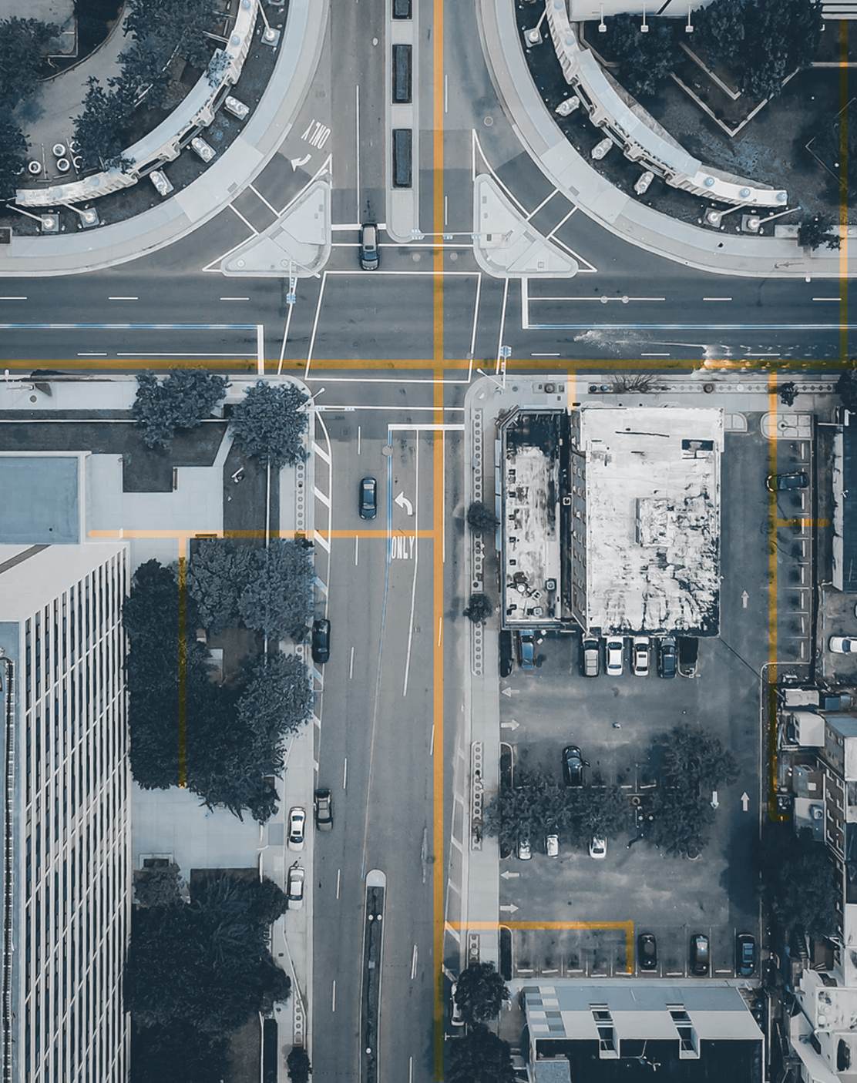
INTRODUCTION TO GIS FOR SOCIAL AND ENVIRONMENTAL ANALYSIS
GIS Ethics

Slide 2
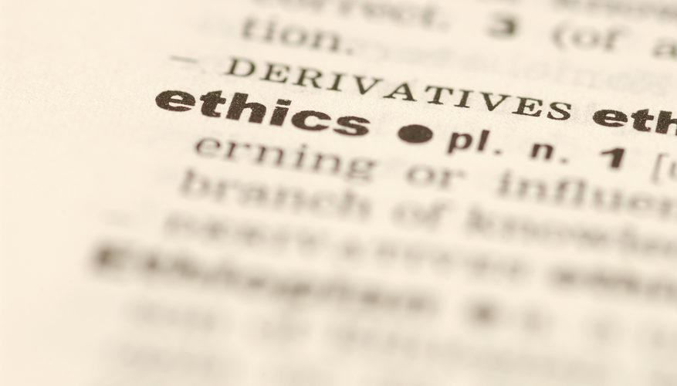
Ethics
1 [usually treated as plural] moral principles that govern a person's behavior or the conducting of an activity: medical ethics also enter into the question | a code of ethics. • the moral correctness of specified conduct: many scientists question the ethics of cruel experiments.
2 [usually treated as singular] the branch of knowledge that deals with moral principles: neither metaphysics nor ethics is the home of religion.
Source: Oxford Dictionary https://en.oxforddictionaries.com/definition/ethics

Slide 3
GIS and ethics
What does it mean to use GIS, spatial data and related technologies within ethical limits?

Slide 4
Code of ethics for GIS professionals
Urban and Regional Information Systems Association (URISA)
  Code of Ethics
  Intended to provide guidelines for GIS professionals
  http://www.urisa.org/about-us/gis-code-of-ethics/
The Code consists of four primary categories:
  I. Obligations to Society
  II. Obligations to Employers and Funders
  III. Obligations to Colleagues and the Profession
  IV. Obligations to Individuals in Society

Slide 5
Obligations to Society
Do the Best Work Possible
  Be objective, use due care, and make full use of education and skills.
  Practice integrity and not be unduly swayed by the demands of others.
  Provide full, clear, and accurate information.
  Be aware of consequences, good and bad.
  Strive to do what is right, not just what is legal.
Contribute to the Community to the Extent Possible, Feasible, and Advisable
  Make data and findings widely available.
  Strive for broad citizen involvement in problem definition, data identification,
  analysis, and decision-making.
  Donate services to the community.
Speak Out About Issues
  Call attention to emerging public issues and identify appropriate responses
  based on personal expertise.
  Call attention to the unprofessional work of others. First take concerns to those
  persons; if satisfaction is not gained and the problems warrant, then additional
  people and organizations should be notified.
  Admit when a mistake has been made and make corrections where possible.

Slide 6
Obligations to Employers and Funders
Deliver Quality Work
  Be qualified for the tasks accepted. Keep current in the field through readings and professional development.
  Identify risks and the potential means to reduce them. Define alternative strategies to reach employer/funder goals, if possible, and the implications of each. Document work so that others can use it. This includes metadata and program documentation.
Have a Professional Relationship
  Hold information confidential unless authorized to release it. Avoid all conflicts of interest with clients and employers if possible, but when they are unavoidable, disclose that conflict.
  Avoid soliciting, accepting, or offering any gratuity or inappropriate benefit
  connected to a potential or existing business or working relationship.
  Accept work reviews as a means to improve performance.
Be Honest in Representations
  State professional qualifications truthfully.
  Make honest proposals that allow the work to be completed for the resources
  requested.
  Deliver an hour's work for an hour's pay.
  Describe products and services fully.
  Be forthcoming about any limitations of data, software, assumptions, models,
  methods, and analysis.

Slide 7
Obligations to Colleagues and the Profession
Respect the Work of Others.
  Cite the work of others whenever possible and appropriate.
  Honor the intellectual property rights of others. This includes their rights in software and data.
  Accept and provide fair critical comments on professional work.
  Recognize the limitations of one's own knowledge and skills and recognize and use the skills of other professionals as needed. This includes both those in other disciplines and GIS professionals with deeper skills in critical sub-areas of the field.
  Work respectfully and capably with others in GIS and other disciplines.
  Respect existing working relationships between others, including employer/employee and contractor/client relationships.
  Deal honestly and fairly with prospective employees, contractors, and vendors.
2. Contribute to the Discipline to the Extent Possible
  Publish results so others can learn about them.
  Volunteer time to professional educational and organizational efforts: local,national, or global.
  Support individual colleagues in their professional development. Special attention should be given to underrepresented groups whose diverse backgrounds will add to the strength of the profession.

Slide 8
Ethics Principles that can apply to GIS
Validity & reliability of data & analysis – acknowledge limitations
Accuracy of representation
Serving “the community” or “the public interest”
Avoid conflicts of interest
Self-determination & informed consent
Confidentiality
Non-discrimination

Slide 9
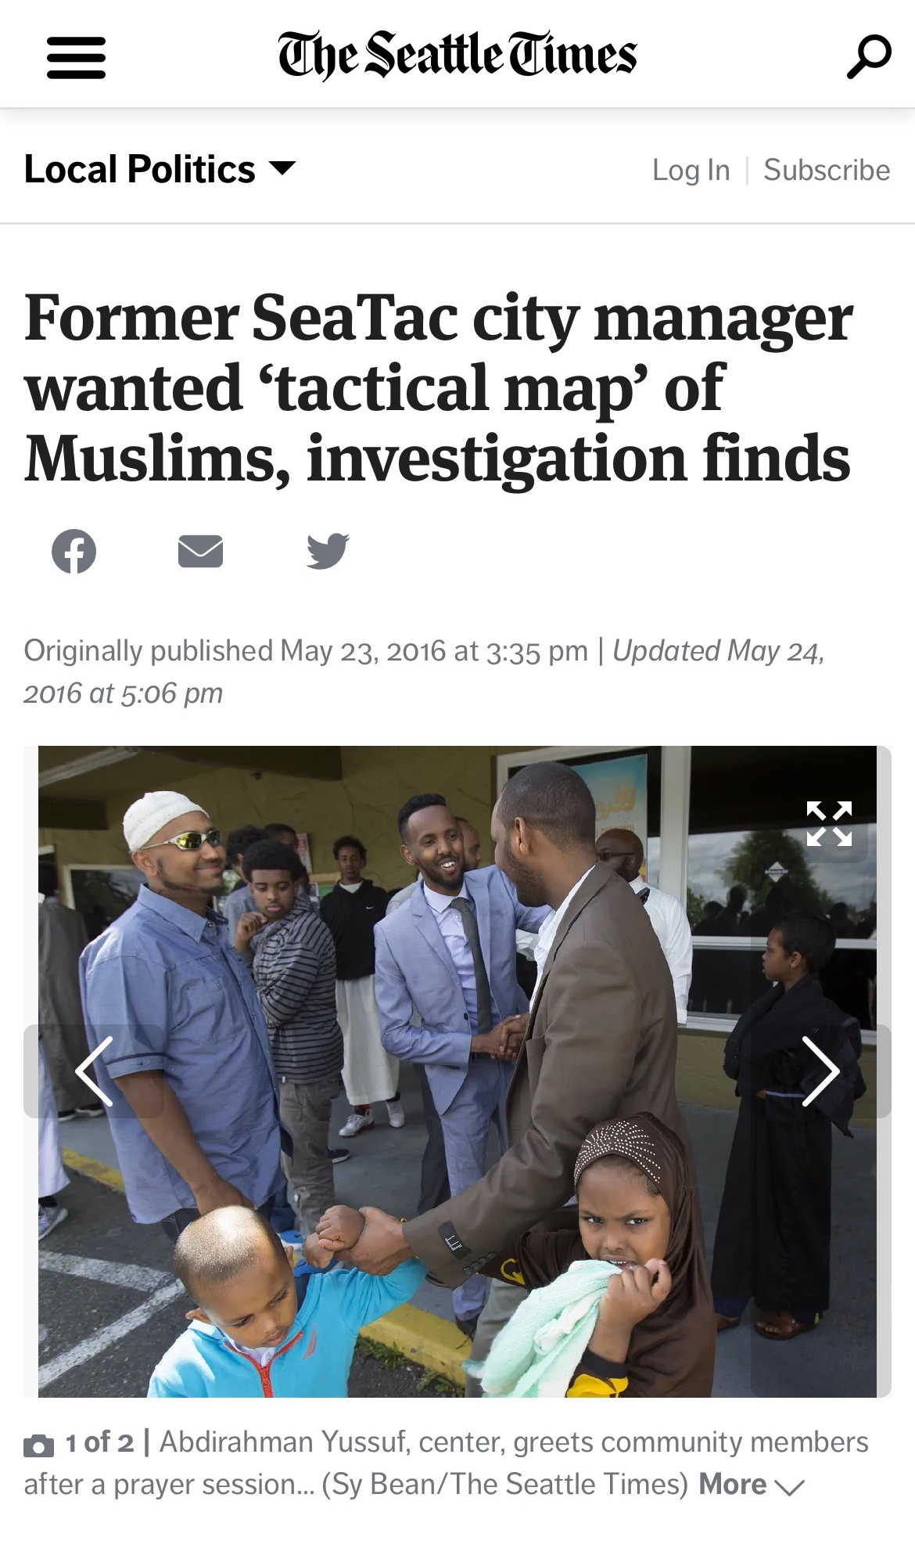
ETHICS CLASS ACTIVITY
SeaTac, WA
In 2016, SeaTac was a city of more than 25,000 residents with a little GIS department, headed by a GIS Coordinator. Today SeaTac’s population is almost 29,000 with one third of residents White and large Black, Hispanic, and Asian populations.
In 2015, a new interim City Manager was hired. The new interim City Manager’s professional background was in the U.S. Army. He had no experience in city government.

Slide 10
ETHICS CLASS ACTIVITY
The City Manager met with the GIS Coordinator and asked if the City had the data and the capability to map the location where city residents of certain designated religions lived. In particular, he wanted to know to the neighborhood and household level where Sunni and Shiite Muslims in SeaTac lived.
He described his desire to have ‘tactical maps’ of city neighborhoods, so that he could ‘make the peace’ if needed. The City Manager described his goal for this GIS mapping request to others in the City as related to the Somali and Eritrean communities within SeaTac and his fears of ‘radicalized’ Muslims.
Later the request was expanded to include mapping individual Christians (Protestant and Catholic) as well as individuals by gender and age group. One of the goals for the project was also to identify the location of ‘Americans who had not adopted American ways.’

Slide 11
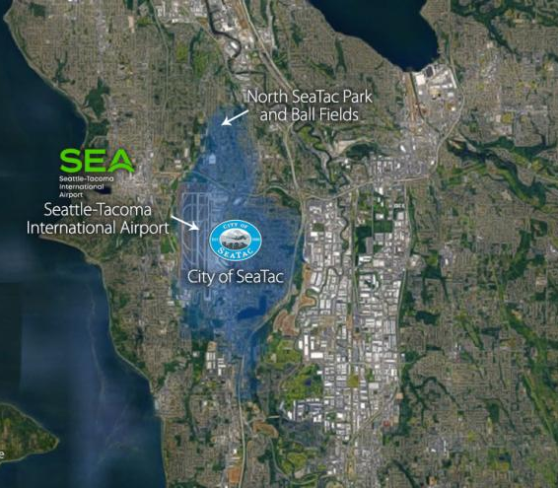
Small group activity
In groups of 3-4, consider the following question:
What do you think are some key ethical issues related to this case?
How would you as a the GIS Coordinator respond to this request?
One rule: You can’t simply say no.
Be ready briefly share important points of your discussion with the rest of the class (1-2 minutes)

Slide 12
How did the GIS Coordinator Respond?
Because she felt uncomfortable and confused, she put her meeting notes in writing and emailed them to the City Manager, asking him to confirm his request.
She told the City Manager that it might be illegal to collect and publish a map for the City with such personal and private data.
Then she spoke to the City Attorney and her manager about the request.
While she consulted with other city staff, she did research into data sources. She determined that US Census data could not provide the type of data desired by the City Manager, but she identified other possible non-Census data sources for information about religious congregations.

Slide 13
GIS and ethics
What does it mean to use GIS, spatial data and related technologies within ethical limits?

